Slide 1

Sparse and Redundant Representations and Their Applications in
Signal and Image Processing (236862)
Section 4: From Exact to Approximate Sparse Solutions
Winter Semester, 2018/2019
Michael (Miki) Elad

Slide 2
Meeting Plan
Quick review of the material covered
Addressing issues raised by other learners
Answering questions from the students and getting their feedback
Discussing a new material: Sub-gradients and LARS
Administrative issues

Slide 3
Overview of the Material
From Exact to Approximate Sparse Solution
General Motivation – Why Approximate ?
Pursuit Algorithms: OMP, and BP Extensions
IRLS Solution of the Basis Pursuit
IRLS Solution of the Basis Pursuit – A Demo
The Unitary Case – A Source of Inspiration (Part 1)
The Unitary Case – A Source of Inspiration (Part 2)
ADMM Solution of the Basis Pursuit

Slide 4
Issues Raised by Other Learners
OMP for P₀^{ε}
The lecturer mentions that the OMP needs some adjustment to solve P0-epsilon, but I don't see any change - the original algorithm already has a stopping condition for norm(residual)≤epsilon.
He is correct – the very same algorithm is used in both cases, and the delicate difference is in the stopping criteria

Slide 5
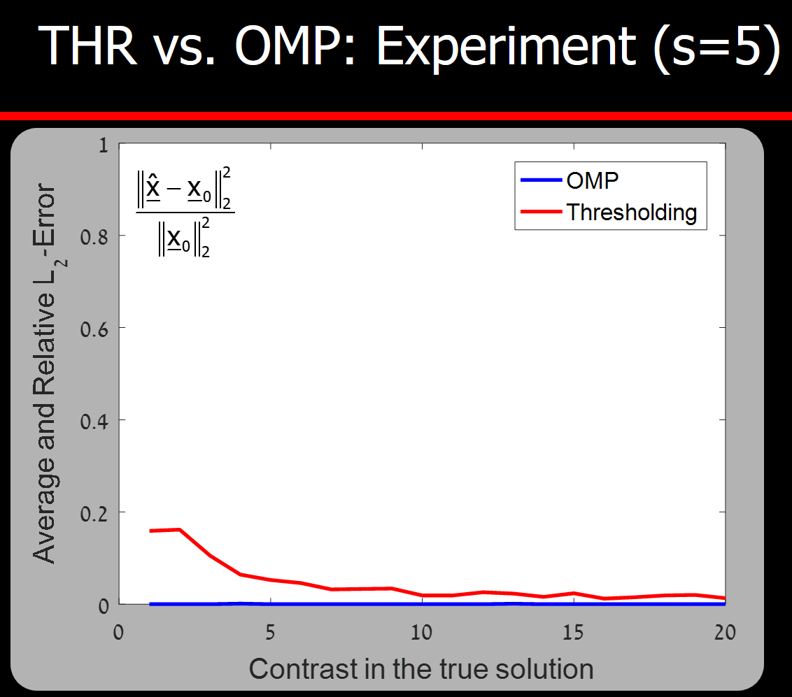
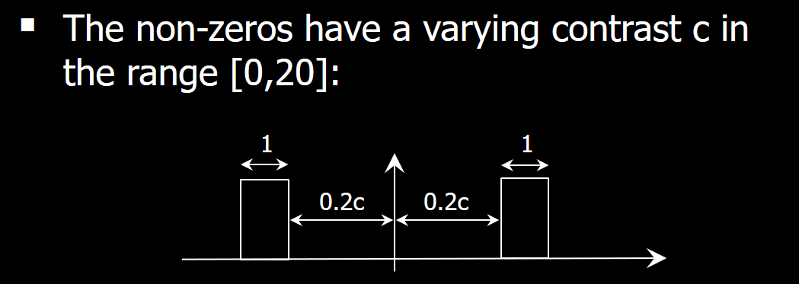
Issues Raised by Other Learners
Equivalence: Analyzing the THR Algorithm - experiment analysis
The diagram shown in the video shows the L2-Error of the experiment. This means that the lower the graph, the less error in the estimations. If my understanding is correct, the diagram is saying that the higher the contrast in the true solution, the better the performance of the algorithm. This means the performance of THR improves a little bit at high contrast, and performance of OMP is worse a little bit at high contrast but still much better than that of THR.
It looks like my understanding is contradict to the analysis?

Slide 6

Your Questions and Feedback

Slide 7
New Material?
The LARS Algorithm
Among the various problems presented in this section, we also met the one called (Q₁^{λ}):
This is a convex problem and there various ways to solve it
We present here an algorithm for getting the full-path of the solutions, i.e., solving this problem for all the λ’s
It sounds like too much to ask!
Think about it – we do something close to this in OMP, when we add one non-zero at a time to the solution
We stress: the proposed solution is an exact solver of Q₁^{λ}

Slide 8
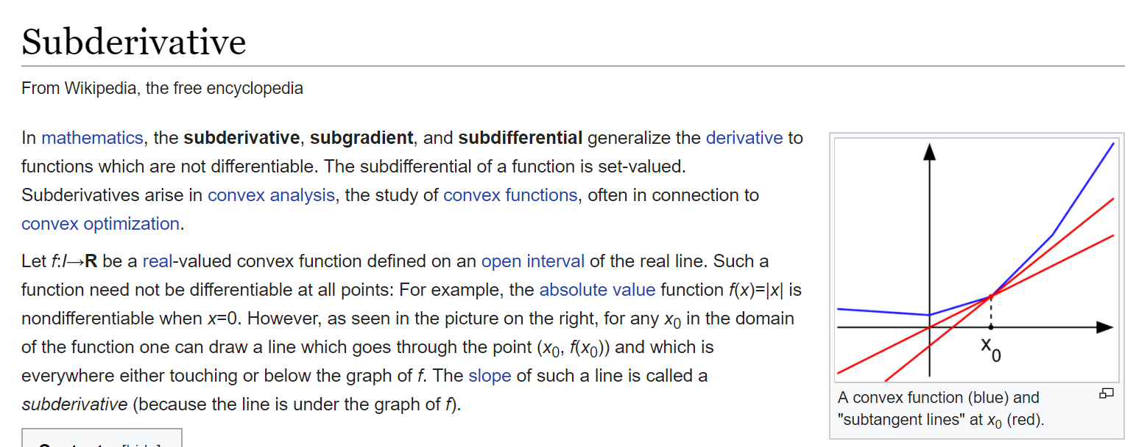
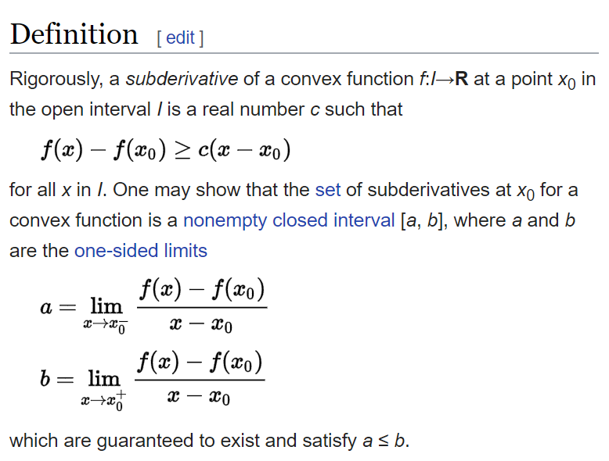
Step 1: Have you Heard of Sub-Gradients?
Example:

Slide 9
Step 2: What to do with Sub-Gradients?
“smooth”
Theorem: Given a convex function f(x) which is to be minimized, the optimal solution must satisfy
Think about this: For smooth functions, where the sub-gradient in every location x is a single vector, this is just like requiring the gradient to be zero
In the more general case, where some points have many “slopes”, the sub-gradient in these locations is a set, and now we require this set to include the null-vector

Slide 10
Sub-Gradients: A Small Exercise
Optimal Value
We should consider three options:
1.
2.
3.

Slide 11
Step 3: Back to Our Problem
Thus, we characterize the optimal solution as the one that has the zero in the set of sub-gradients
&
This will become very clear as we start using this condition
where

Slide 12
Step 4: Start from the Zero Solution
For λ→∞, the solution is simply zero: x*(λ)=0
Our question: as we decrease the value of λ, when will the solution start changing?
Answer: Lets look at the sub-gradient and the optimality condition:
As long as λ≥λ₀ the optimal solution is the zero, and we get the value of z as a by-product

Slide 13
Step 5: Awakening
As we get to λ=λ₀ , one of the entries in z touches the boundaries (either +1 or -1) – Let’s assume that only one entry in z does that: z_{i}=+1 or -1
If we plan to decrease λ, the solution MUST CHANGE, since otherwise z will get values outside [-1,1]
The change: x_{i} is awaken, while all the rest remain zero, and x_{i}-s sign is chosen by
Lets focus now on the following questions:
What will be the value of x_{i} as a function of λ ?
When the solution’s support will have to change again ?

Slide 14
Step 5: Awakening

Slide 15
Step 5: Awakening
Lets look at the i-th row of this system. Recall: x_{i}≠0, and thus z_{i} is fixed
Observe the linearity of x_{i} w.r.t. λ
Lets look at all the other equations
Plug in the value of x_{i}(λ), and identify the next value that leads to a boundary value in z_{c}

Slide 16
Step 6: Proceeding
We are now into the process, and have several non-zeros denoted as the support S
In our notations, x_{S} are the non-zeros and all the rest are zeros. Thus z_{S}=sign(x_{S})
Following the same steps as before, we break the sub-gradient expression into two parts – on support and off-support:

Slide 17
Step 7: Next Break-Point
What is the next value λ_{k+1} where a change takes place?
We seek the largest possible value of λ (satisfying λ <λ_{k}) that brings one of these elements to +1 or -1
This can be tested for each entry:

Slide 18
LARS: Comments
The process we have described should remind you very much of the OMP, due to two main features:
We introduce one non-zero at a time to the solution as λ is getting smaller
The temporal solution looks almost like a LS:
We relied on two simplifying assumption in our description:
When the solution changes, only one non-zero is introduced. His can be easily fixed to manage any number of them
We did not consider ‘death’ of non-zeros, which is a possibility

Slide 19
LARS: Comments
If A is of size n×m, then LARS stops when the number of non-zeros is n – Why?
When λ→0 the solution is such that Ax=b and then the problem we really solve is this:
What do we know about solutions of such problems?
… There MUST be an optimal solution to this problem with at most n non-zeros, which is exactly the claim made here

Slide 20

LARS: The Practice
Run LARS-DEMO.m

Slide 21
Administrative Issues
Registration to the second course – this is urgent
You are required to conclude the projects in course 1:
First project is due on Nov. 25th
Second project is due on Dec. 16th
Moving to the Second Course:
Next week (29/11) – we discuss Section 5
We meet again on 20/12 to resume the course with the second half, with the assumption that you are after the first section in that course
I remind you that the due date for the research project is April 30th 2019 – no delays are allowed

Slide 22

