Slide 1



The Analysis (Co-)Sparse Model Origin, Definition, and Pursuit
Michael Elad
The Computer Science Department
The Technion – Israel Institute of technology
Haifa 32000, Israel
Joint work with
Ron Rubinstein Tomer Peleg Remi Gribonval
and
Sangnam Nam, Mark Plumbley, Mike Davies, Raja Giryes, Boaz Ophir, Nancy Bertin

Slide 2
Practicing Sparsity in Signal Modeling
Sparsity and Redundancy can be Practiced in two different ways
Synthesis
Analysis
The attention to sparsity-based models has been given mostly to the synthesis option, leaving the analysis almost untouched.
For a long-while these two options were confused, even considered to be (near)-equivalent.
Well … now (2014!) we (think that we) know better !! The two are VERY DIFFERENT
Notes:
at

Slide 3
This Talk is About the Analysis Model
Part I – Recalling the Sparsity-Based Synthesis Model
Part II – Analysis Model – Source of Confusion
Part III – Analysis Model – a New Point of View
The co-sparse analysis model is a very appealing alternative to the synthesis model, with a great potential for leading us to a new era in signal modeling.
The message:

Slide 4
Part I - Background Recalling the Synthesis Sparse Model

Slide 5




The Sparsity-Based Synthesis Model
We assume the existence of a synthesis dictionary D∈IR ^{d×n} whose columns are the atom signals.
Signals are modeled as sparse linear combinations of the dictionary atoms:
We seek a sparsity of α, meaning that it is assumed to contain mostly zeros.
This model is typically referred to as the synthesis sparse and redundant representation model for signals.
This model became very popular and very successful in the past decade.
D
…
x
=
D
α

Slide 6


The Synthesis Model – Basics
n
The synthesis representation is expected to be sparse:
Adopting a “synthesis” point of view:
Draw the support T (with k non-zeroes) at random;
Choose the non-zero coefficients randomly (e.g. iid Gaussians); and
Multiply by D to get the synthesis signal.
Such synthesis signals belong to a Union-of-Subspaces (UoS):
This union contains subspaces, each of dimension k.
=
d
Dictionary
$$A=πr^{2}$$
$$⋃$$

Slide 7
The Synthesis Model – Pursuit
Fundamental problem: Given the noisy measurements,
recover the clean signal x – This is a denoising task.
This can be posed as:
While this is a (NP-) hard problem, its approximated solution can be obtained by
Use L₁ instead of L₀ (Basis-Pursuit)
Greedy methods (MP, OMP, LS-OMP)
Hybrid methods (IHT, SP, CoSaMP).
Theoretical studies provide various guarantees for the success of these techniques, typically depending on k and properties of D.
Pursuit Algorithms

Slide 8
Part II – Analysis? Source of Confusion
M. Elad, P. Milanfar, and R. Rubinstein, "Analysis Versus Synthesis in Signal Priors", Inverse Problems. Vol. 23, no. 3, pages 947-968, June 2007.

Slide 9
Synthesis and Analysis Denoising
Synthesis denoising
Analysis Alternative
These two formulations serve the signal denoising problem, and both are used frequently and interchangeably with D=Ω†

Slide 10
Case 1: D is square and invertible
Synthesis
Analysis
The Two are Exactly Equivalent

Slide 11
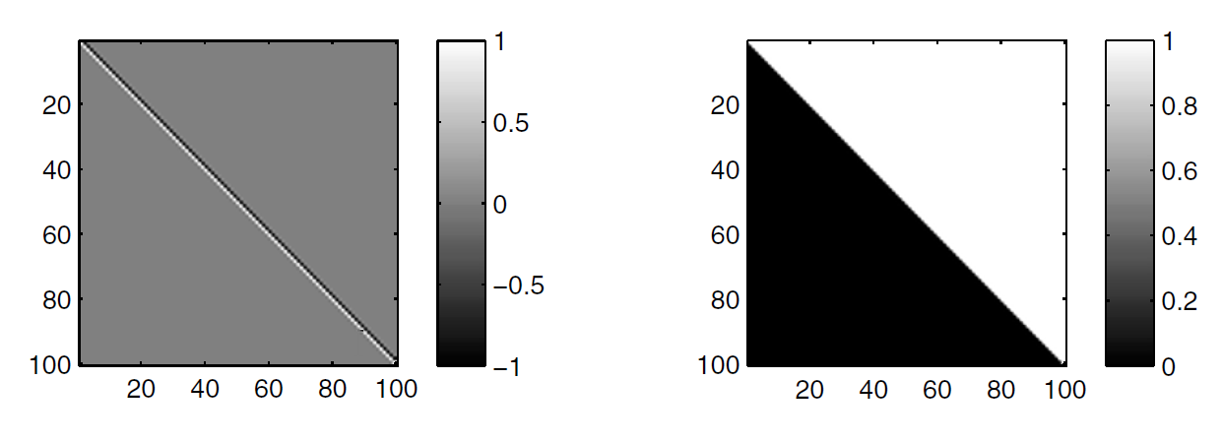
An example for a square and invertible D
Ω convolves the input signal by [+1,-1], and the last row is simply e_{n}
D is known as the heavy-side basis, containing the possible step functions
A sparse Ωx implies that the signal contains only few “jumps” and it is mostly constant. In synthesis terms, such a signal can be composed of few step functions.

Slide 12
Case 2: Redundant D and Ω
Synthesis
Analysis
Exact Equivalence again ?

Slide 13
Not Really !
The vector α defined by α=Ωx must be spanned by the columns of Ω. Thus, what we actually got is the following analysis-equivalent formulation
which means that analysis ≠ synthesis in general.

Slide 14
So, Which is Better? Which to Use?
The paper [Elad, Milanfar, & Rubinstein (`07)] was the first to draw attention to this dichotomy between analysis and synthesis, and the fact that the two may be substantially different.
We concentrated on p=1, showing that
The two formulations refer to very different models,
The analysis is much richer, and
The analysis model may lead to better performance.
In the past several years there is a growing interest in the analysis formulation (see recent work by Portilla et. al., Figueiredo et. al., Candes et. al., Shen et. al., Nam et. al., Fadili & Peyré, Kutyniok et. al., Ward and Needel, …).
Our goal: better understanding of the analysis model, its relation to the synthesis, and how to make the best of it in applications.

Slide 15
Part III - Analysis A Different Point of View Towards the Analysis Model
S. Nam, M.E. Davies, M. Elad, and R. Gribonval, "Co-sparse Analysis Modeling - Uniqueness and Algorithms" , ICASSP, May, 2011.
S. Nam, M.E. Davies, M. Elad, and R. Gribonval, "The Co-sparse Analysis Model and Algorithms" , ACHA, Vol. 34, No. 1, Pages 30-56, January 2013.

Slide 16
The Analysis Model – Basics
d
The analysis representation z is expected to be sparse
Co-sparsity: - the number of zeros in z.
Co-Support: Λ - the rows that are orthogonal to x
If Ω is in general position , then and thus we cannot expect to get a truly sparse analysis representation – Is this a problem? Not necessarily!
This model puts an emphasis on the zeros in the analysis representation, z, rather then the non-zeros, in characterizing the signal. This is much like the way zero-crossings of wavelets are used to define a signal [Mallat (`91)].
=
p
*
Analysis Dictionary

Slide 17
The Analysis Model – Bayesian View
d
Analysis signals, just like synthesis ones, can be generated in a systematic way:
Bottom line: an analysis signal x satisfies:
=
 | Synthesis Signals | Analysis Signals
Support: | Choose the support T (|T|=k) at random | Choose the co-support Λ (|Λ|= ) at random
Coef. : | Choose α_{T} at random | Choose a random vector v
Generate: | Synthesize by: D_{T}α_{T}=x | Orhto v w.r.t. Ω_{Λ}:
p
Analysis Dictionary

Slide 18
The Analysis Model – UoS
d
Analysis signals, just like synthesis ones, leads to a union of subspaces:
The analysis and the synthesis models offer both a UoS construction, but these are very different from each other in general.
=
 | Synthesis Signals | Analysis Signals
What is the Subspace Dimension: | k | d-
How Many Subspaces:
Who are those Subspaces:
p
Analysis Dictionary

Slide 19
The Analysis Model – Count of Subspaces
Example: p=n=2d:
Synthesis: k=1 (one atom) – there are 2d subspaces of dimensionality 1.
Analysis: =d-1 leads to >>O(2^{d}) subspaces of dimensionality 1.
In the general case, for d=40 and p=n=80, this graph shows the count of the number of subspaces. As can be seen, the two models are substantially different, the analysis model is much richer in low-dim., and the two complete each other.
The analysis model tends to lead to a richer UoS. Are these good news?
10
20
Synthesis
Analysis
10
15
# of Sub-Spaces
10
10
10
5
Sub-Space dimension
10
0
0
10
20
30
40

Slide 20
The Analysis Model – Pursuit
Fundamental problem: Given the noisy measurements,
recover the clean signal x – This is a denoising task.
This goal can be posed as:
This is a (NP-) hard problem, just as in the synthesis case.
We can approximate its solution by L₁ replacing L₀ (BP-analysis), Greedy methods (OMP, …), and Hybrid methods (IHT, SP, CoSaMP, …).
Theoretical studies should provide guarantees for the success of these techniques, typically depending on the co-sparsity and properties of Ω. This work has already started [Candès, Eldar, Needell, & Randall (`10)], [Nam, Davies, Elad, & Gribonval, (`11)], [Vaiter, Peyré, Dossal, & Fadili, (`11)], [Giryes et. al. (`12)].

Slide 21
The Analysis Model – Backward Greedy
BG finds one row at a time from Λ for approximating the solution of
Stop condition?
(e.g. )
Output x_{i}
Yes
No

Slide 22
The Analysis Model – Backward Greedy
Is there a similarity to a synthesis pursuit algorithm?
Synthesis OMP
Stop condition?
(e.g. )
Output x
Other options:
A Gram-Schmidt acceleration of this algorithm.
Optimized BG pursuit (xBG) [Rubinstein, Peleg & Elad (`12)]
Greedy Analysis Pursuit (GAP) [Nam, Davies, Elad & Gribonval (`11)]
Iterative Cosparse Projection [Giryes, Nam, Gribonval & Davies (`11)]
L_{p} relaxation using IRLS [Rubinstein (`12)]
CoSaMP, SP, IHT and IHP analysis algorithms [Giryes et. al. (`12)]
= y-r_{i}
Yes
No

Slide 23

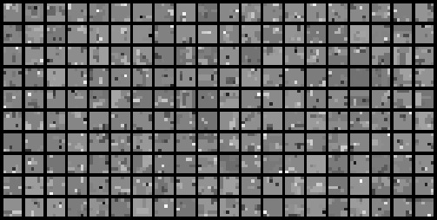
The Analysis Model – Low-Spark Ω
What if spark(Ω^{T})<<d ?
For example: a TV-like operator for image-patches of size 6×6 pixels (Ω size is 72×36).
Here are analysis-signals generated for co-sparsity ( ) of 32:
Their true co-sparsity is higher – see graph:
In such a case we may consider , and thus
… the number of subspaces is smaller.
הסבר לנקודה האחרונה: נניח שאנו בוחרים L=32 שורות בת"ל וכך יוצרים אותות במימד 4. כאשר קיימות התלויות הללו יתקבל שלכל בחירה כזו מצטרפות שורות רבות אחרות שתלויות בקבוצה שנבחרה. לכן, סך האפשרויות אינו בחירה של L מתוך P אלא פחות מכך כי אנו כופים על L השורות להיות בת"ל
800
700
600
500
# of signals
400
300
200
100
0
0
10
20
30
40
50
60
70
80
Co-Sparsity

Slide 24
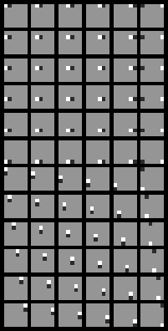
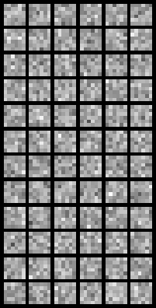
The Analysis Model – The Signature
Consider two possible dictionaries:
1
Ω
Random
Ω
0.8
DIF
Relative number of linear dependencies
0.6
0.4
0.2
# of rows
0
0
10
20
30
40
The Signature of a matrix is more informative than the Spark

Slide 25
The Analysis Model – Low-Spark Ω – Pursuit
An example – performance of BG (and xBG) for these TV-like signals:
1000 signal examples, SNR=25.
We see an effective denoising, attenuating the noise by a factor ~0.2. This is achieved for an effective co-sparsity of ~55.
Denoising Performance
BG or xBG
2
BG
xBG
1.6
1.2
0.8
0.4
Co-Sparsity in the Pursuit
0
0
20
40
60
80

Slide 26
Part IV – We Are Done Summary and Conclusions

Slide 27
Synthesis vs. Analysis – Summary
m
The two align for p=m=d : non-redundant.
Just as the synthesis, we should work on:
Pursuit algorithms (of all kinds) – Design.
Pursuit algorithms (of all kinds) – Theoretical study.
Applications …
Our experience on the analysis model:
Theoretical study is harder.
The role of inner-dependencies in Ω ?
Great potential for modeling signals.
=
d
d
=
p

Slide 28
Today …
Sparsity and Redundancy are practiced mostly in the context of the synthesis model
Yes, the analysis model is a very appealing (and different) alternative, worth looking at
Is there any other way?
Deepening our understanding
Applications ?
Combination of signal models …
In the past few years there is a growing interest in this model, deriving pursuit methods, analyzing them, etc.
So, what to do?
What next?

Slide 29

The Analysis Model is Exciting Because
It poses mirror questions to practically every problem that has been treated with the synthesis model
It leads to unexpected avenues of research and new insights – E.g. the role of the coherence in the dictionary
It poses an appealing alternative model to the synthesis one, with interesting features and a possibility to lead to better results
Merged with the synthesis model, such constructions could lead to new and far more effective models

