Slide 1

Sparse and Redundant Representations and Their Applications in
Signal and Image Processing (236862)
Section 0-1: First Steps in Signal and Image Processing via Sparseland
Winter Semester, 2018/2019
Michael (Miki) Elad

Slide 2
Meeting Plan
Quick review of the material covered
Answering questions from the students and getting their feedback
Discussing a new material – The Co-Sparse Analysis Model
Administrative issues

Slide 3
Overview of the Material
Overview of this Field
Image Priors and the Sparseland Model
Iterative Shrinkage and Image Deblurring

Slide 4
Overview of the Material
Overview of this Field
What This Field is All About: Modeling Data
Sparseland: Theoretical & Algorithmic Background
This Course: Scope and Style
A Word About Notations

Slide 5
Overview of the Material
Overview of this Field
Image Priors and the Sparseland Model
A Prior for Images: How and Why?
The Evolution of Priors in Image Processing
Linear vs. Non-Linear Approximation
The Sparseland Model
The Geometry behind Sparseland
Processing Sparseland’s Signals

Slide 6
Overview of the Material
Overview of this Field
Image Priors and the Sparseland Model
Iterative Shrinkage and Image Deblurring
Image-Deblurring via Sparseland: Problem Formulation
Starting with Classical Optimization
Iterative Shrinkage Thresholding Algorithm (ISTA)
Shrinkage: A Matlab Demo
Image Deblurring: Results & Discussion
Image Deblurring: A Closer Look at the Results

Slide 7
Your Questions and Feedback
You have shown 3 algorithms to solve Q₁^{λ}, which is related to P₁^{ε}. These are:
IRLS, ADMM (and now ISTA is added) and LARS. Can you perhaps provide more insight on the subject of differences between them? In terms of run-time complexity and objective empirical success ?
Tough question !
Generally, these methods are hard to compare (who is better? OMP or BP?)
If the picture is not complicated enough, there is a way to design an “ISTA-like” algorithm based on IRLS.
However, if you insist on an answer, I would say this:
Use LARS for low-dimensions (up to m=500)
Use ISTA for higher dimensions.

Slide 8

Your Questions and Feedback

Slide 9
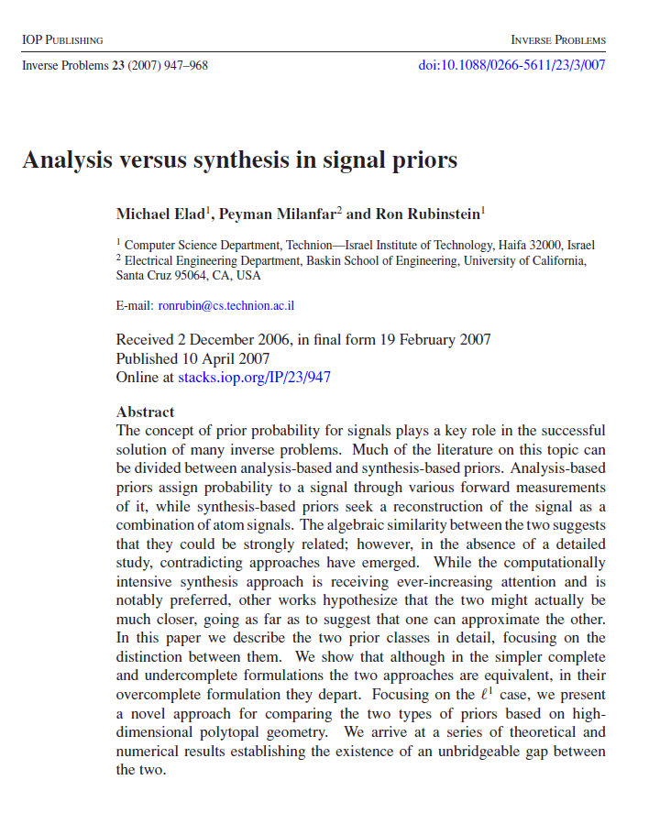
New Material?
Analysis vs. Synthesis
The Sparseland Story is posed in terms of a Synthesis model, but there is an analysis counterpart
In 2007 we exposed this confusion for the first time

Slide 10
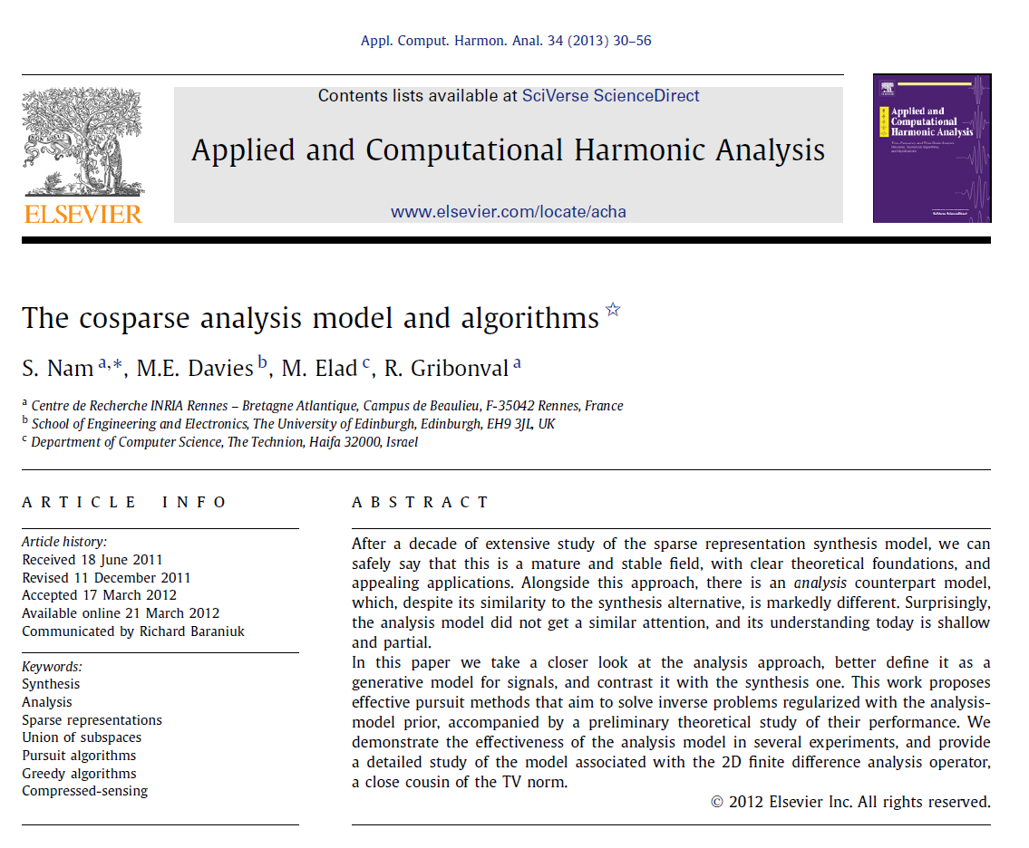
New Material?
The Co-Sparse Analysis Model
In 2013 we made a substantial progress in understanding the analysis alternative
This led to a flood of papers on this alternative (see this)
Bottom line: till today, we are unclear which of the two to use, etc.
BTW: there is a connection between this debate and deep-learning architectures

Slide 11
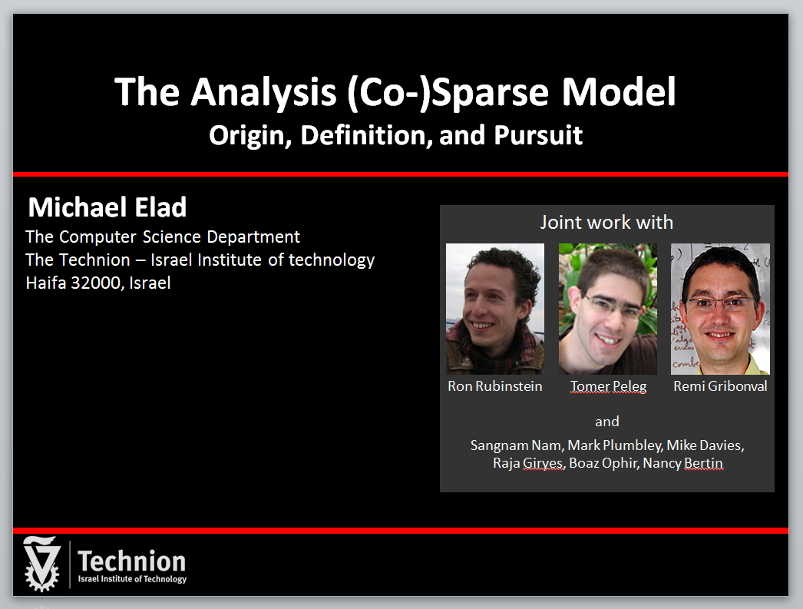
So, What is The Analysis Model?

Slide 12
Administrative Issues
No weekly emails ?
What about your projects?

Slide 13

