Slide 1

Sparse and Redundant Representations and Their Applications in
Signal and Image Processing (236862)
Section 2: The Quest for a Dictionary
Winter Semester, 2018/2019
Michael (Miki) Elad

Slide 2
Meeting Plan
Quick review of the material covered
Answering questions from the students and getting their feedback
Discussing a new material – Kernel Dictionary Learning (by Alona Goltz)
Administrative issues

Slide 3
Overview of the Material
The Quest for a Dictionary – The Basics
Background: Choosing vs. Learning the Dictionary
Dictionary Learning (DL): Problem Formulation
The MOD Algorithm
The K-SVD Algorithm
Matlab Demo
The Quest for a Dictionary – Advanced Topics
Dictionary Learning: Difficulties
The Double-Sparsity Algorithm
Learning Unitary Dictionaries
The Signature Dictionary
Dictionary Learning: Summary

Slide 4
Your Questions and Feedback
Question: Derivative of L₁
In the video starting with Classical Optimization, we mention that the derivative of L₁(x) is sign(x). Isn't this technically incorrect? L₁ does not have a derivative since it is not a continuous function. We can find the sub-gradient for this function, such as the sign function, but it is important to differentiate between derivatives and sub-gradients. Am I missing something here?
Answer: You are correct !
Sign is only one possibility for a sub-gradient of L₁. However, when designing a steepest-descent algorithm, we need a specific direction to use and we pick this option. Note that if we choose a similar function to sign with a value +1 (or in fact any value in the range [-1,1]) at zero, this would be just as good in terms of guaranteeing a descent.

Slide 5
Your Questions and Feedback
Question: Formulating the Lagrangian
In most of the videos and derivations (see Image-Deblurring via Sparseland: Problem Formulation as an example) when we formulate the Lagrangian we add the λ coefficient on the objective rather than on the constraint. That throws me off a little bit. Traditionally the constraint is multiplied by the Lagrangian multiplier. Why do we choose to do it this way?
Answer: You are correct !
We simply follow the convention of our field, which choose this way to insert λ. Note, however, that this changes nothing in our treatment or obtained solutions.

Slide 6
Your Questions and Feedback
Question: Double-Sparsity
In slide 5 of the Double Sparsity method, it is said that the degrees of freedom we are learning is 2*m*k1 - Where does the 2 come from? Why is it not simply m*k1?
Answer: Factor 2 is required
The unknowns are the elements of the matrix A, which are k₁ non-zeros in each of the m columns. Thus, we should store the indices where these non-zeros are located, and their values as well. Bottom line: 2K₁m numbers to train/find.

Slide 7

Your Questions and Feedback

Slide 8
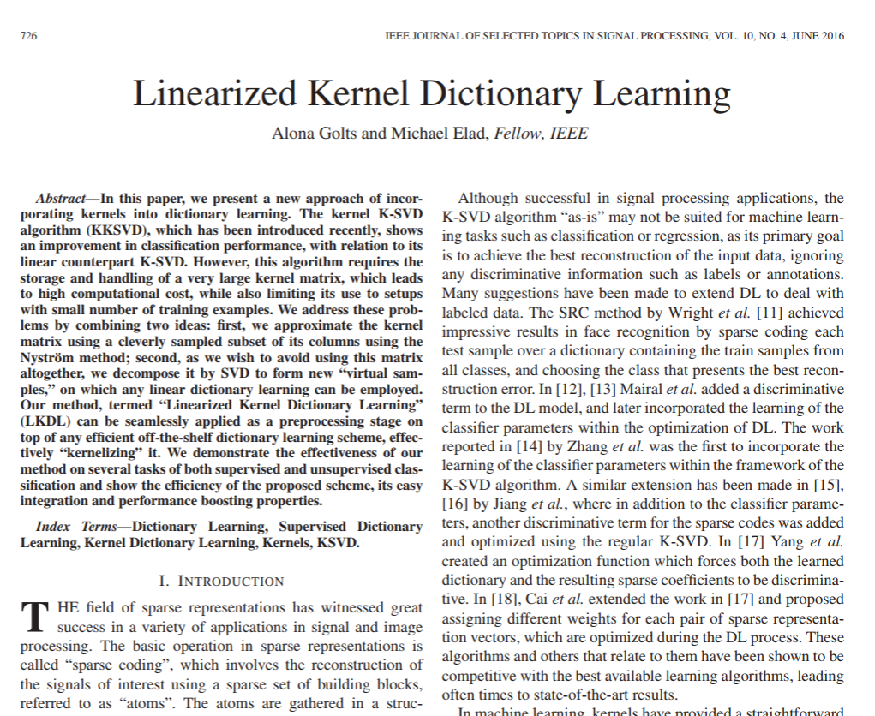
New Material?
Kernel Dictionary Learning
Sparseland assumes that signals are created as linear combination of atoms. Can we “kernelize” this view?

Slide 9
Administrative Issues
Date of submission of mid-project in part II of the course: January 6th at 23:55
Date of submission of final-project + bonus: January 24th at 23:55 (last day of the semester)
All students must finish all of the quizzes + discussions (mandatory) until the last day of the semester (January 24th) at 23:55.
A big Thank-You to Itay Zilberman that has been supplying us with Python code for the last two exercises.

Slide 10

