Slide 1

Sparse and Redundant Representations and Their Applications in
Signal and Image Processing (236862)
Section 3: Image Denoising
Winter Semester, 2018/2019
Michael (Miki) Elad

Slide 2
Meeting Plan
Quick review of the material covered
Answering questions from the students and getting their feedback
Discussing a new material – Facial Image Compression
Administrative issues

Slide 3
Overview of the Material
Image Denoising – The Sparseland Way
The Denoising Problem and its Importance
First Steps in Image Denoising
Variations on the Global Thresholding Algorithm
SURE for Parameter Tuning: The Theory
SURE for Parameter Tuning: The Practice
Patch-Based Denoising – Basics
Patch-Based Denoising: Theoretical Foundations
The K-SVD Image Denoising Algorithm
Patch-Based Denoising – Other Methods
Image Denoising - Summary

Slide 4




Your Questions and Feedback
Question: L₂ – Good or Bad?
The message in this course about the suitability of the L₂ seems to be confusing. When discussing Wiener filter, L₂ was said to be a bad option, yet in defining pursuit algorithms we keep using L₂. Now, when discussing denoising, we are aiming to get a minimal L₂ error. So, what is the bottom line: L₂ – bad or good?
Answer: Sorry for the confusion – lets put some order to this picture. We use the L₂ in three very different contexts, each with it’s own story:
$${\left\|Dα−y\right\|}_{2}^{2}$$
Here the L₂ represents the knowledge that the noise is white & Gaussian – this is well-justified
L₂
Here the L₂ is used as a prior on the representation, causing a spread of the non-zeros everywhere - something that we know to be a VERY BAD choice
$${\left\|α\right\|}_{2}^{2}$$
$${E\left\|\hat{x}−x\right\|}_{2}^{2}→min$$
This is the Mean-Squared-Error between the recovered and the original image. While there are some attacks on this option, it is still important and popular
&

Slide 5

Your Questions and Feedback

Slide 6
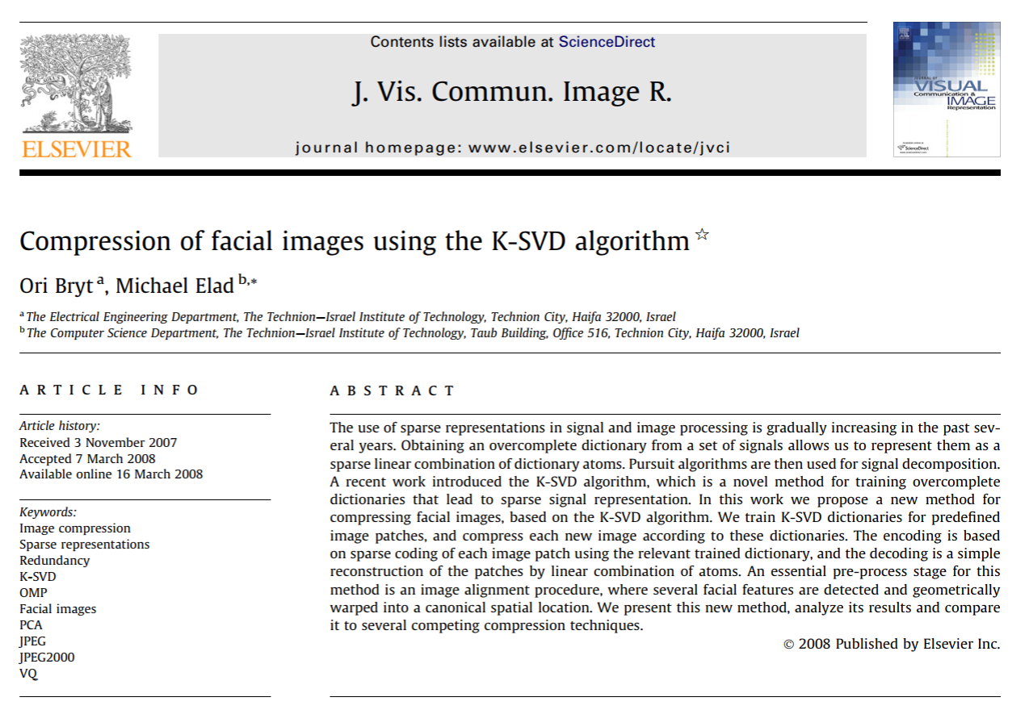
New Material?
Face Image Compression
Here is a chapter that we omitted from the MOOC after a debate, despite its importance and elegance: image compression using the Sparseland model
Rather than discussing general purpose compression, we focus on a specific family of images – frontal faces
This work is a brilliant MSc research by Ori Bryt

Slide 7
Administrative Issues
Lets talk about:
Please provide your feedback to the Technion’s course 236862 (MISHAAL HAMARTZE) & especially with free text comments
Remember the deadline on the 6th for the course mid-project

Slide 8

