Slide 1
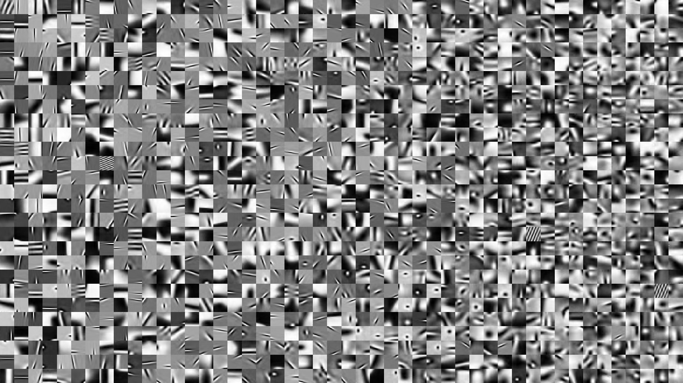
Sparse and Redundant Representations and Their Applications in
Signal and Image Processing (236862)
Section 5 & 6: Image Separation, Inpainting & Super-Resolution
Winter Semester, 2018/2019
Michael (Miki) Elad

Slide 2
Meeting Plan
Quick review of the material covered
Answering questions from the students and getting their feedback
Discussing a new material – CSC and the relation to … Deep-Learning
Administrative issues

Slide 3
Overview of the Material
Image Separation & Inpainting
Morphological Component Analysis: The Core Idea
Cartoon-Texture Image Separation via a Global Treatment
From Separation to Inpainting: A Global Approach
Patch-Based Image Separation
Patch-Based Image Inpainting
Patch-Based Impulse Noise Removal
Single Image Super-Resolution
Single Image Super-Resolution: First Steps
Single Image Super-Resolution: Detailed Algorithm
Single Image Super-Resolution: The Overall Algorithm
Single Image Super-Resolution: Results
Summary
Sparseland: What is it all About?
Sparseland: What is Still Missing

Slide 4

Your Questions and Feedback

Slide 5
Administrative Issues
Lets talk about:
The Final and Bonus projects, along with all the quizzes should be submitted until next Thursday, January 24th 23:55.
Next plans? You are required to present your research projects to me anytime between NOW and April 30th. The grades will be published soon after April 30th.
No submission after this date will be permitted

Slide 6
That’s All
We hope you enjoyed our course

Slide 7
New Material?
The Convolutional Sparse Coding Model and Connections to Deep-Learning

Slide 8
