Slide 1
Hybrid OpenMP and MPI Programming and Tuning
Yun (Helen) He and Chris Ding
Lawrence Berkeley National Laboratory

Slide 2
Outline
Introduction
  Why Hybrid
  Compile, Link, and Run
  Parallelization Strategies
  Simple Example: Ax=b
  MPI_init_thread Choices
  Debug and Tune
Examples
  Multi-dimensional Array Transpose
  Community Atmosphere Model
  MM5 Regional Climate Model
  Some Other Benchmarks
Conclusions

Slide 3


MPI vs. OpenMP
  Pure MPI Pro:
    Portable to distributed and shared memory machines.
    Scales beyond one node
    No data placement problem
  Pure MPI Con:
    Difficult to develop and debug
    High latency, low bandwidth
    Explicit communication
    Large granularity
    Difficult load balancing
  Pure OpenMP Pro:
    Easy to implement parallelism
    Low latency, high bandwidth
    Implicit Communication
    Coarse and fine granularity
    Dynamic load balancing
  Pure OpenMP Con:
    Only on shared memory machines
    Scale within one node
    Possible data placement problem
    No specific thread order

Slide 4

Why Hybrid
Hybrid MPI/OpenMP paradigm is the software trend for clusters of SMP architectures.
Elegant in concept and architecture: using MPI across nodes and OpenMP within nodes. Good usage of shared memory system resource (memory, latency, and bandwidth).
Avoids the extra communication overhead with MPI within node.
OpenMP adds fine granularity (larger message sizes) and allows increased and/or dynamic load balancing.
Some problems have two-level parallelism naturally.
Some problems could only use restricted number of MPI tasks.
Could have better scalability than both pure MPI and pure OpenMP.
My code speeds up by a factor of 4.44.

Slide 5
Why Mixed OpenMP/MPI Code is Sometimes Slower?
OpenMP has less scalability due to implicit parallelism while MPI allows multi-dimensional blocking.
All threads are idle except one while MPI communication.
  Need overlap comp and comm for better performance.
  Critical Section for shared variables.
Thread creation overhead
Cache coherence, data placement.
Natural one level parallelism problems.
Pure OpenMP code performs worse than pure MPI within node.
Lack of optimized OpenMP compilers/libraries.
Positive and Negative experiences:
  Positive: CAM, MM5, …
  Negative: NAS, CG, PS, …

Slide 6
A Pseudo Hybrid Code
Program hybrid
call MPI_INIT (ierr)
call MPI_COMM_RANK (…)
call MPI_COMM_SIZE (…)
… some computation and MPI communication
call OMP_SET_NUM_THREADS(4)
!$OMP PARALLEL DO PRIVATE(i)
!$OMP& SHARED(n)
do i=1,n
… computation
enddo
!$OMP END PARALLEL DO
… some computation and MPI communication
call MPI_FINALIZE (ierr)
end

Slide 7
Compile, link, and Run
% mpxlf90_r –qsmp=omp -o hybrid –O3 hybrid.f90
% setenv XLSMPOPTS parthds=4
(or % setenv OMP_NUM_THREADS 4)
% poe hybrid –nodes 2 –tasks_per_node 4
Loadleveler Script: (% llsubmit job.hybrid)
#@ shell = /usr/bin/csh
#@ output = $(jobid).$(stepid).out
#@ error = $(jobid).$(stepid).err
#@ class = debug
#@ node = 2
#@ tasks_per_node = 4
#@ network.MPI = csss,not_shared,us
#@ wall_clock_limit = 00:02:00
#@ notification = complete
#@ job_type = parallel
#@ environment = COPY_ALL
#@ queue
hybrid
exit

Slide 8
Other Environment Variables
MP_WAIT_MODE: Tasks wait mode, could be poll, yield, or sleep. Default value is poll for US and sleep for IP.
MP_POLLING_INTERVAL: the polling interval.
By default, a thread in OpenMP application goes to sleep after finish its work.
By putting thread in a busy-waiting instead of sleep could reduce overhead in thread reactivation.
  SPINLOOPTIME: time spent in busy wait before yield
  YIELDLOOPTIME: time spent in spin-yield cycle before fall asleep.

Slide 9
Loop-based vs. SPMD
SPMD:
!$OMP PARALLEL DO PRIVATE(start, end, i)
!$OMP& SHARED(a,b)
num_thrds = omp_get_num_threads()
thrd_id = omp_get_thread_num()
start = n* thrd_id/num_thrds + 1
end = n*(thrd_num+1)/num_thrds
do i = start, end
a(i)=a(i)+b(i)
enddo
!$OMP END PARALLEL DO
Loop-based:
!$OMP PARALLEL DO PRIVATE(i)
!$OMP& SHARED(a,b,n)
do i=1,n
a(i)=a(i)+b(i)
enddo
!$OMP END PARALLEL DO
SPMD code normally gives better performance than loop-based code, but more difficult to implement:
  Less thread synchronization.
  Less cache misses.
  More compiler optimizations.

Slide 10
Hybrid Parallelization Strategies
From sequential code, decompose with MPI first, then add OpenMP.
From OpenMP code, treat as serial code.
From MPI code, add OpenMP.
Simplest and least error-prone way is to use MPI outside parallel region, and allow only master thread to communicate between MPI tasks.
Could use MPI inside parallel region with thread-safe MPI.

Slide 11
A Simple Example: Ax=b
thread
=
process
c = 0.0
do j = 1, n_loc
!$OMP DO PARALLEL
!$OMP SHARED(a,b), PRIVATE(i)
!$OMP REDUCTION(+:c)
do i = 1, nrows
c(i) = c(i) + a(i,j)*b(i)
enddo
enddo
call MPI_REDUCE_SCATTER(c)
OMP does not support vector reduction
Wrong answer since c is shared!

Slide 12
Correct Implementations
IBM SMP:
c = 0.0
!$SMP PARALLEL REDUCTION(+:c)
c = 0.0
do j = 1, n_loc
!$SMP DO PRIVATE(i)
do i = 1, nrows
c(i) = c(i) + a(i,j)*b(i)
enddo
!$SMP END DO NOWAIT
enddo
!$SMP END PARALLEL
call MPI_REDUCE_SCATTER(c)
OPENMP:
c = 0.0
!$OMP PARALLEL SHARED(c), PRIVATE(c_loc)
c_loc = 0.0
do j = 1, n_loc
!$OMP DO PRIVATE(i)
do i = 1, nrows
c_loc(i) = c_loc(i) + a(i,j)*b(i)
enddo
!$OMP END DO NOWAIT
enddo
!$OMP CRITICAL
c = c + c_loc
!$OMP END CRITICAL
!$OMP END PARALLEL
call MPI_REDUCE_SCATTER(c)

Slide 13
MPI_INIT_Thread Choices
MPI_INIT_THREAD (required, provided, ierr)
  IN: required, desired level of thread support (integer).
  OUT: provided, provided level of thread support (integer).
  Returned provided maybe less than required.
Thread support levels:
  MPI_THREAD_SINGLE: Only one thread will execute.
  MPI_THREAD_FUNNELED: Process may be multi-threaded, but only main thread will make MPI calls (all MPI calls are ’’funneled'' to main thread). Default value for SP.
  MPI_THREAD_SERIALIZED: Process may be multi-threaded, multiple threads may make MPI calls, but only one at a time: MPI calls are not made concurrently from two distinct threads (all MPI calls are ’’serialized'').
  MPI_THREAD_MULTIPLE: Multiple threads may call MPI, with no restrictions.

Slide 14
MPI Calls Inside OMP MASTER
MPI_THREAD_FUNNELED is required.
OMP_BARRIER is needed since there is no synchronization with OMP_MASTER.
It implies all other threads are sleeping!
!$OMP BARRIER
!$OMP MASTER
call MPI_xxx(…)
!$OMP END MASTER
!$OMP BARRIER

Slide 15
MPI Calls Inside OMP SINGLE
MPI_THREAD_SERIALIZED is required.
OMP_BARRIER is needed since OMP_SINGLE only guarantees synchronization at the end.
It also implies all other threads are sleeping!
!$OMP BARRIER
!$OMP SINGLE
call MPI_xxx(…)
!$OMP END SINGLE

Slide 16

THREAD FUNNELED/SERIALIZED vs. Pure MPI
FUNNELED/SERIALIZED:
  All other threads are sleeping while single thread communicating.
  Only one thread communicating maybe not able to saturate the inter-node bandwidth.
Pure MPI:
  Every CPU communicating may over saturate the inter-node bandwidth.
Overlap communication with computation!

Slide 17
Overlap COMM and COMP
Need at least MPI_THREAD_FUNNELED.
While master or single thread is making MPI calls, other threads are computing!
Must be able to separate codes that can run before or after halo info is received. Very hard!
!$OMP PARALLEL
if (my_thread_rank < 1) then
call MPI_xxx(…)
else
do some computation
endif
!$OMP END PARALLEL

Slide 18
Scheduling for OpenMP
Static: Loops are divided into #thrds partitions, each containing ceiling(#iters/#thrds) iterations.
Affinity: Loops are divided into n_thrds partitions, each containing ceiling(#iters/#thrds) iterations. Then each partition is subdivided into chunks containing ceiling(#left_iters_in_partion/2) iterations.
Guided: Loops are divided into progressively smaller chunks until the chunk size is 1. The first chunk contains ceiling(#iters/#thrds) iterations. Subsequent chunk contains ceiling(#left_iters/#thrds) iterations.
Dynamic, n: Loops are divided into chunks containing n iterations. We choose different chunk sizes.

Slide 19
Debug and Tune Hybrid Codes
Debug and Tune MPI code and OpenMP code separately.
  Use Guideview or Assureview to tune OpenMP code.
  Use Vampir to tune MPI code.
Decide which loop to parallelize. Better to parallelize outer loop. Decide whether Loop permutation, fusion or exchange is needed.
Choose between loop-based or SPMD.
Use different OpenMP task scheduling options.
Experiment with different combinations of MPI tasks and number of threads per MPI task. Less MPI tasks may not saturate inter-node bandwidth.
Adjust environment variables.
Aggressively investigate different thread initialization options and the possibility of overlapping communication with computation.

Slide 20
KAP OpenMP Compiler - Guide
A high-performance OpenMP compiler for Fortran, C and C++.
Also supports the full debugging and performance analysis of OpenMP and hybrid MPI/OpenMP programs via Guideview.
% guidef90 <driver options> -WG,<guide options>
<filename> <xlf compiler options>
% guideview <statfile>

Slide 21
KAP OpenMP Debugging Tools - Assure
A programming tool to validate the correctness of an OpenMP program.
% assuref90 -WApname=pg –o a.exe a.f -O3
% a.exe
% assureview pg
Could also be used to validate the OpenMP section
in a hybrid MPI/OpenMP code.
% mpassuref90 <driver options> -WA,<assure options>
<filename> <xlf compiler options>
% setenv KDD_OUTPUT=project.%H.%I
% poe ./a.out –procs 2 –nodes 4
% assureview assure.prj project.{hostname}.{process-id}.kdd

Slide 22
Other Debugging, Performance Monitoring and Tuning Tools
HPM Toolkit: IBM hardware performance monitor for C/C++, Fortran77/90, HPF.
TAU: C/C++, Fortran, Java performance tool.
Totalview: Graphic parallel debugger for C/C++, F90.
Vampir: MPI performance tool.
Xprofiler: Graphic profiling tool.

Slide 23
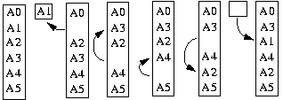
Story 1: Distributed Multi-Dimensional Array Transpose With Vacancy Tracking Method
A(3,2) ➔ A(2,3)
Tracking cycle: 1 – 3 – 4 – 2 - 1
A(2,3,4) →A(3,4,2), tracking cycles:
1 - 4 - 16 - 18 - 3 - 12 - 2 - 8 - 9 - 13 - 6 - 1
5 - 20 - 11 - 21 - 15 - 14 - 10 - 17 - 22 - 19 - 7 – 5
Cycles are closed, non-overlapping.

Slide 24
Multi-Threaded Parallelism
Key: Independence of tracking cycles.
!$OMP PARALLEL DO DEFAULT (PRIVATE)
!$OMP& SHARED (N_cycles, info_table, Array) (C.2)
!$OMP& SCHEDULE (AFFINITY)
do k = 1, N_cycles
an inner loop of memory exchange for each cycle using info_table
enddo
!$OMP END PARALLEL DO

Slide 25
Scheduling for OpenMP within one Node
64x512x128: N_cycles = 4114, cycle_lengths = 16 16x1024x256: N_cycles = 29140, cycle_lengths= 9, 3
Schedule “affinity” is the best for large number of cycles and regular short cycles.
8x1000x500: N_cycles = 132, cycle_lengths = 8890, 1778, 70, 14, 5 32x100x25: N_cycles = 42, cycle_lengths = 168, 24, 21, 8, 3.
Schedule “dynamic,1” is the best for small number of cycles with large irregular cycle lengths.

Slide 26
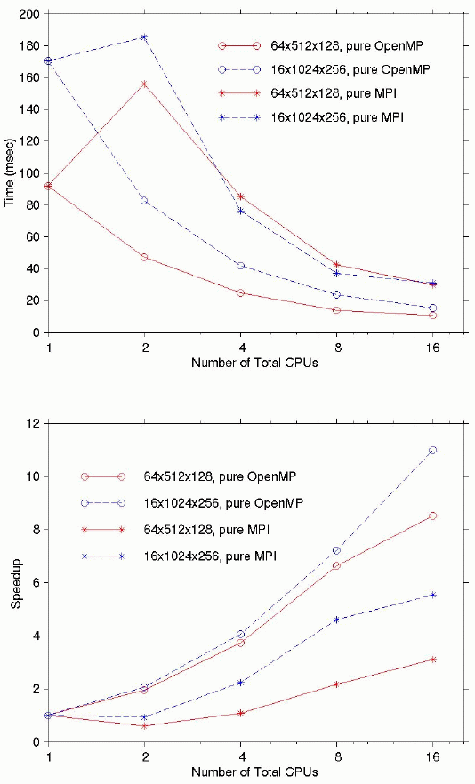
Pure MPI and Pure OpenMP within One Node
OpenMP vs. MPI (16 CPUs)
64x512x128: 2.76 times faster
16x1024x256:1.99 times faster

Slide 27
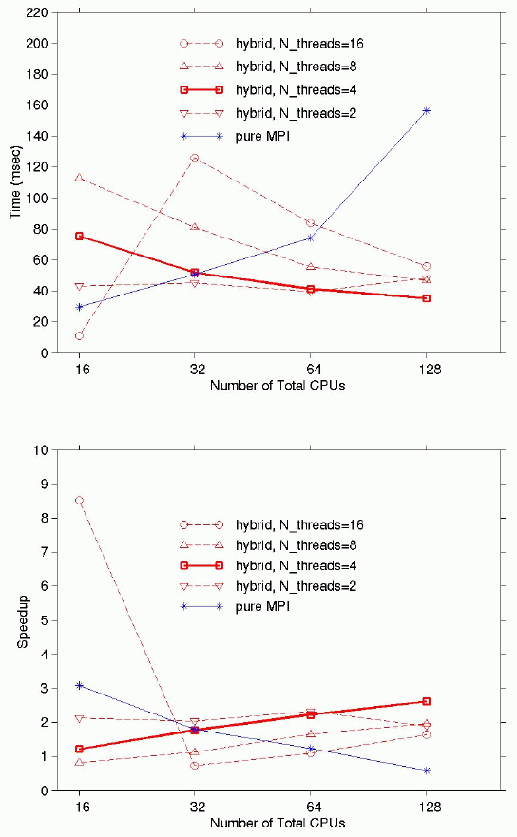
Pure MPI and Hybrid MPI/OpenMP Across Nodes
With 128 CPUs, n_thrds=4 hybrid MPI/OpenMP performs faster than n_thrds=16 hybrid by a factor of 1.59, and faster than pure MPI by a factor of 4.44.

Slide 28
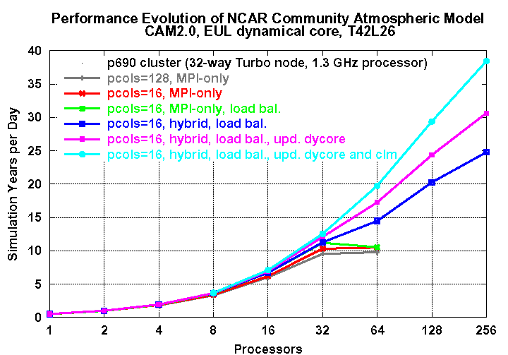
Story 2: Community Atmosphere Model (CAM) Performance on SP
Pat Worley, ORNL
T42L26 grid size:
128(lon)*64(lat)
*26 (vertical)

Slide 29
CAM Observation
CAM has two computational phases: dynamics and physics. Dynamics need much more interprocessor communication than physics.
Original parallelization with pure MPI is limited to 1-D domain decomposition; the number of maximum CPUs used is limited to the number of latitude grids.

Slide 30
CAM New Concept: Chunks
Latitude
Longitude

Slide 31
What Have Been Done to Improve CAM?
The incorporation of chunks (column based data structures) allows dynamic load balancing and the usage of hybrid MPI/OpenMP method:
  Chunking in physics provides extra granularity. It allows an increase in the number of processors used.
  Multiple chunks are assigned to each MPI processor, OpenMP threads loop over each local chunk. Dynamic load balancing is adopted.
  The optimal chunk size depends on the machine architecture, 16-32 for SP.
Overall Performance increases from 7 models years per simulation day with pure MPI to 36 model years with hybrid MPI/OpenMP (allow more CPUs), load balanced, updated dynamical core and community land model (CLM).
(11 years with pure MPI vs. 14 years with MPI/OpenMP both with 64 CPUs and load-balanced)

Slide 32
Story 3: MM5 Regional Weather Prediction Model
MM5 is approximately 50,000 lines of Fortran 77 with Cray extensions. It runs in pure shared-memory, pure distributed memory and mixed shared/distributed-memory mode.
The code is parallelized by FLIC, a translator for same-source parallel implementation of regular grid applications.
The different method of parallelization is implemented easily by including appropriate compiler commands and options to the existing configure.user build mechanism.

Slide 33
MM5 Performance on 332 MHz SMP
Method | Communication (sec) | Total (sec)
64 MPI tasks | 494 | 1755
16 MPI tasks with 4 threads/task | 281 | 1505
85% total reduction is in communication.
threading also speeds up computation.
Data from: http://www.chp.usherb.ca/doc/pdf/sp3/Atelier_IBM_CACPUS_oct2000/hybrid_programming_MPIOpenMP.PDF

Slide 34
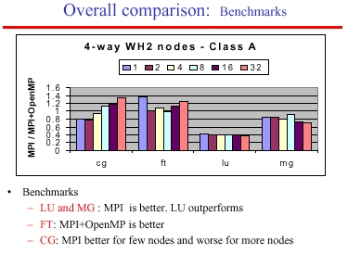

Story 4: Some Benchmark Results
Performance depends on:
  benchmark features
    Communication/computation patterns
    Problem size
  Hardware features
    Number of nodes
    Relative performance of CPU, memory, and communication system (latency, bandwidth)
Data from: http://www.eecg.toronto.edu/~de/Pa-06.pdf

Slide 35
Conclusions
Pure OpenMP performs better than pure MPI within node is a necessity to have hybrid code better than pure MPI across node.
Whether the hybrid code performs better than MPI code depends on whether the communication advantage outcomes the thread overhead, etc. or not.
There are more positive experiences of developing hybrid MPI/OpenMP parallel paradigms now. It’s encouraging to adopt hybrid paradigm in your own application.

Slide 36
The End
Thank you very much!

