Slide 1


Analytical Approach to Similarity Based Prediction
Dr. Alexander Bleakie & Prof. Dragan Djurdjanovic

Slide 2
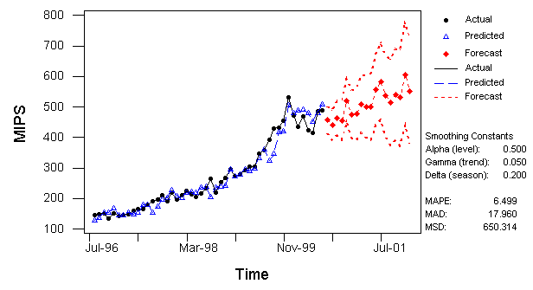
Background
For CBM, the performance of a system is deduced from the available sensor readings being collected:
Fundamental time-series prediction problem
Physics based prediction.
Linear data-driven prediction.
Non-linear data-driven prediction.

Slide 3
Similarity-Based Prediction
Run 1
Run 2
Run 3
Run 4
Current Run
Time
: System Maintenance
?
Residual 2
Feature Vector : (FV)
A set of values selected to describe system performance.
Cycle :
Single Time Step.
Run :
Time period between two of the same maintenance operations, many cycles.
Normal
Operation
Residual 1

Slide 4
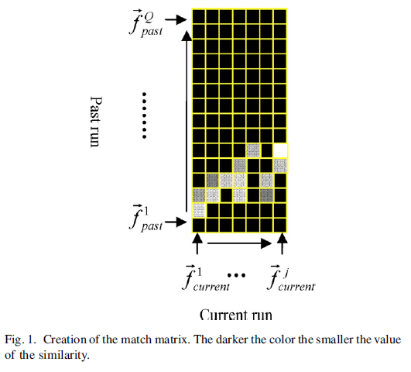
Similarity Based Prediction
Uses similarity metrics of the currently observed time-series with prior realizations:
Ideal for systems undergoing maintenance and repetitive tasks with historical performance.
Liu et al. 2007*: “Match Matrices” gives better long-term prediction than ARMA and RNN on a drilling process.
Wang et al. 2008 [55]: optimal alignment of historical time series for similarity based model.
High accuracy at the expense of computational complexity.
Previous Operation’s Time
Current Operation’s Time
*Liu, J., Djurdjanovic, D., Ni, J., Casoetto, N., and Lee, J., 2007, “Similarity Based Method for Manufacturing Process Performance Prediction and Diagnosis,” Computers in Industry, (6)58, pp. 558-566.

Slide 5
Similarity Based Prediction using Analytically Updating Pdfs
Pdf- probability
density function
Cycle from Past History
Actual Cycle from Current Run
Predicted Cycle for Current Run
…
…
Previous Runs
System Residuals (multidimensional)
….
0
1
2
….
N-1
N
N+1
….
Cycles
Bleakie, A., Djurdjanovic, D., 2013, “Analytical Approach to Similarity Based Prediction of Manufacturing System Performance," accepted to Computers in Industry, Paper No. COMIND-S-12-00170.

Slide 6
Similarity between Past and Current Performance
When cycle i in the Current Run is performed, find the Feature Vector similarities to all Previous Runs’ at that cycle (i):
For K past Runs:
Combine similarity vectors 1 to i with EWMA to predict cycles i+1 to the end.
Sigma is found from largest component
in GMM of that cycle.
Where is the similarity vector
for current cycle i.

Slide 7
Incorporating the Similarity Weights into a Log Likelihood Function
The similarity weights are incorporated into a log-likelihood function (LLF) for estimating the parameters of a pdf.
For example the LLF for Gaussian Mixture Models is:
Weight each observation k in the LLF (Weighted Likelihood Estimator*):
Gradient Descent Optimization for
Model Parameters (EM Algorithm):
M - number of GMM components.
K - number of observations.
(GMMs are fit to cycles i+1 to max run Length)
Closed Form Solutions for GMM means, covariances, and GMM weights.
*Hu, F., Zidek, J.V., 2002. The weighted likelihood. Canad. J. Statist. 30, 347–371.

Slide 8
Advantages of using Similarity Weighted GMMs for Prediction
Prediction of multiple cycles at once.
Weighting the predictions on similarity.
Non-stationary and non-Gaussian feature sets.
Fast computation.

Slide 9
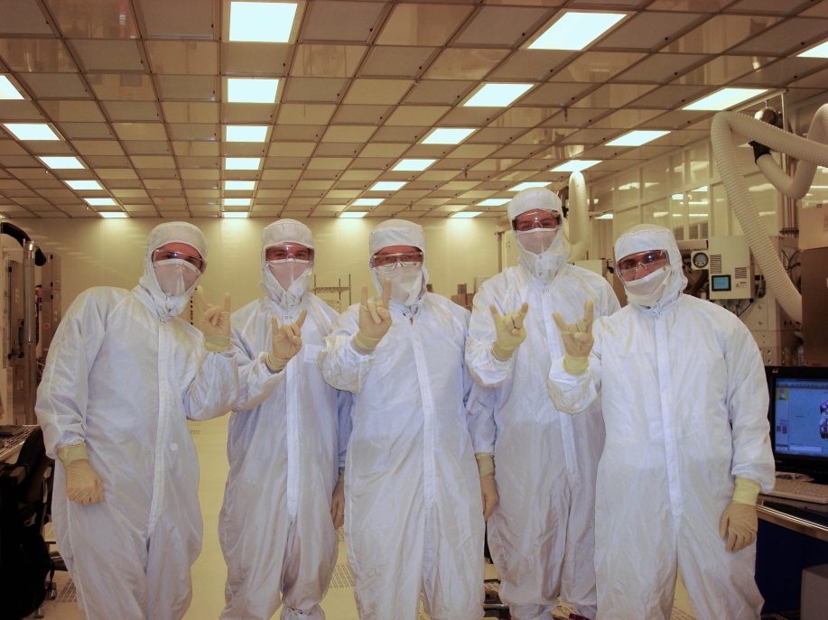
PECVD Tool and Data Collection
HF Gen
RF Power
Plasma Enhanced Chemical Vapor Deposition (PECVD)
HF Match
LF Gen
LF Match
Temperature
Chemistry/
Flow
MFC
MFC
MFC
…..
Showerhead
Robot
Plasma
Pedestal
LL Mano
Chamber Mano
Pressure
Control Valve
Pressure
Pump
Me !
Tool Data Collected from a Micron 300mm Facility:
Over 100,000 Wafers of Fab Data from PECVD Tool, at 10Hz:
RF : HF power, Load Cap, Tune Cap, LF power
Pressure: Chamber, PCV angle, Loadlock
Chemistry: Gas Flows
Temperature: Chamber, Pedestal
Wafer Metrology Measurements for Comparisons:
Product Thickness Mean and Range
Qual Wafer Thickness and Refractive Index
Particle Monitor Data
Full Maintenance Logs
All Operations are TEOS Depositions of Various Thicknesses

Slide 10
PECVD Tool Dynamic Features
Bleakie, A., Djurdjanovic, D., 2011, “Dynamic Feature Monitoring Technique Applied to Thin Film Deposition Processes in an Industrial PECVD Tool,” Proceedings of the ASME 2011 International Manufacturing Science and Engineering Conference, June 13-17.
Bleakie, A., Djurdjanovic, D., 2013, “Feature Extraction, Condition Monitoring, and Fault Modeling in Semiconductor Manufacturing Systems,” Computers in Industry, 64(3), pp. 203-213.

Slide 11
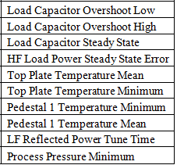
Sensitive Features between Maintenance
Features
-Data Set used to validate methods.
In-situ Clean
Data Utilized for Predictions:
70 runs at ~35 cycles each.
Thickest film recipe.
Results found for 40 ‘current’ runs
Deposition Cycle
‘Current’ run
Past run , ‘m’

Slide 12
Select Trajectories from PECVD Sensitive Features

Slide 13
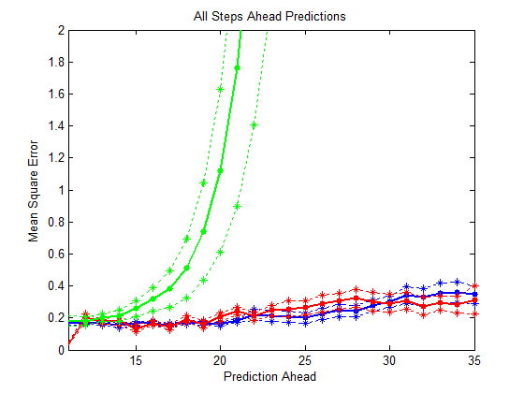
Predictions Beginning from Cycle (Wafer) 11 in the Current Run
PECVD Performance between cleans:
Predicted 35 cycles (wafers) into current inter in-situ clean run of wafers.
Compared to ARMA and similarity matrix method.
Averaged MSE for 45 current runs.
Elapsed time:
13.26 sec.
29.61 min.
1.82 hours
Weighted GMM updating
ARMA Model
ARMA Models of Similarity Matrices
GMM – Gaussian Mixture Model

Slide 14
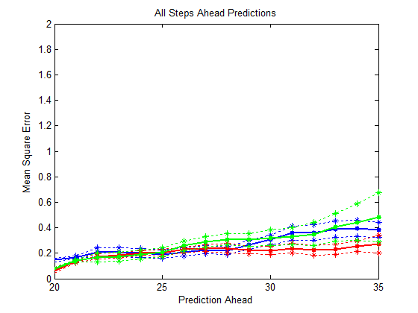
Predictions Beginning from Cycle (Wafer) 20 in the Current Run
Averaged over
45 “Current” runs
Elapsed time:
6.94 sec.
10.05 min.
1.05 hours
Weighted GMM updating
ARMA Model
ARMA Models of Similarity Matrices

