Slide 1

PARALLEL EDGE DETECTION BY SOBEL ALGORITHM USING CUDA C
Sravanthi
Varaprasad
Notes:
NOTE: Want a different image on this slide? Select the picture and delete it. Now click the Pictures icon in the placeholder to insert your own image.

Slide 2
Abstract
Edge detection is one of the most important areas of Image processing.
This paper tests the capability of Graphics Processing Unit (GPU) to compute in parallel against the millions of pixel calculations involved in image processing.
More specifically, this paper focuses on Compute Unified Device Architecture (CUDA) as its parallel programming platform and examines the possible gain in time which can be attained for edge detection in images.
A well-known algorithm SOBEL for edge detection is used in the experiment.
Results showed that parallel implementation is about 262 times and 943 times faster when 2 kernel functions were implemented in parallel on GeForce and Tesla machine’s, respectively.
Hence, an analysis came out that the decision regarding which sections of the algorithm to be parallelized, should be taken wisely.

Slide 3

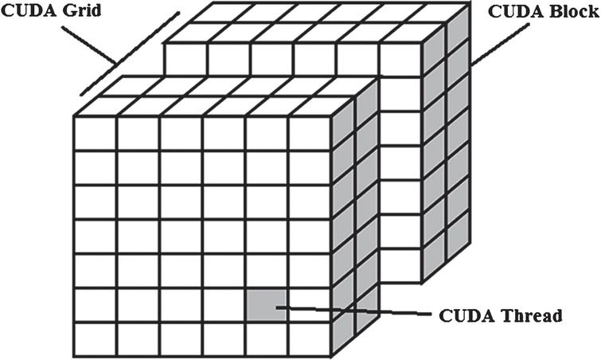
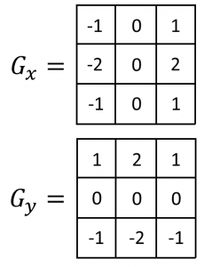

Keywords
Parallel Edge Detection
Parallel Computing
CUDA
Kernel
Sobel Operator
Speedup
Image Processing
MATLAB
Parallelism v/s Speedup

Slide 4
Introduction
The human vision has the capability to easily acquire, understand and interpret the information store in the form of images.
On the other hand it is a challenging task to make the machine understand, acquire these information to automate the task without human intervention.
Image edges are the most basic features of an image. Edges are the set of connected pixel that forms the boundary between two disjoint regions.
Edge detection has several important applications in digital image processing like pattern recognition, medical field, etc.
Sobel operator is one of the classic operator used in edge detection as it is a simple operator, insensitive to noise and requires less computations in comparison to other operators.
This paper compares the performance differences between program code that are run on a sequential processor (CPU) and a parallel processor (GPU).

Slide 5
The organization of this paper
CUDA Processing
CUDA processing flow is described
Sobel edge operator
The Sobel edge detection operator is discussed
CUDA Concepts
Outcome
CUDA thread hierarchy and CUDA kernel is introduced, detailed algorithm to be implemented is explained in section
GPU programming in MATLAB
GPU programming in MATLAB is presented.
Graphs
Outcomes and results are shown
Conclusions
Graphs are analysed along with some observations.
Finally, the conclusions are stated

Slide 6

SOBEL EDGE DETECTION OPERATOR

Slide 7
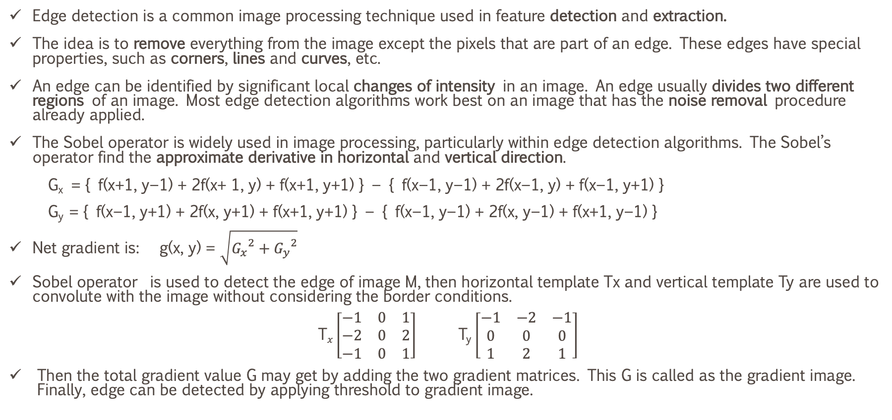
The Sobel edge detection operator is discussed - I
Edge detection is a common image processing technique used in feature detection and extraction.
The idea is to remove everything from the image except the pixels that are part of an edge. These edges have special properties, such as corners, lines and curves, etc.
An edge can be identified by significant local changes of intensity in an image. An edge usually divides two different regions of an image. Most edge detection algorithms work best on an image that has the noise removal procedure already applied.
The Sobel operator is widely used in image processing, particularly within edge detection algorithms. The Sobel’s operator find the approximate derivative in horizontal and vertical direction.
G_{x} = { f(x+1, y−1) + 2f(x+ 1, y) + f(x+1, y+1) } − { f(x−1, y−1) + 2f(x−1, y) + f(x−1, y+1) }
G_{y} = { f(x−1, y+1) + 2f(x, y+1) + f(x+1, y+1) } − { f(x−1, y−1) + 2f(x, y−1) + f(x+1, y−1) }
Net gradient is: g(x, y) = $\sqrt{{G_{x}}^{2}+{G_{y}}^{2}}$
Sobel operator is used to detect the edge of image M, then horizontal template Tx and vertical template Ty are used to convolute with the image without considering the border conditions.
$\text{T}x\left[\begin{matrix}−1 & 0 & 1 \\ −2 & 0 & 2 \\ −1 & 0 & 1\end{matrix}\right]$ T_{y} $\left[\begin{matrix}−1 & −2 & −1 \\ 0 & 0 & 0 \\ 1 & 2 & 1\end{matrix}\right]$
Then the total gradient value G may get by adding the two gradient matrices. This G is called as the gradient image. Finally, edge can be detected by applying threshold to gradient image.

Slide 8
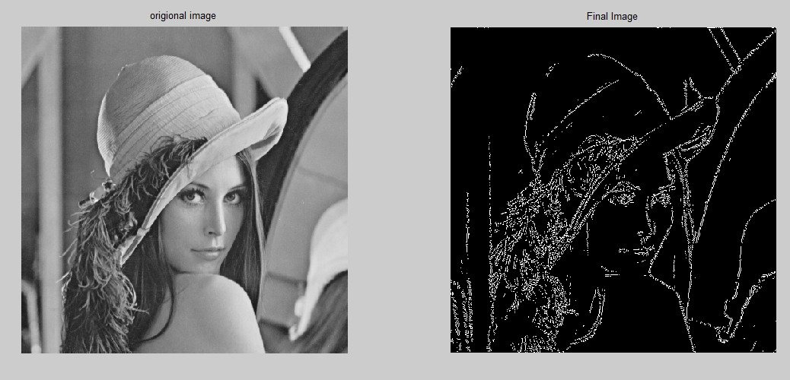
The Sobel edge detection operator is discussed - II
Sobel operator is used to detect the edge of IMAGE M, then horizontal template Tx and vertical template Ty are used to convolute with the image without considering the border conditions.
Then the total gradient value G may get by adding the two gradient matrices. This G is called as the gradient image. Finally, edge can be detected by applying threshold to gradient image.

Slide 9
III. CUDA PROCESSING FLOW
Let us in depth look at the steps involved in the CUDA processing.
Copying image from CPU to GPU.
Loading and Executing the GPU program.
Copying Results back to CPU.

Slide 10
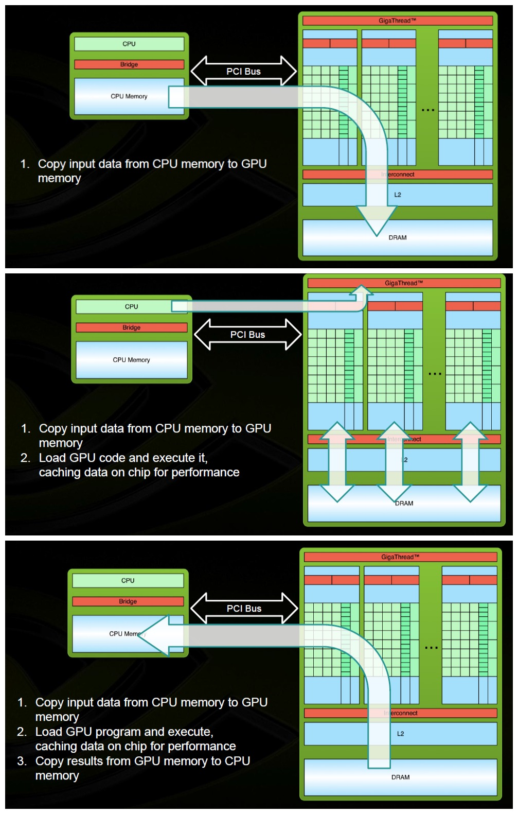
CUDA processing Steps

Slide 11
Detailed Algorithm
For Implementing Sobel Operator for Edge Detection

Slide 12
Algorithm #edit
Step I : Fetch the red(R(i,j)), green(G(i,j)) and blue(B(i,j)) components
of the input colour image.
Step II : Go to step 3 directly if the image is already in grayscale format. Otherwise, convert the input image into the grayscale [8] image using the formula:
gray(i,j) = 0:2989R(i,j)+0:5870G(i,j)+0:1140B(i,j)
Step III : Apply Sobel‘s operator in both the horizontal and vertical direction to calculate horizontal and vertical gradient.
Step IV : Calculate net gradient and call that image as gradient image.
Step V : Finally take input from user through a slider depicting the different threshold values
and apply on the gradient image.

Slide 13
Algorithm
The above algorithm is implemented both, serially on CPU and parallelly on GPU. In this paper, three sections of the algorithm have been identified for executing in parallel which are as follows:
(a) Fetching red, blue and green components from color image.
(b) Conversion of Colored (RGB) image to GRAYSCALE image.
(c) Applying Sobel‘s mask and calculation of gradient image.
First by defining 2 kernels by parallelizing only points (b) and (c).
Secondly, by defining 3 kernels by parallelizing all the above points.
Finally the results are compared regarding speedup on two machines GeForce and Tesla.

Slide 14
Keynote about Parallelization of the code
The decision about which section of the code to be parallelised should be taken wisely.
As the parallelism in a code increases the speedup increases till an image size limit only, after that any more parallelism in the code results in the overall reduction of the speedup.
The main reason being transfer of huge data from CPU to GPU for execution and vice versa from GPU to CPU for results.
Now as the image size increases, both execution time and communication time increases due to more pixel calculations but communication time i.e. overhead increases at a higher rate.
Thus ratio of execution time and communication time decreases with increase in image resolution resulting in the reduction of the overall speedup.

Slide 15
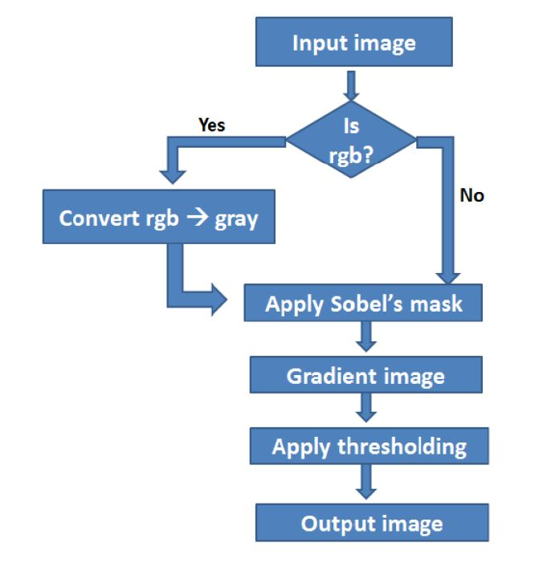
Algorithm Flow

Slide 16
GPU PROGRAMMING
GPUs are increasingly applied to scientific calculations. Unlike a traditional CPU, which includes no more than a handful of cores, a GPU has a massively parallel array of integer and floating-point processors, as well as dedicated, high-speed memory.
The increased throughput made possible by a GPU comes at a cost.
Firstly, for computations to be fast enough data must be sent from the CPU to the GPU before calculation and then retrieved from it afterwards. CPU is connected to GPU; This means that our overall computational speedup is limited by the amount of data transfer that occurs in our algorithm.
Secondly, programming for GPUs requires a different model and a skill set that can be difficult and time-consuming to acquire.
Programmers can write the CUDA code and can use the CUDA Kernel interface in Parallel Computing Toolbox of MATLAB to integrate the with MATLAB.
Creating a MATLAB object that provides access to the existing CUDA kernel which is already converted into PTX code (PTX is a low-level Parallel Threaded eXecution instruction set). They then invoke the feval command to evaluate the kernel on the GPU, using MATLAB arrays as input and output.

Slide 17
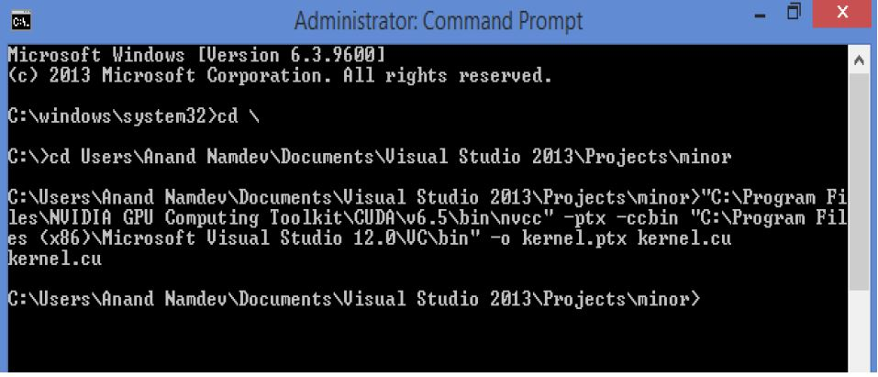
A. 64bit .ptx generation
The CUDA kernel code which is written separately cannot be directly run in MATLAB, hence it is converted to ptx code which is then executed from MATLAB commands by creating an object of the created ptx file.
This can be done by running CMD as administrator and typing in the required command.
Command to generate ptx filek to add text

Slide 18
B. Evaluating the CUDA Kernel in MATLAB
To load the kernel into MATLAB, path is provided to the compiled PTX file and source code:
ptx object = parallel.gpu.CUDAKernel(‘Kernel.ptx‘, ‘Kernel.cu‘)
Once the ptx object is created a few setup task must be completed before one can launch it, such as initializing return data and setting the sizes of the thread blocks and grid.
The kernel can then be used just like any other MATLAB function, except that the kernel is launched using the feval command, with the following syntax:
output = feval(ptx object, input Arguments)

Slide 19

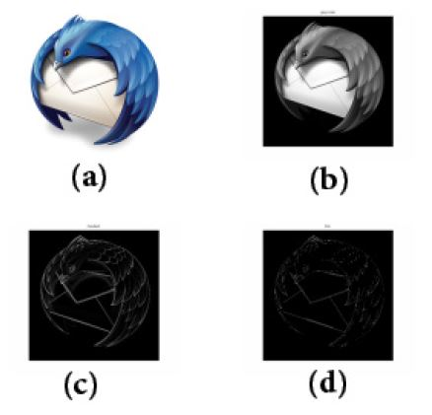
VII. OUTCOMES AND RESULTS
The above four figures are the outcomes of the experiment done with parallel algorithm for Sobel‘s edge detection.
(a) original image Thunderbird of size 1500x1500 pixels,
(b) is greyscale converted image.
(c) is gradient image and image.
(d) is final edge detected image.

Slide 20
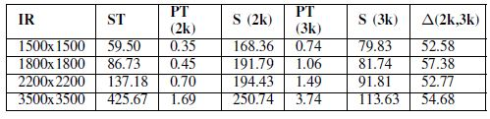
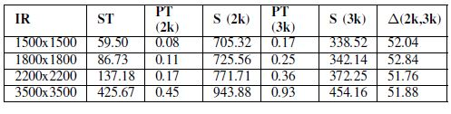
RUNNING TIME AND SPEEDUP
Table 1
IR= Image Resolution in pixel2
ST = Serial Time in seconds
PT(2k)= Parallel Time when two kernels were used in seconds
ALGORITHM RUNNING TIME AND SPEEDUP ON GEFORCE MACHINE (SLOW)
S(2k)= Speedup when two kernels were used
PT(3k)= Parallel Time when three kernels were used in seconds
S(3k)= Speedup when three kernels were used
(2k,3k)= Percentage decrease in speedup
Table 2
ALGORITHM RUNNING TIME AND SPEEDUP ON TESLA MACHINE (FAST)

Slide 21

Running Time and Speedup explained
Table 1 and Table 2 show the results of image datasets.
The same experiment was performed on around 25 image dataset with their resolution ranging from 256x256 to 10000x10000.
The experiment was performed on two machines GeForce and Tesla.
The experiment results showed that on an average there was about 52% decrease in speedup when 3 kernels were used as compared to when 2 kernels were used.
Hence it is not always required to impose parallelism unnecessarily as it comes more with a cost of communication time as explained above in the paper.

Slide 22
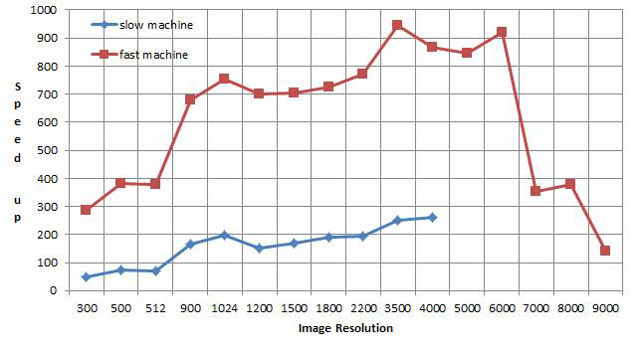
VIII. GRAPHS AND OBSERVATIONS – Comparitive Study
Graph that has been plotted against image resolution (in pixel2) and the speedup on both machines using 2 kernel functions.
From the graph it can be seen that as the image resolution increases, the speedup increases but the increase in the speedup is observed only up to a resolution value of 6500, that is any further increase in the size of the image results in the decrease of the speedup.
This huge decrease in speedup was mainly due to the communication time i.e. it consists of first copying the data on the GPU side and then executing the data over device side.

Slide 23
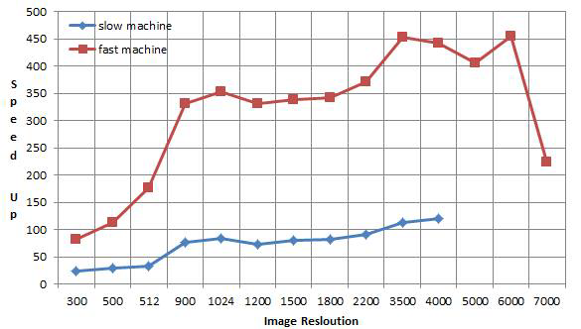
VIII. GRAPHS AND OBSERVATIONS – Comparitive Study
Graph which has been drawn against test cases when GPU code consisted of 3 kernels.
One extra kernel was added in order to produce maximum parallelism in the code and the results were then analyzed.
From the graph it can be clearly observed that the speed up decreased in comparison to the earlier GPU code with 2 kernels.
The reason being the increase in communication overhead due to that extra kernel which also involved transferring the whole data on the GPU side and then executing the kernel on the GPU side.

Slide 24
VIII. GRAPHS AND OBSERVATIONS – Comparative Study
This simply adds to the total time.
The graph has been plotted up to a resolution of 7000 on the faster machine while up to a resolution of 5000 on the slower machine, as memory was insufficient to store the huge arrays of the image on the GPU side.
The graph also shows that the speed up gradually decreases after a resolution of 6500 because of the extra added burden of the communication time of the 3 kernels.

Slide 25
IX Conclusion

Slide 26

Conclusion
This project work now concludes that if parallelism is used optimally then one can achieve higher speedups, even 1000 times or 10000 times faster.
The implementation contains both the sequential version and the parallel version. This research paper allows the reader to compare the performance differences between the two executions.
This project explains the two separate speedups one with (2 kernels) and the other with (3 kernels) and the observation comes out to be that speed up reduced by around 52% on both machines : one GeForce with 96 CUDA cores and the other Tesla with 448 CUDA cores.
So one thing is clear that proper and efficient use of CUDA programming or parallelism can perform complex computations in much less time and provide you with higher speedups.
Future work will involve the edge detection of images with resolution greater than 10000x10000 with the help of Image Segmentation as GPU memory becomes insufficient to store large arrays for high resolution images.

