Slide 1
UE22AM241B – Mathematics for Machine Learning
Course Project
Project Title : Accident Prediction Using EDA and Machine Learning Algorithms
Team member 1 SRN and name: PES1UG22AM138 & S SaiKiran
Team member 2 SRN and name: PES1UG22AM185 & Varun Chincholy
Team member 3 SRN and name: PES1UG22AM191 & Vinayak Sanjumane

Slide 2
Topic
Accident Prediction Using EDA and Machine Learning Algorithms aims to develop a predictive model that can forecast the likelihood of accidents based on various contributing factors.
By leveraging Exploratory data analysis (EDA) techniques and machine learning algorithms, the goal is to identify patterns, correlations, and key features within accident data to enable proactive measures for improving road safety.
The Problem statement entails collecting relevant data, performing thorough analysis, selecting appropriate features, and building predictive models to aid in accident prevention and mitigation efforts.

Slide 3
Uniqueness
Accident Prediction Using EDA and Machine Learning Algorithms presents a unique and compelling opportunity due to several reasons:
Potential to Save Lives: By accurately predicting the likelihood of accidents, this project has the potential to save lives and reduce injuries on the roads. Implementing proactive measures based on predictive models can prevent accidents from occurring or minimize their severity.
Multifaceted Data Analysis: This project involves exploring a diverse range of factors that contribute to accidents, including weather conditions, road types, vehicle characteristics, and human behavior. Analyzing such multifaceted data through EDA provides insights into complex interactions and correlations, making the project intellectually stimulating.
Real-world Impact: The outcomes of this project directly impact public safety and have real-world applications. Predictive models developed through this project can inform policymakers, urban planners, and transportation authorities in implementing targeted interventions to improve road safety and reduce accident rates.
Technological Innovation: Leveraging machine learning algorithms for accident prediction represents a novel application of technology in the field of road safety. This project fosters innovation by pushing the boundaries of data-driven approaches to address societal challenges.

Slide 4
Dataset
Size, attributes, source etc.
Size of Dataset = (10000,12) //10000 Rows and 12 Columns
Attributes = Deals with Details Recorded During Accident. Ex : Severity , Accident_Id etc.
Source - Internet

Slide 5
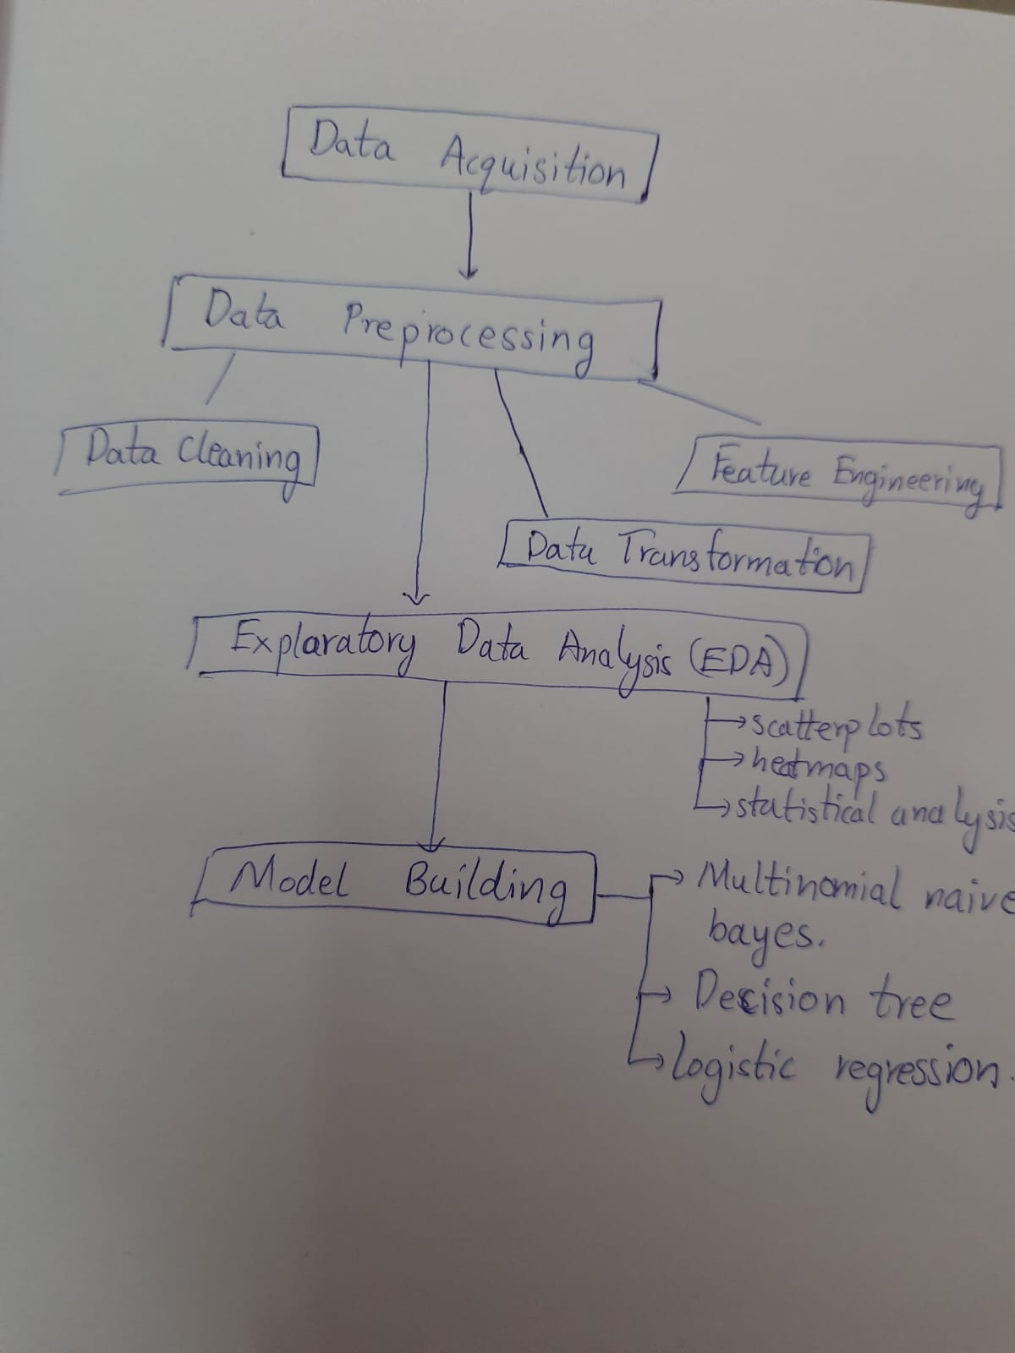
Overall design or approach in a free hand diagram

Slide 6
Overall design or approach in a free hand diagram
Data Preprocessing:
Data Cleaning: This can include handling missing values, outliers, and inconsistencies.
Feature Engineering: This might involve creating new features from existing ones or encoding categorical variables.
Data Transformation: This could involve scaling numerical features or normalizing data.
Exploratory Data Analysis (EDA): This box can mention techniques like visualizations (scatter plots, heatmaps) and statistical analysis (correlation) to understand data patterns and relationships between features and accidents.
Model Building: Here, three specific machine learning algorithms are chosen for accident prediction:
Multinomial Naive Bayes: This is suitable for multicategory classification problems and works well with text data.
Decision Tree: This is a tree-like structure that learns by splitting the data based on features. It is interpretable and can handle various data types.
Logistic Regression: This is a popular algorithm for binary classification problems (accident/no accident) and estimates the probability of an event occurring.

Slide 7
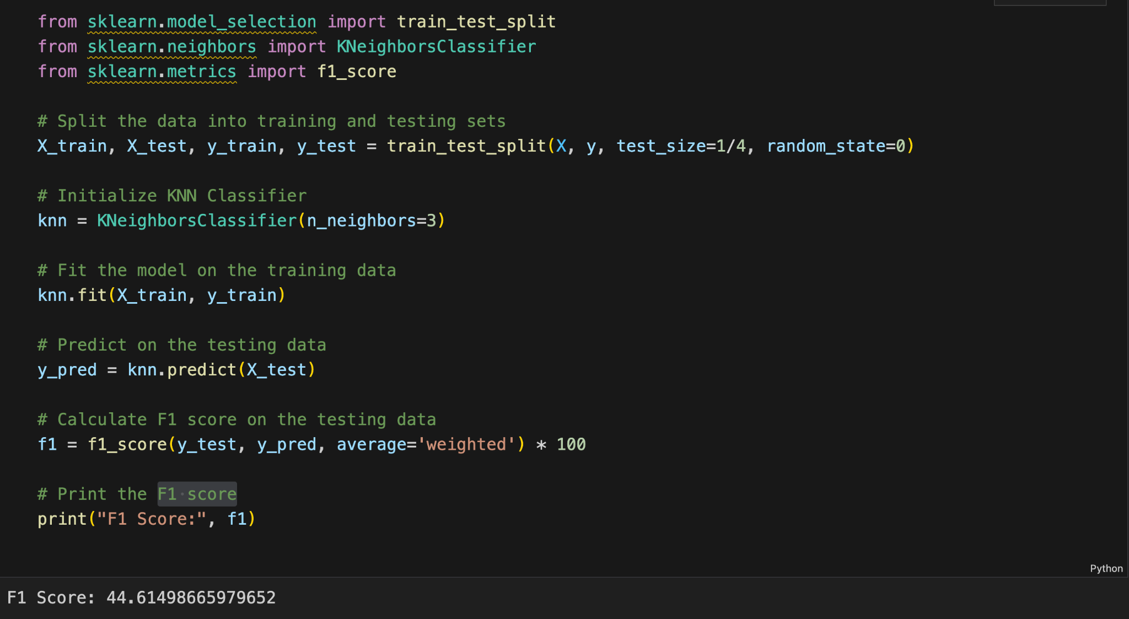
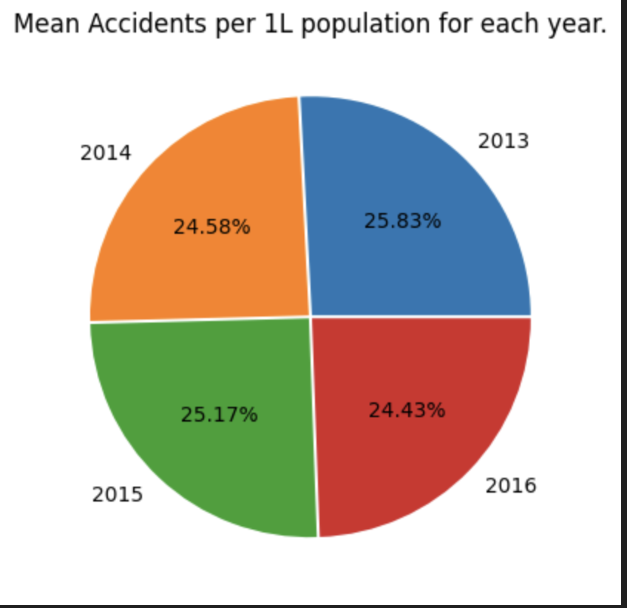
Final results so far

Slide 8
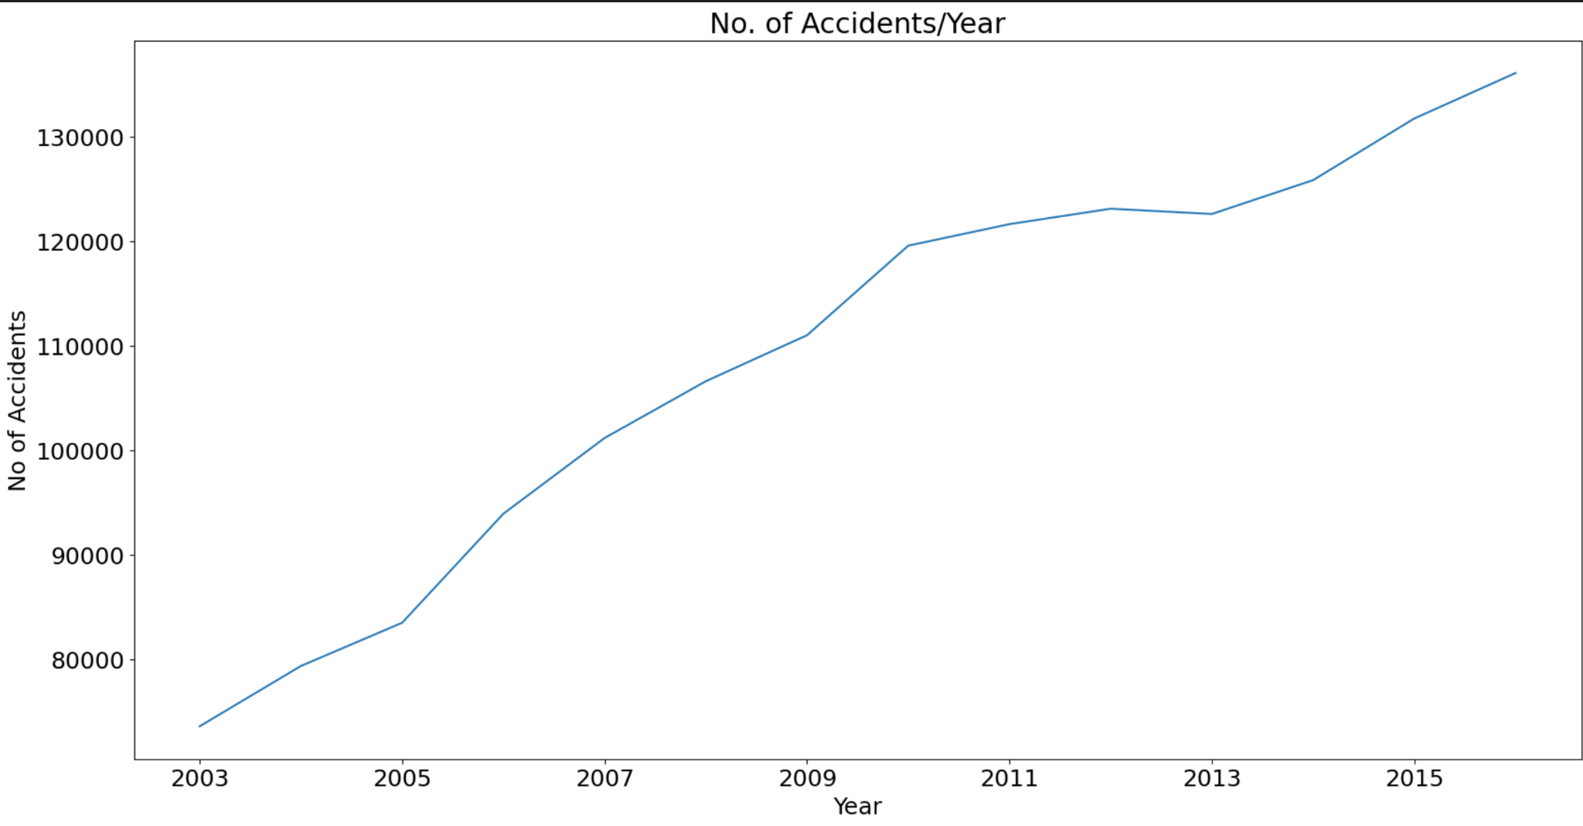
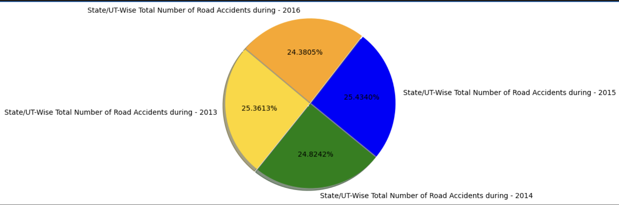
Final results so far

Slide 9
Done vs Remaining to be done ?
No | Description | Done or To be done
1 | Data Acquisition | Done
2 | Data Pre-Processing | Done
3 | Data Cleaning & EDA | Done
4 | Building Model | Done
5 | Model Training | Done
6 | Result Analysis | Done
7

Slide 10
Quantity and quality of work
no | Code functionality | % Complete | Runs without problem (Y/N) | If there are minor issues, indicate
1 | Loading The Datasets | 100 | Y
2 | Checking For Missing/Duplicate Values | 100 | Y
3 | EDA and Data Visualisation | 100 | Y
4 | Training and Testing Models | 100 | Y
5 | Calculating Multinomial NB | 100 | Y
6 | Decision Tree | 100 | Y
7 | Linear Regression | 100 | Y
8 | Calculating SVM and Testing | 100 | Y
9 | Evaluating The Model | 100 | Y

Slide 11
Top few learning
Serial No | Top learning in this project
1 | Through exploratory data analysis (EDA), we can identify the most significant factors contributing to accidents. This can include variables such as weather conditions, road types, time of day, and vehicle characteristics
2 | Through machine learning algorithms, we can develop predictive models to forecast accident likelihood. Evaluating the performance of these models using metrics such as accuracy, precision, recall, and F1-score provides insights into their effectiveness.
3 | By accurately predicting the likelihood of accidents, authorities can implement proactive interventions to prevent accidents or minimize their impact
4 | The predictive models developed through this project can be scaled and adapted to different geographical regions and contexts. This scalability enhances the applicability of the models, allowing them to be used in diverse settings to improve road safety.

