Slide 1
FOR THOSE ABOUT TO ROCK, WE SALUTE YOU

Slide 2
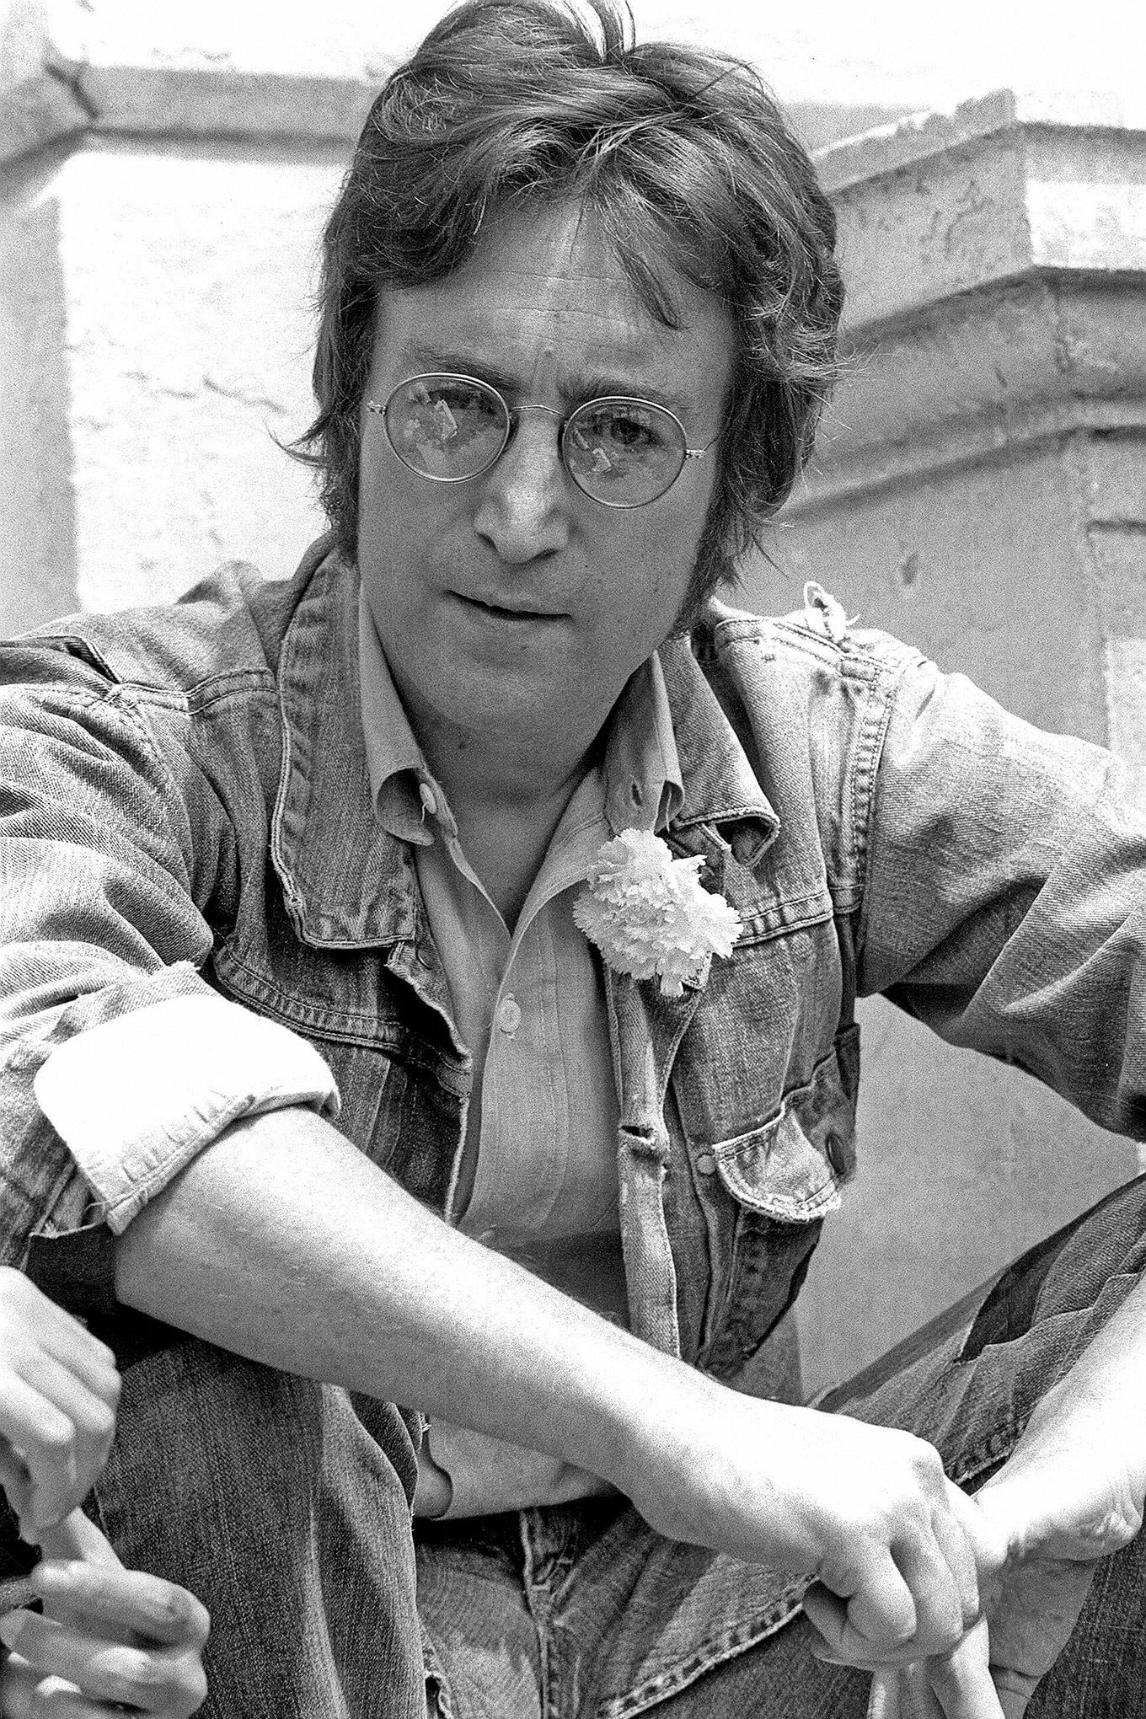

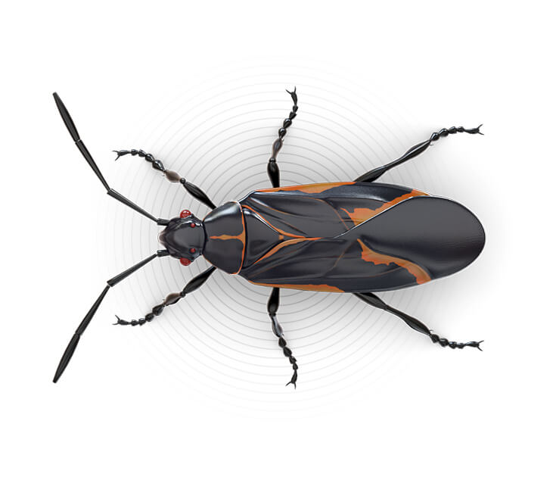

imagine there's no heaven
It's easy if you try
No hell below us
Above us, only sky
Imagine all the people
Living for today
and programmers too

Slide 3
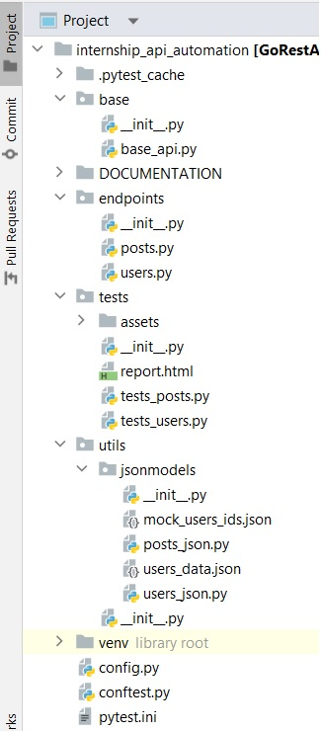
traceback + custom logs
created users ids extracted from
server response
mock data to be POSTed
functions to create json & xml data, delete mock data, fetch mock data to the tests,
extract ids, get json schemas
…
env data

Slide 4
Classes
BaseApi on top of Requests HTTP lib
Posts and Users descendants of BaseApi
Test classes with immediate test logic

Slide 5
SPECIAL THANKS TO
pytest-html for bringing some colors into out life
xml.etree.ElemetTree aka ET & jsonschema for taking care of us

Slide 6
Code SNIPPETS
def delete_mock_data(app_config): """ Attempts to delete user records by ids found in the file. (These ids are stored at the time mock data is POSTed to the server that provides id for each record on his own.) """ url = "https://gorest.co.in/public/v2/users" with open('../utils/jsonmodels/mock_users_ids.json', 'r') as file: file_contents = file.read() if file_contents: json_data = json.loads(file_contents) user_ids = json_data["user_ids"] for user_id in user_ids: response = requests.delete(f"{url}/{user_id}", headers=app_config.token) with open('../utils/jsonmodels/mock_users_ids.json', 'w') as file: file.truncate(0)

Slide 7
class UsersTests(Users): schema = mock_data.get_user_json_schema() # get schema of a correct user record returned by server def test_create_user(self, app_config): """ This particular public API functions in a way that introduces some unexpected bugs. In order to mitigate the pain :) ! Each test-run first deletes mock data if any present, POSTs it to the server again. ! Third parties are allowed to change and repost our data that sometimes lead to failures. """ mock_data.delete_mock_data(app_config) user_data = mock_data.create_users_data() # get mock data from a file for user in user_data: user_json = json.dumps(user) # replaces single quotes with double ones user_json = json.loads(user_json) # probably no longer relevant. Recheck, delete if so. response = self.create_user(app_config.base_url, user_json, 201, app_config.token) mock_data.store_response_ids(response) # writes users' records ids from response to the file assert jsonschema.validate(response.json(), self.schema) is None

Slide 8
class Posts(BaseApi): def get_posts(self, url, expected_status_code): response = self.get_request(url + get_posts_endpoint, headers) self.check_status_code(response, expected_status_code) def get_post_user_id(self, url, expected_status_code): response = self.get_request(url + get_posts_endpoint, headers) self.check_status_code(response, expected_status_code) user_id_list = self.get_json_value_by_key(response, "$.[user_id]") return user_id_list
def test_delete_user_post(app_config): user_id = "941127" json = posts_json.create_post_json(int(user_id), "New project", "New post") posts.create_post(app_config.base_url, 201, json) response_body = posts.get_post_data(app_config.base_url, 200, user_id) assert response_body[0]['user_id'] == int(user_id) post_id = response_body[0]['id'] posts.delete_user_post(app_config.base_url, 204, str(post_id)) new_user_id_list = posts.get_post_user_id(app_config.base_url, 200) assert post_id not in new_user_id_list

Slide 9
Live as if you were to die tomorrow.
Learn as if you were to live forever.
Mahatma Gandhi

