Slide 1
Analyzing the Relationship Between Social Media Sentiment and Stock Prices

Slide 2

Introduction
This project aims to explore how social media sentiment influences stock price movements. By analyzing user comments using sentiment analysis and correlating them with stock price fluctuations, we aim to uncover potential patterns and insights.

Slide 3

Problem Statement
Investors and analysts often rely on news and social media sentiment to make trading decisions. However, the relationship between online sentiment and stock price changes remains uncertain. This study investigates whether sentiment analysis can provide meaningful insights into stock movements.

Slide 4

Data Sources & Preprocessing
• Social media comments dataset (textual data)
• Stock price dataset (historical prices)
• Data preprocessing steps:
- Standardizing date formats
- Applying sentiment analysis using TextBlob
- Merging stock prices with sentiment data

Slide 5

Sentiment Analysis Methodology
• TextBlob is used for sentiment analysis.
• Sentiment polarity is categorized as:
- Positive (Score > 0)
- Neutral (Score = 0)
- Negative (Score < 0)
• Each comment is labeled accordingly for further analysis.

Slide 6
Stock Price Analysis
• Historical stock prices are aligned with sentiment data.
• Daily percentage change in stock prices is calculated.
• The goal is to assess whether sentiment changes impact stock price fluctuations.

Slide 7
Data Insights
• Majority of the comments in the dataset are labeled as Neutral.
• Stock prices fluctuate but do not show immediate drastic shifts based on sentiment.
• A closer examination is needed to determine any lag effect between sentiment and price changes.

Slide 8
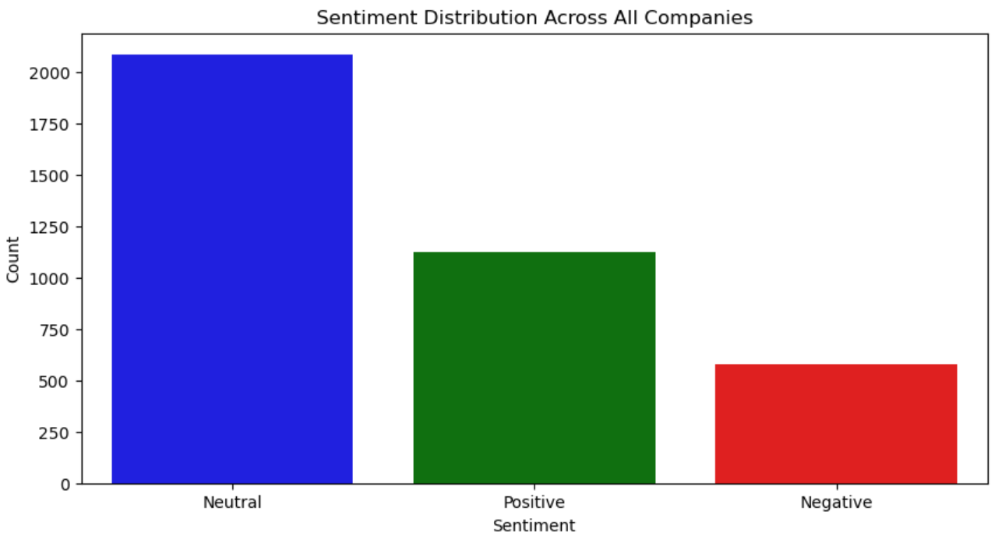
Sentiment Distribution Visualization
A bar chart representing the distribution of Positive, Neutral, and Negative sentiments across all analyzed comments.

Slide 9
Correlation Analysis
• The overall correlation coefficient between Sentiment Score and Stock Price Change is 0.0954.
• This suggests a very weak relationship between social media sentiment and stock price fluctuations.
• Further analysis is required to determine if a time-lagged effect exists.

Slide 10
Company wise correlation between stock prices and sentiments
AMD | 0.2792
CISCO | -0.1777
INTEL | -0.0010
SAMSUNG | 0.0741
SONY | -0.1134
APPLE | 0.1285
MICROSOFT | -0.0296
NVIDIA | 0.0447
TESLA | 0.0299

Slide 11
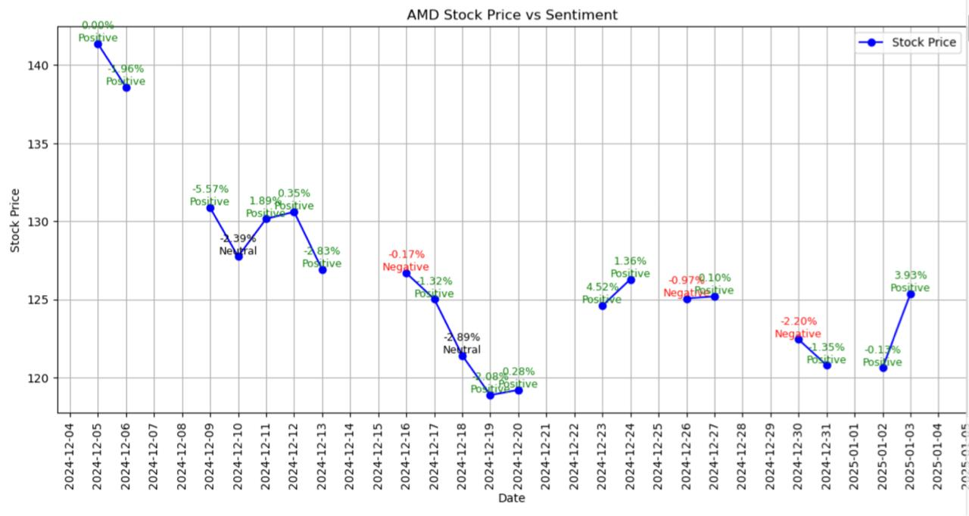

Slide 12
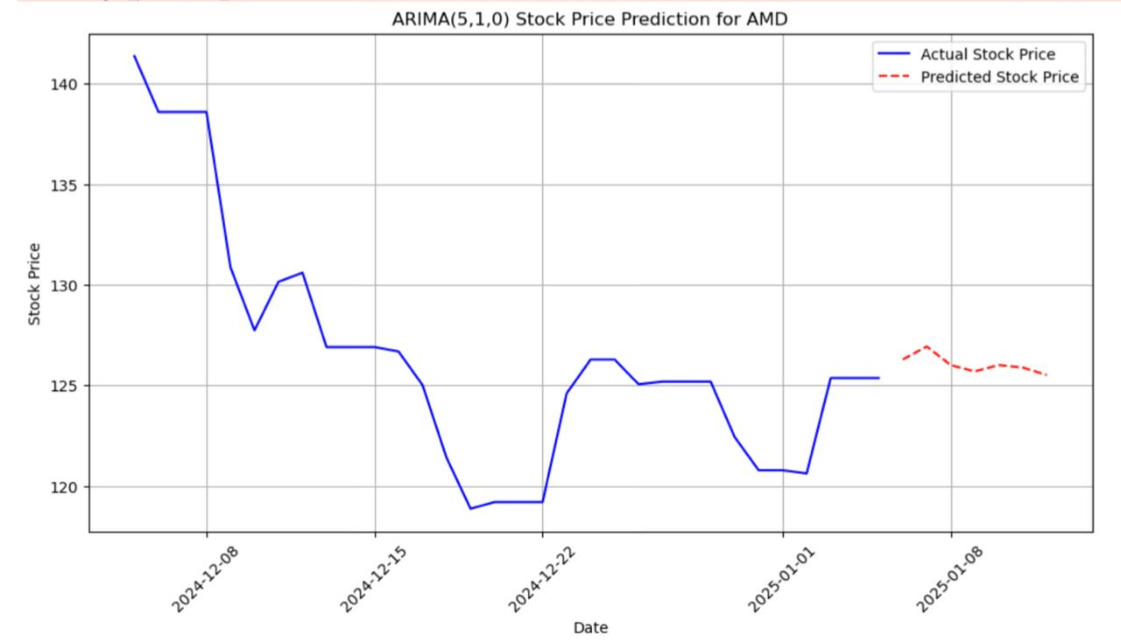

Slide 13
AMD PREDICTION (ARIMA)
6 JAN | 126.28
7 JAN | 126.93
8 JAN | 126.01
9 JAN | 125.69
10 JAN | 126.01
11 JAN | 125.89
12 JAN | 125.52

Slide 14
Key Findings
• Social media sentiment does not show a strong immediate impact on stock prices.
• The prevalence of Neutral sentiment might be a factor in the weak correlation.
• A more detailed study incorporating trading volume and macroeconomic factors could provide better insights.

Slide 15
Limitations & Future Scope
• This analysis is based only on social median sentiments but stock prices are decided by various external and internal sources which are not considered here in this analysis.
• More advanced NLP techniques (e.g., transformer-based models) could improve sentiment classification.
• Future work can explore the impact of news headlines and larger datasets.

Slide 16
Conclusion & Recommendations
• While sentiment analysis provides insights, it should not be used as the sole predictor for stock movements.
• Combining social media sentiment with other indicators (e.g., trading volume, earnings reports) could yield better results.
• Investors should consider multiple data points before making trading decisions.

