Slide 1
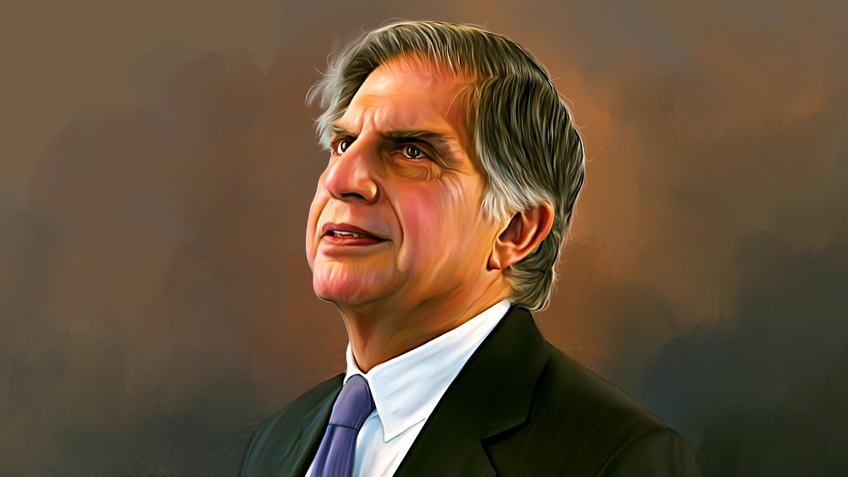

When Less Becomes More
RATAN TATA
By Vardaan

Slide 2
When Less Becomes More
RATAN TATA
By Vardaan

Slide 3






Table of Contents
When Less Becomes More
RATAN TATA
By Vardaan

Slide 4

Table of Contents

Slide 5



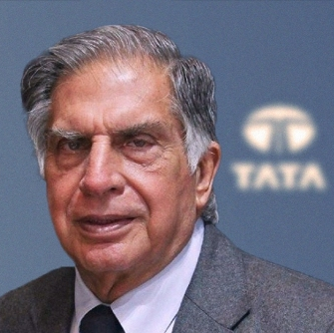
Table of Contents
Who is Ratan Tata
Ratan Tata — Humble. Visionary. Ethical.
Ratan Tata is an Indian industrialist and former Chairman of Tata Sons, known for his quiet leadership, integrity, and people‑first approach. He transformed the Tata Group into a global powerhouse while living a life rooted in simplicity and compassion.
Notes:
Ratan Tata is known for simplicity and modesty.
He personally visited victims and employees after the 26/11 Mumbai attacks, without media coverage, showing genuine empathy.
Global Expansion
Innovation
Future‑Focused
Tata Trusts’ philanthropy in education, healthcare, and rural development, showing that business should serve society.
Fairness in Business

Slide 6

Table of Contents

Slide 7

Table of Contents
When Less is More
Simplicity leads to clarity
He lived a simple, grounded life despite leading a massive business empire, proving that clarity comes from simplicity, not luxury.
Impact without noise
He avoided publicity and let actions speak — especially during crises like 26/11, where he quietly supported victims without media.
Minimalism in leadership
He made fewer but powerful decisions, like the Jaguar Land Rover acquisition, focusing on long‑term impact instead of flashy moves.
Purpose over appearance
He prioritized meaningful work — affordable cars, employee welfare, philanthropy — instead of chasing fame or attention.
Notes:
26 November 2008 Taj Mahal Palace Hotel
Oberoi Trident Hotel
Chhatrapati Shivaji Terminus (CST)
Leopold Café
Nariman House
Ferrari and Mercedes, Tata indica, Nano and Tiago

Slide 8

Table of Contents

Slide 9






Table of Contents
Ratan Tata’s Impact & Legacy
Ratan Tata’s Journey

Slide 10


Table of Contents
Became Chairman in 1991
Modernized the group with a new vision
Faced resistance from older executives
Took over from J.R.D. Tata

Slide 11
Table of Contents
Ratan Tata’s Impact
Modernized the group with a new vision
Became Chairman in 1991
Took over from J.R.D. Tata
Faced resistance from older executives
Notes:
Jehangir Ratanji Dadabhoy Tata
NELCO (National Radio & Electronics Company)
1962

Slide 12
Table of Contents
Became Chairman in 1991
Modernized the group with a new vision
Faced resistance from older executives
Took over from J.R.D. Tata

Slide 13



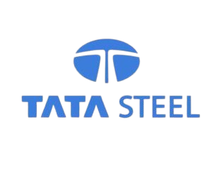




Notes:
Tata Consultancy Services
Corus - Tata Steel
Renewable Energy promoted, national and local(rural), sustainability, long‑term goals that balanced growth with responsibility.
expanded into fertilizers, consumer products (like salt),
Tata Chemicals promoted responsible practices in agriculture and industry, focusing on eco‑friendly solutions and sustainable farming.

Slide 14
Chemicals`
Chemicals`
Chemicals`
Tata Power is India’s largest integrated power company and has made sustainability a central part of its strategy, with nearly half of its total capacity now coming from renewable sources like solar, wind, and hydro. It has built one of the country’s biggest solar businesses, expanded rooftop solar for households and industries, and even set up a large solar module manufacturing plant to boost domestic production. Through its subsidiary Tata Power Renewable Microgrid, the company has brought clean electricity to rural villages by installing solar‑powered microgrids, reducing dependence on diesel and kerosene while improving education, healthcare, and local businesses. Tata Power has also pledged to achieve net‑zero emissions by 2045, aligning with global climate goals, and is investing in energy storage, smart grids, and electric vehicle charging infrastructure to support India’s transition to green mobility. Beyond technology, it runs the Tata Power Skill Development Institute, which has trained hundreds of thousands of people — including women — in clean energy skills, and it supports conservation projects like protecting elephant corridors in Odisha. Altogether, Tata Power shows how a big company can fight climate pollution, shift to green energy, and promote eco‑friendly practices while uplifting communities.
Notes:
Tata Consultancy Services
Corus - Tata Steel
Renewable Energy promoted, national and local(rural), sustainability, long‑term goals that balanced growth with responsibility.
expanded into fertilizers, consumer products (like salt),
Tata Chemicals promoted responsible practices in agriculture and industry, focusing on eco‑friendly solutions and sustainable farming.
All tata group companies are global companies.

Slide 15


Chemicals`
Tata Power is India’s largest integrated power company and has made sustainability a central part of its strategy, with nearly half of its total capacity now coming from renewable sources like solar, wind, and hydro. It has built one of the country’s biggest solar businesses, expanded rooftop solar for households and industries, and even set up a large solar module manufacturing plant to boost domestic production. Through its subsidiary Tata Power Renewable Microgrid, the company has brought clean electricity to rural villages by installing solar‑powered microgrids, reducing dependence on diesel and kerosene while improving education, healthcare, and local businesses. Tata Power has also pledged to achieve net‑zero emissions by 2045, aligning with global climate goals, and is investing in energy storage, smart grids, and electric vehicle charging infrastructure to support India’s transition to green mobility. Beyond technology, it runs the Tata Power Skill Development Institute, which has trained hundreds of thousands of people — including women — in clean energy skills, and it supports conservation projects like protecting elephant corridors in Odisha. Altogether, Tata Power shows how a big company can fight climate pollution, shift to green energy, and promote eco‑friendly practices while uplifting communities.
Technology, trust, global responsibility, innovation
Eco‑friendly, renewable energy, sustainability, environment
Community, social responsibility, conservation
Urgency, climate action, transition, net‑zero goals
Chemicals`
Chemicals`
Chemicals`
Notes:
Blue - Technology, trust, global responsibility, innovation
Green - Eco‑friendly, renewable energy, sustainability, environment
Grey - Community, social responsibility, conservation
Orange - Urgency, climate action, transition, net‑zero goals Tata Power supports healthcare through employee wellness, rural health camps, and powering clinics with clean energy.
Covid 19 - Distributed over 2 lakh meals, Partnered with Delhi Government and Taj Hotels to provide meals to medical staff and patients at major hospitals.
Renewable energy projects (solar, wind, hydro) → SDG 7 (Affordable & Clean Energy)
Carbon reduction, clean electricity → SDG 13 (Climate Action)
Smart grids, innovation in energy → SDG 9 (Industry, Innovation & Infrastructure)
Challenge: India needs stronger corporate action on sustainability.
Ratan Tata’s Role: Advocated for renewable energy expansion through Tata Power, which now has ~66% clean energy capacity.
Impact: Tata Group became a model for other Indian companies to follow in sustainability.

Slide 16


Chemicals`
Tata Chemicals focuses on eco‑friendly products and green chemistry, producing sustainable fertilizers and promoting responsible mining to reduce environmental impact. It invests in waste reduction and recycling, aligns with global sustainability goals, and supports community welfare programs in education, health, and women empowerment. Altogether, it shows how industrial growth can balance with environmental stewardship and social responsibility.
Technology, trust, global responsibility, innovation
Eco‑friendly, renewable energy, sustainability, environment
Community, social responsibility, conservation
Urgency, climate action, transition, net‑zero goals
Chemicals`
Chemicals`
Chemicals`
Notes:
Tata Chemicals Society for Rural Development
trains farmers in sustainable agriculture, supports water and energy conservation
Eco‑friendly products, green chemistry → SDG 12 (Responsible Consumption & Production)
Sustainable fertilizers, waste reduction → SDG 15 (Life on Land)
Challenge: India recycles only ~30% of its plastic waste.
Ratan Tata’s Role: Encouraged Tata Chemicals to pioneer green chemistry and eco‑friendly processes, reducing industrial waste.
Impact: Promoted responsible production and recycling initiatives across Tata companies.

Slide 17
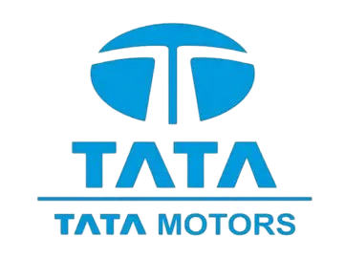
Chemicals`
Tata Motors leads India’s shift to eco‑friendly products through its growing range of EVs like the Nexon EV and Tigor EV. With a strong green mobility vision, the company invests in EV charging infrastructure and advanced technology leadership to reduce dependence on fossil fuels. Beyond innovation, Tata Motors also emphasizes community impact by making safer, affordable transport accessible to millions. Altogether, it shows how automotive growth can align with sustainability and social responsibility.
Technology, trust, global responsibility, innovation
Eco‑friendly, renewable energy, sustainability, environment
Community, social responsibility, conservation
Urgency, climate action, transition, net‑zero goals
Chemicals`
Chemicals`
Chemicals`
Notes:
Eco‑friendly products (EVs: Nexon EV, Tigor EV) → SDG 12: Responsible Consumption & Production
Green mobility vision (future of transport) → SDG 11: Sustainable Cities & Communities
Challenge: PM2.5 levels in Delhi and other cities often exceed WHO limits by 5–7 times.
Ratan Tata’s Role: Pushed Tata Motors to invest in electric vehicles (EVs) and cleaner technologies.
Impact: EV adoption reduces vehicular emissions, directly tackling urban air pollution.

Slide 18
Chemicals`
Tata Motors leads India’s shift to eco‑friendly products through its growing range of EVs like the Nexon EV and Tigor EV. With a strong green mobility vision, the company invests in EV charging infrastructure and advanced technology leadership to reduce dependence on fossil fuels. Beyond innovation, Tata Motors also emphasizes community impact by making safer, affordable transport accessible to millions. Altogether, it shows how automotive growth can align with sustainability and social responsibility.
Technology, trust, global responsibility, innovation
Eco‑friendly, renewable energy, sustainability, environment
Community, social responsibility, conservation
Urgency, climate action, transition, net‑zero goals
Chemicals`
Chemicals`
Chemicals`
Notes:
“Tata Group overall: 30% carbon reduction.”
“Tata Chemicals: 50% eco‑friendly production.”
“Tata Motors: EV sales up 60%.”
“Tata Power: 66% renewable capacity.”
Ratan Tata’s Role: His push for eco‑friendly production and CSR investments (~2% of profits) helped improve awareness and recycling practices.

Slide 19
Chemicals`
Tata Motors leads India’s shift to eco‑friendly products through its growing range of EVs like the Nexon EV and Tigor EV. With a strong green mobility vision, the company invests in EV charging infrastructure and advanced technology leadership to reduce dependence on fossil fuels. Beyond innovation, Tata Motors also emphasizes community impact by making safer, affordable transport accessible to millions. Altogether, it shows how automotive growth can align with sustainability and social responsibility.
Technology, trust, global responsibility, innovation
Eco‑friendly, renewable energy, sustainability, environment
Community, social responsibility, conservation
Urgency, climate action, transition, net‑zero goals
Chemicals`
Chemicals`
Chemicals`
Notes:
“Tata Power: 66% renewable capacity.”
“Tata Motors: EV sales up 60%.”
“Tata Chemicals: 50% eco‑friendly production.”
“Tata Group overall: 30% carbon reduction.”
Ratan Tata’s Role: His push for eco‑friendly production and CSR investments (~2% of profits) helped improve awareness and recycling practices.

Slide 20
Chemicals`
Chemicals`
Chemicals`
Tata Power is India’s largest integrated power company and has made sustainability a central part of its strategy, with nearly half of its total capacity now coming from renewable sources like solar, wind, and hydro. It has built one of the country’s biggest solar businesses, expanded rooftop solar for households and industries, and even set up a large solar module manufacturing plant to boost domestic production. Through its subsidiary Tata Power Renewable Microgrid, the company has brought clean electricity to rural villages by installing solar‑powered microgrids, reducing dependence on diesel and kerosene while improving education, healthcare, and local businesses. Tata Power has also pledged to achieve net‑zero emissions by 2045, aligning with global climate goals, and is investing in energy storage, smart grids, and electric vehicle charging infrastructure to support India’s transition to green mobility. Beyond technology, it runs the Tata Power Skill Development Institute, which has trained hundreds of thousands of people — including women — in clean energy skills, and it supports conservation projects like protecting elephant corridors in Odisha. Altogether, Tata Power shows how a big company can fight climate pollution, shift to green energy, and promote eco‑friendly practices while uplifting communities.
Notes:
Tata Consultancy Services
Corus - Tata Steel
Renewable Energy promoted, national and local(rural), sustainability, long‑term goals that balanced growth with responsibility.
expanded into fertilizers, consumer products (like salt),
Tata Chemicals promoted responsible practices in agriculture and industry, focusing on eco‑friendly solutions and sustainable farming.

Slide 21
Notes:
Tata Consultancy Services
Corus - Tata Steel
Renewable Energy promoted, national and local(rural), sustainability, long‑term goals that balanced growth with responsibility.
expanded into fertilizers, consumer products (like salt),
Tata Chemicals promoted responsible practices in agriculture and industry, focusing on eco‑friendly solutions and sustainable farming.

Slide 22
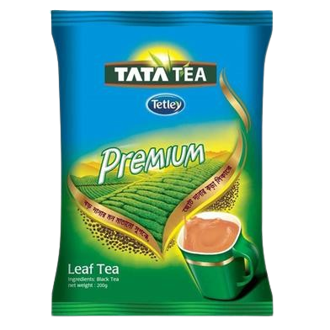
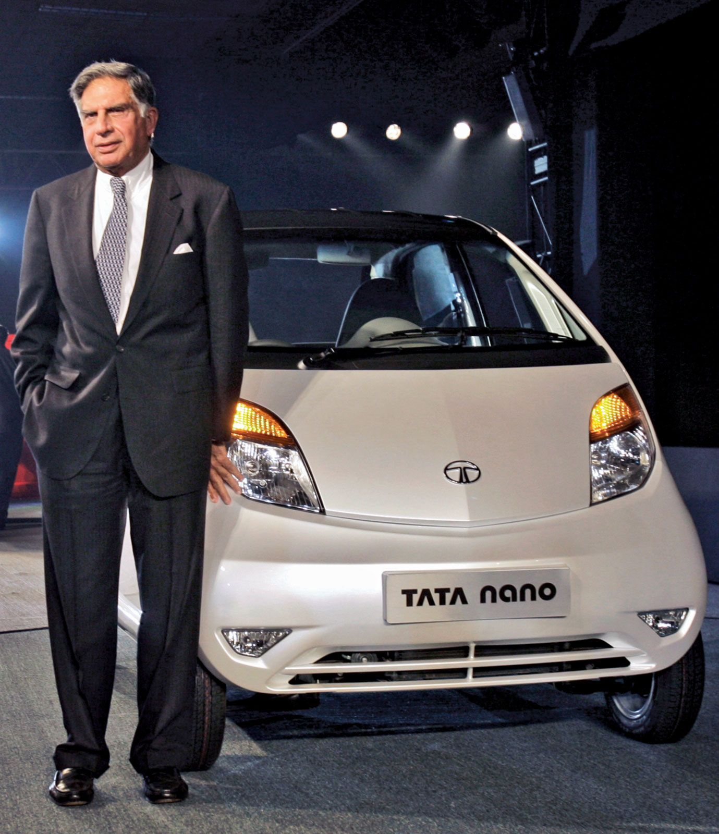



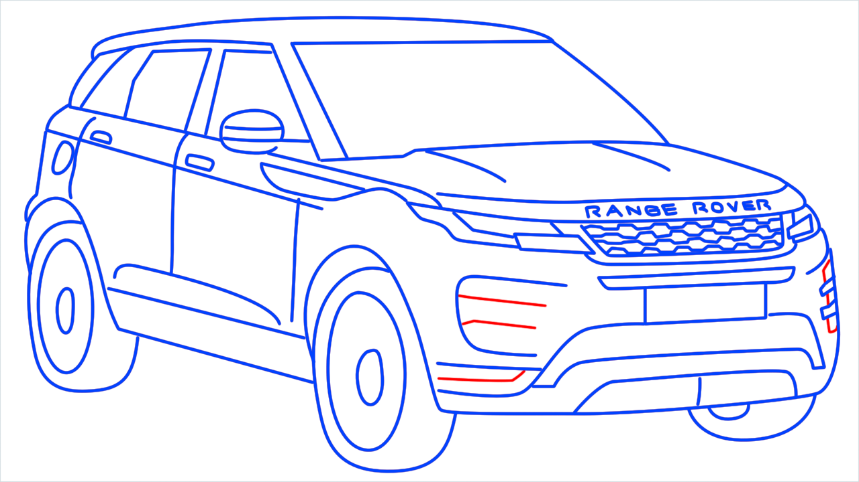

26/11 Response
Tata Nano Project
Jaguar Land Rover Acquisition
Tetley Tea Acquisition
The Tata Nano was created as a response to the growing demand for affordable personal transport in India. Ratan Tata aimed to provide a car that could be easily accessed by the middle class, who often preferred two-wheelers like scooters. The Nano was designed to be a practical and cost-effective solution for families, offering a safe and enclosed space for four to five passengers. Despite its initial success, the Nano faced challenges such as safety concerns, marketing failures, and a perception of low quality.
During the tragic 26/11 Mumbai attacks, Ratan Tata demonstrated quiet yet powerful leadership. He personally stood outside the Taj Mahal Palace Hotel for days, overseeing relief efforts and visiting victims and employees without seeking publicity. He went to hospitals and even the homes of those affected, offering support and ensuring long‑term aid through Tata Group initiatives. His response reflected humility and compassion, showing that true leadership is not about grand gestures but about standing with people in their darkest times.
Tata acquired Tetley in February 2000 for £271 million. This acquisition made Tetley a wholly owned subsidiary of Tata Consumer Products, enhancing Tata's global tea operations.
This helps Tata to:
Expansion into the global market
Increased market share
Enhanced product offerings
Improved brand reputation
Cost efficiency
The Tata Jaguar Land Rover acquisition, valued at approximately $2.3 billion, marked a watershed moment for both Tata Motors and the global automotive industry.
This case study in corporate strategy and foresight exemplifies how a visionary leader, Ratan Tata, recognized an opportunity to elevate Tata Motors onto the global stage by acquiring two iconic British brands.
04
03
02
01

Slide 23
26/11 Response
Tata Nano Project
Jaguar Land Rover Acquisition
Tetley Tea Acquisition
The Tata Nano was created as a response to the growing demand for affordable personal transport in India. Ratan Tata aimed to provide a car that could be easily accessed by the middle class, who often preferred two-wheelers like scooters. The Nano was designed to be a practical and cost-effective solution for families, offering a safe and enclosed space for four to five passengers. Despite its initial success, the Nano faced challenges such as safety concerns, marketing failures, and a perception of low quality.
During the tragic 26/11 Mumbai attacks, Ratan Tata demonstrated quiet yet powerful leadership. He personally stood outside the Taj Mahal Palace Hotel for days, overseeing relief efforts and visiting victims and employees without seeking publicity. He went to hospitals and even the homes of those affected, offering support and ensuring long‑term aid through Tata Group initiatives. His response reflected humility and compassion, showing that true leadership is not about grand gestures but about standing with people in their darkest times.
Tata acquired Tetley in February 2000 for £271 million. This acquisition made Tetley a wholly owned subsidiary of Tata Consumer Products, enhancing Tata's global tea operations.
This helps Tata to:
Expansion into the global market
Increased market share
Enhanced product offerings
Improved brand reputation
Cost efficiency
The Tata Jaguar Land Rover acquisition, valued at approximately $2.3 billion, marked a watershed moment for both Tata Motors and the global automotive industry.
This case study in corporate strategy and foresight exemplifies how a visionary leader, Ratan Tata, recognized an opportunity to elevate Tata Motors onto the global stage by acquiring two iconic British brands.
04
03
02
01
Notes:
26 November 2008 Taj Mahal Palace Hotel
Oberoi Trident Hotel
Chhatrapati Shivaji Terminus (CST)
Leopold Café
Nariman House

Slide 24
26/11 Response
Tata Nano Project
Jaguar Land Rover Acquisition
Tetley Tea Acquisition
The Tata Nano was created as a response to the growing demand for affordable personal transport in India. Ratan Tata aimed to provide a car that could be easily accessed by the middle class, who often preferred two-wheelers like scooters. The Nano was designed to be a practical and cost-effective solution for families, offering a safe and enclosed space for four to five passengers. Despite its initial success, the Nano faced challenges such as safety concerns, marketing failures, and a perception of low quality.
During the tragic 26/11 Mumbai attacks, Ratan Tata demonstrated quiet yet powerful leadership. He personally stood outside the Taj Mahal Palace Hotel for days, overseeing relief efforts and visiting victims and employees without seeking publicity. He went to hospitals and even the homes of those affected, offering support and ensuring long‑term aid through Tata Group initiatives. His response reflected humility and compassion, showing that true leadership is not about grand gestures but about standing with people in their darkest times.
Tata acquired Tetley in February 2000 for £271 million. This acquisition made Tetley a wholly owned subsidiary of Tata Consumer Products, enhancing Tata's global tea operations.
This helps Tata to:
Expansion into the global market
Increased market share
Enhanced product offerings
Improved brand reputation
Cost efficiency
The Tata Jaguar Land Rover acquisition, valued at approximately $2.3 billion, marked a watershed moment for both Tata Motors and the global automotive industry.
This case study in corporate strategy and foresight exemplifies how a visionary leader, Ratan Tata, recognized an opportunity to elevate Tata Motors onto the global stage by acquiring two iconic British brands.
04
03
02
01
Notes:
26 November 2008 Taj Mahal Palace Hotel
Oberoi Trident Hotel
Chhatrapati Shivaji Terminus (CST)
Leopold Café
Nariman House

Slide 25
26/11 Response
Jaguar Land Rover Acquisition
Tetley Tea Acquisition
Tata Nano Project
During the tragic 26/11 Mumbai attacks, Ratan Tata demonstrated quiet yet powerful leadership. He personally stood outside the Taj Mahal Palace Hotel for days, overseeing relief efforts and visiting victims and employees without seeking publicity. He went to hospitals and even the homes of those affected, offering support and ensuring long‑term aid through Tata Group initiatives. His response reflected humility and compassion, showing that true leadership is not about grand gestures but about standing with people in their darkest times.
The Tata Nano was created as a response to the growing demand for affordable personal transport in India. Ratan Tata aimed to provide a car that could be easily accessed by the middle class, who often preferred two-wheelers like scooters. The Nano was designed to be a practical and cost-effective solution for families, offering a safe and enclosed space for four to five passengers. Despite its initial success, the Nano faced challenges such as safety concerns, marketing failures, and a perception of low quality.
Tata acquired Tetley in February 2000 for £271 million. This acquisition made Tetley a wholly owned subsidiary of Tata Consumer Products, enhancing Tata's global tea operations.
This helps Tata to:
Expansion into the global market
Increased market share
Enhanced product offerings
Improved brand reputation
Cost efficiency
The Tata Jaguar Land Rover acquisition, valued at approximately $2.3 billion, marked a watershed moment for both Tata Motors and the global automotive industry.
This case study in corporate strategy and foresight exemplifies how a visionary leader, Ratan Tata, recognized an opportunity to elevate Tata Motors onto the global stage by acquiring two iconic British brands.
04
03
02
01
Notes:
26 November 2008 Taj Mahal Palace Hotel
Oberoi Trident Hotel
Chhatrapati Shivaji Terminus (CST)
Leopold Café
Nariman House

Slide 26
26/11 Response
Jaguar Land Rover Acquisition
Tata Nano Project
Tetley Tea Acquisition
During the tragic 26/11 Mumbai attacks, Ratan Tata demonstrated quiet yet powerful leadership. He personally stood outside the Taj Mahal Palace Hotel for days, overseeing relief efforts and visiting victims and employees without seeking publicity. He went to hospitals and even the homes of those affected, offering support and ensuring long‑term aid through Tata Group initiatives. His response reflected humility and compassion, showing that true leadership is not about grand gestures but about standing with people in their darkest times.
The Tata Nano was created as a response to the growing demand for affordable personal transport in India. Ratan Tata aimed to provide a car that could be easily accessed by the middle class, who often preferred two-wheelers like scooters. The Nano was designed to be a practical and cost-effective solution for families, offering a safe and enclosed space for four to five passengers. Despite its initial success, the Nano faced challenges such as safety concerns, marketing failures, and a perception of low quality.
The Tata Jaguar Land Rover acquisition, valued at approximately $2.3 billion, marked a watershed moment for both Tata Motors and the global automotive industry.
This case study in corporate strategy and foresight exemplifies how a visionary leader, Ratan Tata, recognized an opportunity to elevate Tata Motors onto the global stage by acquiring two iconic British brands.
Tata acquired Tetley in February 2000 for £271 million. This acquisition made Tetley a wholly owned subsidiary of Tata Consumer Products, enhancing Tata's global tea operations.
This helps Tata to:
Expansion into the global market
Increased market share
Enhanced product offerings
Improved brand reputation
Cost efficiency
04
03
02
01
Notes:
26 November 2008 Taj Mahal Palace Hotel
Oberoi Trident Hotel
Chhatrapati Shivaji Terminus (CST)
Leopold Café
Nariman House

Slide 27
26/11 Response
Jaguar Land Rover Acquisition
Tata Nano Project
Tetley Tea Acquisition
The Tata Nano was created as a response to the growing demand for affordable personal transport in India. Ratan Tata aimed to provide a car that could be easily accessed by the middle class, who often preferred two-wheelers like scooters. The Nano was designed to be a practical and cost-effective solution for families, offering a safe and enclosed space for four to five passengers. Despite its initial success, the Nano faced challenges such as safety concerns, marketing failures, and a perception of low quality.
During the tragic 26/11 Mumbai attacks, Ratan Tata demonstrated quiet yet powerful leadership. He personally stood outside the Taj Mahal Palace Hotel for days, overseeing relief efforts and visiting victims and employees without seeking publicity. He went to hospitals and even the homes of those affected, offering support and ensuring long‑term aid through Tata Group initiatives. His response reflected humility and compassion, showing that true leadership is not about grand gestures but about standing with people in their darkest times.
The Tata Jaguar Land Rover acquisition, valued at approximately $2.3 billion, marked a watershed moment for both Tata Motors and the global automotive industry.
This case study in corporate strategy and foresight exemplifies how a visionary leader, Ratan Tata, recognized an opportunity to elevate Tata Motors onto the global stage by acquiring two iconic British brands.
Tata acquired Tetley in February 2000 for £271 million. This acquisition made Tetley a wholly owned subsidiary of Tata Consumer Products, enhancing Tata's global tea operations.
This helps Tata to:
Expansion into the global market
Increased market share
Enhanced product offerings
Improved brand reputation
Cost efficiency
04
03
02
01
Notes:
26 November 2008 Taj Mahal Palace Hotel
Oberoi Trident Hotel
Chhatrapati Shivaji Terminus (CST)
Leopold Café
Nariman House
Tata Sustainability Group - TATA Sustainability Group

Slide 28
26/11 Response
Tata Nano Project
Jaguar Land Rover Acquisition
Tetley Tea Acquisition
The Tata Nano was created as a response to the growing demand for affordable personal transport in India. Ratan Tata aimed to provide a car that could be easily accessed by the middle class, who often preferred two-wheelers like scooters. The Nano was designed to be a practical and cost-effective solution for families, offering a safe and enclosed space for four to five passengers. Despite its initial success, the Nano faced challenges such as safety concerns, marketing failures, and a perception of low quality.
During the tragic 26/11 Mumbai attacks, Ratan Tata demonstrated quiet yet powerful leadership. He personally stood outside the Taj Mahal Palace Hotel for days, overseeing relief efforts and visiting victims and employees without seeking publicity. He went to hospitals and even the homes of those affected, offering support and ensuring long‑term aid through Tata Group initiatives. His response reflected humility and compassion, showing that true leadership is not about grand gestures but about standing with people in their darkest times.
Tata acquired Tetley in February 2000 for £271 million. This acquisition made Tetley a wholly owned subsidiary of Tata Consumer Products, enhancing Tata's global tea operations.
This helps Tata to:
Expansion into the global market
Increased market share
Enhanced product offerings
Improved brand reputation
Cost efficiency
The Tata Jaguar Land Rover acquisition, valued at approximately $2.3 billion, marked a watershed moment for both Tata Motors and the global automotive industry.
This case study in corporate strategy and foresight exemplifies how a visionary leader, Ratan Tata, recognized an opportunity to elevate Tata Motors onto the global stage by acquiring two iconic British brands.
04
03
02
01
Notes:
26 November 2008 Taj Mahal Palace Hotel
Oberoi Trident Hotel
Chhatrapati Shivaji Terminus (CST)
Leopold Café
Nariman House

Slide 29
26/11 Response
Tata Nano Project
Jaguar Land Rover Acquisition
Tetley Tea Acquisition
The Tata Nano was created as a response to the growing demand for affordable personal transport in India. Ratan Tata aimed to provide a car that could be easily accessed by the middle class, who often preferred two-wheelers like scooters. The Nano was designed to be a practical and cost-effective solution for families, offering a safe and enclosed space for four to five passengers. Despite its initial success, the Nano faced challenges such as safety concerns, marketing failures, and a perception of low quality.
During the tragic 26/11 Mumbai attacks, Ratan Tata demonstrated quiet yet powerful leadership. He personally stood outside the Taj Mahal Palace Hotel for days, overseeing relief efforts and visiting victims and employees without seeking publicity. He went to hospitals and even the homes of those affected, offering support and ensuring long‑term aid through Tata Group initiatives. His response reflected humility and compassion, showing that true leadership is not about grand gestures but about standing with people in their darkest times.
Tata acquired Tetley in February 2000 for £271 million. This acquisition made Tetley a wholly owned subsidiary of Tata Consumer Products, enhancing Tata's global tea operations.
This helps Tata to:
Expansion into the global market
Increased market share
Enhanced product offerings
Improved brand reputation
Cost efficiency
The Tata Jaguar Land Rover acquisition, valued at approximately $2.3 billion, marked a watershed moment for both Tata Motors and the global automotive industry.
This case study in corporate strategy and foresight exemplifies how a visionary leader, Ratan Tata, recognized an opportunity to elevate Tata Motors onto the global stage by acquiring two iconic British brands.
04
03
02
01

Slide 30
Issues
Solutions
Delhi and other metros face dangerously high PM2.5 levels, often 5–7 times above WHO limits.
Pushed Tata Motors into electric vehicles (Nexon EV, Tigor EV) and cleaner technologies.
India generates ~62 million tonnes of waste annually, with only ~30% treated/recycled.
Encouraged Tata Chemicals to adopt green chemistry and eco‑friendly soda ash production.
Indian companies historically lagged behind global peers in sustainability and ethical practices.
Positioned Tata Group companies (TCS, Tata Power, Tata Motors) to meet global standards in CSR, renewables, and innovation.

Slide 31
Issues
Solutions
Delhi and other metros face dangerously high PM2.5 levels, often 5–7 times above WHO limits.
Pushed Tata Motors into electric vehicles (Nexon EV, Tigor EV) and cleaner technologies.
India generates ~62 million tonnes of waste annually, with only ~30% treated/recycled.
Encouraged Tata Chemicals to adopt green chemistry and eco‑friendly soda ash production.
Indian companies historically lagged behind global peers in sustainability and ethical practices.
Positioned Tata Group companies (TCS, Tata Power, Tata Motors) to meet global standards in CSR, renewables, and innovation.
Notes:
Local Issue – Air Pollution in Indian Cities
Impact: Helped reduce vehicular emissions, offering a sustainable mobility option for Indian cities.
National Issue – Waste Management & Industrial Sustainability
Impact: Reduced industrial waste, promoted recycling, and set a benchmark for Indian companies in sustainable manufacturing
Global Issue – Corporate Responsibility & Competitiveness
Impact: TCS became a global IT leader, Tata Power expanded renewables (66% clean capacity), and Tata Group earned international respect for ethics and sustainability.
Corporate Social Responsibility – Idea of companies going beyond just making profits — they should also take responsibility for their impact on society and the environment

Slide 32
Issues
Solutions
Delhi and other metros face dangerously high PM2.5 levels, often 5–7 times above WHO limits.
Pushed Tata Motors into electric vehicles (Nexon EV, Tigor EV) and cleaner technologies.
India generates ~62 million tonnes of waste annually, with only ~30% treated/recycled.
Encouraged Tata Chemicals to adopt green chemistry and eco‑friendly soda ash production.
Indian companies historically lagged behind global peers in sustainability and ethical practices.
Positioned Tata Group companies (TCS, Tata Power, Tata Motors) to meet global standards in CSR, renewables, and innovation.
Notes:
Local Issue – Air Pollution in Indian Cities
Impact: Helped reduce vehicular emissions, offering a sustainable mobility option for Indian cities.
National Issue – Waste Management & Industrial Sustainability
Impact: Reduced industrial waste, promoted recycling, and set a benchmark for Indian companies in sustainable manufacturing
Global Issue – Corporate Responsibility & Competitiveness
Impact: TCS became a global IT leader, Tata Power expanded renewables (66% clean capacity), and Tata Group earned international respect for ethics and sustainability.
Corporate Social Responsibility – Idea of companies going beyond just making profits — they should also take responsibility for their impact on society and the environment

Slide 33
Issues
Solutions
Delhi and other metros face dangerously high PM2.5 levels, often 5–7 times above WHO limits.
Pushed Tata Motors into electric vehicles (Nexon EV, Tigor EV) and cleaner technologies.
India generates ~62 million tonnes of waste annually, with only ~30% treated/recycled.
Encouraged Tata Chemicals to adopt green chemistry and eco‑friendly soda ash production.
Indian companies historically lagged behind global peers in sustainability and ethical practices.
Positioned Tata Group companies (TCS, Tata Power, Tata Motors) to meet global standards in CSR, renewables, and innovation.
Notes:
Local Issue – Air Pollution in Indian Cities
Impact: Helped reduce vehicular emissions, offering a sustainable mobility option for Indian cities.
National Issue – Waste Management & Industrial Sustainability
Impact: Reduced industrial waste, promoted recycling, and set a benchmark for Indian companies in sustainable manufacturing
Global Issue – Corporate Responsibility & Competitiveness
Impact: TCS became a global IT leader, Tata Power expanded renewables (66% clean capacity), and Tata Group earned international respect for ethics and sustainability.
Corporate Social Responsibility – Idea of companies going beyond just making profits — they should also take responsibility for their impact on society and the environment

Slide 34
Issues
Solutions
Delhi and other metros face dangerously high PM2.5 levels, often 5–7 times above WHO limits.
Pushed Tata Motors into electric vehicles (Nexon EV, Tigor EV) and cleaner technologies.
India generates ~62 million tonnes of waste annually, with only ~30% treated/recycled.
Encouraged Tata Chemicals to adopt green chemistry and eco‑friendly soda ash production.
Indian companies historically lagged behind global peers in sustainability and ethical practices.
Positioned Tata Group companies (TCS, Tata Power, Tata Motors) to meet global standards in CSR, renewables, and innovation.
Notes:
Local Issue – Air Pollution in Indian Cities
Impact: Helped reduce vehicular emissions, offering a sustainable mobility option for Indian cities.
National Issue – Waste Management & Industrial Sustainability
Impact: Reduced industrial waste, promoted recycling, and set a benchmark for Indian companies in sustainable manufacturing
Global Issue – Corporate Responsibility & Competitiveness
Impact: TCS became a global IT leader, Tata Power expanded renewables (66% clean capacity), and Tata Group earned international respect for ethics and sustainability.
Corporate Social Responsibility – Idea of companies going beyond just making profits — they should also take responsibility for their impact on society and the environment

Slide 35
Issues
Solutions
Delhi and other metros face dangerously high PM2.5 levels, often 5–7 times above WHO limits.
Pushed Tata Motors into electric vehicles (Nexon EV, Tigor EV) and cleaner technologies.
India generates ~62 million tonnes of waste annually, with only ~30% treated/recycled.
Encouraged Tata Chemicals to adopt green chemistry and eco‑friendly soda ash production.
Indian companies historically lagged behind global peers in sustainability and ethical practices.
Positioned Tata Group companies (TCS, Tata Power, Tata Motors) to meet global standards in CSR, renewables, and innovation.
Notes:
Local Issue – Air Pollution in Indian Cities
Impact: Helped reduce vehicular emissions, offering a sustainable mobility option for Indian cities.
National Issue – Waste Management & Industrial Sustainability
Impact: Reduced industrial waste, promoted recycling, and set a benchmark for Indian companies in sustainable manufacturing
Global Issue – Corporate Responsibility & Competitiveness
Impact: TCS became a global IT leader, Tata Power expanded renewables (66% clean capacity), and Tata Group earned international respect for ethics and sustainability.
Corporate Social Responsibility – Idea of companies going beyond just making profits — they should also take responsibility for their impact on society and the environment

Slide 36
Issues
Solutions
Delhi and other metros face dangerously high PM2.5 levels, often 5–7 times above WHO limits.
Pushed Tata Motors into electric vehicles (Nexon EV, Tigor EV) and cleaner technologies.
India generates ~62 million tonnes of waste annually, with only ~30% treated/recycled.
Encouraged Tata Chemicals to adopt green chemistry and eco‑friendly soda ash production.
Indian companies historically lagged behind global peers in sustainability and ethical practices.
Positioned Tata Group companies (TCS, Tata Power, Tata Motors) to meet global standards in CSR, renewables, and innovation.
Notes:
Local Issue – Air Pollution in Indian Cities
Impact: Helped reduce vehicular emissions, offering a sustainable mobility option for Indian cities.
National Issue – Waste Management & Industrial Sustainability
Impact: Reduced industrial waste, promoted recycling, and set a benchmark for Indian companies in sustainable manufacturing
Global Issue – Corporate Responsibility & Competitiveness
Impact: TCS became a global IT leader, Tata Power expanded renewables (66% clean capacity), and Tata Group earned international respect for ethics and sustainability.
Corporate Social Responsibility – Idea of companies going beyond just making profits — they should also take responsibility for their impact on society and the environment

Slide 37
Issues
Solutions
Delhi and other metros face dangerously high PM2.5 levels, often 5–7 times above WHO limits.
Pushed Tata Motors into electric vehicles (Nexon EV, Tigor EV) and cleaner technologies.
India generates ~62 million tonnes of waste annually, with only ~30% treated/recycled.
Encouraged Tata Chemicals to adopt green chemistry and eco‑friendly soda ash production.
Indian companies historically lagged behind global peers in sustainability and ethical practices.
Positioned Tata Group companies (TCS, Tata Power, Tata Motors) to meet global standards in CSR, renewables, and innovation.
Notes:
Local Issue – Air Pollution in Indian Cities
Impact: Helped reduce vehicular emissions, offering a sustainable mobility option for Indian cities.
National Issue – Waste Management & Industrial Sustainability
Impact: Reduced industrial waste, promoted recycling, and set a benchmark for Indian companies in sustainable manufacturing
Global Issue – Corporate Responsibility & Competitiveness
Impact: TCS became a global IT leader, Tata Power expanded renewables (66% clean capacity), and Tata Group earned international respect for ethics and sustainability.
Corporate Social Responsibility – Idea of companies going beyond just making profits — they should also take responsibility for their impact on society and the environment

Slide 38

Table of Contents
04
05
01
02
Put People First From employees to communities, he prioritized human welfare over profits.
Stay Resilient in Crisis His calm and compassionate response during 26/11 showed strength in adversity.
Lead with Humility True leadership is about staying grounded, not showing off power or wealth.
Actions Speak Louder than Words He showed that quiet, meaningful actions create more impact than publicity.
03
Think Long‑Term His decisions, like global acquisitions, were made with future growth in mind.

Slide 39
Lessons We Can Learn
01
02
03
04
05
Lead with Humility True leadership is about staying grounded, not showing off power or wealth.
Actions Speak Louder than Words He showed that quiet, meaningful actions create more impact than publicity.
Think Long‑Term His decisions, like global acquisitions, were made with future growth in mind.
Put People First From employees to communities, he prioritized human welfare over profits.
Stay Resilient in Crisis His calm and compassionate response during 26/11 showed strength in adversity.

Slide 40
01
Lead with Humility True leadership is about staying grounded, not showing off power or wealth.
02
03
04
05
Actions Speak Louder than Words He showed that quiet, meaningful actions create more impact than publicity.
Think Long‑Term His decisions, like global acquisitions, were made with future growth in mind.
Put People First From employees to communities, he prioritized human welfare over profits.
Stay Resilient in Crisis His calm and compassionate response during 26/11 showed strength in adversity.

Slide 41
02
Actions Speak Louder than Words He showed that quiet, meaningful actions create more impact than publicity.
01
03
04
05
Lead with Humility True leadership is about staying grounded, not showing off power or wealth.
Think Long‑Term His decisions, like global acquisitions, were made with future growth in mind.
Put People First From employees to communities, he prioritized human welfare over profits.
Stay Resilient in Crisis His calm and compassionate response during 26/11 showed strength in adversity.

Slide 42
03
Think Long‑Term His decisions, like global acquisitions, were made with future growth in mind.
01
02
04
05
Lead with Humility True leadership is about staying grounded, not showing off power or wealth.
Actions Speak Louder than Words He showed that quiet, meaningful actions create more impact than publicity.
Put People First From employees to communities, he prioritized human welfare over profits.
Stay Resilient in Crisis His calm and compassionate response during 26/11 showed strength in adversity.

Slide 43
04
Put People First From employees to communities, he prioritized human welfare over profits.
01
02
03
05
Lead with Humility True leadership is about staying grounded, not showing off power or wealth.
Actions Speak Louder than Words He showed that quiet, meaningful actions create more impact than publicity.
Think Long‑Term His decisions, like global acquisitions, were made with future growth in mind.
Stay Resilient in Crisis His calm and compassionate response during 26/11 showed strength in adversity.

Slide 44
05
Stay Resilient in Crisis His calm and compassionate response during 26/11 showed strength in adversity.
01
02
03
04
Lead with Humility True leadership is about staying grounded, not showing off power or wealth.
Actions Speak Louder than Words He showed that quiet, meaningful actions create more impact than publicity.
Think Long‑Term His decisions, like global acquisitions, were made with future growth in mind.
Put People First From employees to communities, he prioritized human welfare over profits.

Slide 45
Lessons We Can Learn
01
02
03
04
05
Lead with Humility True leadership is about staying grounded, not showing off power or wealth.
Actions Speak Louder than Words He showed that quiet, meaningful actions create more impact than publicity.
Think Long‑Term His decisions, like global acquisitions, were made with future growth in mind.
Put People First From employees to communities, he prioritized human welfare over profits.
Stay Resilient in Crisis His calm and compassionate response during 26/11 showed strength in adversity.

Slide 46

“
“If you want to walk fast, walk alone. But if you want to walk far, walk together”
-Ratan Tata

Slide 47






Sources
Vecteezy
Flaticon
Mobile data - Free arrows icons
User - Free people icons
Target - Free marketing icons
Example - Free education icons
Lesson - Free education icons
Youtube.com
PowerPoint Slide Zoom Tutorial
PRO Animated PowerPoint Presentation
Animated PowerPoint Slide Tutorial
Dynamic AGENDA slides in PowerPoint
Tata Jaguar and Land Rover Acquisition Unveiled A Journey of Automotive Mastery - TmbTata Motors
Freepik.com
Briefcase Generic Glyph icon | Freepik
Background abstract line digital design gradient template | Free Vector
About TSG
We dream of a better world publication

Slide 48


By Vardaan

