Slide 1

Enhancing Charging Accessibility &
Customer Experience
Proposed Product Solutions & Innovations for Strengthening the Ather Grid Charging Ecosystem
Bhavika Bharadwaj
|
Sneha Tiwari
|
Vardaan Mahendra
Masai School X IIM Rohtak — AI-Powered Product Management & Growth Marketing

Slide 2





Executive Summary
The Core Barrier
Product Approach
Strategic Impact
Range anxiety, charger unavailability, and residential parking constraints remain the top obstacles preventing Indian two-wheeler riders from switching to EVs.
By shifting from basic hardware expansion to data intelligence and predictive software, Ather can eliminate charging uncertainty at every stage of the user journey.
5 proposed high-impact product solutions designed to boost network utilization, enhance customer retention, and capitalize on upcoming policy mandates like Delhi EV Policy 2026.

Slide 3

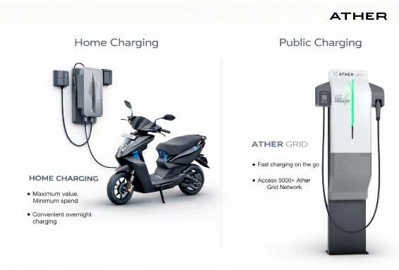
Company Overview: Ather Energy
Ather Energy is one of India's leading electric vehicle manufacturers, pioneering smart, connected, and performance-driven electric scooters designed specifically for urban mobility.
In-House Vertical Integration: Battery packs, BMS, vehicle control software, and charging hardware developed internally.
Software-First Architecture: Connected dashboards and Over-the-Air (OTA) continuous feature updates.
Ecosystem Strategy: Integrated offering of vehicles, Ather Grid fast chargers, and mobile application services.

Slide 4






Product Portfolio & Connected Tech
Ather 450X
Ather 450S
Ather Rizta
Flagship high-performance scooter engineered for urban enthusiasts featuring Warp mode, touchscreen navigation, and fast-charging capability.
Accessible premium offering designed for daily commuters, retaining smart software connectivity with optimized battery economics.
Family-centric electric scooter designed for ultimate comfort, expanded seating, practical storage, and high safety standards.

Slide 5

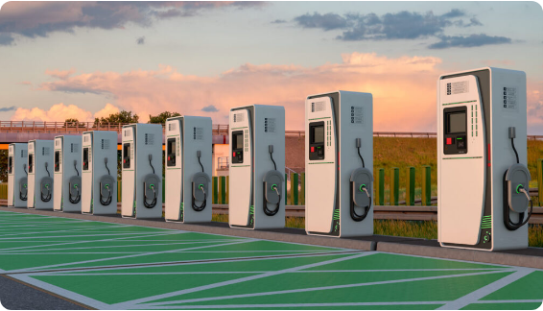
Ather Grid Infrastructure
India's Fast-Charging Network Benchmark
Ather Grid was created to solve the fundamental challenge of EV charging by providing high-speed DC charging across key metropolitan and highway hubs.
DC Fast Charging: Rapid energy top-ups for minimum downtime during transit.
App Discovery: Live status and location mapping via Ather Mobile App.
LECCS Interoperability: Supporting Light Electric Combined Charging Systems for broader OEM adoption.

Slide 6

Problem Statement & Context
80%
Charging Uncertainty Impedes Mass Adoption
Despite improvements in vehicle performance and battery range, uncertainty surrounding charger availability, long queue wait times, and poor route planning keeps potential buyers hesitant.
Riders Report Range Anxiety During Intercity Journeys
Customer expectations are rapidly evolving: riders no longer just want chargers nearby—they demand a predictable, seamless, and reserved charging journey.

Slide 7



Key Customer Pain Points
Uneven Coverage
Apartment Constraints
Peak Congestion
Public chargers are heavily concentrated in Tier-I commercial hubs, leaving residential neighborhoods, Tier II/III cities, and highways underserved.
Urban apartment tenants and society residents lack dedicated parking sockets, making home charging nearly impossible and forcing reliance on public grids.
High utilization during morning/evening commute hours leads to long wait queues, unknown occupancy statuses, and high friction for time-sensitive riders.

Slide 8




Root Cause Analysis (Fishbone)
Charging Operations
Residential Constraints
Business & Partnerships
•
No advance slot booking
•
Lack of dedicated parking bays
•
Limited fuel station partnerships
•
Unpredictable peak-hour queues
•
Housing society approvals friction
•
High capex for solo expansion
•
High station idle times post-charging
•
Shared electricity meter barriers
•
Slow CPO onboarding timelines
Technology & Software
Customer Experience
Infrastructure Gaps
•
No dynamic route optimization
•
Frequent detour requirements
•
Few neighborhood chargers deployed
•
Lack of predictive occupancy tools
•
Uncertainty in long-distance trips
•
Unbalanced spatial distribution
•
Manual searching required while riding
•
Fear of stranded low-SOC batteries
•
Highway charging dead zones

Slide 9

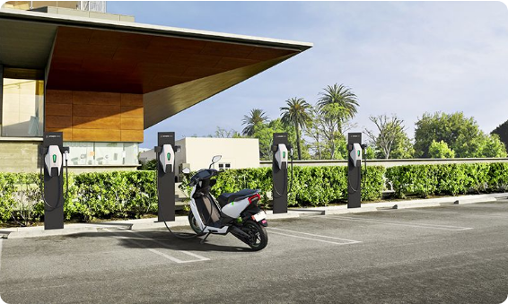
Regulatory Growth Driver: Delhi EV Policy
100% Electric 2-Wheeler Mandate
Under the approved Delhi EV Policy 2026, all new two-wheelers registered in Delhi starting April 1, 2028 MUST be 100% electric.
Product Management Insight: This policy is not merely a legal rule—it is a massive, guaranteed demand-generation catalyst.
Strategic pre-expansion of Ather Grid across Delhi-NCR.
Securing prime commercial & residential charging sites now.

Slide 10
Market Competitor Benchmarking
Feature / Metric | Ather Energy | Ola Electric | TVS iQube | Hero Vida
Fast Charging Network | Extensive (Ather Grid) | Hypercharge Network | Limited | Expanding
App Route Navigation | Built-In (Google Maps) | Built-In | Partial | Basic
Slot Reservation | Not Available | Not Available | Not Available | Not Available
Predictive Route Planning | Basic Search | Basic Search | None | None
Open Charging Standard | LECCS Pioneer | Proprietary focus | Proprietary | LECCS Partner

Slide 11




Ather Charging Ecosystem SWOT
Strengths
Weaknesses
Pioneer in fast charging; deep vertical software integration; high customer brand trust; LECCS interoperability.
Gaps in Tier II/III coverage; lack of slot reservation; challenges for apartment residents without home plugs.
Opportunities
Threats
Delhi 2028 EV mandate; AI-driven route stop automation; fuel station partnership expansions (IOCL, BPCL, HPCL).
Aggressive network expansion by legacy & new EV players; high capex requirements; potential subsidy shifts.

Slide 12





Proposed Strategic Solutions Overview
1. Charging Analytics Team
2. Smart Route Planner
3. Slot Reservations
4. Retail Fuel Partnerships
Premium reservation windows for high-demand Ather Grid hubs to eliminate queue uncertainty.
Cross-functional data intelligence unit deploying Neighborhood Chargers using anonymized rider telematics.
AI feature ("Plan Charging on the Way") predicting SOC drops and automatically scheduling charging stops.
Massive infrastructure co-location with petrol retailers (IOCL, BPCL, HPCL) & Charging+ Subscriptions.

Slide 13


Solution 1: Charging Analytics Team
Data Scientists & GIS
Evidence-Based Site Selection
Spatial heatmaps & predictive clustering models for demand forecasting.
Instead of manual site requests, Ather will establish a dedicated Analytics Team analyzing live connected vehicle telematics:
Key Data Inputs: SOC drops below 20%, high-density residential clusters, daily route corridors.
Product & Ops Leads
Converting data insights into rapid CPO site onboarding & hardware execution.
Target Deployment: Placing Neighborhood Chargers near urban apartments lacking private plugs.

Slide 14
Analytical Framework & Telematics Data
Data Category | Telematics & System Inputs | Strategic Analytical Outcome
Vehicle Telematics | Daily mileage, SOC depletion rate, speed profiles, low-battery locations | Identify "range-danger zones" across city commuter routes
Charging Habits | Home plug frequency, fast-charging durations, idle post-charge times | Highlight apartment clusters relying entirely on public charging
Spatial GIS Data | Commercial POIs, society density, IT parks, highway exit corridors | Optimized placement coordinates for Neighborhood Chargers
Predictive Algorithms | K-Means clustering, route density forecasting, occupancy trends | Maximize charger ROI and eliminate dead-zone deployments

Slide 15
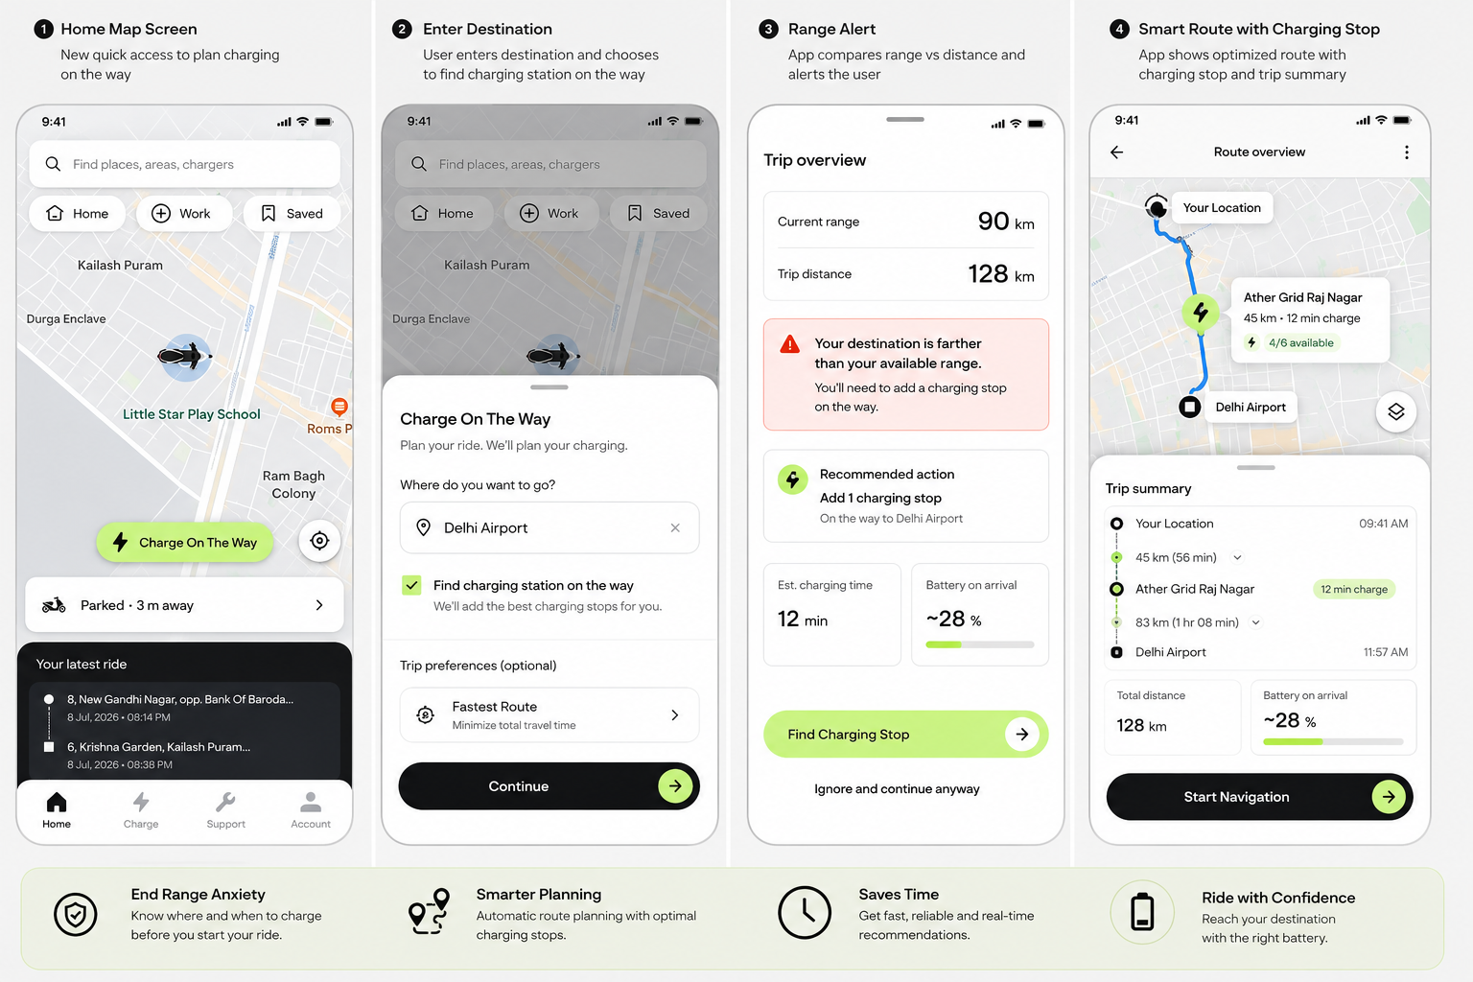
Solution 2: Smart Route Planning
Long-distance rides often cause range anxiety when users try to manually calculate if their battery will last both onward and return legs.
AI-Powered Trip Planning: By integrating real-time SOC, route elevation, weather, traffic, and live grid occupancy, the Ather App automatically calculates precise charging breaks before setting off.

Slide 16




App UX Flow & Interactive Prototype
High-Fidelity Feature Workflow: Plan Charging on the Way
Home Map
Destination
Range Alert
Smart Route
Navigation
Quick shortcut card to "Plan Charging on the Way"
User inputs destination & selects route parameters
App compares distance vs SOC and flags requirement
Recommends Ather Grid Raj Nagar (12 min, +28%)
Trip summary confirmed & live turn navigation starts
Interactive Prototype Link - https://ai.studio/apps/238fd53c-1aea-4de6-9d6d-1316c4127931
Launch Prototype

Slide 17

Solution 3: Charging Slot Reservations
Guaranteed Fast Charging
Revenue & Efficiency Impact
Riders requiring urgent battery top-ups during peak hours can reserve a 15–30 minute charging slot at high-demand Ather Grid hubs for a nominal fee.
Creates a premium monetization channel while dramatically reducing station congestion and customer waiting frustration.
Queue Visibility: Real-time waiting time estimations on mobile map.
Automated Hold Windows: 5-minute grace period to prevent slot hoarding.
Priority Access: Integrated into Ather Charging+ subscription tiers.
Dynamic Off-Peak Rules: Reserved slots revert to public pool if unoccupied.
Prototype link - https://ather-grid-677520987911.asia-southeast1.run.app

Slide 18

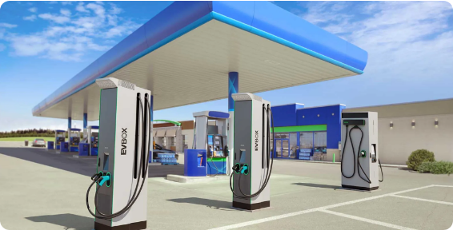
Solution 4: Strategic Fuel Retailer Alliances
Partnering with Oil Marketing Companies
Accelerating Ather Grid expansion through direct partnerships with major fuel retailers including IOCL, BPCL, and HPCL.
Prime Real Estate: Utilizing existing petrol station footprints across Tier I, II, III cities & highways.
Safety & Trust: Secure, well-lit, 24/7 accessible charging environments for commuters.

Slide 19

Solution 5: Ather Charging+ & Marketing
Ather Charging+ Subscription
Demand-Driven B2B Marketing
Recurring revenue model offering bundled benefits for high-mileage users, delivery partners, and daily commuters.
Geospatial marketing to attract private host partners and commercial establishments with low capital outlay.
Discounted or unlimited grid charging options
Targeting commercial property & apartment RWA boards
Free slot reservation credits per month
Low-capex revenue-share host models
Priority customer support & charging discounts
Hyper-local digital awareness campaigns

Slide 20






Success Metrics (KPIs) & Impact Summary
Range Anxiety Index
Grid Utilization Rate
Reservation CSAT
-45%
Reduction in riders reaching critical <15% SOC emergency states.
+35%
Increase in off-peak and neighborhood charger utilization.
4.8 / 5.0
Target satisfaction score for fast-charging slot certainty.
Strategic Takeaway
By combining data intelligence, proactive route planning, and flexible charging reservations, Ather Energy transforms EV charging from a barrier into a decisive competitive advantage.

Slide 21





Image Sources
https://media.atherenergy.com/Home-Charging-vs-Public-Charging.webp
Source: www.atherenergy.com
https://skywell-uk.com/wp-content/uploads/2026/05/what-is-an-ev-charging-hub-public-fast-chargers-1024x576.jpg
Source: skywell-uk.com
https://ww2.mathworks.cn/company/mathworks-stories/green-tech-startup-creates-smart-e-scooters-india/_jcr_content/mainParsys2/columns_1912233028_c/02542e5d-1b7b-48e6-aacb-5a47c2a43a5c/columns_917450907/8313b592-25eb-45a6-b349-bcfc1983e13c/columns_320727814_co/18897323-014e-432d-8828-20872c7d83dd/image_copy.adapt.full.medium.jpg/1778577856484.jpg
Source: ww2.mathworks.cn
https://eleport.com/wp-content/uploads/2025/07/6-Octopus-Electroverse.jpg
Source: eleport.com
https://evbox.com/app/uploads/2025/07/Desktop.b65ff00a.hero_fuelretail.webp
Source: evbox.com
Thank You

