Slide 1
ErrorBuddy
$ ./errorbuddy missing_semicolon.txt
Error on line 2:
Expected ';' at the end of the statement.
Suggestion: Add a semicolon after '10'.
(Found during: Syntax Analysis)
How a beginner-friendly compiler is built, and how it works
C++17 · standard library only · 5 phases · ~1,100 lines
Notes:
ErrorBuddy compiles a small beginner language into three-address code. This deck covers the architecture (which file does what) and how each phase works, ending with the case-study results and what is built versus planned.

Slide 2
Compiler errors talk like grammars
TYPICAL COMPILER (gcc on the equivalent C)
ERRORBUDDY
1 int a = 5;
2 int b = 10
3 printf("%d", a + b);
program.c:3:5: error:
expected ',' or ';' before 'printf'
Error on line 2:
Expected ';' at the end of the
statement.
Suggestion: Add a semicolon
after '10'.
(Found during: Syntax Analysis)
Wrong line: points after the mistake
Line where the fix belongs
Grammar words: "expected … before"
Plain English + one concrete fix
Notes:
Beginners lose time on messages that point to the next line and use parser vocabulary. ErrorBuddy's whole design is organised around producing the message on the right.

Slide 3
Architecture: five phases in three source files
program.txt
lexer.cpp
parser.cpp
main.cpp
Source
Phase 1 · Lexer
Phases 2–4, one pass
Driver
Plain text, read in one go by main.cpp
tokenize() → vector<Token> (type, text, line)
Syntax · recursive descent
Prints TAC, symbol table and phase summary
Semantic · symbol table
TAC · emit t1 = a op b
Phase 5 · CompileError { line, phase, message, suggestion }
Any phase throws it at the first problem; main.cpp catches it, prints the explanation, and no TAC is shown.
web/server.py runs the same binary → JSON → playground
Exit codes: 0 ok · 1 compile error · 2 bad usage
Notes:
Only three C++ files. The lexer is separate; the parser does syntax, semantic checks and code generation together (syntax-directed translation). Errors travel on one channel: a CompileError struct defined in lexer.h, thrown by any phase and caught once in main.cpp.

Slide 4
Phase 1 · The lexer makes tokens
INPUT
int c = a + b * 2;
OUTPUT: vector<Token>
int
c
=
a
+
b
*
2
;
KEYWORD
IDENTIFIER
ASSIGN
IDENTIFIER
OPERATOR
IDENTIFIER
OPERATOR
NUMBER
SEMICOLON
Skips & tracks
Rejects
Hands on
Spaces and // comments
Counts newlines, so every token carries its line
Unknown symbols such as @
Numbers too large for an int
Names that start with a digit: 2nd
Token list ending in END_OF_FILE
--tokens prints it as a table
Notes:
A hand-written scanner. Line numbers recorded here are what later make accurate error lines possible.

Slide 5
Phase 2 · One function per grammar rule
CALL TREE FOR a + b * 2
program → statement*
statement → declaration
| assignment | printStmt
declaration → "int" ID "=" expr ";"
assignment → ID "=" expr ";"
printStmt → "print" expr ";"
expression → term ((+|-) term)*
term → factor ((*|/) factor)*
factor → NUM | ID | ( expr )
expression()
term()
+
term()
factor: a
factor: b
*
factor: 2
b * 2 is finished inside the right-hand term() before + is applied, so the TAC computes it first.
Precedence comes from the grammar, not a table. while loops in expression() and term() make operators left-associative: 10 - 4 - 3 = (10 - 4) - 3.
Notes:
Each grammar rule is a C++ function. expression() calls term(), term() calls factor(). Writing it by hand gives full control over each error message, which is the point of the project.

Slide 6
Phase 3 · The symbol table checks meaning
std::map<string, Symbol> AFTER examples/valid.txt
name
declared
value
Undeclared or misspelled
Declared twice
age
line 2
20
scroe = 2; → Did you mean 'score'?
'age' already declared on line 1
score
line 3
50
bonus
line 5
9
Used in its own declaration
Division by zero, overflow
int a = a + 1;
a / zero, 8 / (4 - 4), int range
There is no input and no loop, so every value is known while compiling. That is how a / zero is caught even when zero is a variable.
Notes:
Semantic checks run inside the parser at the moment each name or operator is seen. Values are tracked alongside declarations, which is only possible because the language has no input or loops.

Slide 7
Phase 4 · Three-address code
SOURCE
TAC
int age = 20;
int score = 10;
score = score + age * 2;
int bonus = (score - 5) / 5;
print score;
print bonus * (age + 1);
age = 20 t4 = t3 / 5
score = 10 bonus = t4
t1 = age * 2 print score
t2 = score + t1 t5 = age + 1
score = t2 t6 = bonus * t5
t3 = score - 5 print t6
At most one operator per instruction
Temps t1, t2… skip names already used
Printed only if the whole program passes
Notes:
This is the real output for examples/valid.txt: 12 instructions. Parentheses change grouping only and produce no instructions. Code for each statement is emitted as soon as it is parsed, so TAC stays in source order.

Slide 8
Phase 5 · Every error is a structured object
line
phase
message
suggestion
2
Syntax Analysis
Expected ';' at the end of the statement.
Add a semicolon after '10'.
Mistake | ErrorBuddy says
x + * 3 | Two operators in a row: '+' followed by '*'.
(x + 3 | Missing ')' to close the '(' opened on line 2.
int a = -5; | Negative numbers such as '-5' are not supported directly. Write 0 - 5.
prnt x; | Unknown word 'prnt'. Did you mean the keyword 'print'?
int a; | Variable 'a' is declared without a starting value.
Notes:
CompileError is defined in lexer.h so every phase can use it. The four fields are what make the output teachable: where, which phase, what, and how to fix it.

Slide 9
Diagnosis reads the surrounding tokens
expectSemicolon(): the statement is over but the next token is not ';'. What is it instead?
)
Found an extra ')' that has no matching '('.
=
Unexpected '='. A statement can contain only one '='.
x 5 (
Same line → Missing operator between the two values.
other
Expected ';' — reported on the line of the previous token.
The last rule is why a missing ';' on line 2 is reported on line 2, not on the line where the parser noticed it.
Notes:
factorError() and unknownStatementError() follow the same idea: look at the previous and next token to name the likely cause instead of printing a generic syntax error.

Slide 10
Typo hints use edit distance
scroe → score 2 edits
prnt → print 1 edit
mx → max 1 edit
Shipped rule
Allow 1 edit for names of up to 3 letters, 2 for longer names, and never suggest the word itself.
Levenshtein distance in a single rolling row (parser.cpp, editDistance). Measured on 23 typo cases from case_study/corpus.py.
Notes:
Looser limits find more right answers but also more wrong ones. The shipped rule gives the fewest wrong suggestions (6) while still getting 12 right. Wrong means it suggested a name other than the intended one.

Slide 11
Case study: the line where the fix belongs
24 / 24
mistakes caught by ErrorBuddy (gcc: 23)
0
reports later than the fix line (gcc: 3)
3
late cases were all a missing ';'
Notes:
case_study/run_study.py runs 24 classic mistakes through gcc (equivalent C, -Wall -Wextra, first diagnostic) and through two ErrorBuddy variants. Reporting the line of the previous token for a missing semicolon is what moves ErrorBuddy from 21 to 24 exact lines. gcc missed division by a variable that is zero.

Slide 12
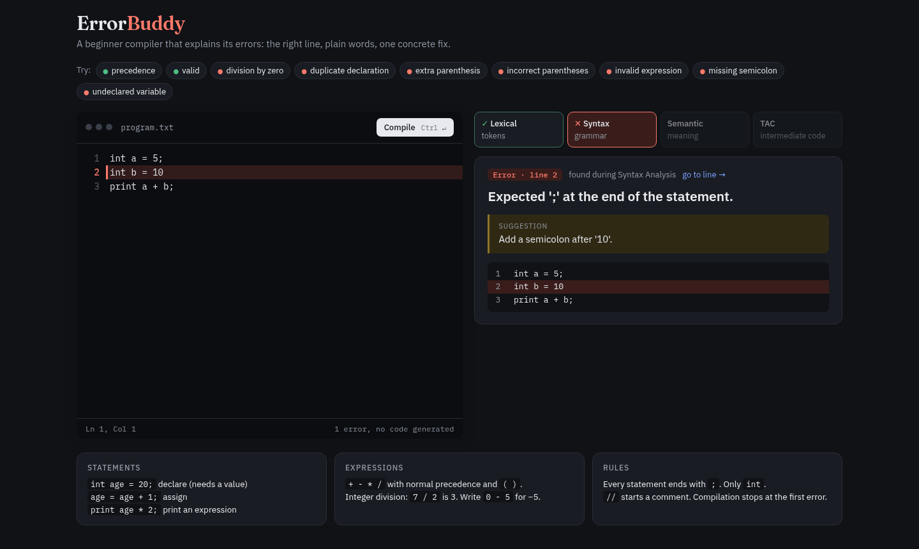
Seeing it work: the web playground
make web → http://localhost:8795
web/server.py: Python standard library only
POST /api/compile runs the real ./errorbuddy --tokens
Parses its output into JSON: tokens, error, TAC, symbols
Editor highlights the error line; phase strip shows where it stopped
Notes:
The playground does not reimplement anything; it shells out to the same compiler binary and recompiles as you type. Example buttons load the programs from examples/.

Slide 13
Built and tested today, and what comes next
BUILT
NEXT (FROM THE PROPOSAL)
int variables with a required starting value
+ - * / with precedence and parentheses
print any expression; // comments
TAC, symbol table, phase summary
Stops at the first error
Web playground
if/else, while and for loops
Comparison and logical operators, printf
Error recovery: several errors per run
Functions and arrays; char and float
Constant folding and other optimisations
10 / 10
example programs match their expected output in make test
Kept small on purpose so every phase is complete. The right column is planned, not built.
Notes:
The original proposal targeted a beginner-C subset. What is implemented now is a smaller language (int, arithmetic, print) so every phase could be done properly. The right-hand column is planned work, not built.

Slide 14
ErrorBuddy
A complete small compiler, lexer to three-address code, whose main contribution is error messages that teach: the right line, plain words, and a concrete fix.
make test
make web → localhost:8795
python3 case_study/run_study.py

