Slide 1
HTML Part II
For Beginners Part II

Slide 2
INTRODUCTION TO HTML
Styling Text
HTML Text Formatting
https://www.codecademy.com/courses/learn-html/lessons/intro-to-html/exercises/text-style-tags
Formatting elements were designed to display special types of text:
<b> - Bold text
<strong> - Important text
<i> - Italic text
<em> - Emphasized text
<mark> - Marked text
<small> - Smaller text
<del> - Deleted text
<ins> - Inserted text
<sub> - Subscript text
<sup> - Superscript text

Slide 3
INTRODUCTION TO HTML
Unordered Lists
https://www.w3schools.com/html/html_lists.asp
<ul>
<li>Coffee</li>
<li>Tea</li>
<li>Milk</li>
</ul>
An unordered HTML list
Coffee
Tea
Milk

Slide 4
Ordered HTML List https://www.w3schools.com/html/html_lists_ordered.asp
<ol>
<li>Coffee</li>
<li>Tea</li>
<li>Milk</li>
</ol>
An ordered HTML list
Coffee
Tea
Milk
https://www.codecademy.com/courses/learn-html/lessons/intro-to-html/exercises/unordered-lists-html

Slide 5
2 ways to put an image:
<img src="pic_trulli.jpg" alt="Italian Trulli">
2. Under the Media <h2> heading, add an image. Use the following URL as the source (src) for the image:
https://content.codecademy.com/courses/web-101/web101-image_brownbear.jpg
Resources and Excercise:
https://www.codecademy.com/courses/learn-html/lessons/intro-to-html/exercises/img-src-html

Slide 6
Layouts: (HTML layout structure)
Every web page has different components to display the intended content and a specific UI. But still, there are few things which are templated and are globally accepted way to structure the web page, such as:
<header>: Stores the starting information about the web page.
<footer>: Represents the last section of the page.
<nav>: The navigation menu of the HTML page.
<article>: It is a set of information.
<section>: It is used inside the article block to define the basic structure of a page.
<aside>: Sidebar content of the page.
<figure> tag specifies the self-contained content, like diagrams, images, code snippets, etc. <figure> tag is used to semantically organize the contents of an image like image, image caption, etc., whereas the <img> tag is used to embed the picture in the HTML5 document.

Slide 7
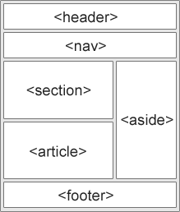
HTML has several semantic elements that define the different parts of a web page:
https://www.w3schools.com/html/html5_semantic_elements.asp#:~:text=What%20are%20Semantic%20Elements%3F,%3E%20%2D%20Clearly%20defines%20its%20content.

Slide 8
Forms and buttons
https://www.w3schools.com/html/html_forms.asp
<form action="/action_page.php">
<label for="fname">First name:</label><br>
<input type="text" id="fname" name="fname" value="John"><br>
<label for="lname">Last name:</label><br>
<input type="text" id="lname" name="lname" value="Doe"><br><br>
<input type="submit" value="Submit">
</form>

Slide 9
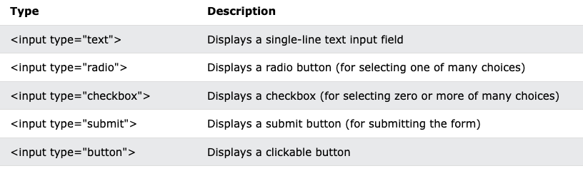
Input Fields(text box, radio button, checkbox, dropdown, text area, etc. HTML5

Slide 10
Example of Radio button
https://www.w3schools.com/html/tryit.asp?filename=tryhtml_form_radio
<form>
<input type="radio" id="html" name="fav_language" value="HTML">
<label for="html">HTML</label><br>
<input type="radio" id="css" name="fav_language" value="CSS">
<label for="css">CSS</label><br>
<input type="radio" id="javascript" name="fav_language" value="JavaScript">
<label for="javascript">JavaScript</label>
</form>

Slide 11
Dropdown example:
https://www.w3schools.com/tags/tag_select.asp
<label for="cars">Choose a car:</label>
<select name="cars" id="cars">
<option value="volvo">Volvo</option>
<option value="saab">Saab</option>
<option value="mercedes">Mercedes</option>
<option value="audi">Audi</option>
</select>

Slide 12
Text area example: https://www.w3schools.com/tags/tryit.asp?filename=tryhtml_textarea
<h1>The textarea element</h1>
<form action="/action_page.php">
<p><label for="w3review">Review of W3Schools:</label></p>
<textarea id="w3review" name="w3review" rows="4" cols="50">At w3schools.com you will learn how to make a website. They offer free tutorials in all web development technologies.</textarea>
<br>
<input type="submit" value="Submit">
</form>

Slide 13
List of Browser support HTML5
Handling cross browser compatibility in HTML5
There is a large range of browsers available in the market while a majority of the chunk is taken by
Google Chrome
Mozilla Firefox
Safari
Opera
Microsoft Edge
https://www.browserstack.com/guide/html5-browser-compatibility-test

Slide 14
Media tags (audio and video tags)
In addition to images, HTML also supports displaying videos. Like the <img> element, the <video> element requires a src attribute with a link to the video source. Unlike the <img> element however, the <video> element requires an opening and a closing tag.
<video src="myVideo.mp4" width="320" height="240" controls>
Video not supported
</video>
Or
<video width="320" height="240" controls>
<source src="movie.mp4" type="video/mp4">
<source src="movie.ogg" type="video/ogg">
Your browser does not support the video tag.
</video>
https://www.codecademy.com/courses/learn-html/lessons/intro-to-html/exercises/videos-html

Slide 15
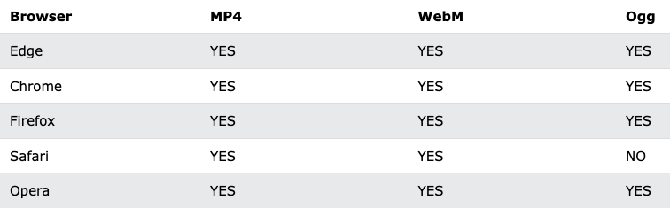
HTML Video Formats
https://www.w3schools.com/html/html5_video.asp

Slide 16
Graphics using Canvas tag
https://www.w3schools.com/html/html5_canvas.asp#:~:text=The%20HTML%20element%20is%20used%20to%20draw%20graphics%2C,%2C%20text%2C%20and%20adding%20images
What is HTML Canvas?
The HTML <canvas> element is used to draw graphics, on the fly, via JavaScript.
The <canvas> element is only a container for graphics. You must use JavaScript to actually draw the graphics.
Canvas has several methods for drawing paths, boxes, circles, text, and adding images.

Slide 17
What is the difference between SVG and Canvas?
SVG | Canvas
SVG is a vector based i.e., composed of shapes. | It is Raster based i.e., composed of pixels.
SVG works better with a larger surface. | Canvas works better with a smaller surface.
SVG can be modified using CSS and scripts. | Canvas can only be modified using scripts.
SVG is highly scalable. So we can print at high quality with high resolution. | It is less scalable.

Slide 18
Drag and Drop features
https://www.w3schools.com/html/html5_draganddrop.asp
In HTML, any element can be dragged and dropped.
Drag and drop is a very common feature. It is when you "grab" an object and drag it to a different location.

Slide 19
Working on locations lat and long using Geolocation
https://www.w3schools.com/html/html5_geolocation.asp
The HTML Geolocation API is used to get the geographical position of a user.
Since this can compromise privacy, the position is not available unless the user approves it.
https://www.geeksforgeeks.org/html-geolocation/

Slide 20
Geolocation:
<body>
<div class="gfg">GeeksforGeeks</div>
<p>Display location in map</p>
<button class="geeks" type="button" onclick="getlocation();">
Current Position
</button>
<div id="demo2"
style="width: 500px; height: 500px"></div>
<script src="https://maps.google.com/maps/api/js?sensor=false">
</script>
<script type="text/javascript">
function getlocation() {
if (navigator.geolocation) {
navigator.geolocation.getCurrentPosition(showLoc, errHand);
}
}
function showLoc(pos) {
latt = pos.coords.latitude;
long = pos.coords.longitude;
var lattlong = new google.maps.LatLng(latt, long);
var OPTions = {
center: lattlong,
zoom: 10,
mapTypeControl: true,
navigationControlOptions: {
style: google.maps.NavigationControlStyle.SMALL,
},
};
var mapg = new google.maps.Map(
document.getElementById("demo2"),
OPTions
);
var markerg = new google.maps.Marker({
position: lattlong,
map: mapg,
title: "You are here!",
});
}
function errHand(err) {
switch (err.code) {
case err.PERMISSION_DENIED:
result.innerHTML =
"The application doesn't have the permission" +
"to make use of location services";
break;
case err.POSITION_UNAVAILABLE:
result.innerHTML = "The location of the device is uncertain";
break;
case err.TIMEOUT:
result.innerHTML = "The request to get user location timed out";
break;
case err.UNKNOWN_ERROR:
result.innerHTML =
"Time to fetch location information exceeded" +
"the maximum timeout interval";
break;
}
}
</script>
</body>

Slide 21
Storing user preferences using LocalStorage
https://www.w3schools.com/html/html5_webstorage.asp
What is HTML Web Storage?
With web storage, web applications can store data locally within the user's browser.
Before HTML5, application data had to be stored in cookies, included in every server request. Web storage is more secure, and large amounts of data can be stored locally, without affecting website performance.
Unlike cookies, the storage limit is far larger (at least 5MB) and information is never transferred to the server.
Web storage is per origin (per domain and protocol). All pages, from one origin, can store and access the same data.
***We will cover this more in Javascript***

Slide 22
Next topics: Form Elements
Get & Post
Validating input values in a form
Form action and type

Slide 23
Get & Post
What is HTTP?
The Hypertext Transfer Protocol (HTTP) is designed to enable communications between clients and servers.
HTTP works as a request-response protocol between a client and server.
Example: A client (browser) sends an HTTP request to the server; then the server returns a response to the client. The response contains status information about the request and may also contain the requested content.
HTTP Methods
GET
POST
PUT
HEAD
DELETE
PATCH
OPTIONS
CONNECT
TRACE
The two most common HTTP methods are: GET and POST.

Slide 24
The GET Method
GET is used to request data from a specified resource.
Note that the query string (name/value pairs) is sent in the URL of a GET request:
/test/demo_form.php?name1=value1&name2=value2
Some notes on GET requests:
GET requests can be cached
GET requests remain in the browser history
GET requests can be bookmarked
GET requests should never be used when dealing with sensitive data
GET requests have length restrictions
GET requests are only used to request data (not modify)

Slide 25
The POST Method
POST is used to send data to a server to create/update a resource.
The data sent to the server with POST is stored in the request body of the HTTP request:
POST /test/demo_form.php HTTP/1.1
Host: w3schools.com
name1=value1&name2=value2
Some notes on POST requests:
POST requests are never cached
POST requests do not remain in the browser history
POST requests cannot be bookmarked
POST requests have no restrictions on data length

Slide 26
Example of Form Get and Post:
https://www.w3schools.com/tags/att_form_method.asp
<form action="welcome.php" method="post" target="_blank">
<label for="fname">First name:</label>
<input type="text" id="fname" name="fname"><br><br>
<label for="lname">Last name:</label>
<input type="text" id="lname" name="lname"><br><br>
<input type="submit" value="Submit">
</form>

Slide 27
Post command :
When the user fills out the form above and clicks the submit button, the form data is sent for processing to a PHP file named "welcome.php". The form data is sent with the HTTP POST method.
To display the submitted data you could simply echo all the variables. The "welcome.php" looks like this:
<html>
<body>
Welcome <?php echo $_POST["fname"]; ?><br>
Your email address is: <?php echo $_POST["email"]; ?>
Your last name: <?php echo $_POST["lname"]; ?>
</body>
</html>
Note: We will explore these later for practical use with React and Angular.

Slide 28
2. Validating input values in a form
https://www.geeksforgeeks.org/how-to-validate-input-field-in-the-html-form/
We will use HTML <input> required attribute. The <input> required attribute is a Boolean attribute that is used to specify the input element must be filled out before submitting the Form.
Syntax:
<input required>
<input type="text" name="fname" id="fname" required>

Slide 29
Form action and type
<form action="/action_page.php" method="get">
<label for="fname">First name:</label>
<input type="text" id="fname" name="fname"><br><br>
<label for="lname">Last name:</label>
<input type="text" id="lname" name="lname"><br><br>
<input type="submit" value="Submit">
</form>
What are the different types in a form?

Slide 30
Advance info
How to optimize website assets loading?
To optimize website load time we need to optimize its asset loading and for that:
CDN hosting - A CDN or content delivery network is geographically distributed servers to help reduce latency.
File compression - This is a method that helps to reduce the size of an asset to reduce the data transfer
File concatenation - This reduces the number of HTTP calls
Minify scripts - This reduces the overall file size of js and CSS files
Parallel downloads - Hosting assets in multiple subdomains can help to bypass the download limit of 6 assets per domain of all modern browsers. This can be configured but most general users never modify these settings.
Lazy Loading - Instead of loading all the assets at once, the non-critical assets can be loaded on a need basis.

Slide 31
Advance info
Can we display a web page inside a web page or Is nesting of webpages possible?
Yes, we can display a web page inside another HTML web page. HTML provides a tag <iframe> using which we can achieve this functionality.
<iframe src=”url of the web page to embed” />

Slide 32
Resources to look over in class hours:
HTML for absolute beginners with Transverymedia and oldie but goddie. https://www.youtube.com/watch?v=UB1O30fR-EE
HTML with Mosh:
https://www.youtube.com/watch?v=qz0aGYrrlhU
Exercises that you can do on your own with your Visual studio code or on the website:
https://www.codecademy.com/learn/learn-html
https://www.freecodecamp.org/learn/2022/responsive-web-design/

