Slide 1
Basics of X86 architecture
Abhijit A M
abhijit.comp@coep.ac.in
Credits: Notes by Prof. Sorav Bansal, https://www.felixcloutier.com/x86/, Intel Documentation

Slide 2
A processor typically has
integer registers and their execution unit
floating-point/vector registers and execution unit(s)
memory management unit (MMU)
multiprocessor/multicore: local interrupt controller (APIC)
etc

Slide 3
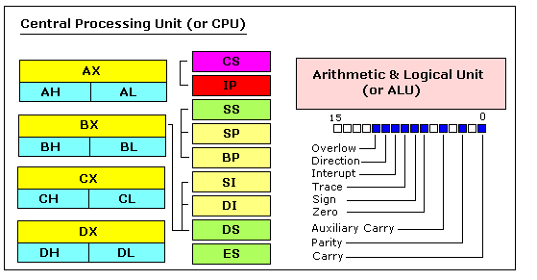
8086: 16 bit CPU
(precursor to x86 family)
https://jerry153fish.github.io/2016/01/01/8086-Registers.html

Slide 4
8086 Registers
16 bit ought to be enough ! (?)
General purpose registers
  four 16-bit data registers: AX, BX, CX, DX
  each in two 8-bit halves, e.g. AH and AL
Registers for memory addressing
  SP, BP, SI, DI : 16 bit
  SP stack pointer, BP base pointer, SI Source Index, DI Destination Index
  IP instruction Pointer
  Addressible memory: 2^16 = 64 kb

Slide 5
8086 address extension
8086 has 20-bit physical addresses ==> 1 MB AS
the extra four bits usually come from a 16-bit "segment register":
  CS - code segment, for fetches via IP
  SS - stack segment, for load/store via SP and BP
  DS - data segment, for load/store via other registers
  ES - another data segment, destination for string operations
%cs:%ip full address: %cs * 16 + %ip is actual address that goes on bus. virtual to physical translation is
  pa = va + seg*16
e.g. set CS = 4096 to execute starting at 65536

Slide 6
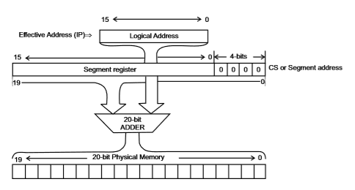
8086 address extension
Extending ‘address space’ with the help of MMU

Slide 7
FLAGS register
FLAGS - various condition codes: whether last arithmetic operation
  overflowed
  was positive/negative
  was [not] zero
  carry/borrow on add/subtract
  etc.
whether interrupts are enabled
direction of data copy instructions
Uses in JP, JN, J[N]Z, J[N]C, J[N]O ...

Slide 8
32 bit 80386
boots in 16-bit mode, then on running particular instructions switches to 32-bit mode (protected mode)
  For backward compatibility, INTEL continued this. The CPU starts in 16 bit mode, called real mode
  If particular instructions are not executed (may be in boot loader) all processors will continue in real mode
registers are 32 bits wide, called EAX rather than AX
  EAX EBX ECX EDX
  ESP EBP ESI EDI
operands and addresses 32-bit in 32-bit mode,
  e.g. ADD does 32-bit arithmetic
Segment registers are 16 bit: CS, SS, DS, etc.

Slide 9
32 bit 80386
Still possible to access 16 bit registers using AX or BX
  Specifix coding of machine instructions to tell whether operands are 16 or 32 bit
  prefixes 0x66/0x67 toggle between 16-bit and 32-bit operands/addresses respectively
  in 32-bit mode, MOVW is expressed as 0x66 MOVW
  the .code32 in bootasm.S tells assembler to generate 0x66 for e.g. MOVW
80386 also changed segments and added paged memory...

Slide 10
Summary of registers in 80386 (32 bit)
General registers
  32 bits : EAX EBX ECX EDX
  16 bits : AX BX CX DX
  8 bits : AH AL BH BL CH CL DH DL

Slide 11
Summary of registers in 80386
Expected usage of Segment Registers
  CS: Holds the Code segment in which your program runs.
  DS : Holds the Data segment that your program accesses.
  ES,FS,GS : These are extra segment registers
  SS : Holds the Stack segment your program uses.
All 16 bit

Slide 12
Summary of registers in 80386
For a typical register, the corresponding segment is used. Pairs of Indexes & pointers (Segment & Registers)
  CS:EIP
    Code Segment: Index Pointer
    E.g. mov $32, %eax ==> The code of move instruction uses CS: EIP
  SS:ESP
    Stack Segment: ESP
    E.g. push $32 ==> The $32 will be pushed on stack. Using SS: ESP address
  SS:EBP
    Stack Segment: EBP ==> mov (%ebp), %eax ==> for accessing (%ebp) SS: EBP address will be used
  DS:ESI , ES: EDI .
    ESI: Extended Source Index, EDI: Extended Destination Index
The EFLAGS register for flags

Slide 13
X86 Assembly Code
Syntax
  Intel syntax: op dst, src (Intel manuals!)
  AT&T (gcc/gas) syntax: op src, dst (xv6)
  uses b, w, l suffix on instructions to specify size of operands
Operands are registers, constant, memory via register, memory via constant

Slide 14
Examples of X86 instructions
AT&T syntax | "C"-ish equivalent | Operands
movl %eax, %edx | edx = eax; | register mode
movl $0x123, %edx | edx = 0x123; | immediate
movl 0x123, %edx | edx = *(int32_t*)0x123; | direct
movl (%ebx), %edx | edx = *(int32_t*)ebx; | indirect
movl 4(%ebx), %edx | edx = *(int32_t*)(ebx+4) | displaced

Slide 15
Instructions suffix/prefix
mov %eax, %ebx # 32 bit data
movw %ax, %bx # move 16 bit data
mov %ax, %bx # ax is 16 bit, so equivalent to movw
mov $123, 0x123 # Ambigious
movw $123, 0x123 # correct, move 16 bit data

Slide 16
Types of Instructions
data movement
  MOV, PUSH, POP, ...
Arithmetic
  TEST, SHL, ADD, AND, ...
i/o
  IN, OUT, ...
Control
  JMP, JZ, JNZ, CALL, RET
String
  REP MOVSB, ...
System
  IRET, INT

Slide 17
Interrupt handling

Slide 18
Privilege levels
The x86 has 4 protection levels, numbered 0 (most privilege) to 3 (least privilege).
In practice, most operating systems use only 2 levels: 0 and 3, which are then called kernel mode and user mode, respectively.
The current privilege level with which the x86 executes instructions is stored in CPL field inside %cs register

Slide 19
Privilege levels
Changes automatically on
  “int” instruction
  hardware interrupt
  exeception
Changes back on
  iret
“int” 10 --> makes 10th hardware interrupt. S/w interrupt can be used to create hardware interrupt’
Xv6 uses “int 64” for actual system calls

Slide 20
Interrupt Descriptor Table (IDT)
IDT is an in memory table. IDT defines intertupt handlers
Has 256 entries
  each giving the %cs and %eip to be used when handling the corresponding interrupt.
Interrupts 0-31 are defined for software exceptions, like divide errors or attempts to access invalid memory addresses.
  Xv6 maps the 32 hardware interrupts to the range 32-63
  and uses interrupt 64 as the system call interrupt

Slide 21

IDTR and IDT
An entry in IDT is called a “gate”
IDTR is a CPU register, IDT is in memory table

Slide 22
Memory Management
in x86

Slide 23
A word of caution
We are getting introduced to x86 memory management features, before learning the basics of memory management.
So we’ll revisit these concepts later.

Slide 24
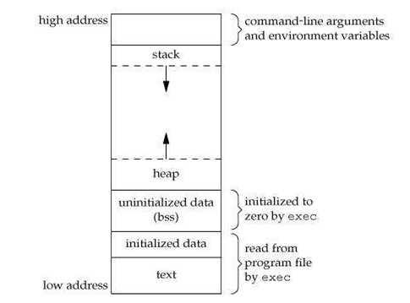
Memory Layout of a C Program
Text: object code of the program
Data: Global variables + (local/global) Static variables
BSS: Uninitialized data, globals that were not initialized
Stack: Region for allocating local variables, function parameters, return values
Heap: Region for use by malloc(), free()
Arguments, Environment variables: Initialized by kernel (during exec)
text, data, bss are also present in the ELF file
stack and heap are not present in ELF file
WHY?

Slide 25
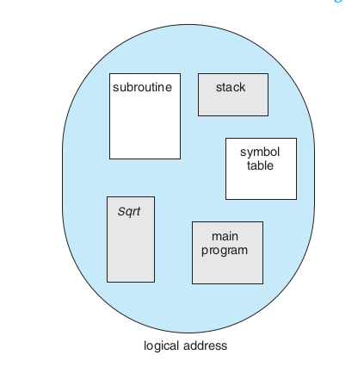
Why the Segment:Offset Pairs In x86 ?
Segmentation
Compiler’s view of the program
Compiler generates object code assuming that different memory regions corresponding to the program are different “segments” in memory
Segment: a continuous chunk
Segment register gives the location of the chunk, index/offset register gives the offset
E.g. in CS:IP CS gives the location of the segment, IP gives the index in it

Slide 26
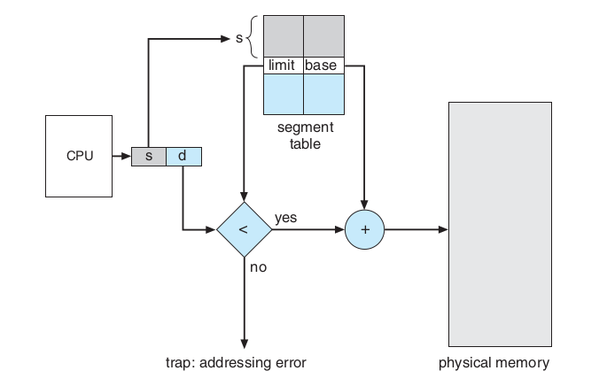
Segmentation
Address Translation, general idea (not x86)

Slide 27
Real mode and protected mode
Beware: note the same as user mode and kernel mode!
Backward compatibility was desired by Intel
  80286 was 32 bit, 8086 was 16 bit
  Binary encoding for 80286 was different, registers were 32 bit, etc; also more speed, different memory management hardware, etc.
  But still they wanted their customers to keep running earlier object code on new processor
  So they ensured that the processor boots up as if it was 16 bit 8086/8088. REAL MODE!
  On running particular machine instruction sequence, the CPU will change to 32 bit . PROTECTED MODE!

Slide 28
More on real mode
addresses in real mode always correspond to real locations in memory.
  Memory address calculation done by MMU in real mode: segment*16+offset
no support for memory protection, multitasking, or code privilege levels (user/kernel mode!)
May use the BIOS routines or OS routines
DOS like OS were written when PCs were in the era of 8088/real-mode.
  Single tasking systems

Slide 29

X86 address : protected mode address translation
Memory Managemnt Unit (MMU)
Processor Chip

Slide 30

X86 segmentation

Slide 31

X86 paging

Slide 32
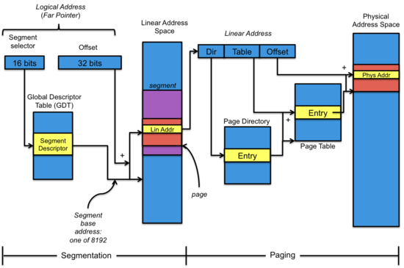
Segmentation + Paging

Slide 33

Segmentation + Paging
Selector value is implicit based on address being accessed.
Instruction: CS
Stack Variable: SS
Data: DS
etc.

Slide 34

GDT Entry
This is an in Memory entry. The diagram shows the format.

Slide 35

Page Directory Entry (PDE)
Page Table Entry (PTE)
These are in memory entries. The diagrams show the format of each entry.

Slide 36


Segment selector
EFLAGS register

Slide 37

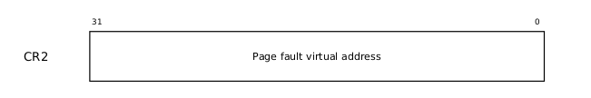
CR0
CR2
PG: Paging enabled or not WP: Write protecion on/off
PE: Protection Enabled --> protected mode.

Slide 38


CR3
CR4

