Slide 1
Basics of X86 architecture
Abhijit A M
abhijit.comp@coep.ac.in
Credits: Notes by Prof. Sorav Bansal, https://www.felixcloutier.com/x86/, Intel Documentation

Slide 2
A processor typically has
integer registers and their execution unit
floating-point/vector registers and execution unit(s)
memory management unit (MMU)
multiprocessor/multicore: local interrupt controller (APIC)
etc

Slide 3
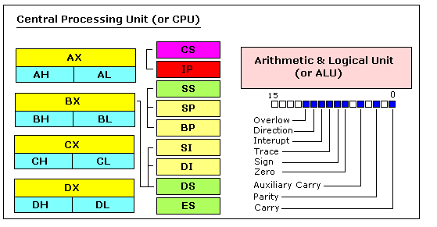
8086: 16 bit CPU
(precursor to x86 family)
https://jerry153fish.github.io/2016/01/01/8086-Registers.html

Slide 4
8086 Registers
16 bit ought to be enough ! (?)
General purpose registers
  four 16-bit data registers: AX, BX, CX, DX
  each in two 8-bit halves, e.g. AH and AL
Registers for memory addressing
  SP, BP, SI, DI : 16 bit
  SP stack pointer, BP base pointer, SI Source Index, DI Destination Index
  IP instruction Pointer
  Addressible memory: 2^16 = 64 kb

Slide 5
8086 address extension
8086 has 20-bit physical addresses ==> 1 MB AS
the extra four bits usually come from a 16-bit "segment register":
  CS - code segment, for fetches via IP
  SS - stack segment, for load/store via SP and BP
  DS - data segment, for load/store via other registers
  ES - another data segment, destination for string operations
%cs:%ip full address: %cs * 16 + %ipis actual address that goes on bus. virtual to physical translation is
  pa = va + seg*16
e.g. set CS = 4096 to execute starting at 65536

Slide 6
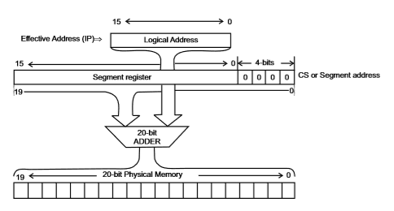
8086 address extension
Extending ‘address space’ with the help of MMU

Slide 7
FLAGS register
FLAGS - various condition codes: whether last arithmetic operation
  overflowed
  was positive/negative
  was [not] zero
  carry/borrow on add/subtract
  etc.
whether interrupts are enabled
direction of data copy instructions
Uses in JP, JN, J[N]Z, J[N]C, J[N]O ...

Slide 8
32 bit 80386
boots in 16-bit mode, then on running particular instructions switches to 32-bit mode (protected mode)
  For backward compatibility, INTEL continued this. The CPU starts in 16 bit mode, called real mode
  If particular instructions are not executed (may be in boot loader) all processors will continue in real mode
registers are 32 bits wide, called EAX rather than AX
  EAX EBX ECX EDX
  ESP EBP ESI EDI
operands and addresses 32-bit in 32-bit mode,
  e.g. ADD does 32-bit arithmetic
Segment registers are 16 bit: CS, SS, DS, etc.

Slide 9
32 bit 80386
Still possible to access 16 bit registers using AX or BX
  Specifix coding of machine instructions to tell whether operands are 16 or 32 bit
  prefixes 0x66/0x67 toggle between 16-bit and 32-bit operands/addresses respectively
  in 32-bit mode, MOVW is expressed as 0x66 MOVW
  the .code32 in bootasm.S tells assembler to generate 0x66 for e.g. MOVW
80386 also changed segments and added paged memory...

Slide 10
Summary of registers in 80386 (32 bit)
General registers
  32 bits : EAX EBX ECX EDX
  16 bits : AX BX CX DX
  8 bits : AH AL BH BL CH CL DH DL

Slide 11
Summary of registers in 80386
Expected usage of Segment Registers
  CS: Holds the Code segment in which your program runs.
  DS : Holds the Data segment that your program accesses.
  ES,FS,GS : These are extra segment registers
  SS : Holds the Stack segment your program uses.
All 16 bit

Slide 12
Summary of registers in 80386
For a typical register, the corresponding segment is used. Pairs of Indexes & pointers (Segment & Registers)
  CS:EIP
    Code Segment: Index Pointer
    E.g. mov $32, %eax ==> The code of move instruction uses CS: EIP
  SS:ESP
    Stack Segment: ESP
    E.g. push $32 ==> The $32 will be pushed on stack. Using SS: ESP address
  SS:EBP
    Stack Segment: EBP ==> mov (%ebp), %eax ==> for accessing (%ebp) SS: EBP address will be used
  DS:ESI , ES: EDI .
    ESI: Extended Source Index, EDI: Extended Destination Index
The EFLAGS register for flags

Slide 13
X86 Assembly Code
Syntax
  Intel syntax: op dst, src (Intel manuals!)
  AT&T (gcc/gas) syntax: op src, dst (xv6)
  uses b, w, l suffix on instructions to specify size of operands
Operands are registers, constant, memory via register, memory via constant

Slide 14
Examples of X86 instructions
AT&T syntax | "C"-ish equivalent | Operands
movl %eax, %edx | edx = eax; | register mode
movl $0x123, %edx | edx = 0x123; | immediate
movl 0x123, %edx | edx = *(int32_t*)0x123; | direct
movl (%ebx), %edx | edx = *(int32_t*)ebx; | indirect
movl 4(%ebx), %edx | edx = *(int32_t*)(ebx+4) | displaced

Slide 15
Instructions suffix/prefix
mov %eax, %ebx # 32 bit data
movw %ax, %bx # move 16 bit data
mov %ax, %bx # ax is 16 bit, so equivalent to movw
mov $123, 0x123 # Ambigious
movw $123, 0x123 # correct, move 16 bit data

Slide 16
Types of Instructions
data movement
  MOV, PUSH, POP, ...
Arithmetic
  TEST, SHL, ADD, AND, ...
i/o
  IN, OUT, ...
Control
  JMP, JZ, JNZ, CALL, RET
String
  REP MOVSB, ...
System
  IRET, INT

Slide 17
Interrupt handling

Slide 18
Privilege levels
The x86 has 4 protection levels, numbered 0 (most privilege) to 3 (least privilege).
In practice, most operating systems use only 2 levels: 0 and 3, which are then called kernel mode and user mode, respectively.
The current privilege level with which the x86 executes instructions is stored in CPL field inside %cs register

Slide 19
Privilege levels
Changes automatically on
“int” instruction
hardware interrupt
exeception
Changes back on
iret
“int” 10 --> makes 10th hardware interrupt. S/w interrupt can be used to create hardware interrupt’
Xv6 uses “int 64” for actual system calls

Slide 20
Interrupt Descriptor Table (IDT)
IDT is an in memory table. IDT defines intertupt handlers
Has 256 entries
  each giving the %cs and %eip to be used when handling the corresponding interrupt.
Interrupts 0-31 are defined for software exceptions, like divide errors or attempts to access invalid memory addresses.
  Xv6 maps the 32 hardware interrupts to the range 32-63
  and uses interrupt 64 as the system call interrupt

Slide 21
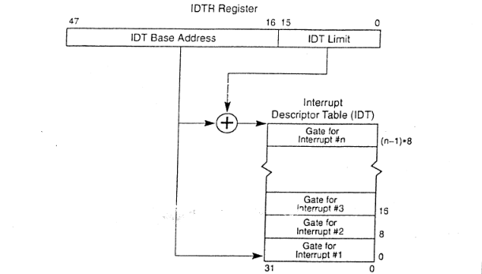
IDTR and IDT
An entry in IDT is called a “gate”
IDTR is a CPU register, IDT is in memory table

Slide 22
Memory Management
in x86

Slide 23
A word of caution
We are getting introduced to x86 memory management features, before learning the basics of memory management.
So we’ll revisit these concepts later.

Slide 24
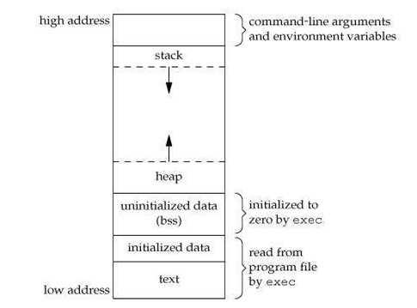
Memory Layout of a C Program
Text: object code of the program
Data: Global variables + (local/global) Static variables
BSS: Uninitialized data, globals that were not initialized
Stack: Region for allocating local variables, function parameters, return values
Heap: Region for use by malloc(), free()
Arguments, Environment variables: Initialized by kernel (during exec)
text, data, bss are also present in the ELF file
stack and heap are not present in ELF file
WHY?

Slide 25
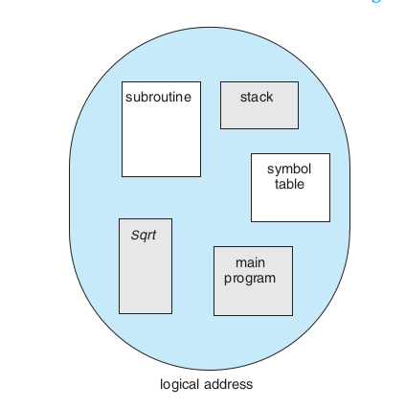
Why the Segment:Offset Pairs In x86 ?
Segmentation
Compiler’s view of the program
Compiler generates object code assuming that different memory regions corresponding to the program are different “segments” in memory
Segment: a continuous chunk
Segment register gives the location of the chunk, index/offset register gives the offset
E.g. in CS:IP CS gives the location of the segment, IP gives the index in it

Slide 26
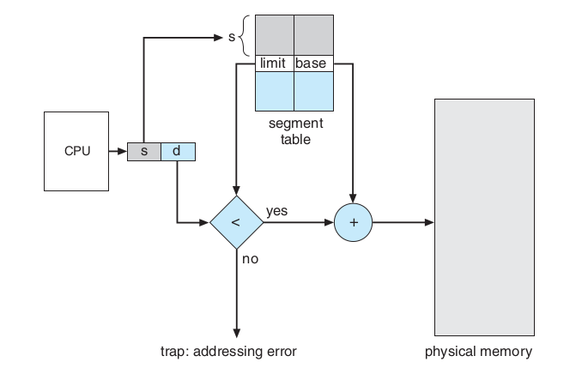
Segmentation
Address Translation, general idea (not x86)

Slide 27
Real mode and protected mode
Beware: note the same as user mode and kernel mode!
Backward compatibility was desired by Intel
  80286 was 32 bit, 8086 was 16 bit
  Binary encoding for 80286 was different, registers were 32 bit, etc; also more speed, different memory management hardware, etc.
  But still they wanted their customers to keep running earlier object code on new processor
  So they ensured that the processor boots up as if it was 16 bit 8086/8088. REAL MODE!
  On running particular machine instruction sequence, the CPU will change to 32 bit . PROTECTED MODE!

Slide 28
More on real mode
addresses in real mode always correspond to real locations in memory.
  Memory address calculation done by MMU in real mode: segment*16+offset
no support for memory protection, multitasking, or code privilege levels (user/kernel mode!)
May use the BIOS routines or OS routines
DOS like OS were written when PCs were in the era of 8088/real-mode.
  Single tasking systems

Slide 29
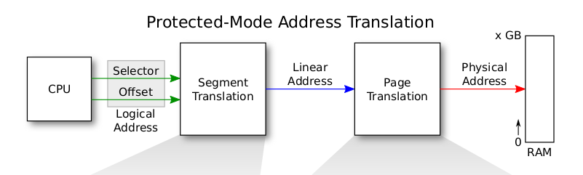
X86 address : protected mode address translation
Memory Managemnt Unit (MMU)
Processor Chip

Slide 30
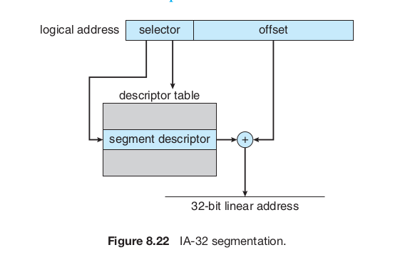
X86 segmentation

Slide 31
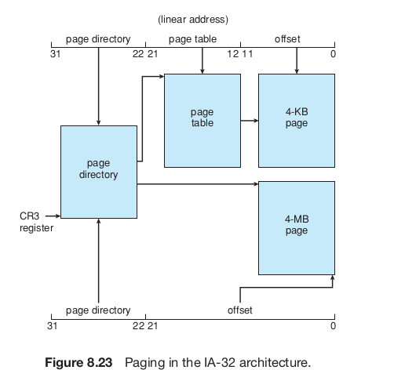
X86 paging

Slide 32
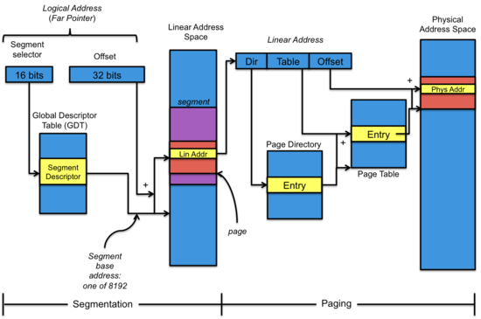
Segmentation + Paging

Slide 33
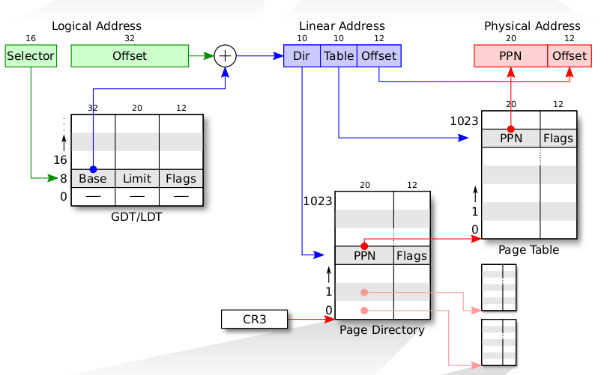
Segmentation + Paging
Selector value is implicit based on address being accessed.
Instruction: CS
Stack Variable: SS
Data: DS
etc.

Slide 34
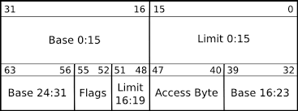
GDT Entry
This is an in Memory entry. The diagram shows the format.

Slide 35
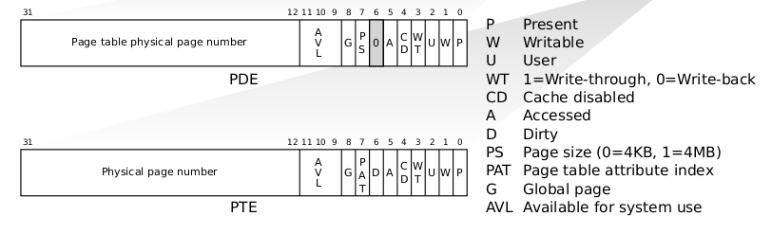
Page Directory Entry (PDE)
Page Table Entry (PTE)
These are in memory entries. The diagrams show the format of each entry.

Slide 36

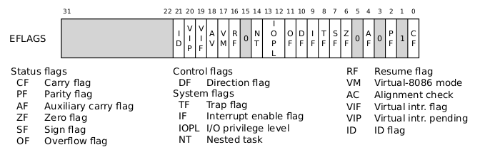
Segment selector
EFLAGS register

Slide 37
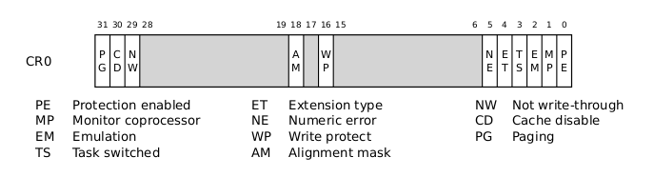
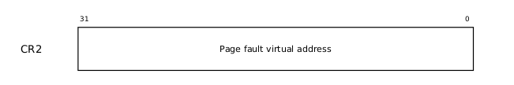
CR0
CR2
PG: Paging enabled or not WP: Write protecion on/off
PE: Protection Enabled --> protected mode.

Slide 38
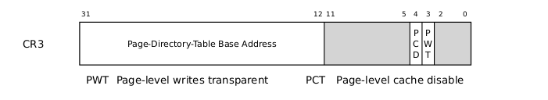
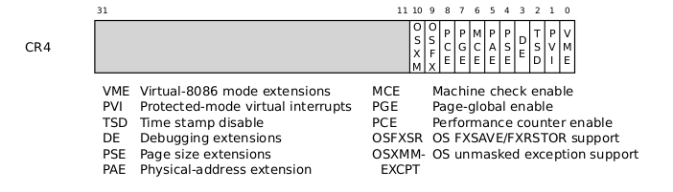
CR3
CR4

Slide 39
XV6 bootloader
Abhijit A. M.
abhijit.comp@coep.ac.in
Credits:
xv6 book by Cox, Kaashoek, Morris
Notes by Prof. Sorav Bansal

Slide 40
A word of caution
We begin reading xv6 code
But it’s not possible to read this code in a “linear fashion”
  The dependency between knowing OS concepts and reading/writing a kernel that is written using all concepts

Slide 41
What we have seen ....
Compilation process, calling conventions
Basics of Memory Management by OS
Basics of x86 architecture
  Registers, segments, memory management unit, addressing, some basic machine instructions,
ELF files
  Objdump, program headers
  Symbol tables

Slide 42
Boot-process
Bootloader itself
  Is loaded by the BIOS at a fixed location in memory and BIOS makes it run
  Our job, as OS programmers, is to write the bootloader code
Bootloader does
  Pick up code of OS from a ‘known’ location and loads it in memory
  Makes the OS run
Xv6 bootloader: bootasm.S bootmain.c (see Makefile)

Slide 43
bootloader
BIOS Runs (automatically)
Loads boot sector into RAM at 0x7c00
Starts executing that code
  Make sure that your bootloader is loaded at 0x7c00
  Makefile has
bootblock: bootblock.S bootmain.c
$(CC) $(CFLAGS) -fno-pic -nostdinc -I. -c bootasm.S .....
...
$(LD) $(LDFLAGS) -N -e start -Ttext 0x7C00 -o bootblock.o bootasm.o bootmain.o
Resuls in:
00007c00 <start>: in bootblock.asm

Slide 44
Processor starts in real mode
Processor starts in real mode – works like 16 bit 8088
eight 16-bit general-purpose registers,
Segment registers %cs, %ds, %es, and %ss --> additional bits necessary to generate 20-bit memory addresses from 16-bit registers.
addr = seg << 4 + addr

Slide 45
Virtual ddress = offset
Address
Effective memory translation in the beginning
At _start in bootasm.S:
%cs=0 %ip=7c00.
So effective address = 0*16+ip = ip

Slide 46
bootloader
First instruction is ‘cli’
  disable interrupts
So that until your code loads all hardware interrupt handlers, no interrupt will occur

Slide 47
Zeroing registers
# Zero data segment registers DS, ES, and SS.
xorw %ax,%ax # Set %ax to zero
movw %ax,%ds # -> Data Segment
movw %ax,%es # -> Extra Segment
movw %ax,%ss # -> Stack Segment
zero ax and ds, es, ss
BIOS did not put in anything perhaps

Slide 48
A not so necessary detail
Enable 21 bit address
Seg:off with 16 bit segments can actually address more than 20 bits of memory. After 0x100000 (=2^20), 8086 wrapped addresses to 0.
80286 introduced 21st bit of address. But older software required 20 bits only. BIOS disabled 21st bit. Some OS needed 21st Bit. So enable it.
Write to Port 0x64 and 0x60 -> keyboard controller
  to enable 21st bit out of address translation
  Why? Before the A20, i.e. 21st bit was introduced, it belonged to keyboard controller
  For more details see https://en.wikipedia.org/wiki/A20_line https://en.wikipedia.org/wiki/A20_line
seta20.1:
inb $0x64,%al # Wait for not busy
testb $0x2,%al
jnz seta20.1
movb $0xd1,%al # 0xd1 -> port 0x64
outb %al,$0x64
seta20.2:
inb $0x64,%al # Wait for not busy
testb $0x2,%al
jnz seta20.2
movb $0xdf,%al # 0xdf -> port 0x60
outb %al,$0x60

Slide 49
After this
Some instructions are run
to enter protected mode
And further code runs in protected mode

Slide 50
Real mode Vs protected mode
Real mode 16 bit registers
Protected mode
  Enables segmentation + Paging both
    No longer seg*16+offset calculations
    Segment registers is index into segment descriptor table. But segment:offset pairs continue
      mov %esp, $32 # SS will be used with esp
    More in next few slides
    Other segment registers need to be explicitely mentioned in instructions
      Mov FS:$200, 30
  32 bit registers
    can address upto 2³² memory
    Can do arithmetic in 32 bits

Slide 51
X86 address : protected mode address translation
Both Segmentation and Paging are used in x86
X86 allows optionally one-level or two-level paging
Segmentation is a must to setup, paging is optional (needs to be enabled)
Hence different OS can use segmentation+paging in different ways

Slide 52
X86 segmentation

Slide 53
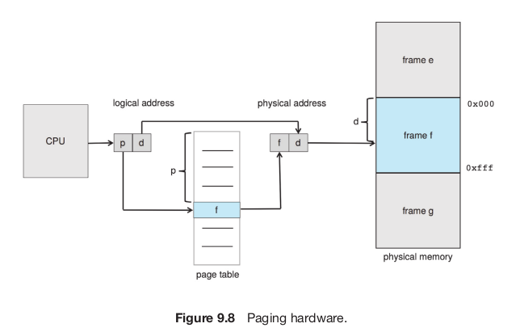
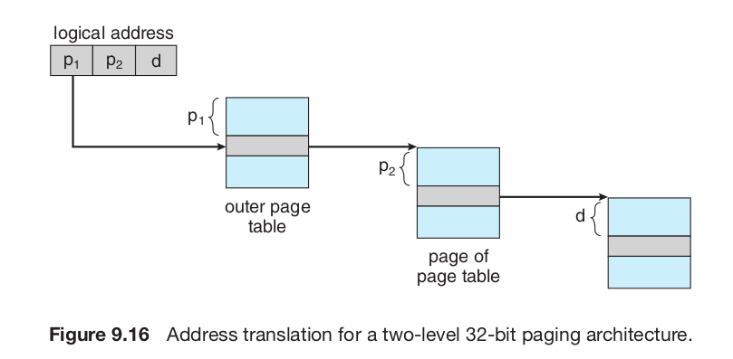
Paging concept, hierarchical paging
Paging scheme
PTBR

Slide 54
X86 paging

Slide 55
Page Directory Entry (PDE)
Page Table Entry (PTE)

Slide 56
CR3
CR4

Slide 57
Segmentation + Paging
Selector value is implicit based on address being accessed.
Instruction: CS
Stack Variable: SS
Data: DS
etc.

Slide 58
Segmentation + Paging setup of xv6
xv6 configures the segmentation hardware by setting Base = 0, Limit = 4 GB
  translate logical to linear addresses without change, so that they are always equal.
  Segmentation is pratically off
Once paging is enabled, the only interesting address mapping in the system will be linear to physical.
  In xv6 paging is NOT enabled while loading kernel
  After kernel is loaded 4 MB pages are used for a while
  Later the kernel switches to 4 kB pages!

Slide 59
GDT Entry
asm.h
#define SEG_ASM(type,base,lim) \
.word (((lim) >> 12) & 0xffff), ((base) & 0xffff); \
.byte (((base) >> 16) & 0xff), (0x90 | (type)), \
(0xC0 | (((lim) >> 28) & 0xf)), (((base) >> 24) & 0xff)

Slide 60
Segment selector
EFLAGS register
Note in 16 bit mode, segment selector is 16 bit, here it’s 13 bit + 3 bits

Slide 61
lgdt
lgdt gdtdesc
...
# Bootstrap GDT
.p2align 2 # force 4 byte alignment
gdt:
SEG_NULLASM # null seg
SEG_ASM(STA_X|STA_R, 0x0, 0xffffffff) # code seg
SEG_ASM(STA_W, 0x0, 0xffffffff)
# data seg
gdtdesc:
.word (gdtdesc - gdt - 1)
# sizeof(gdt) - 1
.long gdt
load the processor’s (GDT) register with the value gdtdesc which points to the table gdt.
table gdt : The table has a null entry, one entry for executable code, and one entry to data.
all segments have a base address of zero and the maximum possible limit
The code segment descriptor has a flag set that indicates that the code should run in 32-bit mode
With this setup, when the boot loader enters protected mode, logical addresses map one-to-one to physical addresses.
At gdtdesc we have this data
2, <4 byte addr of gdt>
Total 6 bytes
  GDTR is : <address 4 byte>, <table limit 2 byte>
  So lgdt gdtdesc loads these two values in GDTR

Slide 62
bootasm.S after “lgdt gdtdesc”
till jump to “entry”
Still
Logical Address = Physical address!
But with GDT in picture and
Protected Mode operation
During this time,
Loading kernel from ELF into physical memory
Addresses in “kernel” file translate to same physical address!
Logical Address = offset
Physical
Address
Base | Limit | Permissions
0 | 4GB | Write
0 | 4GB | Read, Execute
0 | 0 | 0
GDT

Slide 63
Prepare to enable protected mode
Prepare to enable protected mode by setting the 1 bit (CR0_PE) in register %cr0
movl %cr0, %eax
orl $CR0_PE, %eax
movl %eax, %cr0

Slide 64
CR0
PG: Paging enabled or not WP: Write protecion on/off
PE: Protection Enabled --> protected mode.

Slide 65
Complete transition to 32 bit mode
ljmp $(SEG_KCODE<<3), $start32
Complete the transition to 32-bit protected mode by using a long jmp
to reload %cs (=1) and %eip (=start32).
Note that ‘start32’ is the address of next instruction after ljmp.
Note: The segment descriptors are set up with no translation (that is 0-4GB setting), so that the mapping is still the identity mapping.

Slide 66
Jumping to “C” code
movw $(SEG_KDATA<<3), %ax # Our data segment selector
movw %ax, %ds # -> DS: Data Segment
movw %ax, %es # -> ES: Extra Segment
movw %ax, %ss # -> SS: Stack Segment
movw $0, %ax # Zero segments not ready for use
movw %ax, %fs # -> FS
movw %ax, %gs # -> GS
# Set up the stack pointer and call into C.
movl $start, %esp
call bootmain
Setup Data, extra, stack segment with SEG_KDATA (=2), FS & GS (=0)
Copy “$start” i.e. 7c00 to stack-ptr
  It will grow from 7c00 to 0000
Call bootmain() a C function
  In bootmain.c

Slide 67
Setup now
Logical Address = offset
Physical
Address
CS, SS, etc.
Selector
Base | Limit | Permissions
0 | 4GB | Write
0 | 4GB | Read, Execute
0 | 0 | 0
3
2
1
0
DS
SS
CS
GDT

Slide 68
bootmain(): already in memory, as part of ‘bootblock’
bootmain.c , expects to find a copy of the kernel executable on the disk starting at the second sector (sector = 1).
  Why?
The kernel is an ELF format binary
Bootmain loads the first 4096 bytes of the ELF binary. It places the in-memory copy at address 0x10000
readseg() is a function that runs OUT instructions in particular IO ports, to issue commands to read from Disk
void
bootmain(void)
{
struct elfhdr *elf;
struct proghdr *ph, *eph;
void (*entry)(void);
uchar* pa;
elf = (struct elfhdr*)0x10000; // scratch space
// Read 1st page off disk
readseg((uchar*)elf, 4096, 0);

Slide 69
Drivers and Controllers
Syscall interface ...
File system layer
scheduler
Mem mgmt
...
kernel
Keyboard
driver
mouse
driver
SATA disk
driver
...
keyboard
mouse
SATA disk
...
Keyboard
Controller
mouse
Controller
SATA disk
Controller
...
Keyboard
hardware
mouse
hardware
SATA disk
hardware
...

Slide 70
bootmain()
Check if it’s really ELF or not
Next load kernel code from ELF file “kernel” into memory
// Is this an ELF executable?
if(elf->magic != ELF_MAGIC)
return; // let bootasm.S handle error

Slide 71
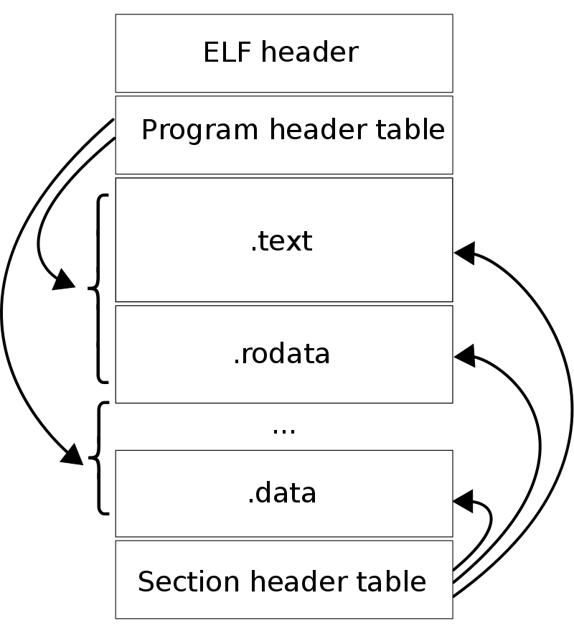
ELF
struct elfhdr {
uint magic; // must equal ELF_MAGIC
uchar elf[12];
ushort type;
ushort machine;
uint version;
uint entry;
uint phoff; // where is program header table
uint shoff;
uint flags;
ushort ehsize;
ushort phentsize;
ushort phnum; // no. Of program header entries
ushort shentsize;
ushort shnum;
ushort shstrndx;
};

Slide 72
ELF
// Program header
struct proghdr {
uint type; // Loadable segment , Dynamic linking information , Interpreter information , Thread-Local Storage template , etc.
uint off; //Offset of the segment in the file image.
uint vaddr; //Virtual address of the segment in memory.
uint paddr; // physical address to load this program, if PA is relevant
uint filesz; //Size in bytes of the segment in the file image.
uint memsz; //Size in bytes of the segment in memory. May be 0.
uint flags;
uint align;
};

Slide 73
Run ‘objdump -x -a kernel | head -15’ & see this
kernel: file format elf32-i386
kernel
architecture: i386, flags 0x00000112:
EXEC_P, HAS_SYMS, D_PAGED
start address 0x0010000c
Program Header:
LOAD off 0x00001000 vaddr 0x80100000 paddr 0x00100000 align 2**12
filesz 0x0000a516 memsz 0x000154a8 flags rwx
STACK off 0x00000000 vaddr 0x00000000 paddr 0x00000000 align 2**4
filesz 0x00000000 memsz 0x00000000 flags rwx
Diff between memsz & filesz, will be filled with zeroes in memory
Code to be loaded at KERNBASE + KERNLINK
Stack : everything zeroes

Slide 74
Load code from ELF to memory
// Load each program segment (ignores ph flags).
ph = (struct proghdr*)((uchar*)elf + elf->phoff);
eph = ph + elf->phnum;
// Abhijit: number of program headers
for(; ph < eph; ph++){
// Abhijit: iterate over each program header
pa = (uchar*)ph->paddr;
// Abhijit: the physical address to load program
/* Abhijit: read ph->filesz bytes, into 'pa',
from ph->off in kernel/disk */
readseg(pa, ph->filesz, ph->off);
if(ph->memsz > ph->filesz)
stosb(pa + ph->filesz, 0, ph->memsz - ph->filesz); // Zero the reminder section*/
}

Slide 75
Jump to Entry
// Call the entry point from the ELF header.
// Does not return!
/* Abhijit:
* elf->entry was set by Linker using kernel.ld
* This is address 0x80100000 specified in kernel.ld
* See kernel.asm for kernel assembly code).
*/
entry = (void(*)(void))(elf->entry);
entry();

Slide 76
Before code of entry(), Reminder:
PDE looks like this

Slide 77
To understand further code
Remember: 4 MB pages are possible

Slide 78
From entry:
Till: inside main(), before kvmalloc()
RAM
Logical Address = offset
Linear Address
4MB
0
CS, SS, etc.
Selector
Base | Limit | Permissions
0 | 4GB | Write
0 | 4GB | Read, Execute
0 | 0 | 0
3
2
1
0
512 | 0 | P,W,PS
.
.
.
3
2
1
0 | 0 | P,W,PS
DS
SS
GDT
CS
CR3
entrypgdir

Slide 79
From entry:
Till: inside main(), before kvmalloc()
RAM
Physical Addr
Logical Address = offset
Dir
Offset
4MB
0
CS, SS, etc.
Selector
Base | Limit | Permissions
0 | 4GB | Write
0 | 4GB | Read, Execute
0 | 0 | 0
3
2
1
0
512 | 0 | P,W,PS
.
.
.
3
2
1
0 | 0 | P,W,PS
DS
SS
GDT
Even now, every Logical address = Physical address, but through Page dir
CS
CR3
entrypgdir

Slide 80
entrypgdir in main.c, is used by entry()
__attribute__((__aligned__(PGSIZE)))
pde_t entrypgdir[NPDENTRIES] = {
// Map VA's [0, 4MB) to PA's [0, 4MB)
[0] = (0) | PTE_P | PTE_W | PTE_PS,
// Map VA's [KERNBASE, KERNBASE+4MB) to PA's [0, 4MB). This is entry 512
[KERNBASE>>PDXSHIFT] = (0) | PTE_P | PTE_W | PTE_PS,
};
This is entry page directory during entry(), beginning of kernel
Mapping 0:0x400000 (i.e. 0: 4MB) to physical addresses 0:0x400000. is required as long as entry is executing at low addresses, but will eventually be removed.
This mapping restricts the kernel instructions and data to 4 Mbytes.
#define PTE_P 0x001 // Present
#define PTE_W 0x002 // Writeable
#define PTE_U 0x004 // User
#define PTE_PS 0x080 // Page Size
#define PDXSHIFT 22 // offset of PDX in a linear address

Slide 81
entry() in entry.S
entry:
movl %cr4, %eax
orl $(CR4_PSE), %eax
movl %eax, %cr4
movl $(V2P_WO(entrypgdir)), %eax
movl %eax, %cr3
movl %cr0, %eax
orl $(CR0_PG|CR0_WP), %eax
movl %eax, %cr0
movl $(stack + KSTACKSIZE), %esp
mov $main, %eax
jmp *%eax
# Turn on page size extension for 4Mbyte pages
# Set page directory. 4 MB pages (temporarily only. More later)
# Turn on paging.
# Set up the stack pointer.
# Jump to main(), and switch to executing at high addresses. The indirect call is needed because the assembler produces a PC-relative instruction for a direct jump.

Slide 82
More about entry()
movl $(V2P_WO(entrypgdir)), %eax
movl %eax, %cr3
-> Here we use physical address using V2P_WO because paging is not turned on yet
V2P is simple: substract 0x80000000 i.e. KERNBASE from address

Slide 83
More about entry()
movl %cr0, %eax
orl $(CR0_PG|CR0_WP), %eax
movl %eax, %cr0
This turns on paging
After this also, entry() is running and processor is executing code at lower addresses
But we have already set 0’th entry in pgdir to address 0
So it still works!

Slide 84
entry()
movl $(stack + KSTACKSIZE), %esp
mov $main, %eax
jmp *%eax
.comm stack, KSTACKSIZE
# Abhijit: allocate here 'stack' of size = KSTACKSIZE
# Set up the stack pointer.
# Abhijit: +KSTACKSIZE is done as stack grows downwards
# Jump to main(), and switch to executing at high addresses. The indirect call is needed because the assembler produces a PC-relative instruction for a direct jump.

Slide 85
bootmasm.S bootmain.c: Steps
Starts in “real” mode, 16 bit mode. Does some misc legacy work.
Runs instructions to do MMU set-up for protected-mode & only segmentation (0-4GB, identity mapping), changes to protected mode.
Reads kernel ELF file and loads it in RAM, as per instructions in ELF file
Sets up paging (4 MB pages)
Runs main() of kernel

Slide 86
Code from bootasm.S bootmain.c is over!
Kernel is loaded.
Now kernel is going to prepare itself

Slide 87
Processes in xv6 code

Slide 88
Process Table
struct {
struct spinlock lock;
struct proc proc[NPROC];
} ptable;
One single global array of processes
Protected by
ptable.lock

Slide 89
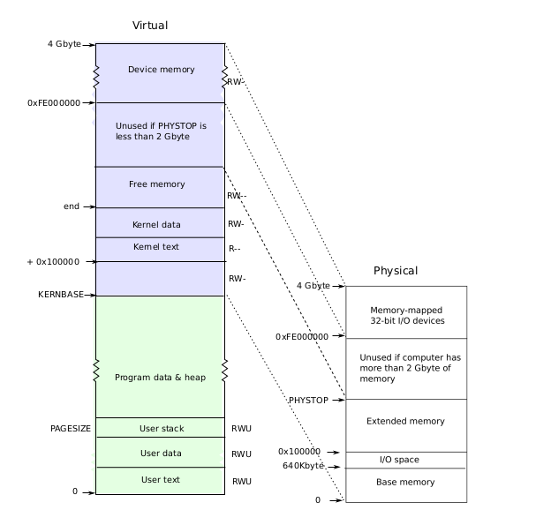
Layout of process’s VA space xv6 schema! different from Linux

Slide 90
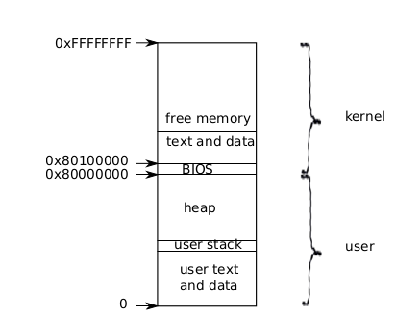
Logical layout of memory for a process
Address 0: code
Then globals
Then stack
Then heap
Each processe’s address space maps kernel’s text, data also --> so that system calls run with these mappings
Kernel code can directly access user memory now

Slide 91
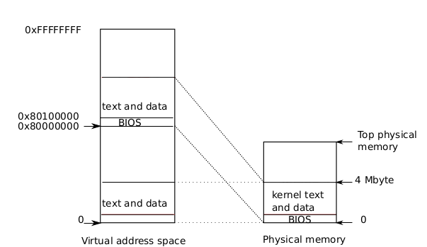
Kernel mappings in user address space actual location of kernel
Kernel is loaded at 0x100000 physical address
PA 0 to 0x100000 is BIOS and devices
Process’s page table will map
VA 0x80000000 to PA 0x00000 and
VA 0x8010000 to 0x100000

Slide 92
Kernel mappings in user address space actual location of kernel
Kernel is not loaded at the PA 0x80000000 because some systems may not have that much memory
0x80000000 is called KERNBASE in xv6

Slide 93
Imp Concepts
A process has two stacks
  user stack: used when user code is running
  kernel stack: used when kernel is running on behalf of a process
Note: there is a third stack also!
  The kernel stack used by the scheduler itself
  Not a per process stack

Slide 94
Struct proc
// Per-process state
struct proc {
uint sz; // Size of process memory (bytes)
pde_t* pgdir; // Page table
char *kstack; // Bottom of kernel stack for this process
enum procstate state; // Process state. allocated, ready to run, running, wait-
ing for I/O, or exiting.
int pid; // Process ID
struct proc *parent; // Parent process
struct trapframe *tf; // Trap frame for current syscall
struct context *context; // swtch() here to run process. Process’s context
void *chan; // If non-zero, sleeping on chan. More when we discuss sleep, wakeup
int killed; // If non-zero, have been killed
struct file *ofile[NOFILE]; // Open files, used by open(), read(),...
struct inode *cwd; // Current directory, changed with “chdir()”
char name[16]; // Process name (for debugging)
};

Slide 95
struct proc diagram: Very imp!
Trapframe
edi, esi, ebp,ebx,
edx, ecx, eax,
gs, fs, es=4,
ds=4, trapno=?,
err, eip, cs = 3,
EFLAGS = FL_IF
ESP = 4096, ss=4
EIP = 0
Code &data
of
“cat”
trapret()
proc
process
stack
sz = a24f
pgdir
kstack
int state=RUNNABLE
int pid = 22
proc *parent
tf
context
void *chan
int killed=0
file *ofile
inode *cwd
name =”cat”
Page table
eip=forkret()
ebp
ebx
esi
edi
Page table
Towards
Kernel
pages
Page table
In use only when you are in kernel on a “trap” = interrupt/syscall. “tf” always used. trapret,forkret used during fork()
pgdir
Inode
for “/”
sz = ELF-code->memsz (includes data, check “ld -N”
+ 2*4096 (for stack)

Slide 96
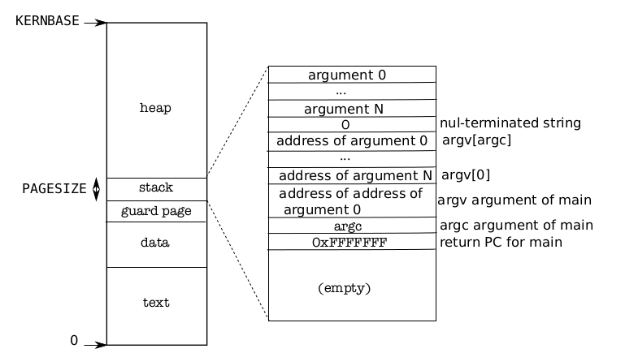
Memory Layout of a user process
Memory Layout of a user process
After exec()
Note the argc, argv on stack
The “guard page” is just a mapping in page table. No frame allocated. It’s marked as invalid. So if stack grows (due to many function calls), then OS will detect it with an exception

Slide 97
Handling Traps

Slide 98
Some basic steps
Xv6.img is created by “make”
  Contains bootsector, kernel code, kernel data
QEMU boots using xv6.img
  First it runs bootloader
  Bootloader loads kernel of xv6 (from xv6.img)
  Kernel starts running
  Kernel running..
    Kernel calls main() of kernel (NOT a C application!) & Initializes:
      memory management data structures
      process data structures
      file handling data structures
      Multi-processors
      Multi-processor data structures
      Interrupt Descriptor Table
      ...
    Then creates init() ...
    Init() fork-execs shell

Slide 99
kmap[] mappings done in kvmalloc(). This shows segmentwise, entries are done in page directory and page table for corresponding VA-> PA mappings
4B
DEVSPACE=3.96GB
KERNBASE+PHYSTOP=2.224GB= 2272MB
data= 2049.3125 MB
KERNBASE+EXTMEM=2049 MB
KERNBASE=2048MB
0
Un
mapped
4GB
DEVSPACE=3.96GB
PHYSTOP = 224MB
1.03125 MB = 1MB + data
EXTMEM=1MB
0
Unused
Kernel
data
+ memory
Kernel
data
+ memory
Kernel
code +
RO Data
I/O Space
Kernel
code +
RO Data
Process
address
space
I/O Space
Physical Memory
0x80108000 =data = 2049.3125 MB
Is obtained from kernel.sym
Logical Address space

Slide 100
Segmentation + Paging
Selector value is implicit based on address being accessed.
Instruction: CS
Stack Variable: SS
Data: DS
etc.

Slide 101
After seginit() in main().
On the processor where we started booting
RAM
Physical Addr
Logical Address = offset
Linear Address
Dir
pg
Offset
4MB
0
CS, SS, etc.
Selector
Base | Limit | Permissions | DPL
0 | 4GB | Write | 3
0 | 4GB | Read, Execute | 3
0 | 4GB | Write | 0
0 | 4GB | Read, Execute | 0
0 | 0 | 0
4
3
2
1
0
DS
SS
Page Table
GDT
CS
Now Linear Address = Logical Address != Physical Address
CR3
kpgdir

Slide 102
Handling traps
Transition from user mode to kernel mode
  On a system call
  On a hardware interrupt
  User program doing illegal work (exception)
Actions needed, particularly w.r.t. to hardware interrupts
  Change to kernel mode & switch to kernel stack
  Kernel to work with devices, if needed
  Kernel to understand interface of device

Slide 103
Handling traps
Actions needed on a trap
  Save the processor’s registers (context) for future use
  Set up the system to run kernel code (kernel context) on kernel stack
  Start kernel in appropriate place (sys call, intr handler, etc)
  Kernel to get all info related to event (which block I/O done?, which sys call called, which process did exception and what type, get arguments to system call, etc)

Slide 104
Privilege level
The x86 has 4 protection levels, numbered 0 (most privilege) to 3 (least privilege).
In practice, most operating systems use only 2 levels: 0 and 3, which are then called kernel mode and user mode, respectively.
The current privilege level with which the x86 executes instructions is stored in %cs register, in the field CPL.

Slide 105
Privilege level
Changes automatically on
“int” instruction
hardware interrupt
exeception
Changes back on
iret
“int” 10 --> makes 10th hardware interrupt. S/w interrupt can be used to create hardware interrupt’
Xv6 uses “int 64” for actual system calls

Slide 106
Interrupt Descriptor Table (IDT)
IDT defines intertupt handlers
Has 256 entries
  each giving the %cs and %eip to be used when handling the corresponding interrupt.
Mapping
  Interrupts 0-31 are defined for software exceptions, like divide errors or attempts to access invalid memory addresses.
  Xv6 maps the 32 hardware interrupts to the range 32-63
  and uses interrupt 64 as the system call interrupt

Slide 107
IDT setup
done by tvinit() function
vectors
vector0
vector1
Vector2
..
vector255
push 0
push 0
jmp alltraps
push 0
push 1
jmp alltraps
...
push 0
push 255
jmp alltraps
The array of “vectors”
And the code of “push, ..jmp”
Is part of kernel image (xv6.img)
The tvinit() is called during kernel initialization
idt
cs:ip = vector0
cs:ip = vector1
..
cs:ip = vector255
This is the IDT table
Each entry is 8 bytes (with more fields than shown here)
as mentioned on next slides
Other kernel data
& code
RAM

Slide 108
IDTR and IDT
IDT is in RAM
IDTR is in CPU

Slide 109
Interrupt Descriptor Table (IDT) entries (in RAM)
// Gate descriptors for interrupts and traps
struct gatedesc {
uint off_15_0 : 16;// low 16 bits of offset in segment
uint cs : 16; // code segment selector
uint args : 5; // # args, 0 for interrupt/trap gates
uint rsv1 : 3; // reserved(should be zero I guess)
uint type : 4; // type(STS_{IG32,TG32})
uint s : 1; // must be 0 (system)
uint dpl : 2; //descriptor(new) privilege level
uint p : 1; // Present
uint off_31_16 : 16;// high bits of offset in segment
};

Slide 110
Setting IDT entries
void
tvinit(void)
{
int i;
for(i = 0; i < 256; i++)
SETGATE(idt[i], 0, SEG_KCODE<<3, vectors[i], 0);
SETGATE(idt[T_SYSCALL], 1, SEG_KCODE<<3,
vectors[T_SYSCALL], DPL_USER);
/* value 1 in second argument --> don't disable interrupts
* DPL_USER means that processes can raise this interrupt. */
initlock(&tickslock, "time");
}

Slide 111
Setting IDT entries
#define SETGATE(gate, istrap, sel, off, d) \
{ \
(gate).off_15_0 = (uint)(off) & 0xffff; \
(gate).cs = (sel); \
(gate).args = 0; \
(gate).rsv1 = 0; \
(gate).type = (istrap) ? STS_TG32 : STS_IG32; \
(gate).s = 0; \
(gate).dpl = (d); \
(gate).p = 1; \
(gate).off_31_16 = (uint)(off) >> 16; \
}

Slide 112
Setting IDT entries
Vectors.S
# generated by vectors.pl - do not edit
# handlers
.globl alltraps
.globl vector0
vector0:
pushl $0
pushl $0
jmp alltraps
.globl vector1
vector1:
pushl $0
pushl $1
jmp alltraps
trapasm.S
#include "mmu.h"
# vectors.S sends all traps here.
.globl alltraps
alltraps:
# Build trap frame.
pushl %ds
pushl %es
pushl %fs
pushl %gs
Pushal
....

Slide 113
How will interrupts be handled?

Slide 114
On int instruction/interrupt the CPU does this:
Fetch the n’th descriptor from the IDT, where n is the argument of int. (IDTR->idt[n])
Check that CPL in %cs is <= DPL, where DPL is the privilege level in the descriptor.
  Temporarily save %esp and %ss in CPU-internal registers, but only if the target segment selector’s PL < CPL.
    Switching from user mode to kernel mode. Hence save user code’s SS and ESP
Load %ss and %esp from a task segment descriptor.
  Stack changes to kernel stack now. TS descriptor is on GDT, index given by TR register. See switchuvm()
Push %ss. // optional
Push %esp. // optional (also changes ss,esp using TSS)
Push %eflags.
Push %cs.
Push %eip.
Clear the IF bit in %eflags, but only on an interrupt.
Set %cs and %eip to the values in the descriptor.

Slide 115
After “int” ‘s job is done
IDT was already set
  Remember vectors.S
So jump to 64th entry in vector’s
vector64:
pushl $0
pushl $64
jmp alltraps
  So now stack has ss, esp,eflags, cs, eip, 0 (for error code), 64
  Next run alltraps from trapasm.S

Slide 116
alltraps:
# Build trap frame.
pushl %ds
pushl %es
pushl %fs
pushl %gs
pushal // push all gen purpose regs
# Set up data segments.
movw $(SEG_KDATA<<3), %ax
movw %ax, %ds
movw %ax, %es
# Call trap(tf), where tf=%esp
pushl %esp # first arg to trap()
call trap
addl $4, %esp
Now stack contains
ss, esp,eflags, cs, eip, 0 (for error code), 64, ds, es, fs, gs, eax, ecx, edx, ebx, oesp, ebp, esi, edi
  This is the struct trapframe !
  So the kernel stack now contains the trapframe
  Trapframe is a part of kernel stcak

Slide 117
trap()
void
trap(struct trapframe *tf)
{
if(tf->trapno == T_SYSCALL){
if(myproc()->killed)
exit();
myproc()->tf = tf;
syscall();
if(myproc()->killed)
exit();
return;
}
switch(tf->trapno){
.....
Argument is trapframe
In alltraps
  Before “call trap”, there was “push %esp” and stack had the trapframe
  Remember calling convention --> when a function is called, the stack contains the arguments in reverse order (here only 1 arg)

Slide 118
trap()
Has a switch
  switch(tf->trapno)
  Q: who set this trapno?
Depending on the type of trap
  Call interrupt handler
Timer
  wakeup(&ticks)
IDE: disk interrupt
  Ideintr()
KBD
  Kbdintr()
COM1
  Uatrintr()
If Timer
  Call yield() -- calls sched()
If process was killed (how is that done?
  Call exit()!

Slide 119
when trap() returns
Stack had (trapframe)
  ss, esp,eflags, cs, eip, 0 (for error code), 64, ds, es, fs, gs, eax, ecx, edx, ebx, oesp, ebp, esi, edi, esp
add $4 %esp
  esp
popal
  eax, ecx, edx, ebx, oesp, ebp, esi, edi
Then gs, fs, es, ds
add $0x8, %esp
  0 (for error code), 64
iret
  ss, esp,eflags, cs, eip,
#Back in alltraps
call trap
addl $4, %esp
# Return falls through to trapret...
.globl trapret
trapret:
popal
popl %gs
popl %fs
popl %es
popl %ds
addl $0x8, %esp # trapno and errcode
iret

Slide 120
Scheduler

Slide 121
Scheduler – in most simple terms
Selects a process to execute and passes control to it !
  The process is chosen out of “READY” state processes
  Saving of context of “earlier” process and loading of context of “next” process needs to happen
Questions
  What are the different scenarios in which a scheduler called ?
  What are the intricacies of “passing control”
  What is “context” ?

Slide 122
Steps in scheduling scheduling
Suppose you want to switch from P1 to P2 on a timer interrupt
P1 was doing
F() { i++; j++;}
P2 was doing
G() { x--; y++; }
P1 will experience a timer interrupt, switch to kernel (scheduler) and scheduler will schedule P2

Slide 123
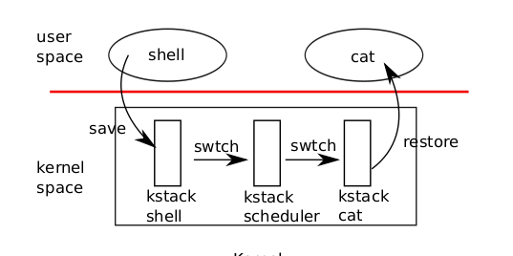
4 stacks need to change!
User stack of process ->
kernel stack of process
  Switch to kernel stack
  The normal sequence on any interrupt !
Kernel stack of process ->
kernel stack of scheduler
  Why?
Kernel stack of scheduler ->
kernel stack of new process . Why?
Kernel stack of new process ->
user stack of new process

Slide 124
scheduler()
Enable interrupts
Find a RUNNABLE process. Simple round-robin!
c->proc = p
switchuvm(p) : Save TSS and make CR3 to point to new process pagedir
p->state = RUNNING
swtch(&(c->scheduler), p->context)

Slide 125
swtch
swtch:
movl 4(%esp), %eax
movl 8(%esp), %edx
# Save old callee-saved registers
pushl %ebp
pushl %ebx
pushl %esi
pushl %edi
# Switch stacks
movl %esp, (%eax)
movl %edx, %esp
# Load new callee-saved registers
popl %edi
popl %esi
popl %ebx
popl %ebp
ret

Slide 126
scheduler()
swtch(&(c->scheduler), p->context)
Note that when scheduler() was called, when P1 was running
After call to swtch() shown above
  The call does NOT return!
  The new process P2 given by ‘p’ starts running !
  Let’s review swtch() again

Slide 127
swtch(old, new)
The magic function in swtch.S
Saves callee-save registers of old context
Switches esp to new-context’s stack
Pop callee-save registers from new context
ret
  where? in the case of first process – returns to forkret() because stack was setup like that !
  in case of other processes, return where?
    Return address given on kernel stack. But what’s that?
    The EIP in p->context
    When was EIP set in p->context ?

Slide 128
scheduler()
Called from?
  mpmain()
  No where else!
sched() is another scheduler function !
  Who calls sched() ?
    exit() - a process exiting calls sched ()
    yield() - a process interrupted by timer calls yield()
    sleep() - a process going to wait calls sleep()

Slide 129
sched()
void
sched(void)
{
int intena;
struct proc *p = myproc();
if(!holding(&ptable.lock))
panic("sched ptable.lock");
if(mycpu()->ncli != 1)
panic("sched locks");
if(p->state == RUNNING)
panic("sched running");
if(readeflags()&FL_IF)
panic("sched interruptible");
intena = mycpu()->intena;
swtch(&p->context, mycpu()->scheduler);
/*A*/ mycpu()->intena = intena;
}
get current process
Error checking code (ignore as of now)
get interrupt enabled status on current CPU (ignore as of now)
call to swtch
  Note the arguments’ order
  p->context first, mycpu()->scheduler second
swtch() is a function call
  pushes address of /*A*/ on stack of current process p
  switches stack to mycpu()->scheduler. Then pops EIP from that stack and jumps there.
  when was mycpu()->scheduler set? Ans: during scheduler()!

Slide 130
sched() and schduler()
sched() {
...
swtch(&p->context, mycpu()->scheduler); /* X */
}
scheduler(void) {
...
swtch(&(c->scheduler), p->context); / * Y */
}
scheduler() saves context in c->scheduler, sched() saves context in p->context
after swtch() call in sched(), the control jumps to Y in scheduler
  Switch from process stack to scheduler’s stack
after swtch() call in scheduler(), the control jumps to X in sched()
  Switch from scheduler’s stack to new process’s stack
Set of co-operating functions

Slide 131
sched() and scheduler() as co-routines
In sched()
swtch(&p->context, mycpu()->scheduler);
In scheduler()
swtch(&(c->scheduler), p->context);
These two keep switching between processes
These two functions work together to achieve scheduling
Using asynchronous jumps
Hence they are co-routines

Slide 132
To summarize
On a timer interrupt during P1
  trap() is called. Stack has changed from P1’s user stack to P1’s kernel stack
  trap()->yield()
  yield()->sched()
  sched() -> swtch(&p->context, c->scheduler()
  Stack changes to scheduler’s kernel stack.
  Switches to location “Y” in scheduler().
Now the loop in scheduler()
  calls switchkvm()
  Then continues to find next process (P2) to run
  Then calls switchuvm(p): changing the page table to the P2’s page tables
  then calls swtch(&c->scheduler, p2’s->context)
  Stack changes to P2’s kernel stack.
  P2 runs the last instruction it was was in ! Where was it?
    mycpu()->intena = intena; in sched()
    Then returns to the one who called sched() i.e. exit/sleep, etc
    Finally returns from it’s own “TRAP” handler and returns to P2’s user stack and user code

Slide 133
File Systems
Abhijit A M
abhijit.comp@coep.ac.in

Slide 134
Introduction
Human end user’s view of file sytem on a modern desktop operating system
  Files, directories(folders), hierarchy – acyclic graph like structure
  Windows Vs Linux logical organization: multiple partitions (C:, D:,etc.), vs single logical namespace starting at “/”

Slide 135
Introduction
Secondary and Tertiary memory
  Hard disks, Pen drives, CD-ROMs, DVDs, Magnetic Tapes, Portable disks, etc. Used for storing files
  Each comes with a hardware “controller” that acts as an intermediary in the hardware/software boundary
  IDE, SATA, SCSI, SAS, etc. Protocols : Different types of cables, speeds, signaling mechanisms
  Controllers provide a block/sector based read/write access
    Block size is most typically 512 bytes
    Can’t read byte no. 33 directly. Must read sector 0 (byte 0 to 511) in memory and then access the byte no 33 in memory.

Slide 136
Introduction
OS and File system
  OS bridges the gap between end user and stoage hardware controller
  Provides data structure to map the logical view of end users onto disk storage
  Essentially an implementation of the acyclic graph on the sequential sector-based disk storage
    Both in memory and on-disk
  Provides system calls (open, read, write, ..., etc. ) to enable access to files, folders

Slide 137
What we are going to learn
The operating system interface (system calls, commands/utilities) for accessing files in a file-sysetm
Design aspects of OS to implement the file system
  On disk data structure
  In memory kernel data structures

Slide 138
What is a file?
A (dumb!) sequence of bytes (typically on a permanent storage:seconary, tertiary) , with
  A name
  Permissions
  Owner
  Timestamps,
  Etc.
Types: Text files, binary files (one classification)
  Text: All bytes are human readable
  Binary: Non-text
Types: ODT, MP4, TXT, DOCX, etc. (another classification)
  Most typically describing the organization of the data inside the file
  Each type serving the needs of a particular application (not kernel)

Slide 139
File types and kernel
For example, MP4 file
  vlc will do a open(...) on the file, and call read(...), interpret the contents of the file as movie and show movie
  Kernel will simply provide open(...) read(...), write(...) to access file data
  Meaning of the file contents is known to VLC and not to kernel!

Slide 140
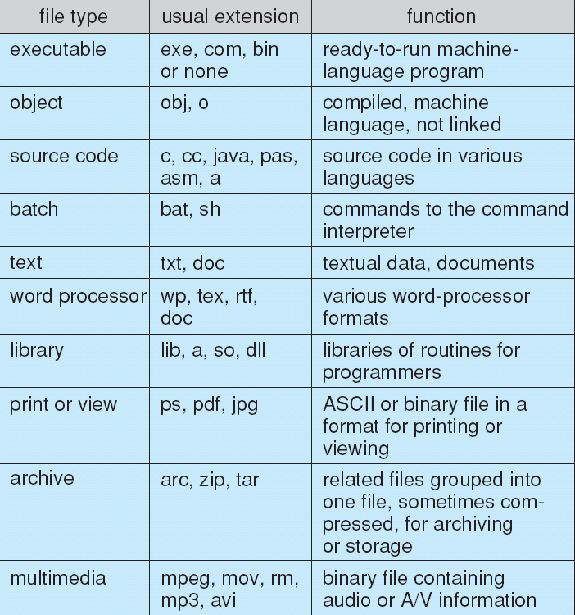

Slide 141
What is a file?
The sequence of bytes can be interpreted (by an application) to be
  Just a sequence of bytes
    E.g. a text file
  Sequence of records/structures
    E.g. a file of student records , by database application, etc
  A complexly organized, collection of records and bytes
    E.g. a “ODT” or “DOCX” file
What’s the role of OS in above mentioned file type, and organization?
  Mostly NO role on Unixes, Linuxes!
  They are handled by applications !
  Types handled by OS: normal file, directory, block device file, character device file, FIFO file (named pipe), etc.
  Also types handled by OS: executable file, non-executable file

Slide 142
File attributes
Run
$ ls -l
on Linux
To see file listing with different attributes
Different OSes and file-systems provide different sets of file attributes
  Some attributes are common to most, while some are different
  E.g. name, size, owner can be found on most systems
  “Executable” permission may not be found on all systems

Slide 143
File protection attributes
File owner/creator should be able to control:
  what can be done
  by whom
Types of access
  Read
  Write
  Execute
  Append
  Delete
  List
Linux: See commands: “chown”, “chgrp” and “chmod”
Linux file permissions
  For owner, group and others
  Read, write and execute
  Total 9 permissions

Slide 144
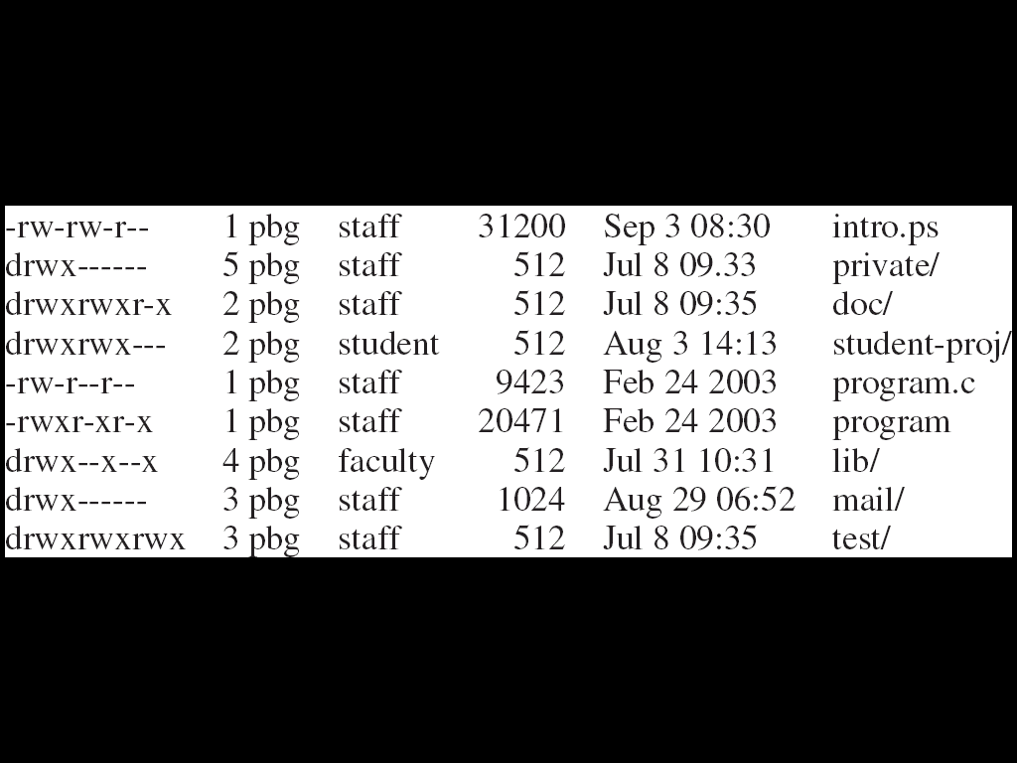
A Sample UNIX Directory Listing

Slide 145
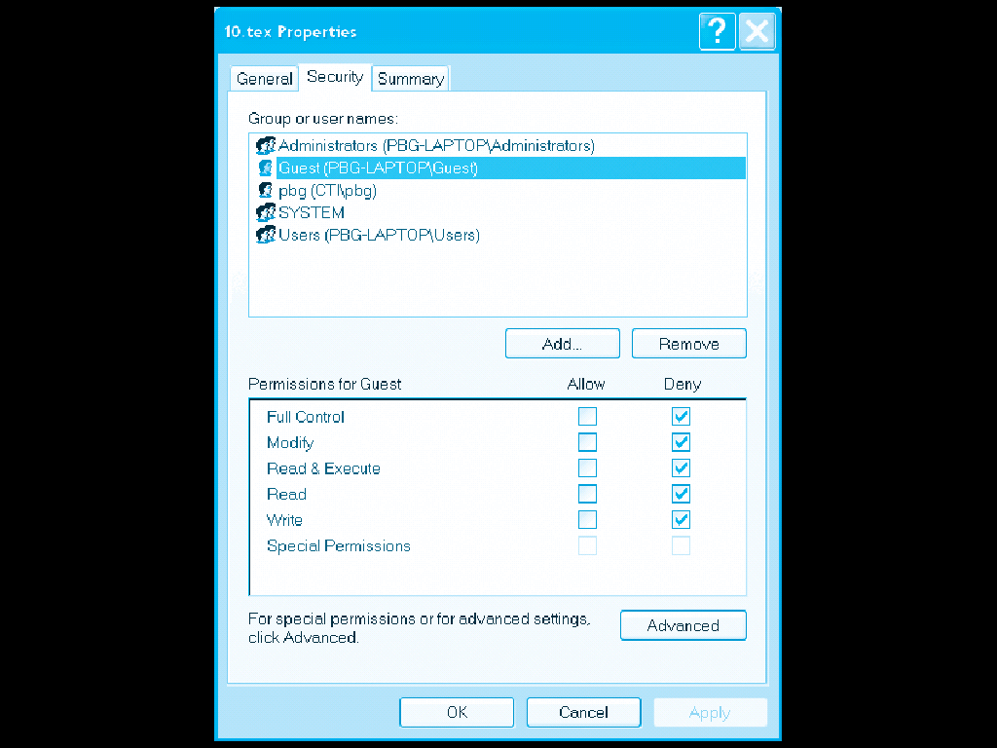
Windows
XP
Access List

Slide 146
Access methods
OS system calls may provide two types of access to files
  Sequential Access
    read next
    write next
    reset
    no read after last write
    (rewrite)
  Linux provides sequential access using open(), read(), write(), ...
  Direct Access
    read n
    write n
    position to n
    read next
    write next
    rewrite n
  n = relative block number
  pread(), pwrite() on Linux
    ssize_t pread(int fd, void *buf, size_t count, off_t offset);
    ssize_t pwrite(int fd, const void *buf, size_t count, off_t offset);

Slide 147
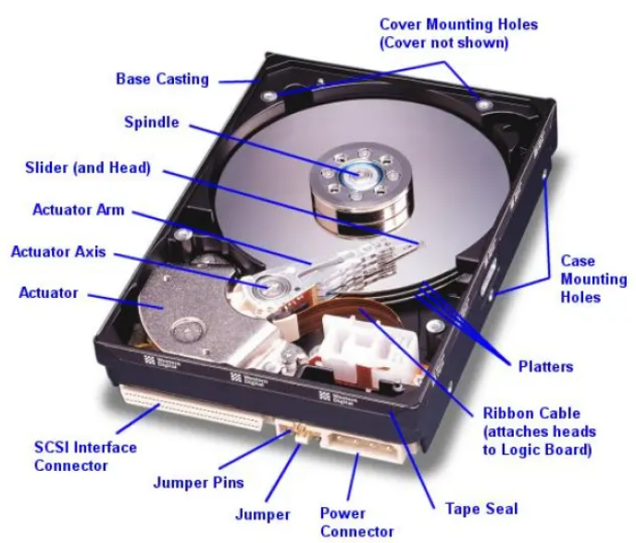
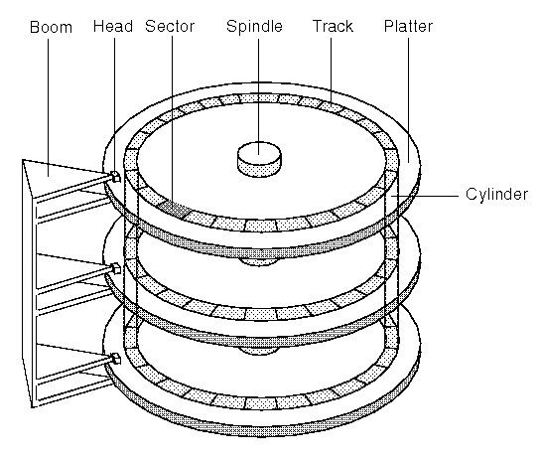
Disk

Slide 148
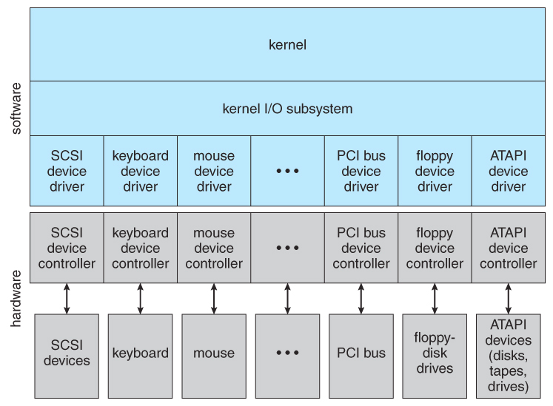
Device Driver

Slide 149
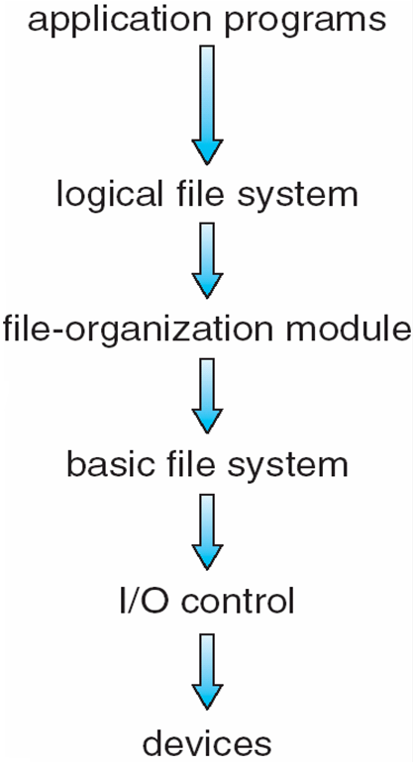
File system implementation: layering

Slide 150
Idea of Layering
Main() { // application
write(fd, "hello", 5);
}
C library
int write(int fd, char *str, int len) {
...
mov 5, eax; // 5 is syscall number
int 80;
}
--- application-kernel-boundary----
Kernel // logical file system
int sys_write(int fd, char *str, int len) {
file *fp = currproc->ofile[fd];
x = file_write(fp, str, len);
}
int file_write(file *fp, char *str, int len) { //file-organization module
// map current position in file to disk block, etc // basic file system
// prepare disc block to be writeen, say *buf
disk_device_driver_write(blockno, buf);
}
disk_device_driver_write(int blockno, char *buf) { // device-control
cyllinder, track, sector = convert(blockno)
//assembly code
//ask controller to write "buf" to cyllinder,track,sector
}
---hardware-software-boundary----
Controller (hw)
writes.

Slide 151
Application programs
int main() {
char buf[128]; int count;
fd = open(...):
read(fd, buf, count);
}
-----
OS
Logical file system:
sys_read(int fd, char *buf, int count) {
file *fp = currproc->fdarray[fd];
file_read(fp, ...);
}
File organization module:
file_read(file *fp, char *buf, int count) {
offset = fp->current-offset;
translate offset into blockno;
basic_read(blockno, buf, count);
}
Basic File system:
basic_read(int blockno, char *buf, ...) {
os_buffer *bp;
sectorno = calculation on blockno;
disk_driver_read(sectono, bp );
move-process-to-wait-queue;
copy-data-to-user-buffer(bp, buf);
}
IO Control, Device driver:
disk_driver_read(sectorno) {
issue instructions to disk controller (often assembly code)
to read sectornointo specific location;
}
XV6 does it slightely differently, but following the layering principle!

Slide 152
Device Drivers
Hardware manufacturers provide “hardware controllers” for their devices
Hardware controllers can operate the hardware, as instructed
Hardware controllers are instructed by writing to particular I/O ports using CPU’s machine instructions
  This bridges the hardware-software gap
OS programmers, typically, write one “device driver” code that interacts with one hardware controller
  This is pure C code
  Which calls I/O instructions for hardware controller
  This code is independent of most of the OS code
  Often this code is like an add-on Module , eg. Linux kernel

Slide 153
Disk device driver
OS views the disk as a logical sequence of blocks
  OS’s assumed block size may be > sector size
OS Talks to disk controller
Helps the OS Convert it’s view of “logical block” of the disk, into physical sector numbers
Acts as a translator between rest of OS and hardware controller
xv6: ide.c

Slide 154
OS’s job now
To implement the logical view of file system as seen by end user
Using the logical block-based view offerred by the device driver

Slide 155
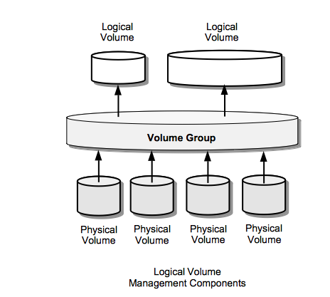
Volume Managers
Special type of kernel device drives, which reside on top of disk device drivers
Provide a more abstract view of the underlying hardware
E.g. Can combine two physical hard disks, and present them as one
Allow end users to
  “combine one more more physical disks to create physical volumes”
  “create volume groups out of a set of physical volumes”,
  “create logical volums within volume groups”

Slide 156
Formatting
Physical hard disk divided into partitions
  Partitions also known as minidisks, slices
A raw disk partition is accessible using device driver – but no block contains any data !
  Like an un-initialized array, or sectors/blocks
Formatting
  Creating an initialized data structure on the partition, so that it can start storing the acyclic graph tree structure on it
  Different formats depending on different implementations of the directory tree structure: ext4, NTFS, vfat, VxFS, ReiserFS, WafleFS, etc.
Formatting happens on “a physical partition” or “a logical volume made available by volume manager”

Slide 157
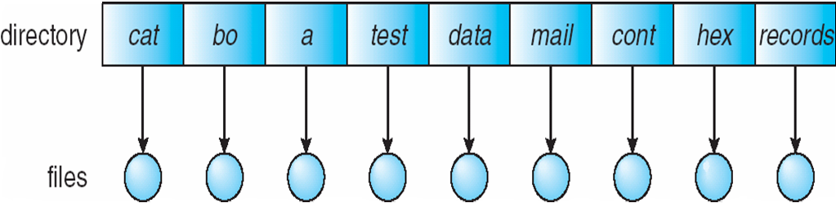
Different types of “layouts”
Single level directory
Naming problem
Grouping problem
Example: RT-11, from 1970s https://en.wikipedia.org/wiki/RT-11

Slide 158
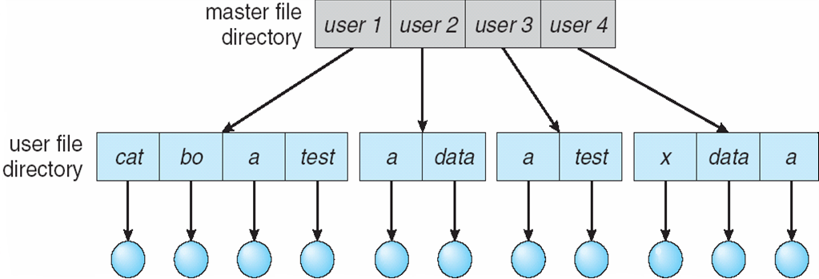
Different types of “layouts”
Two level directory
Path name
Can have the same file name for different user
Efficient searching
No grouping capability

Slide 159
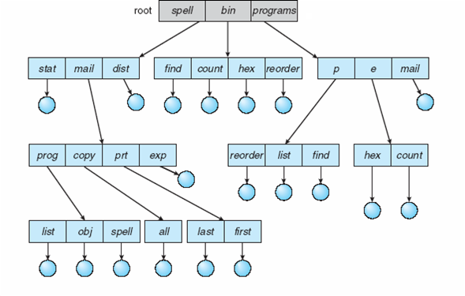
Tree Structured directories

Slide 160
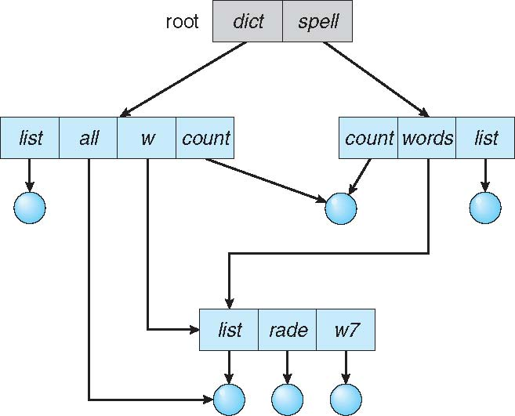
Acyclic Graph Directories

Slide 161
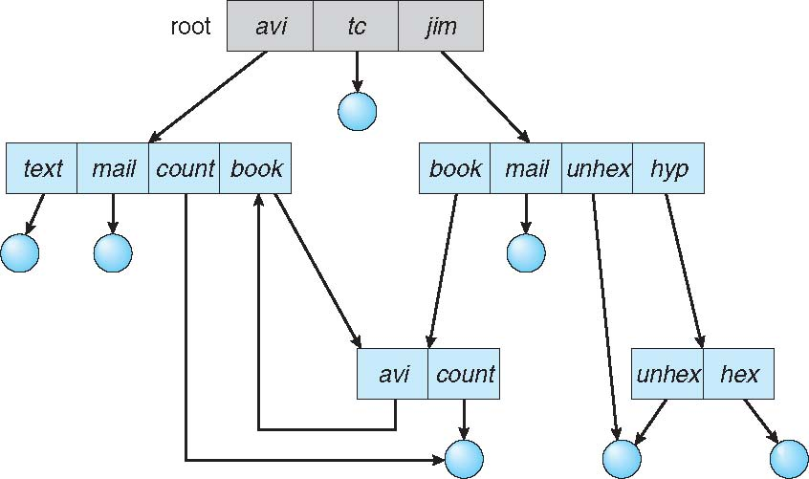
General Graph directory

Slide 162
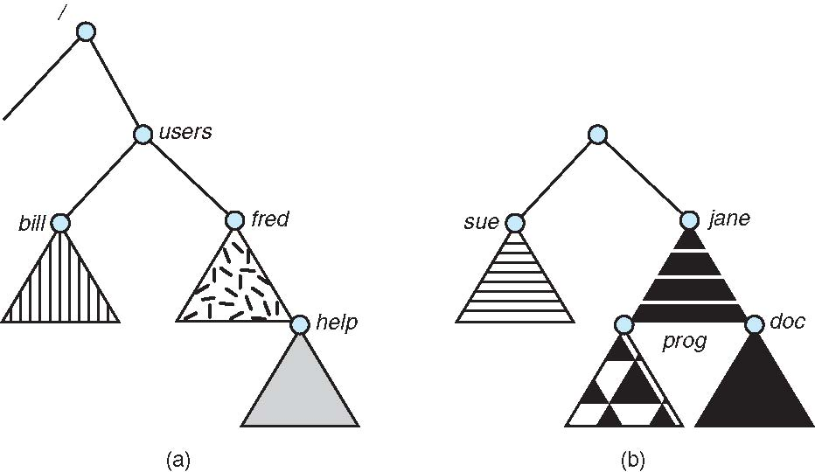
Mounting of a file system: before
/dev/sda3
/dev/sda5

Slide 163
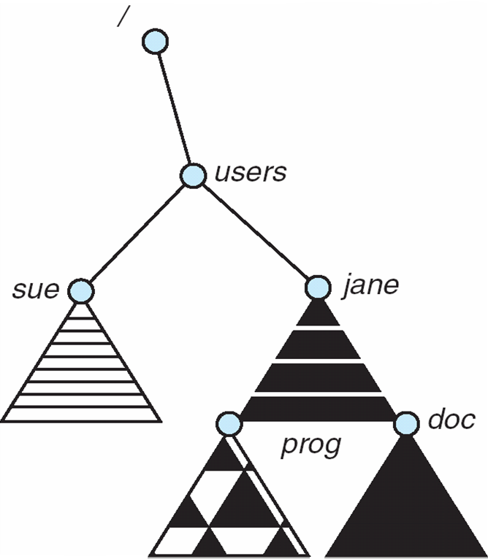
Mounting of a file system: after
$sudo mount /dev/sda5 /users

Slide 164
Remote mounting: NFS
Network file system
$ sudo mount 10.2.1.2:/x/y /a/b
  The /x/y partition on 10.2.1.2 will be made available under the folde /a/b on this computer

Slide 165
File sharing semantics
Consistency semantics specify how multiple users are to access a shared file simultaneously
Unix file system (UFS) implements:
  Writes to an open file visible immediately to other users of the same open file
  One mode of sharing file pointer to allow multiple users to read and write concurrently
AFS has session semantics
  Writes only visible to sessions starting after the file is closed

Slide 166
Implementing file systems

Slide 167
File system on disk
What we know
  Disk I/O in terms of sectors (512 bytes)
  File system: implementation of acyclic graph using the linear sequence of sectors
    Store a acyclic graph into array of “blocks”/“sectors”
  Device driver available: gives sector/block wise access to the disk

Slide 168
File system implementation: layering

Slide 169
File system: Layering
Device drivers manage I/O devices at the I/O control layer
  Given commands like “read drive1, cylinder 72, track 2, sector 10, into memory location 1060” outputs low-level hardware specific commands to hardware controller
Basic file system given command like “retrieve block 123” translates to device driver
  Also manages memory buffers and caches (allocation, freeing, replacement)
  Buffers hold data in transit
  Caches hold frequently used data
File organization module understands files, logical address, and physical blocks
  Translates logical block # to physical block #
  Manages free space, disk allocation
Logical file system manages metadata information
  Translates file name into file number, file handle, location by maintaining file control blocks (inodes in Unix)
  Directory management
  Protection

Slide 170
Application programs
int main() {
char buf[128]; int count;
fd = open(...):
read(fd, buf, count);
}
-----
OS
Logical file system:
sys_read(int fd, char *buf, int count) {
file *fp = currproc->fdarray[fd];
file_read(fp, ...);
}
File organization module:
file_read(file *fp, char *buf, int count) {
offset = fp->current-offset;
translate offset into blockno;
basic_read(blockno, buf, count);
}
Basic File system:
basic_read(int blockno, char *buf, ...) {
os_buffer *bp;
sectorno = calculation on blockno;
disk_driver_read(sectono, bp );
move-process-to-wait-queue;
copy-data-to-user-buffer(bp, buf);
}
IO Control, Device driver:
disk_driver_read(sectorno) {
issue instructions to disk controller (often assembly code)
to read sectornointo specific location;
}
XV6 does it slightely differently, but following the layering principle!

Slide 171
Layering advantages
Layering useful for reducing complexity and redundancy, but adds overhead and can decrease performance
  Logical layers can be implemented by any coding method according to OS designer
Many file systems, sometimes many within an operating system
  Each with its own format (CD-ROM is ISO 9660; Unix has UFS, FFS; Windows has FAT, FAT32, NTFS as well as floppy, CD, DVD Blu-ray, Linux has more than 40 types, with extended file system ext2 and ext3 leading; plus distributed file systems, etc)
  New ones still arriving – ZFS, GoogleFS, Oracle ASM, FUSE
  The Virtual File System (to be discussed later) helps us combine multiple physically different file systems into one logical layer at the top

Slide 172
File system implementation: Different problems to be solved
What to do at boot time, how to locate kernel ?
How to store directories and files on the partition ?
  Complex problem. Hiearchy + storage allocation + efficiency + limits on file/directory sizes + links (hard, soft)
How to manage list of free sectors/blocks?
How to store the summary information about the complete file system : #files, #free-blocks, ...
How to mount a file system , how to unmount?

Slide 173
File system implementation: Different problems to be solved
About storing a file, how to store
  Data
  Attributes
  Name
  Link count

Slide 174
The hard link problem
Need to separate name from data !
  /x/y and /a/b should be same file. How?
  Both names should refer to same data !
  Data is separated separately from name, and the name gives a “reference” to data
What about attributes ?
  They go with data! (not with name!)
So solution was: indirection !

Slide 175
The hard link problem
Name1
Data of file
Name2
We are not considering other problems here , just focussing on hard link problem

Slide 176
File system implementation
We have system calls at the API level, but how do we implement their functions?
  On-disk and in-memory structures. Let’s see some of the important ones.
  Boot control block contains info needed by system to boot OS from that volume
    Not always needed. Needed if volume contains OS, usually first block of volume
  Volume control block (superblock, master file table) contains volume details
    Total # of blocks, # of free blocks, block size, free block pointers or array
  Per-file File Control Block (FCB) contains many details about the file
    Inode(FCB) number, permissions, size, dates
  Directory structure organizes the files
    Names and inode numbers, master file table

Slide 177
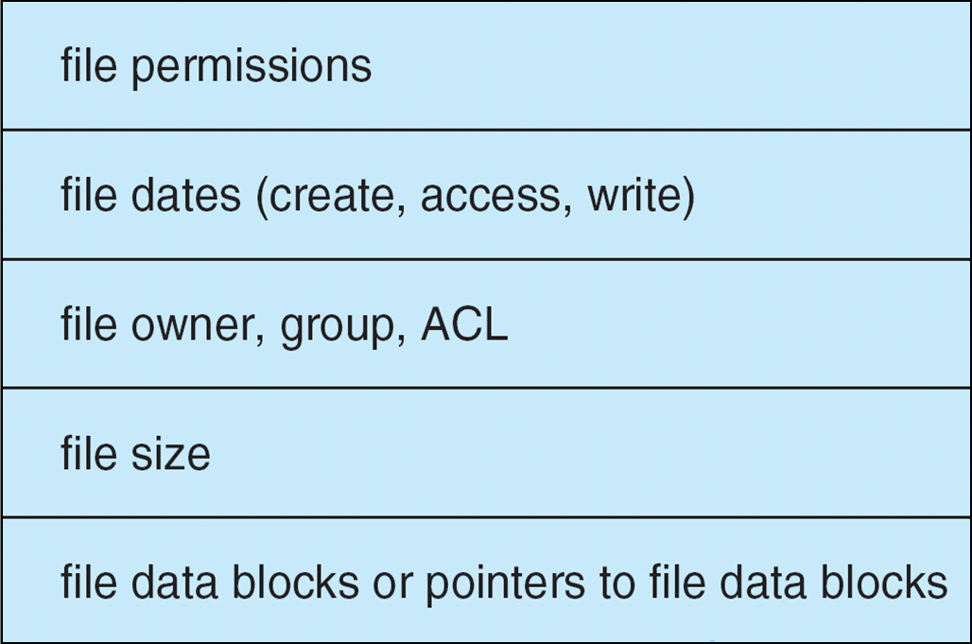
A typical file control block (inode)
Name is stored separately
Where?
IN data block of directory

Slide 178
In memory data structures
Mount table
  storing file system mounts, mount points, file system types
See next slide for “file” related data structures
Buffers
  hold data blocks from secondary storage

Slide 179
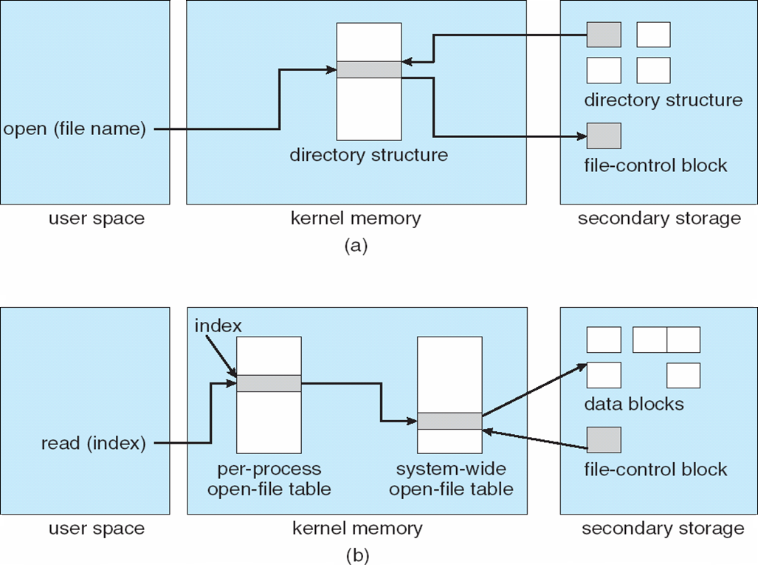
In memory data structures: for open,read,write, ...
Open returns a file handle for subsequent use
Data from read eventually copied to specified user process memory address

Slide 180
At boot time
Root partition
  Contains the file system hosting OS
  “mounted” at boot time – contains “/”
    Normally can’t be unmounted!
Check all other partitions
  Specified in /etc/fstab on Linux
  Check if the data structure on them is consistent
    Consistent != perfect/accurate/complete

Slide 181
Directory Implementation
Problem
  Directory contains files and/or subdirectories
  Operations required – create files/directories, access files/directories, search for a file (during lookup), etc.
  Directory needs to give location of each file on disk

Slide 182
Directory Implementation
Linear list of file names with pointer to the data blocks
  Simple to program
  Time-consuming to execute
    Linear search time
    Could keep ordered alphabetically via linked list or use B+ tree
  Ext2 improves upon this approach.
Hash Table – linear list with hash data structure
  Decreases directory search time
  Collisions – situations where two file names hash to the same location
  Only good if entries are fixed size, or use chained-overflow method

Slide 183
Disk space allocation for files
File contain data and need disk blocks/sectors for storing it
File system layer does the allocation of blocks on disk to files
Files need to
  Be created, expanded, deleted, shrunk, etc.
  How to accommodate these requirements?

Slide 184
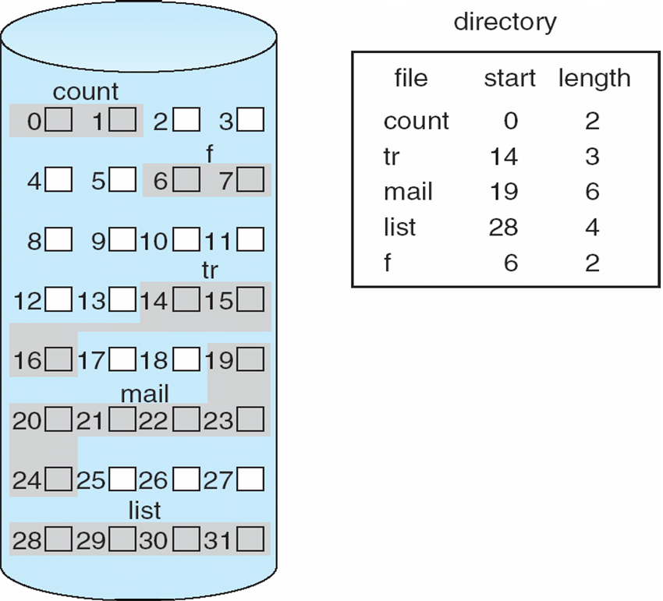
Contiguous Allocation of Disk Space

Slide 185
Contiguous allocation
Each file occupies set of contiguous blocks
Best performance in most cases
Simple – only starting location (block #) and length (number of blocks) are required
Problems include finding space for file, knowing file size, external fragmentation, need for compaction off-line (downtime) or on-line

Slide 186
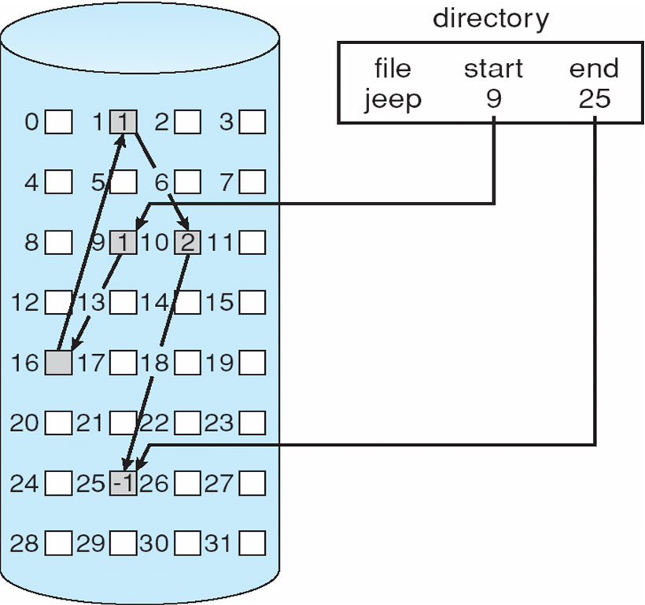
Linked allocation of blocks to a file

Slide 187
Linked allocation of blocks to a file
Linked allocation
  Each file a linked list of blocks
  File ends at nil pointer
  No external fragmentation
  Each block contains pointer to next block (i.e. data + pointer to next block)
  No compaction, external fragmentation
  Free space management system called when new block needed
  Improve efficiency by clustering blocks into groups but increases internal fragmentation
  Reliability can be a problem
  Locating a block can take many I/Os and disk seeks

Slide 188
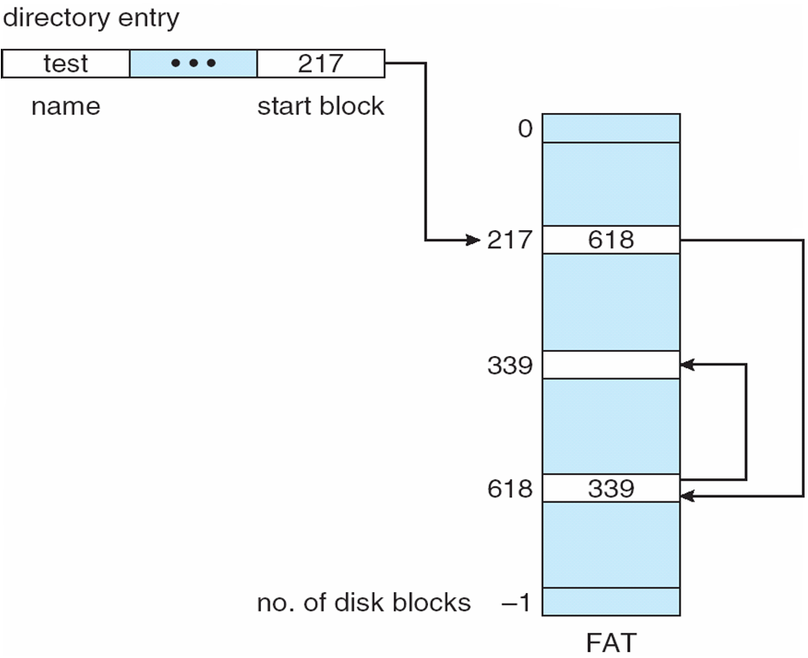
FAT: File Allocation Table
FAT (File Allocation Table), a variation
  Beginning of volume has table, indexed by block number
  Much like a linked list, but faster on disk and cacheable
  New block allocation simple

Slide 189
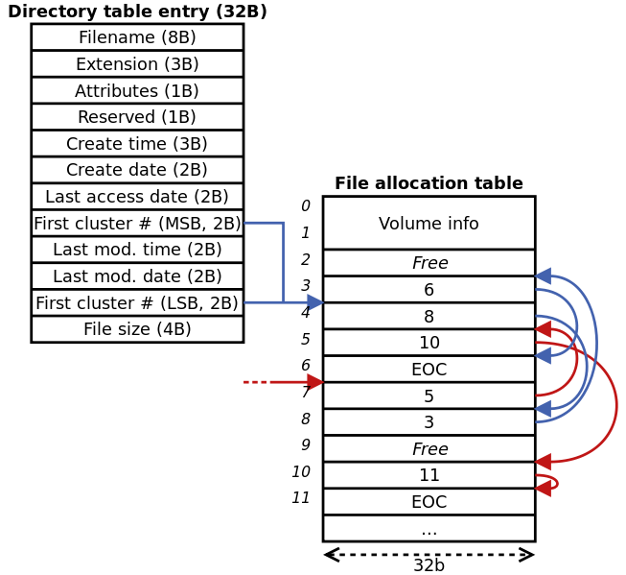
FAT: File Allocation Table
Variants: FAT8, FAT12, FAT16, FAT32, VFAT, ...

Slide 190
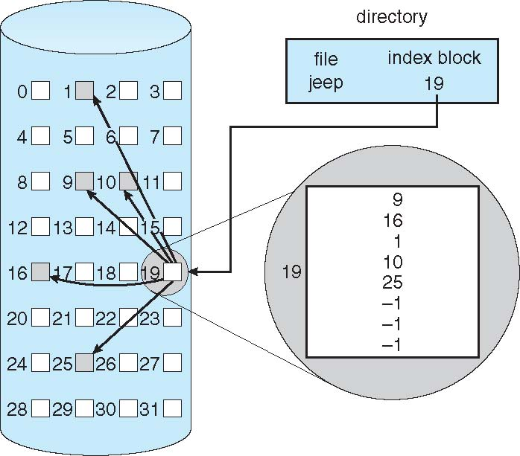
Indexed allocation

Slide 191
Indexed allocation
Need index table
Random access
Dynamic access without external fragmentation, but have overhead of index block
Mapping from logical to physical in a file of maximum size of 256K bytes and block size of 512 bytes. We need only 1 block for index table

Slide 192
Multi level indexing
outer-index
index table
file

Slide 193
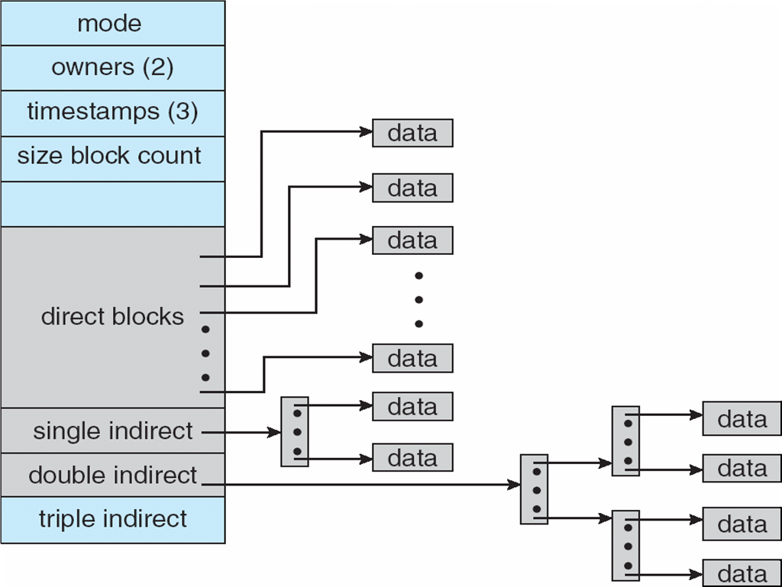
Unix UFS: combined scheme for block allocation

Slide 194
Free Space Management
File system maintains free-space list to track available blocks/clusters
  Bit vector or bit map (n blocks)
  Or Linked list

Slide 195
Free Space Management: bit vector
Each block is represented by 1 bit.
If the block is free, the bit is 1; if the block is allocated, the bit is 0.
  For example, consider a disk where blocks 2, 3, 4, 5, 8, 9, 10, 11, 12, 13, 17 18, 25, 26, and 27 are free and the rest of the blocks are allocated. The free-space bitmap would be
  001111001111110001100000011100000 ...
A 1- TB disk with 4- KB blocks would require 32 MB (2⁴⁰ / 2¹² = 2²⁸ bits = 2²⁵ bytes = 2⁵ MB) to store its bitmap

Slide 196
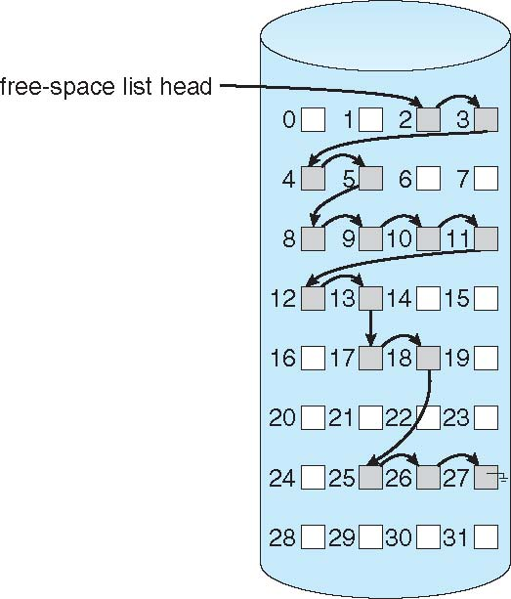
Free Space Management: Linked list (not in memory, on disk!)

Slide 197
Further improvements on link list method of free-blocks
Grouping
Counting
Space Maps (ZFS)
Read as homework

Slide 198
Ext2 FS layout

Slide 199
struct ext2_inode {
__le16 i_mode; /* File mode */
__le16 i_uid; /* Low 16 bits of Owner Uid */
__le32 i_size; /* Size in bytes */
__le32 i_atime; /* Access time */
__le32 i_ctime; /* Creation time */
__le32 i_mtime; /* Modification time */
__le32 i_dtime; /* Deletion Time */
__le16 i_gid; /* Low 16 bits of Group Id */
__le16 i_links_count; /* Links count */
__le32 i_blocks; /* Blocks count */
__le32 i_flags; /* File flags */

Slide 200

Inode in ext2

Slide 201
struct ext2_inode {
...
union {
struct {
__le32 l_i_reserved1;
} linux1;
struct {
__le32 h_i_translator;
} hurd1;
struct {
__le32 m_i_reserved1;
} masix1;
} osd1; /* OS dependent 1 */
__le32 i_block[EXT2_N_BLOCKS];/* Pointers to blocks */
__le32 i_generation; /* File version (for NFS) */
__le32 i_file_acl; /* File ACL */
__le32 i_dir_acl; /* Directory ACL */
__le32 i_faddr; /* Fragment address */

Slide 202
struct ext2_inode {
...
union {
struct {
__u8 l_i_frag; /* Fragment number */ __u8 l_i_fsize; /* Fragment size */
__u16 i_pad1; __le16 l_i_uid_high; /* these 2 fields */
__le16 l_i_gid_high; /* were reserved2[0] */
__u32 l_i_reserved2;
} linux2;
struct {
__u8 h_i_frag; /* Fragment number */ __u8 h_i_fsize; /* Fragment size */
__le16 h_i_mode_high; __le16 h_i_uid_high;
__le16 h_i_gid_high;
__le32 h_i_author;
} hurd2;
struct {
__u8 m_i_frag; /* Fragment number */ __u8 m_i_fsize; /* Fragment size */
__u16 m_pad1; __u32 m_i_reserved2[2];
} masix2;
} osd2; /* OS dependent 2 */

Slide 203

Ext2 FS Layout: Entries in directory’s data blocks

Slide 204

Ext2 FS Layout
Size of block
4k,1k, etc
Determined at time of mkfs (formatting)

Slide 205
Calculations done by “mkfs” like this
Block size = 4KB (specified to mkfs)
Number of total blocks = size of partition / 4KB
  How to get size of partition ?
4KB = 4 * 1024 * 8 = 32768 bits
Data Block Bitmap, Inode Bitmap are always one block
So
  size of a group is 32,768 Blocks
  #groups = #blocks-in-partition / 32,768

Slide 206
struct ext2_super_block {
__le32 s_inodes_count; /* Inodes count */
__le32 s_blocks_count; /* Blocks count */
__le32 s_r_blocks_count; /* Reserved blocks count */
__le32 s_free_blocks_count; /* Free blocks count */
__le32 s_free_inodes_count; /* Free inodes count */
__le32 s_first_data_block; /* First Data Block */
__le32 s_log_block_size; /* Block size */
__le32 s_log_frag_size; /* Fragment size */
__le32 s_blocks_per_group; /* # Blocks per group */
__le32 s_frags_per_group; /* # Fragments per group */
__le32 s_inodes_per_group; /* # Inodes per group */
__le32 s_mtime; /* Mount time */
__le32 s_wtime; /* Write time */
__le16 s_mnt_count; /* Mount count */
__le16 s_max_mnt_count; /* Maximal mount count */
__le16 s_magic; /* Magic signature */
__le16 s_state; /* File system state */
__le16 s_errors; /* Behaviour when detecting errors */

Slide 207
struct ext2_super_block {
...
__le16 s_minor_rev_level; /* minor revision level */
__le32 s_lastcheck; /* time of last check */
__le32 s_checkinterval; /* max. time between checks */
__le32 s_creator_os; /* OS */
__le32 s_rev_level; /* Revision level */
__le16 s_def_resuid; /* Default uid for reserved blocks */
__le16 s_def_resgid; /* Default gid for reserved blocks */
__le32 s_first_ino; /* First non-reserved inode */
__le16 s_inode_size; /* size of inode structure */
__le16 s_block_group_nr; /* block group # of this superblock */
__le32 s_feature_compat; /* compatible feature set */
__le32 s_feature_incompat; /* incompatible feature set */
__le32 s_feature_ro_compat; /* readonly-compatible feature set */
__u8 s_uuid[16]; /* 128-bit uuid for volume */
char s_volume_name[16]; /* volume name */
char s_last_mounted[64]; /* directory where last mounted */
__le32 s_algorithm_usage_bitmap; /* For compression */

Slide 208
struct ext2_super_block {
...
__u8 s_prealloc_blocks; /* Nr of blocks to try to preallocate*/
__u8 s_prealloc_dir_blocks; /* Nr to preallocate for dirs */
__u16 s_padding1;
/*
* Journaling support valid if EXT3_FEATURE_COMPAT_HAS_JOURNAL set.
*/
__u8 s_journal_uuid[16]; /* uuid of journal superblock */
__u32 s_journal_inum; /* inode number of journal file */
__u32 s_journal_dev; /* device number of journal file */
__u32 s_last_orphan; /* start of list of inodes to delete */
__u32 s_hash_seed[4]; /* HTREE hash seed */
__u8 s_def_hash_version; /* Default hash version to use */
__u8 s_reserved_char_pad;
__u16 s_reserved_word_pad;
__le32 s_default_mount_opts;
__le32 s_first_meta_bg; /* First metablock block group */
__u32 s_reserved[190]; /* Padding to the end of the block */

Slide 209
struct ext2_group_desc
{
__le32 bg_block_bitmap; /* Blocks bitmap block */
__le32 bg_inode_bitmap; /* Inodes bitmap block */
__le32 bg_inode_table; /* Inodes table block */
__le16 bg_free_blocks_count; /* Free blocks count */
__le16 bg_free_inodes_count; /* Free inodes count */
__le16 bg_used_dirs_count; /* Directories count */
__le16 bg_pad;
__le32 bg_reserved[3];
};

Slide 210
Traversal / path-name resolution
//resolving /a/b
s = read_superblock(); // struct
g = read_bg_descriptors(); // array
inode getinode(int n) {
calculate the block number for n'th inode
(using info from superblock, bg descriptors, block-size etc)
read that block
extract inode from block
return inode
}
ino = 2
i = getinode(ino) ; //root
while (path not complete) {
if (i is directory and path not complete)
x = get-pathname-component(path); // give "a" from "/a/b", then "b" , etc
read-data blocks of i'th inode
search for x in the data-blocks
if found
ino = inode for found entry
else
return not-found
else
return not-found
}

Slide 211
Let’s see a program to read superblock of an ext2 file system.

Slide 212
Synchronization

Slide 213
My formulation
OS = data structurs + synchronization
Synchronization problems make writing OS code challenging
Demand exceptional coding skills

Slide 214
Race problem
long c = 0, c1 = 0, c2 = 0, run = 1;
void *thread1(void *arg) {
while(run == 1) {
c++;
c1++;
}
}
void *thread2(void *arg) {
while(run == 1) {
c++;
c2++;
}
}
int main() {
pthread_t th1, th2;
pthread_create(&th1, NULL, thread1, NULL);
pthread_create(&th2, NULL, thread2, NULL);
//fprintf(stdout, "Ending main\n");
sleep(2);
run = 0;
fprintf(stdout, "c = %ld c1+c2 = %ld c1 = %ld c2 = %ld \n", c, c1+c2, c1, c2);
fflush(stdout);
}

Slide 215
Race problem
On earlier slide
  Value of c should be equal to c1 + c2, but it is not!
  Why?
There is a “race” between thread1 and thread2 for updating the variable c
thread1 and thread2 may get scheduled in any order and interrupted any point in time
The changes to c are not atomic!
  What does that mean?

Slide 216
Race problem
C++, when converted to assembly code, could be
mov c, r1
add r1, 1
mov r1, c
Now following sequence of instructions is possible among thread1 and thread2
thread1: mov c, r1
thread2: mov c, r1
thread1: add r1, 1
thread1: mov r1, c
thread2: add r1, 1
thread2: mov r1, c
What will be value in c, if initially c was, say 5?
  It will be 6, when it is expected to be 7. Other variations also possible.

Slide 217
Races: reasons
Interruptible kernel
  If entry to kernel code does not disable interrupts, then modifications to any kernel data structure can be left incomplete
  This introduces concurrency
Multiprocessor systems
  On SMP systems: memory is shared, kernel and process code run on all processors
  Same variable can be updated parallely (not concurrently)
What about non-interruptible kernel on multiprocessor systems?
What about non-interruptible kernel on uniprocessor systems?

Slide 218

Critical Section problem

Slide 219
Critical Section Problem
Consider system of n processes {p0, p1, … pn-1}
Each process has critical section segment of code
  Process may be changing common variables, updating table, writing file, etc
  When one process in critical section, no other may be in its critical section
Critical section problem is to design protocol to solve this
Each process must ask permission to enter critical section in entry section, may follow critical section with exit section, then remainder section
Especially challenging with preemptive kernels

Slide 220
Expected solution characteristics
1. Mutual Exclusion
  If process Pi is executing in its critical section, then no other processes can be executing in their critical sections
2. Progress
  If no process is executing in its critical section and there exist some processes that wish to enter their critical section, then the selection of the processes that will enter the critical section next cannot be postponed indefinitely
3. Bounded Waiting
  A bound must exist on the number of times that other processes are allowed to enter their critical sections after a process has made a request to enter its critical section and before that request is granted
    Assume that each process executes at a nonzero speed
    No assumption concerning relative speed of the n processes

Slide 221
suggested solution - 1
int flag = 1;
void *thread1(void *arg) {
while(run == 1) {
while(flag == 0)
;
flag = 0;
c++;
flag = 1;
c1++;
}
}
What’s wrong here?
Assumes that
while(flag ==) ; flag = 0
will be atomic

Slide 222
suggested solution - 2
int flag = 0;
void *thread1(void *arg) {
while(run == 1) {
if(flag)
c++;
else
continue;
c1++;
flag = 0;
}
}
void *thread2(void *arg) {
while(run == 1) {
if(!flag)
c++;
else
continue;
c2++;
flag = 1;
}
}

Slide 223
Peterson’s solution
Two process solution
Assume that the LOAD and STORE instructions are atomic; that is, cannot be interrupted
The two processes share two variables:
int turn;
Boolean flag[2]
The variable turn indicates whose turn it is to enter the critical section
The flag array is used to indicate if a process is ready to enter the critical section. flag[i] = true implies that process Pi is ready!

Slide 224
Peterson’s solution
do {
flag[i] = TRUE;
turn = j;
while (flag[j] && turn == j)
;
critical section
flag[i] = FALSE;
remainder section
} while (TRUE);
Provable that
  Mutual exclusion is preserved
  Progress requirement is satisfied
  Bounded-waiting requirement is met

Slide 225
Hardware solution – the one actually implemented
Many systems provide hardware support for critical section code
Uniprocessors – could disable interrupts
  Currently running code would execute without preemption
  Generally too inefficient on multiprocessor systems
  Operating systems using this not broadly scalable
Modern machines provide special atomic hardware instructions
  Atomic = non-interruptable
  Either test memory word and set value
  Or swap contents of two memory words
  Basically two operations (read/write) done atomically in hardware

Slide 226
Solution using test-and-set
lock = false; //global
do {
while ( TestAndSet (&lock ))
; // do nothing
// critical section
lock = FALSE;
// remainder section
} while (TRUE);
Definition:
boolean TestAndSet (boolean *target)
{
boolean rv = *target;
*target = TRUE;
return rv:
}

Slide 227
Solution using swap
lock = false; //global
do {
key = true
while ( key == true))
swap(&lock, &key)
// critical section
lock = FALSE;
// remainder section
} while (TRUE);

Slide 228
Spinlock
A lock implemented to do ‘busy-wait’
Using instructions like T&S or Swap
As shown on earlier slides
spinlock(int *lock){
While(test-and-set(lock))
;
}
spinunlock(lock *lock) {
*lock = false;
}

Slide 229
Bounded wait M.E. with T&S
do {
waiting[i] = TRUE;
key = TRUE;
while (waiting[i] && key)
key = TestAndSet(&lock);
waiting[i] = FALSE;
// critical section
j = (i + 1) % n;
while ((j != i) && !waiting[j])
j = (j + 1) % n;
if (j == i)
lock = FALSE;
else
waiting[j] = FALSE;
// remainder section
} while (TRUE);

Slide 230
sleep-locks
Spin locks result in busy-wait
CPU cycles wasted by waiting processes/threads
Solution – threads keep waiting for the lock to be available
  Move thread to wait queue
  The thread holding the lock will wake up one of them

Slide 231
Sleep locks/mutexes
//ignore syntactical issues
typedef struct mutex {
wait(mutex *m) {
}
Block(mutex *m, spinlock *sl) {
}
release(mutex *m) {

Slide 232
Some thumb-rules of spinlocks
Never block a process holding a spinlock !
Typical code:
while(condition)
{ Spin-unlock()
Schedule()
Spin-lock()
}
Hold a spin lock for only a short duration of time
  Spinlocks are preferable on multiprocessor systems
  Cost of context switch is a concern in case of sleep-wait locks
  Short = < 2 context switches

Slide 233
Locks in xv6 code

Slide 234
struct spinlock
// Mutual exclusion lock.
struct spinlock {
uint locked; // Is the lock held?
// For debugging:
char *name; // Name of lock.
struct cpu *cpu; // The cpu holding the lock.
uint pcs[10]; // The call stack (an array of program counters)
// that locked the lock.
};

Slide 235
spinlocks in xv6 code
struct {
struct spinlock lock;
struct buf buf[NBUF];
struct buf head;
} bcache;
struct {
struct spinlock lock;
struct file file[NFILE];
} ftable;
struct {
struct spinlock lock;
struct inode inode[NINODE];
} icache;
struct sleeplock {
uint locked; // Is the lock held?
struct spinlock sl;
static struct spinlock idelock;
struct {
struct spinlock lock;
int use_lock;
struct run *freelist;
} kmem;
struct log {
struct spinlock lock;
...}
struct pipe {
struct spinlock lock;
...}
struct {
struct spinlock lock;
struct proc proc[NPROC];
} ptable;
struct spinlock tickslock;

Slide 236
Spinlock in xv6
static inline uint
xchg(volatile uint *addr, uint newval)
{
uint result;
// The + in "+m" denotes a read-modify-write operand.
asm volatile("lock; xchgl %0, %1" :
"+m" (*addr), "=a" (result) :
"1" (newval) :
"cc");
return result;
}
struct spinlock {
uint locked; // Is the lock held?
// For debugging:
char *name; // Name of lock.
struct cpu *cpu; // The cpu holding the lock.
uint pcs[10]; // The call stack (an array of program counters) that locked the lock.
};
void acquire(struct spinlock *lk)
{
pushcli(); // disable interrupts to avoid deadlock.
// The xchg is atomic.
while(xchg(&lk->locked, 1) != 0)
;
//extra debugging code
}
void release(struct spinlock *lk)
{ //extra debugging code
asm volatile("movl $0, %0" : "+m" (lk->locked) : );
popcli();
}

Slide 237
spinlocks
Void acquire(struct spinlock *lk)
{
pushcli(); // disable interrupts to avoid deadlock.
if(holding(lk))
panic("acquire");
......
void pushcli(void)
{
int eflags;
eflags = readeflags();
cli();
if(mycpu()->ncli == 0)
mycpu()->intena = eflags & FL_IF;
mycpu()->ncli += 1;
}
static inline uint
readeflags(void)
{
uint eflags;
asm volatile("pushfl; popl %0" : "=r" (eflags));
return eflags;
}
Pushcli() - disable interrupts on that processor
One after another many acquire() can be called on different spinlocks
  Keep a count of them in mycpu()->ncli

Slide 238
spinlocks
void
release(struct spinlock *lk)
{
...
asm volatile("movl $0, %0" : "+m" (lk->locked) : );
popcli();
}
.
Void popcli(void)
{
if(readeflags()&FL_IF)
panic("popcli - interruptible");
if(--mycpu()->ncli < 0)
panic("popcli");
if(mycpu()->ncli == 0 && mycpu()->intena)
sti();
}
Popcli()
  Restore interrupts if last popcli() call restores ncli to 0 & interrupts were enabled before pushcli() was called

Slide 239
spinlocks
Always disable interrupts while acquiring spinlock
  Suppose iderw held the idelock and then got interrupted to run ideintr.
  Ideintr would try to lock idelock, see it was held, and wait for it to be released.
  In this situation, idelock will never be released
  Deadlock
General OS rule: if a spin-lock is used by an interrupt handler, a processor must never hold that lock with interrupts enabled
Xv6 rule: when a processor enters a spin-lock critical section, xv6 always ensures interrupts are disabled on that processor.

Slide 240
sleeplocks
Sleeplocks don’t spin. They move a process to a wait-queue if the lock can’t be acquired
XV6 approach to “wait-queues”
  Any memory address serves as a “wait channel”
  The sleep() and wakeup() functions just use that address as a ‘condition’
  There are no per condition process queues! Just one global queue of processes used for scheduling, sleep, wakeup etc. --> Linear search everytime !
    costly, but simple

Slide 241
sleep()
void
sleep(void *chan, struct spinlock *lk)
{
struct proc *p = myproc();
....
if(lk != &ptable.lock){
acquire(&ptable.lock);
release(lk);
}
p->chan = chan;
p->state = SLEEPING;
sched();
// Reacquire original lock.
if(lk != &ptable.lock){
release(&ptable.lock);
acquire(lk);
}
At call must hold lock on the resource on which you are going to sleep
since you are going to change p-> values & call sched(), hold ptable.lock if not held
p->chan = given address remembers on which condition the process is waiting
call to sched() blocks the process

Slide 242
Calls to sleep() : examples of “chan” (output from cscope)
0 console.c consoleread 251 sleep(&input.r, &cons.lock);
2 ide.c iderw 169 sleep(b, &idelock);
3 log.c begin_op 131 sleep(&log, &log.lock);
6 pipe.c piperead 111 sleep(&p->nread, &p->lock);
7 proc.c wait 317 sleep(curproc, &ptable.lock);
8 sleeplock.c acquiresleep 28 sleep(lk, &lk->lk);
9 sysproc.c sys_sleep 74 sleep(&ticks, &tickslock);

Slide 243
Wakeup()
void wakeup(void *chan)
{
acquire(&ptable.lock);
wakeup1(chan);
release(&ptable.lock);
}
static void wakeup1(void *chan)
{
struct proc *p;
for(p = ptable.proc; p < &ptable.proc[NPROC]; p++)
if(p->state == SLEEPING && p->chan == chan)
p->state = RUNNABLE;
}
Acquire ptable.lock since you are going to change ptable and p-> values
just linear search in process table for a process where p->chan is given address
Make it runnable

Slide 244
sleeplock
// Long-term locks for processes
struct sleeplock {
uint locked; // Is the lock held?
struct spinlock sl; // spinlock protecting this sleep lock
// For debugging:
char *name; // Name of lock.
int pid; // Process holding lock
};

Slide 245
Sleeplock acquire and release
void
acquiresleep(struct sleeplock *lk)
{
acquire(&lk->lk);
while (lk->locked) {
/* Abhijit: interrupts are not disabled in sleep !*/
sleep(lk, &lk->lk);
}
lk->locked = 1;
lk->pid = myproc()->pid;
release(&lk->lk);
}
void
releasesleep(struct sleeplock *lk)
{
acquire(&lk->lk);
lk->locked = 0;
lk->pid = 0;
wakeup(lk);
release(&lk->lk);
}

Slide 246
Where are sleeplocks used?
struct buf
  waiting for I/O on this buffer
struct inode
  waiting for I/o to this inode
Just two !

Slide 247
Sleeplocks issues
sleep-locks support yielding the processor during their critical sections.
This property poses a design challenge:
  if thread T1 holds lock L1 and has yielded the processor (waiting for some other condition),
  and thread T2 wishes to acquire L1,
  we have to ensure that T1 can execute
  while T2 is waiting so that T1 can release L1.
  T2 can’t use the spin-lock acquire function here: it spins with interrupts turned off, and that would prevent T1 from running.
To avoid this deadlock, the sleep-lock acquire routine (called acquiresleep) yields the processor while waiting, and does not disable interrupts.
Sleep-locks leave interrupts enabled, they cannot be used in interrupt handlers.

Slide 248
More needs of synchronization
Not only critical section problems
Run processes in a particular order
Allow multiple processes read access, but only one process write access
Etc.

Slide 249
Semaphore
Synchronization tool that does not require busy waiting
Semaphore S – integer variable
Two standard operations modify S: wait() and signal()
  Originally called P() and V()
Less complicated
Can only be accessed via two indivisible (atomic) operations
wait (S) {
while S <= 0
; // no-op
S--;
}
signal (S) {
S++;
}
--> Note this is Signal() on a semaphore, different froms signal system call

Slide 250
Semaphore for synchronization
Counting semaphore – integer value can range over an unrestricted domain
Binary semaphore – integer value can range only between 0
and 1; can be simpler to implement
Also known as mutex locks
Can implement a counting semaphore S as a binary semaphore
Provides mutual exclusion
Semaphore mutex; // initialized to 1
do {
wait (mutex);
// Critical Section
signal (mutex);
// remainder section
} while (TRUE)

Slide 251
Different uses of semaphores

Slide 252
For mutual exclusion
/*During inialization*/
semaphore sem;
initsem (&sem, 1);
/* On each use*/
P (&sem);
Use resource;
V (&sem);

Slide 253
Event-wait
/* During initialization */
semaphore event;
initsem (&event, 0); /* probably at boot time */
/* Code executed by thread that must wait on event */
P (&event); /* Blocks if event has not occurred */
/* Event has occurred */
V (&event); /* So that another thread may wake up */
/* Continue processing */
/* Code executed by another thread when event occurs */
V (&event); /* Wake up one thread */

Slide 254
Control countable resources
/* During initialization */
semaphore counter;
initsem (&counter, resourceCount);
/* Code executed to use the resource */
P (&counter); /* Blocks until resource is available */
Use resource; /* Guaranteed to be available now */
V (&counter); /* Release the resource */

Slide 255
Semaphore implementation
Wait(sem *s) {
while(s <=0)
block(); // could be ";"
s--;
}
signal(sem *s) {
s++;
}
Left side – expected behaviour
Both the wait and signal should be atomic.
This is the sematics of the semaphore.

Slide 256
Semaphore implementation? - 1
struct semaphore {
int val;
spinlock sl;
};
sem_init(semaphore *s, int initval) {
s->val = initval;
s->sl = 0;
}
wait(semaphore *s) {
spinlock(&(s->sl));
while(s->val <=0)
;
(s->val)--;
spinunlock(&(s->sl));
}
signal(seamphore *s) {
spinlock(*(s->sl));
(s->val)++;
spinunlock(*(s->sl));
}
- suppose 2 processes trying wait.
val = 1;
Th1: spinlock Th2: spinlock-waits
Th1: while -> false, val-- => 0; spinulock;
Th2: spinlock success; while() -> true, loops;
Th1: is done with critical section, it calls signal. it calls spinlock() -> wait.
Who is holding spinlock-> Th2. Itis waiting for val > 0. Who can set value > 0 , ans: Th1, and Th1 is waiting for spinlock which is held by The2.
circular wait. Deadlock.
None of them will proceed.

Slide 257
Semaphore implementation? - 2
struct semaphore {
int val;
spinlock sl;
};
sem_init(semaphore *s, int initval) {
s->val = initval;
s->sl = 0;
}
signal(seamphore *s) {
spinlock(*(s->sl));
(s->val)++;
spinunlock(*(s->sl));
}
wait(semaphore *s) {
spinlock(&(s->sl));
while(s->val <=0) {
spinunlock(&(s->sl));
spinlock(&(s->sl));
}
(s->val)--;
spinunlock(&(s->sl));
}
Problem: race in spinlock of whille loop and signal's spinlock. Bounded wait not guaranteed.
Spinlocks are not good for a long wait.

Slide 258
Semaphore implementation? - 3, idea
struct semaphore {
int val;
spinlock sl;
};
sem_init(semaphore *s, int initval) {
s->val = initval;
s->sl = 0;
}
block() {
put this current process on wait-q;
schedule();
}
wait(semaphore *s) {
spinlock(&(s->sl));
while(s->val <=0) {
Block();
}
(s->val)--;
spinunlock(&(s->sl));
}
signal(seamphore *s) {
spinlock(*(s->sl));
(s->val)++;
spinunlock(*(s->sl));
}

Slide 259
Semaphore implementation? - 3a
struct semaphore {
int val;
spinlock sl;
list l;
};
sem_init(semaphore *s, int initval) {
s->val = initval;
s->sl = 0;
}
block(semaphore *s) {
listappend(s->l, current);
schedule();
}
problem is that block() will be called without holding the spinlock and the access to the list is not protected.
Note that - so far we have ignored changes to signal()
wait(semaphore *s) {
spinlock(&(s->sl));
while(s->val <=0) {
spinunlock(&(s->sl));
block(s);
}
(s->val)--;
spinunlock(&(s->sl));
}
signal(seamphore *s) {
spinlock(*(s->sl));
(s->val)++;
spinunlock(*(s->sl));
}

Slide 260
Semaphore implementation? - 3b
struct semaphore {
int val;
spinlock sl;
list l;
};
sem_init(semaphore *s, int initval) {
s->val = initval;
s->sl = 0;
}
block(semaphore *s) {
listappend(s->l, current);
spinunlock(&(s->sl));
schedule();
}
wait(semaphore *s) {
spinlock(&(s->sl));
while(s->val <=0) {
block(s);
}
(s->val)--;
spinunlock(&(s->sl));
}
signal(seamphore *s) {
spinlock(*(s->sl));
(s->val)++;
x = dequeue(s->sl) and enqueue(readyq, x);
spinunlock(*(s->sl));
}
Problem: after a blocked process comes out of the block, it does not hold the spinlock and it's goinng to change the s->sl;

Slide 261
Semaphore implementation? - 3c
struct semaphore {
int val;
spinlock sl;
list l;
};
sem_init(semaphore *s, int initval) {
s->val = initval;
s->sl = 0;
}
block(semaphore *s) {
listappend(s->l, current);
spinunlock(&(s->sl));
schedule();
}
wait(semaphore *s) {
spinlock(&(s->sl)); // A
while(s->val <=0) {
block(s);
spinlock(&(s->sl)); // B
}
(s->val)--;
spinunlock(&(s->sl));
}
signal(seamphore *s) {
spinlock(*(s->sl));
(s->val)++;
x = dequeue(s->sl) and enqueue(readyq, x);
spinunlock(*(s->sl));
}
Question: there is race between A and B. Can we guarantee bounded wait ?

Slide 262
Semaphore Implementation
Must guarantee that no two processes can execute wait () and signal () on the same semaphore at the same time
Thus, implementation becomes the critical section problem where the wait and signal code are placed in the critical section
  Could now have busy waiting in critical section implementation
    But implementation code is short
    Little busy waiting if critical section rarely occupied
Note that applications may spend lots of time in critical sections and therefore this is not a good solution

Slide 263
Semaphore Implementation with no Busy waiting
With each semaphore there is an associated waiting queue
Each entry in a waiting queue has two data items:
  value (of type integer)
  pointer to next record in the list
Two operations:
  block – place the process invoking the operation on the appropriate waiting queue
  wakeup – remove one of processes in the waiting queue and place it in the ready queue

Slide 264
Semaphore Implementation with no Busy waiting
wait(semaphore *S) {
S->value--;
if (S->value < 0) {
add this process
to S->list;
block();
}
}
signal(semaphore *S) {
S->value++;
if (S->value <= 0) {
remove a process P
from S->list;
wakeup(P);
}
}

Slide 265
Semaphore in Linux
struct semaphore {
raw_spinlock_t lock;
unsigned int count;
struct list_head wait_list;
};
static noinline void __sched __down(struct semaphore *sem)
{
__down_common(sem, TASK_UNINTERRUPTIBLE, MAX_SCHEDULE_TIMEOUT);
}
void down(struct semaphore *sem)
{
unsigned long flags;
raw_spin_lock_irqsave(&sem->lock, flags);
if (likely(sem->count > 0))
sem->count--;
else
__down(sem);
raw_spin_unlock_irqrestore(&sem->lock, flags);
}

Slide 266
Semaphore in Linux
static inline int __sched __down_common(struct semaphore *sem, long state, long timeout)
{
struct task_struct *task = current;
struct semaphore_waiter waiter;
list_add_tail(&waiter.list, &sem->wait_list);
waiter.task = task;
waiter.up = false;
for (;;) {
if (signal_pending_state(state, task))
goto interrupted;
if (unlikely(timeout <= 0))
goto timed_out;
__set_task_state(task, state);
raw_spin_unlock_irq(&sem->lock);
timeout = schedule_timeout(timeout);
raw_spin_lock_irq(&sem->lock);
if (waiter.up)
return 0;
}
....
}

Slide 267
Drawbacks of semaphores
Need to be implemented using lower level primitives like spinlocks
Context-switch is involved in blocking and signaling – time consuming
Can not be used for a short critical section

Slide 268
Deadlocks

Slide 269
Deadlock
two or more processes are waiting indefinitely for an event that can be caused by only one of the waiting processes
Let S and Q be two semaphores initialized to 1
P0 P1
wait (S); wait (Q);
wait (Q); wait (S);
. .
. .
. .
signal (S); signal (Q);
signal (Q); signal (S);

Slide 270
Example of deadlock
Let’s see the pthreads program : deadlock.c
Same programe as on earlier slide, but with pthread_mutex_lock();

Slide 271
Non-deadlock, but similar situations
Starvation – indefinite blocking
  A process may never be removed from the semaphore queue in which it is suspended

Slide 272

Non-deadlock, but similar situations
Priority Inversion
  Scheduling problem when lower-priority process holds a lock needed by higher-priority process (so it can not pre-empt lower priority process), and a medium priority process (that does not need the lock) pre-empts lower priority task, denying turn to higher priority task
  Solved via priority-inheritance protocol : temporarily enhance priority of lower priority task to highest

Slide 273
Livelock
Similar to deadlock, but processes keep doing ‘useless work’
E.g. two people meet in a corridor opposite each other
  Both move to left at same time
  Then both move to right at same time
  Keep Repeating!
No process able to progress, but each doing ‘some work’ (not sleeping/waiting), state keeps changing

Slide 274
Livelock example
#include <stdio.h>
#include <pthread.h>
struct person {
int otherid;
int otherHungry;
int myid;
};
int main() {
pthread_t th1, th2;
struct person one, two;
one.otherid = 2; one.myid = 1;
two.otherid = 1; two.myid = 2;
one.otherHungry = two.otherHungry = 1;
pthread_create(&th1, NULL, eat, &one);
pthread_create(&th2, NULL, eat, &two);
printf("Main: Waiting for threads to get over\n");
pthread_join(th1, NULL);
pthread_join(th2, NULL);
return 0;
}
/* thread two runs in this function */
int spoonWith = 1;
void *eat(void *param)
{
int eaten = 0;
struct person person= *(struct person *)param;
while (!eaten) {
if(spoonWith == person.myid)
printf("%d going to eat\n", person.myid);
else
continue;
if(person.otherHungry) {
printf("You eat %d\n", person.otherid);
spoonWith = person.otherid;
continue;
}
printf("%d is eating\n", person.myid);
break;
}
}

Slide 275
More on deadlocks
Under which conditions they can occur?
How can deadlocks be avoided/prevented?
How can a system recover if there is a deadlock ?

Slide 276
System model for understanding deadlocks
System consists of resources
Resource types R1, R2, . . ., Rm
  CPU cycles, memory space, I/O devices
  Resource: Most typically a lock, synchronization primitive
Each resource type Ri has Wi instances.
Each process utilizes a resource as follows:
  request
  use
  release

Slide 277
Deadlock characterisation
Deadlock is possible only if ALL of these conditions are TRUE at the same time
  Mutual exclusion:only one process at a time can use a resource
  Hold and wait: a process holding at least one resource is waiting to acquire additional resources held by other processes
  No preemption:a resource can be released only voluntarily by the process holding it, after that process has completed its task
  Circular wait: there exists a set {P0, P1, …, Pn} of waiting processes such that P0 is waiting for a resource that is held by P1, P1 is waiting for a resource that is held by P2, …, Pn–1 is waiting for a resource that is held by Pn, and Pn is waiting for a resource that is held by P0.

Slide 278
Resource-Allocation Graph
A set of vertices V and a set of edges E
V is partitioned into two types:
  P = {P1, P2, …, Pn}, the set consisting of all the processes in the system
  R = {R1, R2, …, Rm}, the set consisting of all resource types in the system
request edge – directed edge Pi -> Rj
assignment edge – directed edge Rj -> Pi

Slide 279

Resource Allocation Graph Example
One instance of R1
Two instances of R2
One instance of R3
Three instance of R4
T1 holds one instance of R2 and is waiting for an instance of R1
T2 holds one instance of R1, one instance of R2, and is waiting for an instance of R3
T3 is holds one instance of R3

Slide 280

Resource Allocation Graph with a Deadlock

Slide 281

Graph with a Cycle But no Deadlock

Slide 282
Basic Facts
If graph contains no cycles -> no deadlock
If graph contains a cycle :
  if only one instance per resource type, then deadlock
  if several instances per resource type, possibility of deadlock

Slide 283
Methods for Handling Deadlocks
Ensure that the system will never enter a deadlock state:
1) Deadlock prevention
2) Deadlock avoidance
3) Allow the system to enter a deadlock state and then recover
4) Ignore the problem and pretend that deadlocks never occur in the system.

Slide 284
(1) Deadlock Prevention
Invalidate one of the four necessary conditions for deadlock:
Mutual Exclusion – not required for sharable resources (e.g., read-only files); must hold for non-sharable resources
Hold and Wait – must guarantee that whenever a process requests a resource, it does not hold any other resources
  Require process to request and be allocated all its resources before it begins execution, or allow process to request resources only when the process has none allocated to it.
  Low resource utilization; starvation possible

Slide 285
(1) Deadlock Prevention (Cont.)
No Preemption:
  If a process that is holding some resources requests another resource that cannot be immediately allocated to it, then all resources currently being held are released
  Preempted resources are added to the list of resources for which the process is waiting
  Process will be restarted only when it can regain its old resources, as well as the new ones that it is requesting
Circular Wait:
  Impose a total ordering of all resource types, and require that each process requests resources in an increasing order of enumeration

Slide 286

(1) Deadlock prevention: Circular Wait
Invalidating the circular wait condition is most common.
Simply assign each resource (i.e., mutex locks) a unique number.
Resources must be acquired in order.
If:
first_mutex is mapped to order 1
second_mutex is mapped to order 5
code for thread_two could not be
written like on RHS

Slide 287
(1) Preventing deadlock: cyclic wait
Locking hierarchy : Highly preferred technique in kernels
  Decide an ordering among all ‘locks’
  Ensure that on ALL code paths in the kernel, the locks are obtained in the decided order!
  Poses coding challenges!
  A key differentiating factor in kernels
  Do not look at only the current lock being taken, look at all the locks the code may be holding at any given point in code!

Slide 288
(1) Prevention in Xv6:
Lock Ordering
lock on the directory, a lock on the new file’s inode, a lock on a disk block buffer, idelock, and ptable.lock.

Slide 289
(2) Deadlock avoidance
Requires that the system has some additional a priori information available
  Processes declare resources the want, BEFORE-hand
  Resources are always allocated by an ALLOCATOR algorithm
    It can predict if a deadlock can happen

Slide 290
(2) Deadlock avoidance
Please see: concept of safe states, unsafe states, Banker’s algorithm

Slide 291
(3) Deadlock detection and recovery
How to detect a deadlock in the system?
The Resource-Allocation Graph is a graph. Need an algorithm to detect cycle in a graph.
How to recover?
  Abort all processes or abort one by one?
  Which processes to abort?
    Priority ?
    Time spent since forked()?
    Resources used?
    Resources needed?
    Interactive or not?
    How many need to be terminated?

Slide 292
“Condition”
Synchronization Tool

Slide 293
What is condition variable?
A variable with a sleep queue
Threads can sleep on it, and wake-up all remaining
Struct condition {
Proc *next
Proc *prev
Spinlock *lock
}
Different variables of this type can be used as different ‘conditions

Slide 294
Code for condition variables
//Spinlock s is held before calling wait
void wait (condition *c, spinlock_t *s)
(
spin_lock (&c->listLock);
add self to the linked list;
spin_unlock (&c->listLock);
spin_unlock (s); /* release
spinlock before blocking */
swtch(); /* perform context switch */
/* When we return from swtch, the event has occurred */
spin_lock (s); /* acquire the spin lock again */
return;
)
void do_signal (condition *c)
/*Wakeup one thread waiting on thecondition*/
{
spin_lock (&c->listLock);
remove one thread from linked list, if it is nonempty;
spin_unlock (&c->listLock);
if a thread was removed from the list, make it
runnable;
return;
}
void do broadcast (condition *c)
/*Wakeup al lthreads waiting on the condition*/
{
spin_lock (&c->listLock);
while (linked list is nonempty) {
remove a thread from linked list;
make it runnable;
}
spin_unlock (&c->listLock);
}

Slide 295
Semaphore implementation using condition variables?
Is this possible?
Can we try it?
typedef struct semaphore {
//something
condition c;
}semaphore;
Now write code for semaphore P() and V()

Slide 296
Classical Synchronization Problems

Slide 297
Bounded-Buffer Problem
Producer and consumer processes
  N buffers, each can hold one item
Producer produces ‘items’ to be consumed by consumer , in the bounded buffer
Consumer should wait if there are no items
Producer should wait if the ‘bounded buffer’ is full

Slide 298
Bounded-Buffer Problem: solution with semaphores
Semaphore mutex initialized to the value 1
Semaphore full initialized to the value 0
Semaphore empty initialized to the value N

Slide 299
Bounded-buffer problem
The structure of the producer process
do {
// produce an item in nextp
wait (empty);
wait (mutex);
// add the item to the buffer
signal (mutex);
signal (full);
} while (TRUE);
The structure of the Consumer process
do {
wait (full);
wait (mutex);
// remove an item from
// buffer to nextc
signal (mutex);
signal (empty);
// consume item in nextc
} while (TRUE);

Slide 300
Bounded buffer problem
Example : pipe()
Let’s see code of pipe in xv6 – a solution using sleeplocks

Slide 301
Readers-Writers problem
A data set is shared among a number of concurrent processes
  Readers – only read the data set; they do not perform any updates
  Writers – can both read and write
Problem – allow multiple readers to read at the same time
  Only one single writer can access the shared data at the same time
Several variations of how readers and writers are treated – all involve priorities
Shared Data
  Data set
  Semaphore mutex initialized to 1
  Semaphore wrt initialized to 1
  Integer readcount initialized to 0

Slide 302
Readers-Writers problem
The structure of a reader process
do {
wait (mutex) ;
readcount ++ ;
if (readcount == 1)
wait (wrt) ;
signal (mutex)
// reading is performed
wait (mutex) ;
readcount - - ;
if (readcount == 0)
signal (wrt) ;
signal (mutex) ;
} while (TRUE);
The structure of a writer process
do {
wait (wrt) ;
// writing is performed
signal (wrt) ;
} while (TRUE);

Slide 303
Readers-Writers Problem Variations
First variation – no reader kept waiting unless writer has permission to use shared object
Second variation – once writer is ready, it performs write asap
Both may have starvation leading to even more variations
Problem is solved on some systems by kernel providing reader-writer locks

Slide 304
Reader-write lock
A lock with following operations on it
  Lockshared()
  Unlockshared()
  LockExcl()
  UnlockExcl()
Possible additions
  Downgrade() -> from excl to shared
  Upgrade() -> from shared to excl

Slide 305
Code for reader-writer locks
struct rwlock {
int nActive; /* num of active readers, or-1 if a writer is active */
int nPendi ngReads;
int nPendingWrites;
spinlock_t sl;
condition canRead;
condition canWrite;
);
void lockShared {struct rwlock *r)
(
spin_lock {&r->sl);
r->nPendingReads++;
if (r->nPendingWrites > O)
wait (&r->canRead, &r->sl ); /*don'tstarve writers */
while {r->nActive < 0) /* someone has
exclusive lock */
wait (&r->canRead, &r->sl);
r->nActive++;
r->nPendingReads--;
spin_unlock (&r->sl);
)

Slide 306
Code for reader-writer locks
void unlockShared (struct rwlock *r)
{
spin_lock (&r->sl);
r->nActive--;
if (r->nActive == O) {
spin_unlock (&r->sl);
do signal (&r->canWrite);
} else
spin_unlock (&r->M);
)
void lockExclusive (struct rwlock *r)
(
spin_lock (&r->sl);
r->nPendingWrltes++;
while (r->nActive)
wait (&r->canWrite, &r->sl);
r->nPendingWrites--;
r->nActive = -1;
spin_unlock (&r->sl);
}

Slide 307
Code for reader-writer locks
void unlockExclusive (struct rwlock *r){
boolean t wakeReaders;
spin_lock (&r->sl);
r->nActive = O;
wakeReaders = (r->nPendingReads != 0);
spin_unlock (&r->sl);
if (wakeReaders)
do broadcast (&r->canRead); /* wake allreaders */
else
do_signal (&r->canWrite);
/*wakeasinglewrir */
}
Try writing code for downgrade and upgrade
Try writing a reader-writer lock using semaphores!

Slide 308

Dining-Philosophers Problem
Philosophers spend their lives thinking and eating
Don’t interact with their neighbors, occasionally try to pick up 2 chopsticks (one at a time) to eat from bowl
  Need both to eat, then release both when done
In the case of 5 philosophers
  Shared data
    Bowl of rice (data set)
    Semaphore chopstick [5] initialized to 1

Slide 309
Dining philosophers: One solution
The structure of Philosopher i:
do {
wait ( chopstick[i] );
wait ( chopStick[ (i + 1) % 5] );
// eat
signal ( chopstick[i] );
signal (chopstick[ (i + 1) % 5] );
// think
} while (TRUE);
What is the problem with this algorithm?

Slide 310
Dining philosophers: Possible approaches
Allow at most four philosophers to be sitting simultaneously at the table.
Allow a philosopher to pick up her chopsticks only if both chopsticks are available
  to do this, she must pick them up in a critical section
Use an asymmetric solution
  that is, an odd-numbered philosopher picks up first her left chopstick and then her right chopstick
  whereas an even-numbered philosopher picks up her right chopstick and then her left chopstick.

Slide 311
Other solutions to dining philosopher’s problem
Using higher level synchronization primitives like ‘monitors’

Slide 312
Practical Problems

Slide 313

Lost Wakeup problem
Requires some mechanism to combine the test for the resource and the call to sleep () into a single atomic operation.

Slide 314
Lost Wakeup problem
The sleep/wakeup mechanism does not function correctly on a multiprocessor.
Consider a potential race:
  Thread T1 has locked a resource R1.
  Thread T2, running on another processor, tries to acquire the resource, and finds it locked.
  T2 calls sleep() to wait for the resource.
  Between the time T2 finds the resource locked and the time it calls s]eep (), T1 frees the resource and proceeds to wake up all threads blocked on it.
  Since T2 has not yet been put on the sleep queue, it will miss the wakeup.
  The end result is that the resource is not locked, but T2 is blocked waiting for it to be unlocked.
  If no one else tries to access the resource, T2 could block indefinitely.
  This is known as the lost wakeup problem,
Requires some mechanism to combine the test for the resource and the call to sleep () into a single atomic operation.

Slide 315
Thundering herd problem
Thundering Herd problem
  On a multiprocessor, if several threads were locked the resource
  Waking them all may cause them to be simultaneously scheduled on different processors
  and they would all fight for the same resource again.
Starvation
  Even if only one thread was blocked on the resource, there is still a time delay between its waking up and actually running.
  In this interval, an unrelated thread may grab the resource causing the awakened thread to block again. If this happens frequently, it could lead to starvation of this thread.
  This problem is not as acute on a uniprocessor, since by the time a thread runs, whoever had locked the resource is likely to have released it.

Slide 316
Case Studies

Slide 317
Linux Synchronization
Prior to kernel Version 2.6, disables interrupts to implement short critical sections
Version 2.6 and later, fully preemptive
Linux provides:
  semaphores
  spinlocks
  reader-writer versions of both
  Atomic integers
On single-cpu system, spinlocks replaced by enabling and disabling kernel preemption

Slide 318

Linux Synchronization
Atomic variables
atomic_t is the type for atomic integer
Consider the variables
atomic_t counter;
int value;

Slide 319
Pthreads synchronization
Pthreads API is OS-independent
It provides:
  mutex locks
  condition variables
Non-portable extensions include:
  read-write locks
  spinlocks

Slide 320
Solaris Synchronization
Implements a variety of locks to support multitasking, multithreading (including real-time threads), and multiprocessing
Uses adaptive mutexes for efficiency when protecting data from short code segments
  Starts as a standard semaphore spin-lock
  If lock held, and by a thread running on another CPU, spins
  If lock held by non-run-state thread, block and sleep waiting for signal of lock being released

Slide 321
Solaris Synchronization
Uses condition variables
Uses readers-writers locks when longer sections of code need access to data
Uses turnstiles to order the list of threads waiting to acquire either an adaptive mutex or reader-writer lock
  Turnstiles are per-lock-holding-thread, not per-object
Priority-inheritance per-turnstile gives the running thread the highest of the priorities of the threads in its turnstile

Slide 322
Synchronization issues in xv6 kernel

Slide 323
Difference approaches
Pros and Cons of locks
  Locks ensure serialization
  Locks consume time !
Solution – 1
  One big kernel lock
  Too enefficient
Solution – 2
  One lock per variable
  Often un-necessary, many data structures get manipulated in once place, one lock for all of them may work
Problem: ptable.lock for the entire array and every element within
  Alternatively: one lock for array, one lock per array entry

Slide 324
Three types of code
System calls code
  Can it be interruptible?
  If yes, when?
Interrupt handler code
  Disable interrupts during interrupt handling or not?
  Deadlock with iderw ! - already seen
Process’s user code
  Ignore. Not concerned with it now.

Slide 325
Interrupts enabling/disablilng in xv6
Holding every spinlock disables interrupts!
System call code or Interrupt handler code won’t be interrupted if
  The code path followed took at least once spinlock !
  Interrupts disabled only on that processor!
Acquire calls pushcli() before xchg()
Release calls popcli() after xchg()

Slide 326
Memory ordering
Compiler may generate machine code for out-of-order execution !
Processor pipelines can also do the same!
This often improves performance
Compiler may reorder 4 after 6 --> Troble!
Solution: Memory barrier
  __sync_synchronize(), provided by GCC
  Do not reorder across this line
  Done only on acquire and release()
Consider this
  l = malloc(sizeof *l);
  l->data = data;
  acquire(&listlock);
  l->next = list;
  list = l;
  release(&listlock);

Slide 327
Lost Wakeup?
Do we have this problem in xv6?
Let’s analyze again!
  The race in acquiresleep()’s call to sleep() and releasesleep()
T1 holding lock, T2 willing to acquire lock
  Both running on different processor
  Or both running on same processor
  What happens in both scenarios?
Introduce a T3 and T4 on each of two different processors. Now how does the scenario change?
See page 69 in xv6 book revision-11.

Slide 328
Code of sleep()
if(lk != &ptable.lock){
acquire(&ptable.lock);
release(lk);
}
Why this check?
Deadlock otherwise!
Check: wait() calls with ptable.lock held!

Slide 329
Exercise question : 1
Sleep has to check lk != &ptable.lock to avoid a deadlock
Suppose the special case were eliminated by replacing
if(lk != &ptable.lock){
acquire(&ptable.lock);
release(lk);
}
with
release(lk);
acquire(&ptable.lock);
Doing this would break sleep. How?
`

Slide 330
bget() problem
bget() panics if no free buffers!
Quite bad
Should sleep !
But that will introduce many deadlock problems. Which ones ?

Slide 331
iget() and ilock()
iget() does no hold lock on inode
Ilock() does
Why this separation?
  Performance? If you want only “read” the inode, then why lock it?
What if iget() returned the inode locked?

Slide 332
Interesting cases in namex()
while((path = skipelem(path, name)) != 0){
ilock(ip);
if(ip->type != T_DIR){
iunlockput(ip);
return 0;
}
if(nameiparent && *path == '\0'){
// Stop one level early.
iunlock(ip);
return ip;
}
if((next = dirlookup(ip, name, 0)) == 0){
iunlockput(ip);
return 0;
}
iunlockput(ip);
ip
}
--> only after obtaining next from dirlookup() and iget() is the lock released on ip;
-> lock on next obtained only after releasing the lock on ip. Deadlock possible if next was “.”

Slide 333
Xv6
Interesting case of holding and releasing
ptable.lock in scheduling
One process acquires, another releases!

Slide 334
Giving up CPU
A process that wants to give up the CPU
  must acquire the process table lock ptable.lock
  release any other locks it is holding
  update its own state (proc->state),
  and then call sched()
Yield follows this convention, as do sleep and exit
Lock held by one process P1, will be released another process P2 that starts running after sched()
  remember P2 returns either in yield() or sleep()
  In both, the first thing done is releasing ptable.lock

Slide 335
Interesting race if ptable.lock is not held
Suppose P1 calls yield()
Suppose yield() does not take ptable.lock
  Remember yield() is for a process to give up CPU
Yield sets process state of P1 to RUNNABLE
Before yield’s sched() calls swtch()
Another processor runs scheduler() and runs P1 on that processor
Now we have P1 running on both processors!
P1 in yield taking ptable.lock prevents this

Slide 336
Homework
Read the version-11 textbook of xv6
Solve the exercises!

