Slide 1


Slide 2

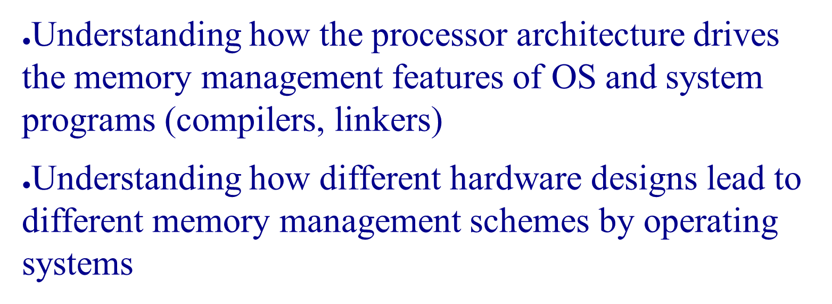

Slide 3

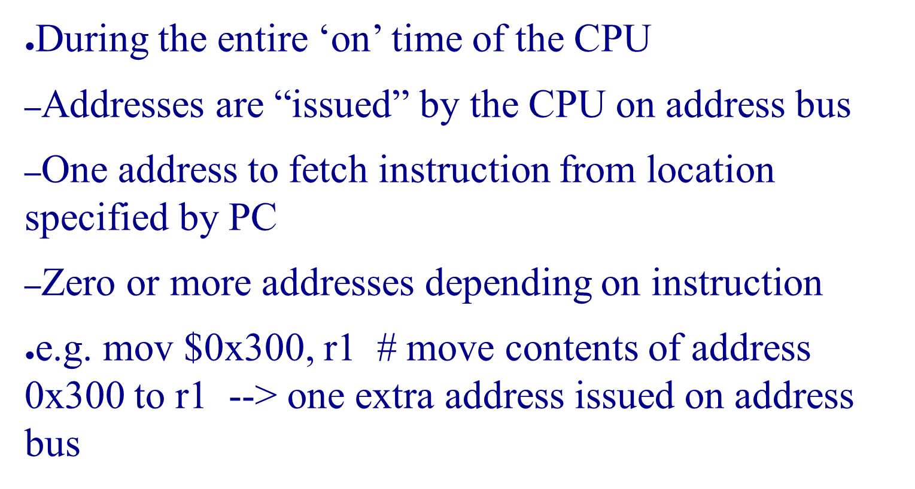

Slide 4

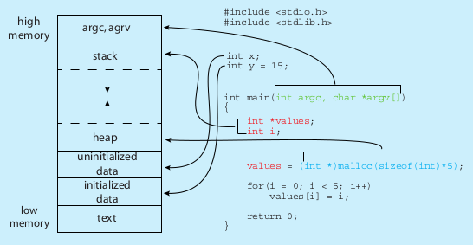
This “layout” shows
(a) which parts of a C program occupy memory, when the program is running
(b) A typical conceptual layout assumed by many compilers for calculating addresses in the generated machine code. This does not mean that other layouts are not possible
$ size /bin/ls
text data bss dec hex filename
128069 4688 4824 137581 2196d /bin/ls

Slide 5

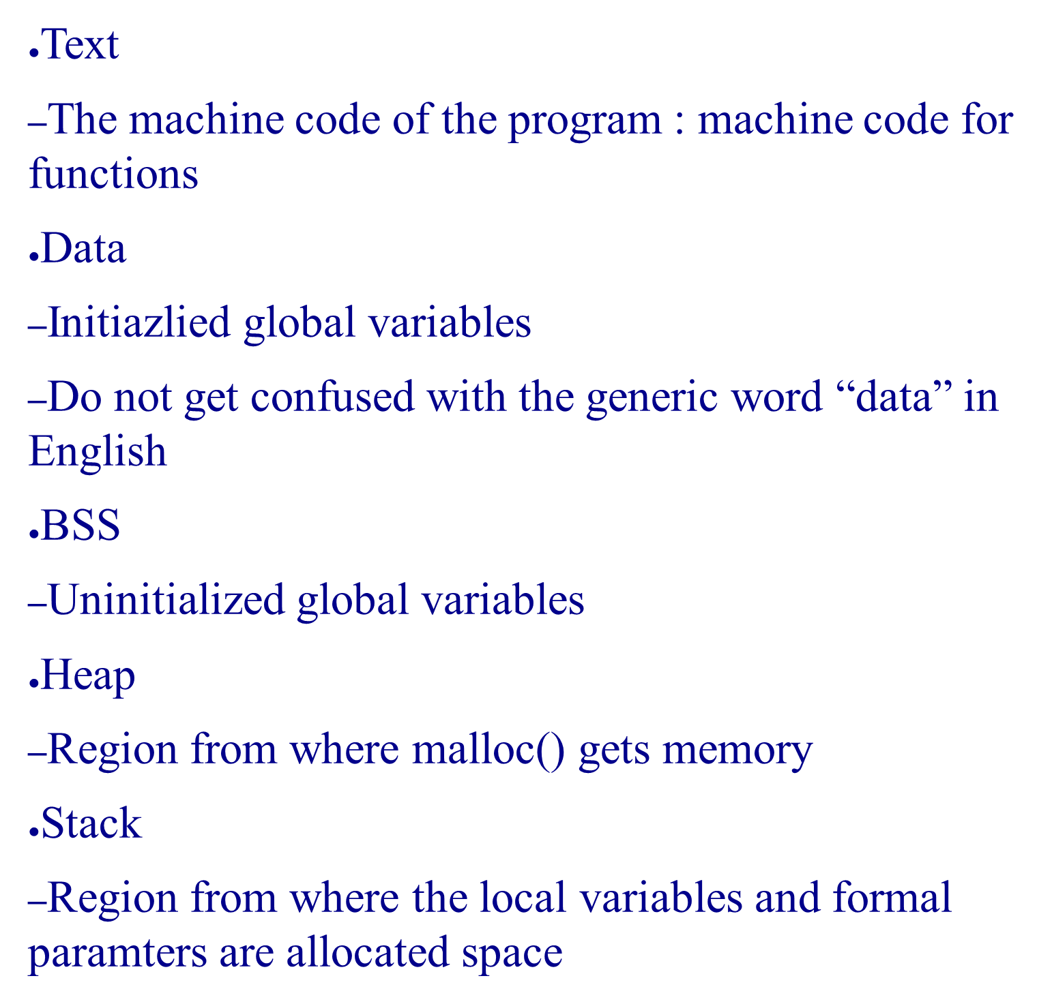

Slide 6

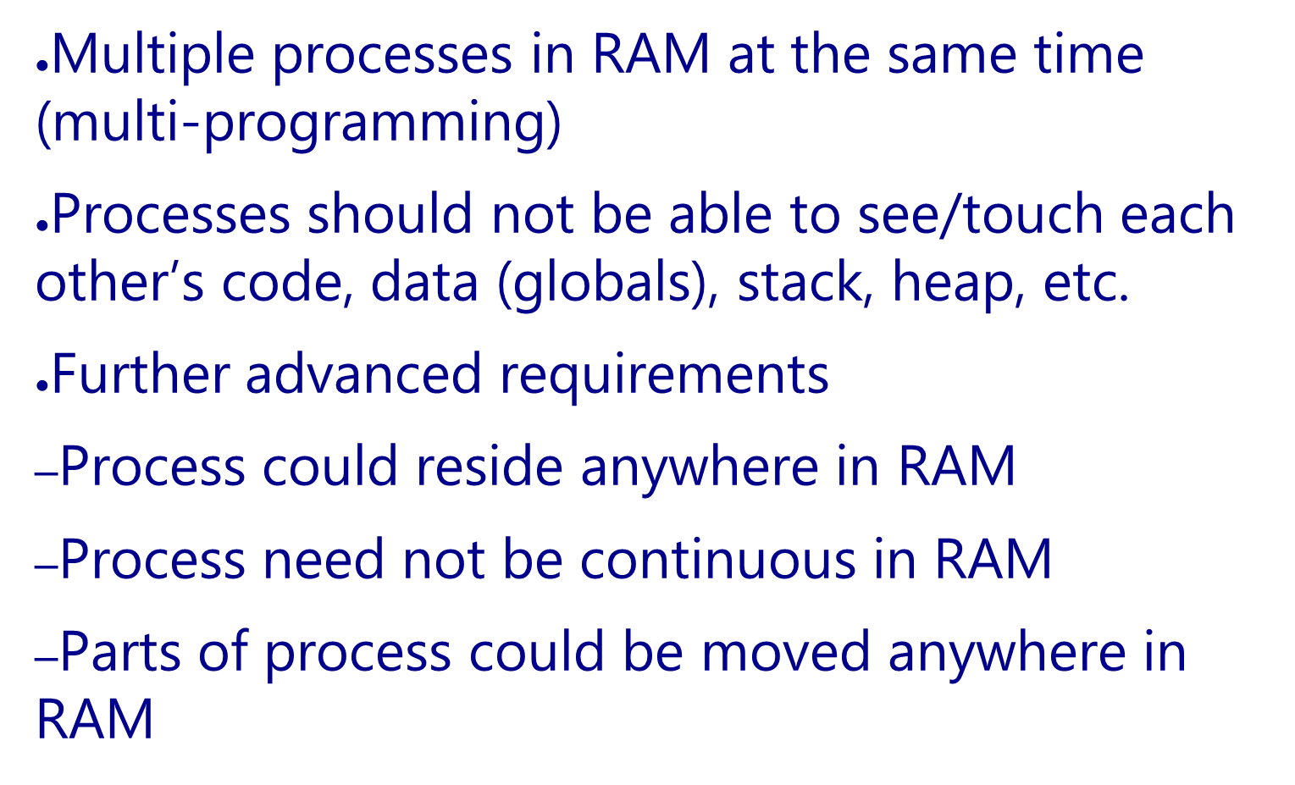

Slide 7

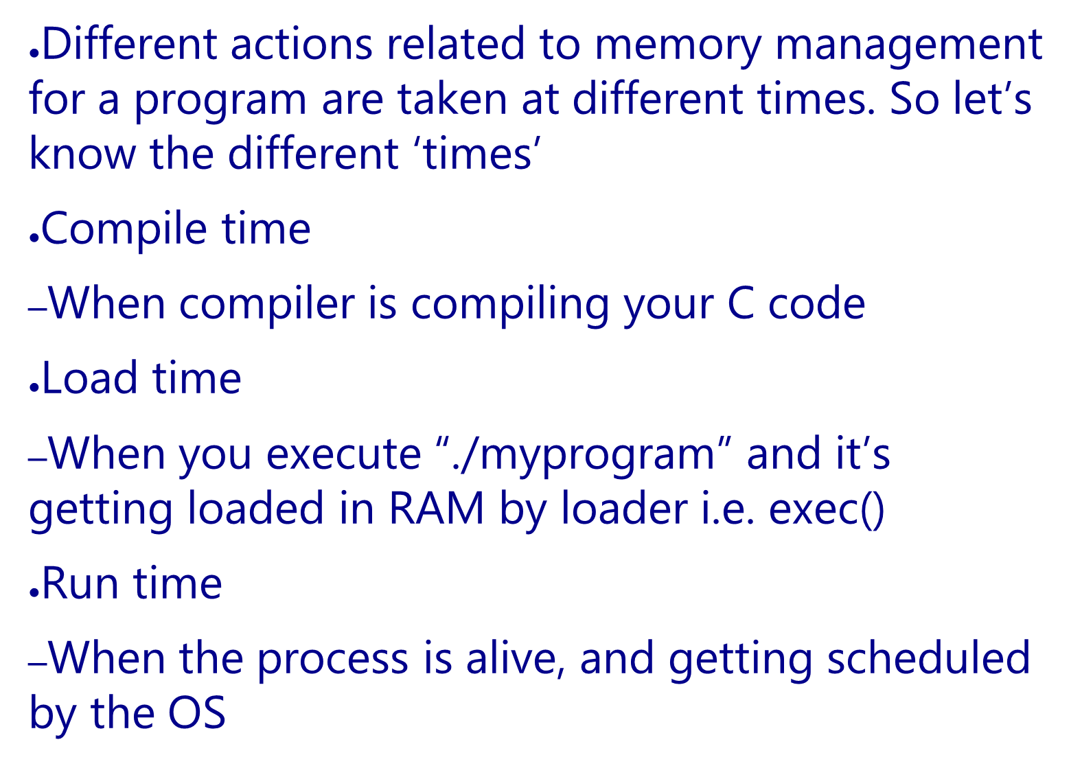

Slide 8

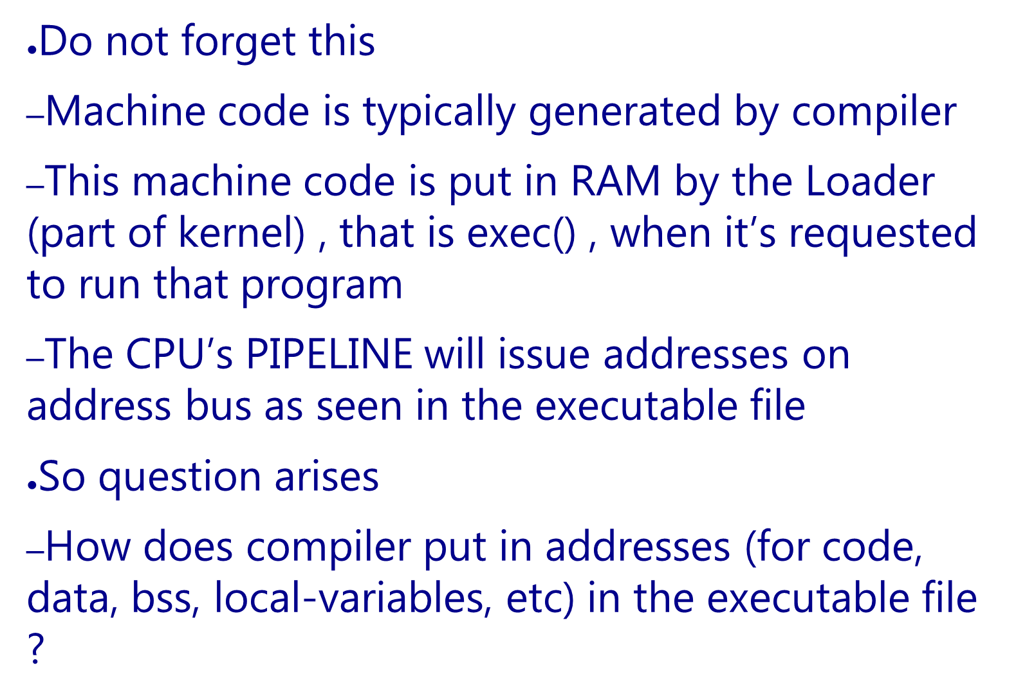

Slide 9

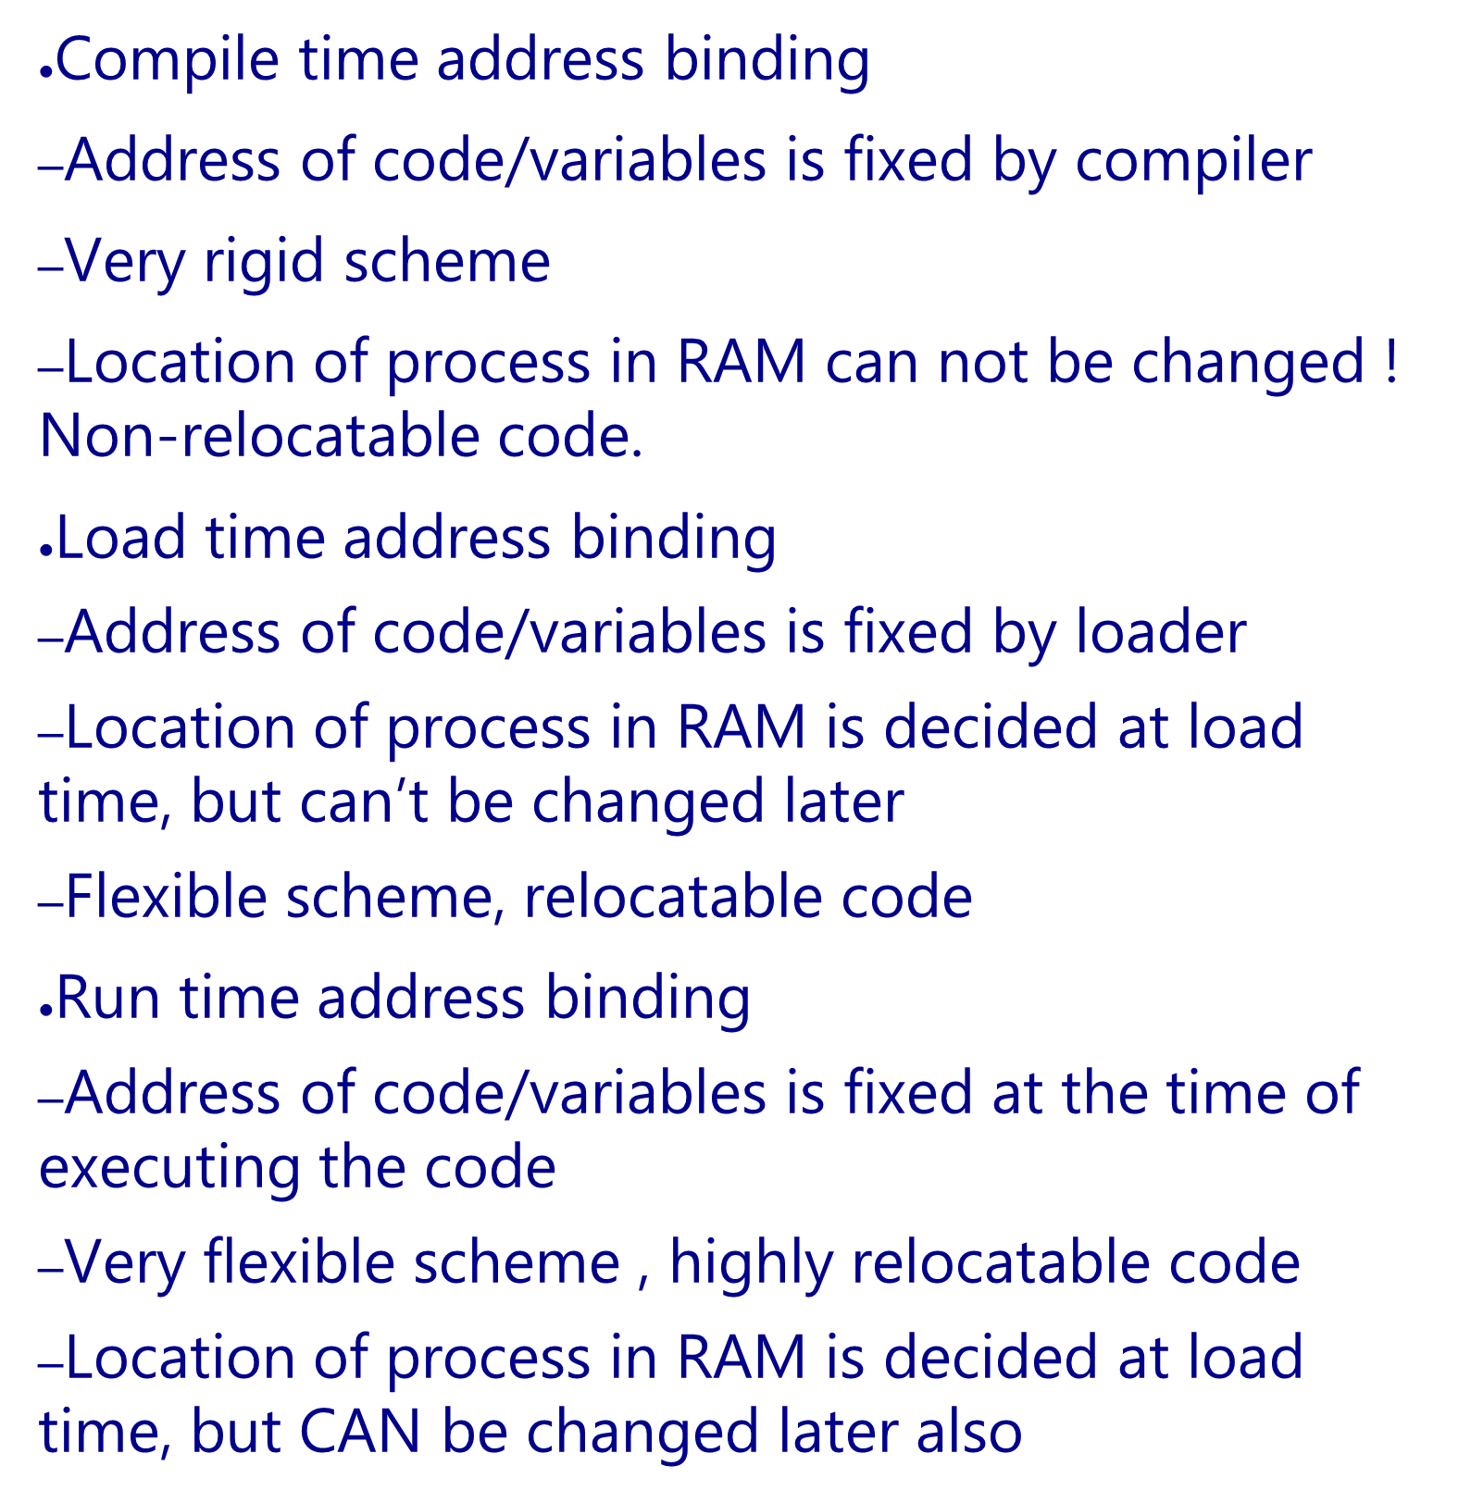
Which binding is actually used, is mandated by processor features + OS

Slide 10

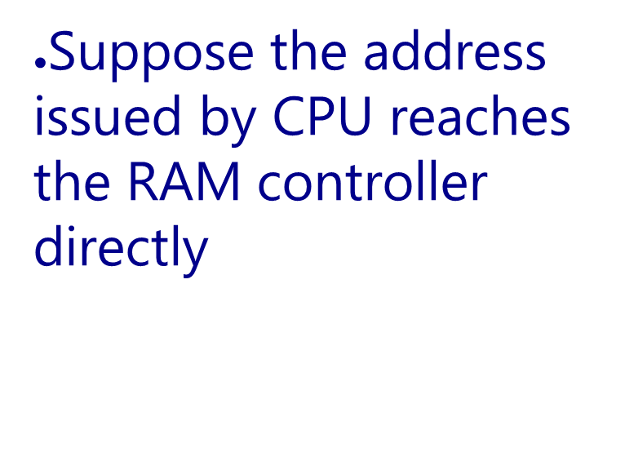
RAM
CPU
address

Slide 11
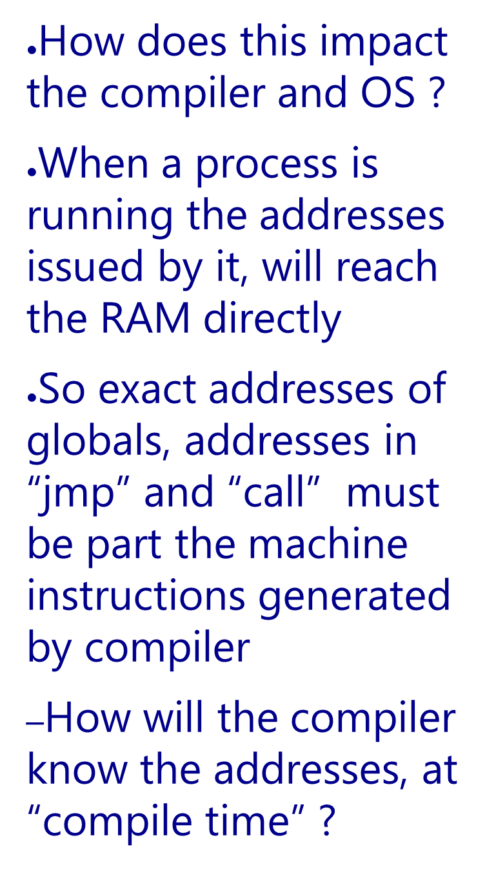
RAM
CPU
address
Example
address: instruction
1000: mov $0x300, r1
1004: add r1, -3
1008: jnz 1000
Sequence of addressed sent by CPU: 1000, 0x300, 1004, 1008, 1000, 0x300, ...

Slide 12
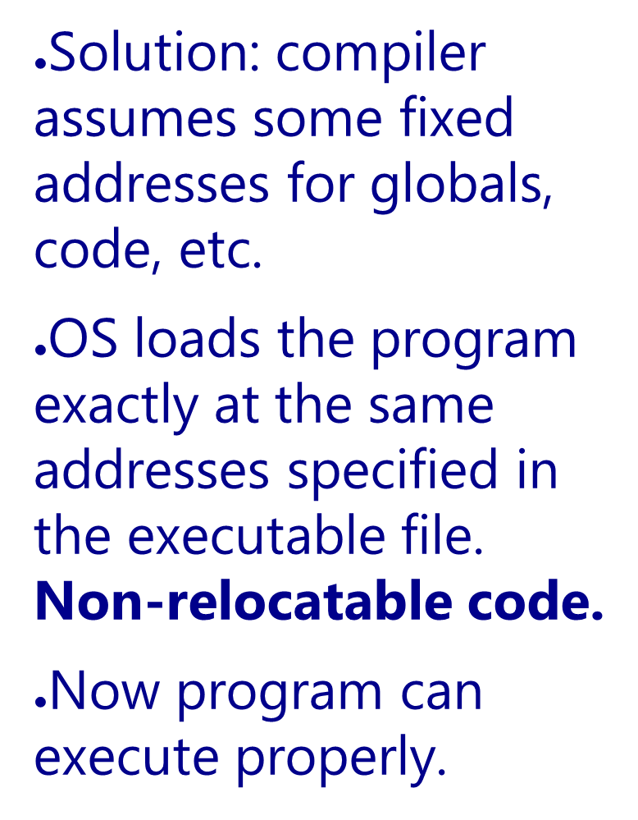
RAM
CPU
address
Example
1000: mov $0x300, r1
1004: add r1, -3
1008: jnz 1000

Slide 13
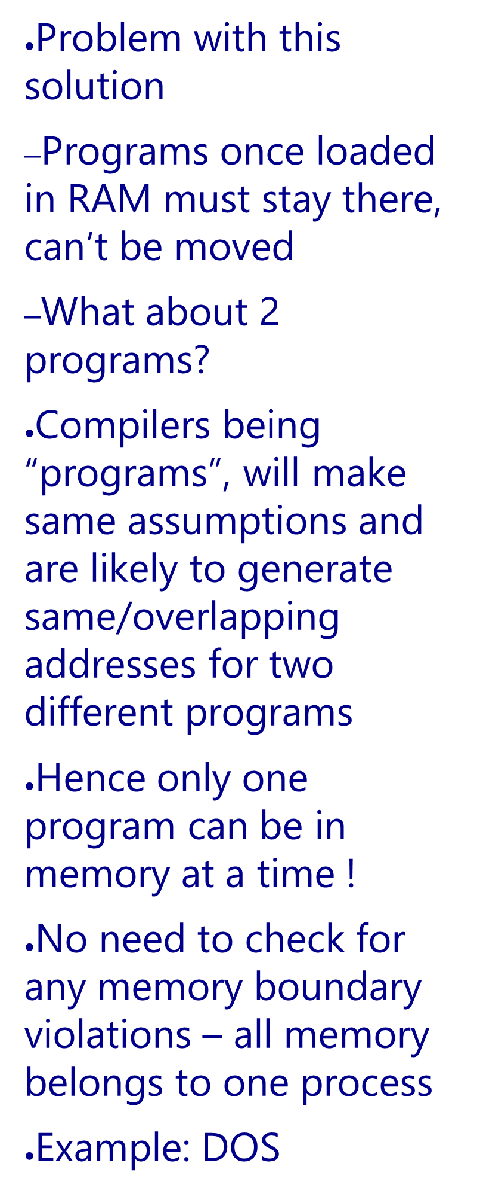
RAM
CPU
address
Example
1000: mov $0x300, r1
1004: add r1, -3
1008: jnz 1000

Slide 14

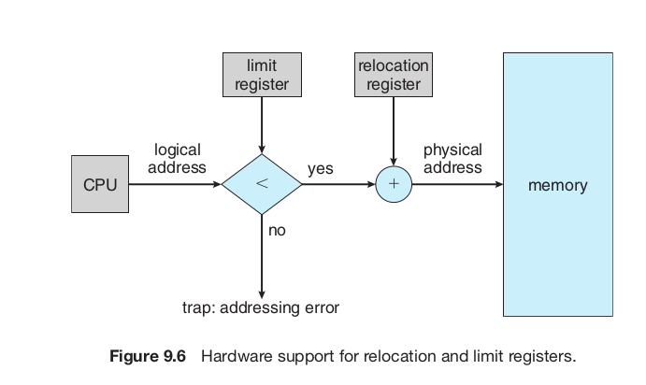
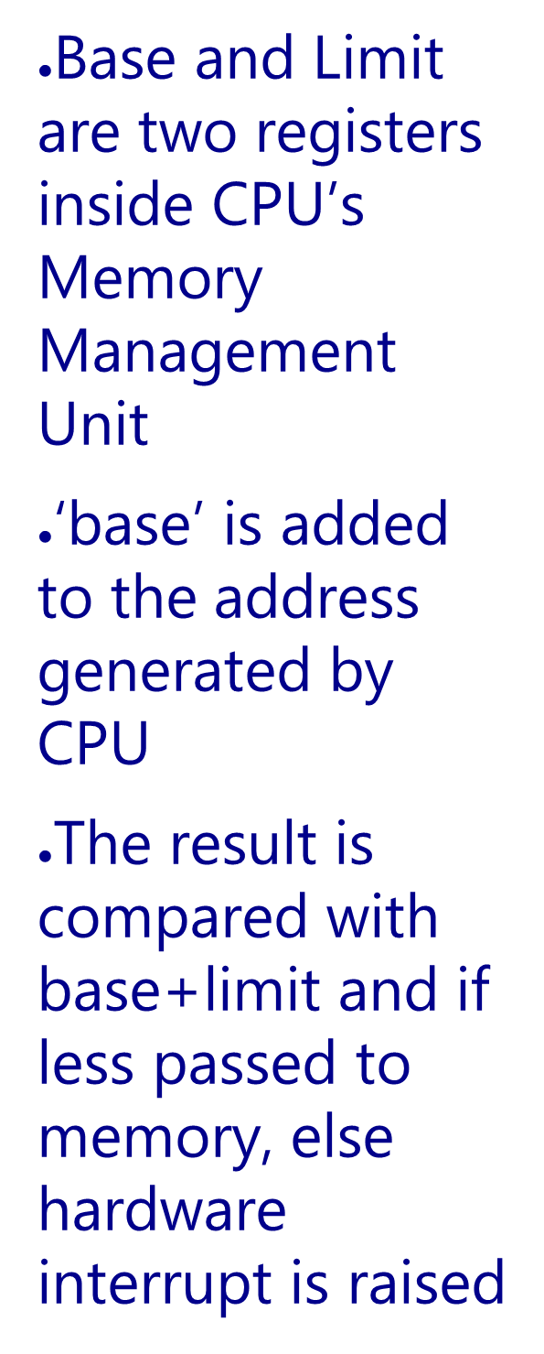
base/relocation address
Process
In
RAM

Slide 15
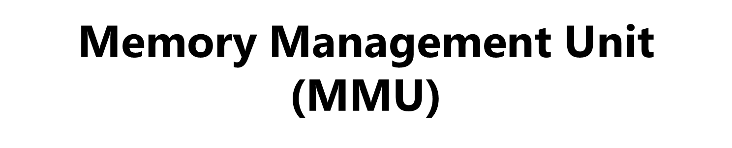
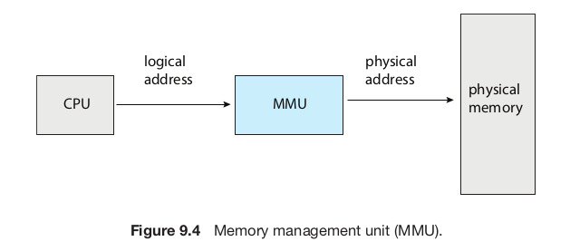
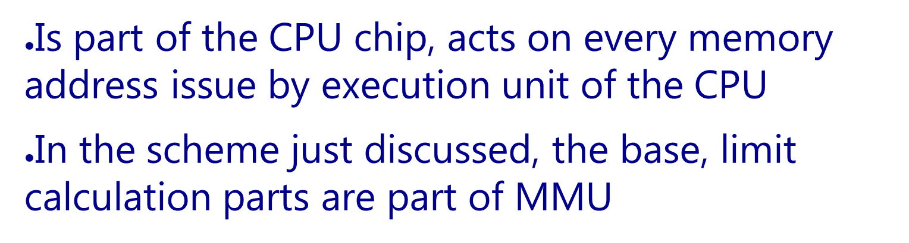

Slide 16
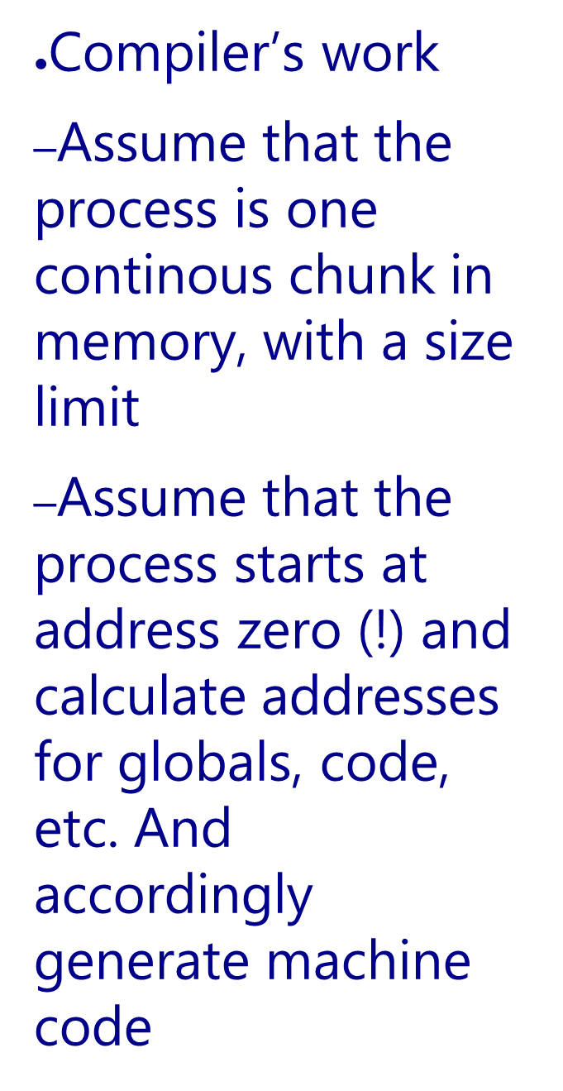
base
Compiler’s
view
Process
In
RAM
Base =0
Limit
Code
--
data
--
Bss
--
heap
--
stack
Limit
RAM

Slide 17
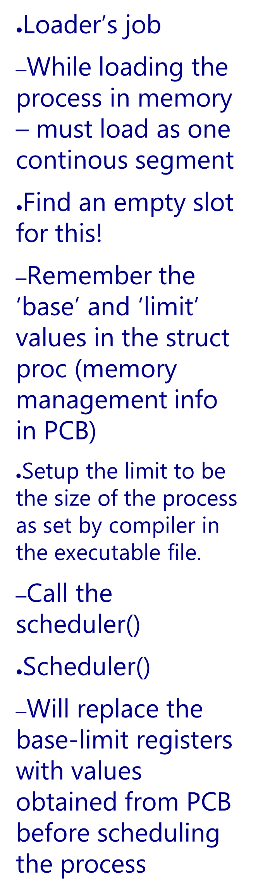
base/relocation address
Process
In
RAM

Slide 18
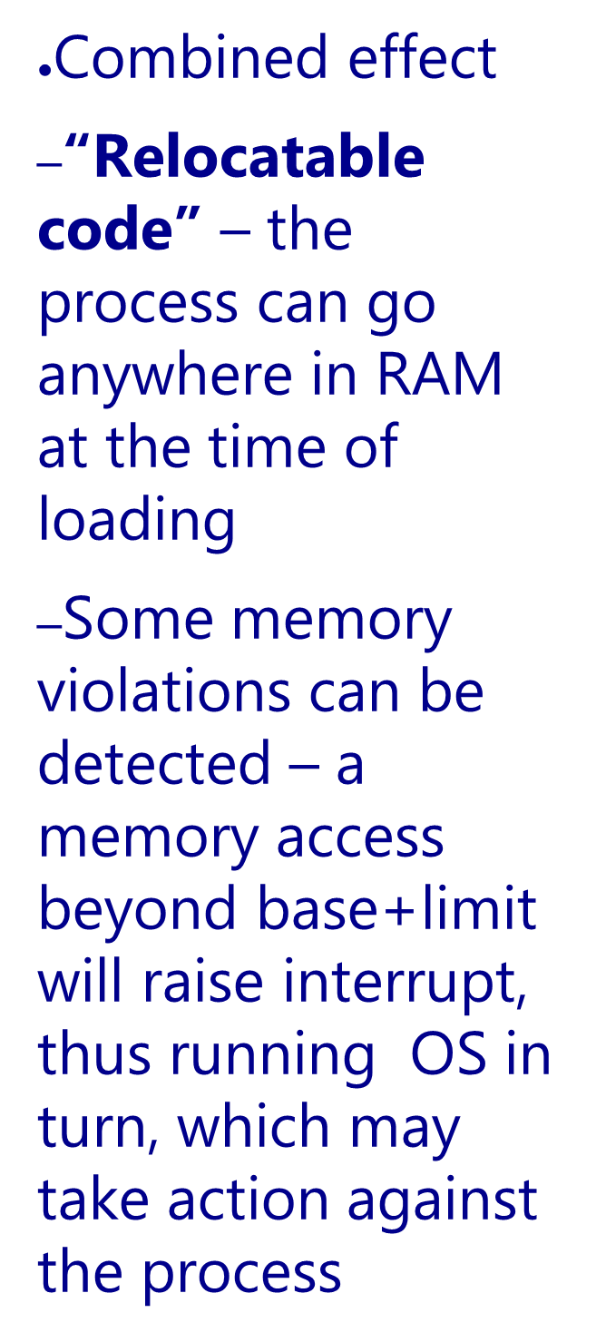
base/relocation address
Process
In
RAM

Slide 19

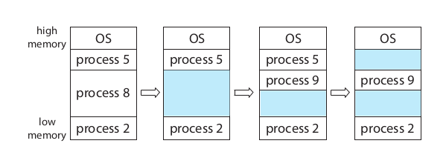
Process 8 called exit()
Process 9 forked
Process 5 terminated

Slide 20
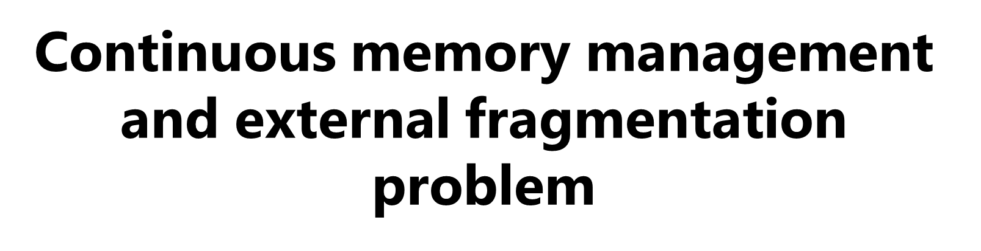
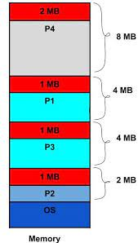
Free chunks: 2 MB, 1MB, 1MB, 1MB
Total 5 MB is available!
Can we create a process of size 3MB?
No! - 3 MB not continous!

Slide 21

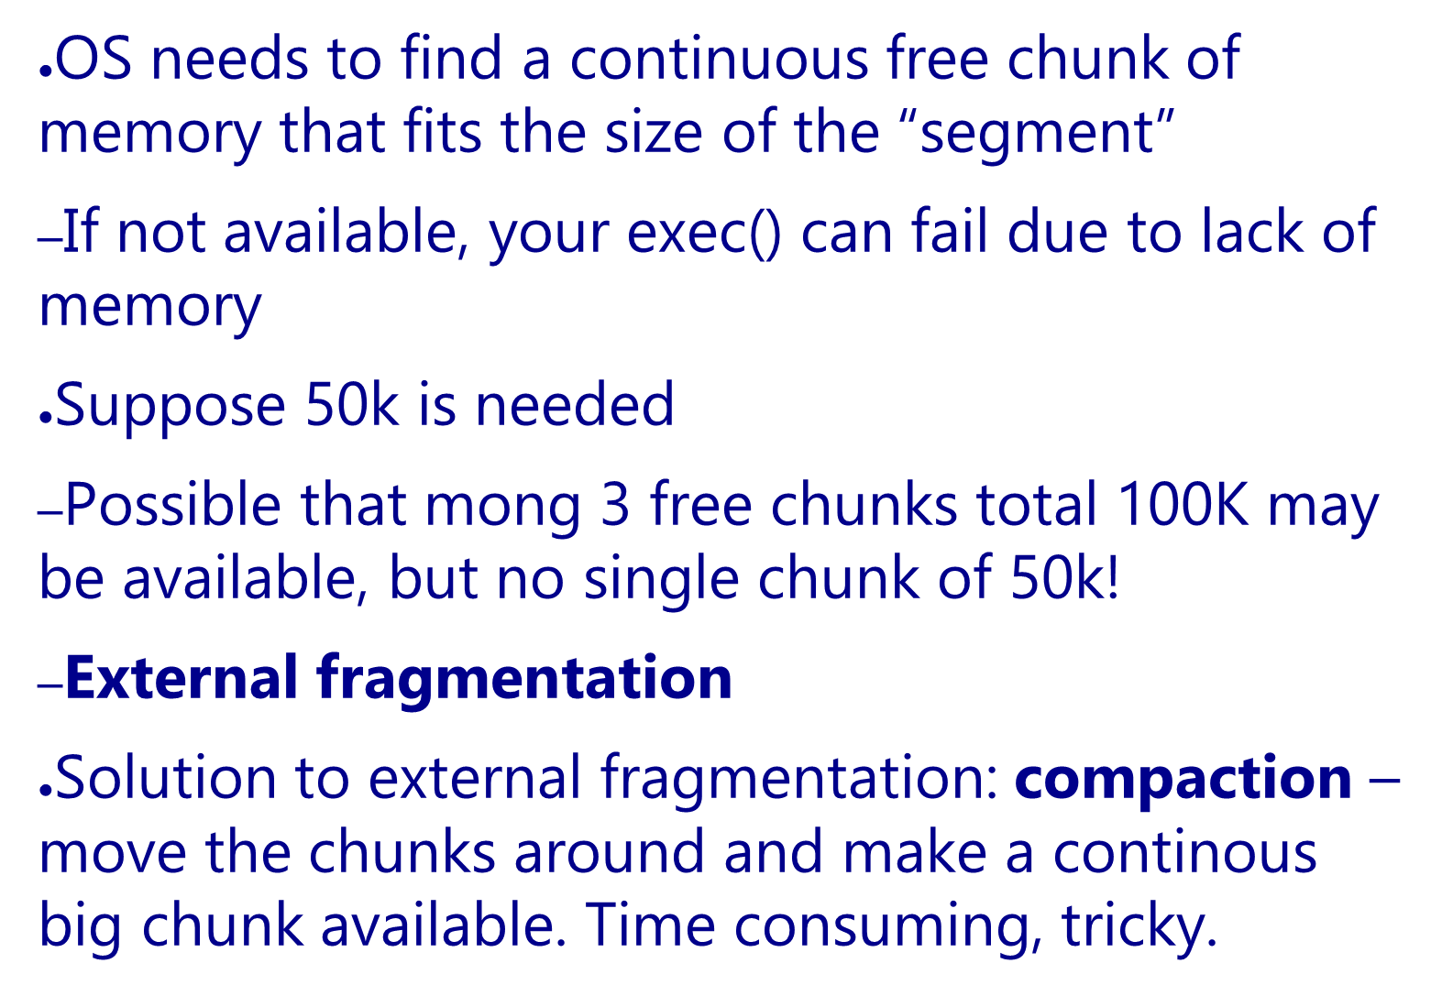

Slide 22
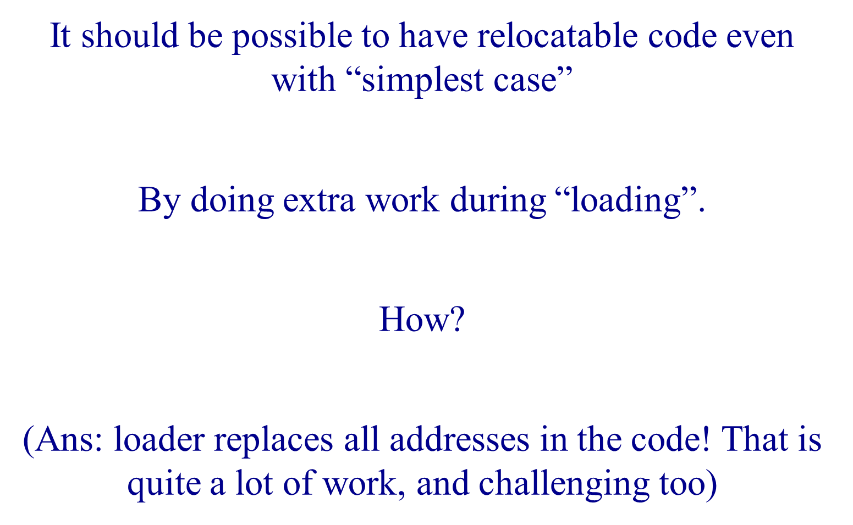

Slide 23

Limit:text
Base: text
Limit:data
Base: data
Limit: heap
Base: heap
P1: text
Limit: stack
Base: stack
Segment selector
P1: data
P1: heap
>
+
Logical address
Physical address
P1: stack
trap

Slide 24

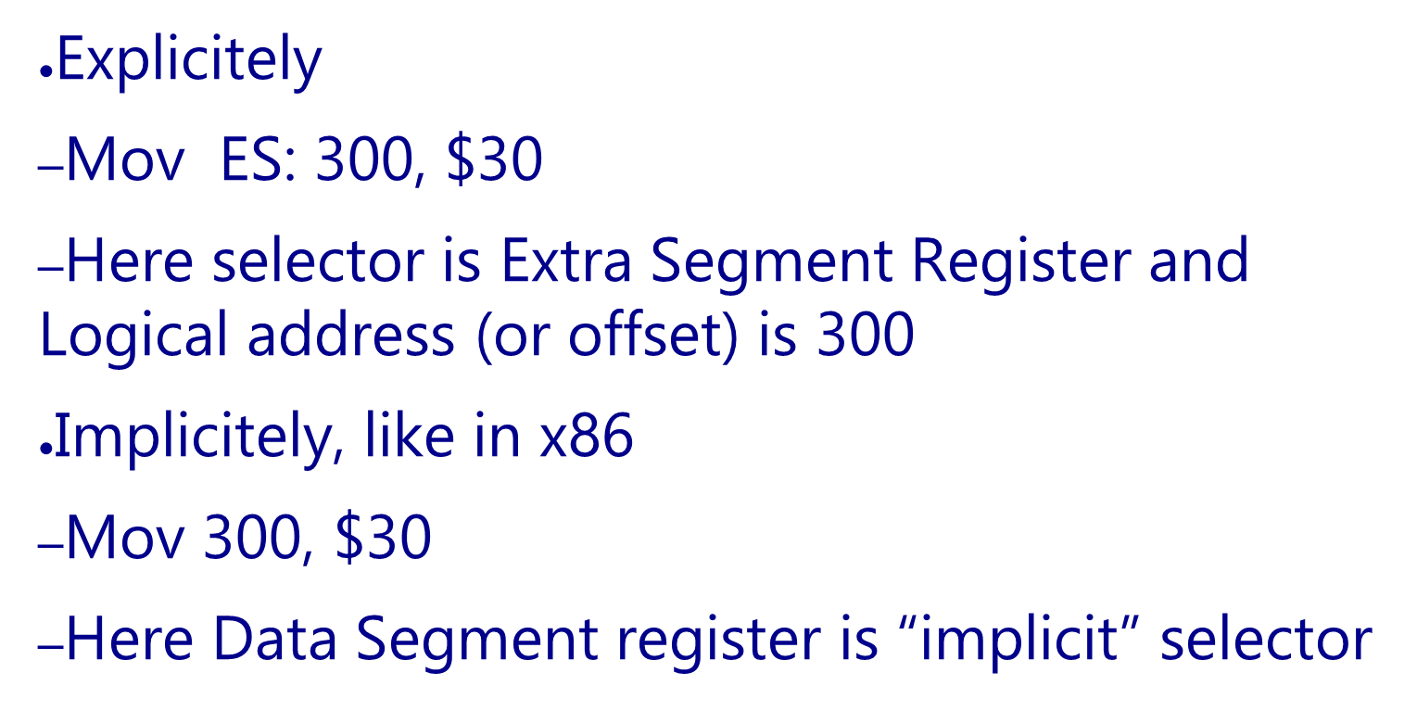

Slide 25

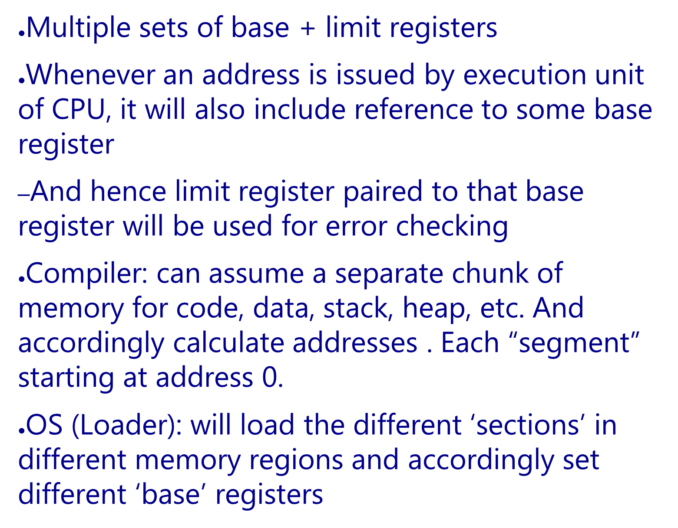

Slide 26

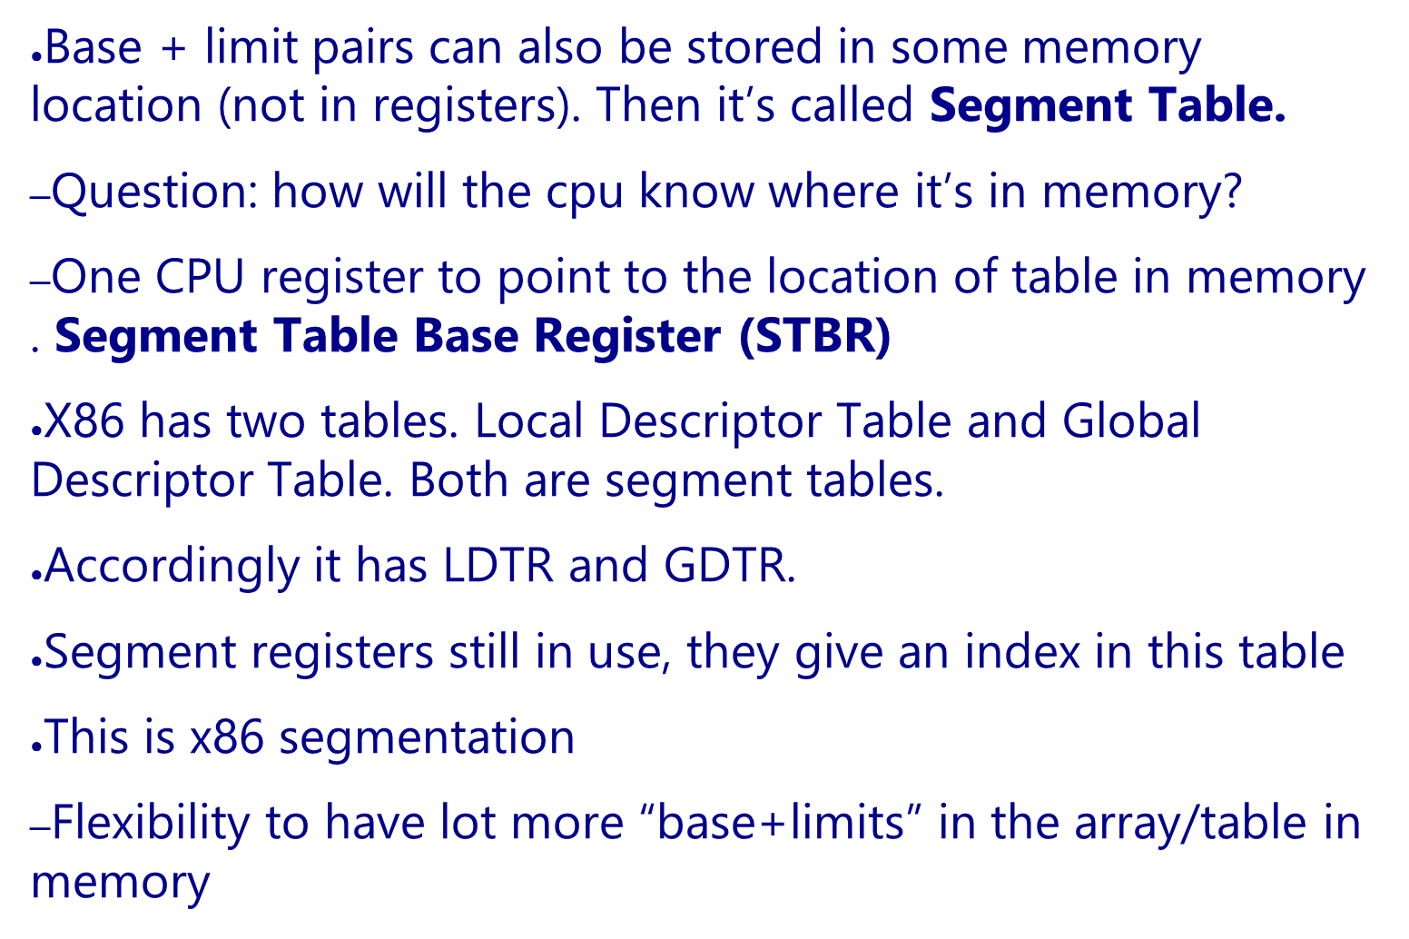

Slide 27

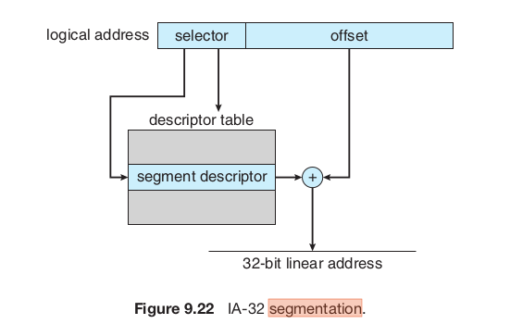
Note:
”Selector” here is normally a segment register, like CS, DS
The machine code only has offset in it
The “Descriptor table” is a segmentation table

Slide 28

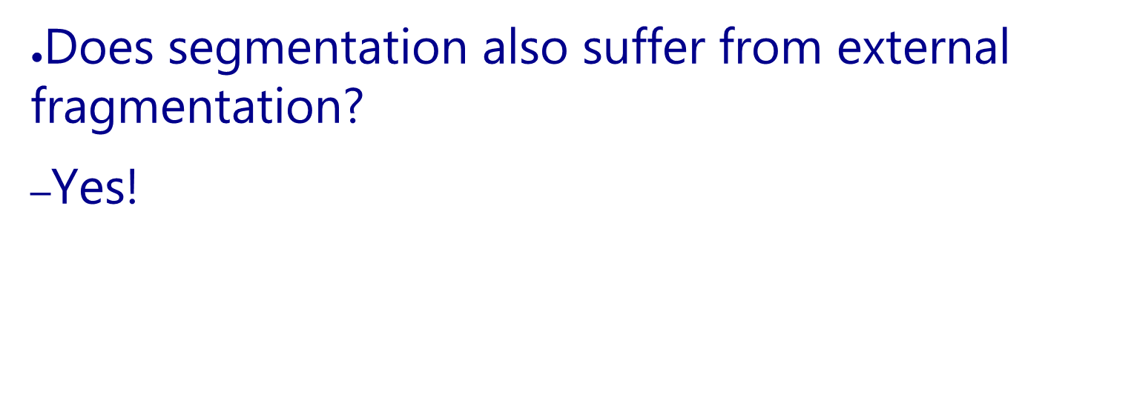

Slide 29

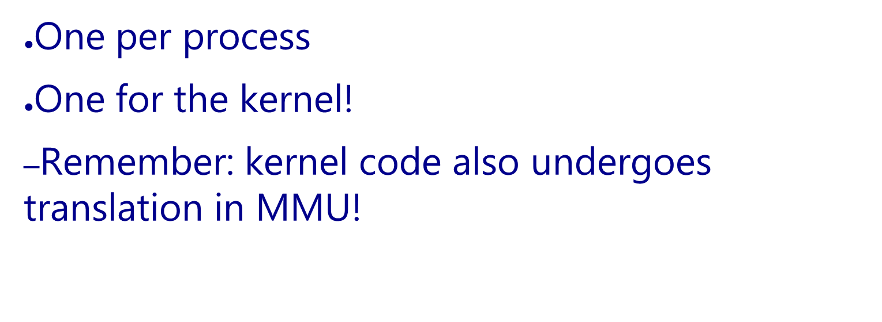

Slide 30

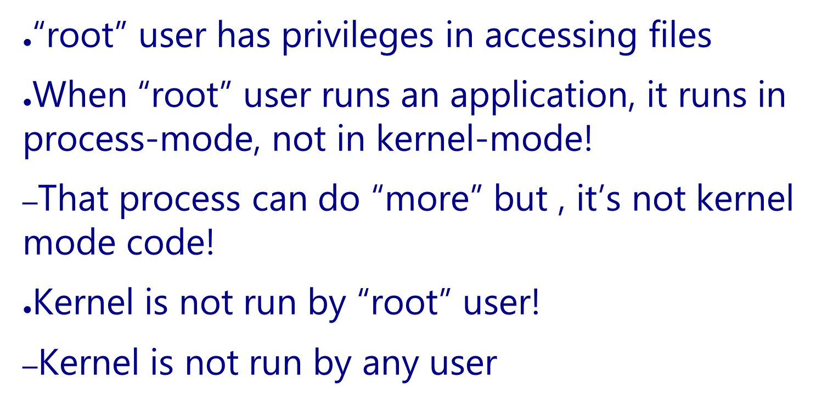

Slide 31

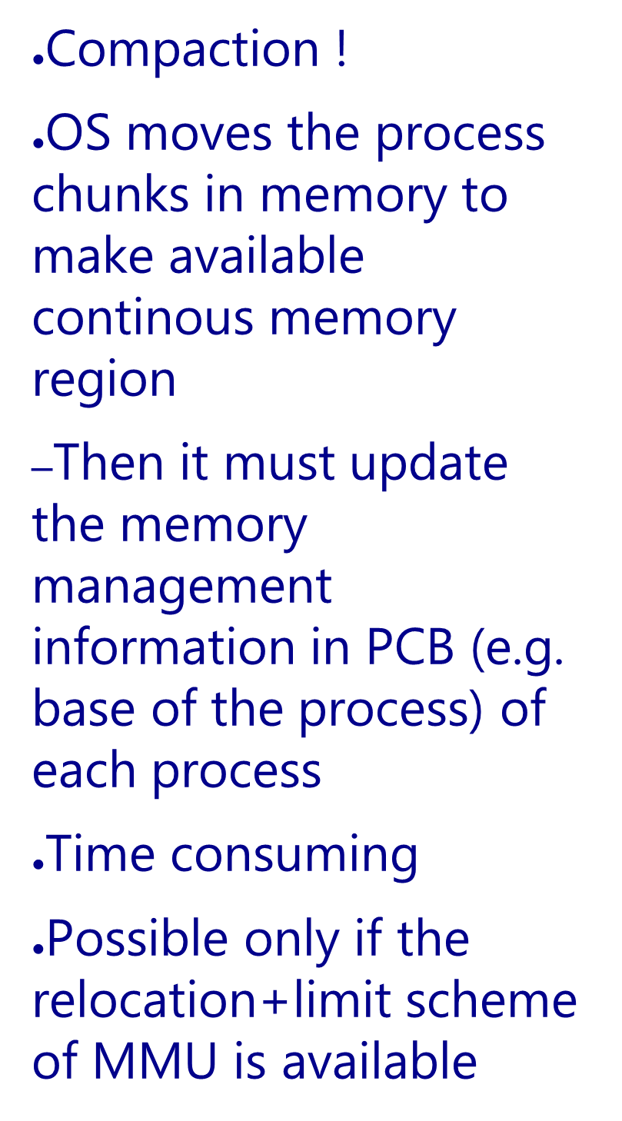
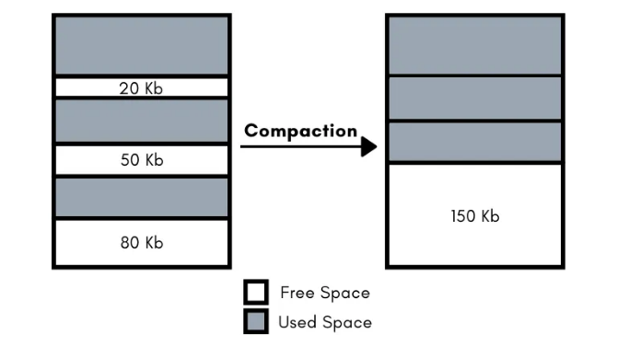
P1
P1
P2
P2
P3
P3

Slide 32

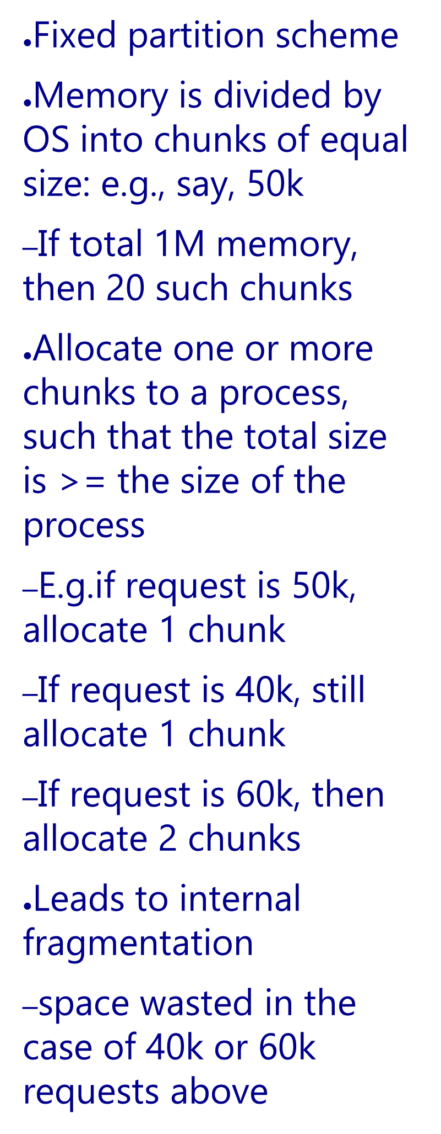


50K
Kernel
50K
Kernel
50K
Free
50K
P1 (50 KB)
50K
P2 (80 KB)
50K
50K
Free
50K
P3 (120 KB)
50K
50K
50K
Free
50K
Free

Slide 33

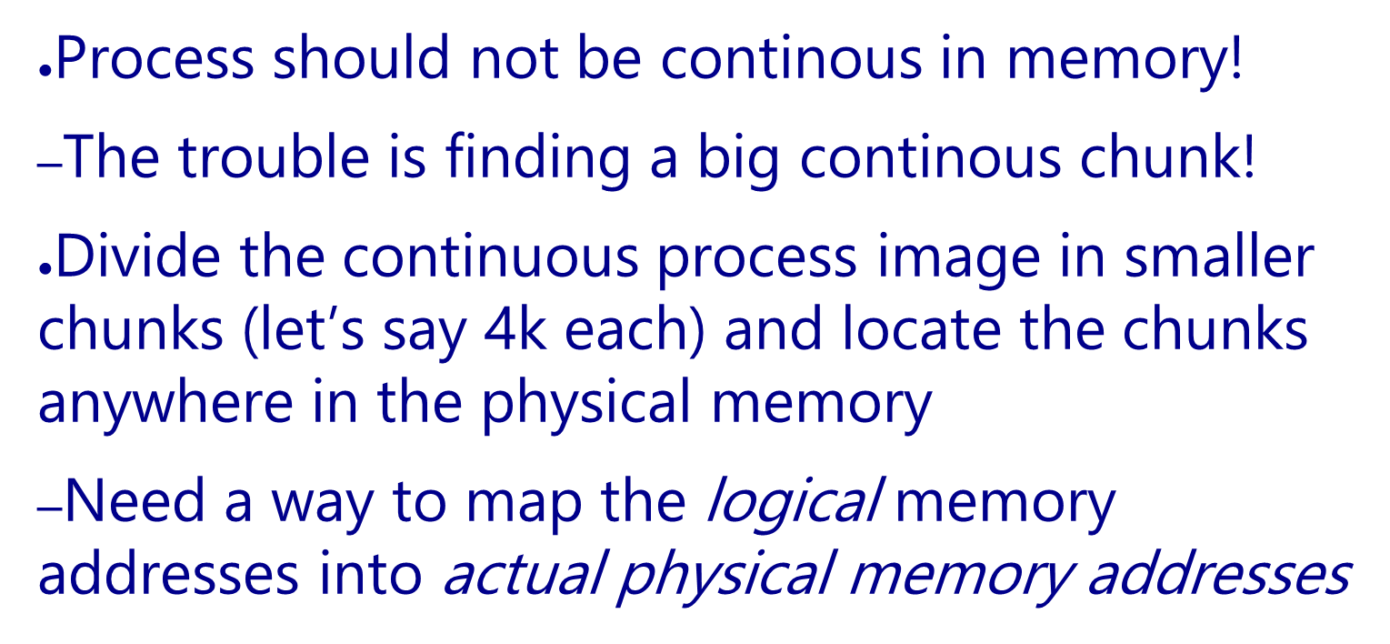

Slide 34
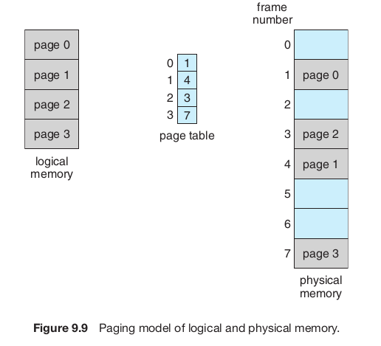

Slide 35
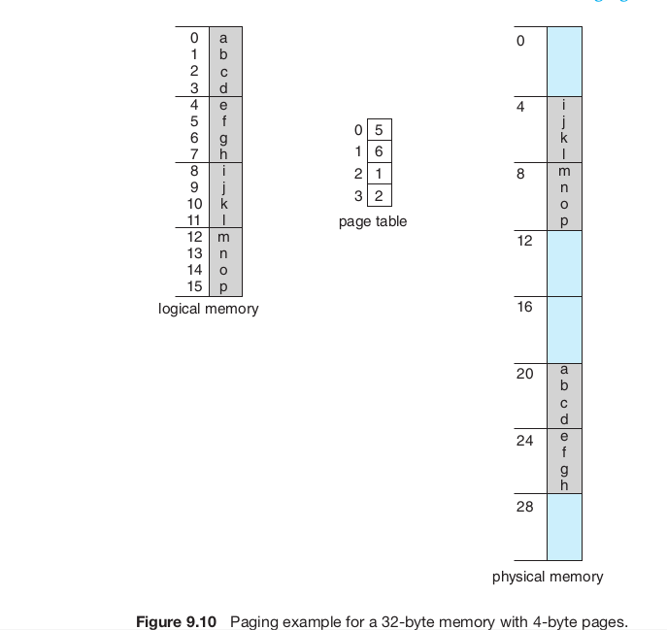

Slide 36
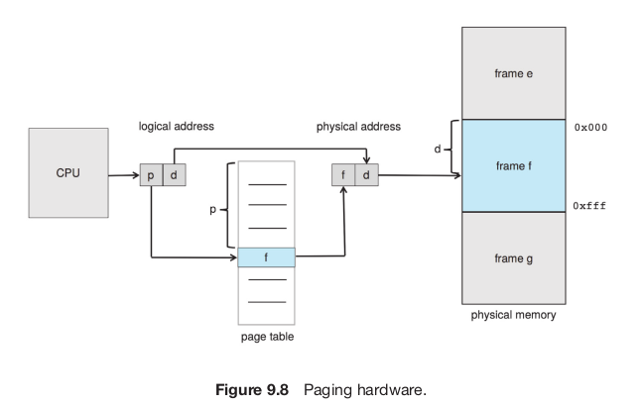

PTBR

Slide 37

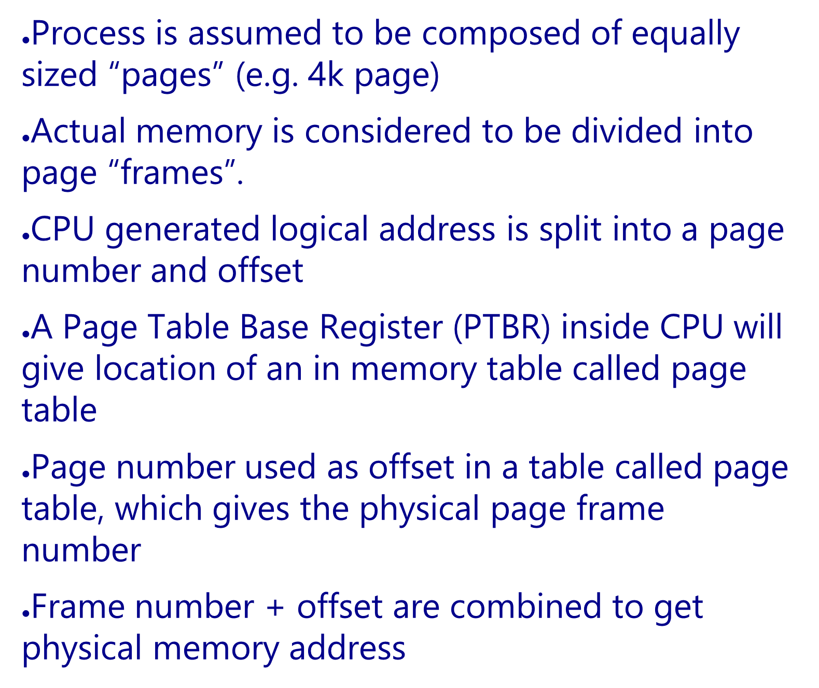

Slide 38
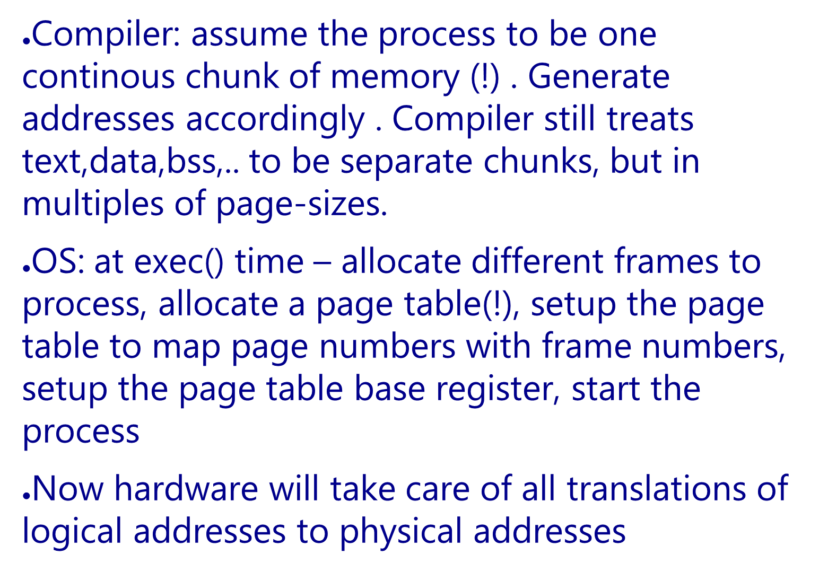

Slide 39
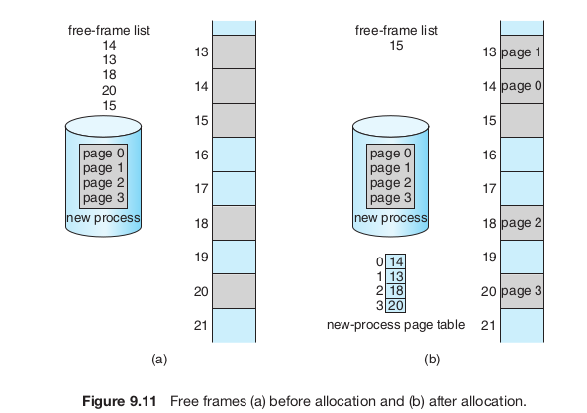

Slide 40

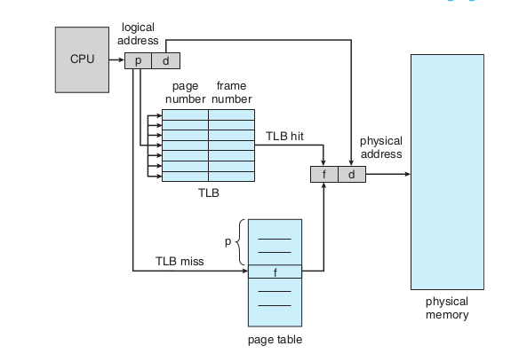
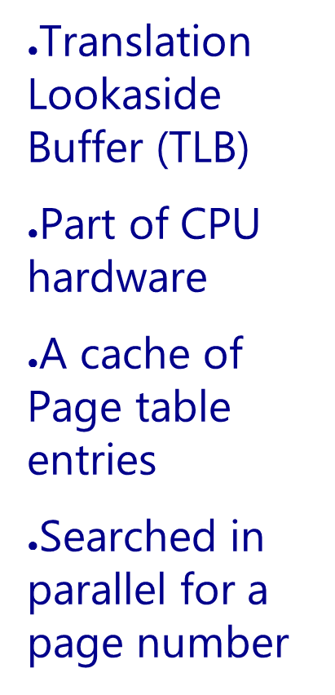

Slide 41

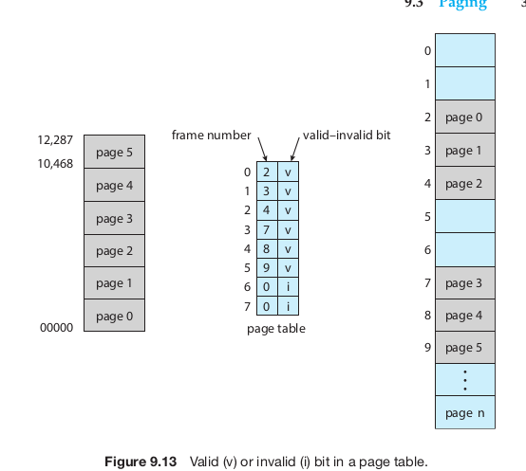

Slide 42
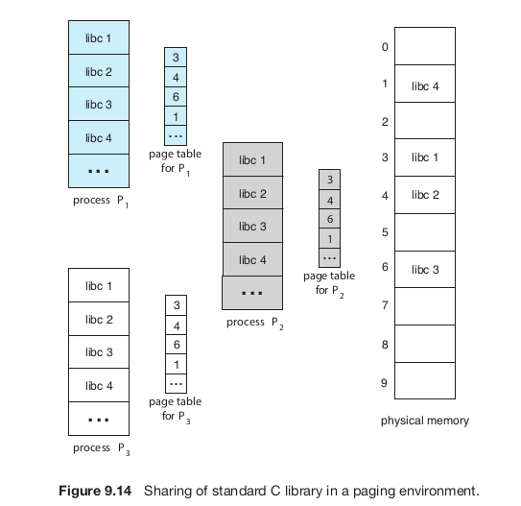


Slide 43

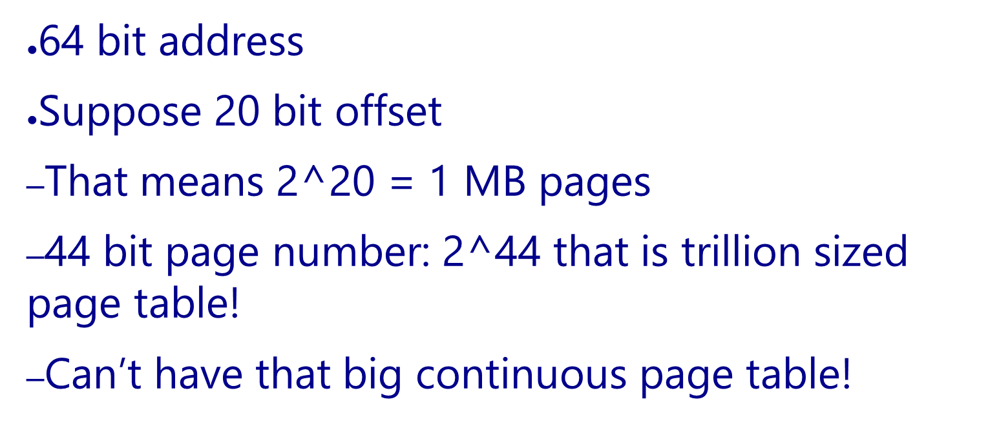

Slide 44
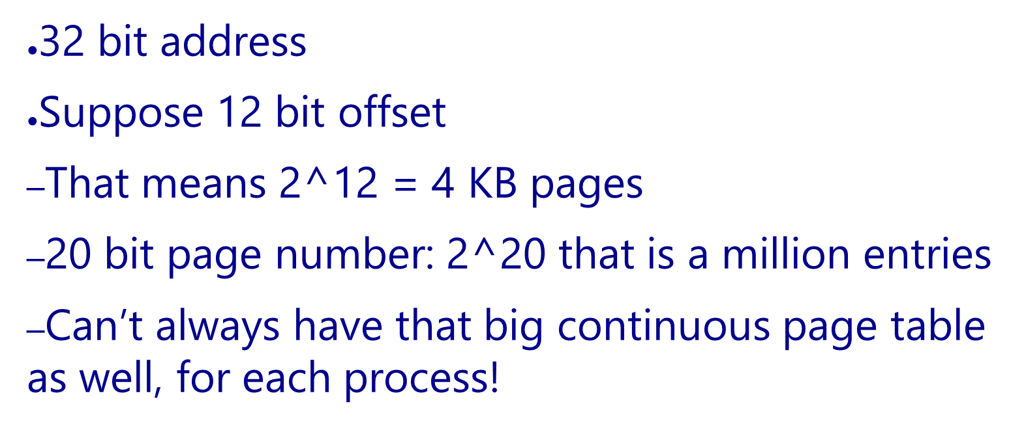

Slide 45
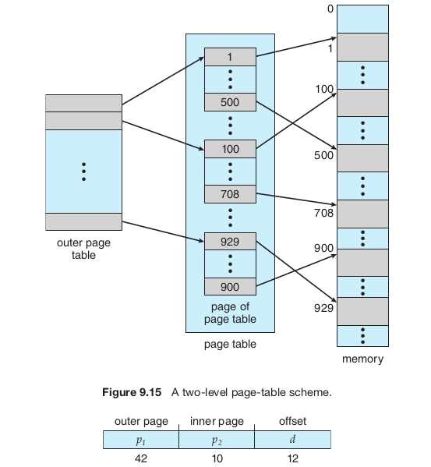

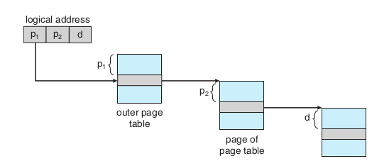

Slide 46


Slide 47


Slide 48




Slide 49




Slide 50


GDTR
Selector value is implicit based on address being accessed.
Instruction: CS
Stack Variable: SS
Data: DS
etc.

Slide 51



