Slide 1
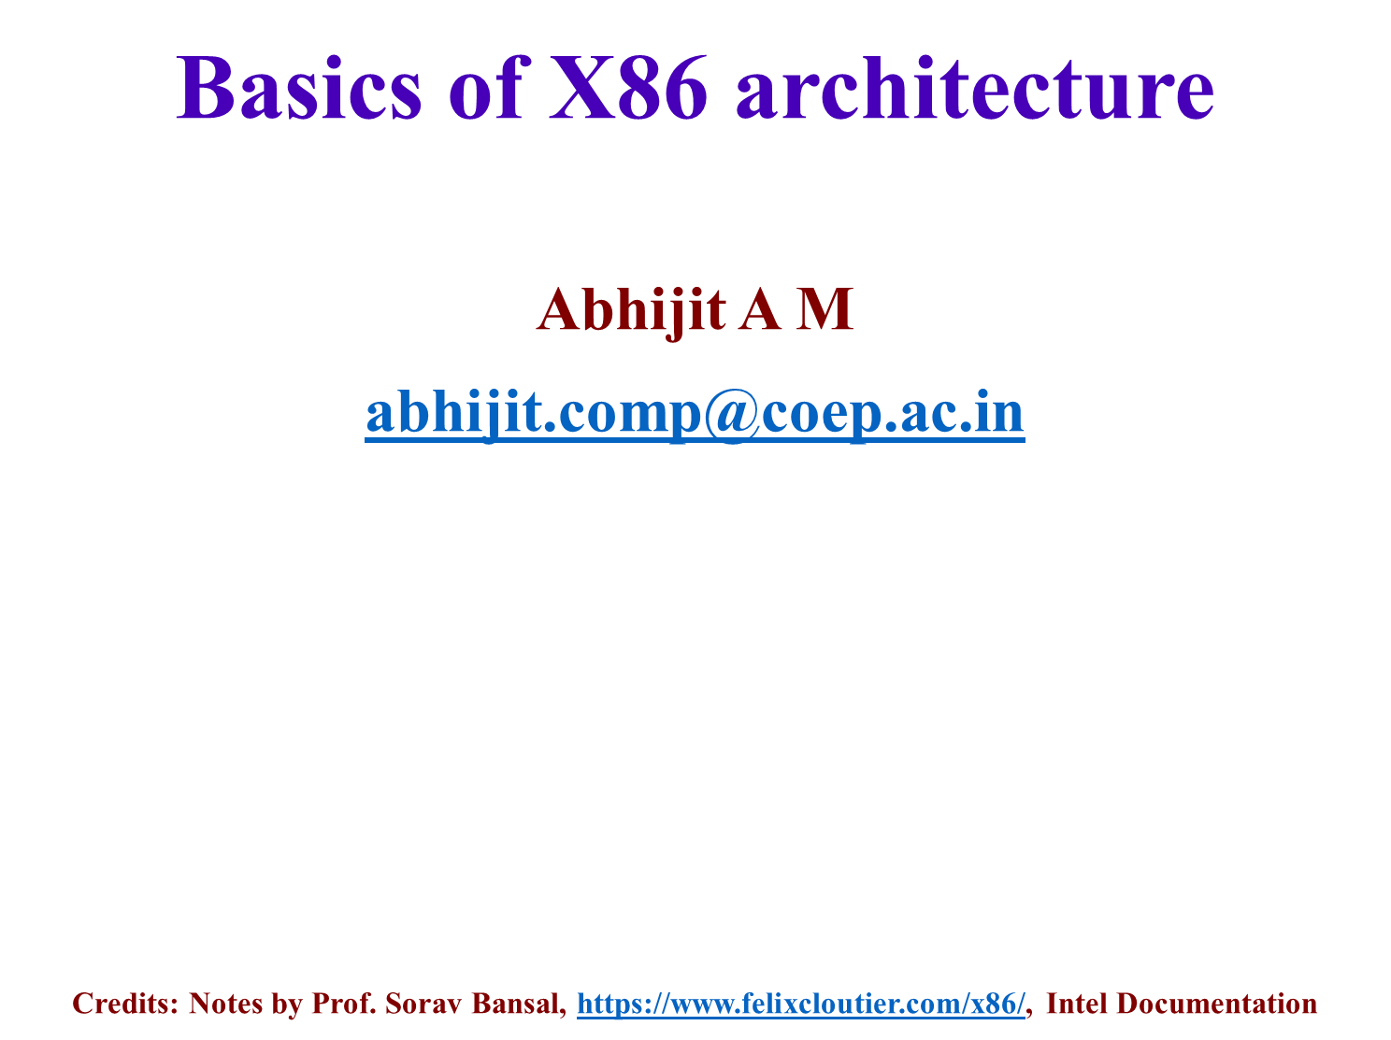

Slide 2

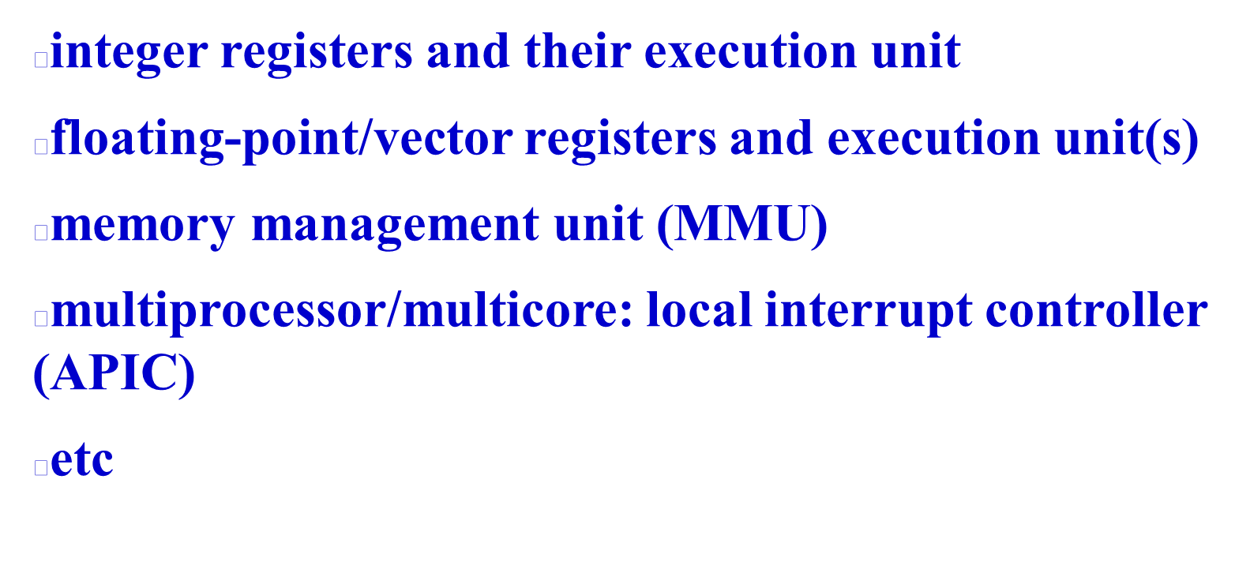

Slide 3

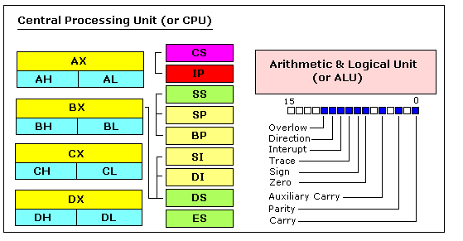
https://jerry153fish.github.io/2016/01/01/8086-Registers.html

Slide 4

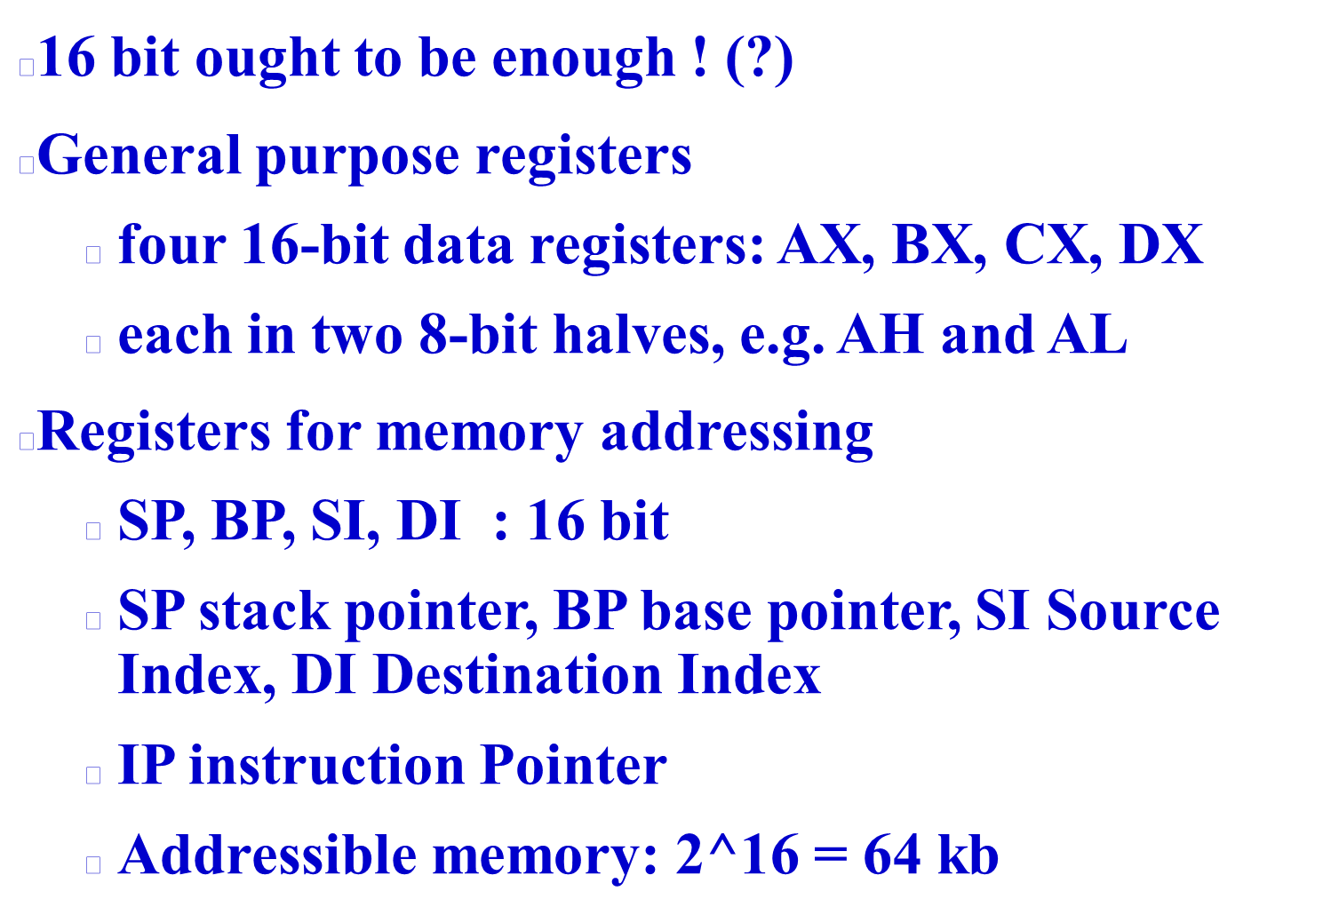

Slide 5

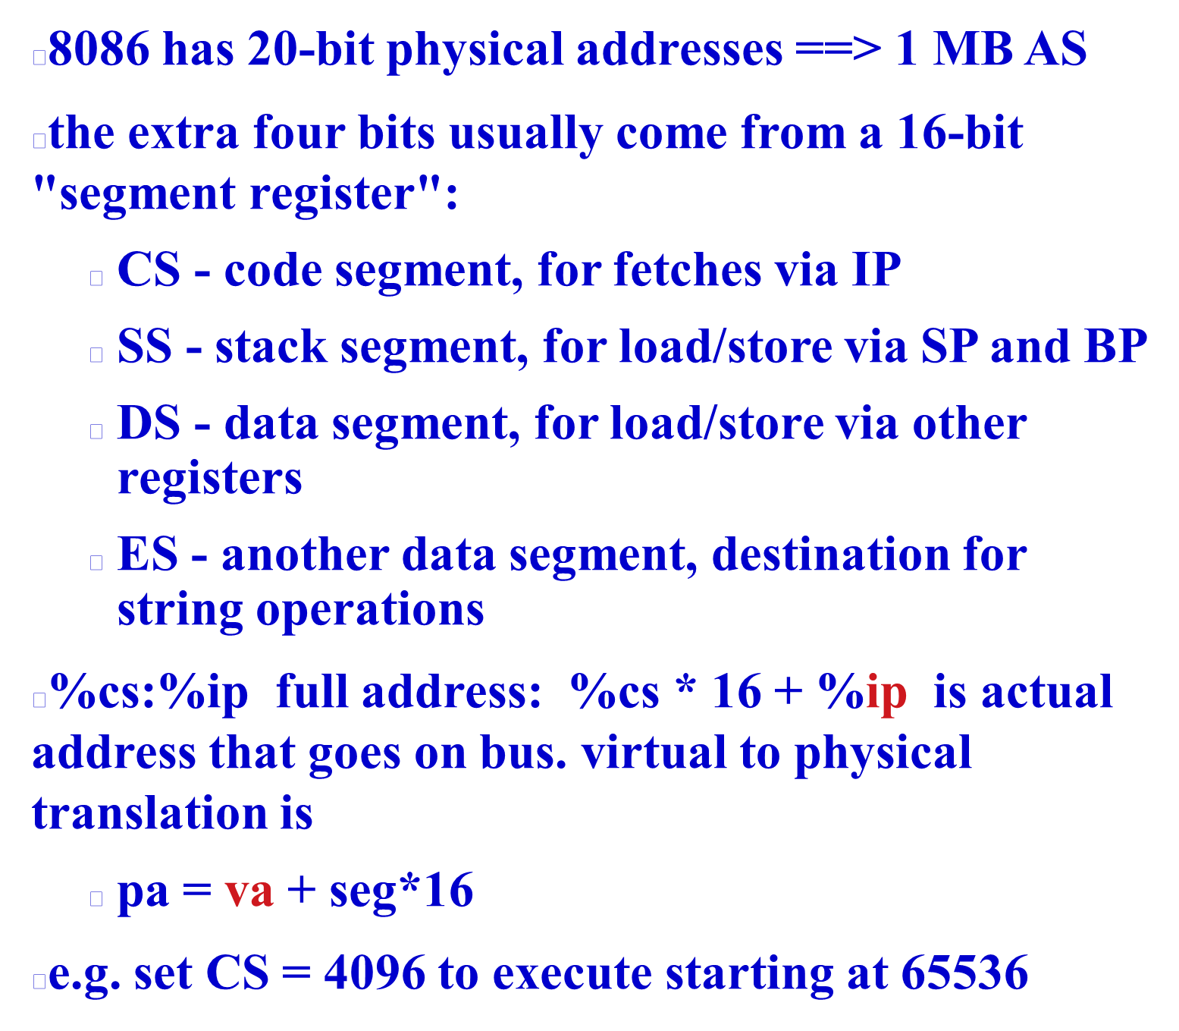

Slide 6
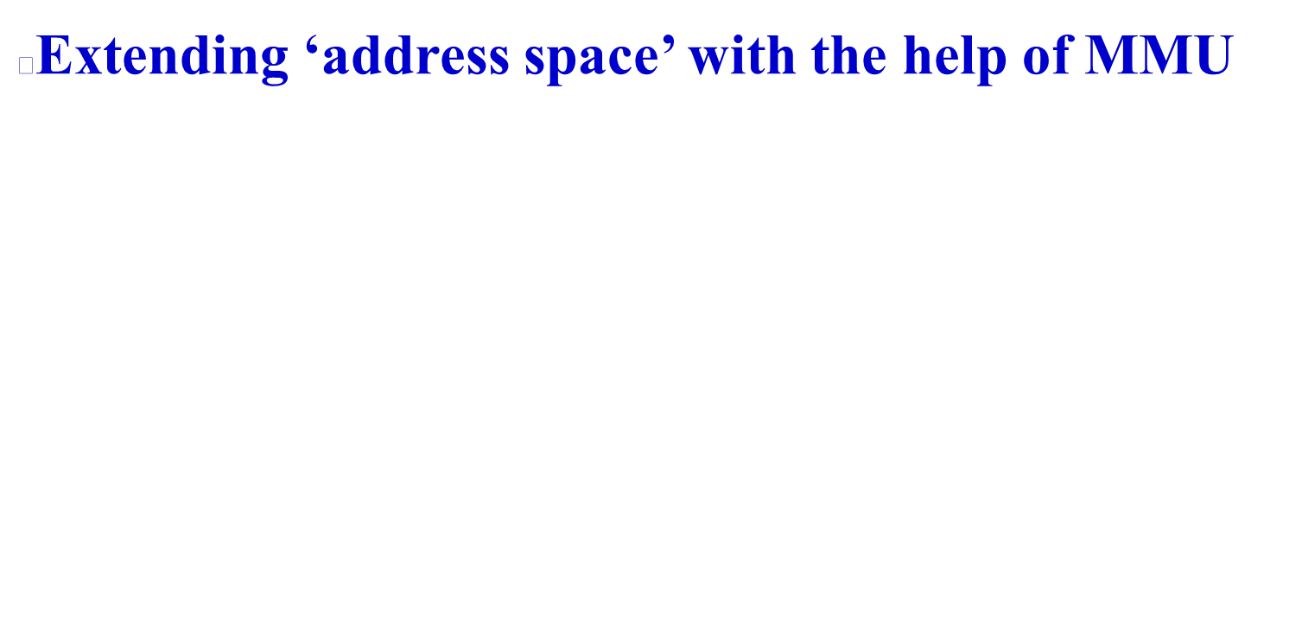
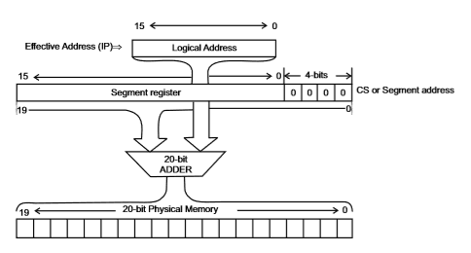

Slide 7

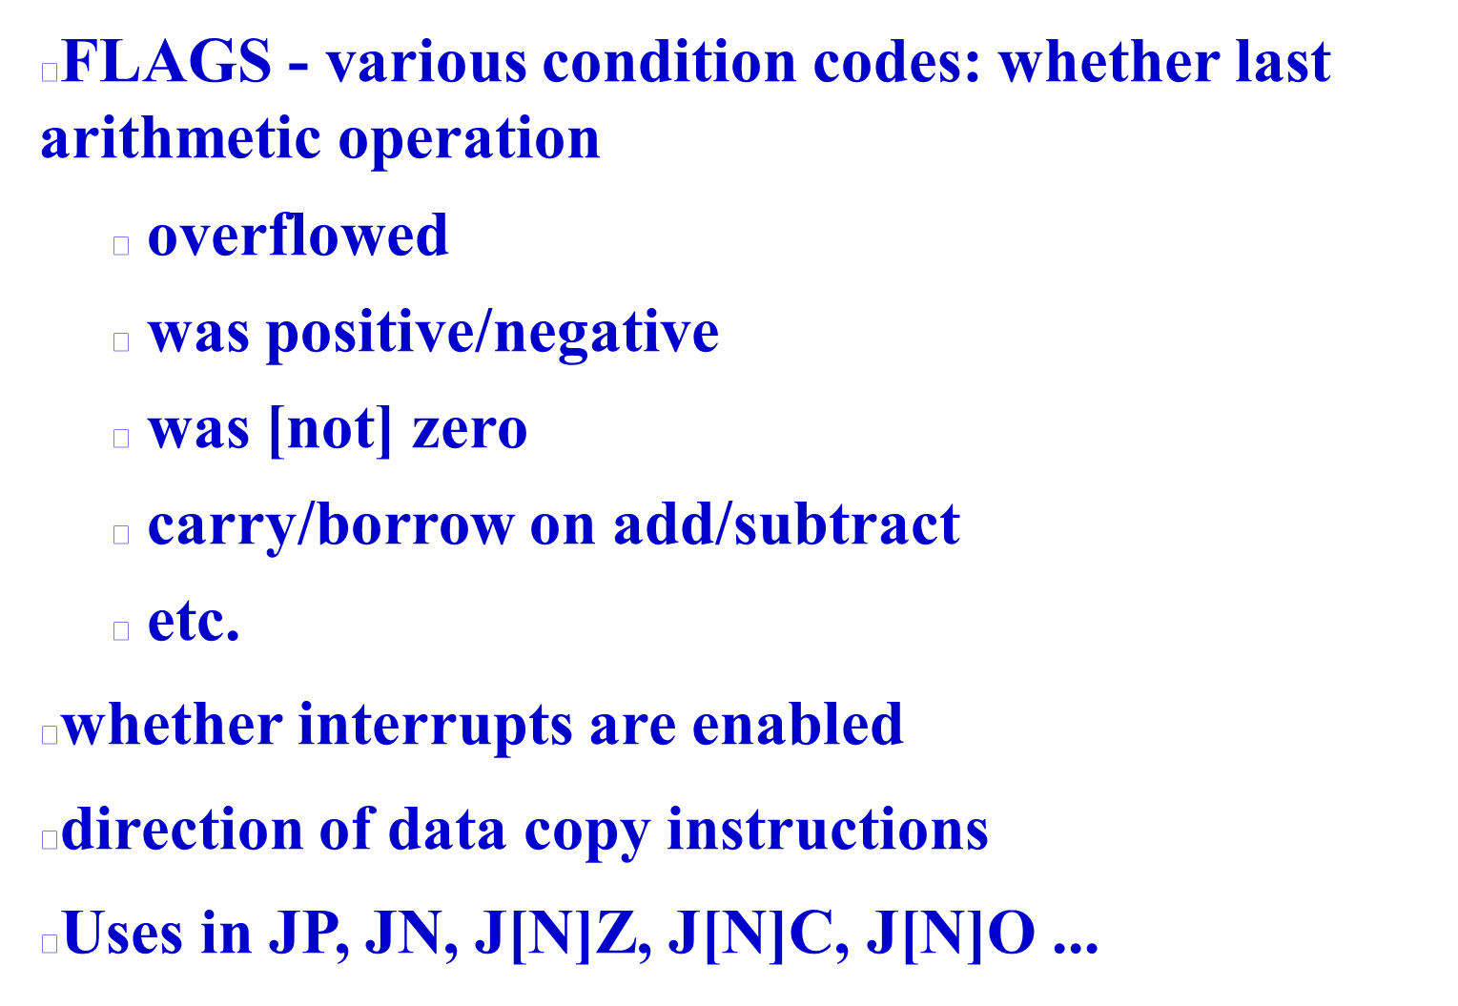

Slide 8

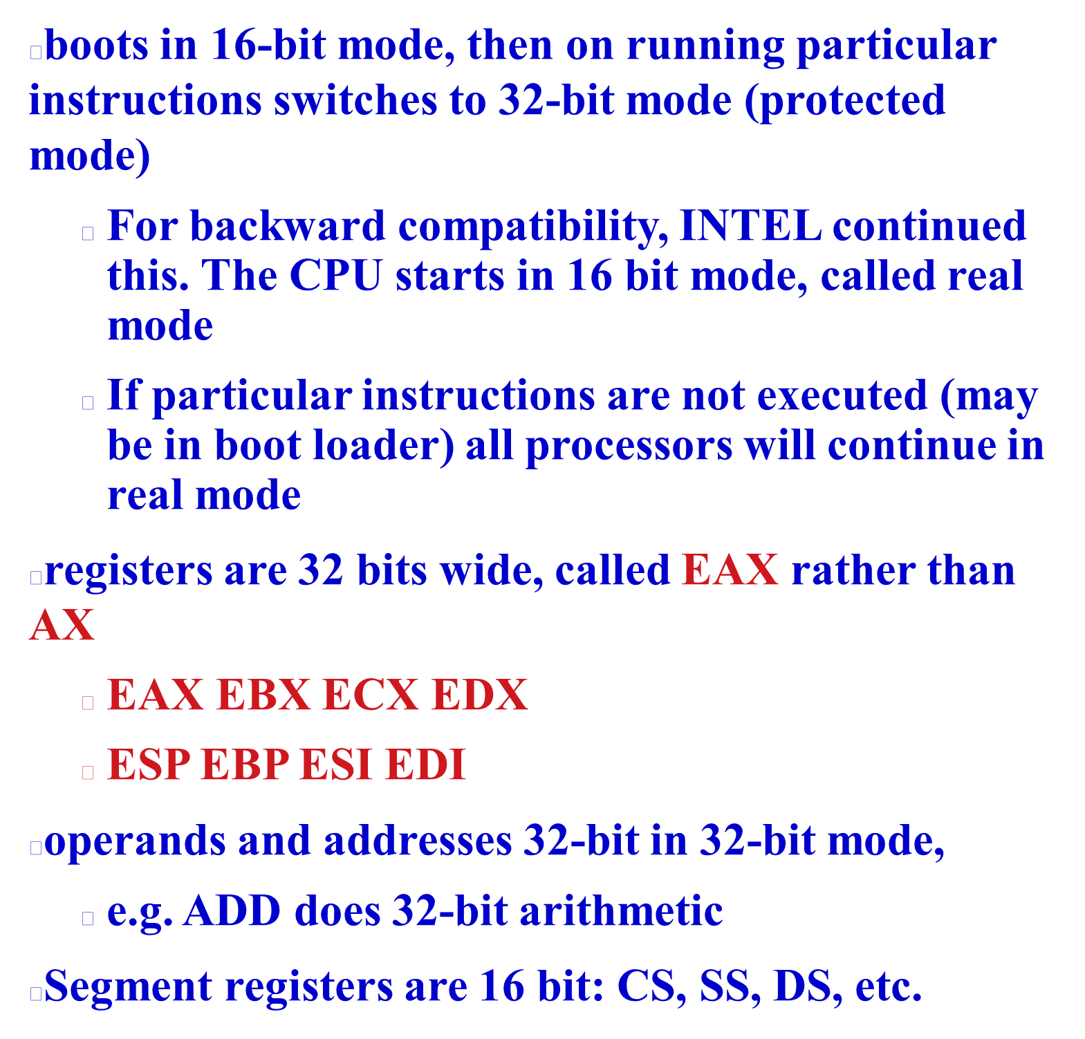

Slide 9
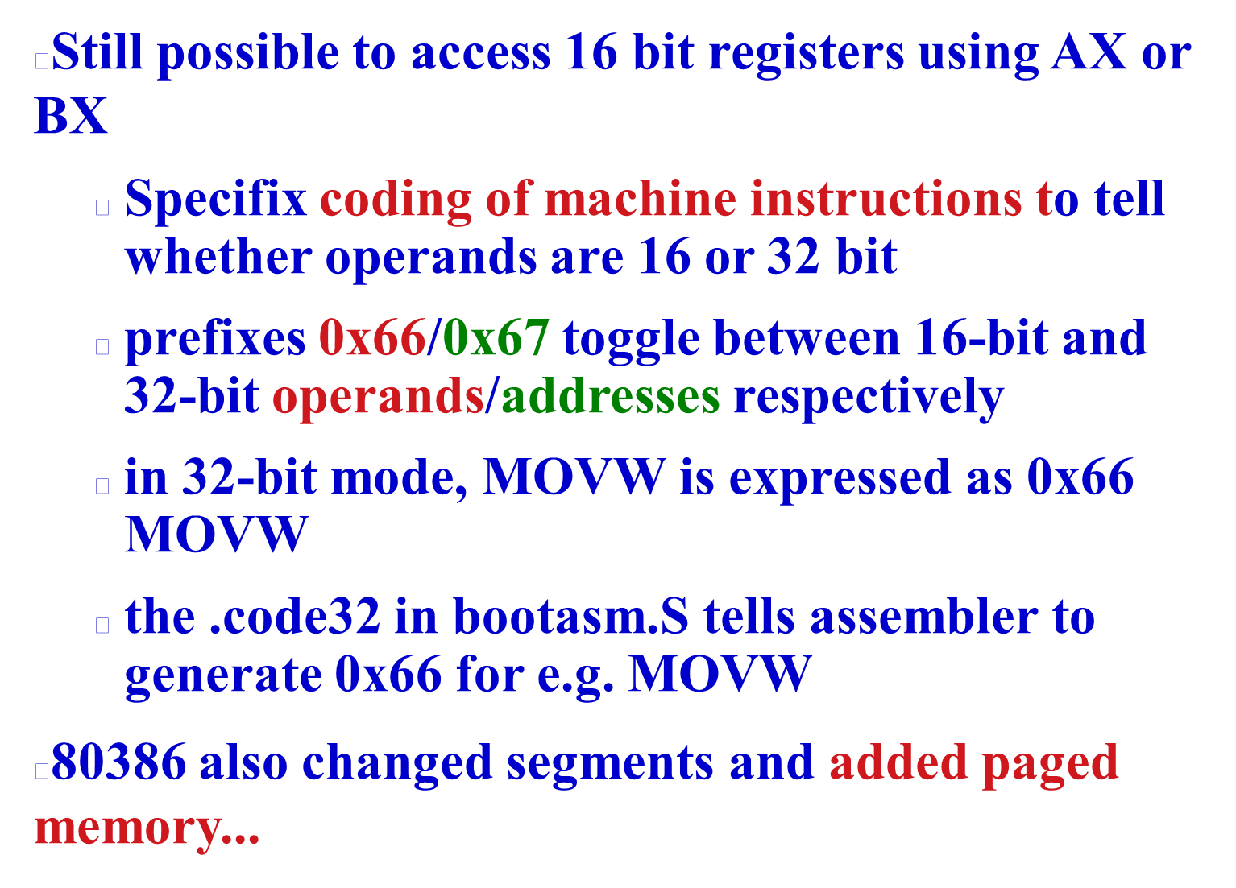

Slide 10
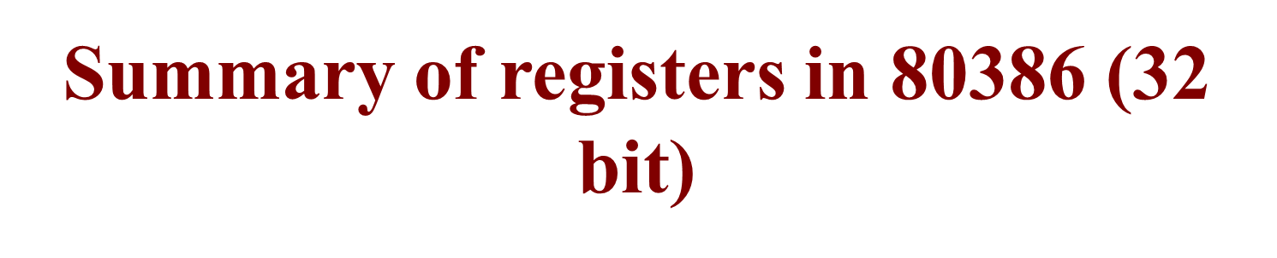
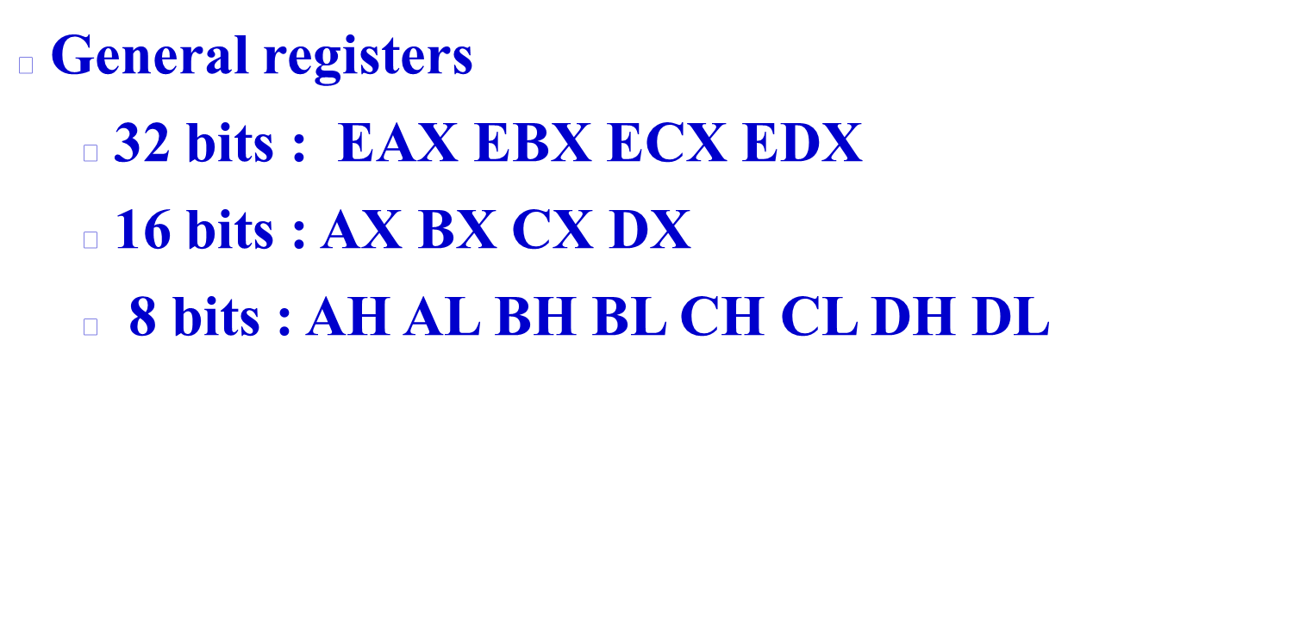

Slide 11

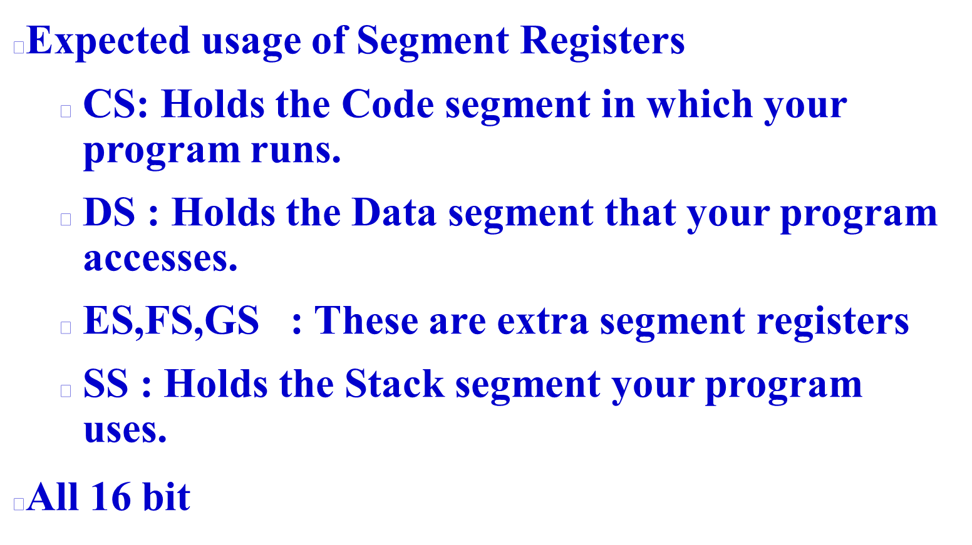

Slide 12
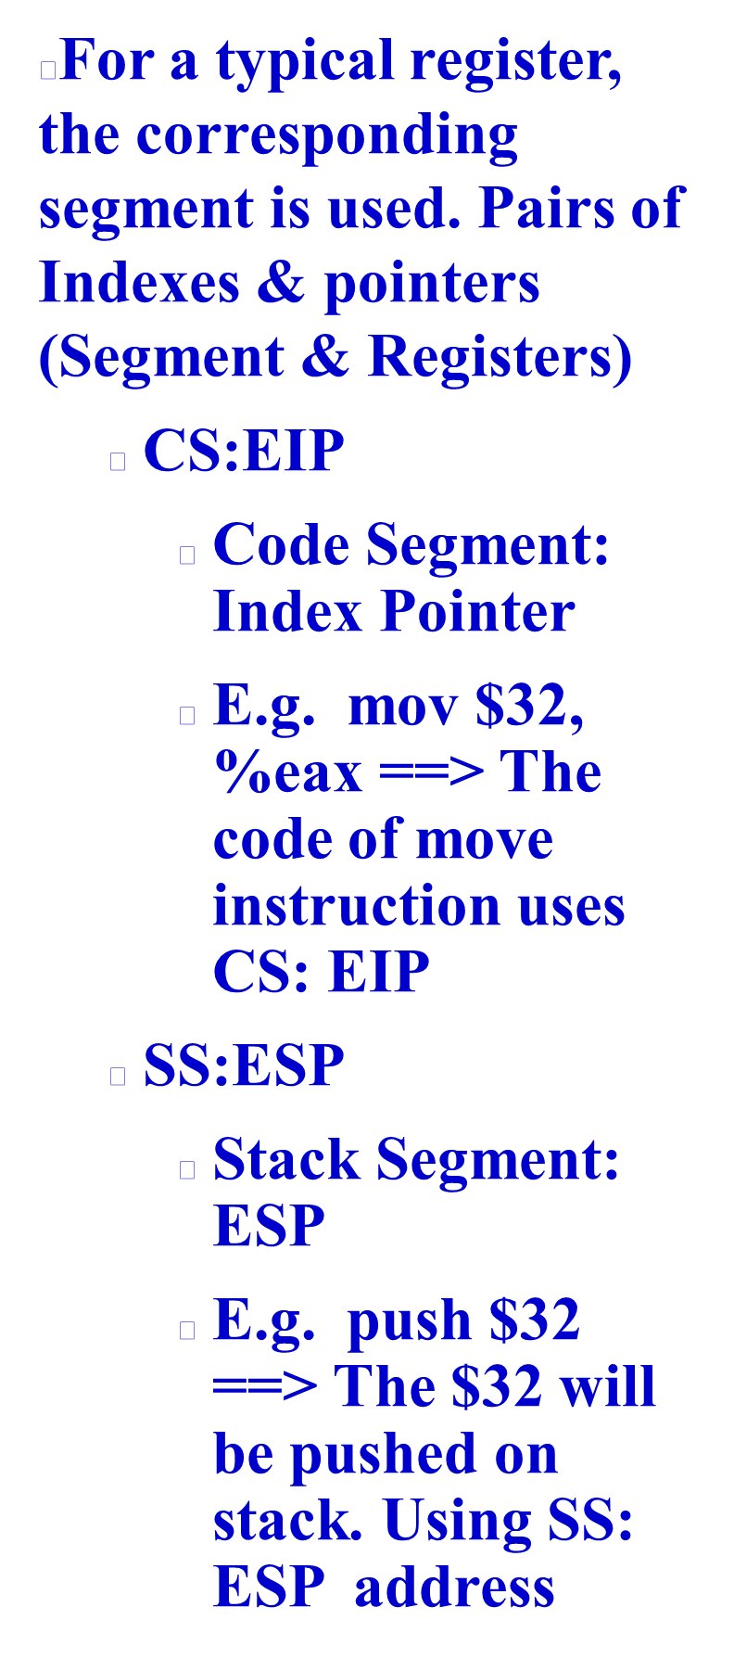
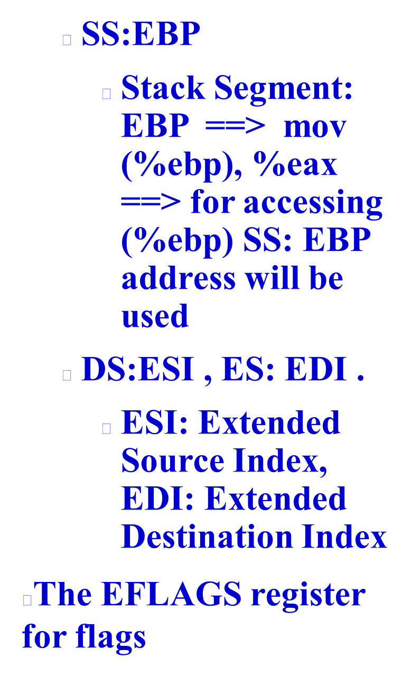

Slide 13

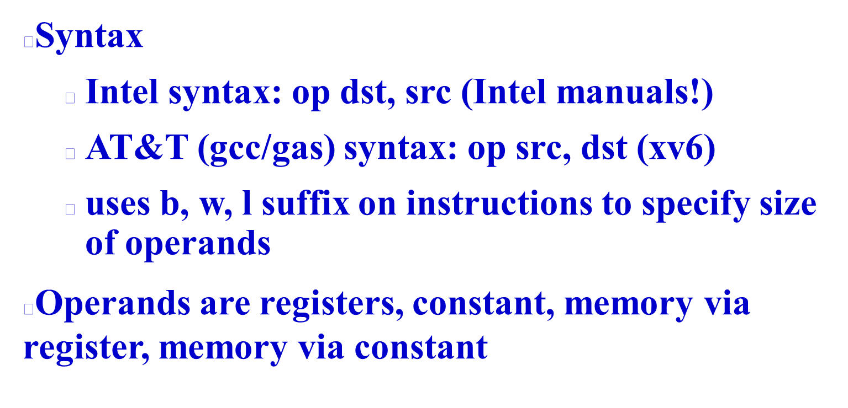

Slide 14

AT&T syntax | "C"-ish equivalent | Operands
movl %eax, %edx | edx = eax; | register mode
movl $0x123, %edx | edx = 0x123; | immediate
movl 0x123, %edx | edx = *(int32_t*)0x123; | direct
movl (%ebx), %edx | edx = *(int32_t*)ebx; | indirect
movl 4(%ebx), %edx | edx = *(int32_t*)(ebx+4) | displaced

Slide 15

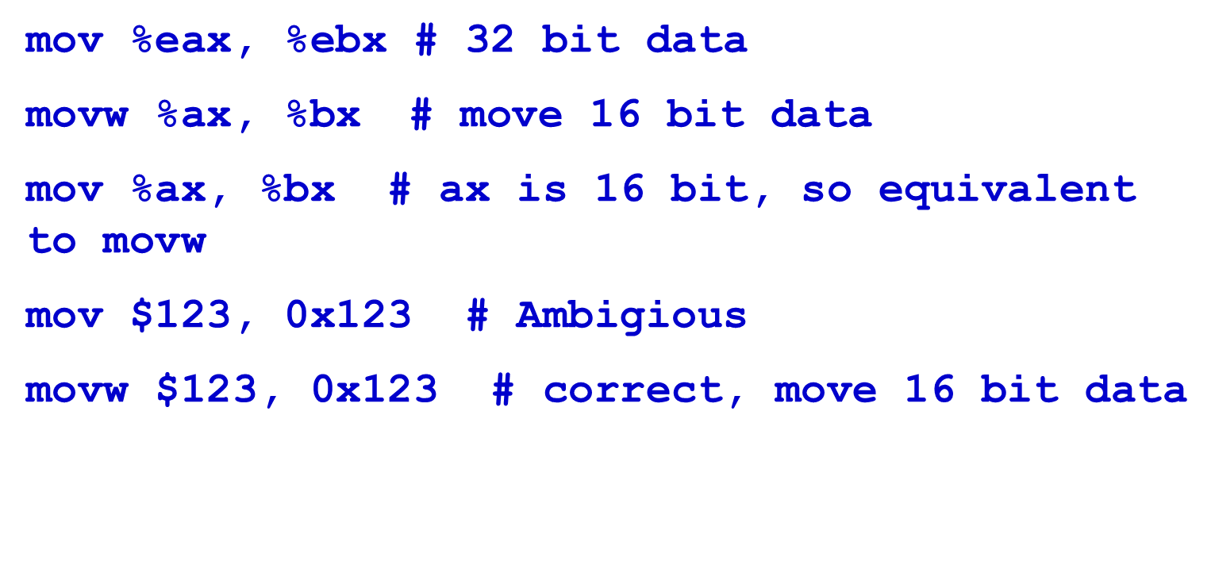

Slide 16

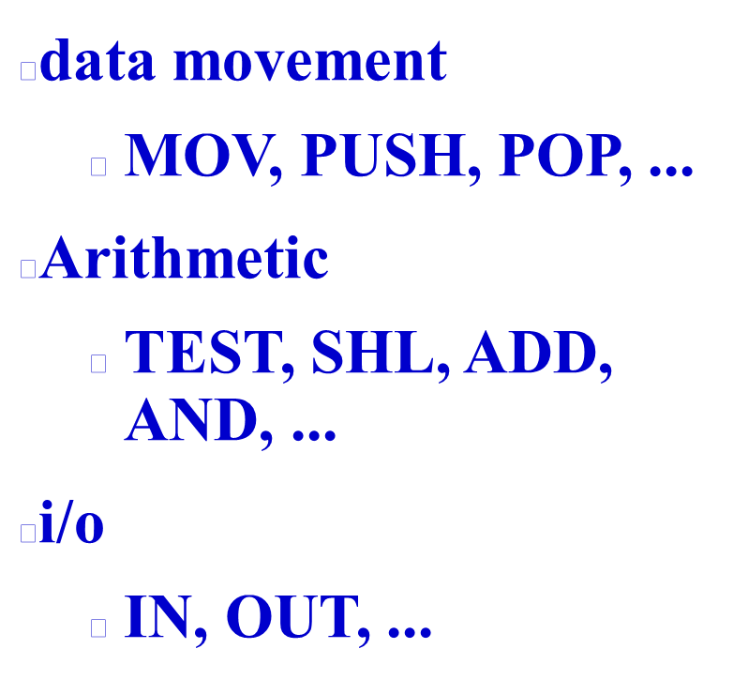
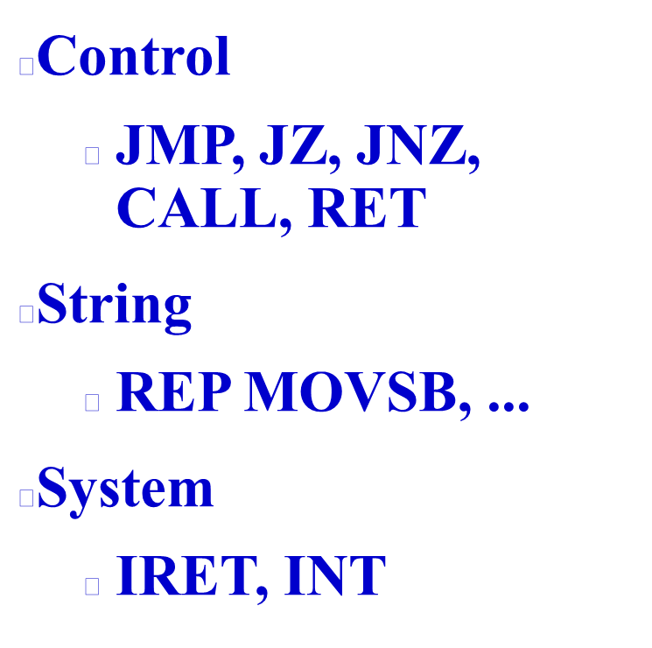

Slide 17
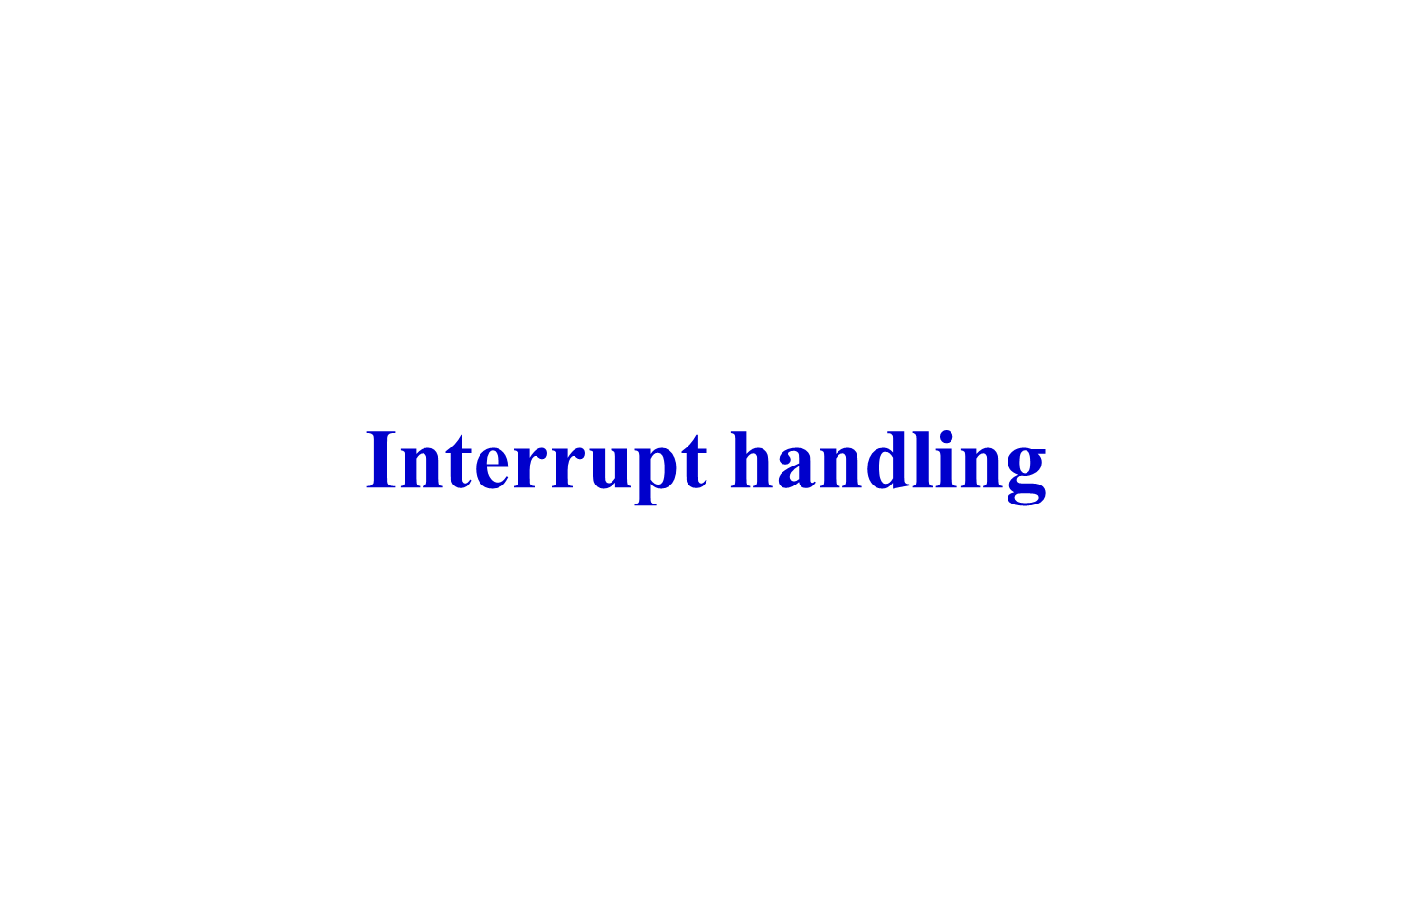

Slide 18

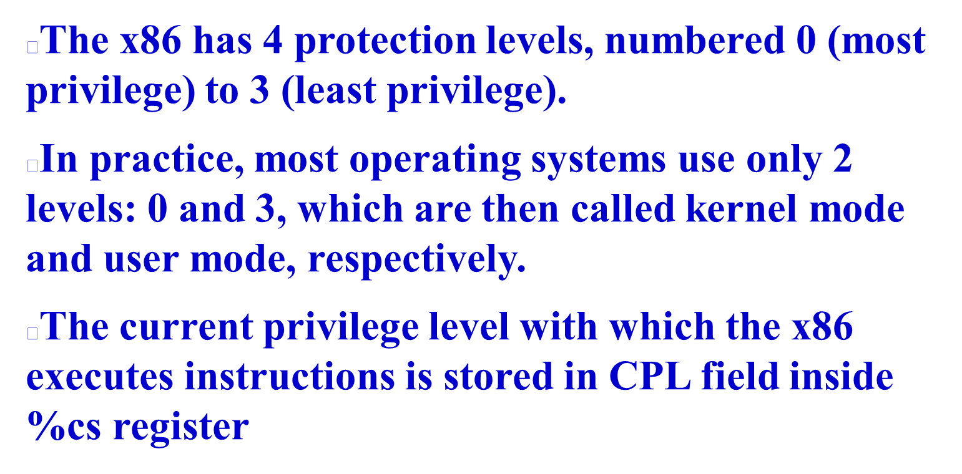

Slide 19
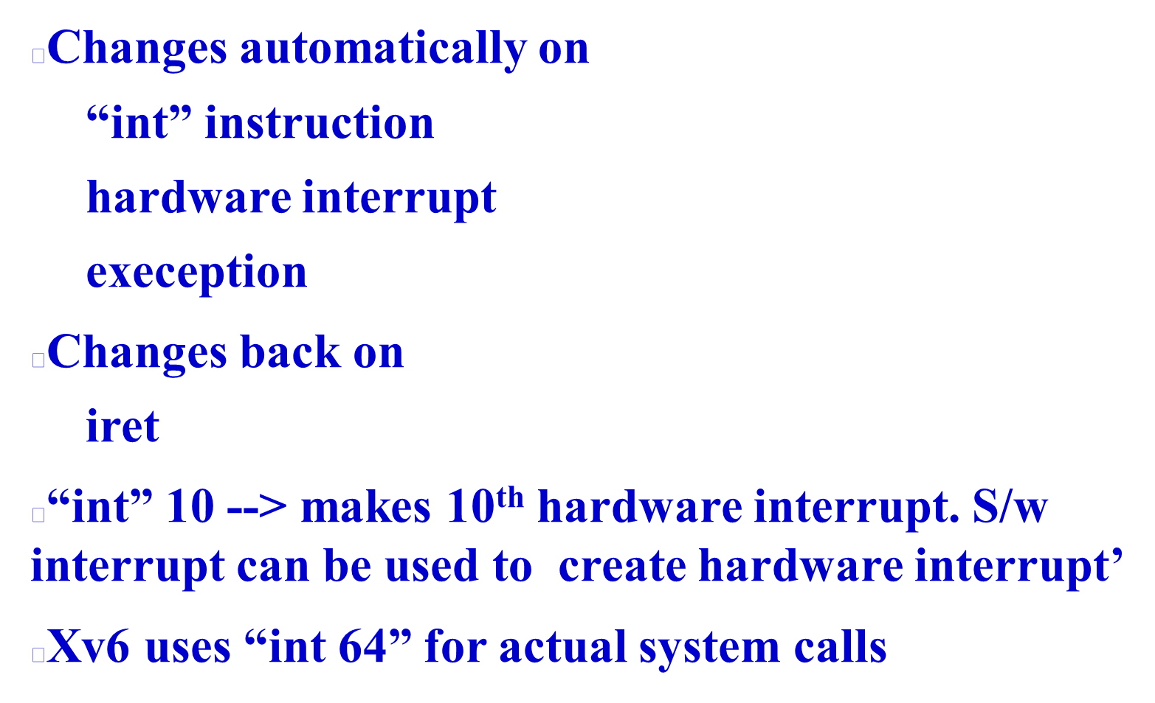

Slide 20

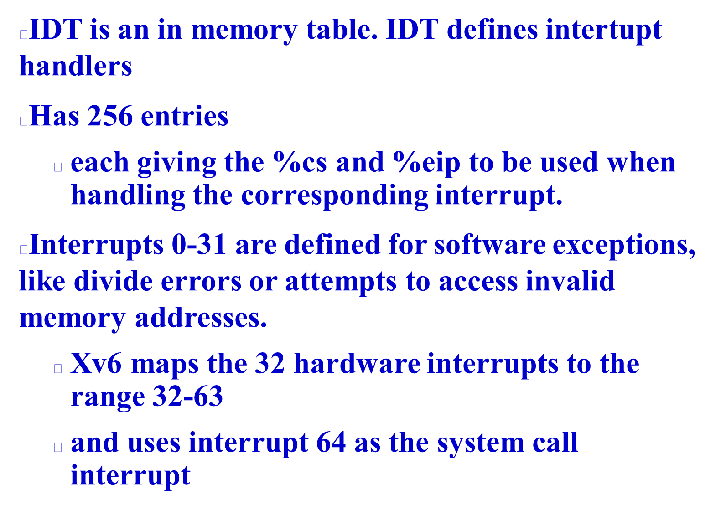

Slide 21

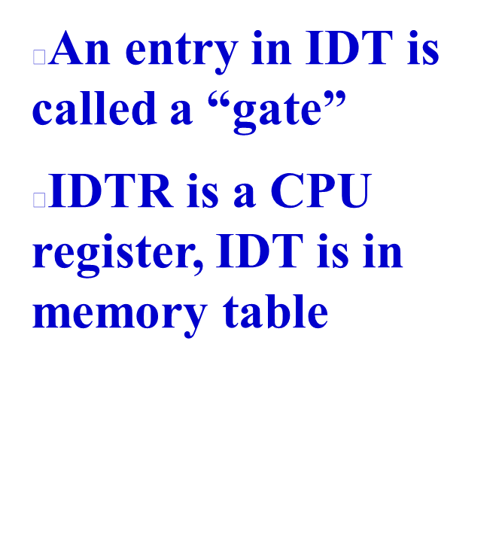
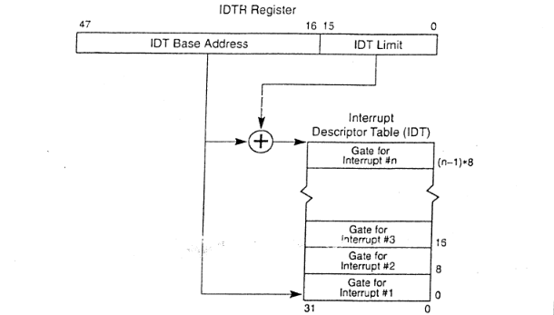

Slide 22
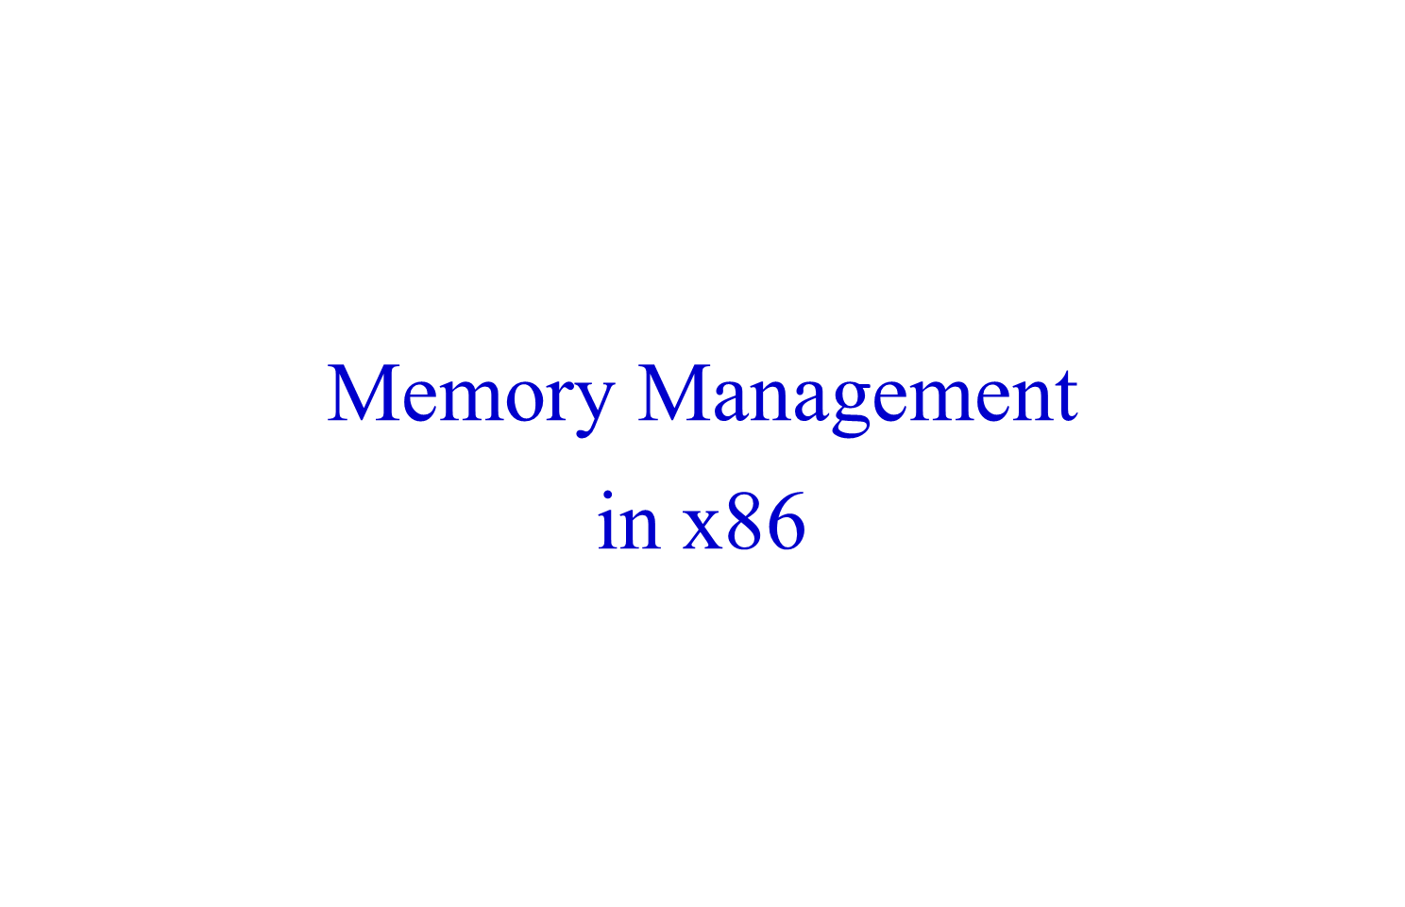

Slide 23
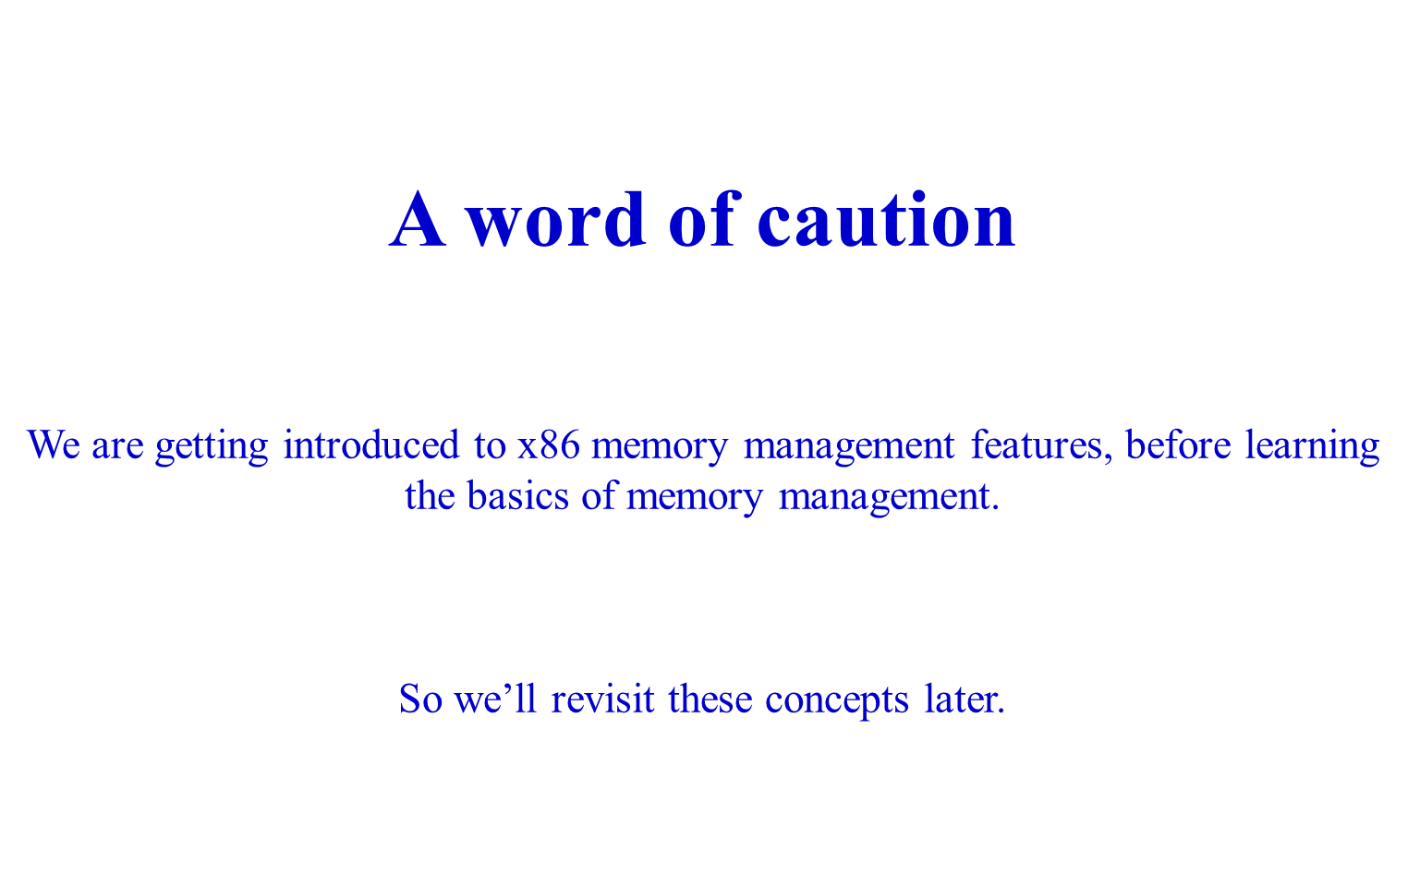

Slide 24

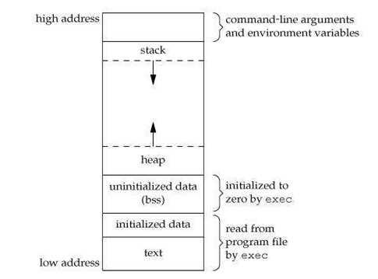
Text: object code of the program
Data: Global variables + (local/global) Static variables
BSS: Uninitialized data, globals that were not initialized
Stack: Region for allocating local variables, function parameters, return values
Heap: Region for use by malloc(), free()
Arguments, Environment variables: Initialized by kernel (during exec)
text, data, bss are also present in the ELF file
stack and heap are not present in ELF file
WHY?

Slide 25

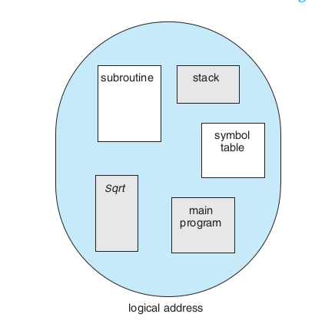
Segmentation
Compiler’s view of the program
Compiler generates object code assuming that different memory regions corresponding to the program are different “segments” in memory
Segment: a continuous chunk
Segment register gives the location of the chunk, index/offset register gives the offset
E.g. in CS:IP CS gives the location of the segment, IP gives the index in it

Slide 26

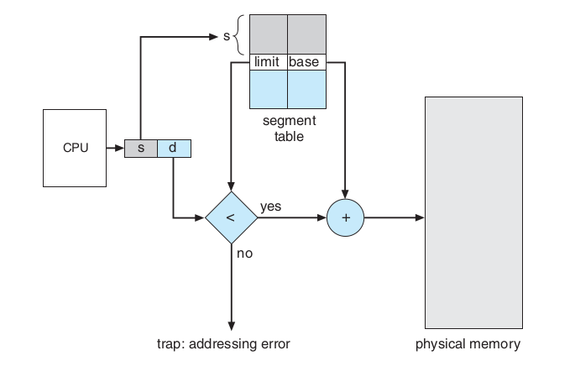

Slide 27

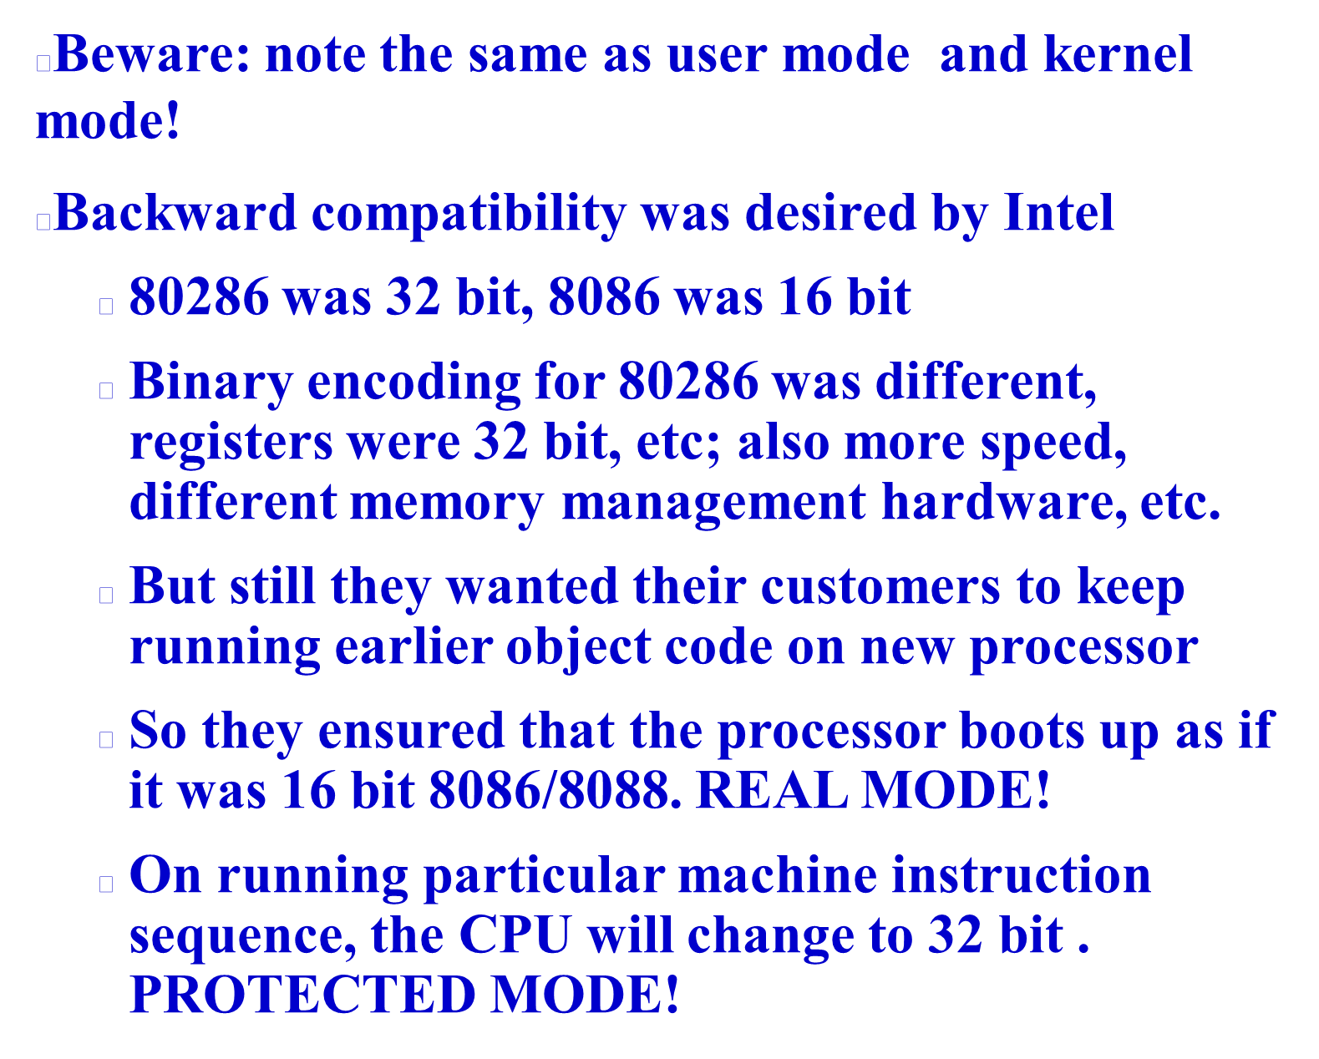

Slide 28

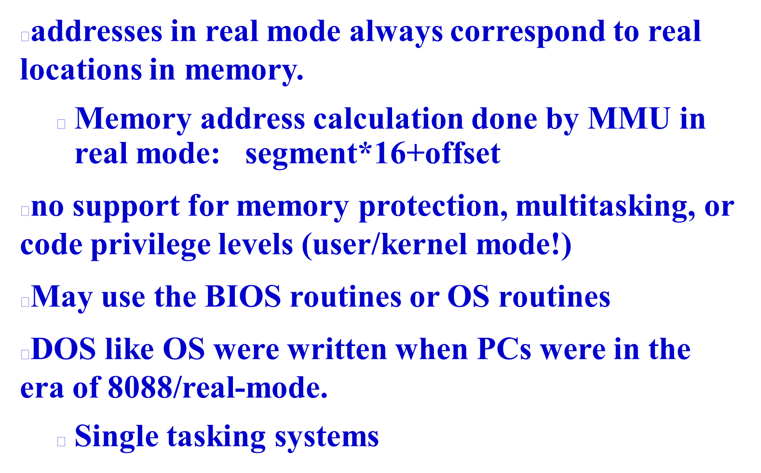

Slide 29
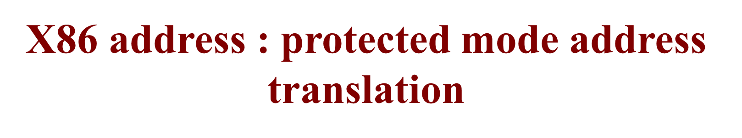
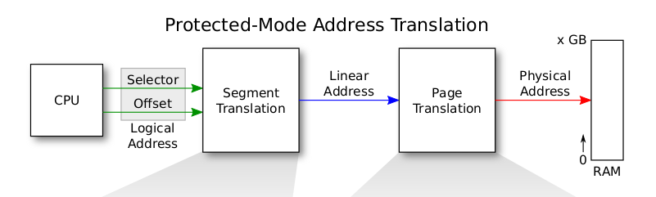
Memory Managemnt Unit (MMU)
Processor Chip

Slide 30

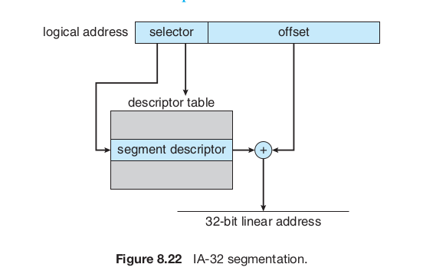

Slide 31

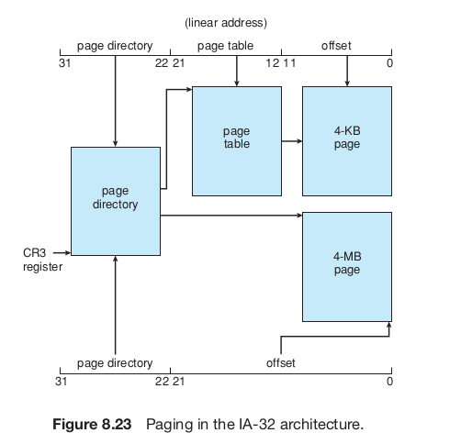

Slide 32

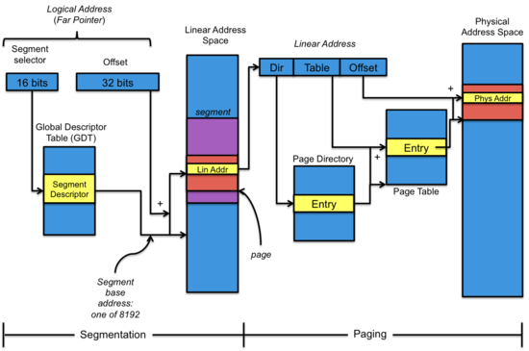

Slide 33
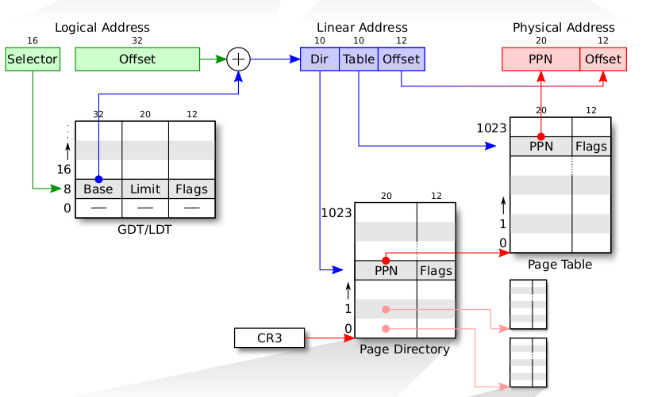
Selector value is implicit based on address being accessed.
Instruction: CS
Stack Variable: SS
Data: DS
etc.

Slide 34

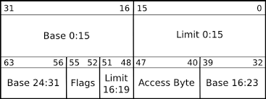
This is an in Memory entry. The diagram shows the format.

Slide 35
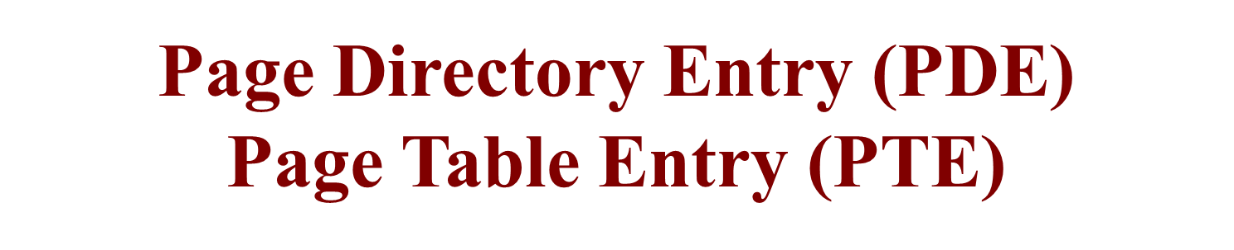
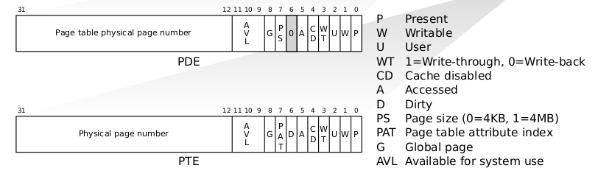
These are in memory entries. The diagrams show the format of each entry.

Slide 36



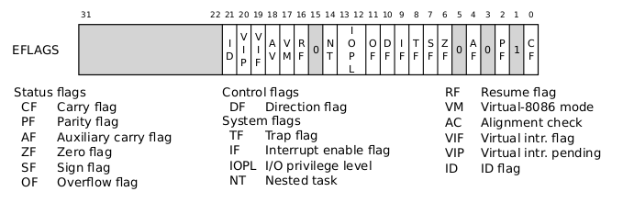

Slide 37

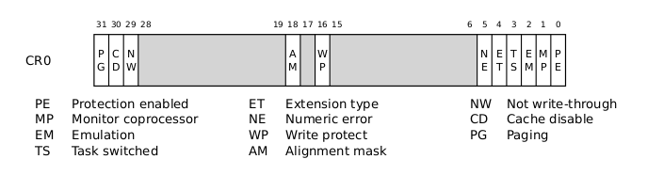

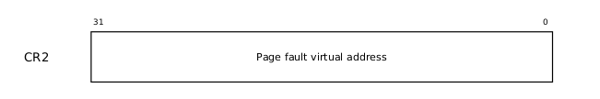
PG: Paging enabled or not WP: Write protecion on/off
PE: Protection Enabled --> protected mode.

Slide 38

