Slide 1
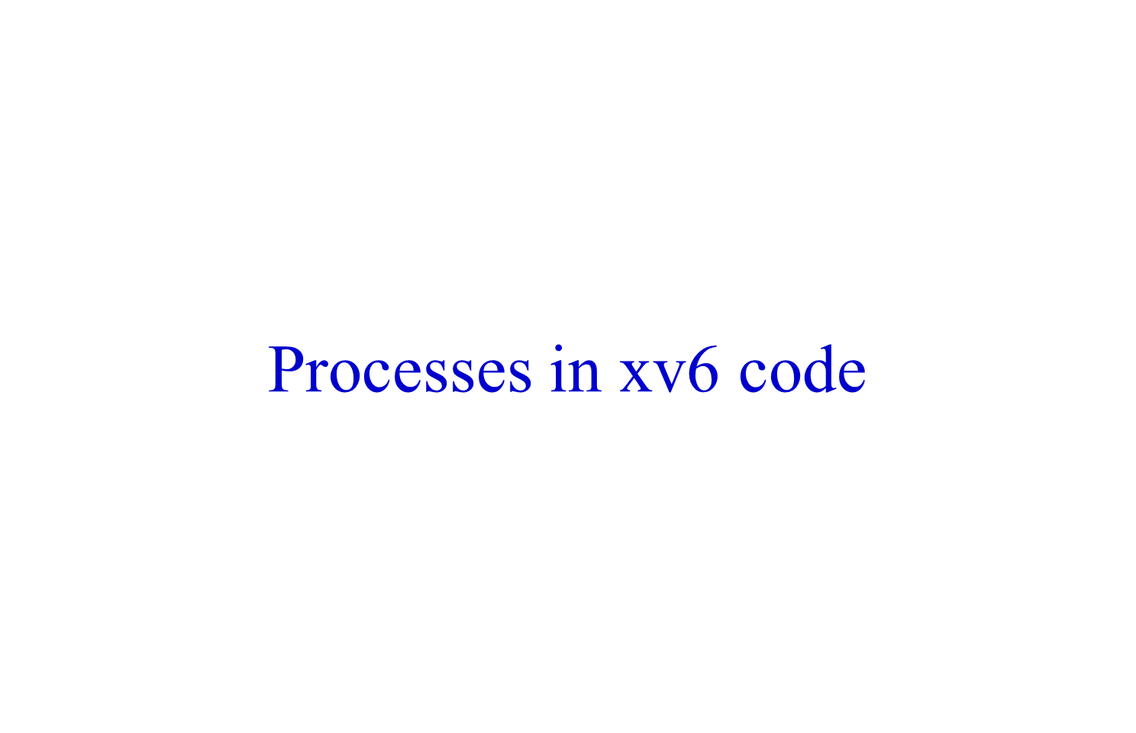

Slide 2

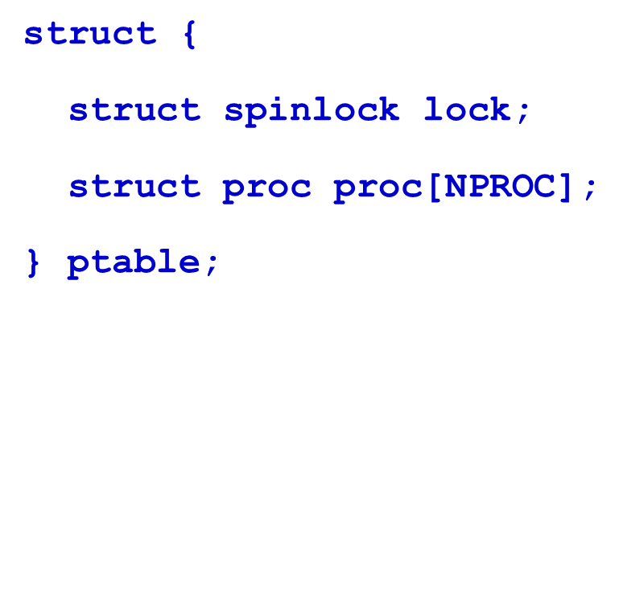
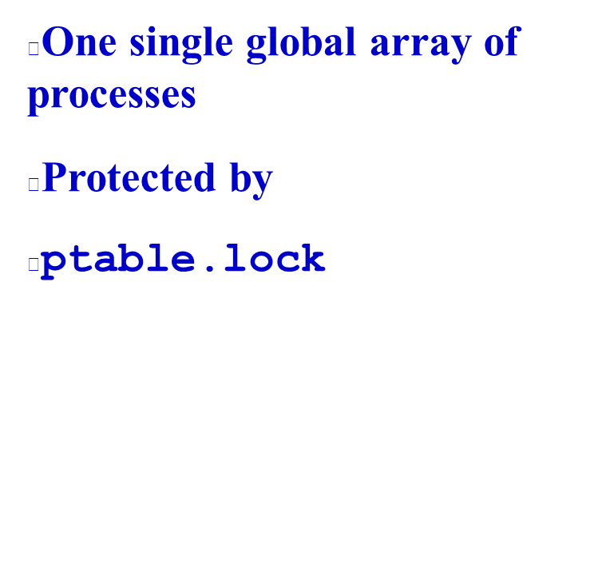

Slide 3
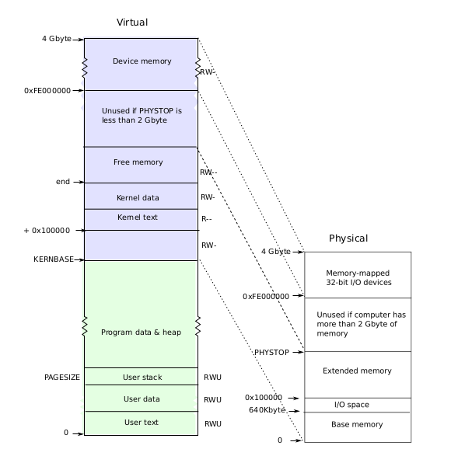


Slide 4
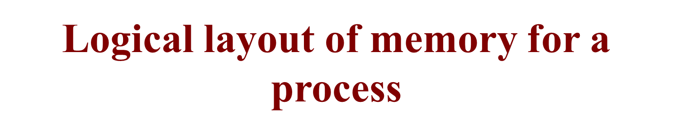
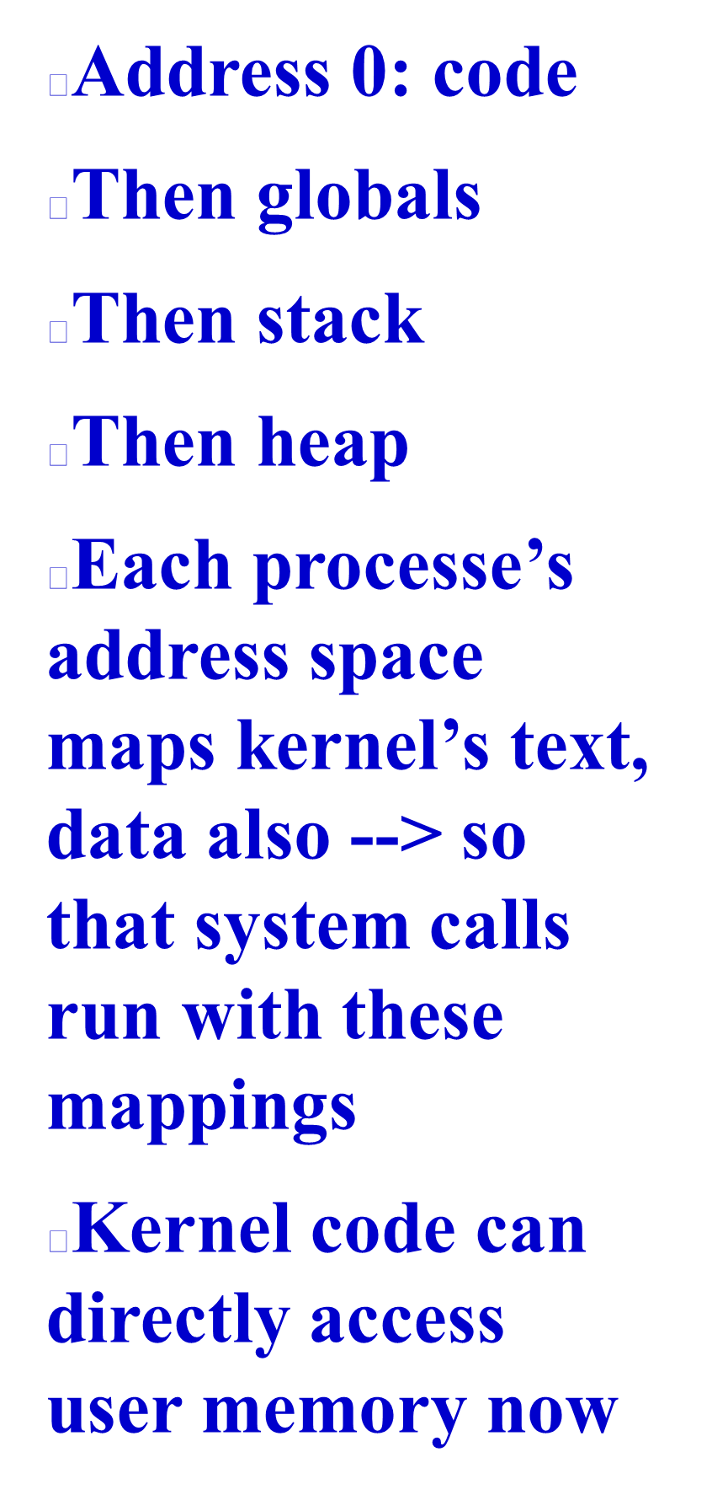
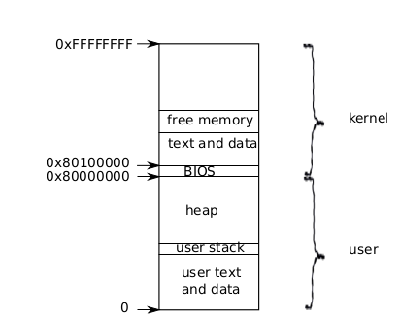

Slide 5

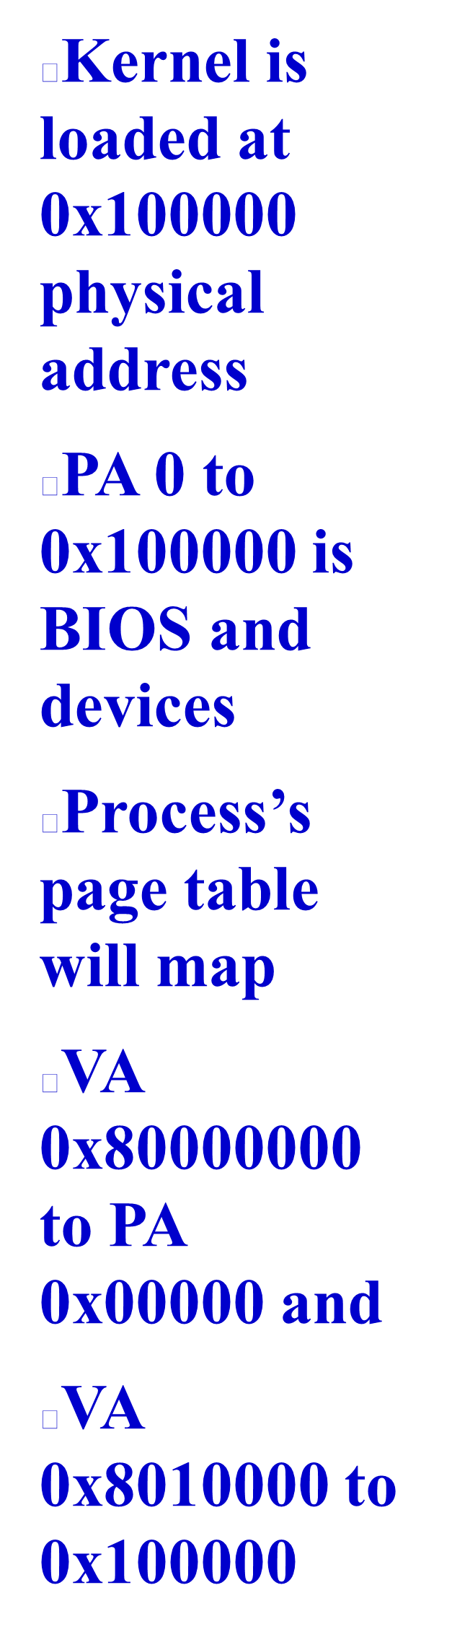
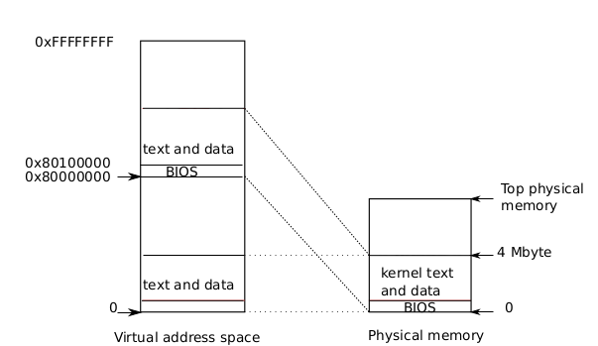

Slide 6
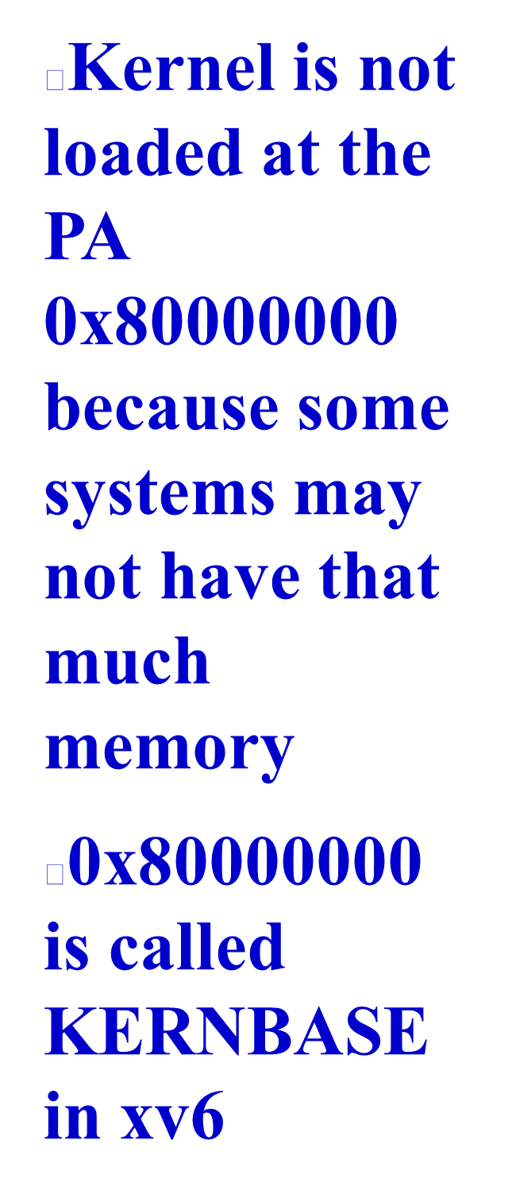

Slide 7

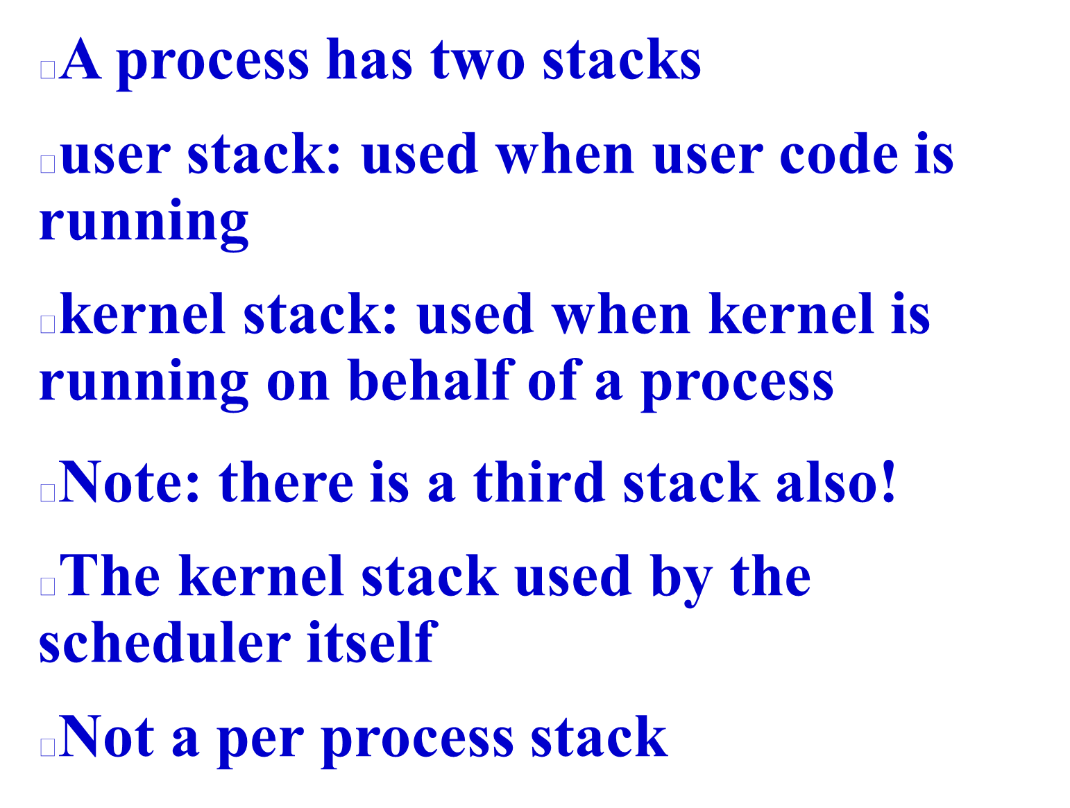

Slide 8

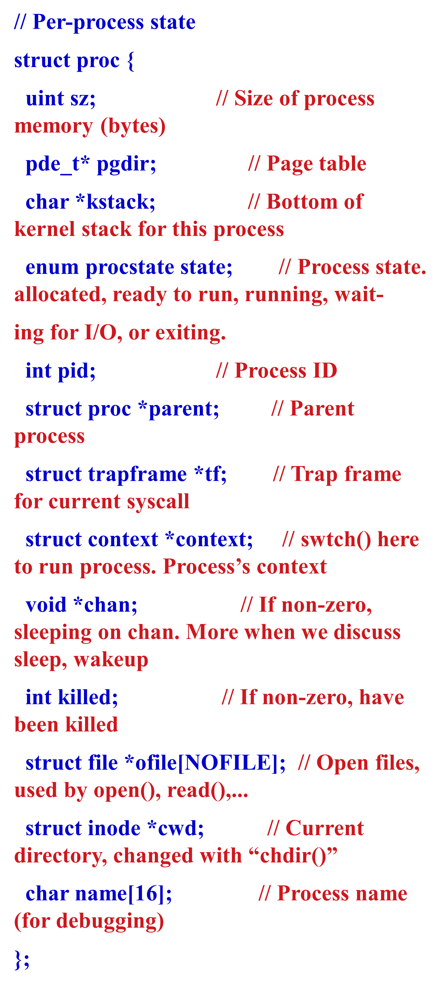

Slide 9

Trapframe
edi, esi, ebp,ebx,
edx, ecx, eax,
gs, fs, es=4,
ds=4, trapno=?,
err, eip, cs = 3,
EFLAGS = FL_IF
ESP = 4096, ss=4
EIP = 0
Code &data
of
“cat”
trapret()
proc
process
stack
sz = a24f
pgdir
kstack
int state=RUNNABLE
int pid = 22
proc *parent
tf
context
void *chan
int killed=0
file *ofile
inode *cwd
name =”cat”
Page table
eip=forkret()
ebp
ebx
esi
edi
Page table
Towards
Kernel
pages
Page table
In use only when you are in kernel on a “trap” = interrupt/syscall. “tf” always used. trapret,forkret used during fork()
pgdir
Inode
for “/”
sz = ELF-code->memsz (includes data, check “ld -N”
+ 2*4096 (for stack)

Slide 10
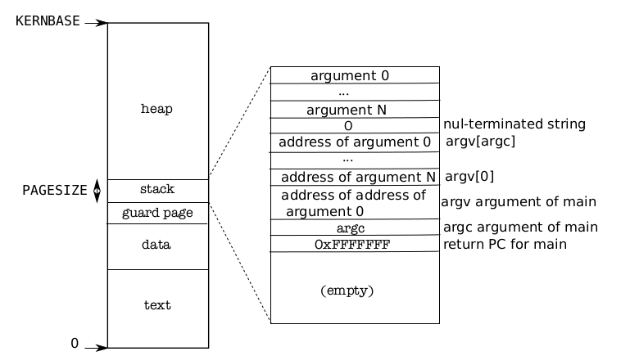
Memory Layout of a user process
Memory Layout of a user process
After exec()
Note the argc, argv on stack
The “guard page” is just a mapping in page table. No frame allocated. It’s marked as invalid. So if stack grows (due to many function calls), then OS will detect it with an exception

Slide 11
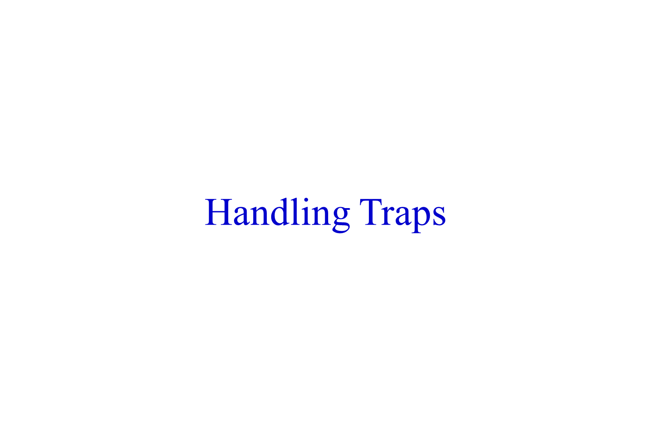

Slide 12

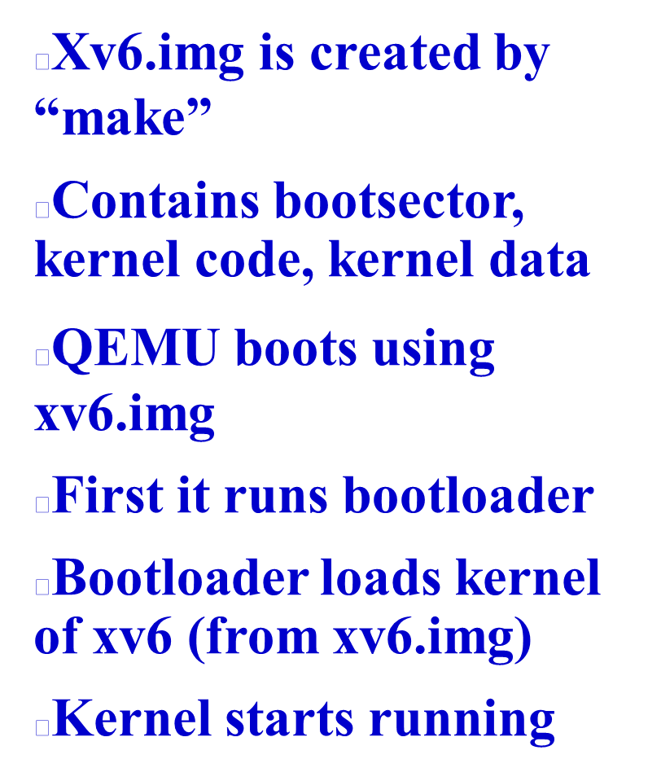
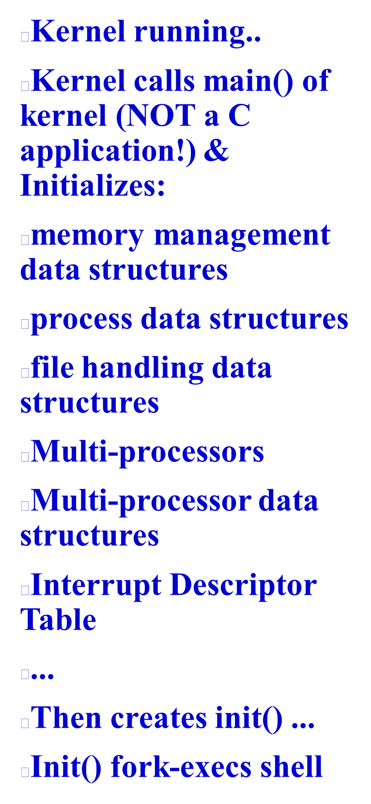

Slide 13
kmap[] mappings done in kvmalloc(). This shows segmentwise, entries are done in page directory and page table for corresponding VA-> PA mappings
4B
DEVSPACE=3.96GB
KERNBASE+PHYSTOP=2.224GB= 2272MB
data= 2049.3125 MB
KERNBASE+EXTMEM=2049 MB
KERNBASE=2048MB
0
Un
mapped
4GB
DEVSPACE=3.96GB
PHYSTOP = 224MB
1.03125 MB = 1MB + data
EXTMEM=1MB
0
Unused
Kernel
data
+ memory
Kernel
data
+ memory
Kernel
code +
RO Data
I/O Space
Kernel
code +
RO Data
Process
address
space
I/O Space
Physical Memory
0x80108000 =data = 2049.3125 MB
Is obtained from kernel.sym
Logical Address space

Slide 14

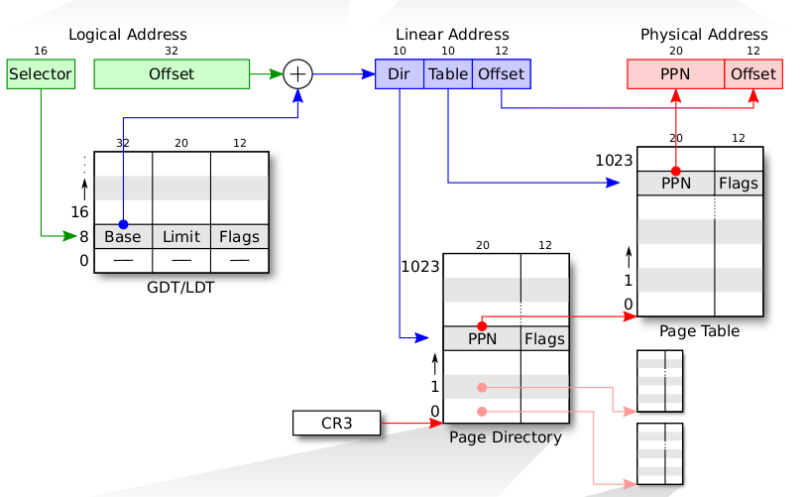
Selector value is implicit based on address being accessed.
Instruction: CS
Stack Variable: SS
Data: DS
etc.

Slide 15
After seginit() in main().
On the processor where we started booting
RAM
Physical Addr
Logical Address = offset
Linear Address
Dir
pg
Offset
4MB
0
CS, SS, etc.
Selector
Base | Limit | Permissions | DPL
0 | 4GB | Write | 3
0 | 4GB | Read, Execute | 3
0 | 4GB | Write | 0
0 | 4GB | Read, Execute | 0
0 | 0 | 0
4
3
2
1
0
DS
SS
Page Table
GDT
CS
CR3
Now Linear Address = Logical Address != Physical Address
kpgdir

Slide 16

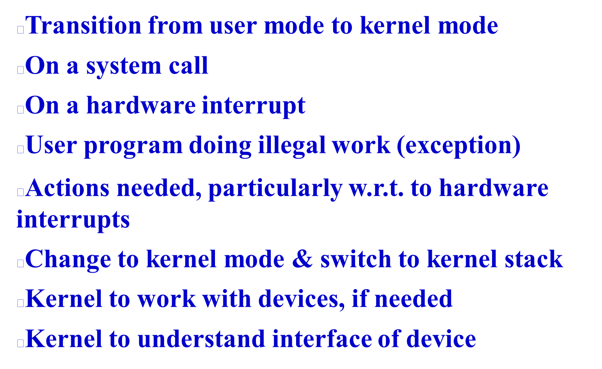

Slide 17
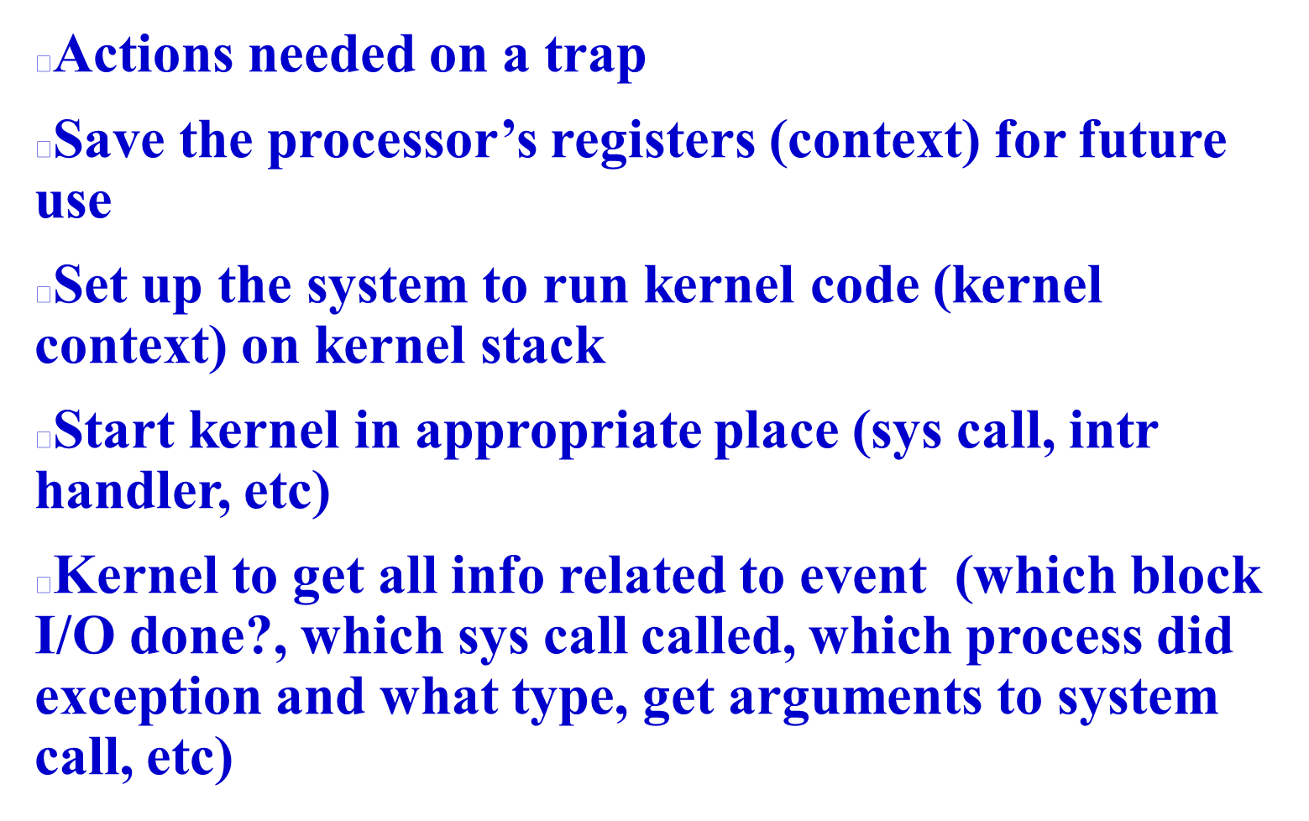

Slide 18

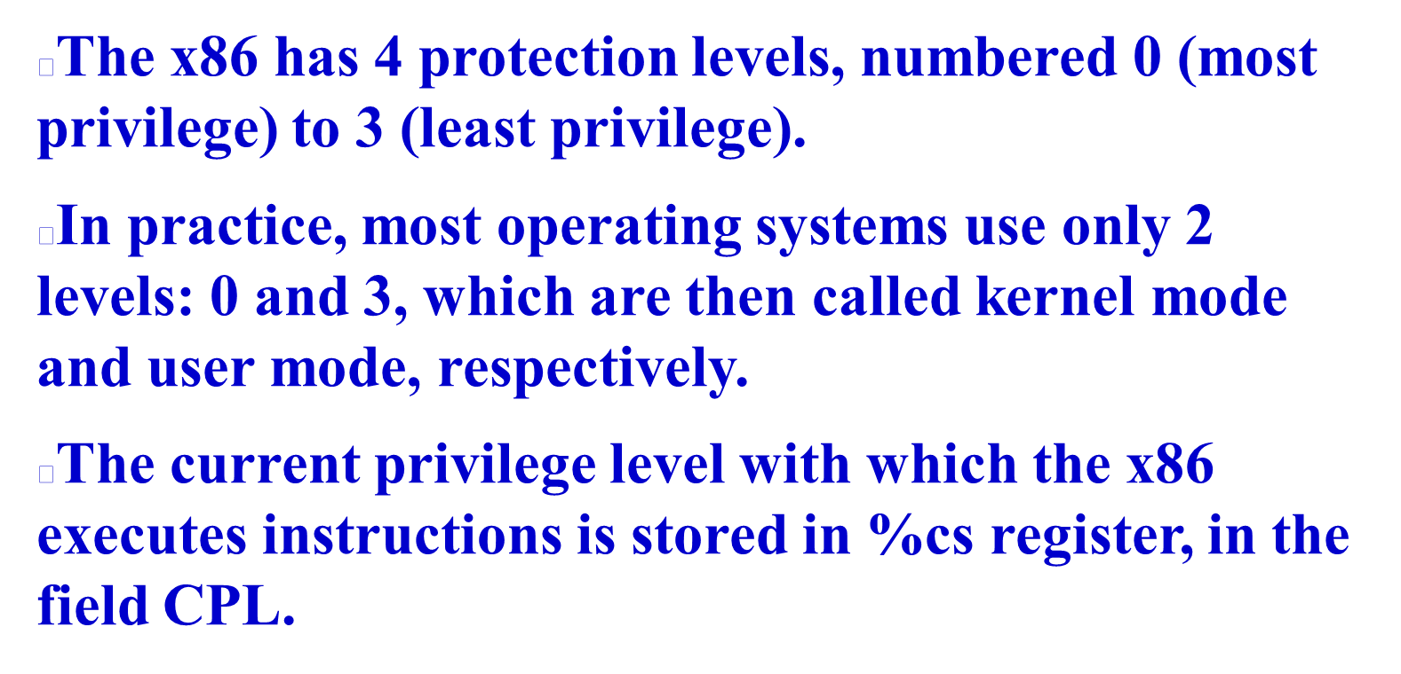


Slide 19
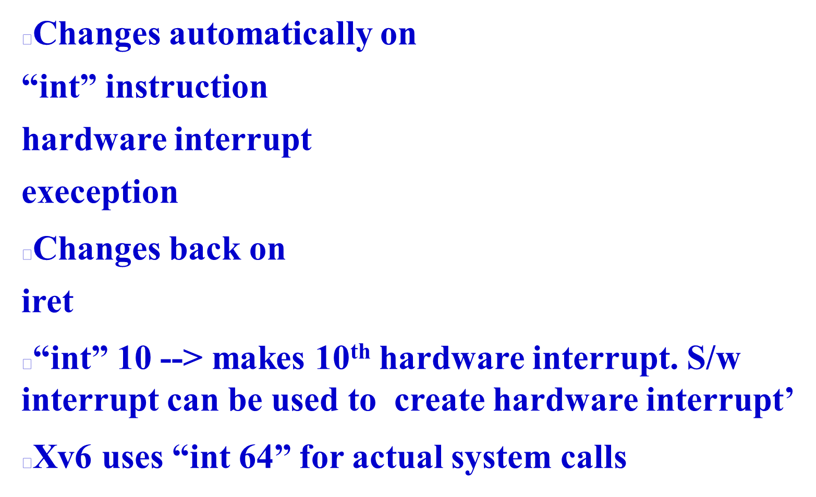

Slide 20

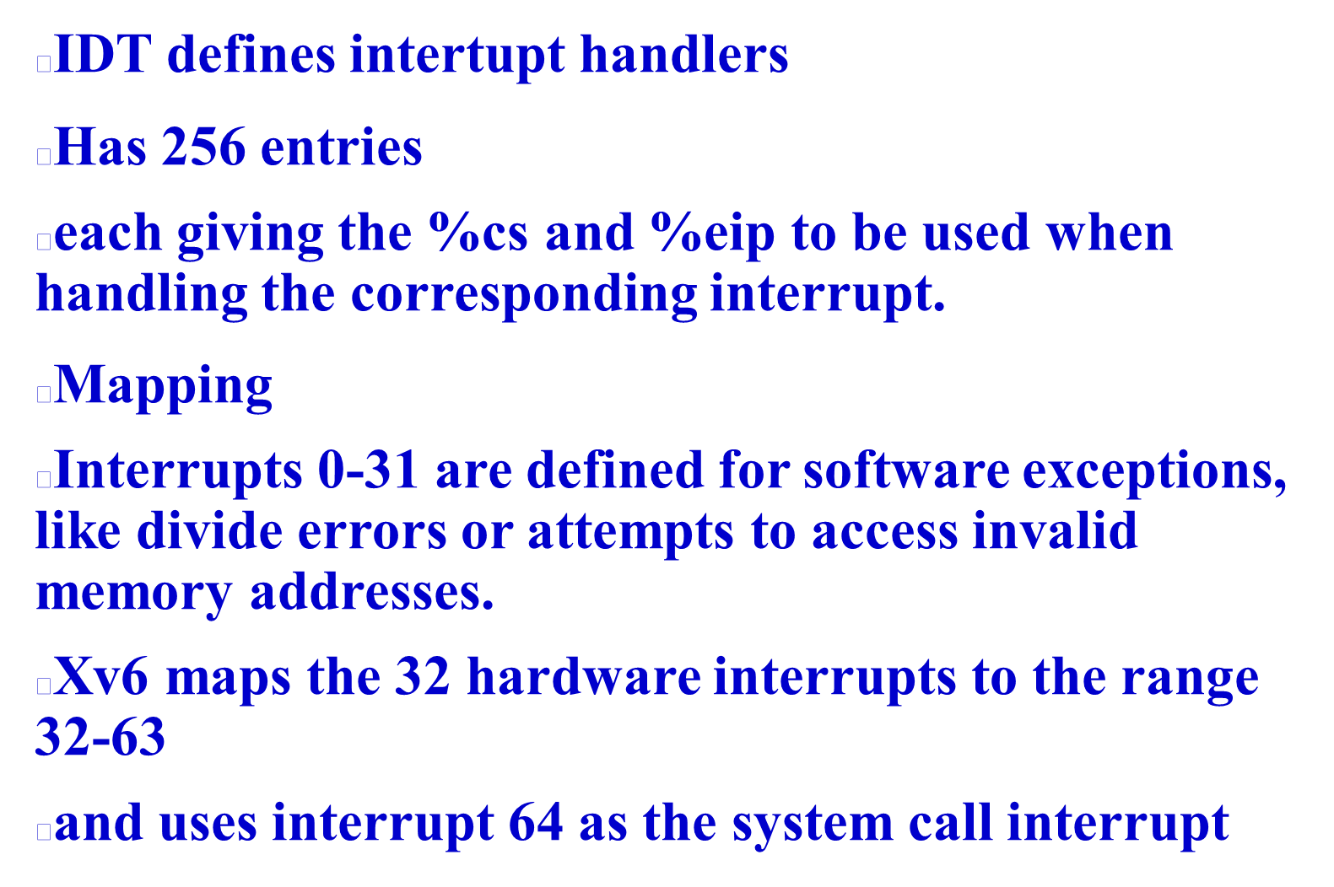

Slide 21
IDT setup
done by tvinit() function
vectors
vector0
vector1
Vector2
..
vector255
push 0
push 0
jmp alltraps
push 0
push 1
jmp alltraps
...
push 0
push 255
jmp alltraps
The array of “vectors”
And the code of “push, ..jmp”
Is part of kernel image (xv6.img)
The tvinit() is called during kernel initialization
idt
cs:ip = vector0
cs:ip = vector1
..
cs:ip = vector255
This is the IDT table
Each entry is 8 bytes (with more fields than shown here)
as mentioned on next slides
Other kernel data
& code
RAM

Slide 22

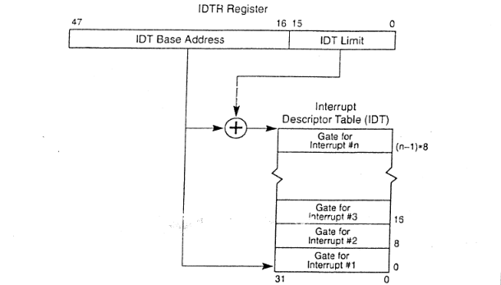
IDT is in RAM
IDTR is in CPU

Slide 23

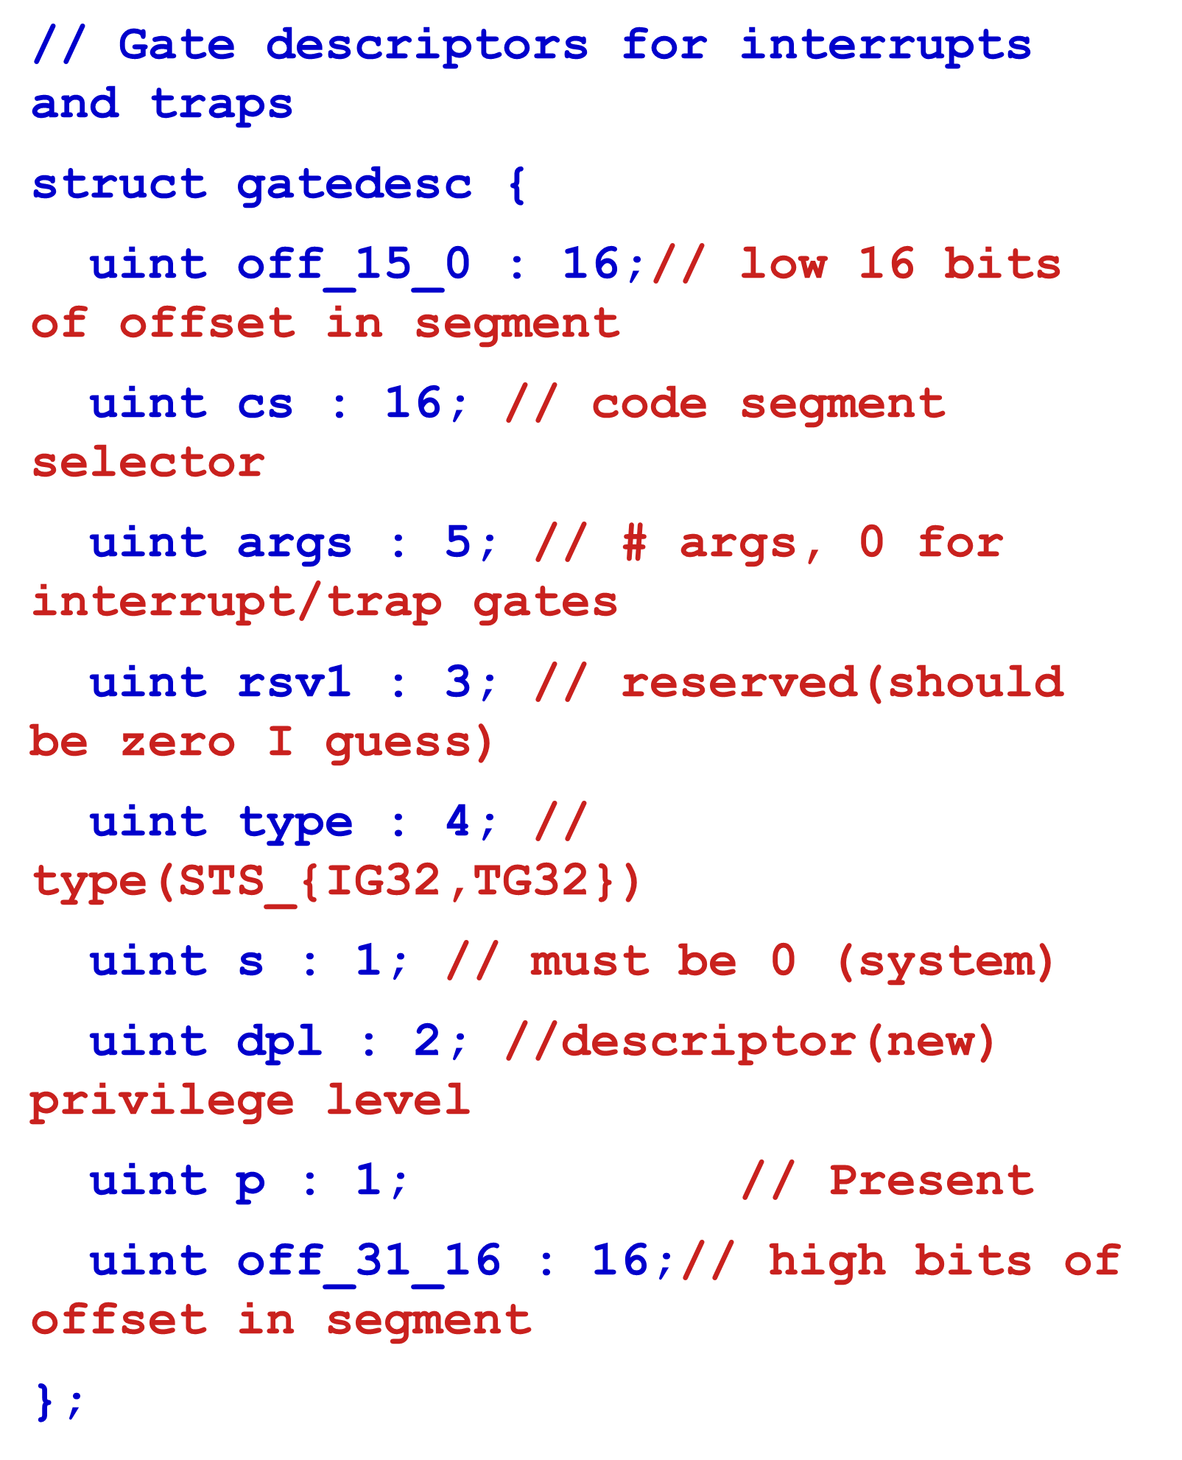

Slide 24

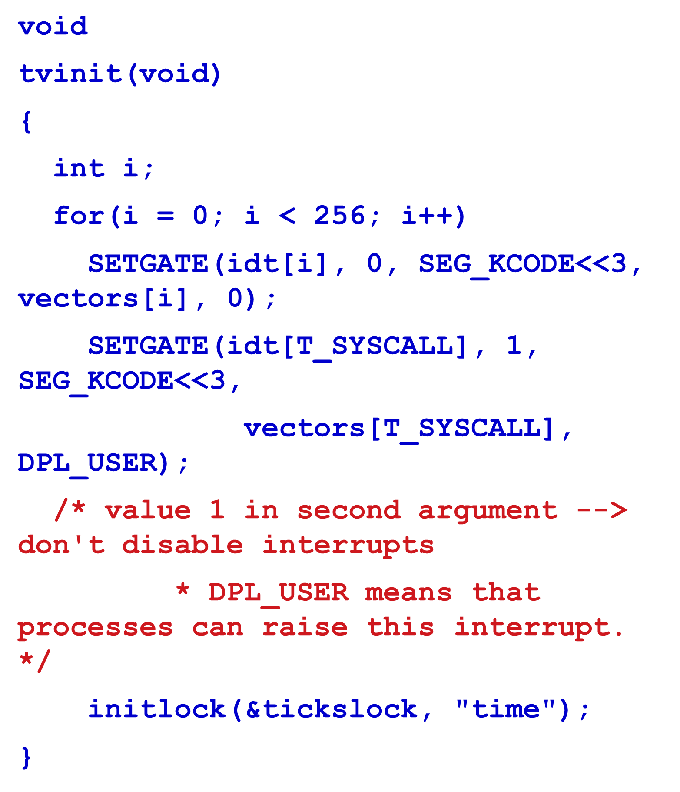

Slide 25
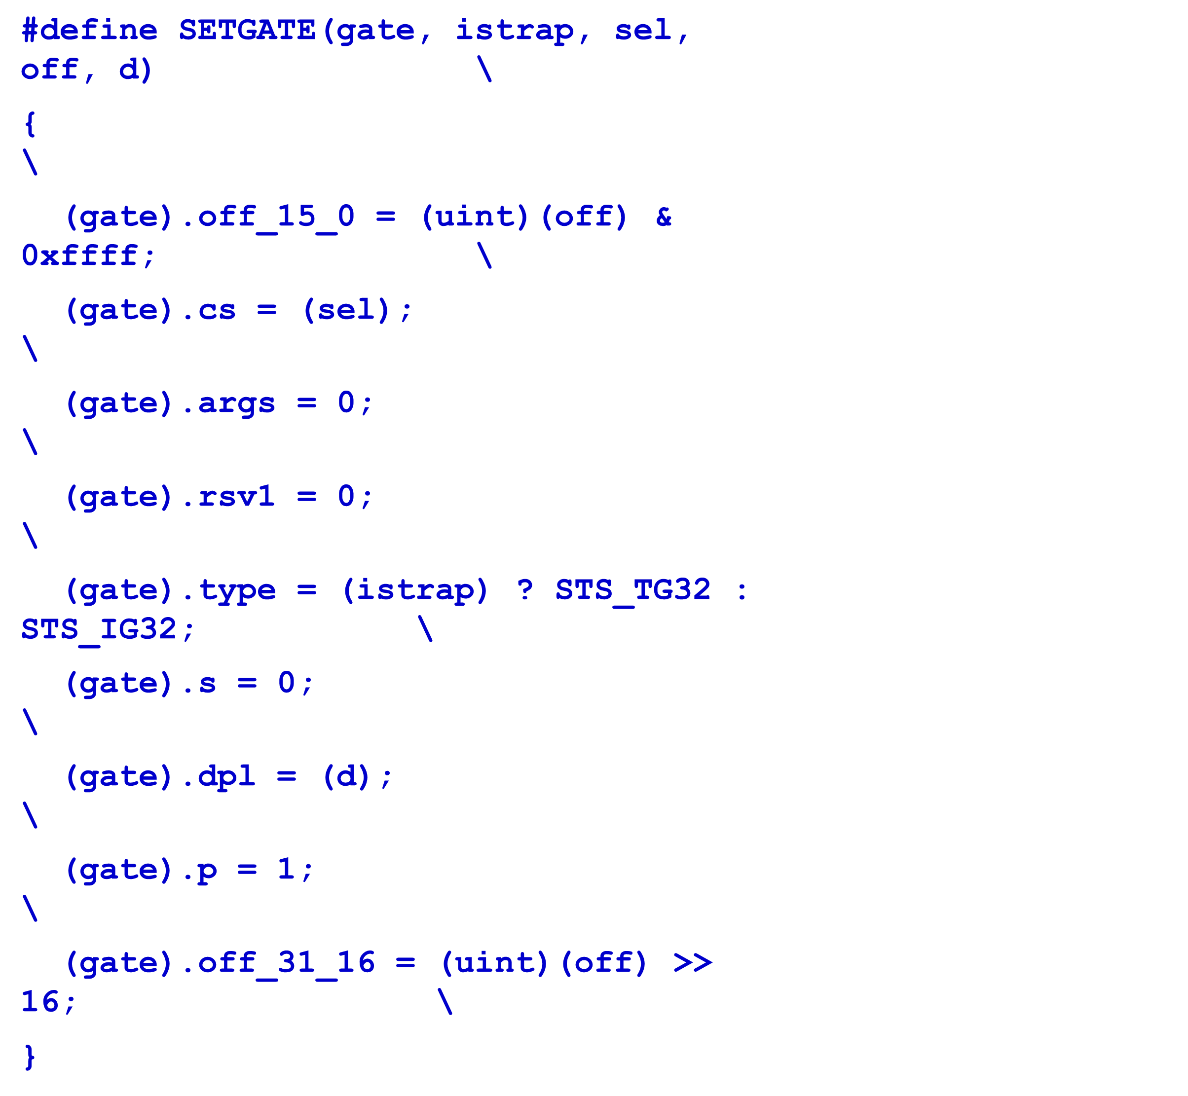

Slide 26
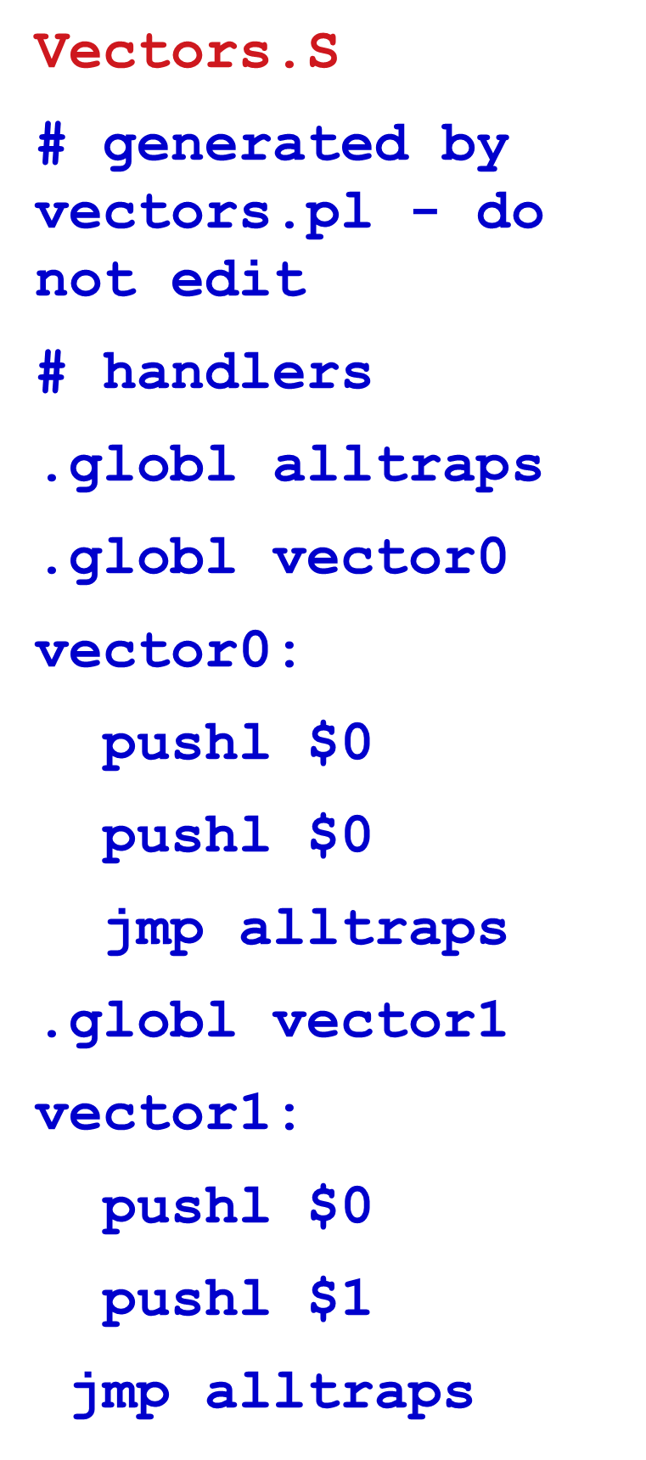
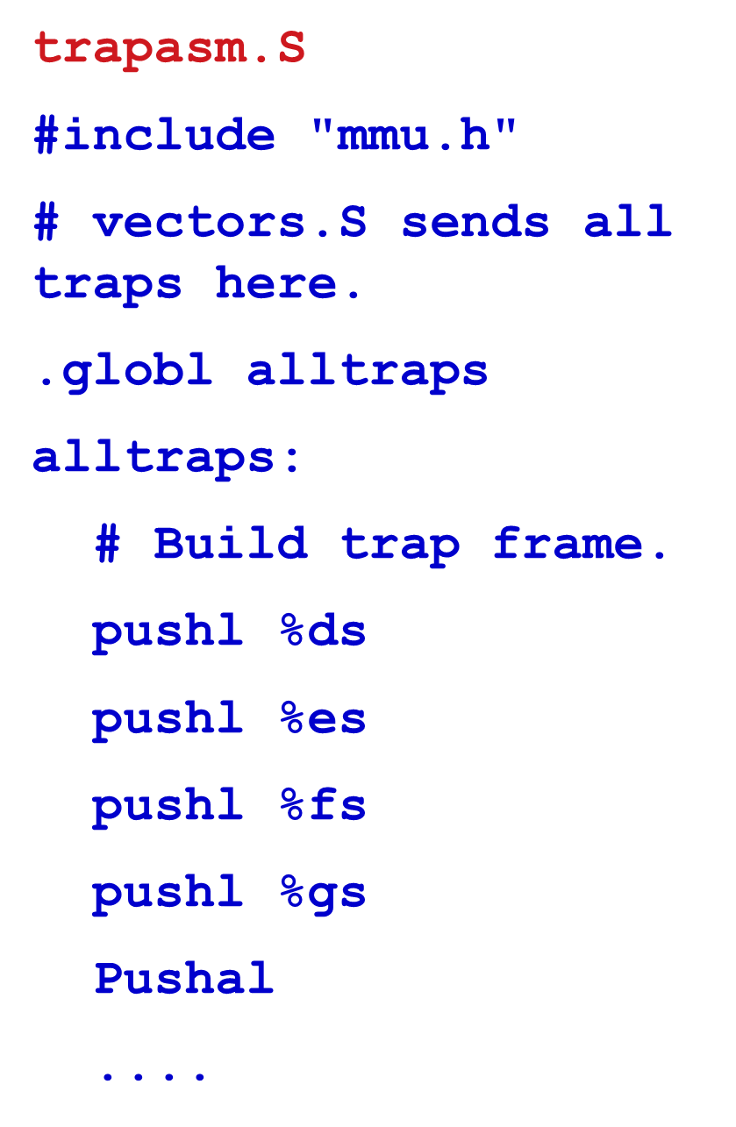

Slide 27


Slide 28
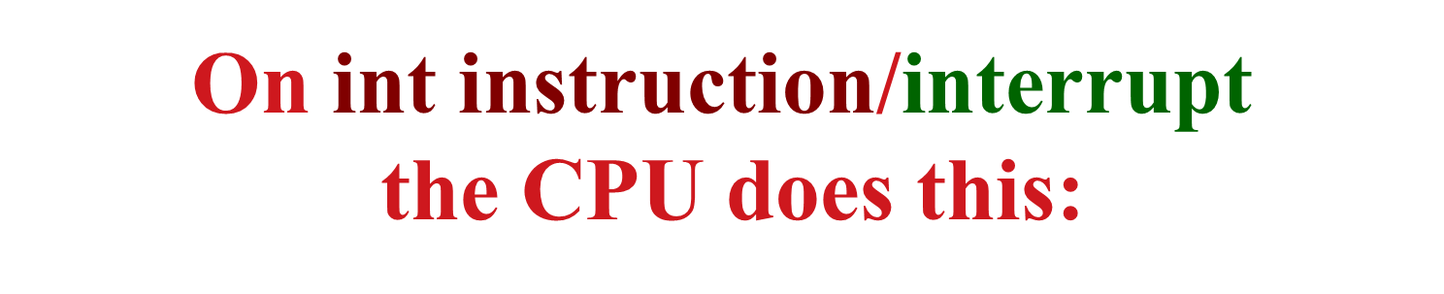
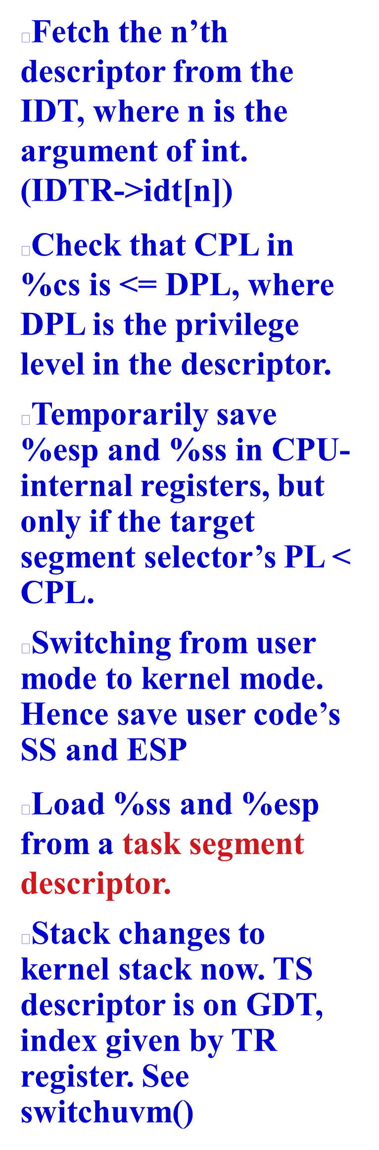
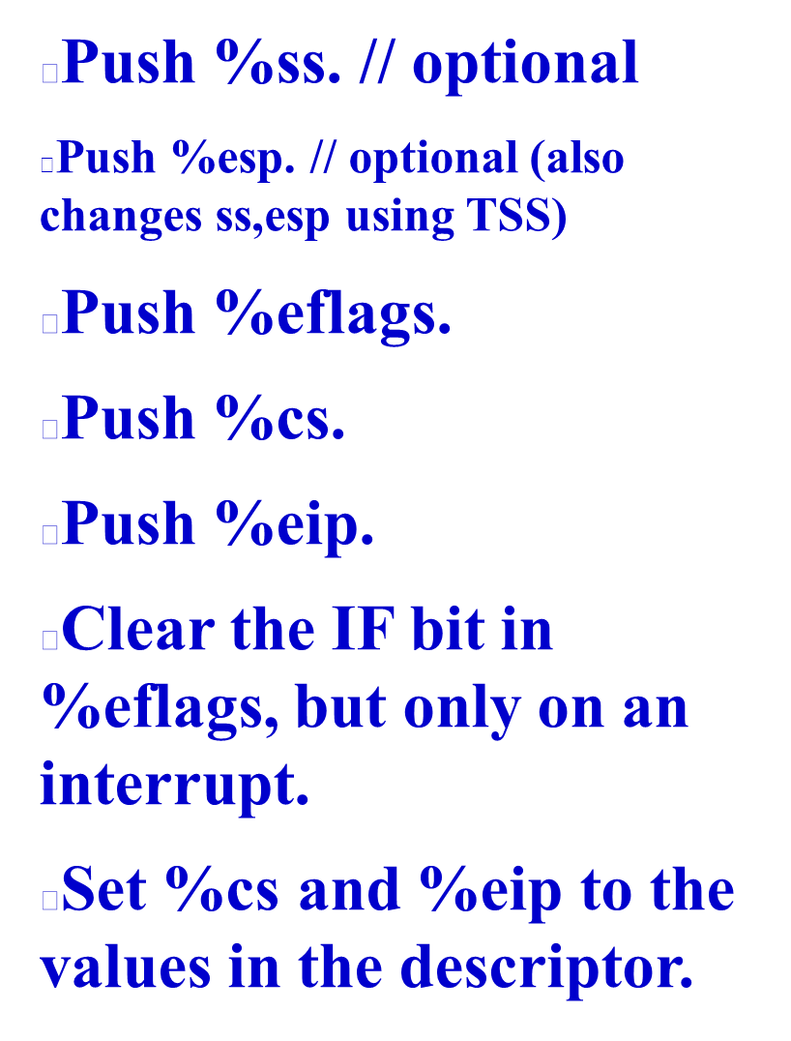

Slide 29

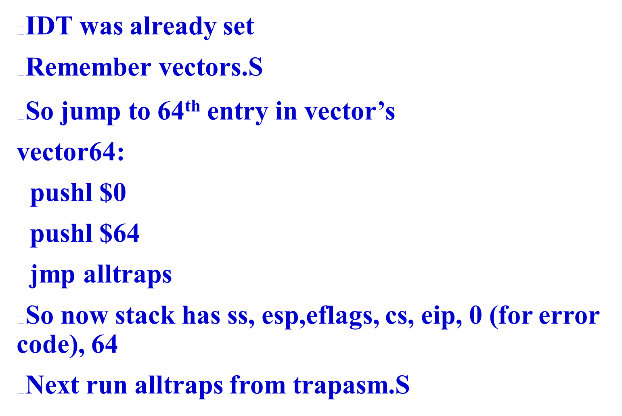

Slide 30
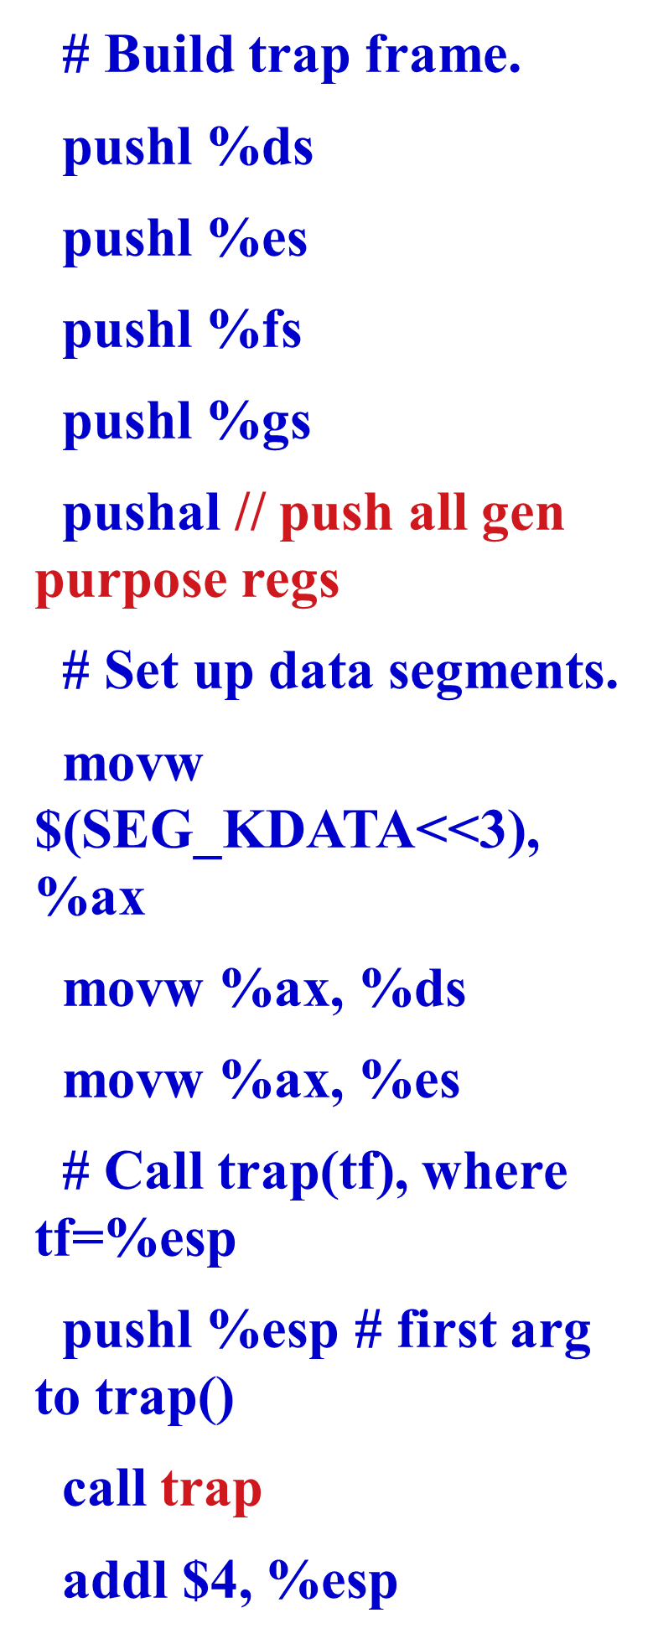

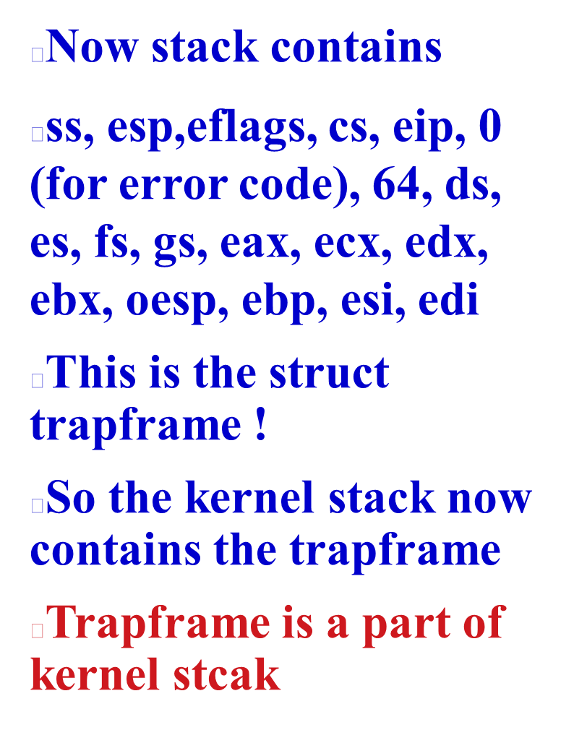

Slide 31
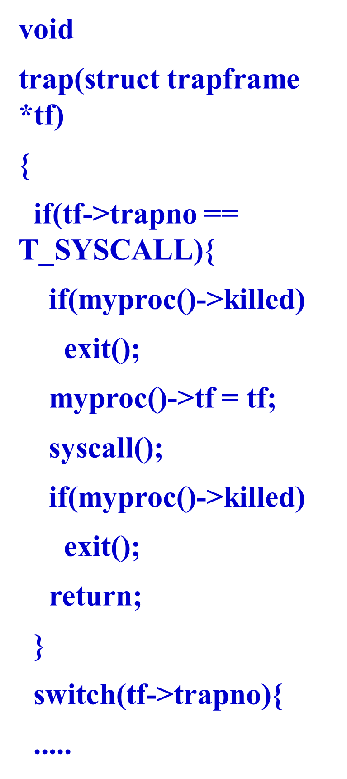

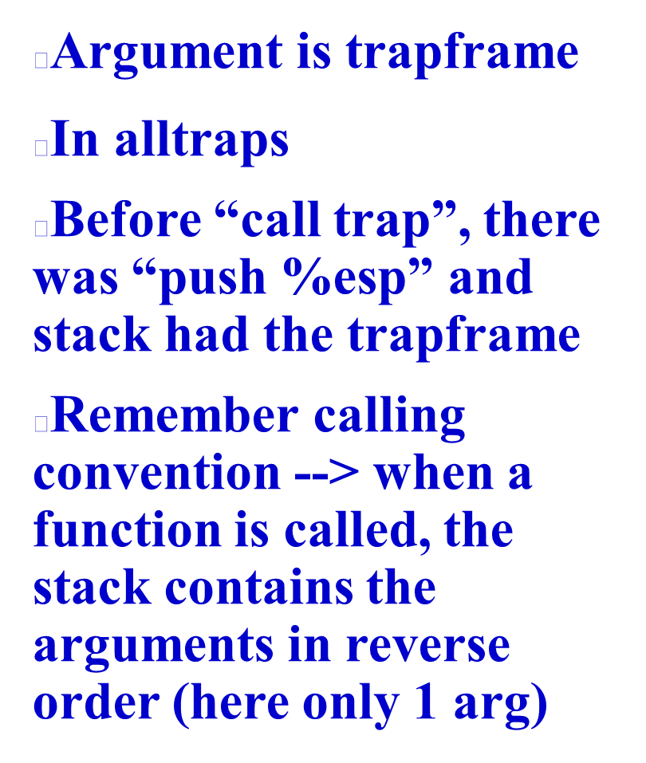

Slide 32


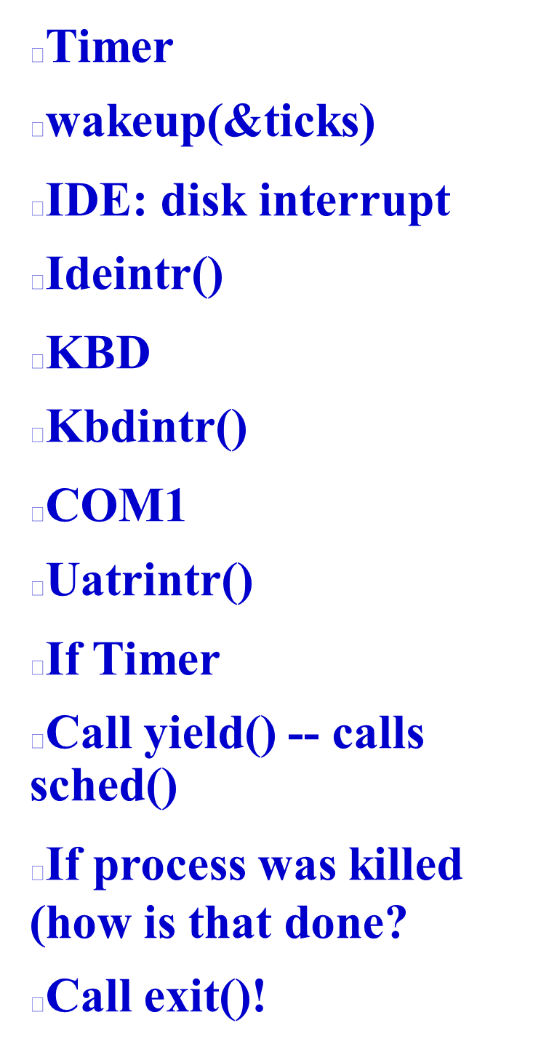

Slide 33
