Slide 1
Staff Documentation
Url: http://192.168.0.199/staff/index.php

Slide 2
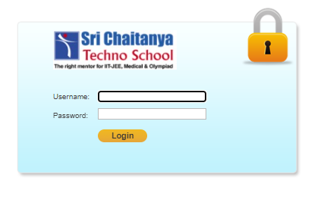
Login Page
Login Procedure for Branch Principal Role into SCTS Application:
Enter User Name and Password, Click on Login Button, It will redirect to Staff User Home Page
Example:
Username : Kavalipri
Password : Scts@123
After clicking on “Login” button, Branch principal will redirected to Home Page which is shown below

Slide 3
Reports page

Slide 4
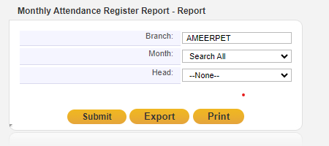

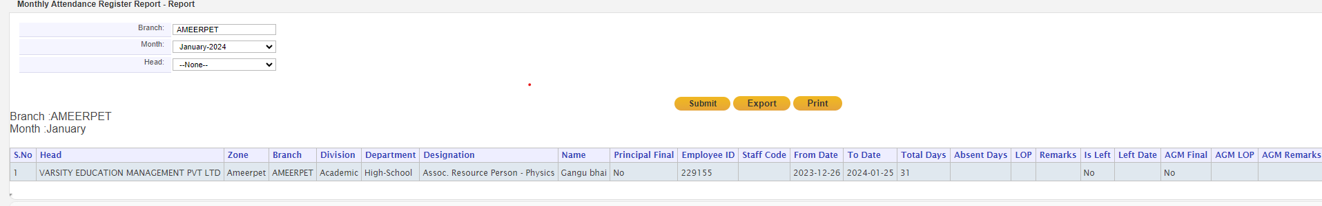
Report => Monthly Attendance register Report
Once click on submit button based on Monthly Attendance report details are displayed
On Export Data is downloaded on excel format

Slide 5
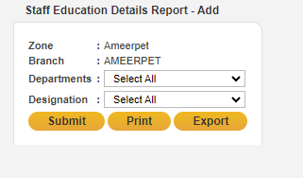
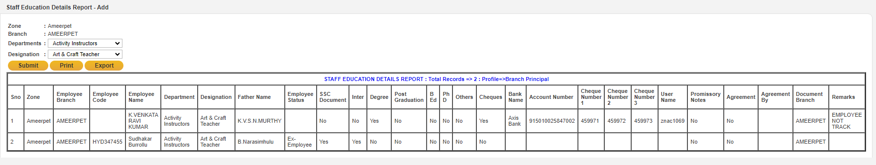
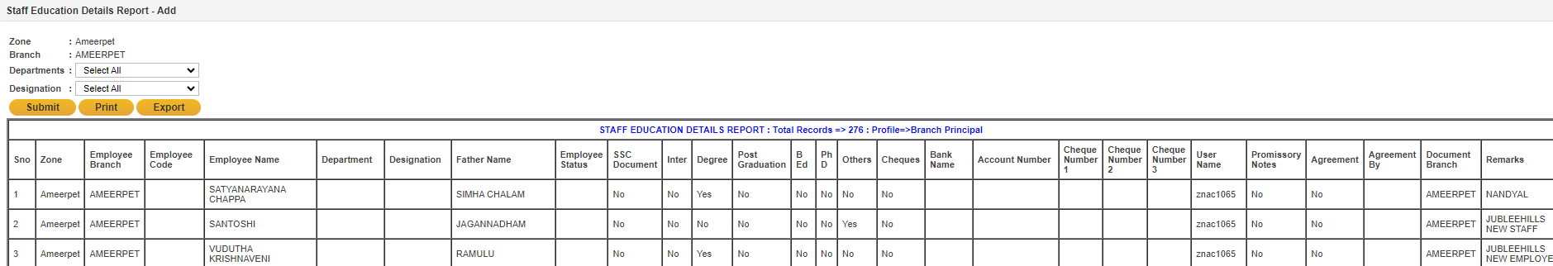
Staff education details Report
In this module, we can display employee education details .
On Submit
Did not select departments ,designation whole data is appeared for selected Branch
On Export Data is downloaded on excel format

Slide 6
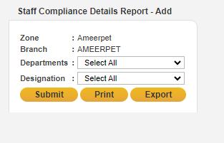
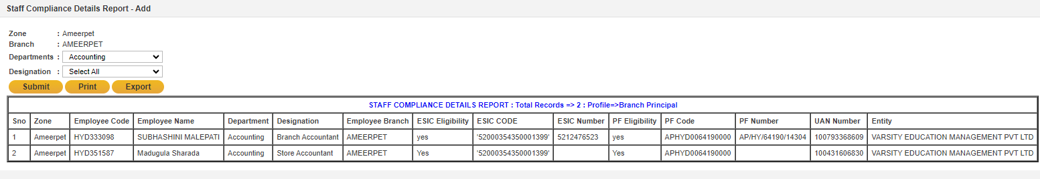
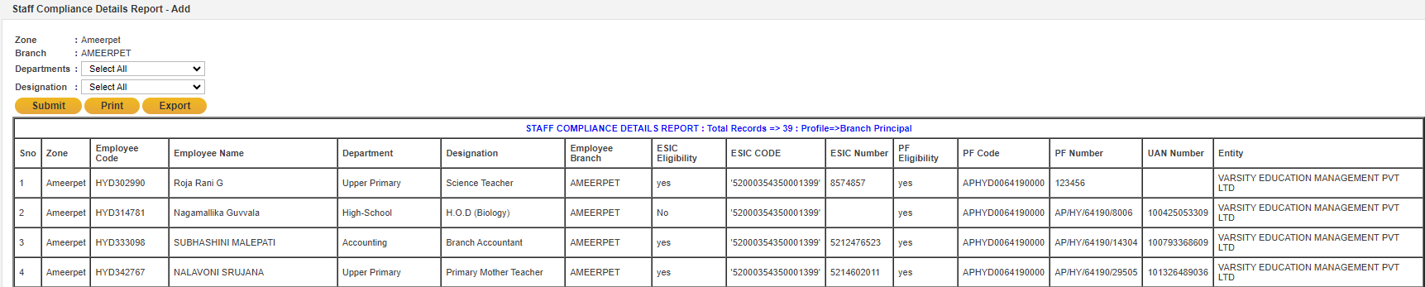
Staff Compliance Details Report
In this module, we can display staff eligibility for PF or ESI.
In this module, we can display staff eligibility for PF or ESI.
Did not select departments, designation whole data is appeared for selected Branch
On Export Data is downloaded on excel format

Slide 7
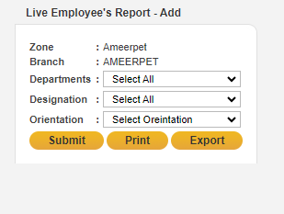
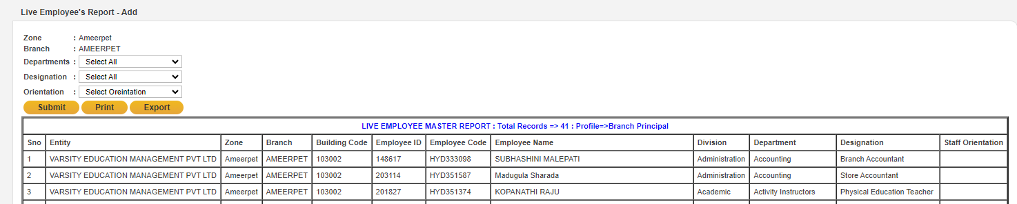
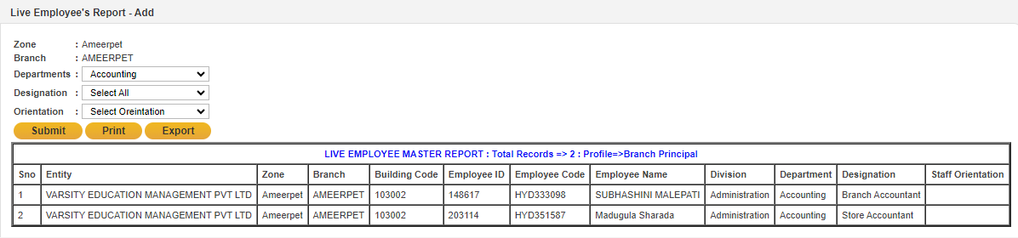
Live Employee's Report
In this module ,payroll employees are displayed
On submit
Did not select departments ,designation whole data is appeared for selected Branch
Click on submit button then based on selection all the details are displayed.
On Export Data is downloaded on excel format

Slide 8
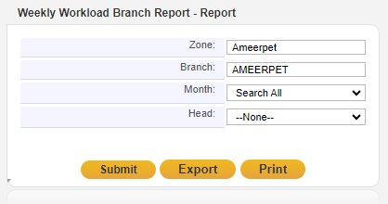
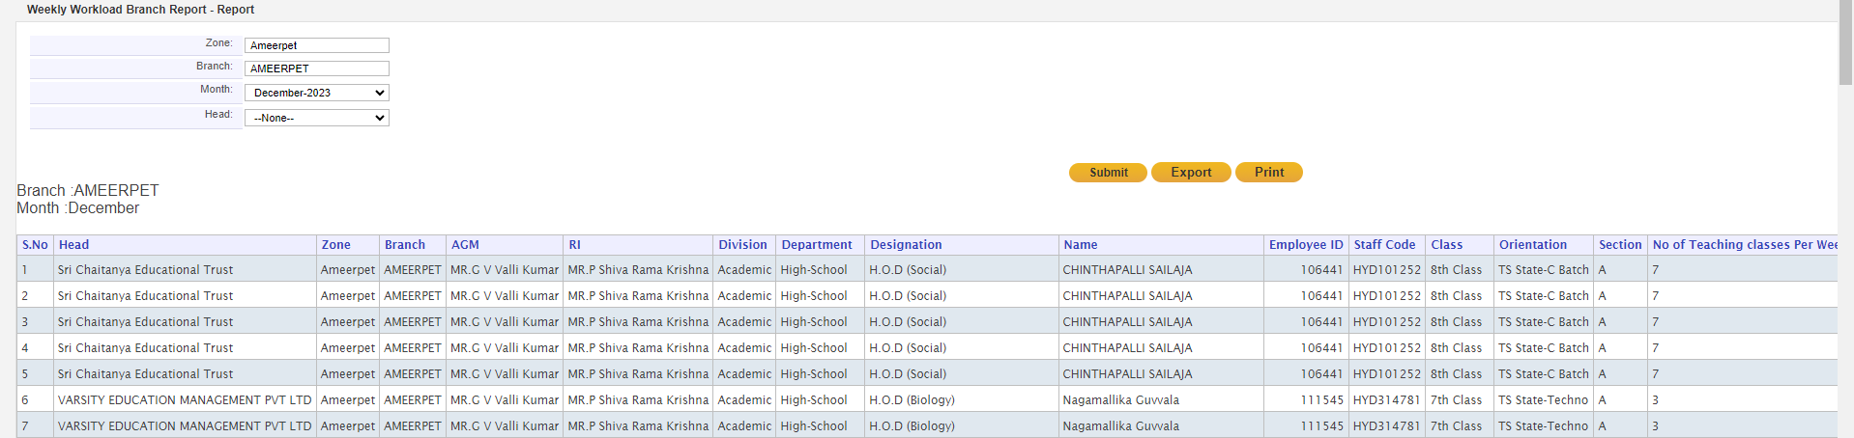
Weekly Workload Branch Report
In this module, we can display the number of teaching classes, practice sessions, and other activity classes per week.
Click on submit button then based on selection all the details are displayed.
On Export Data is downloaded on excel format

Slide 9
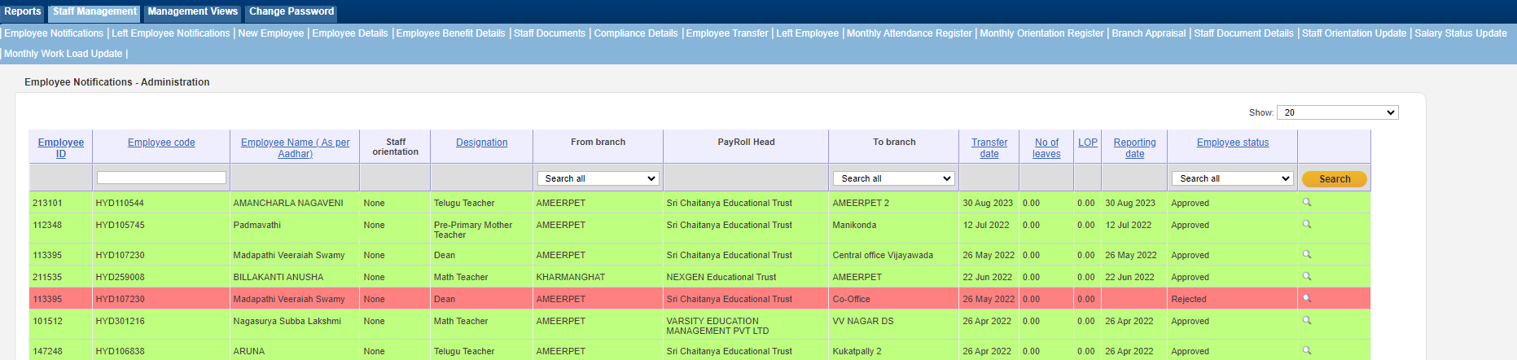
Staff Management → Empolyee Notfication
In this module, we can display the Employee Transfer Status.
For example, if an employee is transferring from Ameerpet to SR Nagar, the SR Nagar branch has the options to accept or reject the transfer, while the Ameerpet branch can only view the status.

Slide 10
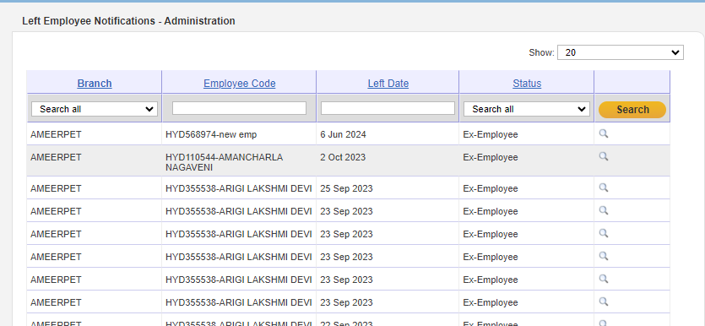
Left Employee Notification
Here in notifications left employee details is shown
After the approval of a specific employee's resignation, it will be reflected in this notifications.

Slide 11
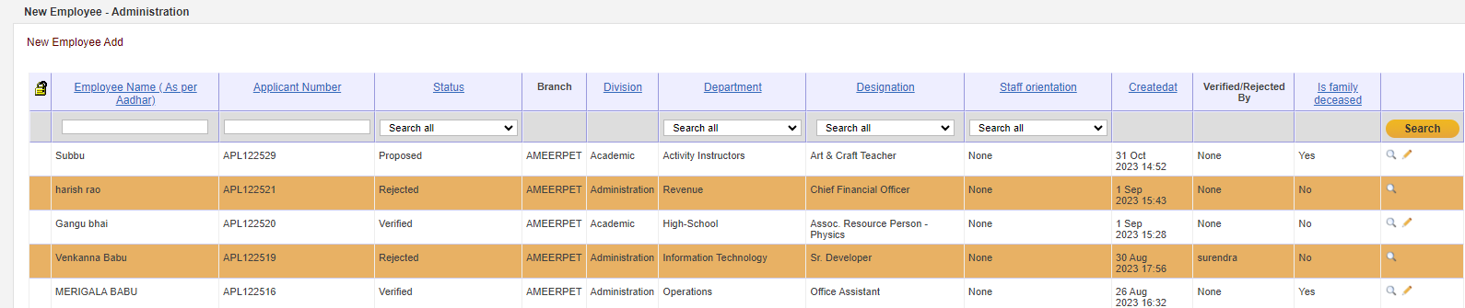
New Employee
Now Branch Principal Click on New Employee Screen, Here New employee add button is displayed, Click on that button it will be redirected to another page.

Slide 12
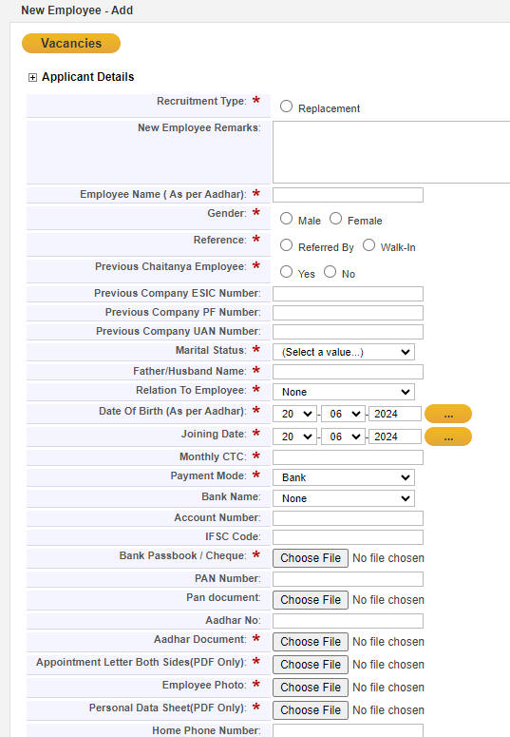
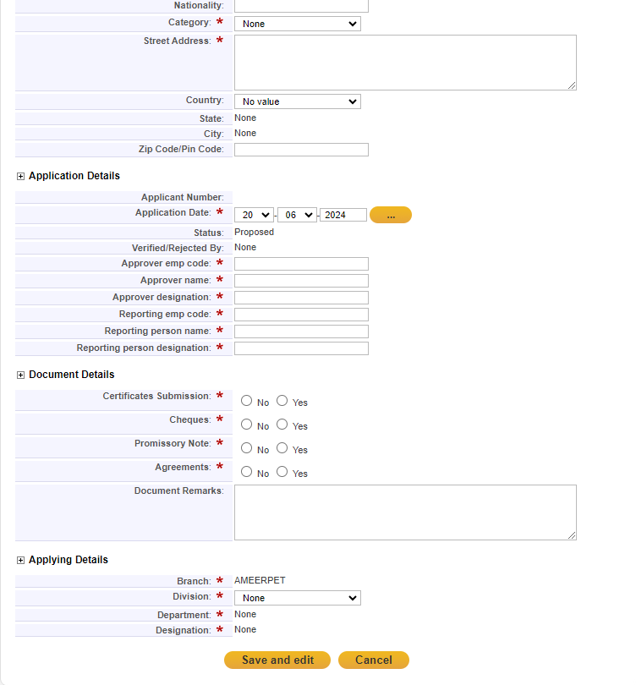
=
Once Click on save and close button, all the fields are displayed as read only, click on save and close button Principal is not edit to any field.
Employee status is displayed as Proposed

Slide 13
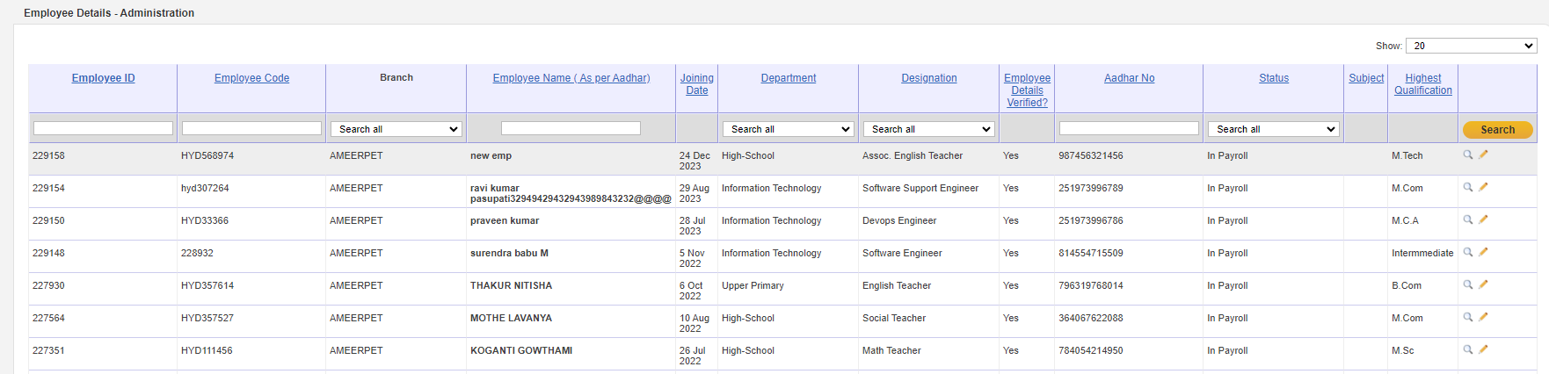
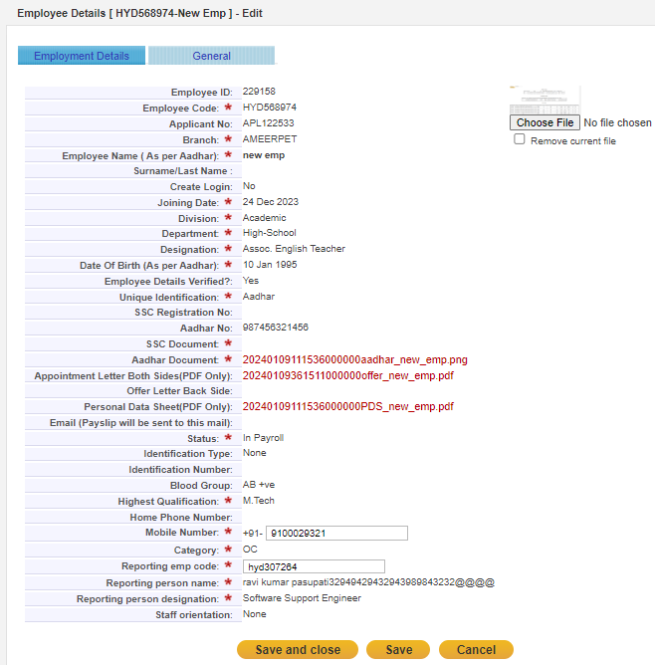
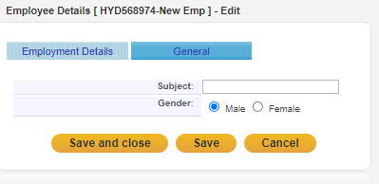
Employee details
Here we can find all the approved employee details
All Approved employees status displayed as in payroll

Slide 14
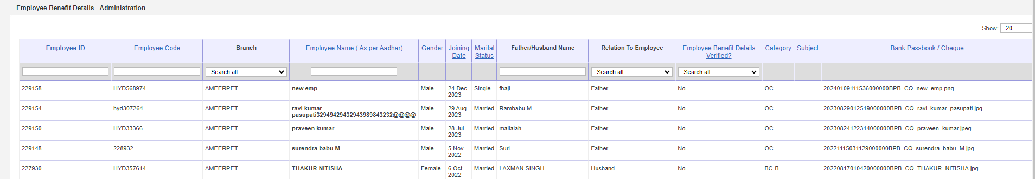
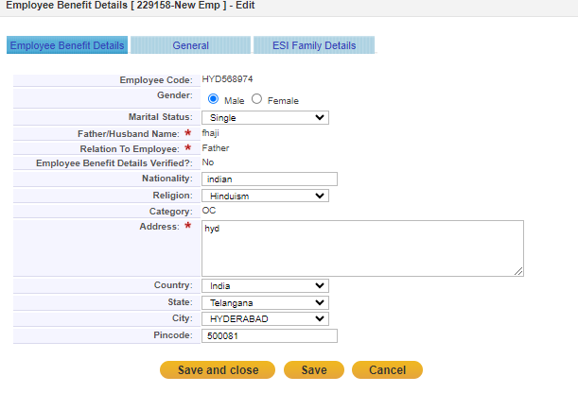
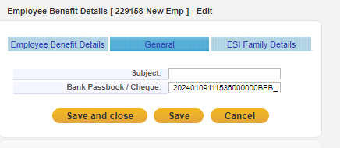
Employee Benefits Details
Employee Nominee details and health benefit details are shown here
Add required details to fulfill Employee Details

Slide 15
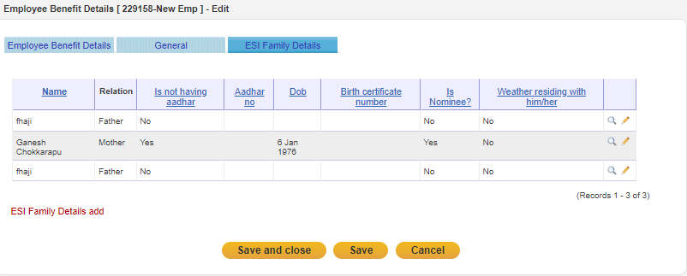
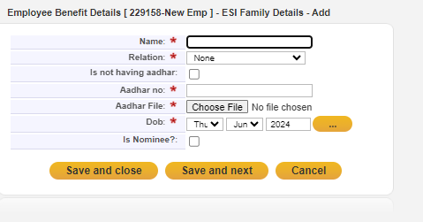
Fill in the required family details for employee benefits

Slide 16
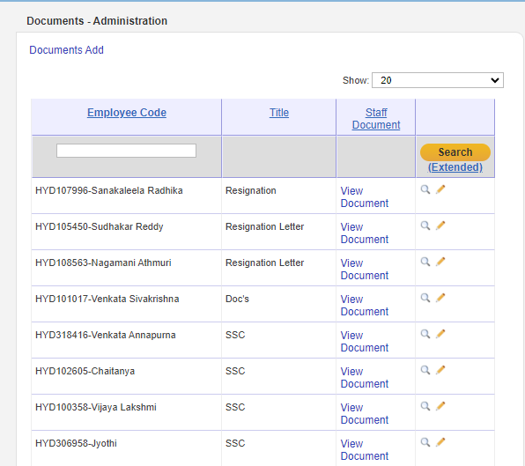
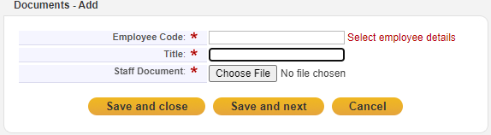
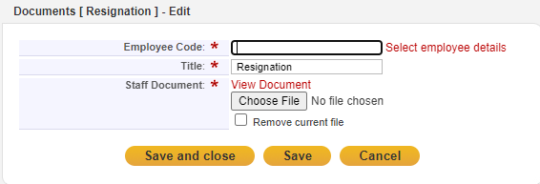
Staff Documents
click on document add
Fill in the required details. If you are entering a single data point, click 'Save and Close'. If you need to enter more data, click 'Save and Next‘.
Fill in the required details. To edit the data and after that click 'Save'. To exit, click 'Save and Close'.

Slide 17
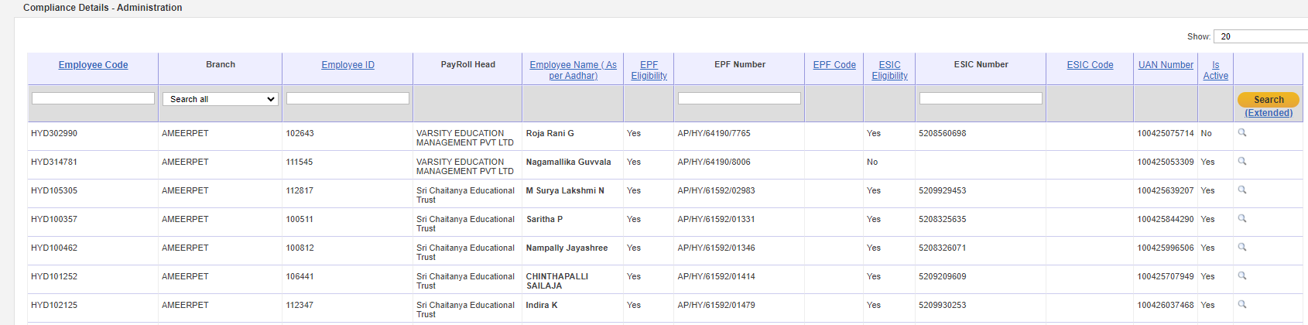
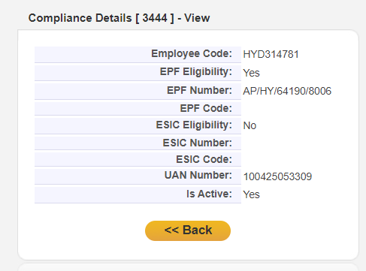
Compliance Details
In this module, we can display staff eligibility for PF or ESI.
To check individual details click on the specific field

Slide 18
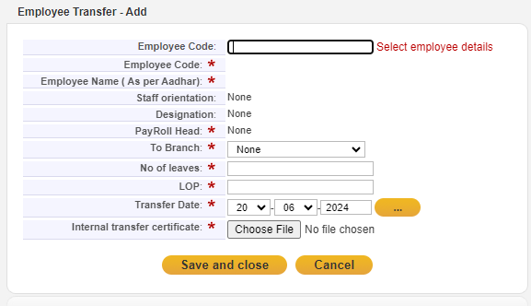
Enter the required fields to transfer the employee

Slide 19
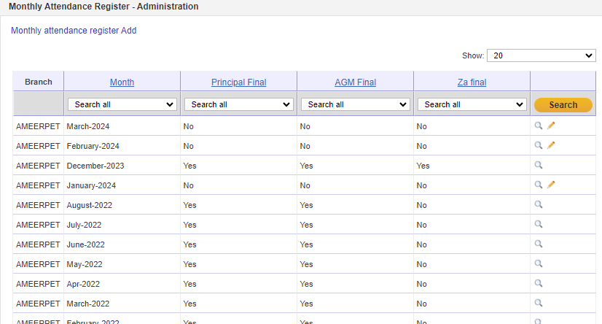
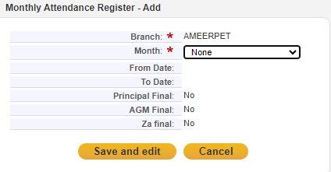
Monthly Attendance Register
Branch Principal Click on monthly attendance register then it will redirect to add page.
Enter the required details and Once click on submit button based on selection employee attendance is displayed

Slide 20
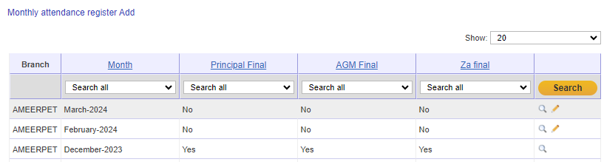
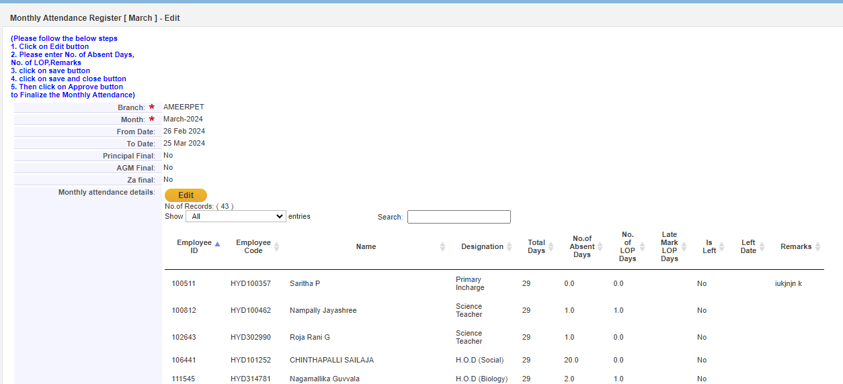
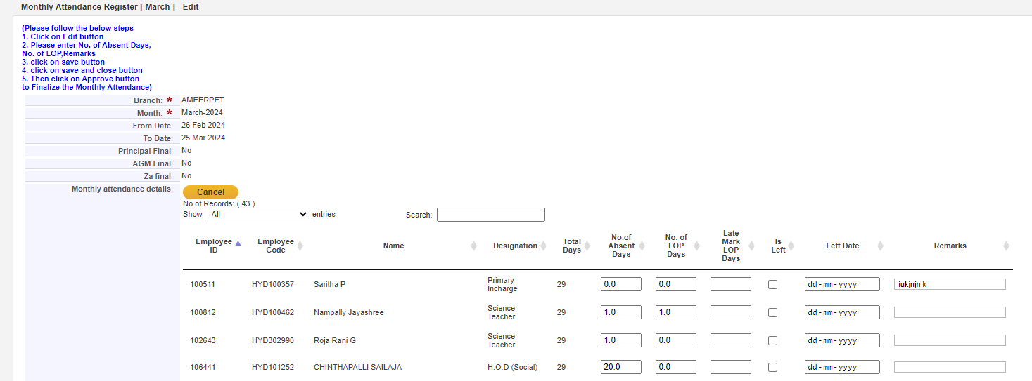
To edit follow this steps

Slide 21
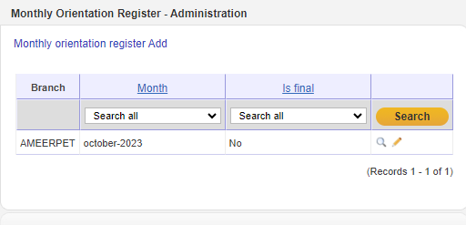
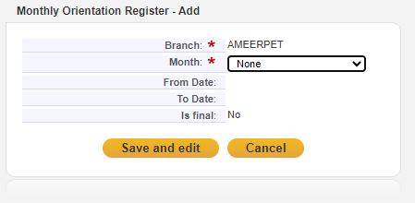
Monthly Orientation List
Click on monthly orientation register then it will redirect to add page.
Enter the required details and Once click on Save and edit button based on selection employee orientation is displayed

Slide 22
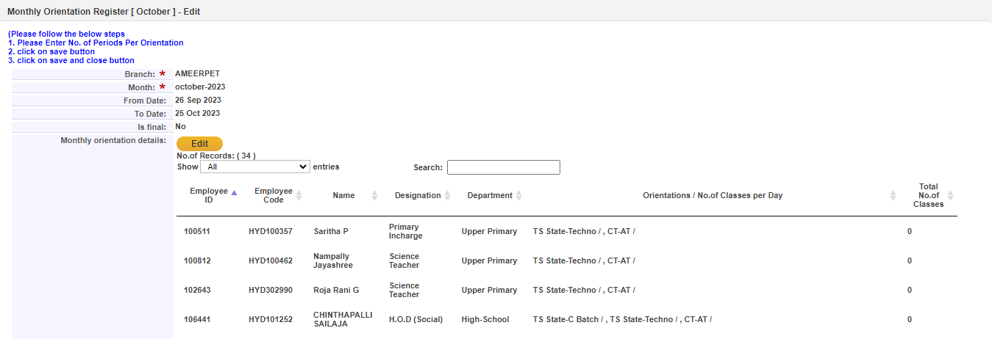
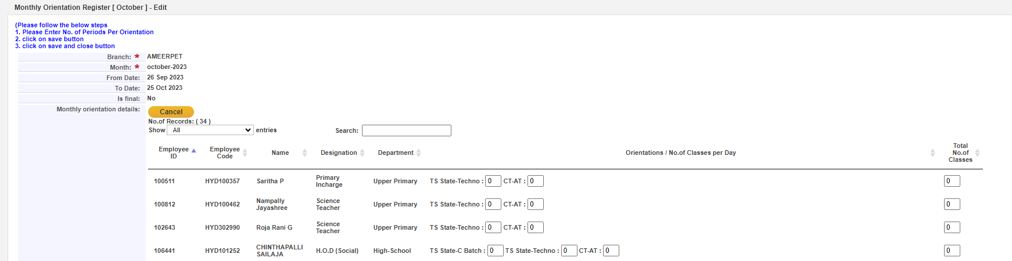
To Edit the fields follow the steps

Slide 23
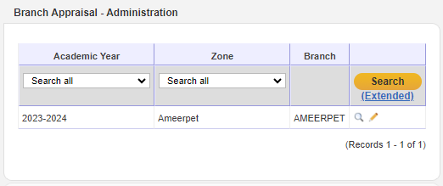
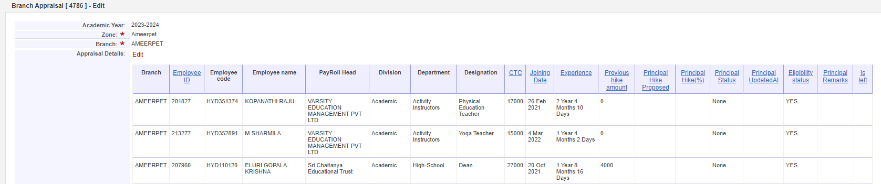
Branch Appraisal
In this screen we can find an edit option click on that on then it will be editable.

Slide 24
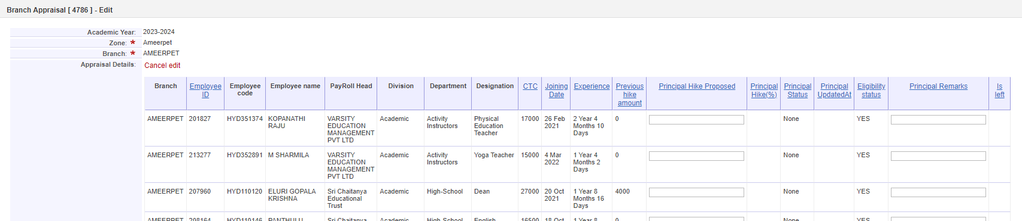
Now enter the proposed hike amount then click on save button.
Proposed hike amounts are saved.
After saving all the details then finalized the hike amounts.
Once finalize then it will not be editable

Slide 25
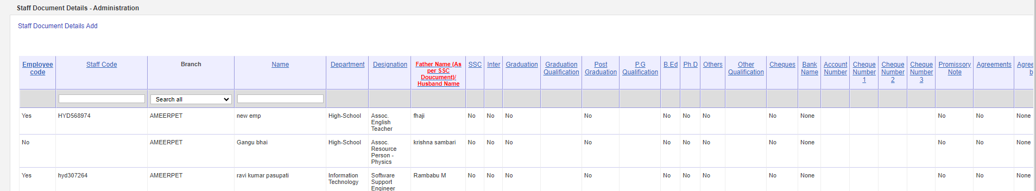
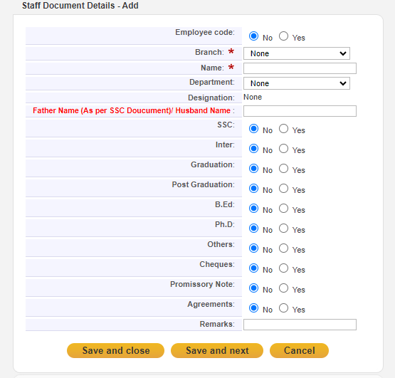
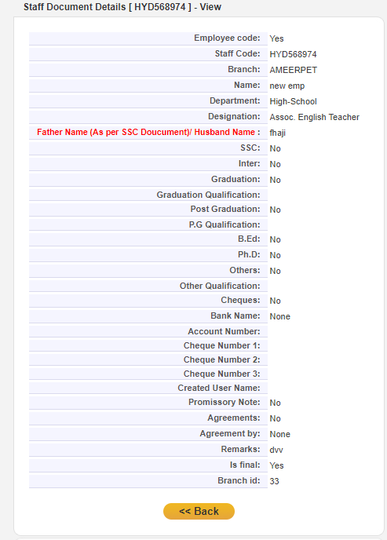
Staff Document Details
Now Click on Staff Document screen then it will redirect to another page.
Here we can find an option Documents add.
Click on that one then it will redirect another page.
Here we can add the employee document details

Slide 26
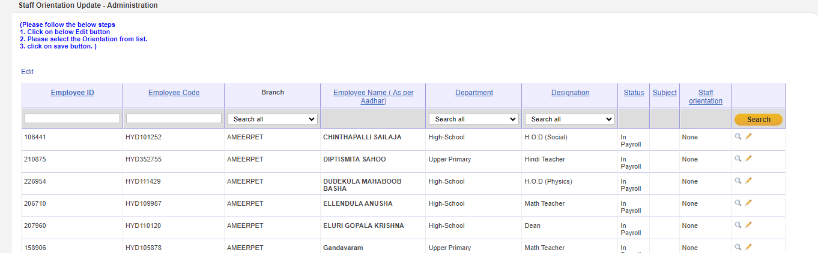
Staff orientation
To change the orientation of a specific teacher, click the edit symbol .

Slide 27
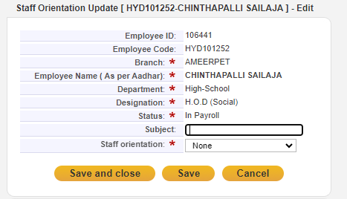

In staff orientation field you can change the orientation.

Slide 28


Employee Salary Status
To check the employee's salary status, whether it is on hold , release, in progress
Click on the edit option to edit

Slide 29

To edit the salary status of the employee to make hold and add remarks

Slide 30


Monthly Work Load Update
In this module, we can display the number of teaching classes, practice sessions, and other activity classes per week.
Click on submit button then based on selection all the details are displayed.

Slide 31

Enter the required fields and click on save and edit

Slide 32

Left Employment
Enter the required fields of the left employee(resigned employee to be proposed that is going left)

Slide 33

Relieved Staff Details
In this module, we can display Relieved Empolyee Details.

Slide 34

Change Password
Branch Principal can change his/her password by clicking on “Change Password” module.
After entering all the details like current password, new password and Reenter password and by clicking on “Save” button.
Branch Principal will get one conformation message after clicking on “Save” button.

