Slide 1

ARMapper - IgniteAR
An Idea by :
Vardhan Viswanath
Praneeth Kaligotla
Narun T
Theme – Web / App Development

Slide 2
Problem Statement
What if we plan to go to a new place and we don't know how the situation is of that place before ? Could we devise a way to view such places to be prepared just in case the weather is not good ?
Many a times students tend to travel large distances to attend exams : Be it college entrance or hackathon events , How do they get to know about the best hotels to stay at and good restaurants to stop by ?
How can we create a simple mapping app which is user friendly and also has tons of great features ?
We Have A Solution ! ---> ARMapper

Slide 3


Target Audience
This app focuses and benefits all age ranges from a minimum age of 7 to 90 being the maximum because of obvious reasons.
The app helps MNCs and government agencies to keep a track of what's happening around them . (How exactly ?...Hmm we'll come to that)
The app has interactive AR filters for kids to keep them entertained at all places when the elders are busy. This would also possibly increase their interest in the AR domain.
With a never before connectivity , with this app you can connect with various people and share your live location or use smart navigation to that person if you both don't know how to describe the place .

Slide 4
App Description and its role
ARMapper is a smart mapper filled with multiple features such as AR navigation, Voice recognition , Smart suggestions, Live feed (Limited time) , filters (Entertainment) and chats.
This app is beneficial in all the domains you could think of.
Would be of great use if any bio - hazard scenario takes place.

Slide 5








Resources to be used

Slide 6
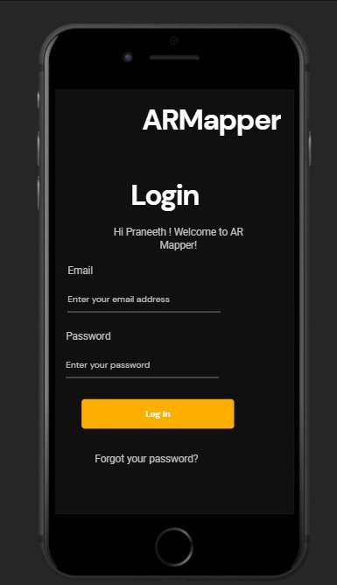
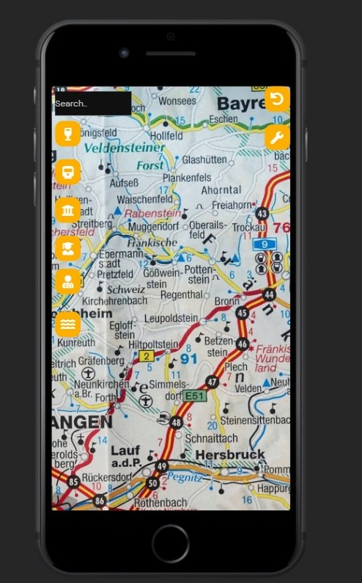
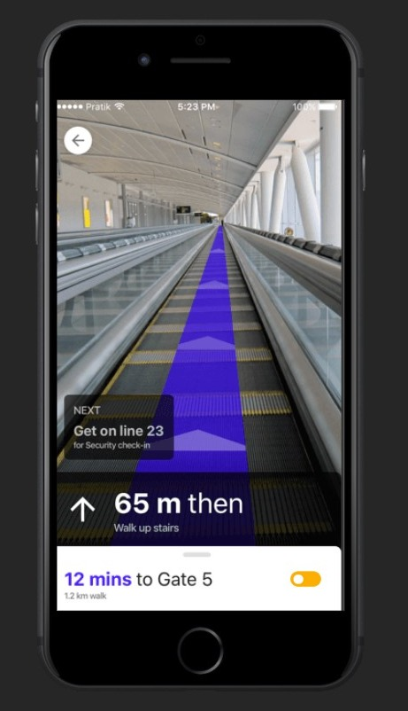

Slide 7
