Slide 1



Principles
of
Soft Computing
Dr. Pandu Sowkuntla
Asst. Professor,
Dept. of CSE, SRM University AP

Slide 2


Fuzzy logic
Unit-III

Slide 3
Introduction to Fuzzy Logic

Slide 4
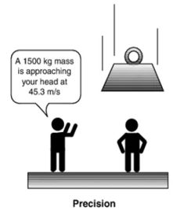

Why Fuzzy Logic?
Knowledge in real world can be inaccurate, unclear, imprecise, indecisive, probabilistic, approximate.
Crisp set can not tolerate the imprecision in the data.
Example: If we touch something, instead of measuring exact temperature, we think whether the object is cold, warm, hot or very hot etc.
Precision is not everything.
Most of the times, we are looking for the significance rather than precision.

Slide 5
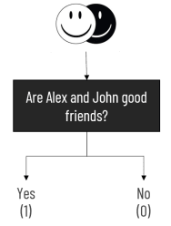

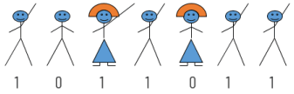
Why Fuzzy Logic?
If we ask: Are Alex and John good friends?
(vague statement)
Using crisp representation, the possible outcome is either 0 or 1.
But the possible outcomes could be extremely good friends, or good friends, or not so good
friends, or they are not friends at all.
If we ask:
“who does have a driving license?”
But if we ask:
“who can drive well?” (vague statement)

Slide 6
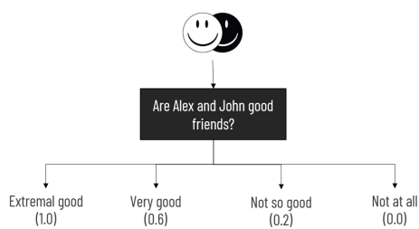
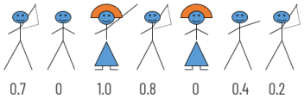
Why Fuzzy Logic?
Fuzzy logic is an approach to computing based on “degree of truth” rather than the usual “true (1) or false (0) value”.
Crisp logic is binary valued logic.
Any element in crisp set has membership value either 0 or 1.
Fuzzy Logic which is also known as multi-valued logic has multiple membership values possible.
For multi-valued logic, element can take any real value between 0 and 1.
“who can drive well?”

Slide 7
What is Fuzzy Set?
Fuzzy set is a natural way to deal with the imprecision.
Fuzzy set is an extension of crisp set.
Fuzzy logic deals with the range, rather than individual elements, so its easy-to-handle vague information.
Fuzzy logic allows decision making with estimated values under incomplete or uncertain information.
Convenient way to express expert and common-sense knowledge based on linguistic terms.

Slide 8

What is Fuzzy Set?
Lofti Zadeh introduced the notion of an infinite-valued logic in his seminal work ”Fuzzy Sets”.
He described the mathematics of fuzzy set theory, and by extension fuzzy logic.
He is being referred as the father of fuzzy logic.
Proposed systematic way of modeling imprecision of the data using fuzzy sets.
Also proposed strong mathematical background to support his claim.
1921-2017

Slide 9
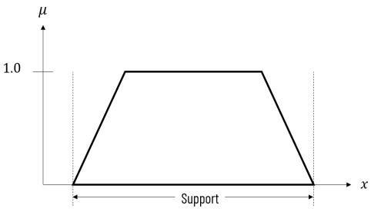
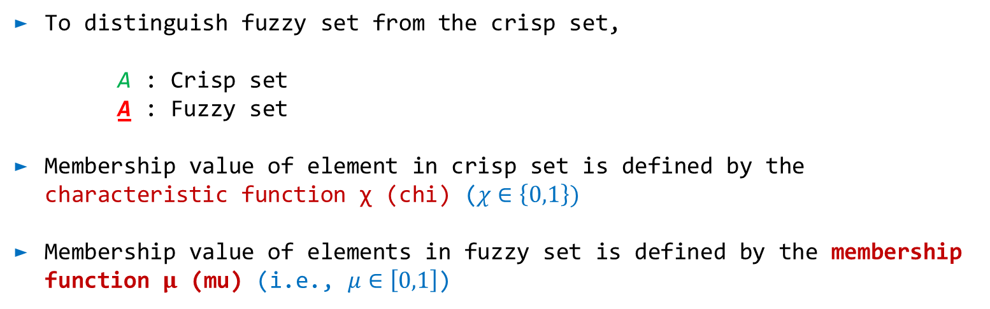
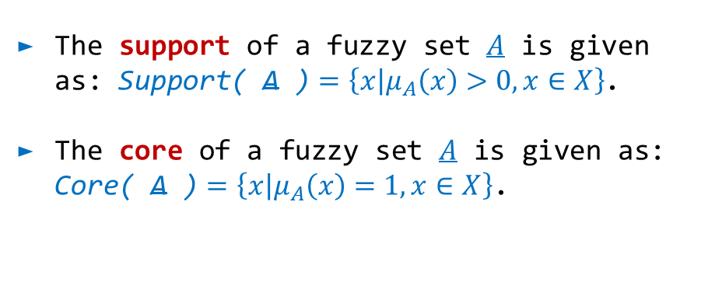
Terminology of Fuzzy Sets
To distinguish fuzzy set from the crisp set,
A : Crisp set
A : Fuzzy set
Membership value of element in crisp set is defined by the characteristic function χ (chi) ($χ∈\left\{0,1\right\})$
Membership value of elements in fuzzy set is defined by the membership function $μ$ (mu) (i.e., $μ∈\left[0,1\right]$)
The support of a fuzzy set $A$ is given as: $\text{Support}\text{( }\text{A}\text{ )}=\left\{\left.x\right|μ_{A}\left(x\right)>0,x∈X\right\}$.
The core of a fuzzy set $A$ is given as: $\text{C}\text{ore}\text{( }\text{A}\text{ )}=\left\{\left.x\right|μ_{A}\left(x\right)=1,x∈X\right\}$.
Core

Slide 10
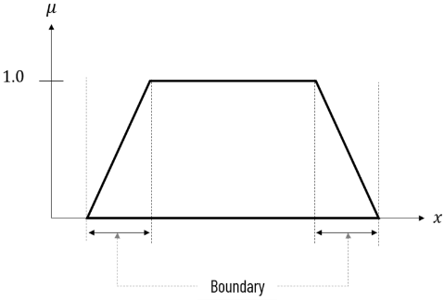
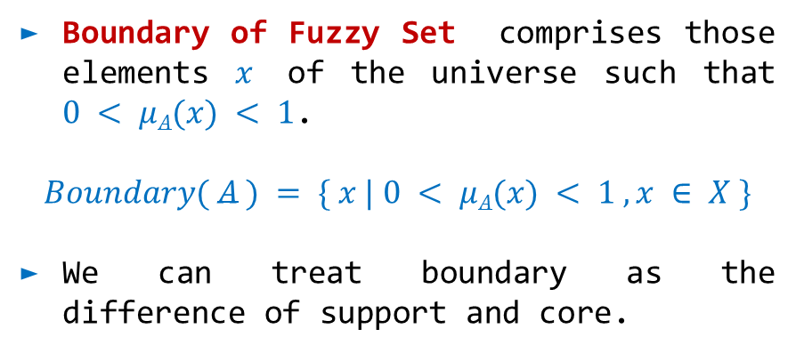
Terminology of Fuzzy Sets
The Height of Fuzzy Set is defined as the largest membership value of the elements contained in that set.
It may not be 1 always. If core of fuzzy set is non-empty, then height of fuzzy set is 1.
Boundary of Fuzzy Set comprises those elements $x$ of the universe such that $0 < μA(x) < 1$.
$$Boundary( A ) = \{ x | 0 < μA(x) < 1 , x ∈ X \}$$
We can treat boundary as the difference of support and core.

Slide 11
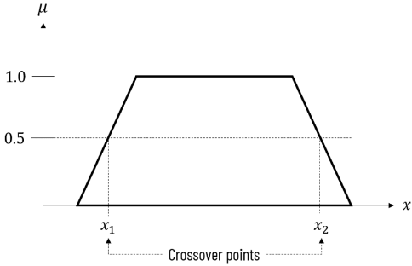
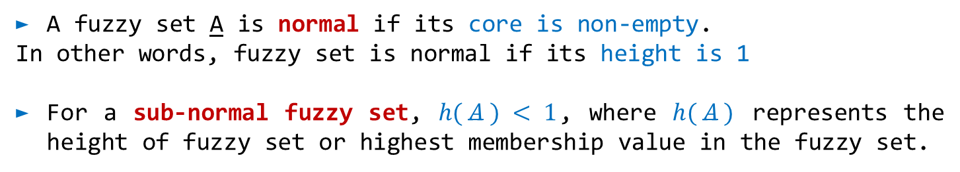
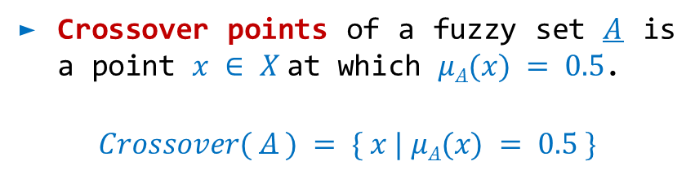
Terminology of Fuzzy Sets
A fuzzy set A is normal if its core is non-empty.
In other words, fuzzy set is normal if its height is 1
For a sub-normal fuzzy set, $h( A ) < 1$, where $h( A )$ represents the height of fuzzy set or highest membership value in the fuzzy set.
Crossover points of a fuzzy set $A$ is a point $x ∈ X$at which $μA(x) = 0.5$.
$$Crossover( A ) = \{ x | μA(x) = 0.5 \}$$

Slide 12
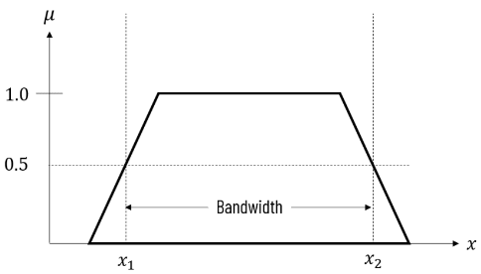
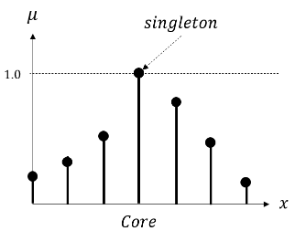
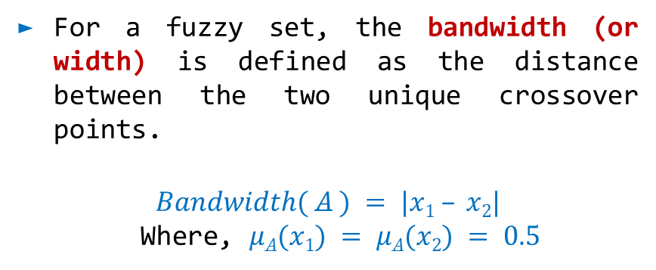
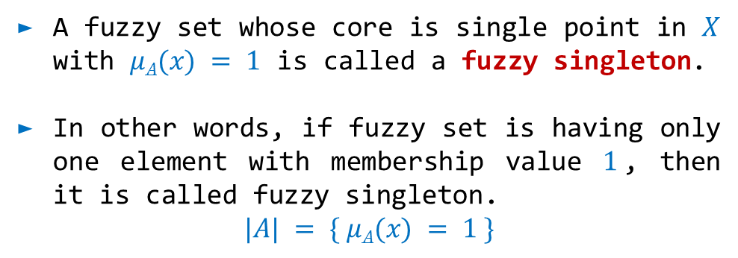
Terminology of Fuzzy Sets
For a fuzzy set, the bandwidth (or width) is defined as the distance between the two unique crossover points.
$$Bandwidth( A ) = |x1 – x2|$$
Where, $μA(x1) = μA(x2) = 0.5$
A fuzzy set whose core is single point in $X$ with $μA(x) = 1$ is called a fuzzy singleton.
In other words, if fuzzy set is having only one element with membership value $1$, then it is called fuzzy singleton.
$$|A| = \{ μA(x) = 1 \}$$

Slide 13
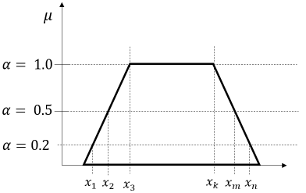
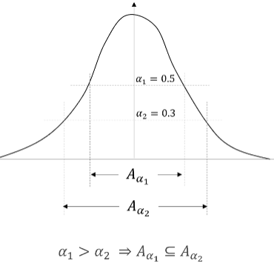
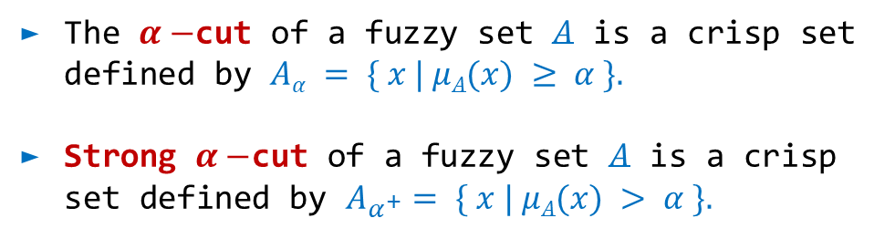
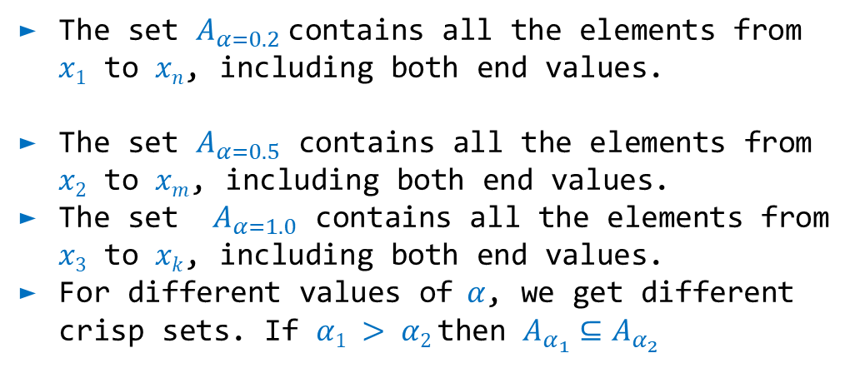
Terminology of Fuzzy Sets
The $α−$cut of a fuzzy set $A$ is a crisp set defined by $Aα = \{ x | μA(x) ≥ α \}.$
Strong $α−$cut of a fuzzy set $A$ is a crisp set defined by $A_{α^{+}}= \{ x | μA(x) > α \}.$
The set $A_{α=0.2}$contains all the elements from $x1$ to $xn$, including both end values.
The set $A_{α=0.5}$ contains all the elements from $x2$ to $xm$, including both end values.
The set $A_{α=1.0}$ contains all the elements from $x3$ to $xk$, including both end values.
For different values of$α$, we get different crisp sets. If $α1 > α2$then $A_{α_{1}}⊆A_{α_{2}}$

Slide 14
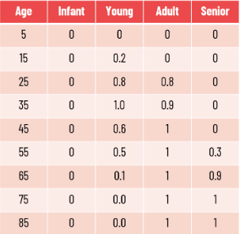
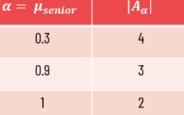
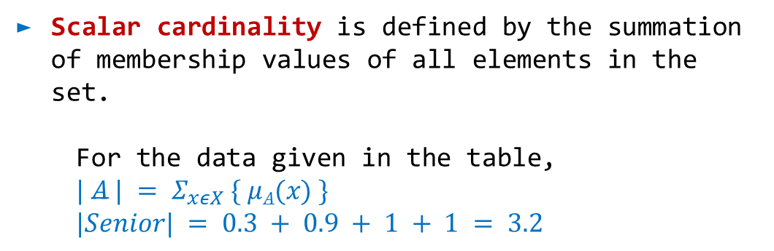
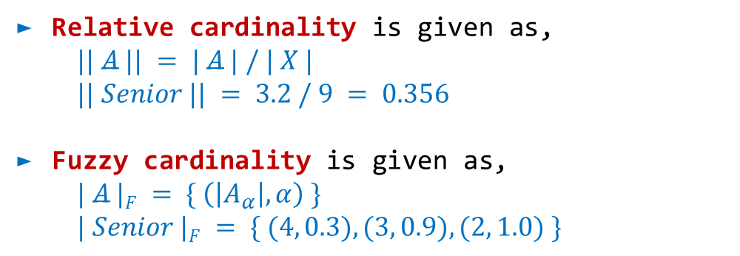
Terminology of Fuzzy Sets
Scalar cardinality is defined by the summation of membership values of all elements in the set.
For the data given in the table,
$$| A | = Σ_{xεX} \{ μA(x) \}$$
$$|Senior| = 0.3 + 0.9 + 1 + 1 = 3.2$$
Relative cardinality is given as,
$$|| A || = | A | / | X |$$
$$|| Senior || = 3.2 / 9 = 0.356$$
Fuzzy cardinality is given as,
$$| A |F = \{ \left(\left|A_{α}\right|,α\right) \}$$
$$| Senior |F = \{ (4, 0.3), (3, 0.9), (2, 1.0) \}$$

Slide 15
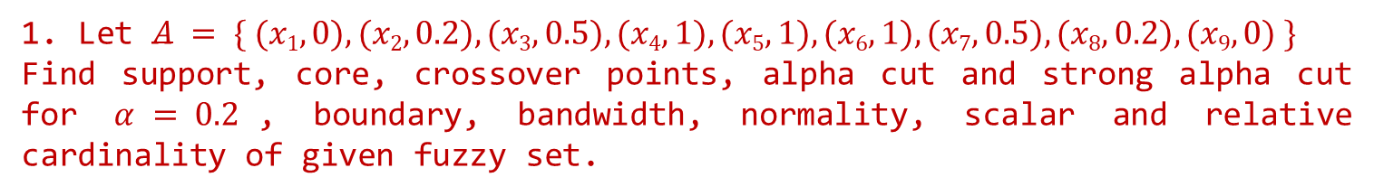
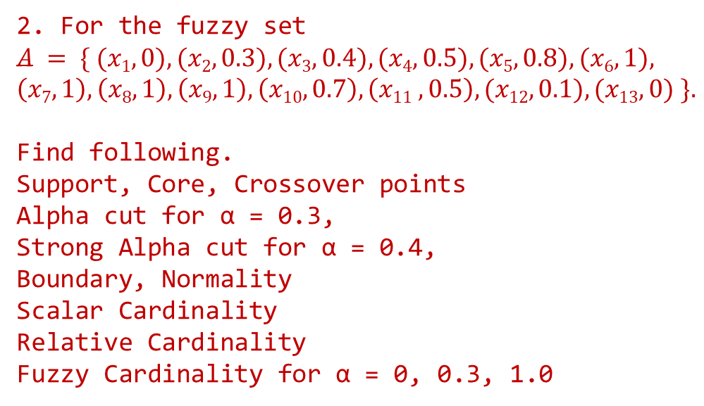
Terminology of Fuzzy Sets
1. Let $A = \{ (x1, 0), (x2, 0.2), (x3, 0.5), (x4, 1), (x5, 1), (x6, 1), (x7, 0.5), (x8, 0.2), (x9, 0) \}$
Find support, core, crossover points, alpha cut and strong alpha cut for $α = 0.2$, boundary, bandwidth, normality, scalar and relative cardinality of given fuzzy set.
2. For the fuzzy set
$$A = \{ (x1, 0), (x2, 0.3), (x3, 0.4), (x4, 0.5), (x5, 0.8), (x6, 1),$$
$$\left(x7, 1\right), \left(x8, 1\right), \left(x9, 1\right), \left(x10, 0.7\right), \left(x11 , 0.5\right), (x12, 0.1), (x13, 0) \}.$$
Find following.
Support, Core, Crossover points
Alpha cut for α = 0.3,
Strong Alpha cut for α = 0.4,
Boundary, Normality
Scalar Cardinality
Relative Cardinality
Fuzzy Cardinality for α = 0, 0.3, 1.0

Slide 16
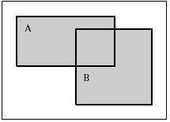

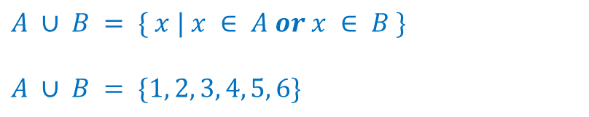
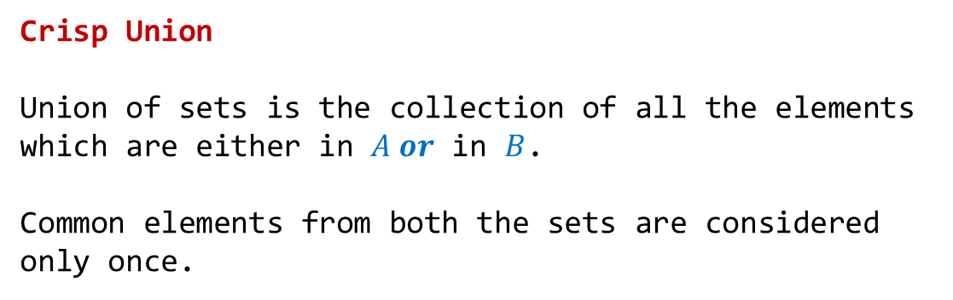
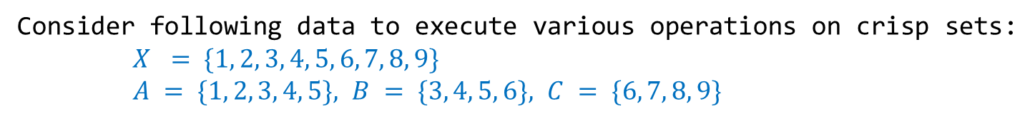
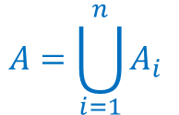
Operations on Fuzzy sets
Consider following data to execute various operations on crisp sets:
$X = \{1, 2, 3, 4, 5, 6, 7, 8, 9\}$
$A = \{1, 2, 3, 4, 5\}, B = \{3, 4, 5, 6\}, C = \{6, 7, 8, 9\}$
Crisp Union
Union of sets is the collection of all the elements which are either in $A or$ in $B$.
Common elements from both the sets are considered only once.
$$A ∪ B = \{ x | x ∈ A or x ∈ B \}$$
$$A ∪ B = \{1, 2, 3, 4, 5, 6\}$$
$$For A1, A2, A3, …,A_{n}$$
$$A=\bigcup_{i=1}^{n}{A_{i}}$$

Slide 17
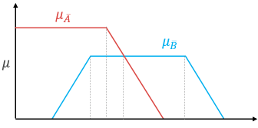
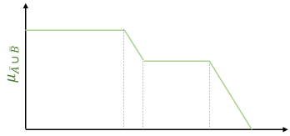
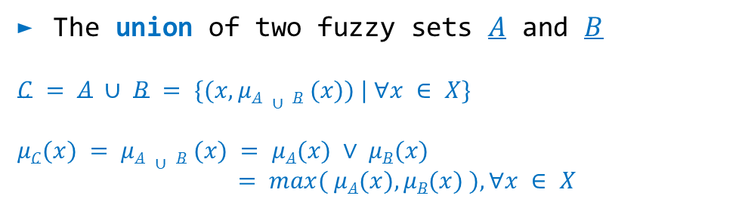
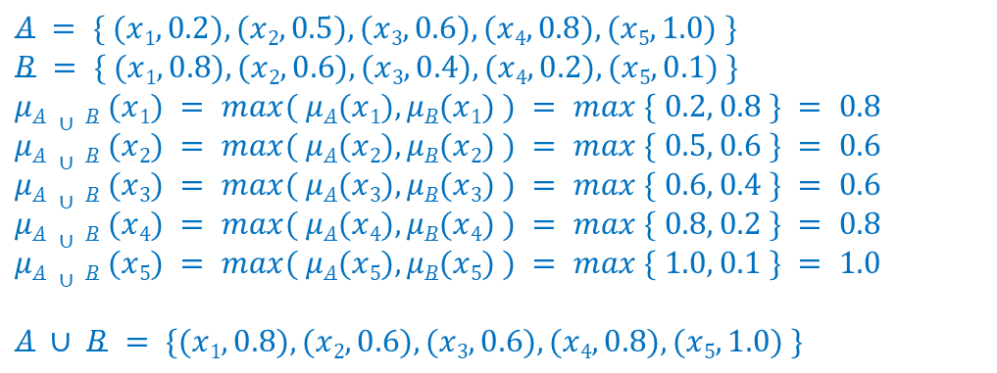
Operations on Fuzzy sets
If there are common elements in both the fuzzy sets, we should select the element with the maximum membership value.
The union of two fuzzy sets $A$ and $B$
$$C = A ∪ B = \{(x, μA ∪ B (x)) | ∀x ∈ X\}$$
$$μC(x) = μA ∪ B (x) = μA(x) ∨ μB(x)$$
$$= max⁡( μA(x), μB(x) ), ∀x ∈ X$$
$$A = \{ (x1, 0.2), (x2, 0.5), (x3, 0.6), (x4, 0.8), (x5, 1.0) \}$$
$$B = \{ (x1, 0.8), (x2, 0.6), (x3, 0.4), (x4, 0.2), (x5, 0.1) \}$$
$$μA ∪ B (x1) = max⁡( μA(x1), μB(x1) ) = max⁡ \{ 0.2, 0.8 \} = 0.8$$
$$μA ∪ B (x2) = max⁡( μA(x2), μB(x2) ) = max⁡ \{ 0.5, 0.6 \} = 0.6$$
$$μA ∪ B (x3) = max⁡( μA(x3), μB(x3) ) = max⁡ \{ 0.6, 0.4 \} = 0.6$$
$$μA ∪ B (x4) = max⁡( μA(x4), μB(x4) ) = max⁡ \{ 0.8, 0.2 \} = 0.8$$
$$μA ∪ B (x5) = max⁡( μA(x5), μB(x5) ) = max⁡ \{ 1.0, 0.1 \} = 1.0$$
$$A ∪ B = \{(x1, 0.8), (x2, 0.6), (x3, 0.6), (x4, 0.8), (x5, 1.0) \}$$

Slide 18
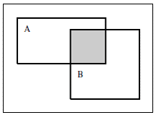
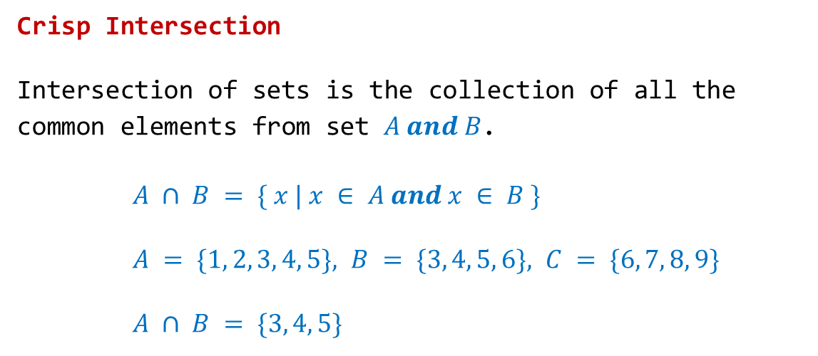
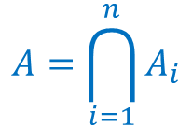
Operations on Fuzzy sets
Crisp Intersection
Intersection of sets is the collection of all the common elements from set $A and B$.
$A ∩ B = \{ x | x ∈ A and x ∈ B \}$
$A = \{1, 2, 3, 4, 5\}, B = \{3, 4, 5, 6\}, C = \{6, 7, 8, 9\}$
$A ∩ B = \{3, 4, 5\}$
$$For A = A1 ∩ A2 ∩ A3 ∩ … ∩ An$$
$$A=\bigcap_{i=1}^{n}{A_{i}}$$

Slide 19
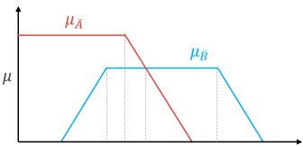
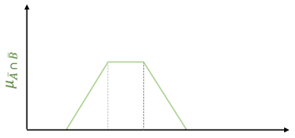
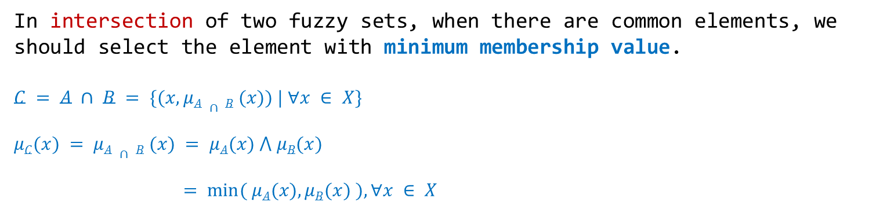
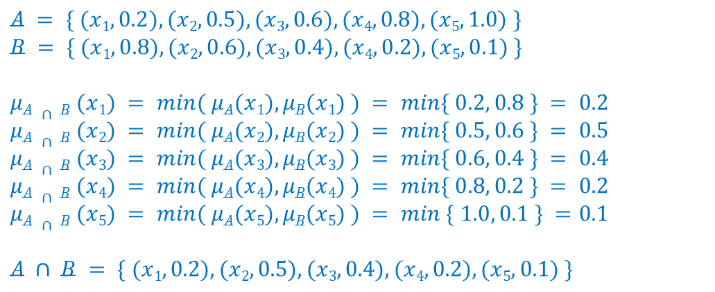
Operations on Fuzzy sets
In intersection of two fuzzy sets, when there are common elements, we should select the element with minimum membership value.
$$C = A ∩ B = \{(x, μA ∩ B (x)) | ∀x ∈ X\}$$
$$μC(x) = μA ∩ B (x) = μA(x) ⋀ μB(x)$$
$$= min⁡( μA(x), μB(x) ), ∀x ∈ X$$
$$A = \{ (x1, 0.2), (x2, 0.5), (x3, 0.6), (x4, 0.8), (x5, 1.0) \}$$
$$B = \{ (x1, 0.8), (x2, 0.6), (x3, 0.4), (x4, 0.2), (x5, 0.1) \}$$
$$μA ∩ B (x1) = min⁡( μA(x1), μB(x1) ) = min⁡\{ 0.2, 0.8 \} = 0.2$$
$$μA ∩ B (x2) = min⁡( μA(x2), μB(x2) ) = min⁡\{ 0.5, 0.6 \} = 0.5$$
$$μA ∩ B (x3) = min⁡( μA(x3), μB(x3) ) = min⁡\{ 0.6, 0.4 \} = 0.4$$
$$μA ∩ B (x4) = min⁡( μA(x4), μB(x4) ) = min⁡\{ 0.8, 0.2 \} = 0.2$$
$$μA ∩ B (x5) = min⁡( μA(x5), μB(x5) ) = min⁡ \{ 1.0, 0.1 \} =0.1$$
$$A ∩ B = \{ (x1, 0.2), (x2, 0.5), (x3, 0.4), (x4, 0.2), (x5, 0.1) \}$$

Slide 20
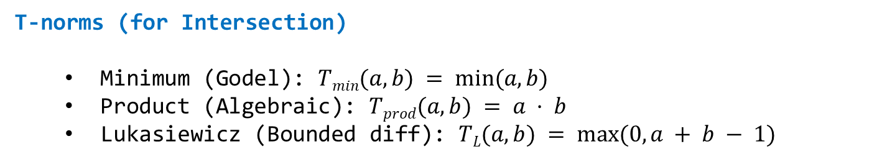
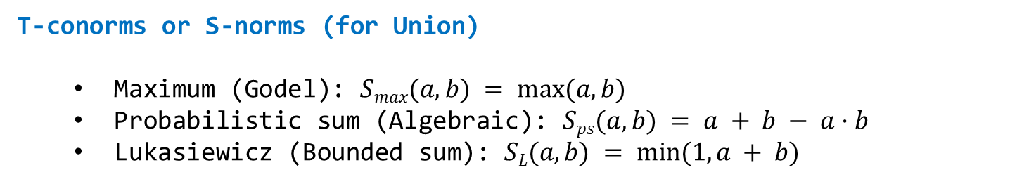
Operations on Fuzzy sets
T-norms (for Intersection)
Minimum (Godel): $Tmin(a,b) = min⁡(a, b)$
Product (Algebraic): $Tprod(a,b) = a · b$
Lukasiewicz (Bounded diff): $TL(a,b) = max⁡(0, a + b − 1)$
T-conorms or S-norms (for Union)
Maximum (Godel): $Smax(a,b) = max⁡(a, b)$
Probabilistic sum (Algebraic): $Sps(a,b) = a + b − a·b$
Lukasiewicz (Bounded sum): $SL(a,b) = min⁡(1, a + b)$

Slide 21

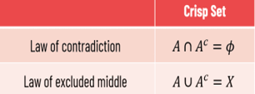
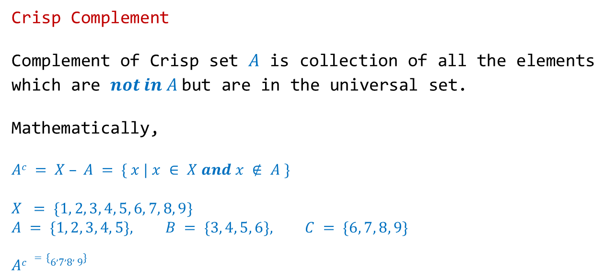
Operations on Fuzzy sets
Crisp Complement
Complement of Crisp set $A$ is collection of all the elements which are $not in A$but are in the universal set.
Mathematically,
$$Ac = X – A = \{ x | x ∈ X and x ∉ A \}$$
$$X = \{1, 2, 3, 4, 5, 6, 7, 8, 9\}$$
$$A = \{1, 2, 3, 4, 5\}, B = \{3, 4, 5, 6\}, C = \{6, 7, 8, 9\}$$
$$Ac =\{6,7,8, 9\}$$

Slide 22
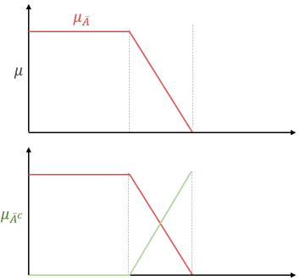
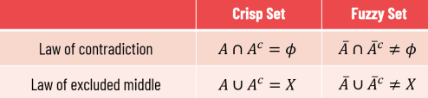
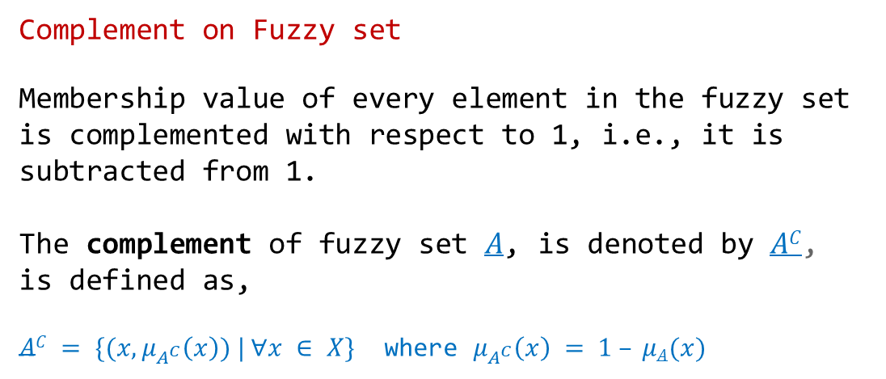

Operations on Fuzzy sets
Complement on Fuzzy set
Membership value of every element in the fuzzy set is complemented with respect to 1, i.e., it is subtracted from 1.
The complement of fuzzy set $A$, is denoted by $AC$, is defined as,
$AC = \{(x, μ_{A^{C}}\left(x\right)) | ∀x ∈ X\}$ where $μ_{A^{C}}\left(x\right) = 1 – μA(x)$
$$A = \{ (x1, 0.2), (x2, 0.5), (x3, 0.6), (x4, 0.8), (x5, 1.0) \}$$
$$AC = \{ (x1, 0.8), (x2, 0.5), (x3, 0.4), (x4, 0.2), (x5, 0.0) \}$$
$$A ∪ AC = \{ (x1, 0.8), (x2, 0.5), (x3, 0.6), (x4, 0.8), (x5, 1.0) \} ≠ X$$
$$A ∩ AC = \{ (x1, 0.2), (x2, 0.5), (x3, 0.4), (x4, 0.2), (x5, 0.0) \} ≠ ∅$$

Slide 23










Properties of Fuzzy sets
Property
Crisp Sets
Fuzzy Sets
Involution
$$(A’)’$$
$$( A‘ )’ = A$$
Commutativity
$$A ∪ B = B ∪ A, A ∩ B = B ∩ A$$
$$A ∪ B = B ∪ A, A ∩ B = B ∩ A$$
$$(A ∪ B) ∪ C= A ∪ ( B ∪ C ),$$
$$(A ∩ B) ∩ C= A ∩ ( B ∩ C)$$
$$A ∪ ( B ∪ C ) = ( A ∪ B ) ∪ C,$$
$$A ∩ ( B ∩ C ) = ( A ∩ B ) ∩ C$$
Associativity
Distributivity
$$A ∪ (B ∩ C) = (A ∪ B) ∩ (A ∪ C),$$
$$A ∩ (B ∪ C) = (A ∩ B) ∪ (A ∩ C)$$
$$A ∪ ( B ∩ C ) = ( A ∪ B ) ∩ ( A ∪ C ),$$
$$A ∩ ( B ∪ C ) = ( A ∩ B ) ∪ ( A ∩ C )$$
Absorption
$$A ∪ (A ∩ B) = A, A ∩ (A ∪ B) = A$$
$$A ∪ ( A ∩ B) = A , A ∩ ( A ∪ B ) = A$$
Idempotency/Tautology
$$A ∪ A = A, A ∩ A = A$$
$$A ∪ A = A, A ∩ A = A$$
$$A ∪ X = X, A ∩ X = A$$
$$A ∪ φ = A, A ∩ φ = φ$$
$$A ∪ X = X, A ∩ X = A$$
$$A ∪ φ = A, A ∩ φ = φ$$
Identity
De Morgan’s Laws
$$\left(A ∪ B\right)’=A’∩ B’, (A ∩ B)’= A’ ∪ B’$$
$$( A ∪ B )’ =A‘ ∩ B‘, ( A ∩ B )’=A’ ∪ B‘$$
Fuzzy Transitivity: $If A ⊆ B and B ⊆ C then A ⊆ C$

Slide 24

Crisp and Fuzzy relations
Crisp relation
It is defined over the cartesian product of two crisp sets.
The Cartesian product denoted as $A×B$is a collection of order pairs, such that $A × B = \{ (a, b) | a ∈ A and b ∈ B \}$
Crisp relation is set of order pairs $(a, b)$from Cartesian product $A × B$ such that $a ∈ A and b ∈ B$.
Note: $A × B ≠ B × A, \left|A × B\right|= \left|A\right|× \left|B\right|,$
$A × B$provides a mapping from $a ∈ A to b ∈ B$
Here, $\left|A\right|$ (cardinality of $A$) denotes no. of elements in set $A$, and $\left|A × B\right|$ denotes no. of order pairs in cartesian product.
Characteristic function can be given as, $χ_{R\left(a,b\right)}=\left\{\begin{matrix}1 if\left(a,b\right)∈A×B \\ 0 if\left(a,b\right)∉A×B\end{matrix}\right.$

Slide 25

Crisp and Fuzzy relations
Crisp relation
Example: Consider two crisp sets: $C = \{1, 2, 3\}$and $D = \{4, 5, 6\}.$
a) Find Cartesian product of $C×D$
b) Also find relation R over this Cartesian product such that
$$R=\{(c, d) | d = c+2, (c, d) ∈ C×D \}$$
Solution:
a) Cartesian product of $C×D$
$$C × D = \{ (1, 4), (1, 5), (1, 6),(2, 4), (2, 5), (2, 6),(3, 4), (3, 5), (3, 6) \}$$
b) Relation $R=\{(2, 4), (3, 5)\}$

Slide 26



Crisp and Fuzzy relations
Representation of crisp relation
We can represent crisp relation in various ways.
Consider the relation R defined over set A and B as,
$$A = \{1, 2, 3\}, B = \{4, 5, 6\}, R = \{(2, 4), (3, 5)\}$$
Popular representations

Slide 27

Crisp and Fuzzy relations
Fuzzy relation
Fuzzy relation defines the mapping of variables from one fuzzy set to another.
Let $A$ be a fuzzy set on universe $X$ and $B$ be fuzzy set on universe $Y$,
Cartesian product between $A$ and $B$ will result in a fuzzy relation $R$ which is contained with the full Cartesian product space, or it is subset of cartesian product of fuzzy subsets.
Formally, we can define fuzzy relation as,
$$R = A × B$$
and
$$R ⊂ (X×Y)$$
where the relation $R$ has membership function,
$$μR(x, y) = μA X B(x, y) = min⁡( μA(x), μB(y) )$$

Slide 28




Crisp and Fuzzy relations
Fuzzy relation
Let $A = \{a1, a2, …, an\}$and $B = \{b1, b2, .., bm\},$then fuzzy relation between $A$ and $B$ is described by the fuzzy relation matrix as,
Example-1:
Given $A = \{ (a1, 0.2), (a2, 0.7), (a3, 0.4) \} and B = \{ (b1, 0.5), (b2, 0.6)\},$ the fuzzy relation (cartesian product) over $A × B$

Slide 29


Crisp and Fuzzy relations
Fuzzy relation
2. For the given fuzzy sets, find the relation $R$ by performing cartesian product over the sets

Slide 30


Crisp and Fuzzy relations
Fuzzy relation
Example-3:
Find fuzzy relation on $X = \{1, 2, 3\},$where the membership function of $R$ is given by,
$$R\left(x, y\right)= \left\{\begin{matrix}1 if x=y \\ \begin{aligned}0.7 if \left|x−y\right|=1 \\ 0.3 if \left|x−y\right|=2 \end{aligned}\end{matrix}\right.$$
Solution:
$$R(1, 1) = R(2, 2) = R(3, 3) = 1$$
$$R(1, 2) = R(2, 1) = R(2, 3) = R(3, 2) = 0.7$$
$$R(1, 3) = R(3, 1) = 0.3$$

Slide 31





Operations on Crisp relations
Let $R(x, y)$and $S(x, y)$are the two relations defined over two crisp sets, where $x ∈ A and y ∈ B$.
Relations $R$ and $S$ given as,
Union of crisp relation
$$R ∪ S = χR ∪ S (x, y) = max⁡( χR(x, y), χS(x, y) )$$
Union of relations $R$ and $S$ is given as,

Slide 32







Operations on Crisp relations
Intersection of crisp relation
$$R∩S=χR∩ S (x, y)= min⁡( χR(x, y), χS(x, y) )$$
Intersection of relations $R$ and $S$ given as,
Containment
$$R⊂S=χR⊂S (x, y)=χR(x, y) ≤ χS(x, y)$$
Relation $R$ is not contained within relation $S$.
Consider the relation $T$ as given below:
Complement of crisp relation
$$Rc = χRc (x, y)= 1 – χR(x, y)$$
Complement of given relation R,
Here, $χR(x, y) ≤ χT(x, y)$, so $R$ is contained within T.
Data Structures--> Unit-I: Operations on Crisp relations

Slide 33

Operations on Crisp relations
Composition of crisp relations
Composition of relation $R$ and $S$ is denoted as $R ∘ S$. Mathematically, it is defined as,
$$R ∘ S = \{(x, z) | (x, y) ∈ R, and (y, z) ∈ S, ∀y ∈ Y\}$$
Composition of relation is computed in two different ways:
Max–min composition
$T=R ∘ S$ where $χ_{T}\left(x,z\right)=\bigcup_{y∈Y}{\left\{ χ_{R}\left(x,y\right) ∩χ_{S}\left(y,z\right)\right\}}$
Max–product composition
$T=R ∘ S$ where $χ_{T}\left(x,z\right)=\bigcup_{y∈Y}{\left\{ χ_{R}\left(x,y\right) .χ_{S}\left(y,z\right)\right\}}$

Slide 34





Operations on Crisp relations
Max-Min composition crisp relations
Example 1: Let $R = \{ (x1, y1), (x1, y3), (x2, y4) \}$and $S = \{ (y1, z2), (y3, z2) \},$find Max-Min composition of these relations.
The above relation$R$and $S$ we can represent as,
We have to find $T=R ∘ S$, where

Slide 35





Operations on Fuzzy relations
Let $R(x, y)$and $S(x, y)$are the two relations defined over two fuzzy sets, where $x ∈ A and y ∈ B$.
Relations $R$ and $S$ given as,
Union of fuzzy relations
$$R ∪ S = μR ∪ S (x, y) = max⁡(μR(x, y),μS(x, y) )$$
Union of relations $R$ and $S$ is given as,

Slide 36




Operations on Fuzzy relations
Intersection of fuzzy relations
$$R∩S=μ R∩ S (x, y)= min⁡(μR(x, y),μS(x, y) )$$
Intersection of relations $R$ and $S$ given as,
Complement of fuzzy relation
$$Rc =μRc (x, y)= 1 –μR(x, y)$$
Complement of given relation R,

Slide 37

Operations on Fuzzy relations
Composition of fuzzy relations
Composition of relation $R$ and $S$ is denoted as R ∘ S. Mathematically, it is defined as,
$$R ∘ S = \{(x, z) | (x, y) ∈ R, and (y, z) ∈ S, ∀y ∈ Y\}$$
Composition of relation is computed in two different ways:
Max–min composition
$T=R ∘ S$ where $μ_{T}\left(x,z\right)=\bigcup_{y∈Y}{\left\{ μ_{R}\left(x,y\right) ∩μ_{S}\left(y,z\right)\right\}}$
Max–product composition
$T=R ∘ S$ where $μ_{T}\left(x,z\right)=\bigcup_{y∈Y}{\left\{ μ_{R}\left(x,y\right) .μ_{S}\left(y,z\right)\right\}}$

Slide 38



Operations on Fuzzy relations
Composition of fuzzy relations
Two fuzzy relations are given by,
Obtain the composition in both the methods
Max-min composition
Max-product composition

Slide 39




Properties of Fuzzy relations
Reflexive
Relation$R$is reflexive if every element in set is associated with itself, i.e., $μR(x, x) = 1, ∀x ∈ X$
Example
Following is reflexive fuzzy relation $R$ over $X = \{1, 2, 3\},$
Anti-reflexive
Relation $R$ is an anti-reflexive if $∀x ∈ X, (x, x)∉ R, i.e. μR(x, x)= 0, ∀x ∈ X$
Example
Following is reflexive fuzzy
relation R over X = {1, 2, 3},

Slide 40





Properties of Fuzzy relation
Symmetric
Relation $R$ is called symmetric if element $x$ is related to element $y$ then element $y$ must be related to $x$,
i.e., $μR(x, y) = μR(y, x), ∀x, y ∈ X$
Example
For the universe $X = \{1, 2, 3\}.$The fuzzy relation $R$ defined over $X$ is symmetric.
Anti-symmetric
Relation R is called anti-symmetric if,
$$μR(x, y) > 0, then μR(y, x) = 0, x, y ∈ X, x ≠ y$$
Example
For the universe $X = \{1, 2, 3\}.$The fuzzy relation $R$ defined over $X$ is Anti-symmetric.

Slide 41


Properties of Fuzzy relation
Transitive relation
For crisp Relation:
Crisp Relation $R$ is called transitive if $x$ is related to $y$ and $y$ is related to $z$ then $x$ must be related to $z$.
i.e., if, $(x, y) ∈ R$and $(y, z) ∈ R ⇒ (x, z) ∈ R$
For fuzzy relation:
Let $λ1= μR(xi, xj ), λ2= μR(xj, xk)$and $λ = μR(xi, xk)$,
for fuzzy relation to be transitive, $λ ≥\min\left(λ1, λ2 \right), ∀λ$
Is given relation $R$ transitive?

Slide 42



Properties of Fuzzy relation
How to test transitivity?
We can also find whether the given relation $R$ is transitive or not by finding composition on itself.
i.e., $R2= R ∘ R$
$R$ is transitive if R² ⊂ R$,$ i.e., μ_{R^2}(x, y) ≤ μ_{R}(x, y)
Example:
Is given relation $R$ transitive?
Solution:
For the above matrices,
$μR2(1, 1) ≤ μR(1, 1), μR2(1, 2) ≤ μR(1, 2)$but
$μR2(1, 3) ≤ μR(1, 3)$,Hence $R$ is not transitive

Slide 43





Properties of Fuzzy relation
Similarity / Equivalence Relation
If relation $R$ ̅is reflexive, symmetric and transitive then it is a similarity (equivalence) relation
Anti-Similarity or Partial Order Relation
If $R$ is similarity relation, then its complement is anti-similarity relation, i.e., $μR(x, y)=1 – μR(x, y)$
Weak Similarity or Tolerance Relation
If relation $R$ is reflexive and symmetric but not transitive, then it is a weak similarity relation.

Slide 44

Properties of Fuzzy relation
Tolerance to Equivalence relation conversion
Tolerance relation can be converted to equivalence (similarity) by taking composition of relation with itself.
Finding composition is repeated until relation is converted to equivalence.
$$R′→ R ° R$$
$$R′′→ R′ ° R′$$
$$:$$

Slide 45


Properties of Fuzzy relation
Tolerance to Equivalence relation conversion
Check if given crisp relation is equivalence or not ?
Solution
Here, $(xi, xi ) ∈ R, ∀i,$so $R$ is reflexive
$R = R^T$, so $R$ is symmetric
μ$\left(x1, x2\right)= 1,\text{μ}\left(x2, x5\right)= 1 but \text{μ}(x1, x5) = 0$, so $R$ is not transitive
Hence R is Not equivalence, but it is Tolerance.

Slide 46



Properties of Fuzzy relation
Example 2:
Convert following relation into equivalence if it is not already
Solution:
$μR(xi, xi) = 1, ∀i,$so relation is reflexive
$μR(xi, xj) = μR(xj, xi)$, so relation is symmetric
$$λ1 = μR(x1, x2) = 0.8$$
$$λ2 = μR(x2, x5) = 0.9$$
$$λ = μR(x1, x5) = 0.2$$
For fuzzy relation to be transitive, $λ ≥ min⁡(λ1, λ2)$
For given relation matrix $λ < min⁡( λ1, λ2 ),$so given relation is tolerance but not equivalence

Slide 47





Properties of Fuzzy relation
Solution Contd…
We can convert tolerance relation into equivalence relation by taking composition of relation with it self.
$$λ1 = μR(x1, x2) = 0.8$$
$$λ2 = μR(x2, x4) = 0.5$$
$$λ = μR(x1, x4) = 0.2$$
For obtained matrix $λ < min⁡( λ1, λ2 ),$ so given relation is not yet equivalence.
Take the composition once again.
$$λ1 = μR(x1, x3) = 0.4$$
$$λ2 = μR(x3, x2) = 0.4$$
$$λ = μR(x1, x2) = 0.8$$
For obtained matrix $λ > min⁡( λ1, λ2 ),$and this is true for any pair. Hence given relation is now equivalence.

Slide 48

Properties of Fuzzy relation
Given the relation matrix,
Answer the following questions:
Is relation reflexive? Why?
Is relation symmetric? Why?
Is relation transitive? Why?
Is relation similarity or equivalence? Why?
Is relation partial order or anti-similar? Why?
Is relation weak similar or tolerance? Why?

Slide 49

Fuzzy control system
Rule base and inference engine
linguistic variable values
linguistic variable values
Output: Crisp values
Input: Crisp values

Slide 50
Linguistic variables in fuzzy logic
Linguistic variables are variables whose values are words or sentences in a natural or artificial language
Fuzzy variable ranges over states – which are fuzzy numbers rather than real numbers.
Example:
If the temperature is 9ºC then this crisp value can be converted to linguistic variable values such as cold, warm or hot. A person can take a decision whether he has to wear a jacket or not.
Linguistic variables are defined in terms of base variables, whose values are real numbers.
The base variable is the one that determines the linguistic variable’s value.

Slide 51

Linguistic variables in fuzzy logic
Each linguistic variable consists of:
A name, which should capture the meaning of the base variable.
A base variable with its range of values.
A set of linguistic terms that refer to values of the base variable
A semantic rule, which assigns to each linguistic term its meaning—an appropriate fuzzy number defined on the range of the base variable.
Linguistic values (terms)of base variable.
Range of values of base variable
Base variable
(name: Temperature)

Slide 52
Linguistic hedges in fuzzy logic
A linguistic hedge is an operation that modifies the meaning of a fuzzy set.
Hedges are the operators which modify the shapes of fuzzy sets by using adverbs such as more, high, less, and slightly.
Example:
Depending upon the situation we can say a high temperature as very high or slightly high temperature etc.
Types of hedges:
Intensify a fuzzy set (very, extremely)
Dilute a fuzzy set (somewhat, sort of)
Express probabilities (probably, not likely)
Approximate a scalar or single number (exactly)
Express vague quantities (most, seldom)

Slide 53
Fuzzification
Fuzzification is the process of converting a crisp set to a fuzzy set.
That is crisp quantities are converted to fuzzy quantities.
Fuzzification translates crisp input values into linguistic (fuzzy) variables.
Fuzzy membership function is used to convert the crisp input to fuzzy set by assigning membership values to fuzzy variables.
That is fuzziness in the data is best described by the fuzzy membership function
There are several ways to assign membership values to fuzzy variables.

Slide 54

Fuzzification
A membership function for a fuzzy set A on the universe of discourse $X$ is defined as $µA: X → [0, 1].$
Each element of $X$ is mapped to a value between $0$ and $1$, this value, called membership value or degree of membership.
Membership value quantifies the grade of membership of the element in $X$ to the fuzzy set $A$.
Fuzzy membership function is the graphical way of visualizing degree of membership of any value in given fuzzy set.
In a graph, $X$ axis represents the universe of discourse and $Y$ axis represents the degree of membership in the range $[0, 1]$
The membership functions can be defined by various shapes: triangular, trapezoidal, bell-shaped, Gaussian etc.

Slide 55




Fuzzy membership functions
Singleton membership function
Singleton membership function assigns membership value 1 to particular value of x and assigns value 0 to rest of all.
Triangular membership function
This is one of the most widely accepted and used membership function.
The triangle which fuzzifies the input can be defined by three parameters $a, b$and $c$.
Here, $a$ and $c$ defines the base and $b$ defines the height of the triangle.

Slide 56




Fuzzy membership functions
Triangular function for different cases is given as,
Example:
Determine membership value, corresponding to x = 8.0 ?

Slide 57



Fuzzy membership functions
Trapezoidal membership function
It is defined by four parameters: $a, b, c$and $d.$
Span b to c represents the highest membership that element can take.
If x is between (a, b) or (c, d), then it will have membership value between 0 and 1.

Slide 58


Fuzzification
Trapezoidal membership function
Example
Determine membership value, corresponding to $x = 3.5$ ?

Slide 59





Fuzzification
Trapezoidal membership function
There are two special forms of trapezoidal function based on open-ness of function.
L-function: It has $c = d = +∞$
R-function: it has $a = b = −∞$
Example
Determine membership value, corresponding to $x = 3.5$ ?

Slide 60






Fuzzification
Gaussian membership function
It is specified by two parameters $\{m, σ\}$and can be defined as follows.
Here, $m$ represents the center of the gaussian curve and σ represents the spread (mean) of the curve.
This is more natural way of representing the data distribution.
Example
Determine membership value, corresponding to $x = 9, m = 10$and $σ = 3.0$

Slide 61



Fuzzification
Generalized bell shaped function
It is also called Cauchy MF. A generalized bell MF is specified by three parameters {a, b, c} and can be defined as follows.
The function $μ(X)=1/(1 + x2 )$can be modelled by setting $a=b=1$ and $c = 0.$
Similarly, we can produce other shapes or functions by setting appropriate $a, b$and $c$.

Slide 62


Fuzzification
Sigmoid Membership function
Sigmoid functions are widely used in classification task in machine learning.
Specifically, it is used in logistic regression and neural network, where it suppresses the input and maps it between 0 and 1.
It is controlled by parameters a and c. Where a controls the slope at the crossover point x = c
Mathematically, it is defined as,

Slide 63
Defuzzification
Fuzzification converts the crisp input into fuzzy value.
Defuzzification converts the fuzzy output of fuzzy inference engine into crisp value.
The fuzzy results generated can not be used in an application, where decision has to be taken only on crisp values.
Controller can only understand the crisp output.
It is necessary to convert the fuzzy output into crisp value.
Different methods exist for defuzzification.

Slide 64
Defuzzification
Defuzzification methods:
Lambda Cut Method
Maxima Methods
Height method
First of maxima (FoM)
Last of maxima (LoM)
Mean of maxima (MoM) or Mean-Max
Weighted average method
Centroid methods
Centre of gravity method (CoG)
Centre of sums method (CoS)
Centre of area method (CoA)

Slide 65


Defuzzification
Lambda Cut Method
This Lambda-cut set $Aλ$ is also called alpha-cut set.
Lambda-cut method is applicable to derive crisp value of a fuzzy set.
In this method a fuzzy set $A$ is transformed into a crisp set $Aλ$ for a given value of $λ (0 ≤ λ ≤ 1)$as,
$$Aλ = \left\{ x \right| μA\left(x\right)≥λ \}$$
Example – 1: Lambda-cut for Fuzzy Set
$$A = \{ (x1, 1.0), (x2, 0.5) , (x3, 0.3) , (x4, 0.4) \}$$
$$For λ = 1: A1= \{ x1 \}$$
$$For λ = 0.5: A0.5= \{ x1, x2 \}$$
$$For λ = 0.4: A1= \{ x1, x2, x4 \}$$

Slide 66



Defuzzification
Maxima methods
Maxima methods relies on the position of maximum membership of element at particular position in fuzzy set.
Height method
This method is based on Max-membership principle and defined as follows.
$$μC(x∗) ≥ μC(x), ∀x ∈ X$$
Note: This method is applicable when height is unique.
Example:

Slide 67





Defuzzification
First of Maxima (FoM) method
Determine the smallest value of the domain with maximized membership degree
FoM = First of Maxima: $x∗ = min⁡\{ x | μC(x) = h(C) \}$
Last of Maxima (LoM) method
Determine the largest value of the domain with maximized membership degree
LoM = Last of Maxima: $x∗ = max⁡\{ x | μC(x) = h(C) \}$
Example
Find the defuzzification value for given fuzzy set
First of Maxima: x∗=1
Last of Maxima: x∗=6

Slide 68





Defuzzification
Middle of Maxima (MoM) or Mean-Max method
To find middle of maxima, we have to find the “middle” of elements with maximum membership value.
Here, $M =\{ xi | μC(xi) = h(C) \},$ (It is the set of points having highest membership value).
Note: This method is applicable to symmetric functions only.
Example:
Find the defuzzified value for given fuzzy set using middle of maxima method:
$$x∗ = (2 +3+4+5) / 4$$
$$x∗ = 3.5$$

Slide 69

Defuzzification
For the given fuzzy set Young, perform defuzzification using following methods:
0. Height method
First of Maxima (FoM)
Last of Maxima (LoM)
Middle of Maxima (MoM)
$$Young = \{(15,0.5), (20,0.8), (25,0.8),(30,0.5), (35,0.3)\}$$

Slide 70


Defuzzification
Weighted average method
It is one of the simplest, less computationally intensive and widely used defuzzification technique.
This method is also known as ”Sugeno defuzzification” method.
Formed by weighting each function in the output by its respective maximum membership value.
The maximum membership value of each function is used to calculate the defuzzified (crisp) value as given below,
Note: The method can be used only for symmetrical output membership functions.

Slide 71


Defuzzification
Weighted average method
Example:
Find defuzzified value for given aggregated fuzzy output set using weighted average method:
$$x∗ = ((0.7 × 3) + (1.0 × 7)) / (0.7 + 1.0)$$
$$x∗ = 5.941$$
Here, 3 is average element from first membership function which has maximum membership value (0.7) and 7 is average element from second membership function which has maximum membership value (1.0)

Slide 72



Defuzzification
Determine the $λ$-cut sets for the following fuzzy sets
Express the following for $λ$=0.5

Slide 73


Defuzzification
For the functions as shown in figures, determine the defuzzified output value by using following methods:
0. Height method
First of Maxima (FoM)
Last of Maxima (LoM)
Middle of Maxima (MoM)(Mean-max)
Weighted average method

Slide 74




Defuzzification
Centre of Gravity (CoG) method or Centre of Mass (CoM) or Centroid method
The basic principle in CoG method is to find the point x∗ where a vertical line would slice the aggregate into two equal masses.
The value of $x∗$is computed as,
$\int{}μC\left(x\right).xdx$denotes the area of the region bounded by the curve $C$.

Slide 75



Defuzzification
Example:

Slide 76

Defuzzification
Equation of line ab
$$(y – y1) / (x – x1) = (y2 – y1) / (x2 – x1)$$
$$For line ab, (x1, y1) = (0, 0) and (x2, y2) = (1, 0.5)$$
$$(y – 0) / (x – 0) = (0.5 – 0) / (1 – 0)$$
$$y / x = 0.5 / 1$$
$y = 0.5x$
Line ranges from $[0, 1]$on $X−axis$
Equation of line bc
$$(y – y1) / (x – x1) = (y2 – y1) / (x2 – x1)$$
$$For line ab, (x1, y1) = (1, 0.5) and (x2, y2) = (3.5, 0.5)$$
Horizontal line has slope zero, and for any value of $x$, the $y$ coordinate will remain unchanged. So, for line $bc$
$$y = 0.5$$
Line ranges from $[1, 3.5]$on $X−axis$

Slide 77




Defuzzification
Equation of line cd:
$$y=(3x / 5) – (8 / 5)$$
Line ranges from $[3.5, 4]$on $X−axis$
Equation of line de:
$y = 0.8$
Line ranges from $[4, 6]$on $X−axis$
Putting all these values in equation for CoG method,
Equation of line ef:
$y = −0.4x + 3.2$
Line ranges from $[6, 8]$on $X−axis$

Slide 78



Defuzzification
Center of Sums (CoS) method
It is most commonly used defuzzification method.
The crisp value according to CoS is defined as,
Here, $Ai$ denotes the area of the region bounded by the fuzzy set $Ci$ and $xi$ is the $geometric center$of that area.
Note: In CoG method, the overlapping area is counted once, whereas, in CoS, the overlapping is counted twice or so

Slide 79







Defuzzification
Example – 1:
Given following three fuzzy output sets, find the corresponding crisp value.
Area of trapezoidal (symmetric) is computed as shown in this diagram:
$$x2 = (2 + 6) / 2 = 4$$
$$A2= 1/2 (2 + 4) × 0.4$$
$$A2= 1.2$$
$$x1=(1 + 5) / 2 =3$$
$$A1 =1/2 (2 + 4)× 0.2$$
$$A1 = 0.6$$
$$x3= (3 + 7) / 2 = 5$$
$$A3= 1/2 (2 + 4) × 1.0$$
$$A3= 3$$

Slide 80


Defuzzification
We can find the corresponding crisp value using the formula of CoS method:
Example – 2:
Given following three fuzzy output sets, find the corresponding crisp value.

Slide 81


Defuzzification
Center of Largest Area (CoA)
This method is simple, computationally effective and widely used defuzzification.
If the fuzzy set has two sub regions, then the center of gravity of the sub region with the largest area can be used to calculate the defuzzified value.
$$x∗= (∫ μCm(x) . x′ dx) / ( ∫ μCm(x) dx )$$
Here, $Cm$ is the region with largest area, $x′$ is the center of gravity of $Cm$

Slide 82


Defuzzification
Example: Find the crisp value for the given fuzzy output functions

Slide 83
Classical and fuzzy logic
What is logic?
It is a method for developing a quantitative reasoning process that can be duplicated and altered using mathematical proofs.
It is the ability of humans to think rationally about something using suitable evidence and inferences.
Proposition
It is a collection of declarative statements that have either a truth value as true or a truth value as false.
The veracity (truth: T) of an element in the proposition P can be assigned a binary truth value, called T (P)
Examples:(i) Man is mortal
(ii) Sun rises in the West
(iii) Virat Kohli is great batsman

Slide 84

Classical and fuzzy logic
Logical Connectives
It connects the propositional statements together to form new propositions.
If $P$ and $Q$ are two propositions on the same universe, they can be combined using $5$ logical connectives.
Disjunction $(∨)$
Conjunction $(∧)$
Negation $(−)$ or $(\sim )$
Implication $(→)$
Equivalence $(⟷)$

Slide 85




Classical and fuzzy logic
Disjunction
The disjunction connective or “logical or” is a term used to represent inclusive or.
$$P ∨ Q: x ∈ A or x ∈ B$$
Hence, $T(P ∨ Q) = max⁡(T(P), T(Q))$
Conjunction
If both the proposition P and Q are true, then the compound proposition will be true.
It performs logical ‘and’ operation
$$P ∧ Q: x ∈ A and x ∈ B$$
Hence, $T(P ∧ Q) = min⁡(T(P), T(Q))$

Slide 86





Classical and fuzzy logic
Negation
The negation of a proposition $P$ is false when $P$ is true and vice versa
$$if T(P) = 1, then T(P’) = 0$$
$$if T(P) = 0, then T(P’) = 1$$
Implication
$P→Q: ”p entails q”$means that it can never happen that $p$ is true and $q$ is not true.
It is also written as $“If P then Q”,$where P is called as the premise/hypothesis and Q is called as conclusion
$$(P → Q): x ∉ A or x ∈ B$$
$$T(P → Q) = T(P’ ∪ Q)$$
In other words,

Slide 87




Classical and fuzzy logic
Equivalence
The equivalence connective is generally used when we have a dual implication for propositions $P$ and $Q$
if $P → Q$and $Q → P$, then we can say that $P ⟷ Q$
All five connectives are summarized in following table:

