Slide 1

Department of Computer Science and Engineering VIGNAN’S LARA INSTITUTE OF TECHNOLOGY AND SCIENCE Project Review on
CENTRALISED PLATFORM FOR ACADEMIC
RESOURCES IN ANDHRA PRADESH
Under The Esteemed Guidance of
Dr.Senthil Kumar
Professor
CSE Department
Presented By
V.NANDINI 22FE1A4260
P.LAHARI 23FE5A4206
B.VARDHAN 22FE1A4206 P.YASWANTH VARMA 22FE1A4236

Slide 2

TITLE
CENTRALISED PLATFORM FOR ACADEMIC
RESOURCES IN ANDHRA PRADESH
Department of Computer Science & Engineering
2

Slide 3
CONTENTS
Title
Abstract
Introduction
Literature Survey
Existing System
Existing system Drawbacks
Proposed System
System Architecture
Proposed Methodology
Conclusion
References

Slide 4
ABSTRACT
This project focuses on developing a centralized platform for academic resources in Andhra Pradesh, designed to streamline access to research institutions, academic resources, and relevant field sites within the state. The platform will facilitate the identification of optimal research locations, provide access to academic databases, and ensure that researchers can easily connect with valuable resources like local libraries, universities, and research organizations.The platform aims to support both academic researchers and independent professionals by centralizing research opportunities and field sites. Key features include location-based recommendations for research, curated resource lists, and real-time collaboration opportunities, ensuring a user-friendly experience for researchers across various disciplines. The project ultimately seeks to empower the academic community in Andhra Pradesh by enhancing access to critical research infrastructure.

Slide 5
INTRODUCTION
Importance of research in driving socio-economic growth in AP.
Current landscape of research and academic institutions in Andhra Pradesh.
Challenges faced by researchers in accessing resources and suitable research locations.
Objective: To create an integrated platform to streamline research efforts.
The project aims to support both academic researchers and independent professionals in the state.
The platform will also serve as a knowledge-sharing space, allowing experienced researchers to provide insights and reviews on institutions and locations.
Encouraging collaboration between institutions, industries, and researchers through the web platform.

Slide 6
INTRODUCTION
Andhra Pradesh has diverse geographic and climatic zones, making it suitable for various types of research (e.g., agriculture, marine studies, technology).
Researchers often face challenges in identifying optimal research locations without prior knowledge of the region.
The rise of digital platforms provides an opportunity to centralize and streamline research information.
Department of Computer Science & Engineering
6

Slide 7
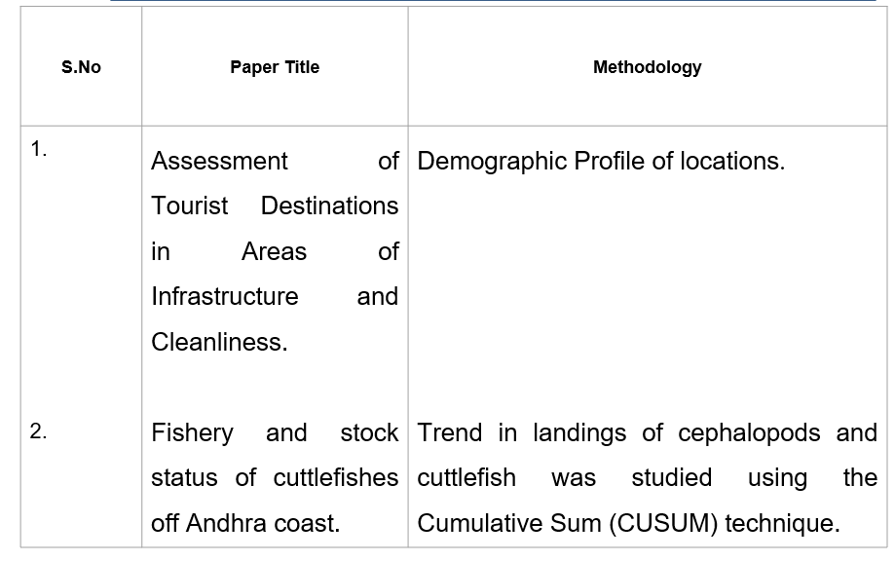
LITERATURE SURVEY
Department of Computer Science & Engineering
7

Slide 8
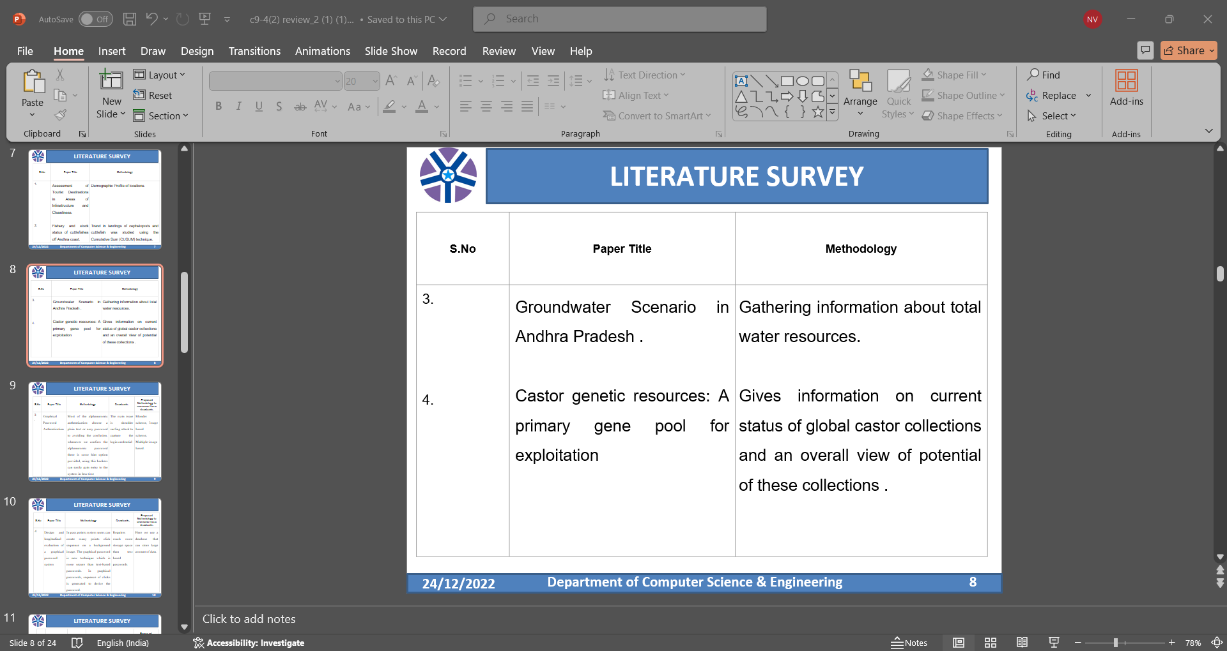
LITERATURE SURVEY
Department of Computer Science & Engineering
8

Slide 9
EXISTING SYSTEM
Limited digital platforms offering research guidance specific to Andhra Pradesh.
Researchers rely on general search engines or isolated institutional websites.
Difficulty in finding specific locations conducive to various research domains.
No integrated tool that combines institutional data and location-based recommendations.
Lack of a dedicated platform that caters to the unique research needs of Andhra Pradesh’s diverse academic and geographical landscape.

Slide 10
EXISTING SYSTEM
Difficulty in tracking the availability of research grants, fellowships, or government initiatives in Andhra Pradesh.
Researchers often face language barriers and the absence of localized content in regional languages.
Lack of a dedicated platform that caters to the unique research needs of Andhra Pradesh’s diverse academic and geographical landscape.

Slide 11
EXISTING SYSTEM DRAWBACKS
Fragmented information scattered across different sources.
Time-consuming for researchers to identify suitable locations and institutions.
Lack of localized focus on research infrastructure specific to Andhra Pradesh.
Absence of user interactivity and customization.

Slide 12
PROPOSED SYSTEM
Development of a centralized web platform for researchers in Andhra Pradesh.
Features:
A comprehensive list of research institutions, labs, and universities.
Search filters for selecting suitable research locations based on specific needs.
Real-time collaboration and resource-sharing capabilities.
Regular updates on research trends and available resources in Andhra Pradesh.

Slide 13
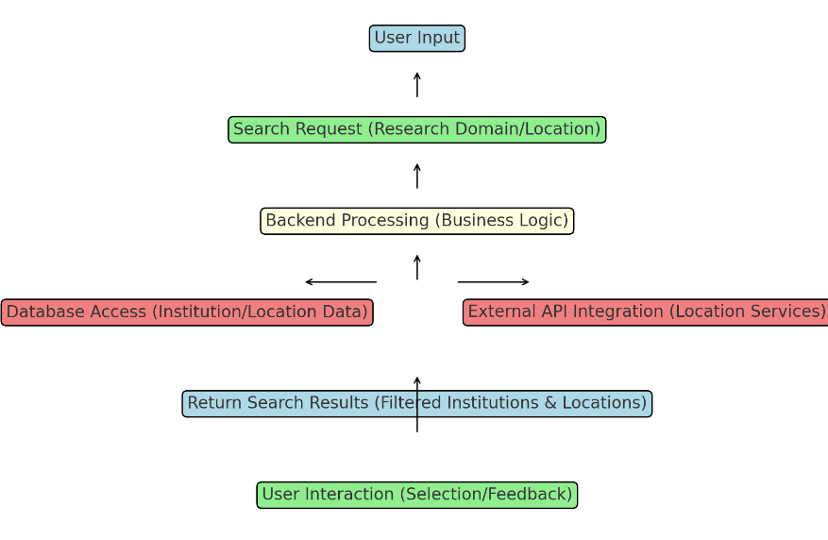
SYSTEM ARCHITECTURE
Department of Computer Science & Engineering
13

Slide 14
PROPOSED METHODOLOGY
Research and Analysis:
Collect data from various research institutions and locations in Andhra Pradesh.
Understand the needs of researchers based on different research domains.
Design:
Create a user-friendly interface with easy navigation.
Integrate features like filtering based on research domains, location suitability, and available resources.

Slide 15
PROPOSED METHODOLOGY
Development:
Utilize web development technologies (HTML, CSS, JavaScript, Python, etc.).
Ensure the platform is responsive and can handle large datasets.
Testing and Deployment:
Thorough testing for functionality, usability, and scalability.
Deployment on a reliable server with necessary security measures.

Slide 16
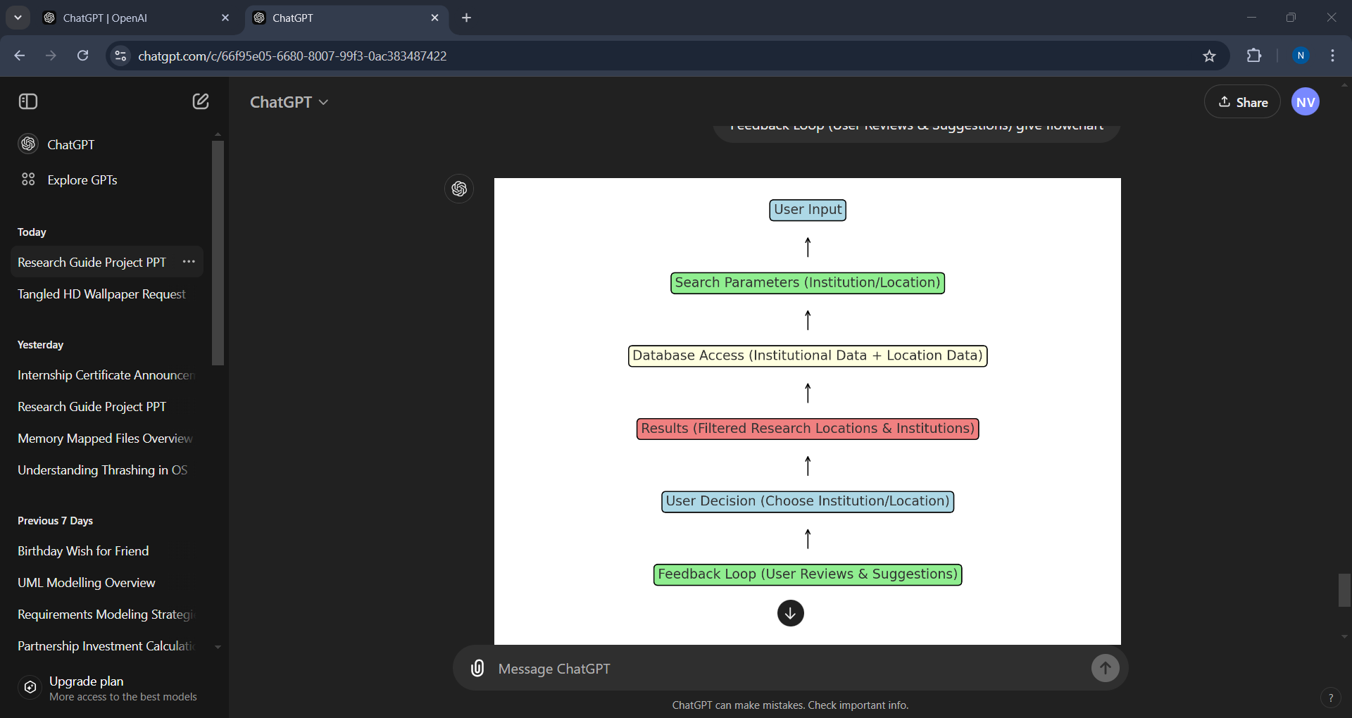
PROPOSED METHODOLOGY

Slide 17
CONCLUSION
The proposed web platform is designed to be a valuable resource for researchers in Andhra Pradesh, offering a centralized hub for accessing information on research institutions, locations, and resources. By bridging the gap between researchers and the broader research ecosystem in the state, the platform addresses the current lack of integration and accessibility. As the platform evolves, future enhancements could include AI-driven recommendations that personalize research suggestions based on user preferences and activities. Additionally, collaboration features with international institutions may be incorporated, fostering global research partnerships and knowledge exchange.
Department of Computer Science & Engineering
17

Slide 18
REFERENCES
1.Assessment of Tourist Destinations in Areas of Infrastructure and Cleanliness(September 2023) .
Ministry of Tourism ,Government of India
2. Fishery and stock status of cuttlefishes off Andhra coast(2018).
F. JASMIN , M. MUKTHA , S. GHOSH , K. S. MOHAMED , A. K. JAISWAR , P. LAXMILATHA AND LATHA SHENOY
3. Groundwater Scenario in Andhra Pradesh .
A.K.Jain , B.M.Muralikrishna Rao ,
M.S. Rama Mohan Rao ,M. Venkata Swamy.
4. Castor genetic resources: A primary gene pool for exploitation .
K. Anjani
Department of Computer Science & Engineering
18

Slide 19
Thank You

