Slide 1
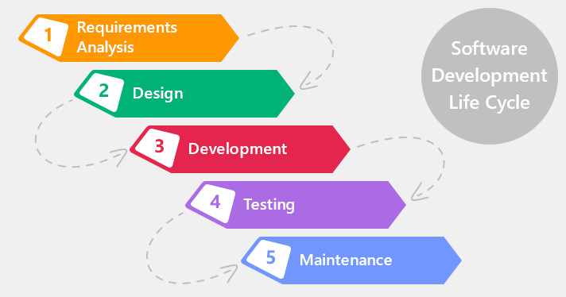
Testing: Testing is the process of executing the program with the intension of finding errors. Software Development Life Cycle (SDLC) is a process used by the software industry to design, develop and test high quality softwares.

Slide 2
A test engineer have to test software of various application domains(range of possible values). Before starting the testing, you need to understand the application, from an end user point of view. Test cases can be defined as sets of inputs parameters for which the software will be tested.
Below fig shows the Testing process using test cases
Strictly all combinations of inputs must be checked. If this is done, it is known as exhaustive testing.
How ever, exhaustive testing is costly, time consuming and impossible in many cases, so it is highly impractical . So a subset of all combinations is used for testing- this is known as test cases.
Select Test cases
Execute Test Cases
Analyze Test Results

Slide 3
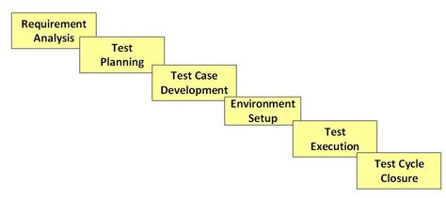
Software Testing Life Cycle:
_{L1}
The different stages in Software Test Life Cycle :

Slide 4
Testing: 1.automated testing 2.manual testing
Automated Testing:
The process of performing software testing activities with little or no human interaction. The key advantages to automated testing include:
Saves time and money by making testing more efficient.
Goal is reducing testing efforts .
Helps developers by finding bugs and errors more quickly.
Ex: selenium , jmeter, unit testing

Slide 5
Manual testing : It requires human intervention for test execution . Manual testing will require skilled labour, long time & will imply high costs.
Ex: data flow testing, control flow testing, decision coverage, and path testing.

Slide 6
Requirement Analysis:
During this phase, test team studies the requirements from a testing point of view to identify the testable requirements.
Gather details about testing priorities and focus.
Test Planning/Test Strategy:
A Senior QA manager will determine effort and cost estimates for the project and would prepare and finalize the Test Plan.
Activities:
Test tool selection ,Test effort estimation ,
Training requirement
Test Case Development:
Test data , is identified/created and is reviewed and then reworked as well.

Slide 7
Test Environment Setup:
Test environment decides the software and hardware conditions under which a work product is tested. Setup test Environment and test data .
Test Execution:
During this phase test team will carry out the testing based on the test plans and the test cases prepared.
Bugs will be reported back to the development team for correction and retesting will be performed.
Test Cycle Closure:
Testing team will meet , discuss and analyze testing artifacts to identify strategies that have to be implemented in future.

Slide 8
Test cases have to be designed based on two criteria :
reliability(detects all errors) and validity(at least one test case reveals the errors).
Techniques used for selecting the Test Cases:
Serial No
Action
Input Required
Expected
Actuals
Result
Comments

Slide 9
Test Case format
_{L1}
Serial No. | Action | Input Required | Expected | Actuals | Result | Comments

Slide 10
Test Scenario | Test Case ID | Pre condition(optional) | Test steps | Test Data | Expected Results | Actual Results | Test Pass/Fail | Remarks
Validation of gmail login | Gml_01 | Open Browser Enter URL | Entered valid mailid Enter valid pwd Press ok | mahendar.ieg@gmail.com ***** | Login successful | Login successful | pass
 | Gml__02 | Open Browser Enter URL | Entered valid mailid Enter valid pwd Press ok | mahendar@gmail.com ***** | Login unsuccessful | Login successful | Fail

Slide 11
UNIT- I Introduction
Testing: is the process of evaluating a system or system components by manual or automated means to verify that it satisfies specified requirements.
Ex: Selenium: web application testing , bug tracking tools TFS (Team Foundation Server(Microsoft TFS)) , jmeter, unit testing, functional testing, component testing.
In 2018, Microsoft changed the name TFS to Azure DevOps Services.

Slide 12
The Purpose of Testing:
The biggest part of software cost is the cost of bugs: the cost of detecting them, the cost of correcting them, the cost of designing tests that discover them, and the cost of running those tests.
For software, quality and productivity are indistinguishable because the cost of a software copy is trivial.
Testing and Test Design are parts of quality assurance should also focus on bug.
prevention. A prevented bug is better than a detected and corrected bug.

Slide 13
Phases in a tester's mental life:
Phase 0: (Until 1956: Debugging Oriented) There is no difference between testing and Debugging.
Phase 1: (1957-1978: Demonstration Oriented):
IT says Testing is to show that the software works.
the purpose of testing here is to show that software works. Highlighted during the late 1970s. This failed because the probability of showing that software works 'decreases' as testing increases. I.e. the more you test, the more likely you will find a bug.

Slide 14
Phase 2: (1979-1982: Destruction Oriented) :
It says Software does not work.
the purpose of testing is to show that software doesn’t work. This also failed because the software will never get released as you will find one bug. Also, a bug corrected may also lead to another bug.
Phase 3: (1983-1987: Evaluation Oriented) :The purpose of testing is not to prove anything.
Note: This is applied to large software products with millions of code and years of use.

Slide 15
Phase 4: (1988-2000: Prevention Oriented):
A state of mind regarding “What testing can do & cannot do.
Testability is the factor considered here. One reason is to reduce the labour of testing. Other reason is to check the testable and non-testable code.
Applying this knowledge reduces amount of testing.
Testable software reduces effort
Testable software has less bugs than the code hard to test

Slide 16
Test Design:
Testing isn’t everything:
Inspection Methods: Methods like desk checking, formal inspections. (examination :Ultrasonic testing , Visual Inspection: X-Ray equipment)
Design Style: clarity can do much to prevent bugs.
Static Analysis Methods: Includes formal analysis of source code during compilation.(compilers)

Slide 17
4. Languages: The source language can help reduce certain kinds of bugs. Programmers find new bugs while using new languages.
5. Development Methodologies and Development Environment: The development process and the environment in which that methodology is embedded can prevent many kinds of bugs.

Slide 18
Dichotomies: Division into two especially mutually exclusive or contradictory groups or entities
the dichotomy between theory and practice.
Testing Versus Debugging
Function versus Structure
Designer versus Tester
Modularity versus Efficiency
Small versus Large
Builder versus Buyer

Slide 19
1.Testing Versus Debugging:
Many people consider both as same. Purpose of testing is to show that a program has bugs.
The purpose of testing is to find the error or misconception that led to the program's failure and to design and implement the program changes that correct the error.
Debugging usually follows testing, but they differ as to goals, methods.

Slide 20
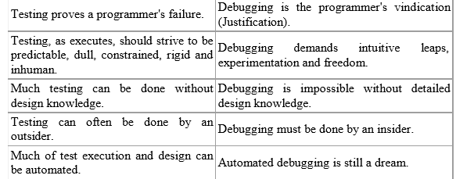

Slide 21
2.Function versus Structure:
Functional testing:
It is a white box Testing. It is performed based on the knowledge of the internal structure of the source.
The test cases take finite time but cannot detect all bugs.
It helps to removing the unnecessary code that may results is some bugs.
Structural testing(Black box testing):
It is performed without the knowledge of the internal structure of the software.
The test cases take infinite time and detect all errors.
It helps to disclosing the problems that may rise in functional specifications .

Slide 22
3.Designer versus Tester:
Designer:
It is based on the structural specifications of the system. Test designer is the person who designs the tests.
Designer is responsible for designing and executing the tests.
Tester:
It is based on the functional specifications of the system. where as the tester is the one actually tests the code.
Tester is responsible for executing the tests.

Slide 23
4.Modularity versus Efficiency:
A module is a discrete, well-defined, small component of a system. Smaller the modules , difficult to integrate.
larger the modules, difficult to understand. Both tests and systems can be modular.
There is a trade off between modularity(increases) and efficiency (also increases).
Small, independent test cases can be designed to test independent modules.

Slide 24
5.Small versus Large:
Small:
Small programs have only few lines of code. It is written by a single programmer.
Small programs are more efficient.
Quality of small programs is high compared to that of a large program.
Large:
large programs have large number of lines of code. It is written by Different programmers.
Large programs are less efficient. Quality of large programs is low compared to that of a small program.

Slide 25
6.Builder versus Buyer:
Builder: Who designs the system and is accountable to the buyer.
Buyer: Who pays for the system in the hope of profits from providing services?
User: Ultimate beneficiary or victim of the system. The user's interests are also guarded by.

Slide 26
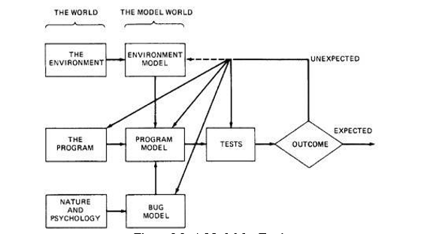
MODEL FOR TESTING:

Slide 27
Model for includes three models:
Environment
Program
Bugs
Tests
1.Environment:
A Program's environment is the hardware and software required to make it run.
For online systems, the environment may include communication lines, other systems, terminals and operators.

Slide 28
The environment also includes all programs that interact with and are used to create the program under test - such as OS, linkage editor, loader, compiler, utility , routines.
2.Program:
The concept of the program is to be simplified in order to test it. And if that fails, we may have to modify the program.
3.Bugs:
Bugs are very harmful than ever we expect them to be.
An unexpected test result may lead us to change our notion of what a bug is and our model of bugs.

Slide 29
Optimistic notions about bugs:
Benign Bug Hypothesis: The belief that bugs are nice, tame and logical. (Benign: Not Dangerous)
Bug Locality Hypothesis: The belief that a bug discovered with in a component affects only that component's behavior.
Control Bug Dominance: The belief those errors in the control structures (if, switch etc) of programs dominate the bugs.

Slide 30
4.Tests:
1. Unit / Component Testing: A Unit is the smallest testable piece of
software that can be compiled, assembled, linked, loaded etc. A unit is
usually the work of one programmer and consists of several hundred or
fewer lines of code.
Unit Testing is the testing we do to show that the unit does not satisfy its functional specification or that its implementation structure does not match the intended design structure.
A Component is an integrated aggregate of one or more units. Component Testing is the testing we do to show that the component does not satisfy its functional specification or that its implementation structure does not match the intended design structure.

Slide 31
2. Integration Testing: Integration is the process by which components are aggregated to create larger components.
Integration Testing is testing done to show that even though the components were individually satisfactory (after passing component testing), checks the combination of components are incorrect or inconsistent.
3. System Testing: A System is a big component. System Testing is aimed at revealing bugs that cannot be attributed to components. It includes testing for performance, security, accountability, configuration sensitivity, startup and recovery.

Slide 32
Ex: login page
U name :
P wd :
submit

Slide 33
CONSEQUENCES OF BUGS:
Importance of bugs:
The importance of bugs depends on frequency, correction cost, installation cost, and consequences.
Frequency: It refers to the rate at which it occures.Pay more attention to the more frequent bug types.
Correction Cost: What does it cost to correct the bug after it is found?
The cost is the sum of 2 factors: (1) the cost of discovery
(2) the cost of correction.
These costs go up dramatically later in the development cycle when the bug is discovered. Correction cost also depends on system size.

Slide 34
3. Installation Cost: Installation cost depends on the number of installations.
4. Consequences: What are the consequences of the bug? Bug consequences can range from mild to catastrophic(damage).
Importance ($) = Frequency * (Correction cost + Installation cost + Consequential cost)

Slide 35
Various Consequences of bugs:
1 Mild: misspelled output or a misaligned printout.
2 Moderate: Outputs are misleading or redundant(outputs/files).
3 Annoying: The system's behaviour will be degraded. E.g. Names are truncated ,bills for $0.0 are sent.
4 Disturbing: even some times correct (authorized / legal) transactions does not executed. The ATM won’t give you money. My credit card is declared invalid.
5 Serious: It loses track of its transactions. Not just the transaction itself but the fact that the transaction occurred. Accountability is lost.

Slide 36
Very Serious: The bug causes the system to do the wrong transactions. the system credits it to another account or converts deposits to withdrawals.
Extreme: The problems aren't limited to a few users or to few transaction types. They are frequent for unusual cases.
Intolerable: Long term unrecoverable corruption of the database occurs and the corruption is not easily discovered. Serious consideration is given to shutting the system down(large data is corrupted)
Catastrophic: The decision to shutdown is taken out of our hands because the system fails.
Infectious: Malwares and VIRUS.

Slide 37
Flexible severity rather than absolutes:
The factors involved in bug severity are:
1. Correction Cost: Not so important because bugs may be
Corrected easier and small bugs may take major time to debug.
2. Context and Application Dependency: Severity depends on the context and the application in which it is used.
3. Creating Culture Dependency: Test tool vendors are more sensitive about bugs in their software then games software vendors.
4. The software development phase: Severity depends on development phase. Any bugs gets more severe as it gets closer to field use and more severe the longer it has been around.

Slide 38
TAXONOMY OF BUGS:
The major categories are:
(1) Requirements, Features and Functionality Bugs
(2)Structural Bugs
(3) Data flow Bugs
(4) Coding Bugs(Documentation bugs)
(5) Interface, Integration and System Bugs
(6) Test and Test Design Bugs.
(7) System bugs
(8) Integration Bugs

Slide 39
Requirements, Features and Functionality Bugs :
a)Requirements and Specifications Bugs:
These bugs raise due to specifications which were taken by the system.
The features are added, modified and deleted. Requirements, especially, as expressed in specifications are a major source of expensive bugs.
The range is from a few percentages to more than 50%, depending on the application and environment.
What hurts most about the bugs is that they are the earliest to invade the system and the last to leave.

Slide 40
b)Feature Bugs:
Specification problems usually create corresponding feature problems. A missing feature or case is easier to detect and correct.
A wrong feature could have deep design implications. Removing the features might complicate the software, consume more resources, and foster more bugs.
c) Functionality Bug :
The specification features that are : accurate, transparent and achievable .
Short term Support: Specification languages facilitate formalization of requirements and inconsistency and ambiguity analysis.
Long term Support: Assume that we have a great specification language and that can be used to create unambiguous, complete specifications.

Slide 41
(2)Structural Bugs:
These bugs are caused due to errors in the structure of the program or code such as syntax errors, logic errors, etc.,
Based on the kind of errors, these structural bugs are divided into following bugs. They are.
a) Control and Sequence Bugs:
Bugs raise in structure like : unreachable code, improper nesting of loops, missing process steps, duplicated processing, unnecessary processing.
Most of the control flow bugs are easily tested and caught in unit testing.
b) Logic Bugs:
Bugs in logic, especially those related to misunderstanding how case statements and logic operators behave singly and combinations.

Slide 42
c) Processing Bugs:
Processing bugs include arithmetic bugs, algorithm selection and general processing.
Ex: of Processing bugs include: ignoring overflow, improper use of greater-than-or-equal etc
Although these bugs are frequent (12%), they tend to be caught in good unit testing.
d)Initialization Bugs:
Initialization bugs are very common & less harmful.
Ex: Forgetting to initialize the variables before first use, initializing to the wrong format etc

Slide 43
e)Data-Flow Bugs and Anomalies:
A data flow anomaly occurs where there is a path along which we expect to do something unreasonable with data.
Ex: initializing twice without an intermediate use.
3)Data flow bugs
a)Data bugs:
Data bugs include all bugs that arise from the specification of data objects, their formats, the number of such objects, and their initial values.
Ex: redundant data

Slide 44
b)Content, Structure and Attributes:
Structure relates to the size, shape and numbers that describe the data object(Ex. A two dimensional array).
Attributes relates to the specification meaning that is the semantics associated with the contents of a data object.
(4) Coding Bugs
Syntax errors are generally not important in the scheme of things if the source language translator has adequate syntax checking.

Slide 45
(5) Interface, Integration and System Bugs:
a) External Interfaces:
The external interfaces are the means used to communicate with the world ex : sensors, input terminals, printers, and communication lines.
The protocol may be wrong or incorrectly implemented.
b)Internal Interfaces:
A best example for internal interfaces is communicating routines.

Slide 46
c)Hardware Architecture:
Examples of hardware architecture bugs: i/o device operation / instruction error, waiting too long for a response, etc.
The remedy for hardware architecture and interface problems is good Programming and Testing.
d)Operating System Bugs:
Misunderstanding of what it is the operating system does.
Use operating system interface specialists, and use explicit macros for all operating system calls.

Slide 47
e)Software Architecture:
Many of them depend on load, and their symptoms emerge only when the system is stressed.
Ex: Assumption that there will be no interrupts etc
f) Integration Bugs:
These bugs results from inconsistencies or incompatibilities between components.
Ex: registers, communication links and protocols results in integration bugs.

Slide 48
g)System Bugs:
It occurs when there is a complete interactions between many components such as programs hardware, and o.s.
Test and Test Design Bugs:
If the specification is correct, it is correctly interpreted and implemented, and a proper test has been designed,

Slide 49
Remedies: The remedies of test bugs are:
1. Test Debugging: The first remedy for test bugs is testing and debugging the tests.
2. Test Quality Assurance: Programmers have the right to ask how quality in independent testing is monitored.
3. Test Execution Automation: Assemblers, loaders, compilers are developed to reduce the incidence of programming and operation errors.
4. Test Design Automation: Just as much of software development has been automated, much test design can be and has been automated.

