Slide 2
UNIT II Flow graphs and Path testing
Basics concepts of path testing: white box testing
Path Testing is a method that is used to design the test cases.
In path testing method, the control flow graph of a program is designed to find a set of linearly independent paths of execution.
In this method Cyclomatic Complexity is used to determine the number of linearly independent paths and then test cases are generated for each path.
Cyclomatic complexity is a software metric used to indicate the complexity of a program.

Slide 3
Pick enough paths to assure that every source statement has been executed at least once.
Path testing techniques are the oldest of all structural test techniques. It requires complete knowledge of the program's structure.
It is most often used by programmers to unit test their own code.
Bug Assumption: The bug assumption for the path testing strategies is that something has gone wrong with the software that makes it take a different path than intended.
As an example "GOTO X" where "GOTO Y" had been intended. Structured programming languages prevent many of the bugs

Slide 4
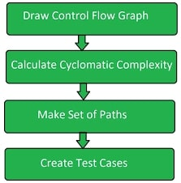
Path testing

Slide 5
Cyclomatic complexity
Every Program encompasses statements to execute in order to perform some task and other decision making statements that decide, what statements need to be executed. These decision making constructs change the flow of the program.
If we compare two programs of same size, the one with more decision making statements will be more complex as the control of program jumps frequently. Cyclomatic Complexity measure to quantity complexity of a given software.
It is graph driven model that is based on decision making constructs of program such as if-else, do-while, repeat-until, switch-case and goto statements.

Slide 6
Cyclomatic complexity is a software metric used to indicate the complexity of a program.
It is a quantitative measure of the number of linearly independent paths through a program's source code. It was developed by Thomas J. McCabe, in 1976.
Cyclomatic complexity V(G)= E - N + 2
where,
E = number of edges in the flow graph.
N = number of nodes in the flow graph.
//P = number of nodes that have exit points (Number of Predicate nodes).
V(G) = ∏ + 1 (∏ or P is represents the number of predicate nodes (node that contains condition))
V(G) = ∑ R (R is the number of regions, closed region). Count outer region.

Slide 7
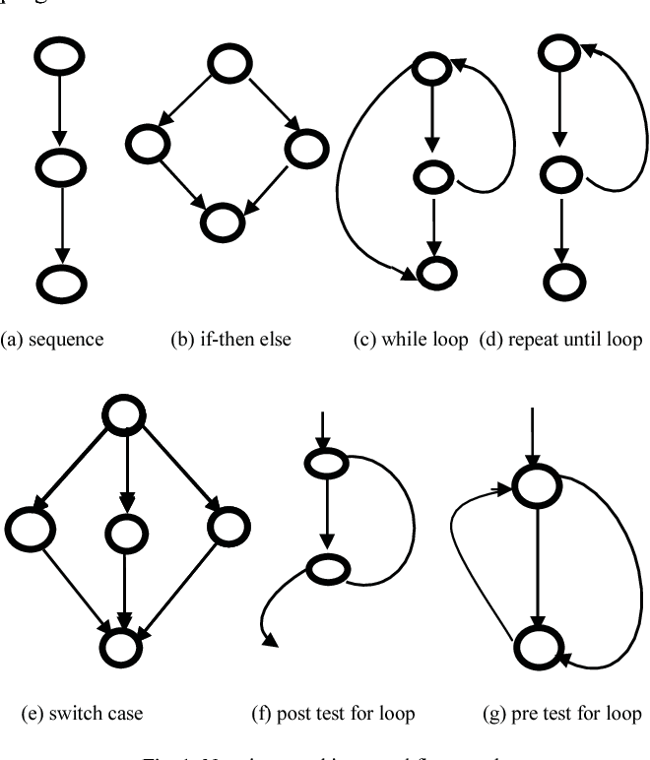
Notations used in control flow graph:

Slide 8
Process to make flow control graph:
Break program in smaller blocks, delimited by decision making constructs.
Create nodes representing each of these nodes.
Connect nodes as follows:
If control can branch from block i to block j
Draw an arc.
From exit node to entry node
Draw an arc.
Note: until or do while loop.

Slide 9
Steps that should be followed in calculating Cyclomatic complexity and test cases design are:
1. Construction of graph with nodes and edges from code.
2. Identification of independent paths.
3. Cyclomatic Complexity Calculation.
4. Design of Test Cases.

Slide 10
Example:
A = 10
IF B > C THEN
A = B
ELSE
A = C
ENDIF
Print A
Print B
Print C

Slide 11
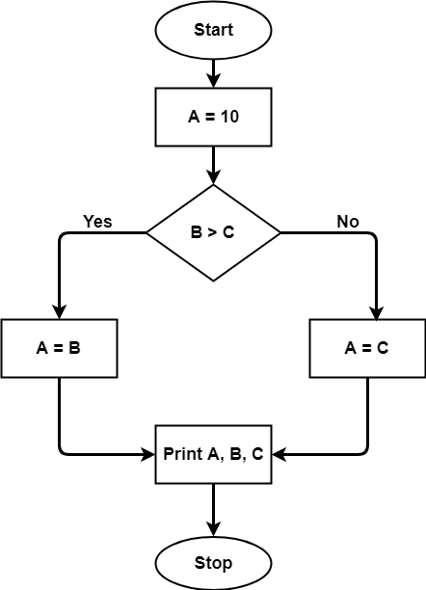
Flow Graph:

Slide 12
1

Slide 13
The Cyclomatic complexity calculated for above code will be from control flow graph.
The graph shows seven shapes(nodes), seven lines(edges),
Cyclomatic complexity V(G) = E - N + 2
Edges=7
Nodes=7
hence Cyclomatic complexity is 7-7+2 = 2.
According to P.Jorgensen Cyclomatic Complexity of a module should not exceed 10.

Slide 14
Properties of Cyclomatic complexity:
Following are the properties of Cyclomatic complexity:
1. V(G) is the maximum number of independent paths in the graph.
2. V(G) >=1
3. G will have on path if V(G) = 1
4. Minimize complexity to 10
If the value of Cyclomatic complexity is less ( a value less than or equal to 10 is considered awesome, the code is assumed to be well structured, highly testable and maintainable.

Slide 15
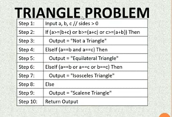
Ex:

Slide 16
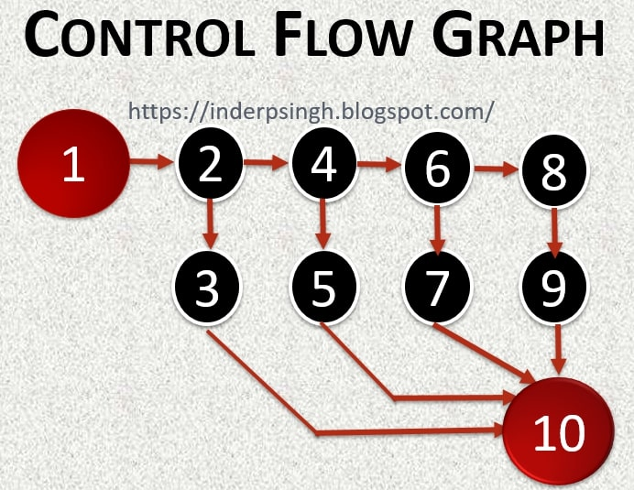
Calculate Cyclomatic complexity:
CC=E-N+2
CC=12-10+2
CC=4

Slide 17
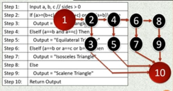
Paths:
1-2-3-10
1-2-4-6-8-9-10
1-2-4-6-7-10
1-2-4-5-10

Slide 18
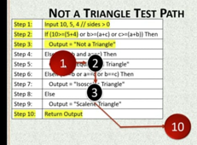
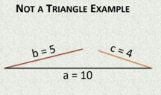

Slide 19
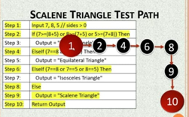
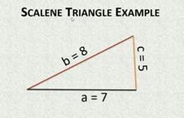

Slide 20
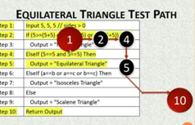
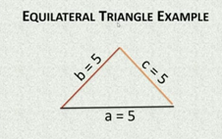

Slide 21
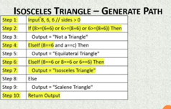
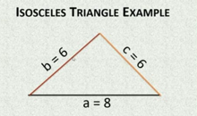

Slide 22
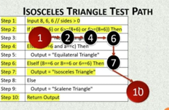

Slide 23
Basic of path testing
Path testing
Path testing is the name given to a family of test techniques.
If the set of paths are properly chosen then we have achieved some measure of test thoroughness.
Path testing techniques are the oldest of all structural test techniques.
Path testing is most applicable to new software for unit testing. It is a structural technique.
It requires complete knowledge of the program’s structure.
It is most often used by programmers to unit test their own code.
The effectiveness of path testing rapidly deteriorates as the size of the software aggregate under test increases.

Slide 24
Control Flow Graphs/program graph:
The control flow graph is a graphical representation of a program's control structure. It uses the elements named process blocks, decisions, and junctions.
The flow graph is similar to the earlier flowchart, with which it is not to be confused.
Flow Graph Elements: A flow graph contains four different types of elements.
(1) Process Block
(2) Decisions
(3) Junctions
(4) Case Statements

Slide 25
Process Block:
A process block is a sequence of program one of statement of the block is executed, then all statements. It is a sequence of statements such that if any statement there of are executed.
Formally, a process block is a piece of straight line code of one statement or hundreds of statements. A process has one entry and one exit.
It can consist of a single statement or instruction, a sequence of statements or instructions, a single entry/exit subroutine, a macro or function call, or a sequence of these.

Slide 26
2. Decisions: Machine language conditional branch and conditional skip instructions are examples of decisions. Most of the decisions are two-way but some are three way branches in control flow.
3. Case Statements: A case statement is a multi-way branch or decisions. Ex: case statement are a jump table in assembly language, and the PASCAL case statement.
From the point of view of test design, there are no differences between Decisions and Case Statements

Slide 27
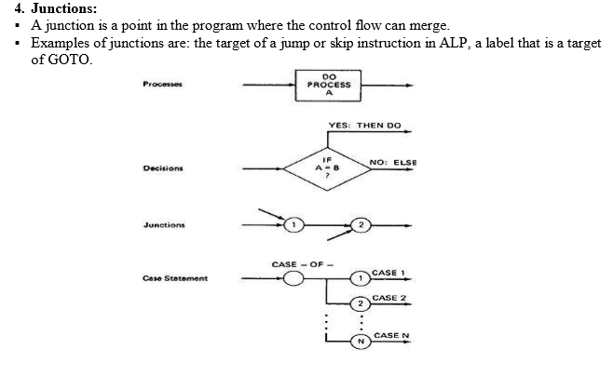

Slide 28
Control Flow Graphs Vs Flowcharts:
A program's flow chart resembles a control flow graph.
In flow graphs, we don't show the details of what is in a process block.
In flow charts every part of the process block is drawn.
The flowchart focuses on process steps, where as the flow graph focuses on control flow of the program.
The act of drawing a control flow graph is a useful tool that can help us clarify the control flow and data flow issues.

Slide 29
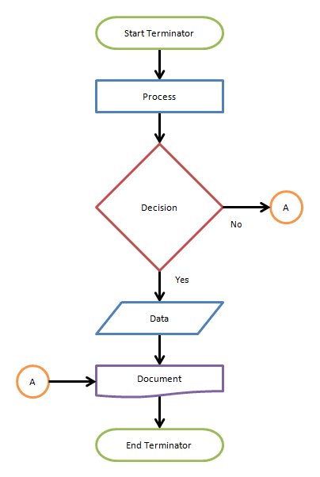
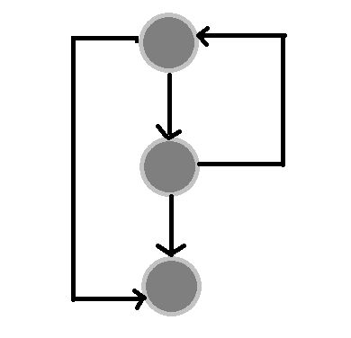
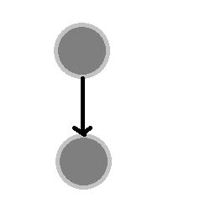
Flow chart: Flow graph:
node while loop

Slide 30
Notational Evolution:
The control flow graph is simplified representation of the program's structure. The notation changes made in creation of control flow graphs:
The process boxes weren't really needed. There is an implied process on every line joining junctions and decisions.
We don't need to know the specifics of the decisions, just the fact that there is a branch.
The specific target label names aren't important-just the fact that they exist. So we can replace them by simple numbers.
To understand this, we will go through an example (Figure 2.2) written in a FORTRAN like programming language called Programming Design Language (PDL). The program's corresponding flowchart (Figure 2.3) and flow graph (Figure 2.4) were also provided below for better understanding.

Slide 31
To understand this, we will go through an example (Figure 2.2) written in a FORTRAN like programming language called Programming Design Language (PDL). The program's corresponding flowchart (Figure 2.3) and flow graph (Figure 2.4) were also provided below for better understanding.

Slide 32
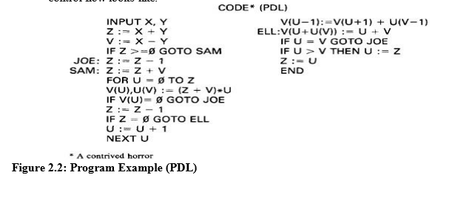
ex:written in a FORTRAN like programming language called Programming Design Language (PDL)

Slide 33
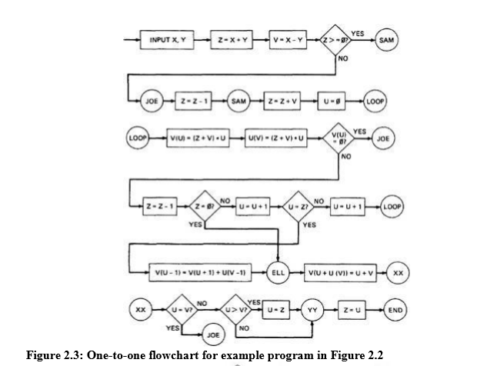
The program's corresponding flowchart

Slide 34
Representation:
Process block/statement: square box
Junction: circle
loop?/loop:rambos

Slide 35
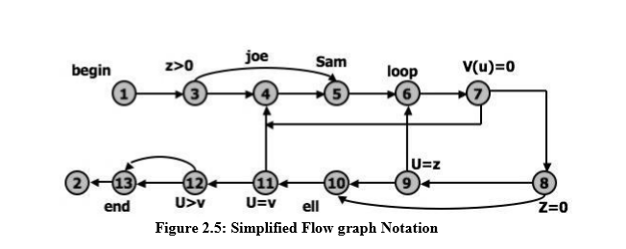
Simplified flow graph

Slide 36
PATH TESTING - PATHS, NODES AND LINKS:
Path: A path is a sequence of instructions or statements that starts at an entry, junction, or decision and ends at another, or possibly the same junction, decision, or exit.
A path may go through several junctions, processes, or decisions, one or more times.
Paths consist of segments. The segment is a link - a single process that lies between two nodes.
The length of path measured by the number of links in it and not by the number of the instructions or statements executed along that path.
The name of a path is the name of the nodes along the path.

Slide 37
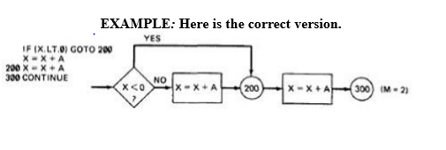
FUNDAMENTAL PATH SELECTION CRITERIA: 1. Defining complete testing: 2. Exercise every path from entry to exit. 3. Exercise every statement or instruction at least once. 4. Exercise every branch and case statement, In each direction at least once. If prescription 1 is followed then 2 and 3 are automatically followed.

Slide 38
For X negative, the output is X+A, while for X greater than or equal to zero, the output is X+2A.
A negative value produces the correct answer.
Every statement can be executed, but if the test cases do not force each branch to be taken, the bug can remain hidden.
The next example uses a test based on executing each branch but does not force the execution of all statements:

Slide 39
PATH TESTING CRITERIA:
Any testing strategy based on paths must at least both exercise every instruction and take branches in all directions. A set of tests that does this is not complete in an absolute sense, but it is complete in the sense that any thing less must leave something untested.
Path Testing (Pinf):
1. Execute all possible control flow paths through the program.
2. If we achieve this prescription, we are said to have achieved 100% path coverage. This is the strongest criterion in the path testing strategy family: it is generally impossible to achieve.

Slide 40
ii. Statement Testing (P1):
1. Execute all statements in the program at least once under some test. If we do enough tests to achieve this, we are said to have achieved 100% statement coverage.
2. An alternate equivalent characterization is to say that we have achieved 100% node coverage. We denote this by C1.
iii. Branch Testing (P2):
Execute enough tests to assure that every branch alternative has been exercised at least once under some test.
An alternative characterization is to say that we have achieved 100% link coverage.
For structured software, branch testing and therefore branch coverage strictly includes statement coverage.
We denote branch coverage by C2.

Slide 41
Which paths to be tested?
You must pick enough paths to achieve C1+C2. The question of what is the fewest number of such paths is interesting to the designer of test tools that help automate the path testing, but it is not crucial to the pragmatic (practical) design of tests. It is better to make many simple paths than a few complicated paths.

Slide 42
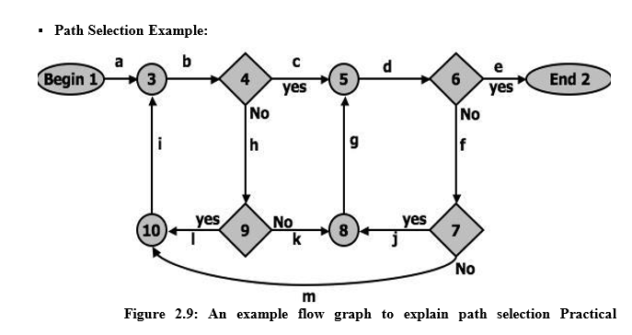
Which paths to be tested? You must pick enough paths to achieve C1+C2. The question of what is the fewest number of such paths is interesting to the designer of test tools that help automate the path testing, but it is not crucial to the pragmatic (practical) design of tests. It is better to make many simple paths than a few complicated paths.

Slide 43
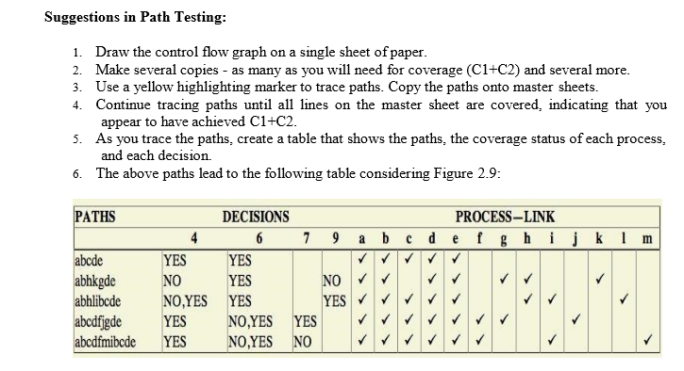

Slide 44
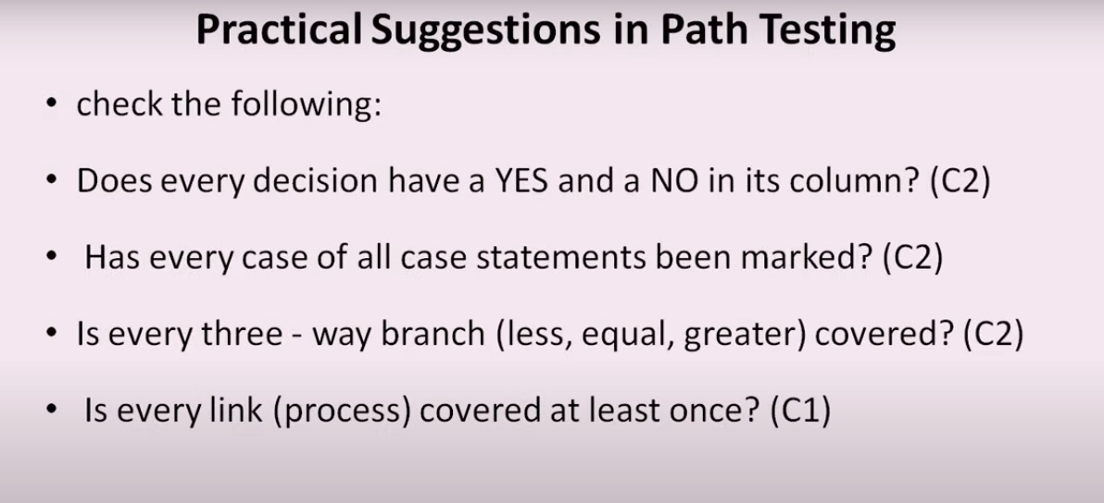

Slide 45
LOOPS: Cases for a single loop
CASE 1: Single loop, Zero minimum, N maximum, No excluded values
Try bypassing the loop (zero iterations). If you can't, you either have a bug, or zero is not the minimum and you have the wrong case.
Could the loop-control variable be negative? Could it appear to specify a negative number of iterations? What happens to such a value?
One pass through the loop.
Two passes through the loop.
A typical number of iterations, unless covered by a previous test.
One less than the maximum number of iterations.
The maximum number of iterations.
Attempt one more than the maximum number of iterations. What prevents the loop-control variable from having this value? What will happen with this value if it is forced?

Slide 46
Nested Loops:
The number of tests to be performed on nested loops will be the exponent of the tests performed on single loops.
1. Start at the inner most loop. Set all the outer loops to their minimum values.
2. Test the minimum, minimum+1, typical, maximum-1 , and maximum for the innermost loop, while holding the outer loops at their minimum iteration parameter values. Expand the tests as required for out of range and excluded values.
3. If you've done the outmost loop, GOTO step 5, else move out one loop and set it up as in step 2 with all other loops set to typical values.
4. Continue outward in this manner until all loops have been covered.
5. Do all the cases for all loops in the nest simultaneously.

Slide 47
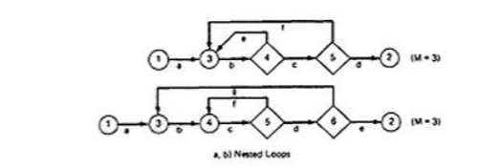
Nested Loops: 1. Start at the inner most loop. Set all the outer loops to their minimum values. 2. If you've done the outmost loop, GOTO step 4, else move out one loop and set it up as in step 2 with all other loops set to typical values. 3. Continue outward in this manner until all loops have been covered. 4. Do all the cases for all loops in the nest simultaneously.

Slide 48
Loop Testing Time:
Any kind of loop can lead to long testing time, especially if all the extreme value cases are to attempted (Max-1, Max, Max+1).
This situation is obviously worse for nested and dependent concatenated loops.
Consider nested loops in which testing the combination of extreme values lead to long test times.

Slide 49
PREDICATES, PATH PREDICATES AND ACHIEVABLE PATHS:
PREDICATE: The logical function evaluated at a decision is called Predicate. The direction taken at a decision depends on the value of decision variable. Some examples are: A>0, x+y>=90.......
PATH PREDICATE: A predicate associated with a path is called a Path Predicate. For example, "x is greater than zero", "x+y>=90“.

Slide 50
MULTIWAY BRANCHES:
The path taken through a multiway branch such as a computed GOTO's, case statement, or jump tables cannot be directly expressed in TRUE/FALSE terms.
Although, it is possible to describe such alternatives by using multi valued logic, an expedient (practical approach) is to express multiway branches as an equivalent set of if..then..else statements.
For example a three way case statement can be written as: If case=1 DO A1 ELSE (IF Case=2 DO A2 ELSE DO A3 ENDIF)ENDIF.

Slide 51
INPUTS:
In testing, the word input is not restricted to direct inputs, such as variables in a subroutine call, but includes all data objects referenced by the routine whose values are fixed prior to entering it.
For example,
inputs in a calling sequence,
objects in a data structure,
values left in registers, or
any combination of object types.
The input for a particular test is mapped as a one dimensional array called as an Input Vector.

Slide 52
PREDICATE INTERPRETATION:
The simplest predicate depends only on input variables.
For example if x1,x2 are inputs, the predicate might be x1+x2>=7, given the values of x1 and x2 the direction taken through the decision is based on the predicate is determined at input time and does not depend on processing.
Another example, assume a predicate x1+y>=0 that along a path prior to reaching this predicate we had the assignment statement y=x2+7. Although our predicate depends on processing, we can substitute the symbolic expression for y to obtain an equivalent predicate x1+x2+7>=0.

Slide 53
PREDICATE INTERPRETATION:
The act of symbolic substitution of operations along the path in order to express the predicate solely in terms of the input vector is called PREDICATE INTERPRETATION.
Sometimes the interpretation may depend on the path;

Slide 54
PREDICATE INTERPRETATION:
Example:
INPUT X
ON X GOTO A,B,C, ….
Z:= 7 @GOTO HEM (Label)
Z:= 7 @GOTO HEM
Z:= 7 @GOTO HEM
…….
HEM: Do SOMETHING
………
HEN: IF Y+Z > 0 GOTO ELL ELSE GOTO EMM
The predicate interpretation at HEN depends on the path we took through the first multiway branch. It yields for the three cases respectively, if Y+7>0, Y-7>0, Y>0.
The path predicates are the specific form of the predicates of the decisions along the selected path after interpretation.

Slide 55
INDEPENDENCE OF VARIABLES AND PREDICATES:
The path predicates take on truth values based on the values of input variables, either directly or indirectly.
If a variable's value does not change as a result of processing, that variable is independent of the processing.
If the variable's value can change as a result of the processing, the variable is process dependent.
A predicate whose truth value can change as a result of the processing is said to be process dependent and one whose truth value does not change as a result of the processing is process independent.
Process dependence of a predicate does not always follow from dependence of the input variables on which that predicate is based.

Slide 56
CORRELATION OF VARIABLES AND PREDICATES:
Two variables are correlated if every combination of their values cannot be independently specified.
Variables whose values can be specified independently without restriction are called uncorrelated.
A pair of predicates whose outcomes depend on one or more variables in common are said to be correlated predicates.
For example, the predicate X==Y is followed by another predicate X+Y == 8. If we select X and Y values to satisfy the first predicate, we might have forced the 2nd predicate's truth value to change. Every path through a routine is achievable only if all the predicates in that routine are uncorrelated.

Slide 57
PATH PREDICATE EXPRESSIONS:
A path predicate expression is a set of Boolean expressions, all of which must be satisfied to achieve the selected path.
Ex:X1+3X2+17>=0 X3=17 X4-X1>=14X2 30
Any set of input values that satisfy all of the conditions of the path predicate expression will force the routine to the path.
Sometimes a predicate can have an OR in it. Example:
A: X5 > 0 B: X1 + 3X2 + 17 >= 0 C: X3 = 17 D: X4 - X1 >= 14X2 E: X6 < 0 B: X1 + 3X2 + 17 >= 0 C: X3 = 17 D: X4 - X1 >= 14X2 Boolean algebra notation to denote the boolean expression:  ABCD+EBCD=(A+E)BCD

Slide 58
PREDICATE COVERAGE:
Compound Predicate:
Predicates of the form A OR B, A AND B and more complicated Boolean expressions are called as compound predicates.
Sometimes even a simple predicate becomes compound after interpretation. Example: the predicate if (x=17) whose opposite branch is if x.NE.17 which is equivalent to x>17. Or. X<17.
Predicate coverage is being the achieving of all possible combinations of truth values corresponding to the selected path have been explored under some test.
As achieving the desired direction at a given decision could still hide bugs in the associated predicates.

Slide 59
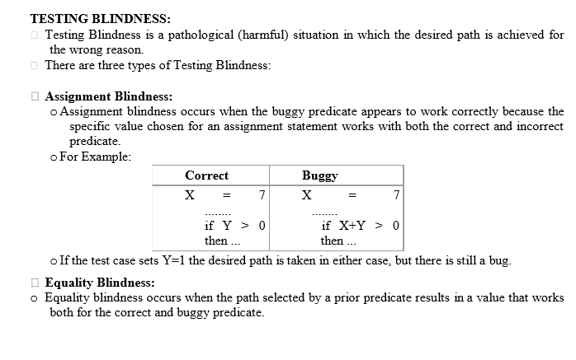

Slide 60
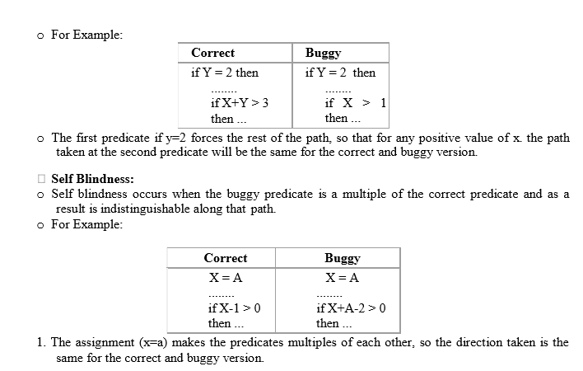

Slide 61
PATH SENSITIZING:
Review: achievable and unachievable paths:
1. We want to select and test enough paths to achieve a satisfactory notion of test completeness such as C1+C2.
2. Extract the programs control flow graph and select a set of tentative covering paths.
3. For any path in that set, interpret the predicates along the path as needed to express them in terms of the input vector.
4. Trace the path through, multiplying the individual compound predicates to achieve a Boolean expression such as (A+BC) (D+E) (FGH) (IJ) (K) (l) (L).
5. Multiply out the expression to achieve a sum of products form: ADFGHIJKL+AEFGHIJKL+BCDFGHIJKL+BCEFGHIJKL
6. Each product term denotes a set of inequalities that if solved will yield an input vector that drive the routine along the designated path.

Slide 62
PATH SENSITIZING:
Solve any one of the inequality sets for the chosen path and you have found a set of input values for the path.
If you can find a solution, then the path is achievable.
If you can’t find a solution to any of the sets of inequalities, the path is un achievable.
The act of finding a set of solutions to the path predicate expression is called Path Sensitization.

Slide 63
HEURISTIC PROCEDURES FOR SENSITIZING PATHS:
This is a workable approach, instead of selecting the paths without considering how to sensitize, attempt to choose a covering path set that is easy to sensitize and pick hard to sensitize paths only as you must to achieve coverage.
Identify all variables that affect the decision.
Classify the predicates as dependent or independent. (X1,X2,X3 X1+X2=4, Here X3 is not used)
Start the path selection with un correlated, independent predicates.
If coverage has not been achieved using independent uncorrelated predicates, extend the path set using correlated predicates.
If coverage has not been achieved extend the cases to those that involve dependent predicates.
Last, use correlated, dependent predicates.

Slide 64
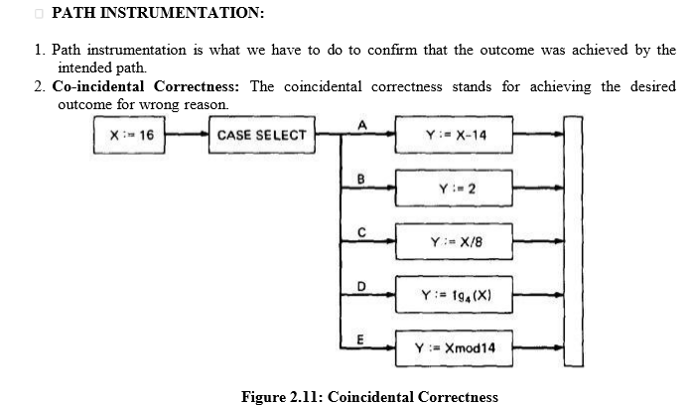

Slide 65
Therefore, the tests chosen this way will not tell us whether we have achieved coverage.
For example, the five cases could be totally jumbled and still the outcome would be the same.
Path Instrumentation is what we have to do to confirm that the outcome was achieved by the intended path.
The types of instrumentation methods include:
Interpretive Trace Program
Traversal Marker or Link Marker
Two Link Marker Method
Link Counter.

Slide 66
1. Interpretive Trace Program:
An interpretive trace program is one that executes every statement in order and records the intermediate values of all calculations, the statement labels traversed etc.
If we run the tested routine under a trace (F7 key in C), then we have all the information we need to confirm the outcome and, furthermore, to confirm that it was achieved by the intended path. (Sequential order)
The trouble with traces is that they give us far more information than we need.
In fact, the typical trace program provides so much information that confirming the path from its massive output dump is more work than simulating the computer by hand to confirm the path.

Slide 67
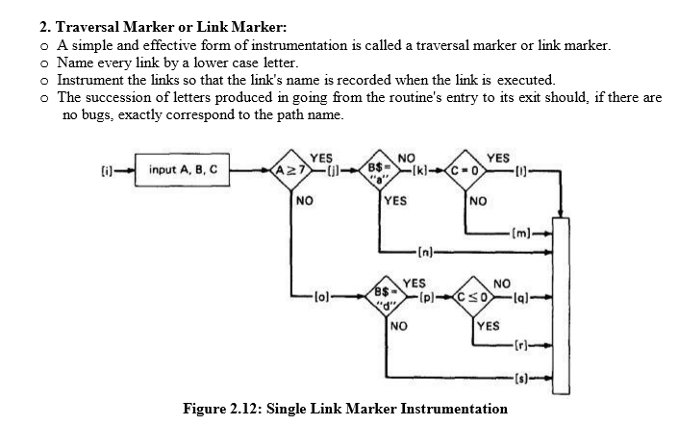

Slide 68
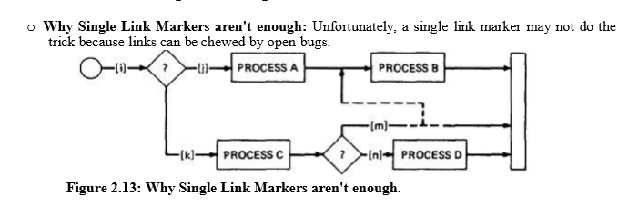

Slide 69
We intended to traverse the ikm path, but because of a rampaging GOTO in the middle of the m link, we go to process B.

Slide 70
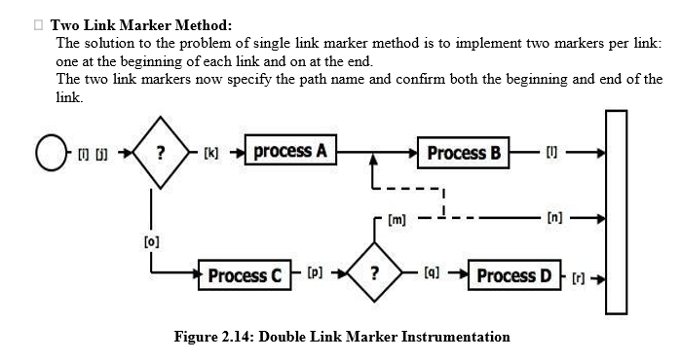

Slide 71
4. Link Counter:
A less disruptive (and less informative) instrumentation method is based on counters.
Instead of a unique link name to be pushed into a string when the link is traversed, we simply increment a link counter.
We now confirm that the path length is as expected.
The same problem that led us to double link markers also leads us to double link counters.

Slide 72
PATH TESTING CRITERIA
Any testing strategy based on paths must at least both exercise every instruction and take branches in all directions.
Three different testing criteria or strategies used for this.
Continue from slide No 36.

Slide 73
Path Testing (P_{inf})
Execute all possible control flow paths through the program.
If we achieve this we have achieved 100% path coverage.
It is generally impossible to achieve.

Slide 74
Statement Testing (P₁)
Execute all statements in the program at least once under some test.
If we do enough tests to achieve this, we are said to have achieved 100% statement coverage.
An alternate equivalent characterization is to say that we have achieved 100% node coverage.
We denote this by C1.

Slide 75
Branch Testing (P₂)
Execute enough tests to assure that every branch alternative has been exercised at least once under some test.
If we do enough tests to achieve this prescription, then we have achieved 100% branch coverage.
An alternative characterization is to say that we have achieved 100% link coverage.
We denote branch coverage by C2.

Slide 76
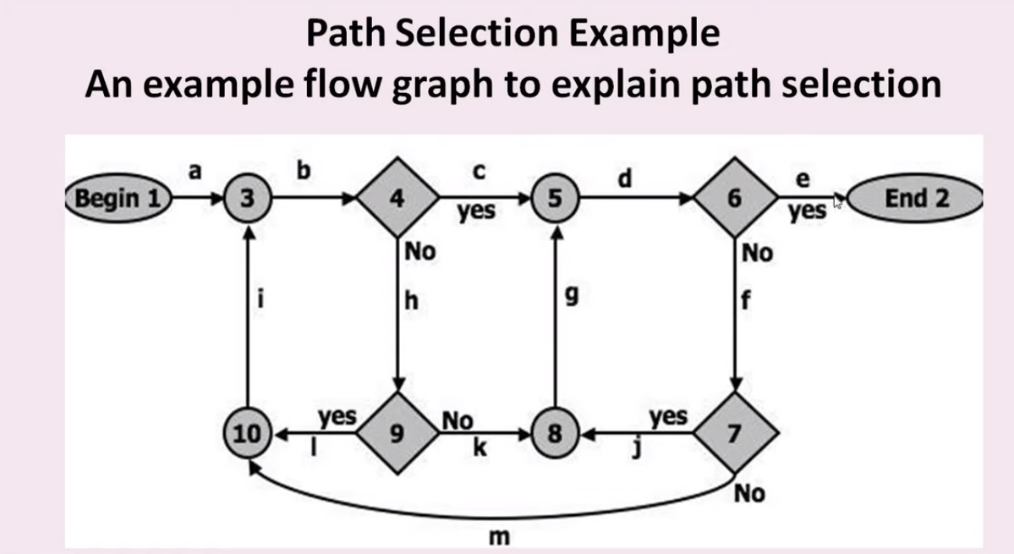

Slide 77
TRANSACTION FLOW TESTING INTRODUCTION:
A transaction is a unit of work seen from a system user's point of view.
Ex: of a transaction: A transaction for an online information retrieval system might consist of the following steps or tasks:
1. Accept input (tentative birth)
2. Validate input (birth)
3. Transmit acknowledgement to requester
4. Do input processing
5.Search file
6. Request directions from user
7.Accept input
8. Validate input
9. Process request
10.Update file
11.Transmit output
12.Record transaction in log and clean up

Slide 78
TRANSACTION FLOW GRAPHS:
Transaction flows are introduced as a representation of a system's processing.
The methods that were applied to control flow graphs are then used for functional testing.
Transaction flows and transaction flow testing are to the independent system tester what control flows are path testing is to the programmer.
The transaction flow graph is to create a behavioral model of the program that leads to functional testing.
The transaction flow graph is a model of the structure of the system's behavior (functionality).
An example of a Transaction Flow is as follows:

Slide 79
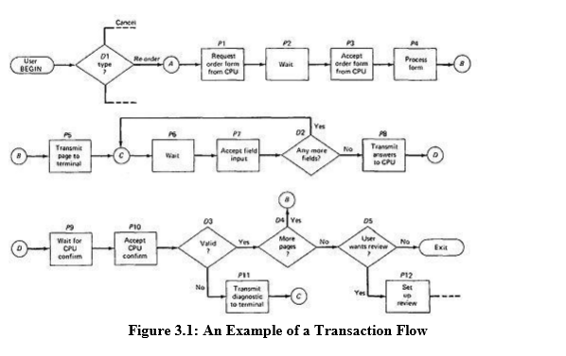

Slide 80
USAGE:
Transaction flows are indispensable for specifying requirements of complicated systems, especially online systems.
A big system such as an air traffic control or airline reservation system, has not hundreds, but thousands of different transaction flows.
The flows are represented by relatively simple flowgraphs, many of which have a single straight-through path.
Loops are infrequent compared to control flowgraphs.
The most common loop is used to request a retry after user input errors. An ATM system, for example, allows the user to try, say three times, and will take the card away

Slide 81
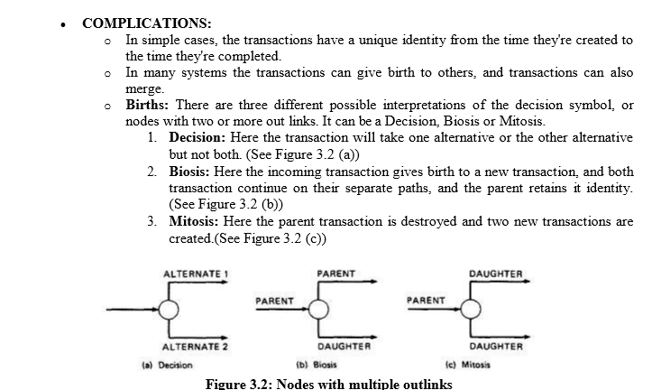

Slide 82
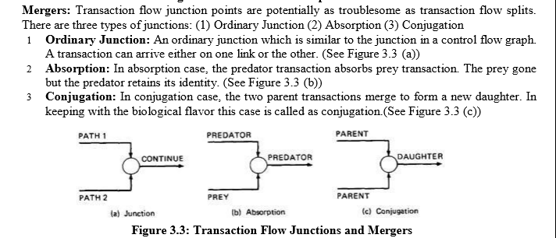

Slide 83
TRANSACTION FLOW TESTING TECHNIQUES:
GET THE TRANSACTIONS FLOWS:
Complicated systems that process a lot of different, complicated transactions should have explicit representations of the transactions flows, or the equivalent.
Transaction flows are like control flow graphs, and consequently we should expect to have them in increasing levels of detail.
The system's design documentation should contain an overview section that details the main transaction flows.
Detailed transaction flows are a mandatory pre requisite to the rational design of a system's functional test.

Slide 84
INSPECTIONS, REVIEWS AND WALKTHROUGHS:
Discuss paths through flows in functional rather than technical terms. Ask the designers to relate every flow to the specification and to show how that transaction, directly or indirectly, follows from the requirements.
Make transaction flow testing the corner stone of system functional testing just as path testing is the corner stone of unit testing.
Select additional flow paths for loops, extreme values, and domain boundaries.
Design more test cases to validate all births and deaths.
Publish and distribute the selected test paths through the transaction flows as early as possible so that they will exert the maximum beneficial effect on the project.

Slide 85
PATH SELECTION:
Select a set of covering paths (c1+c2) using the analogous criteria you used for structural path testing.
Select a covering set of paths based on functionally sensible transactions as you would for control flow graphs.
Try to find the most tortuous, longest, strangest path from the entry to the exit of the transaction flow.
PATH SENSITIZATION:
Most of the normal paths are very easy to sensitize-80% - 95% transaction flow coverage (c1+c2) is usually easy to achieve.
The remaining small percentage is often very difficult.
Sensitization is the act of defining the transaction. If there are sensitization problems on the easy paths, then bet on either a bug in transaction flows or a design bug.

Slide 86
PATH INSTRUMENTATION:
Instrumentation plays a bigger role in transaction flow testing than in unit path testing.
The information of the path taken for a given transaction must be kept with that transaction and can be recorded by a central transaction dispatcher or by the individual processing modules.
In some systems, such traces are provided by the operating systems or a running log.

Slide 87
UNIT III
DATA FLOW TESTING:
BASICS OF DATA FLOW TESTING:
DATA FLOW TESTING:
Data Flow Testing :software testing that focuses on data variables and their values. It makes use of the control flow graph.
The control flow is the order in which the computer executes statements in a script.
(or)
Data flow testing :selecting paths through the program's control flow in order to explore sequences of events related to the status of data objects.

Slide 88
For ex: pick enough paths to assure that every data object has been initialized prior to use or that all defined objects have been used for something.
DATA FLOW MACHINES:
Dataflow machines are programmable computers.
There are two types of data flow machines with different architectures:
(1) Von Neumann machines
(2) Multi-instruction, multi-data machines (MIMD)

Slide 89
Von Neumann Machine Architecture:
Most computers today are von-neumann machines like PC. the main units are a control unit, ALU, memory, and input and output facilities;
micro instruction sequence:
Fetch instruction from memory
Interpret instruction
Fetch operands
Process or Execute
Store result
Increment program counter
GOTO 1

Slide 90
Multi-instruction, Multi-data machines (MIMD) Architecture:
These machines can fetch several instructions and objects in parallel.
Machines using MIMD have a number of processors that function asychronously and independently. At any time, different processors may be executing different instructions on different pieces of data.
They can also do arithmetic and logical operations simultaneously on different data objects.
The decision of how to sequence them depends on the compiler.
MIMD architectures may be used in :CAD(computer aided design), and communication switches.

Slide 91
BUG ASSUMPTION:
The bug assumption for data-flow testing strategies is that control flow is generally correct and that something has gone wrong with the software so that data objects are not available when they should be, or silly things are being done to data objects.
Ex: control flow, data flow graphs.

Slide 92
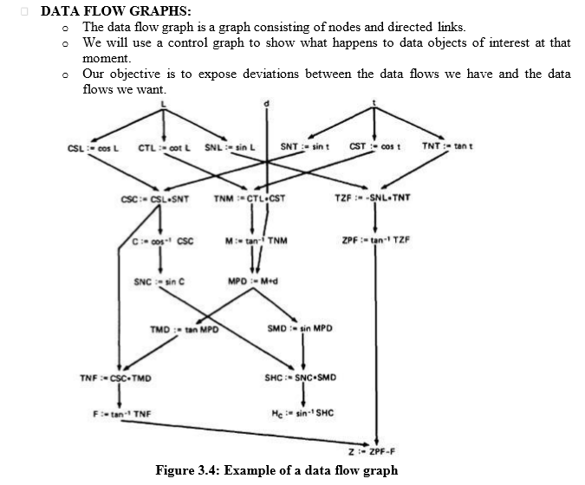

Slide 93
Data Object State and Usage:
Data Objects can be created, killed and used.
They can be used in two distinct ways:
(1) In a Calculation
(2) As a part of a Control Flow Predicate.
The following symbols denote these possibilities:
Defined: d - defined, created, initialized etc
Killed or undefined: k - killed, undefined, released etc
3. Usage: u - used for something (c - used in Calculations, p - used in a predicate)

Slide 94
1.Defined (d):
An object is defined explicitly when it appears in a data declaration Or implicitly when it appears on the left hand side of the assignment.
It is also to be used to mean that a file has been opened. A dynamically allocated object has been allocated.
Something is pushed on to the stack.
2.Killed or Undefined (k):
An object is killed on undefined when it is released or otherwise made unavailable.
The old top of the stack after it is popped.

Slide 95
An assignment statement can kill and redefine immediately. For example, if A had been previously defined and we do a new assignment such as A : = 17, we have killed A's previous value and redefined A
3.Usage (u):
A variable is used for computation (c) when it appears on the right hand side of an assignment statement.
A file record is read or written. It is used in a Predicate (p) when it appears directly in a predicate.

Slide 96
DATA FLOW ANOMALIES:
An anomaly is denoted by a two-character sequence of actions.
For ex: ku means that the object is killed and then used, where as dd means that the object is defined twice without an intervening usage.
There are nine possible two-letter combinations for d, k and u.
1. dd :- probably harmless but suspicious. Why define the object twice without an intervening usage?
2 .dk :- probably a bug. Why define the object without using it?
3. du :- the normal case. The object is defined and then used.
4. kd :- normal situation. An object is killed and then redefined. 5 kk :- harmless but probably buggy. Did you want to be sure it was really killed?

Slide 97
6.ku :- a bug. the object does not exist.
7.ud :- usually not a bug because the language permits reassignment at almost any time.
8. uk :- normal situation.
9 .uu :- normal situation.

Slide 98
Possible anomalies are:
-k :- the entrance to this point on the path, the variable had not been defined. We are killing a variable that does not exist.
-d :- okay. This is just the first definition along this path.
-u :- possibly anomalous. Not anomalous if the variable is global and has been previously defined.
k- :- not anomalous. The last thing done on this path was to kill the variable.
d- :- possibly anomalous. The variable was defined and not used on this path. But this could be a global definition.
u- :- not anomalous. The variable was used but not killed on this path.

Slide 99
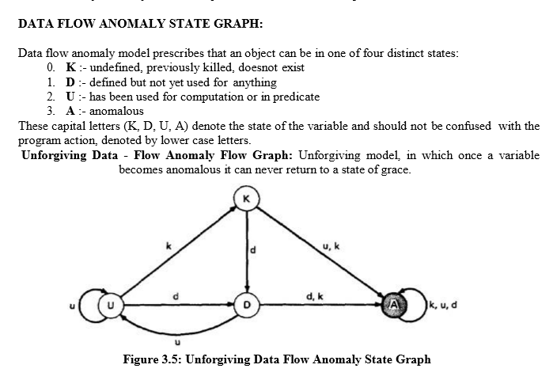

Slide 100
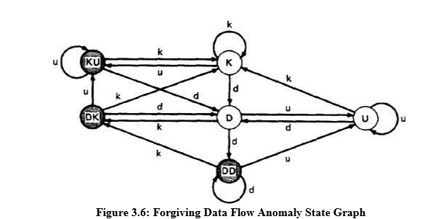
Forgiving Data - Flow Anomaly Flow Graph: Forgiving model is an alternate model where redemption (recover) from the anomalous state is possible

Slide 101
STATIC Vs DYNAMIC ANOMALY DETECTION:
Static analysis is analysis done on source code without actually executing it.
ex: source code syntax error detection is the static analysis result.
Dynamic analysis is done on the fly as the program is being executed and is based on intermediate values that result from the program's execution.
ex: a division by zero warning is the dynamic result.

Slide 102
Why Static Analysis isn't enough They are:
Dead Variables: Although it is often possible to prove that a variable is dead or alive at a given point in the program.
Arrays: Arrays are problematic in that the array is defined or killed as a single object, but reference is to specific locations within the array. Array pointers are usually dynamically calculated, so there's no way to do a static analysis to validate the pointer value.

Slide 103
Dynamic Subroutine and Function Names in a Call:
subroutine or function name is a dynamic variable in a call. What is passed, or a combination of subroutine names and data objects, is constructed on a specific path. There's no way, without executing the path, to determine whether the call is correct or not.
False Anomalies: Anomalies are specific to paths. Even a "clear bug" such as ku may not be a bug if the path along which the anomaly exists is unachievable. Such "anomalies" are false anomalies. Unfortunately, the problem of determining whether a path is or is not achievable is unsolvable.

Slide 104
Recoverable Anomalies and Alternate State Graphs: How does the compiler know which model I have in mind? It can't because the definition of "anomaly" is not fundamental. The language processor must have a built-in anomaly definition with which you may or may not (with good reason) agree.
Concurrency, Interrupts, System Issues:
Much of integration and system testing is aimed at detecting data-flow anomalies that cannot be detected in the context of a single routine. .

Slide 105
DATA FLOW MODEL:
The data flow model is based on the program's control flow graph - Don't confuse that with the program's data flow graph.
Here we annotate each link with symbols (for example, d, k, u, c, and p) or sequences of symbols (for example, dd, du, ddd) that denote the sequence of data operations on that link with respect to the variable of interest.
Such annotations are called link weights. The control flow graph structure is same for every variable: it is the weights that change.

Slide 106
Components of the Data flow Model:
To every statement there is a node, whose name is unique. Every node has at least one outlink and at least one inlink except for exit nodes and entry nodes.
Exit nodes are dummy nodes placed at the outgoing arrowheads of exit statements (e.g., END, RETURN), to complete the graph. Similarly, entry nodes are dummy nodes placed at entry statements (e.g., BEGIN) for the same reason.

Slide 107
3)The outlink of simple statements (statements with only one outlink) are weighted by the proper sequence of data-flow actions for that statement. Note that the sequence can consist of more than one letter.
For ex:the assignment statement A:= A + B in most languages is weighted by cd or possibly ckd for variable A. Languages that permit multiple simultaneous assignments and/or compound statements can have anomalies within the statement. The sequence must correspond to the order in which the object code will be executed for that variable.

Slide 108
4.Predicate nodes (e.g., IF-THEN-ELSE, DO WHILE, CASE) are weighted with the p - use(s) on every outlink, appropriate to that outlink.
5. Every sequence of simple statements (e.g., a sequence of nodes with one inlink and one outlink) can be replaced by a pair of nodes that has, as weights on the link between them, the concatenation of link weights.
6. If there are several data-flow actions on a given link for a given variable, then the weight of the link is denoted by the sequence of actions on that link for that variable.
7. Conversely, a link with several data-flow actions on it can be replaced by a succession of equivalent links, each of which has at most one data-flow action for any variable.

Slide 109
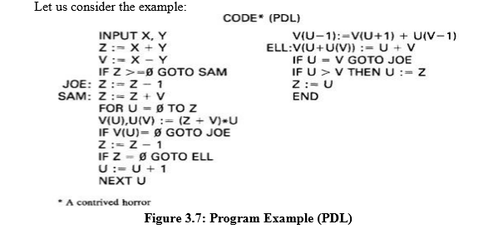

Slide 110
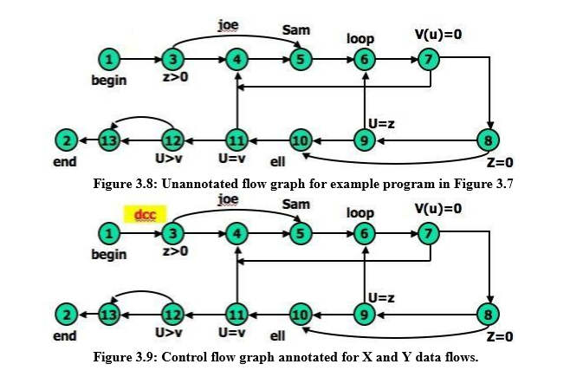

Slide 111
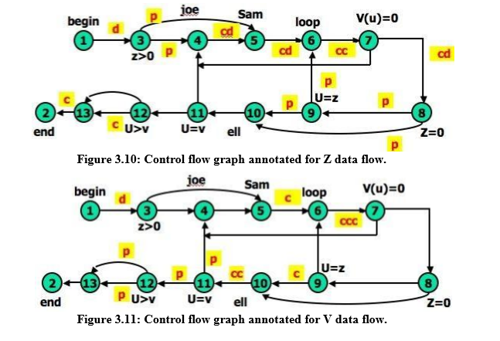

Slide 112
STRATEGIES OF DATA FLOW TESTING:
INTRODUCTION:
Data Flow Testing Strategies are structural strategies. In contrast to the path-testing strategies, data-flow strategies take into account what happens to data objects on the links in addition to the raw connectivity of the graph.
In other words, data flow strategies require data-flow link weights (d,k,u,c,p). Data Flow Testing Strategies are based on selecting test path segments (also called sub paths) that satisfy some characteristic of data flows for all data objects.
For ex: all sub paths that contain a d (or u, k, du, dk).

Slide 113
TERMINOLOGY:
1. Definition-Clear Path Segment, with respect to variable X, is a connected sequence of links such that X is (possibly) defined on the first link and not redefined or killed on any subsequent link of that path segment. ll paths in Figure 3.9 are definition clear because variables X and Y are defined only on the first link (1,3) and not thereafter. In Figure 3.10, we have a more complicated situation. The following path segments are definition-clear: (1,3,4), (1,3,5), (5,6,7,4), (7,8,9,6,7), (7,8,9,10), (7,8,10), (7,8,10,11). Subpath (1,3,4,5) is not definition-clear because the variable is defined on (1,3) and again on (4,5). For practice, try finding all the definition-clear subpaths for this routine (i.e., for all variables).

Slide 114
2. Loop-Free Path Segment is a path segment for which every node in it is visited atmost once. For Example, path (4,5,6,7,8,10) in Figure 3.10 is loop free, but path (10,11,4,5,6,7,8,10,11,12) is not because nodes 10 and 11 are each visited twice.
3. Simple path segment is a path segment in which at most one node is visited twice. For example, in Figure 3.10, (7,4,5,6,7) is a simple path segment. A simple path segment is either loop-free or if there is a loop, only one node is involved.
4. A du path from node i to k is a path segment such that if the last link has a computational use of X, then the path is simple and definition-clear; if the penultimate (last but one) node is j - that is, the path is (i,p,q,...,r,s,t,j,k) and link (j,k) has a predicate use - then the path from i to j is both loop-free and definition- clear.

Slide 115
STRATEGIES:
Various types of data flow testing strategies in decreasing order of their effectiveness are:
All - du Paths (ADUP): The all-du-paths (ADUP) strategy is the strongest data-flow testing strategy discussed here. It requires that every du path from every definition of every variable to every some test.
For variable X and Y:In Figure 3.9, because variables X and Y are used only on link (1,3), any test that starts at the entry satisfies this criterion (for variables X and Y, but not for all variables as required by the strategy).

Slide 116
For variable Z: The situation for variable Z (Figure 3.10) is more complicated because the variable is redefined in many places. For the definition on link (1,3) we must exercise paths that include subpaths (1,3,4) and (1,3,5). The definition on link (4,5) is covered by any path that includes (5,6), such as subpath (1,3,4,5,6, ...). The (5,6) definition requires paths that include subpaths (5,6,7,4) and (5,6,7,8).
For variable V: Variable V (Figure 3.11) is defined only once on link (1,3). Because V has a predicate use at node 12 and the subsequent path to the end must be forced for both directions at node 12, the all-du-paths strategy for this variable requires that we exercise all loop-free entry/exit paths and at least one path that includes the loop caused by (11,4).

Slide 117
All Uses Startegy (AU):
Just as we reduced our ambitions by stepping down from all paths (P) to branch coverage (C2), say, we can reduce the number of test cases by asking that the test set should include at least one path segment from every definition to every use that can be reached by that definition.
For variable V: In Figure 3.11, ADUP requires that we include subpaths (3,4,5) and (3,5) in some test because subsequent uses of V, such as on link (5,6), can be reached by either alternative. In AU either (3,4,5) or (3,5) can be used to start paths, but we don't have to use both. Similarly, we can skip the (8,10) link if we've included the (8,9,10) subpath.
Note the hole. We must include (8,9,10) in some test cases because that's the only way to reach the c use at link (9,10) - but suppose our bug for variable V is on link (8,10) after all? Find a covering set of paths under AU for Figure 3.11.

Slide 118
All p-uses/some c-uses strategy (APU+C) :
For variable Z:In Figure 3.10, for APU+C we can select paths that all take the upper link (12,13) and therefore we do not cover the c-use of Z: but that's okay according to the strategy's definition because every definition is covered.
Links (1,3), (4,5), (5,6), and (7,8) must be included because they contain definitions for variable Z. Links (3,4), (3,5), (8,9), (8,10), (9,6), and (9,10) must be included because they contain predicate uses of Z. Find a covering set of test cases under APU+C for all variables in this example - it only takes two tests.
For variable V:In Figure 3.11, APU+C is achieved for V by (1,3,5,6,7,8,10,11,4,5,6,7,8,10,11,12[upper], 13,2) and (1,3,5,6,7,8,10,11,12[lower], 13,2). Note that the c-use at (9,10) need not be included under the APU+C criterion.

Slide 119
All c-uses/some p-uses strategy (ACU+P) : The all c-uses/some p-uses strategy (ACU+P) is to first ensure coverage by computational use cases and if any definition is not covered by the previously selected paths, add such predicate use cases as are needed to assure that every definition is included in some test.
For variable Z: In Figure 3.10, ACU+P coverage is achieved for Z by path (1,3,4,5,6,7,8,10, 11,12,13[lower], 2), but the predicate uses of several definitions are not covered. Specifically, the (1,3) definition is not covered for the (3,5) p-use, the (7,8) definition is not covered for the (8,9), (9,6) and (9, 10) p-uses.
The above examples imply that APU+C is stronger than branch coverage but ACU+P may be weaker than, or incomparable to, branch coverage.

Slide 120
All Definitions Strategy (AD) : The all definitions strategy asks only every definition of every variable be covered by at least one use of that variable, be that use a computational use or a predicate use.
For variable Z: Path (1,3,4,5,6,7,8, . . .) satisfies this criterion for variable Z, whereas any entry/exit path satisfies it for variable V. From the definition of this strategy we would expect it to be weaker than bothACU+P and APU+C.
1. All Predicate Uses (APU), All Computational Uses (ACU) Strategies : The all predicate uses strategy is derived from APU+C strategy by dropping the requirement that we include a c- use for the variable if there are no p-uses for the variable. The all computational uses strategy is derived from ACU+P strategy by dropping the requirement that we include a p-use for the variable if there are no cuses for the variable.
It is intuitively obvious that ACU should be weaker than ACU+P and that APU should be weaker than APU+C.

Slide 121
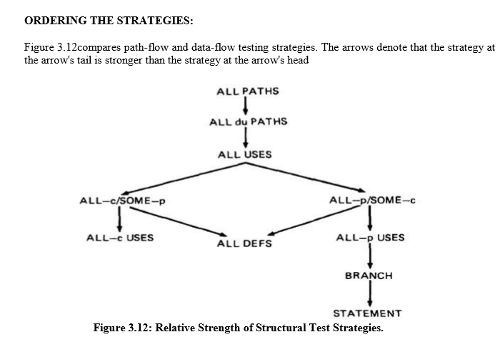

Slide 122
SLICING AND DICING:
A (static) program slice is a part of a program(X) . where the influence of a faulty statement could result from an improper computational use or predicate use of some other variables at prior statements.
If X is incorrect at statement i, it follows that the bug must be in the program slice for X with respect to i .
A program dice is a part of a slice in which all statements which are known to be correct have been removed.
In other words, a dice is obtained from a slice by incorporating information obtained through testing or experiment (e.g., debugging).

Slide 123
Debugging can be modeled as an iterative procedure in which slices are further refined by dicing, where the dicing information is obtained from ad hoc tests aimed primarily at eliminating possibilities.
Debugging ends when the dice has been reduced to the one faulty statement.
Dynamic slicing is a refinement of static slicing in which only statements on achievable paths to the statement in question are included.

