Slide 1
Unit-III Domain Testing
I.DOMAINS AND PATHS
INTRODUCTION:
Domain: domain is a set of possible values of an independent variable or the variables of a function.
Programs as input data classifiers: domain testing attempts to determine whether the classification is or is not correct.
Domain testing can be based on specifications or equivalent implementation information. If domain testing is based on specifications, it is a functional test technique.
If domain testing is based implementation details, it is a structural test technique. For ex, you're doing domain testing when you check extreme values of an input variable.

Slide 2
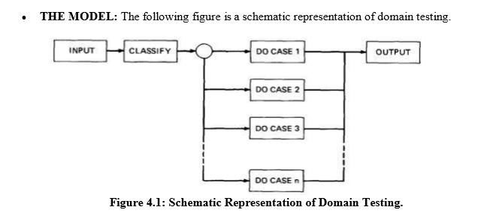

Slide 3
An invalid input (e.g., value too big) is just a special processing case called 'reject'. In domain testing, we focus on the classification aspect of the routine rather than on the calculations. Structural knowledge is not needed for this model - only a consistent, complete specification of input values for each case.
A DOMAIN IS A SET:
An input domain is a set. If the source language supports set definitions (E.g. PASCAL set types and C enumerated types) less testing is needed because the compiler does much of it for us.
Domain for a loop-free program corresponds to a set of numbers defined over the input vector.

Slide 4
DOMAINS, PATHS AND PREDICATES:
In domain testing, predicates are assumed to be interpreted in terms of input vector variables.
If domain testing is applied to structure, then predicate interpretation must be based on actual paths through the routine - that is, based on the implementation control flow graph.
For every domain, there is at least one path through the routine. Domain boundaries are also where most domain bugs occur. o For every boundary there is at least one predicate that specifies what numbers belong to the domain and what numbers don't.

Slide 5
A DOMAIN CLOSURE:
A domain boundary is closed with respect to a domain if the points on the boundary belong to the domain.
If the boundary points belong to some other domain, the boundary is said to be open.
Figure 4.2 shows three situations for a one-dimensional domain - i.e., a domain defined over one input variable; call it x The importance of domain closure is that incorrect closure bugs are frequent domain bugs. For example, x >= 0 when x > 0 was intended

Slide 6
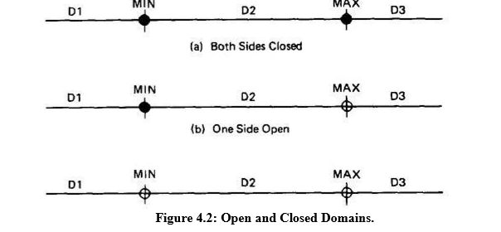

Slide 7
DOMAIN DIMENSIONALITY:
Every input variable adds one dimension to the domain.
One variable defines domains on a number line.
Two variables define planar domains.
Three variables define solid domains.
BUG ASSUMPTION:
The bug assumption for the domain testing is that processing is okay but the domain definition is wrong.
An incorrectly implemented domain means that boundaries are wrong, which may in turn mean that control flow predicates are wrong.

Slide 8
Domain Errors:
1.Double Zero Representation: boundary errors for negative zero are common.
2. Floating point zero check: A floating point number can equal zero only if the previous definition of that number set it to zero or if it is subtracted from itself or multiplied by zero.
3. Contradictory domains:domain specification means that at least two supposedly distinct domains overlap.
4.Ambiguous domains: Ambiguous domains mean that union of the domains is incomplete i.e there are missing domains or holes in the specified domains.

Slide 9
5.Boundary Errors: Errors caused in and around the boundary of a domain. Example, boundary closure bug, shifted, tilted, missing, extra boundary.
6. Closure Reversal: A common bug. The predicate is defined in terms of >=. The programmer chooses to implement the logical complement.
7.Faulty Logic: If the predicates define domain boundaries, all kinds of domain bugs can result from faulty logic manipulations.
8.RESTRICTIONS TO DOMAIN TESTING: Domain testing has restrictions, as do other testing techniques.

Slide 10
9.Co-incidental Correctness: Domain testing isn't good at finding bugs for which the outcome is correct for the wrong reasons. If we're plagued by coincidental correctness we may misjudge an incorrect boundary.
10. Representative Outcome: Partition-testing strategies divide the program's input space into domains such that all inputs within a domain are equivalent (not equal, but equivalent) in the sense that any input represents all inputs in that domain.
11.Functional Homogeneity of Bugs: Whatever the bug is, it will not change the functional form of the boundary predicate. For example, if the predicate is ax >= b, the bug will be in the value of a or b but it will not change the predicate to ax >= b, say.

Slide 11
12. Linear Vector Space: Most papers on domain testing, assume linear boundaries .
13. Loop Free Software: Loops are problematic for domain testing.
NICE AND UGLY DOMAINS:
NICE DOMAINS:
Some important properties of nice domains are: Linear, Complete, Systematic, And Orthogonal, Consistently closed, Convex and simply connected. o To the extent that domains have these properties domain testing is easy as testing gets. o The bug frequency is lesser for nice domain than for ugly domains.

Slide 12
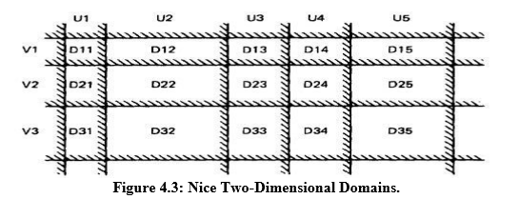

Slide 13
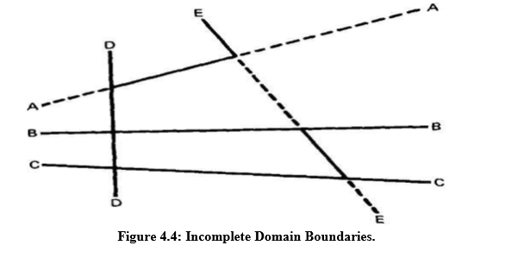
LINEAR AND NON LINEAR BOUNDARIES:
Nice domain boundaries are defined by linear inequalities or equations.
COMPLETE BOUNDARIES:
Nice domain boundaries are complete in that they span the number space from plus to minus infinity in all dimensions.

Slide 14
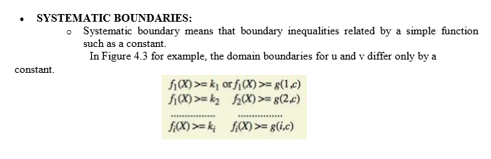

Slide 15
ORTHOGONAL BOUNDARIES:
Two boundary sets U and V (See Figure 4.3) are said to be orthogonal if every inequality in V is perpendicular to every inequality in U.

Slide 16
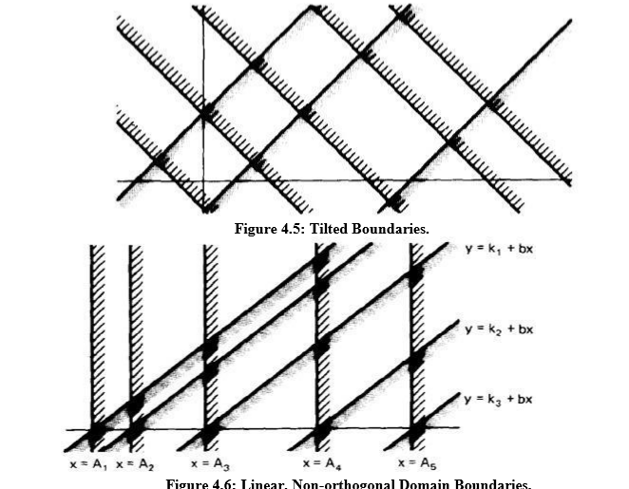

Slide 17
CLOSURE CONSISTENCY: The shaded areas on the boundary denote that the boundary belongs to the domain in which the shading lies - e.g., the boundary lines belong to the domains on the right.
CONVEX: A geometric figure (in any number of dimensions) is convex if you can take two arbitrary points on any two different boundaries, join them by a line and all points on that line lie within the figure. Nice domains are convex; dirty domains aren't.
SIMPLY CONNECTED:
Nice domains are simply connected; that is, they are in one piece rather than pieces all over the place interspersed with other domains.

Slide 18
UGLY DOMAINS:
Some domains are born ugly and some are uglified by bad specifications. Every simplification of ugly domains by programmers can be either good or bad.
If the ugliness results from bad specifications and the programmer's simplification is harmless, then the programmer has made ugly good.
But if the domain's complexity is essential (e.g., the income tax code), such "simplifications" constitute bugs.
Nonlinear boundaries are so rare in ordinary programming that there's no information on how programmers might "correct" such boundaries if they're essential.

Slide 19
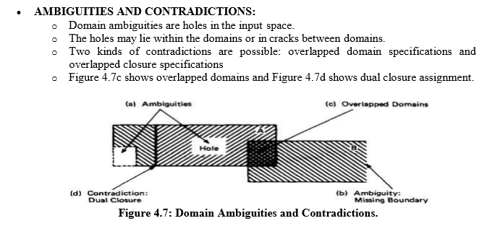

Slide 20
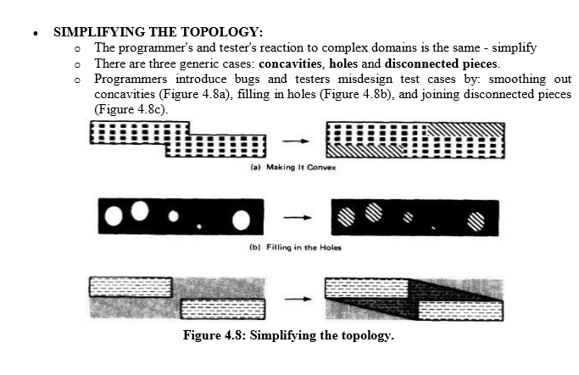

Slide 21
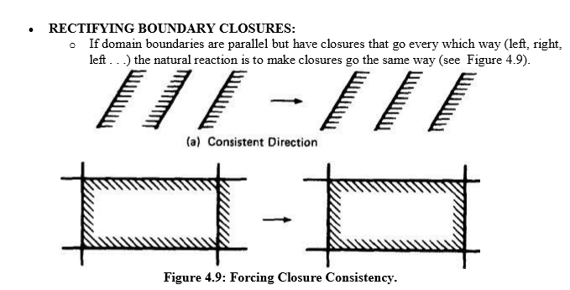

Slide 22
DOMAIN TESTING:
DOMAIN TESTING STRATEGY:
Domains are defined by their boundaries; therefore, domain testing concentrates test points on or near boundaries. o Classify what can go wrong with boundaries, then define a test strategy for each case. Pick enough points to test for all recognized kinds of boundary errors. o Because every boundary serves at least two different domains, test points used to check one domain can also be used to check adjacent domains. Remove redundant test points. o Run the tests and by posttest analysis (the tedious part) determine if any boundaries are faulty and if so, how. o Run enough tests to verify every boundary of every domain.

Slide 23
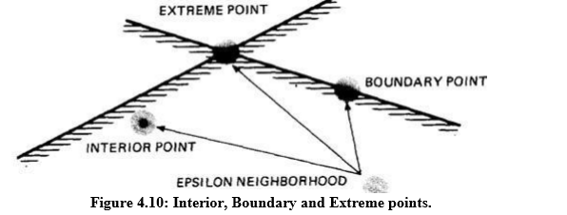
DOMAIN BUGS AND HOW TO TEST FOR THEM:
An interior point is a point in the domain such that all points within an arbitrarily small distance (called an epsilon neighborhood) are also in the domain.
A boundary point is one such that within an epsilon neighborhood there are points both in the domain and not in the domain.
An extreme point is a point that does not lie between any two other arbitrary but distinct points of a (convex) domain.

Slide 24
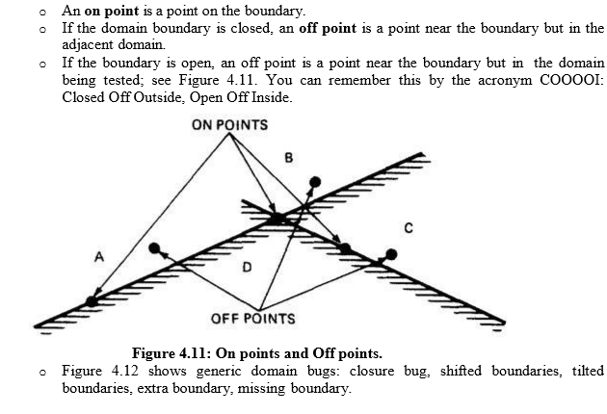

Slide 25
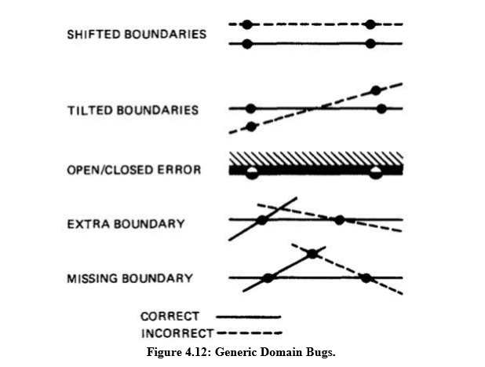

Slide 26
TESTING ONE DIMENSIONAL DOMAIN:
The closure can be wrong (i.e., assigned to the wrong domain) or the boundary (a point in this case) can be shifted one way or the other, we can be missing a boundary, or we can have an extra boundary.
Figure 4.13 shows possible domain bugs for a one-dimensional open domain boundary.
In Figure 4.13a we assumed that the boundary was to be open for A. The bug we're looking for is a closure error, which converts > to >= or < to <= (Figure 4.13b).
One test (marked x) on the boundary point detects this bug because processing for that point will go to domain A rather than B.

Slide 27
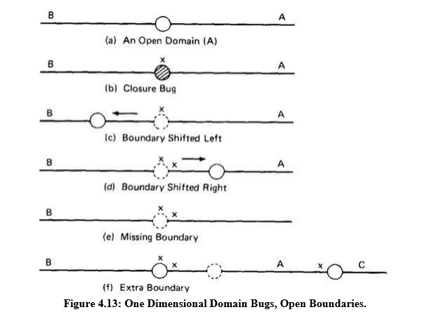

Slide 28
Figure 4.13d shows a shift the other way. The on point doesn't tell us anything because the boundary shift doesn't change the fact that the test point will be processed in B. To detect this shift we need a point close to the boundary but within A. The boundary is open, therefore by definition, the off point is in A (Open Off Inside).
The same open off point also suffices to detect a missing boundary because what should have been processed in A is now processed in B. 6. To detect an extra boundary we have to look at two domain boundaries.
In this context an extra boundary means that A has been split in two. The two off points that we selected before (one for each boundary) does the job. If point C had been a closed boundary, the on test point at C would do it

Slide 29
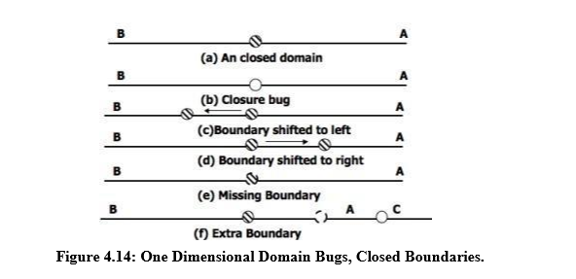

Slide 30
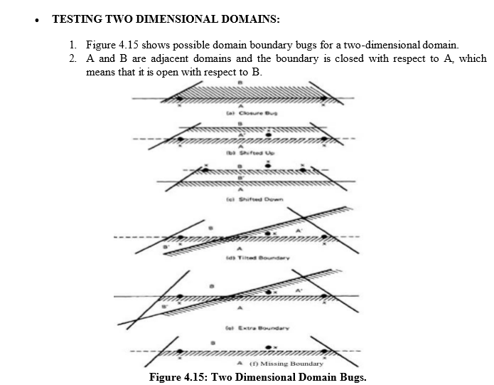

Slide 31
Shifted Boundary:
In Figure 4.15b the bug is a shift up, which converts part of domain B into A processing, denoted by A'.
This result is caused by an incorrect constant in a predicate, such as x + y >= 17 when x + y >= 7 was intended. The off point (closed off outside) catches this bug. Figure 4.15c shows a shift down that is caught by the two on points.
2. Tilted Boundary: A tilted boundary occurs when coefficients in the boundary inequality are wrong. For example, 3x + 7y > 17 when 7x + 3y > 17 was intended.
Figure 4.15d has a tilted boundary, which creates erroneous domain segments A' and B'. In this example the bug is caught by the left on point.

Slide 32
3. Extra Boundary:
An extra boundary is created by an extra predicate. An extra boundary will slice through many different domains and will therefore cause many test failures for the same bug.
The extra boundary in Figure 4.15e is caught by two on points, and depending on which way the extra boundary goes, possibly by the off point also.
4. Missing Boundary:
A missing boundary is created by leaving a boundary predicate out. A missing boundary will merge different domains and will cause many test failures although there is only one bug.
A missing boundary, shown in Figure 4.15f, is caught by the two on points because the processing for A and B is the same - either A or B processing.

Slide 33
PROCEDURE FOR TESTING:
The procedure is conceptually is straight forward. It can be done by hand for two dimensions and for a few domains and practically impossible for more than two variables.
Identify input variables.
Identify variable which appear in domain defining predicates, such as control flow predicates.
Interpret all domain predicates in terms of input variables.
For p binary predicates, there are at most 2p combinations of TRUE-FALSE values and therefore, at most 2p domains. Find the set of all non null domains. The result is a boolean expression in the predicates consisting a set of AND terms joined by OR's.
Solve these inequalities to find all the extreme points of each domain using any of the linear programming methods.

Slide 34
DOMAIN AND INTERFACE TESTING :
INTRODUCTION:
Recall that we defined integration testing as testing the correctness of the interface between two otherwise correct components.
Components A and B have been demonstrated to satisfy their component tests, and as part of the act of integrating them we want to investigate possible inconsistencies across their interface.
Interface between any two components is considered as a subroutine call.
For a single variable, the domain span is the set of numbers between (and including) the smallest value and the largest value.

Slide 35
DOMAINS AND RANGE:
The set of output values produced by a function is called the range of the function, in contrast with the domain, which is the set of input values over which the function is defined.
Interface testing requires that we select the output values of the calling routine i.e. caller's range must be compatible with the called routine's domain.
An interface test consists of exploring the correctness of the following mappings: caller domain --> caller range (caller unit test) caller range --> called domain (integration test) called domain --> called range (called unit test)

Slide 36
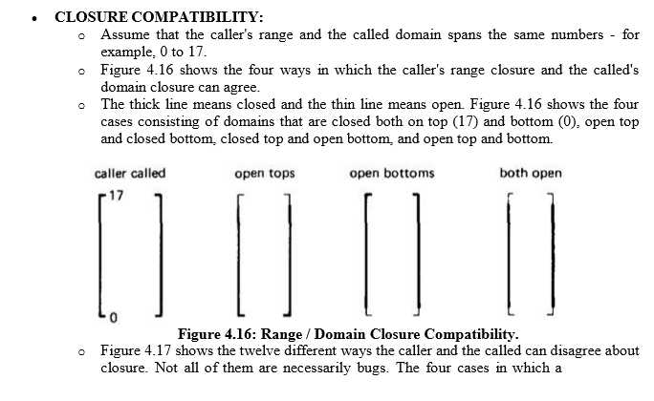

Slide 37
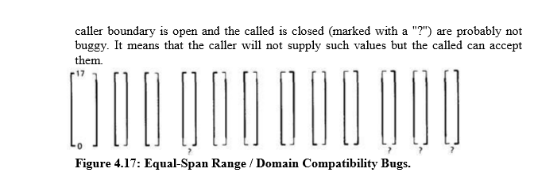

Slide 38
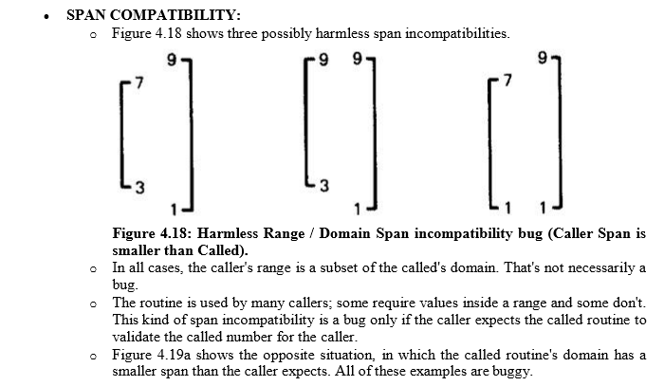

Slide 39
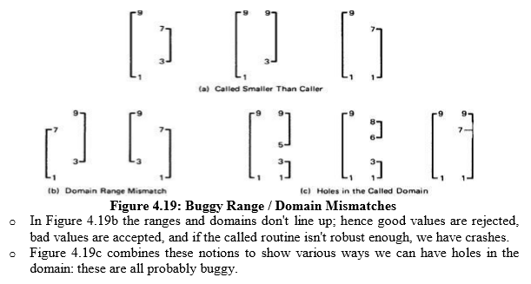

Slide 40
INTERFACE RANGE / DOMAIN COMPATIBILITY TESTING:
For interface testing, bugs are more likely to concern single variables rather than peculiar combinations of two or more variables.
Test every input variable independently of other input variables to confirm compatibility of the caller's range and the called routine's domain span and closure of every domain defined for that variable.
There are two boundaries to test and it's a one-dimensional domain; therefore, it requires one on and one off point per boundary or a total of two on points and two off points for the domain - pick the off points appropriate to the closure (COOOOI).

Slide 41
Start with the called routine's domains and generate test points in accordance to the domain-testing strategy used for that routine in component testing.
Unless you're a mathematical whiz you won't be able to do this without tools for more than one variable at a time.

Slide 43
Last page:DATA FLOW MACHINES:
Dataflow machines are programmable computers. von Neumann machine Any computer characterized by the following concepts: (a) the main units are a control unit, ALU, memory, and input and output facilities; (b) programs and data share the same memory, thus the concept of a stored program is fundamental; (c) the control unit and ALU, usually combined into a central processor (which may contain internal storage – accumulators and other registers), determine the actions to be carried out by reading instructions from the memory.

Slide 44
MIMD (multiple instruction, multiple data) is a technique employed to achieve parallelism. Machines using MIMD have a number of processors that function asynchronously and independently. At any time, different processors may be executing different instructions on different pieces of data.
MIMD architectures may be used in a number of application areas such as computer-aided design/computer-aided manufacturing, simulation, modeling, and as communication switches.

