Slide 1
Netflix Dataset Case Study and Visualization
POWERBI Project Presentation

Slide 2
Overview:
● Analyse and visualise a real-life dataset and generate insights out of it.
● Get answers to questions around a dataset through Power BI visualisations.

Slide 3
Dataset Details
The dataset needs to be understood and explored first. This step can be done in either Excel or Power BI. We will scrutinise the useful fields to understand the meaning and data distribution of each.
● id: A unique count of this ID would be useful while calculating and understanding trends. Example: The number of movies released in 2020 would simply be a unique count of the ID field.
● release_year: At the outset, it seems that it includes movies from 1953 to 2022, i.e. 70 years of data. But on closer inspection, we notice that some years are missing e.g. 1955, 1957.
● title: The dataset becomes very interesting as many of the titles can be recognised.
● type: If we use the FILTER option in Excel to see the different TYPE values that are there, we will see two: MOVIE and SHOW.

Slide 4
● description: Although for our analysis, description may not be very important but we can extract keywords out of it and use machine learning to extract information like the genre of the movie/show.
● age_certification: Something to note here is that in many cases age certification is missing. We may want to handle missing values separately in some cases, but here since there is no effective way to substitute this missing information, we will leave it as is for our analysis.
● runtime: Although it is not mentioned, it is clear that runtime is in minutes. One should see the range of values, visualise the distribution and if required, handle outliers in this field.
● imdb_score: This is the IMDb rating of the movie/show. This tells us how well the movie was rated by the voters.
● imdb_votes: This is the number of people who voted on IMDb for a movie or show. It is important to recognise that this leads to a lot of subjectivity because if very few people have voted for a movie/show its imdb_score will not be very reliable. The dataset has 5283 records and this data includes both movies and shows.

Slide 5
Data Cleaning and Manipulation in Power Query Editor
To make more sense out of our Netflix Dataset, one manipulation we did is to create a custom column that is a combination of both IMDb score (imdb_score) and number of votes (imdb_votes). Score alone may not be sufficient to conclude anything about a movie/show.
Example: What if only one person voted for the movie and the rating given by that person is a 9.5. Does this mean that the movie is better than most of the movies? Maybe not. We would want to prefer watching a movie that is rated highly by many people. We will hence definitely prefer one that has a 9 rating but has been voted by 50000 people. Hence, we should not see either IMDb score or IMDb votes in isolation. It may be more useful for us to combine both columns and one meaningful way to do that is to multiply scores and votes. This is where a custom column becomes useful.

Slide 6
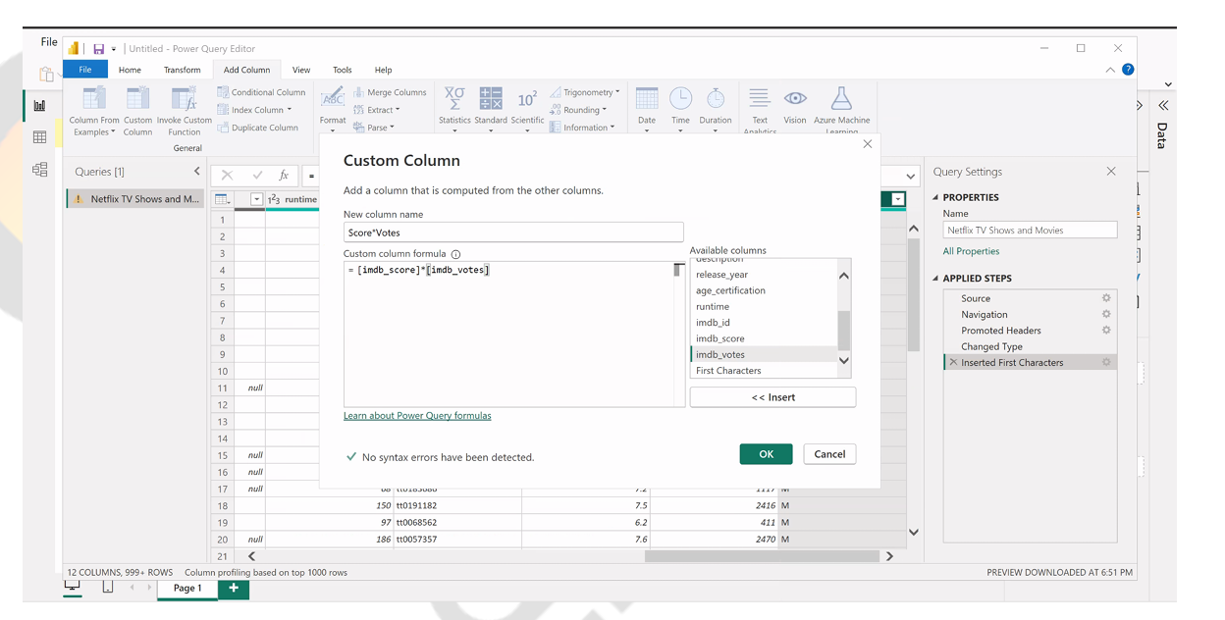
Custom Column

Slide 7
Observations:
Further, we have dropped the index and imdb_id columns as they may not be useful for our analysis and will not be required.
A closer look at imdb_votes reveals that there are movies/shows where IMDb votes are absent. While we cannot remove these rows since they have other valuable data, we have ignore these rows when analysing votes.
Loading Data and Creating a Model:
After cleaning and manipulation is done, we can move to creating a model in Power BI. Since we are using only one dataset, it is not required to create a model.

Slide 8
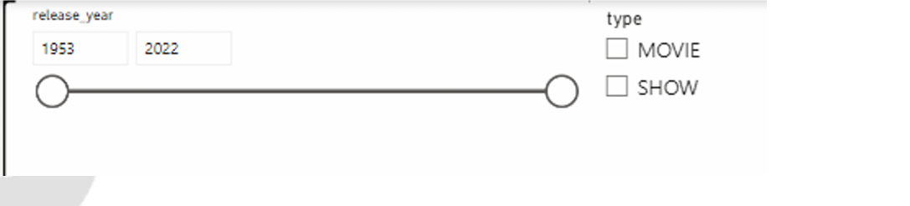
Visualisations
It is a good practice to start with selecting a theme. Next, we can have created slicers. In this case we have created two slicers: one for type and the other for release year.

Slide 9
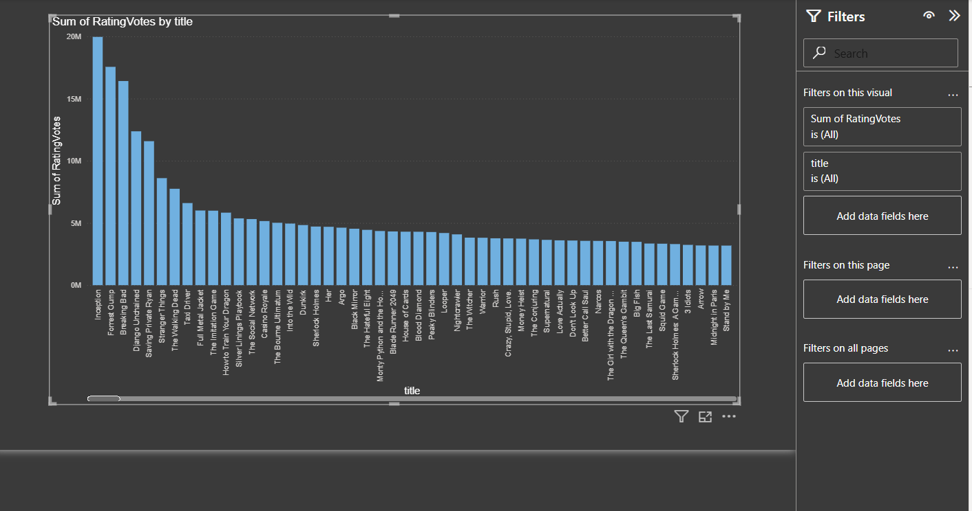
Problem Statement 1 :
Which was the best movie and TV show overall in the last 50 years?
Analysis:
From the visualization, Inception has received the highest number of rating votes, indicating that it is the among the most popular and well-received titles over the last 50 years

Slide 10
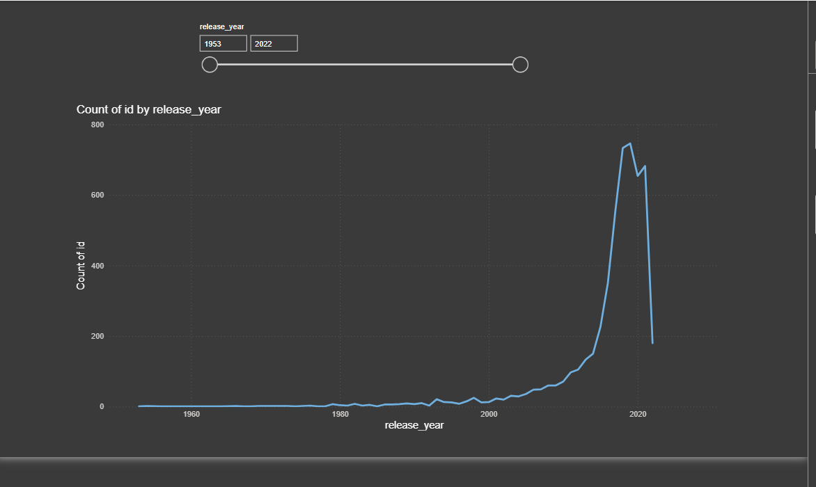
Problem Statement 2 :
How many movies do we have in our dataset across the last few years?
Analysis:
The dataset shows a significant increase in the number of movies produced after the 2000s, peaking around 2018–2020. This indicates rapid growth in global film production driven by digital platforms and easier content creation. A slight dip after 2020 may reflect disruptions caused by the COVID-19 pandemic.

Slide 11
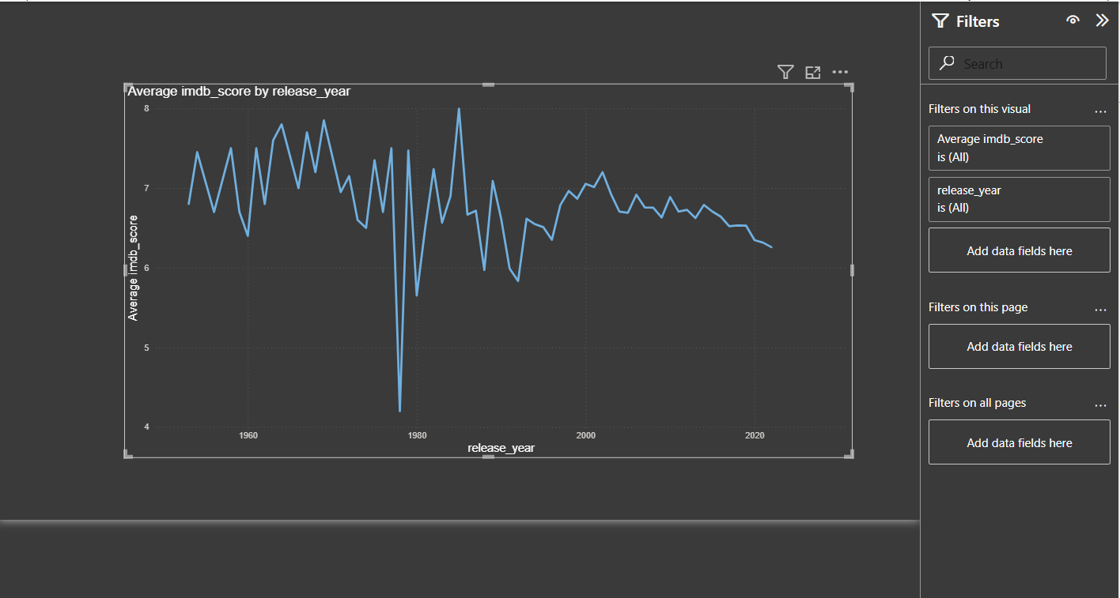
Problem Statement 3 :
Across the last 50 years, how has the average IMDb score varied?
Analysis:
The average IMDb score has fluctuated over the last 50 years, showing high variability during earlier decades and stabilizing around a range of 6.5–7.0 in recent years. This suggests that while movie quality has become more consistent, fewer exceptionally high-rated films are being produced compared to earlier periods.

Slide 12
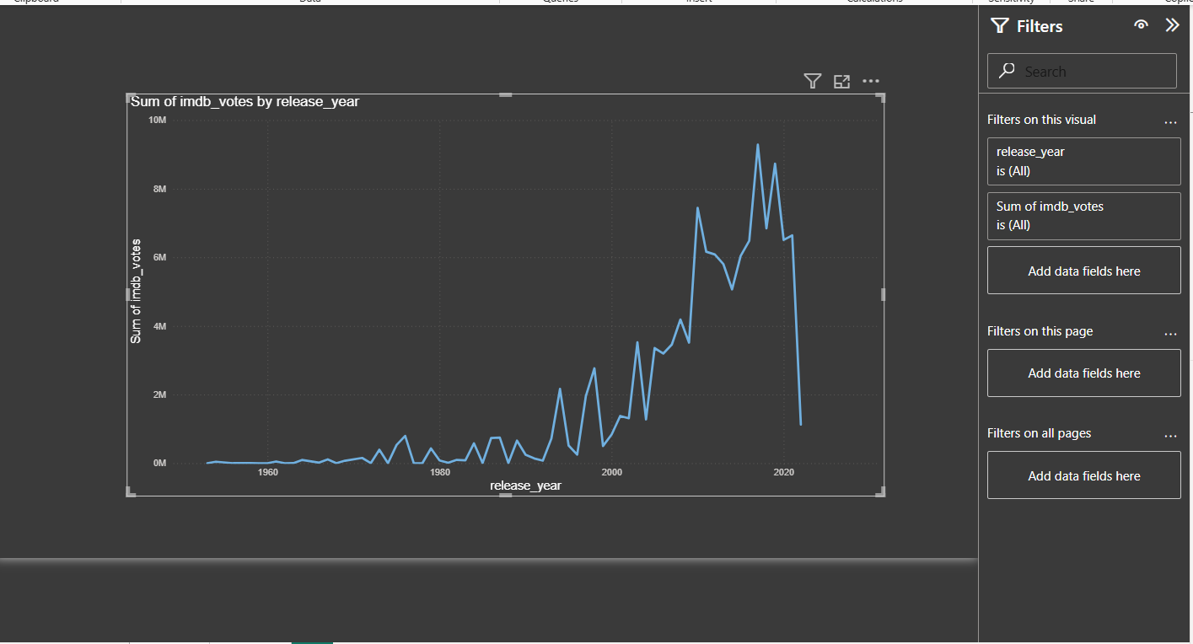
Problem Statement 4 :
Have more people started voting for movies/shows on IMDb over the last 50 years?
Analysis:
The number of IMDb votes has increased dramatically over the last 50 years, especially after 2000. This shows a surge in audience engagement due to wider internet access, growing popularity of online ratings, and increased use of digital streaming platforms.

Slide 13
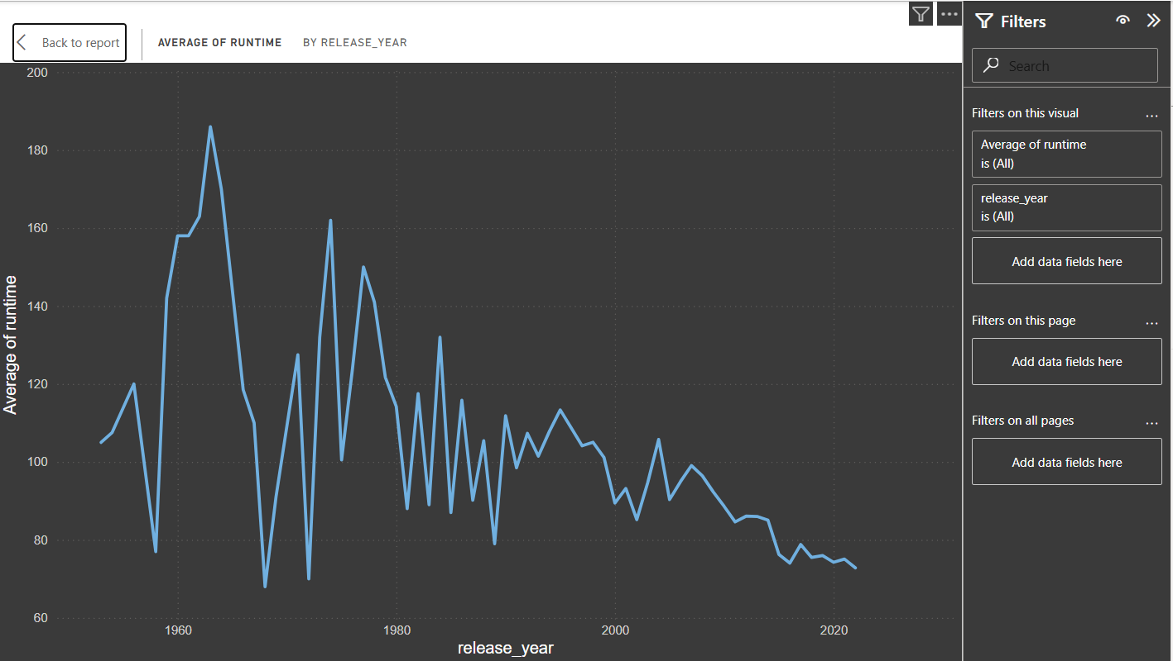
Problem Statement 5 :
On average, how has the runtime changed over the last 50 years?
Analysis:
The average runtime of movies has gradually decreased over the last 50 years. Earlier films, especially during the mid-20th century, tended to have longer durations, while modern movies are generally shorter, likely due to changing audience preferences and the rise of digital streaming platforms favoring concise content.

Slide 14
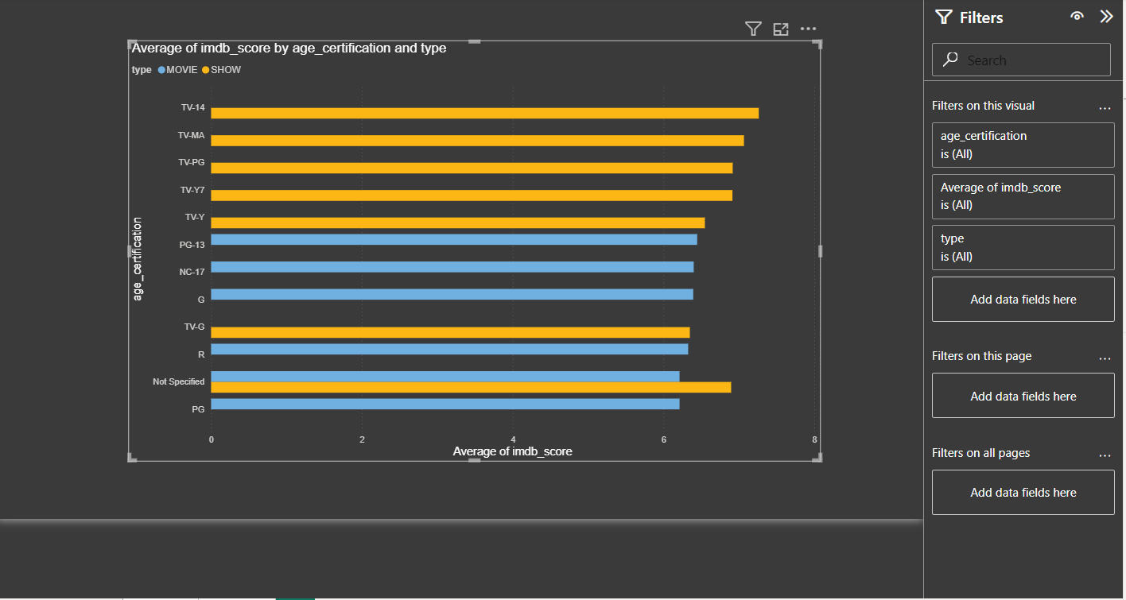
Problem Statement 6 :
How does age certification of a movie affect its rating?
Analysis:
We have three insights from this:
● On average, TV shows have higher ratings as compared to movies.
● On average, within TV shows, TV-14 gets the highest rating.
● On average, within Movies, PG-13 movies have the highest rating. This can also be seen from the image above.

Slide 15
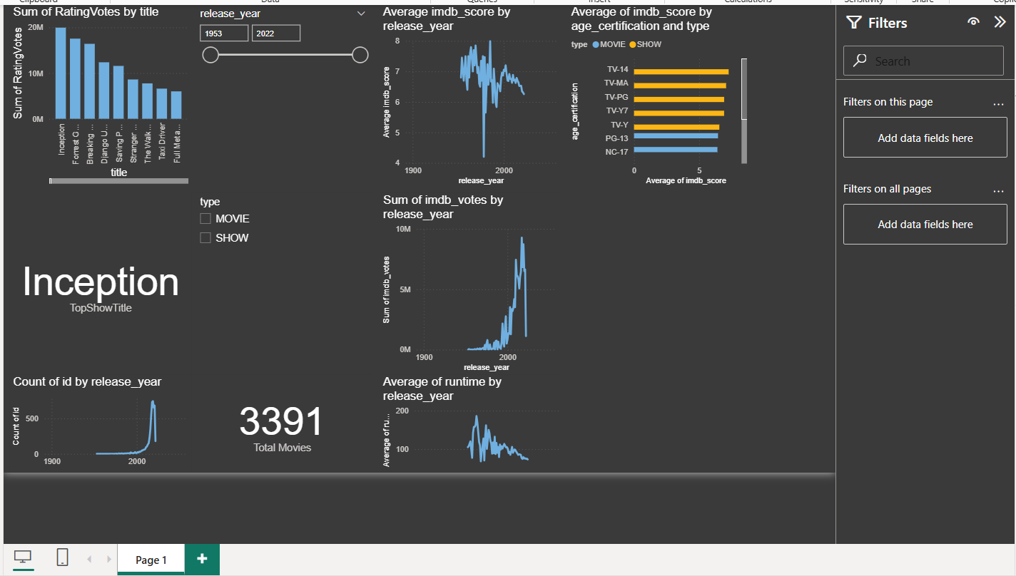
FINAL DASHBOARD

