Slide 1
K-means clustering using spark in a Hadoop cluster
Varderes barsegyan

Slide 2

Hadoop in a nutshell
Developed by researchers at Google in 2003 to store and process large datasets in a cluster
“Open-source software library for reliable, scalable, distributed computing”
All modules are designed with fault tolerance in mind
Scalable to thousands of machines
Core modules
Hadoop Common: core libraries and utilities used by other modules
Hadoop Distributed File System (HDFS): data storage system
YARN: resource manager
MapReduce: MapReduce programming model implementation

Slide 3
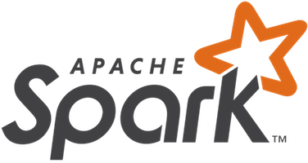
Spark in a nutshell
Designed at UC Berkeley for fast, distributed machine learning
Data is abstracted into resilient distributed datasets (RDDs) and distributed across nodes of a cluster; fault tolerance is a priority
Can use a cluster management (Hadoop YARN) and can interface with a file system (HDFS)
Data is processed/analyzed in-memory
Up to 100x faster than Hadoop MapReduce
Parallelizable
Java, Python, R, and Scala bindings
Ever-growing, highly supported, versatile, valuable and definitely worth looking into

Slide 4
Building my own Hadoop cluster

Slide 5
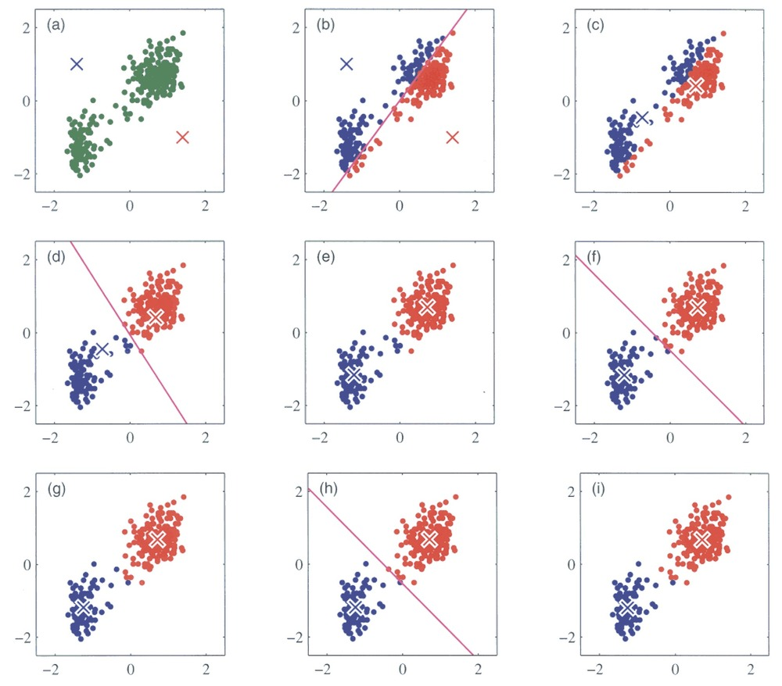
K-means clustering
Unsupervised learning algorithm based on the Expectation Maximization algorithm
Popular and widely-used in many industries
Parallelizable and fast
Perfect for a distributed environment

Slide 6
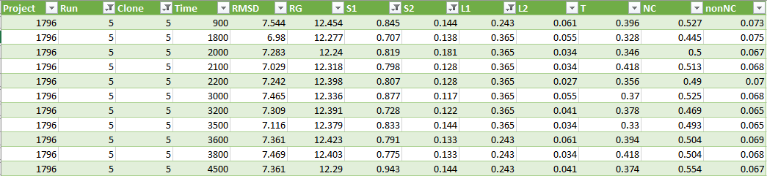
Luteo protein dataset
1.1 million rows
9 dimensions (8 are used for clustering)
Hidden structures: stable energy states

Slide 7
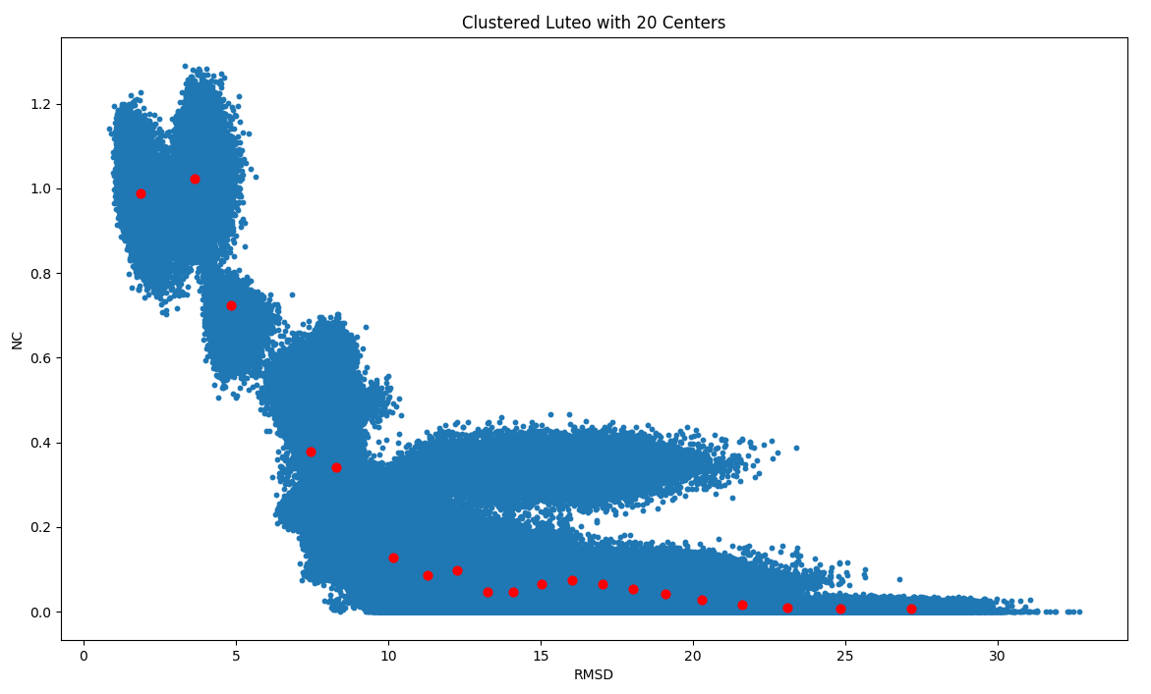
Clustering the luteo dataset

Slide 8
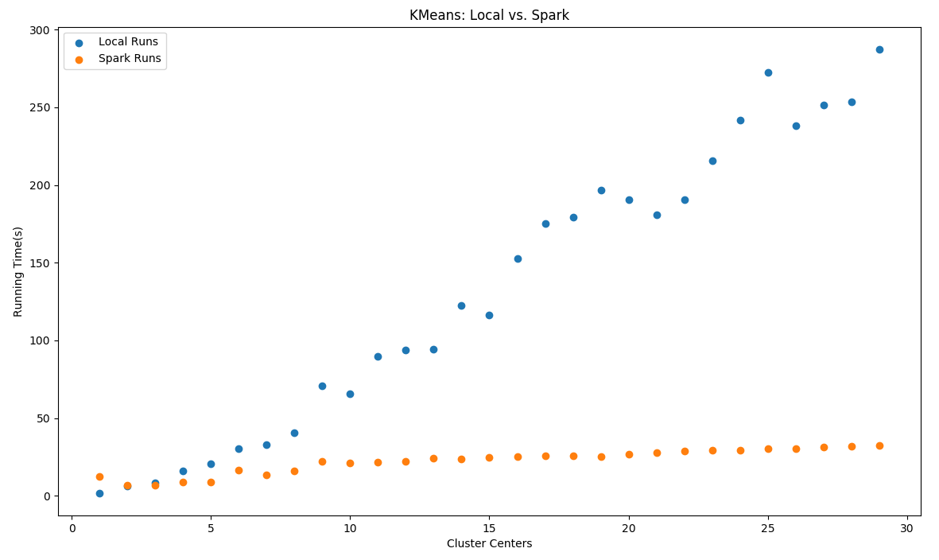
K-means: spark vs local

