Slide 1
Density-based clustering
Varderes Barsegyan
DBSCAN
HDBSCAN
SUBCLU

Slide 2
Fundamental challenges (Jain 2010)
What is a cluster?
What features should used?
Should the data be normalized?
How do we define similarity?
How can clusters are there?
How should we perform clustering?
Are the results valid?
Does the data contain any outliers?
Me must consider all of these for our huge and complex datasets

Slide 3
Clustering in a nutshell
Given representation of n objects, find k groups based on a measure of similarity s.t. the similarities between objects in the same group are high while the similarities between the objects in different groups are low
Clusters can be defined by shape, size, and density
Presence of noise (outliers) makes clustering much more difficult
Although clusters can be defined (compact or isolated), it is a subjective entity that is in the eye of the beholder
Although humans can visually cluster 1-3 dimensions, algorithms are needed for higher dimensional data (luteo)

Slide 4
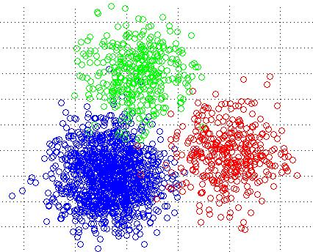
K-means no more
Requires 3 parameters; no way of figuring out exactly which values to choose
# of clusters, cluster initialization, and distance metric
Relies strongly on heuristics
Diminished repeatability
Euclidean metric is used
Only spherical cluster regions
Different distance metrics have succeeded but only in specific domains

Slide 5
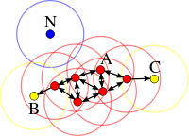
DBSCAN Density-based sPatial Clustering of applications with noise (kriegel et al. 1996)
Clusters can be defined as high-density regions in feature space
Searches for connected dense regions in the space by estimating density
Two input parameters
Neighborhood(ε) size
Minimum number of points(m) in a neighborhood
Classifies data points in three ways
Core point: at least an m number of points are within ε of the point
Boundary point: reachable by a core point but does not satisfy the above condition
Outlier: neither a core point nor reachable by one
Most attractive feature: can find arbitrarily-shaped clusters
Limitations
Performs poorly with high-dimensional data: high-density regions become difficult to detect due to sparsity of points in higher dimensions (addressed by SUBCLU algorithm)
Cannot distinguish clusters of varying densities (addressed by HDBSCAN algorithm)

Slide 6
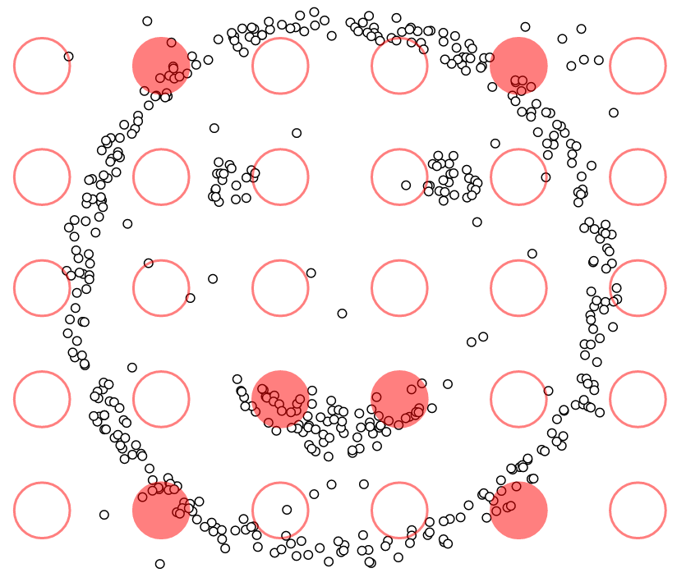
DBSCAN DEMO

