Slide 1
Uncovering Large-Scale Conformational Change in MD w/o Prior Knowledge
Melvin et al.
Wake Forest University

Slide 2
ABSTRACT
Clustering is important for partitioning trajectories into conformational bins
Presents non-parametric use of two modern clustering algorithms
No prior knowledge required
No parameter tuning required
Algorithm #1: HDBSCAN (2013)
Fast
Performs well with unstructured/disordered systems
Algorithm #2: Amorim-Hennig (2015)
Relatively slower
Performs well with stable, structured systems
Using both algorithms, one can discern quickly w/o prior knowledge the stability of a system and identify local/global conformational changes

Slide 3
INTRODUCTION & METHODS
Desire a first-pass, exploratory clustering alg for MD sim data
HDBSCAN
High density points separated by low density points
Finds clusters of varying densities and arbitrary shapes
Amorim-Hennig (explicit rescaling followed by K-Means)
Estimate a max # of clusters using Intelligent K-means (“i”)
Perform round of k-means:
Rescale points based on distance to their respective centroids (“explicit rescaling”); silhouette score used
Rescale features based on the dispersion of a feature in a given cluster (“MW”); feature weighted Minkowski distance used
Because of the rescaling, the cluster centers for outlier points can change
Repeated until no points change preferred cluster center
Last round of standard k-means performed with final weighted data

Slide 4
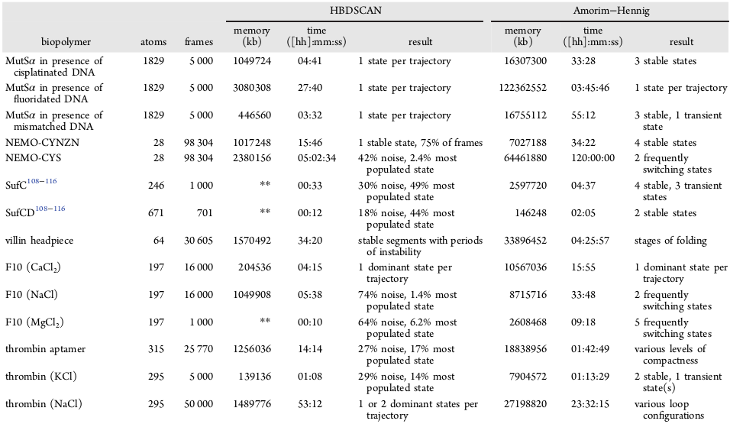
Summary

Slide 5


Slide 6
IMPLEMENTATION
HDBSCAN
Python implementation by Leland McInnes (I use this too!)
Determining min samples parameter of HBSCAN
Min sample size is 2 in all MD data since singleton states are considered noise
If no prior knowledge exists, setting min sample size to 1 makes the clustering method non-parametric
Amorim-Hennig
Algorithm author’s implementation in Matlab
Python Scikit-Learn’s K-means and silhouette index methods (I use this too!)
Other libraries
MDtraj and Numpy
Computational resources
Eight 2.4 GHz cores
120GB of RAM

Slide 7
CONCLUSION
Automated methods for clustering MD trajectories become increasingly desirable as computational power grows
Amorim-Hennig and HDBSCAN are great for first-pass non-parametric analysis
HDBSCAN is fast and good at discarding noise
Ideal of initial investigation
Detects large-scale, global conformations
For stable and small systems, Amorim-Hennig wins
Good at finding distinct and stable conformations due to feature rescaling
Future work: replace final K-Means step in Amorim-Hennig with HDBSCAN

