Slide 1
Density-based clustering
Varderes Barsegyan
DBSCAN
HDBSCAN
SUBCLU

Slide 2
Fundamental challenges (Jain 2010)
What is a cluster?
Which features should be used?
Should the data be normalized?
How do we define similarity?
How many clusters are there?
How should we perform clustering?
Are the results valid?
Does the data contain any outliers?
We must consider all of these for our huge and complex datasets

Slide 3
Clustering in a nutshell
Given representation of n objects, find k groups based on a measure of similarity s.t. the similarities between objects in the same group are high while the similarities between the objects in different groups are low
Clusters can be defined by shape, size, and density
Presence of noise (outliers) makes clustering much more difficult
Although clusters can be defined (compact or isolated), it is a subjective entity that is in the eye of the beholder
Although humans can visually cluster 1-3 dimensions, algorithms are needed for higher dimensional data (luteo)

Slide 4
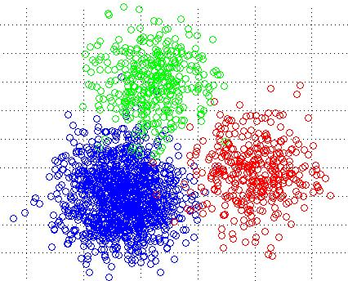
K-means no more
Requires 3 parameters; no way of figuring out exactly which values to choose for them
# of clusters, cluster initialization, and distance metric
Relies strongly on heuristics
Diminished repeatability
Euclidean metric is used
Only spherical cluster regions are found
Different distance metrics have succeeded but only in specific domains

Slide 5
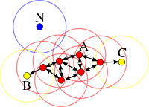
DBSCAN Density-based spatial Clustering of applications with noise (kriegel et al. 1996)
Clusters can be defined as high-density regions in feature space
Searches for connected dense regions in the space by estimating density
Two input parameters
Neighborhood(ε) size
Minimum number of points(m) in a neighborhood
Core point: at least an m number of points are within ε of the point
Boundary point: reachable by a core point but does not satisfy the above condition
Outlier: neither a core point nor reachable by one
Most attractive feature: can find arbitrarily-shaped clusters
Performs poorly with high-dimensional data: high-density regions become difficult to detect due to sparsity of points in higher dimensions (addressed by SUBCLU algorithm)
Cannot distinguish clusters of varying densities (addressed by HDBSCAN algorithm)

Slide 6
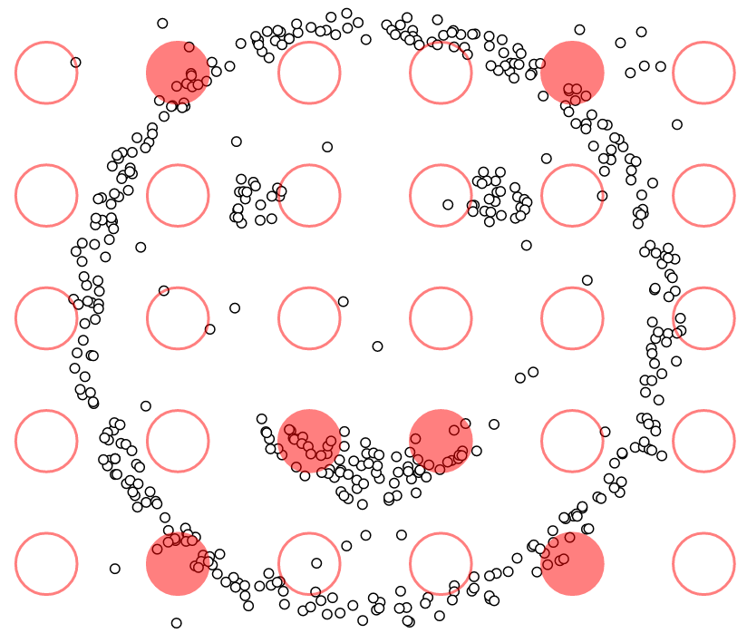
DBSCAN DEMO

Slide 7
HDBSCAN hierarchical density-based spatial Clustering of applications with noise (Campello et al. 2015)
Extends DBSCAN by converting it into a hierarchical clustering algorithm
Only 1 input parameter: minimum number of points in a cluster
Steps
Transform space according to the density/sparsity
Build the minimum spanning tree of the distance weighted graph
Construct a cluster hierarchy of connected components
Condense the cluster hierarchy based on minimum cluster size
Extract the stable clusters from the condensed tree

Slide 8
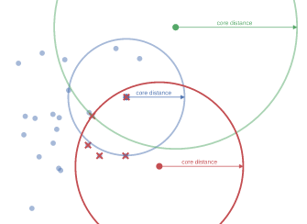
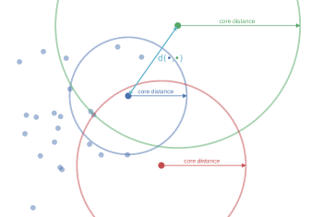
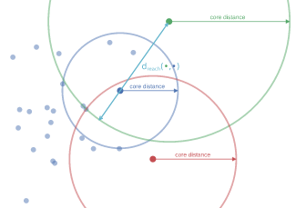
Step 1: transom the space
Identify low density (sea) and high density (land) points
Lower the sea level by making sea points more distant from each other and land points
Estimate density by calculating core distance of points and mutual reachability distance (MRD) between points
Core distance: distance to the kth nearest neighbor
MRD:
Thus dense points (low core distance) remain the same distance from each other; sparser points are pushed away to at least their core distance away from any other point (lowers sea level)

Slide 9
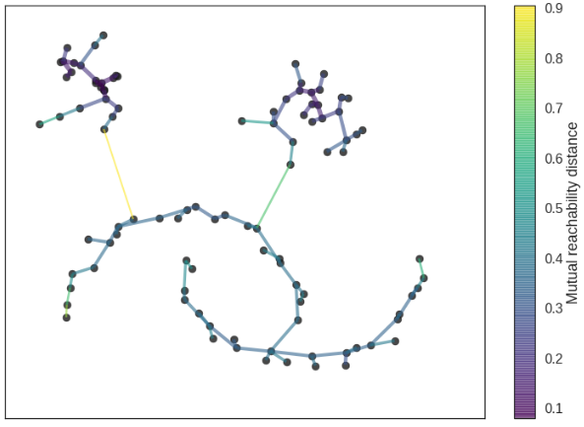
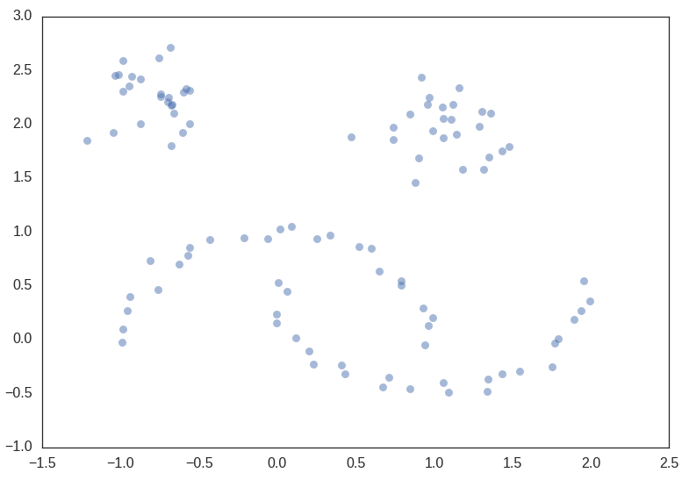
Step 2: Build minimum spanning tree
Consider data as a weighted graph with the data points as vertices and MRD as edge weights
Find the minimum spanning tree of this graph
Single-linkage clustering

Slide 10
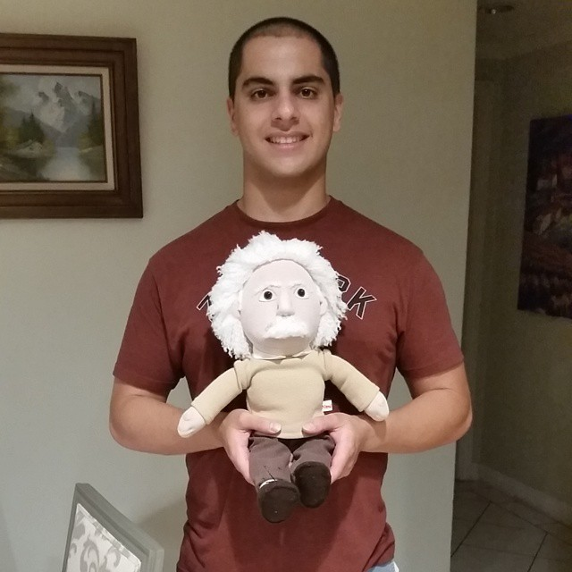

Slide 11
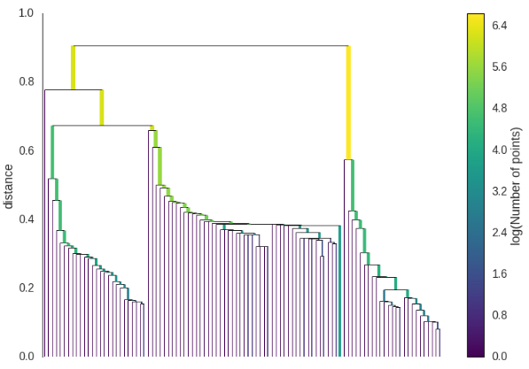
Step 3: Build cluster hierarchy
Given minimum spanning tree, convert tree into hierarchy of connected components
Sort edges of tree by distance
Iterate through the edges and create a new merged cluster for each edge
Identify merging clusters using a disjoint set data structure

Slide 12
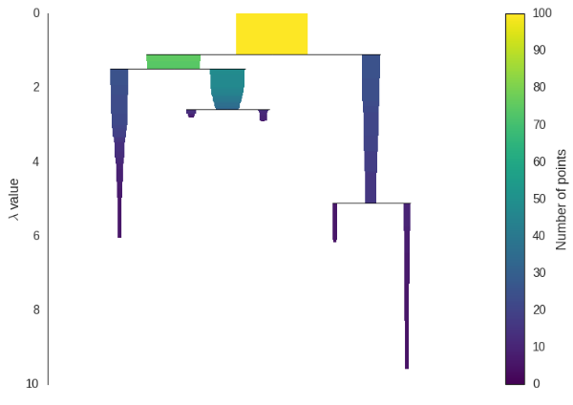
Step 4: Condense cluster tree
Condense cluster hierarchy into smaller tree
Since we have a minimum cluster size input, we walk through the hierarchy and at each split check if one of the new clusters created has fewer points than the minimum cluster size
If after splitting we have at least the required number of points for each cluster, then we consider this a “true” split and let that persist in the tree
Otherwise remove the points from the subtree, and store the distance from the parent to the removed subtree

Slide 13
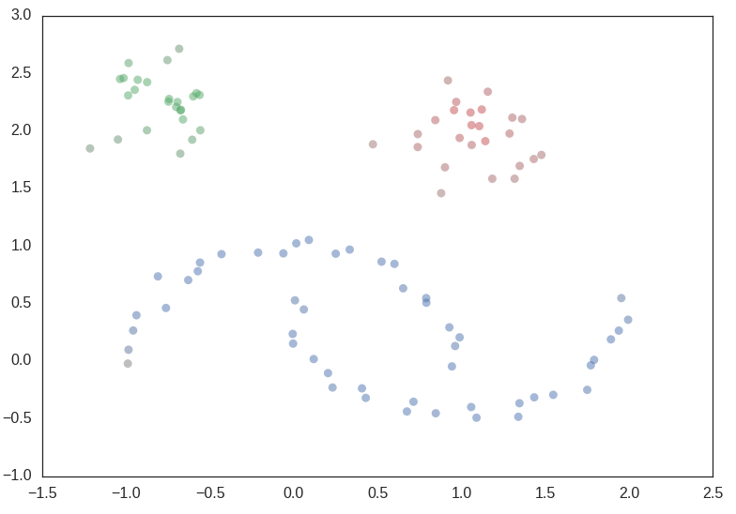
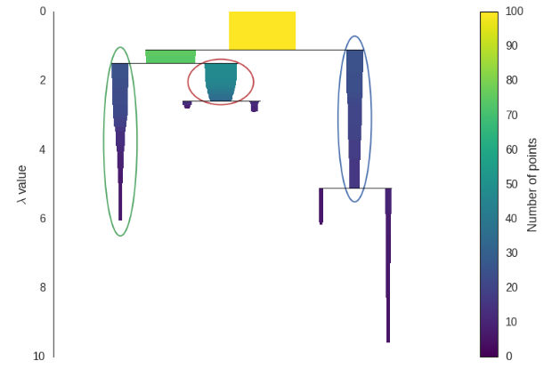

Step 5: Extract the clusters
Choose clusters that have the greatest area in the condensed tree
Constraint: if you select a cluster then you cannot select any descendent cluster
For each cluster compute the stability:
Inverse of the distance at which the points break away from their parent clusters and form their own cluster, and so on…
Start from leaf nodes and work up the tree
If the sum of the stabilities of the child clusters is greater than their parent, then the parent cluster stability is the sum of its children’s
If the sum of the stabilities of the parent is greater than its children’s, then we declare the parent as a final cluster and disregard its children
This results in selecting clusters with the “largest area”

Slide 14
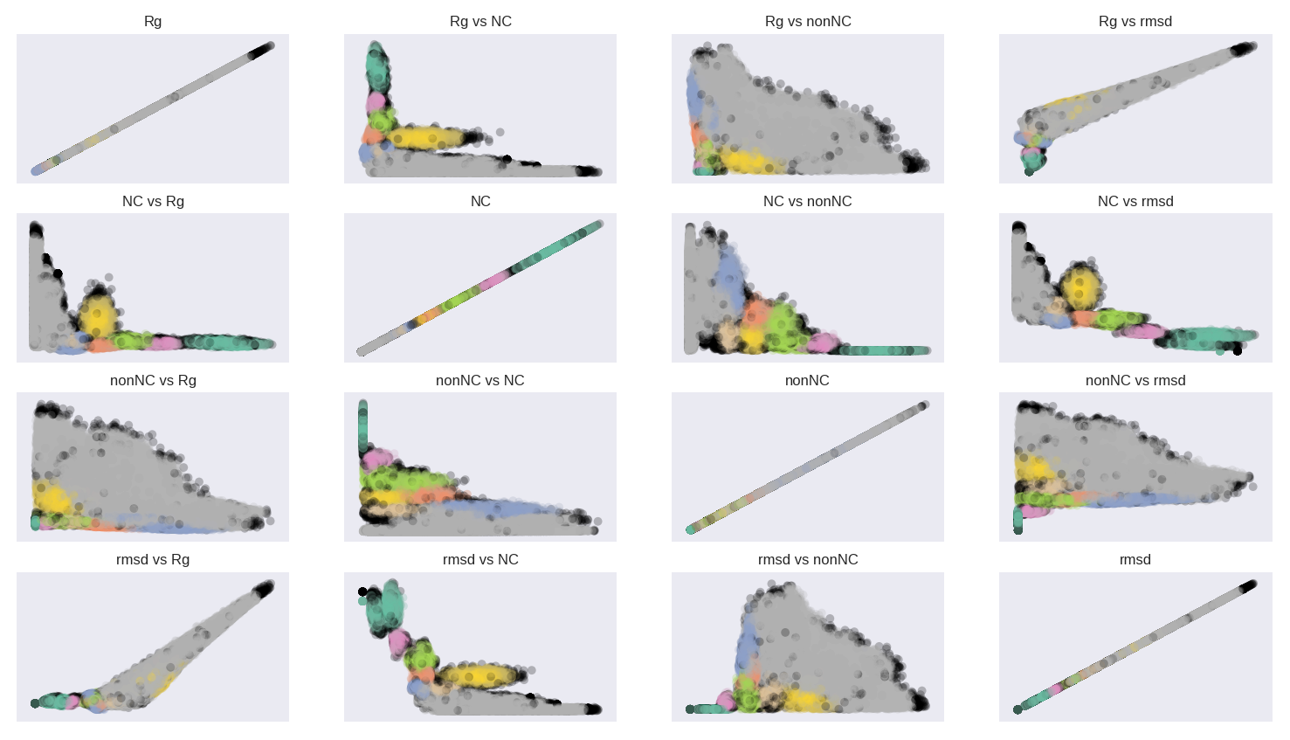

Slide 15
