Slide 1
✚
HealthEase
AI-Powered Healthcare Management Platform
Final Year B.Tech Project
Presented by
2022BITE018 — Vardan Pal
2022BITE037 — U Rajeshwar
2022BITE007 — Karan Kharadi

Slide 2
OUTLINE
Agenda
1
Introduction
4
Implementation
2
Background & Literature
5
Results & Testing
3
System Design
6
Conclusion
HealthEase — AI Healthcare Platform
2

Slide 3
OVERVIEW
Abstract
HealthEase is a full-stack MERN platform that digitises paper and handwritten prescriptions using an AI vision-language OCR engine, then applies a custom-trained machine-learning classifier to map each prescribed medicine to the disease it treats.
It tracks patient vitals and medication compliance, computes a Smart Health Score (0–100), checks drug interactions, and connects patients to doctors through telemedicine — unifying fragmented healthcare workflows into one secure system.
HealthEase — AI Healthcare Platform
3

Slide 4
WHY HEALTHEASE
Problem Statement
📄
Hard-to-read prescriptions
Paper and handwritten prescriptions are difficult to digitise.
❓
Unclear medicines
Patients don't understand what each medicine is for.
💊
Poor compliance
Missed doses and refills lead to worse outcomes.
🧩
Fragmented data
Vitals, prescriptions and consultations live in silos.
HealthEase — AI Healthcare Platform
4

Slide 5
BACKGROUND
Motivation
• Rising chronic-disease burden demands better tracking.
• Prescriptions must be made understandable to patients.
• Compliance monitoring should be active, not passive.
• Healthcare data needs a single, unified platform.
• Modern AI (vision models + ML) enables real clinical value.
🏥
Patient-centric, AI-driven care
HealthEase — AI Healthcare Platform
5

Slide 6
GOALS
Objectives
1
Automatically extract data from prescription images (OCR).
2
Map medicines to their indication using a trained ML model.
3
Track vitals and medication compliance with analytics.
4
Quantify patient health as a single Smart Health Score.
5
Enable secure multi-role telemedicine (Patient/Doctor/Admin).
6
Deliver everything in one responsive, secure web app.
HealthEase — AI Healthcare Platform
6

Slide 7
EXISTING SYSTEMS
Literature Survey
Feature | HealthEase | Practo | 1mg | EHR
OCR prescription reading | ✓ | ✗ | ✗ | ✗
AI medicine → disease mapping | ✓ | ✗ | ~ | ✗
Smart Health Score | ✓ | ✗ | ✗ | ✗
Compliance tracking | ✓ | ✗ | ✓ | ~
Vitals analytics | ✓ | ~ | ✗ | ✓
Drug-interaction check | ✓ | ✗ | ✓ | ~
Real-time notifications | ✓ | ✓ | ✓ | ✗
HealthEase — AI Healthcare Platform
7

Slide 8
SYSTEM DESIGN
Technology Stack
Frontend
React + Vite · Tailwind CSS · Context API
Backend
Node.js + Express · JWT · bcrypt
Database
MongoDB + Mongoose
Real-time
Socket.IO live notifications
OCR Microservice
Python + FastAPI
OCR Engine
Groq Llama-4 Vision (pre-trained)
Machine Learning
scikit-learn (custom-trained classifier)
PDF Export
jsPDF + html2canvas
HealthEase — AI Healthcare Platform
8

Slide 9
SYSTEM DESIGN
System Architecture
React + Vite Client
REST + WebSockets
Node.js + Express API Gateway
Mongoose ODM
HTTP REST
MongoDB Database
Python FastAPI Service
Groq Vision OCR
ML Classifier
HealthEase — AI Healthcare Platform
9

Slide 10
SYSTEM DESIGN
Data Flow Diagram (Level 1)
1.0 Upload Prescription
2.0 OCR Extraction
3.0 Medicine Classification
Patient
Prescriptions
Medicines
4.0 Vitals Logging
5.0 Health Score
6.0 Tele- medicine
Vitals
Doctor
HealthEase — AI Healthcare Platform
10

Slide 11
SYSTEM DESIGN
Use-Case Diagram
HealthEase System
Upload Prescription
View Records
Log Vitals
Add Diagnosis
🧍 Patient
🧍 Doctor
View Health Score
Conduct Consult
Book Consultation
Set Reminders
Approve Doctors
Manage Users
🧍 Admin
HealthEase — AI Healthcare Platform
11

Slide 12
SYSTEM DESIGN
Database Design (ER Diagram)
User
email · role · passwordHash
1 : 1
Patient
Doctor
age · gender · contact
specialty · approved
1 : N
Prescription
Medicine
Consultation
doctorName · medications[]
dosage · frequency · stock
date · status · notes
HealthEase — AI Healthcare Platform
12

Slide 13
SYSTEM DESIGN
Sequence Diagram — Prescription Flow
Patient
Client
API
OCR Svc
ML Model
Database
upload image
POST /api/ocr
forward image
↻ vision request → Groq
extracted text
POST /classify-medicines
class + indication
save prescription
result
display
HealthEase — AI Healthcare Platform
13

Slide 14
IMPLEMENTATION
OCR Prescription Reader
• Type: AI Vision-Language OCR (not classic Tesseract).
• Engine: Groq Llama-4 Scout vision model (pre-trained).
• Handles printed AND handwritten prescriptions.
• Returns structured fields ready for the database.
Image Upload
Preprocess (resize + RGB)
Base64 Encode
Vision Model + Medical Prompt
Structured Output Doctor/Diagnosis/Meds
HealthEase — AI Healthcare Platform
14

Slide 15
IMPLEMENTATION · ML
Medicine-Indication Classifier
• Predicts therapeutic class + disease from the medicine NAME.
• Generalises to drug names never seen in training.
• Built on WHO INN naming stems (e.g. -pril, -statin).
• Custom-trained — fully reproducible from our dataset.
Stem | Class | Example
-pril | ACE Inhibitor | Lisinopril
-statin | Statin | Atorvastatin
-cillin | Penicillin | Amoxicillin
-floxacin | Fluoroquinolone | Ciprofloxacin
-prazole | PPI | Omeprazole
-dipine | Ca-Channel Blocker | Amlodipine
HealthEase — AI Healthcare Platform
15

Slide 16
IMPLEMENTATION · ML
ML Methodology
Curated Dataset — 321 medicines · 27 classes
Feature Extraction — Character n-gram TF-IDF (n = 2–4)
Train / Test Split — 75% / 25% stratified
Model Training — Logistic Regression
5-Fold Cross-Validation
Evaluation — Accuracy · F1 · Confusion Matrix
Deployed Model — medicine_classifier.joblib
HealthEase — AI Healthcare Platform
16

Slide 17
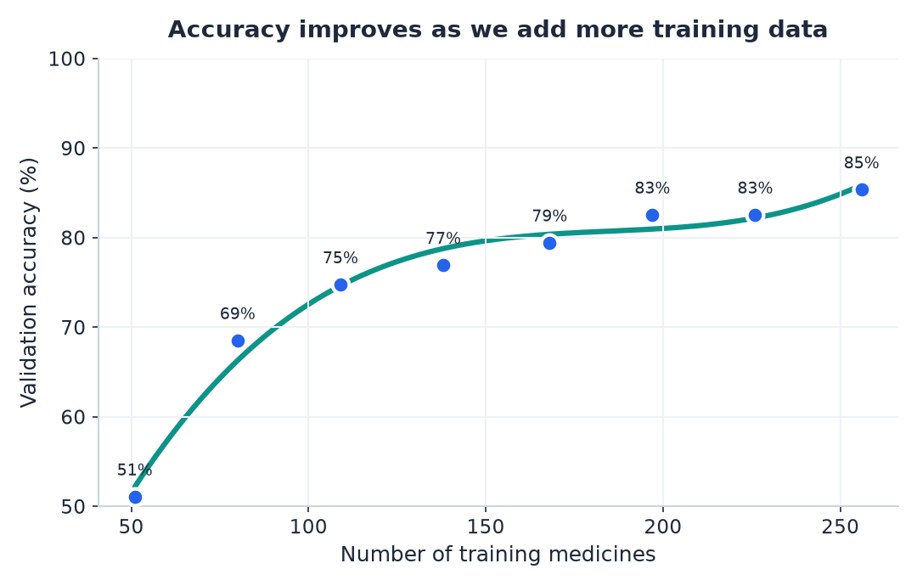
IMPLEMENTATION · ML
ML Results
85.4%
76.5%
0.78
Cross-Validated Accuracy
Test Accuracy
Macro F1-Score
Model comparison (5-fold CV):
Logistic Regression
82.9%
Linear SVM
81.7%
Naive Bayes
77.9%
The model independently rediscovered medical naming conventions from data.
HealthEase — AI Healthcare Platform
17

Slide 18
IMPLEMENTATION
Key Features
🔐
📄
🧠
⚠️
Multi-role Auth
AI OCR Digitiser
Medicine→Disease
Interaction Check
📈
💯
💊
🔔
Vitals Analytics
Health Score
Tracker+Reminders
Notifications
🏥
🛡️
📑
🌗
Telemedicine
Admin Dashboard
PDF Export
Dark Mode / UI
HealthEase — AI Healthcare Platform
18

Slide 19
IMPLEMENTATION
End-to-End Workflow
1
Upload Prescription
2
OCR Extraction
3
ML Classification
4
Interaction Check
5
Schedule Reminders
6
Log Vitals
7
Update Health Score
8
Doctor Review / PDF Export
HealthEase — AI Healthcare Platform
19

Slide 20
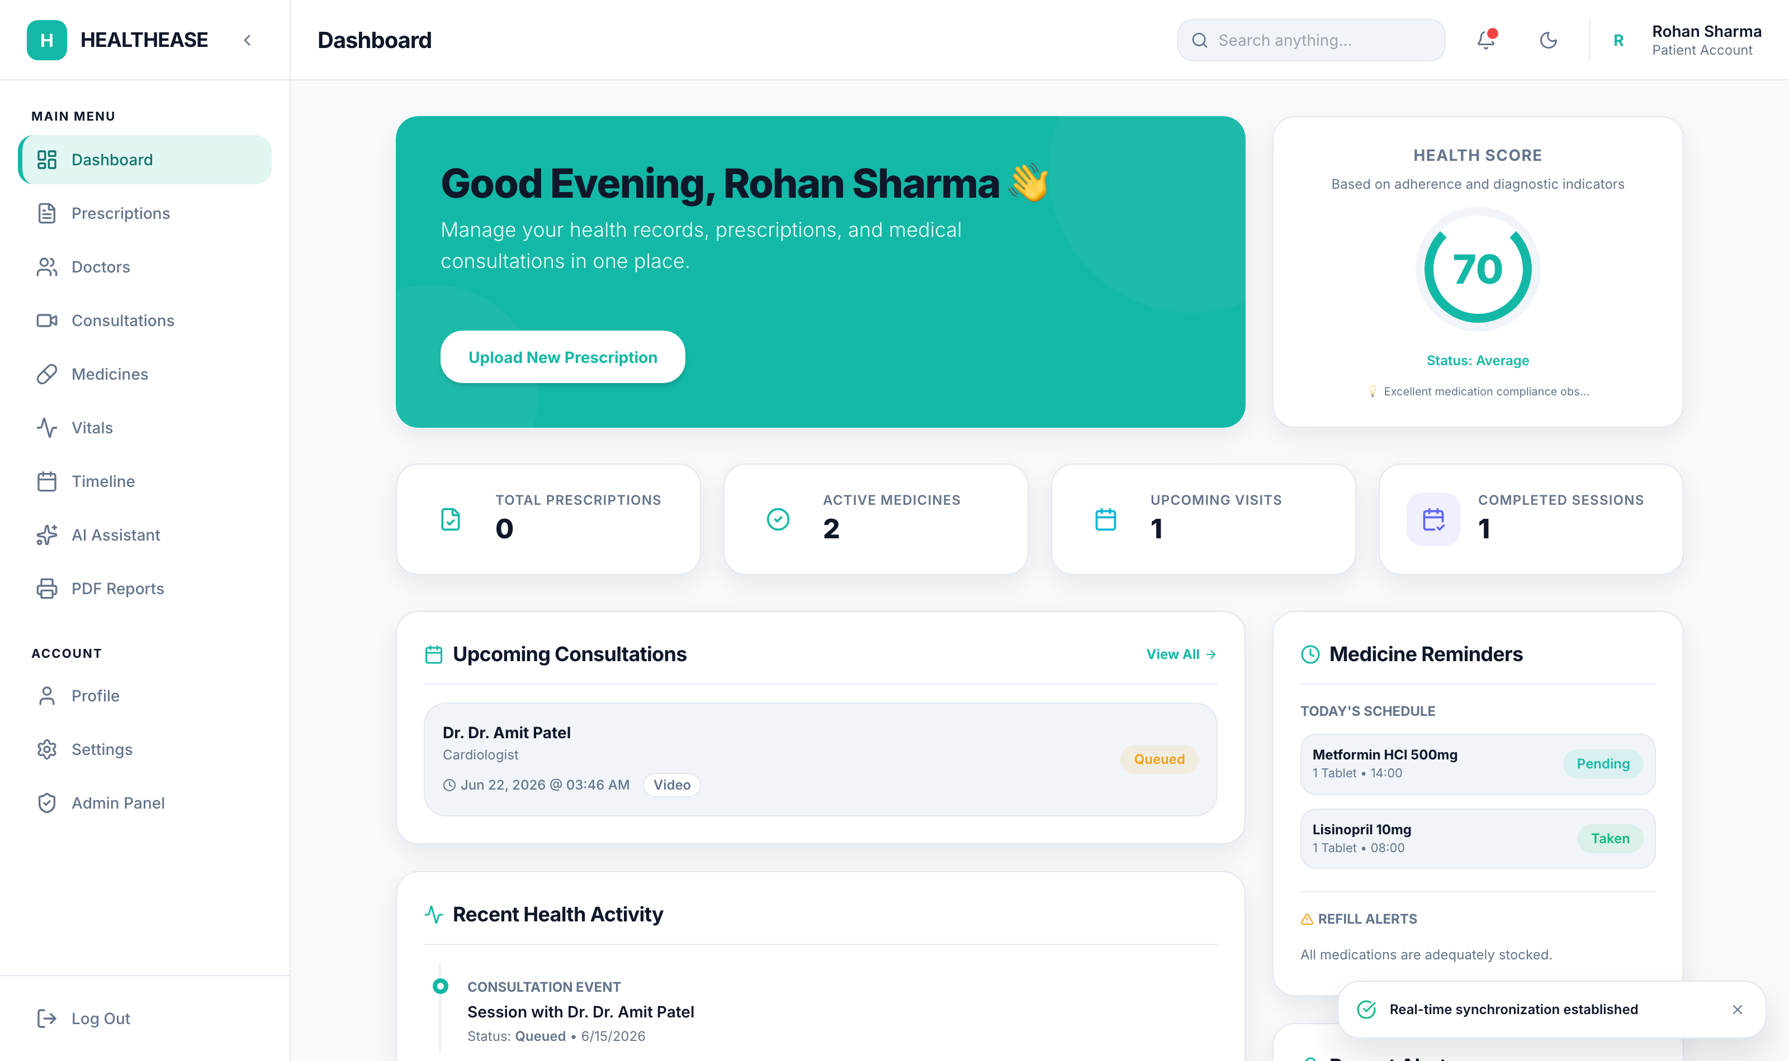
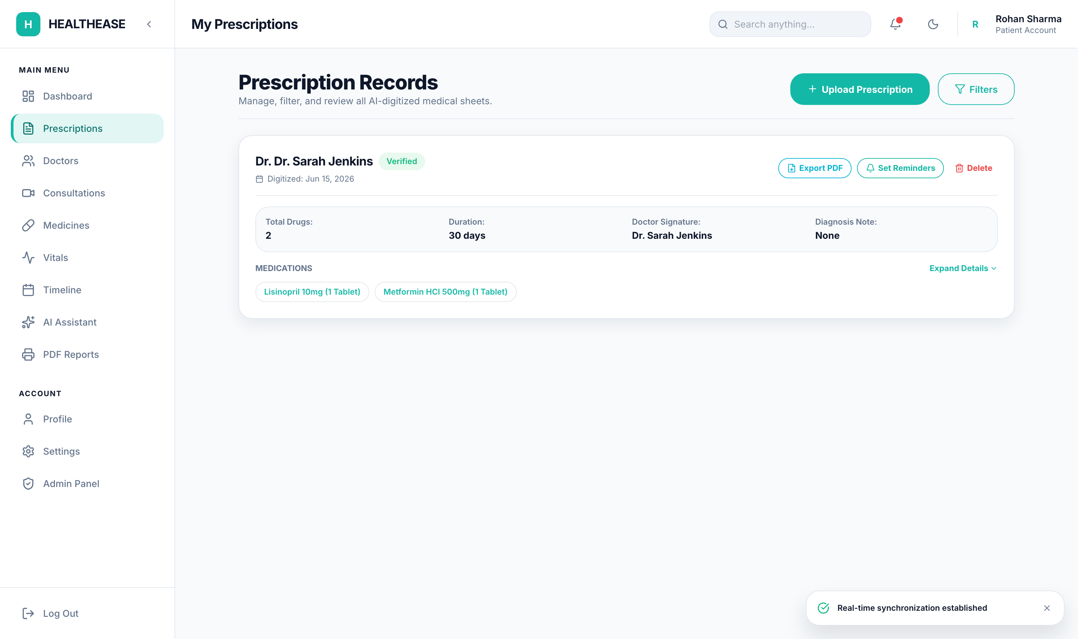
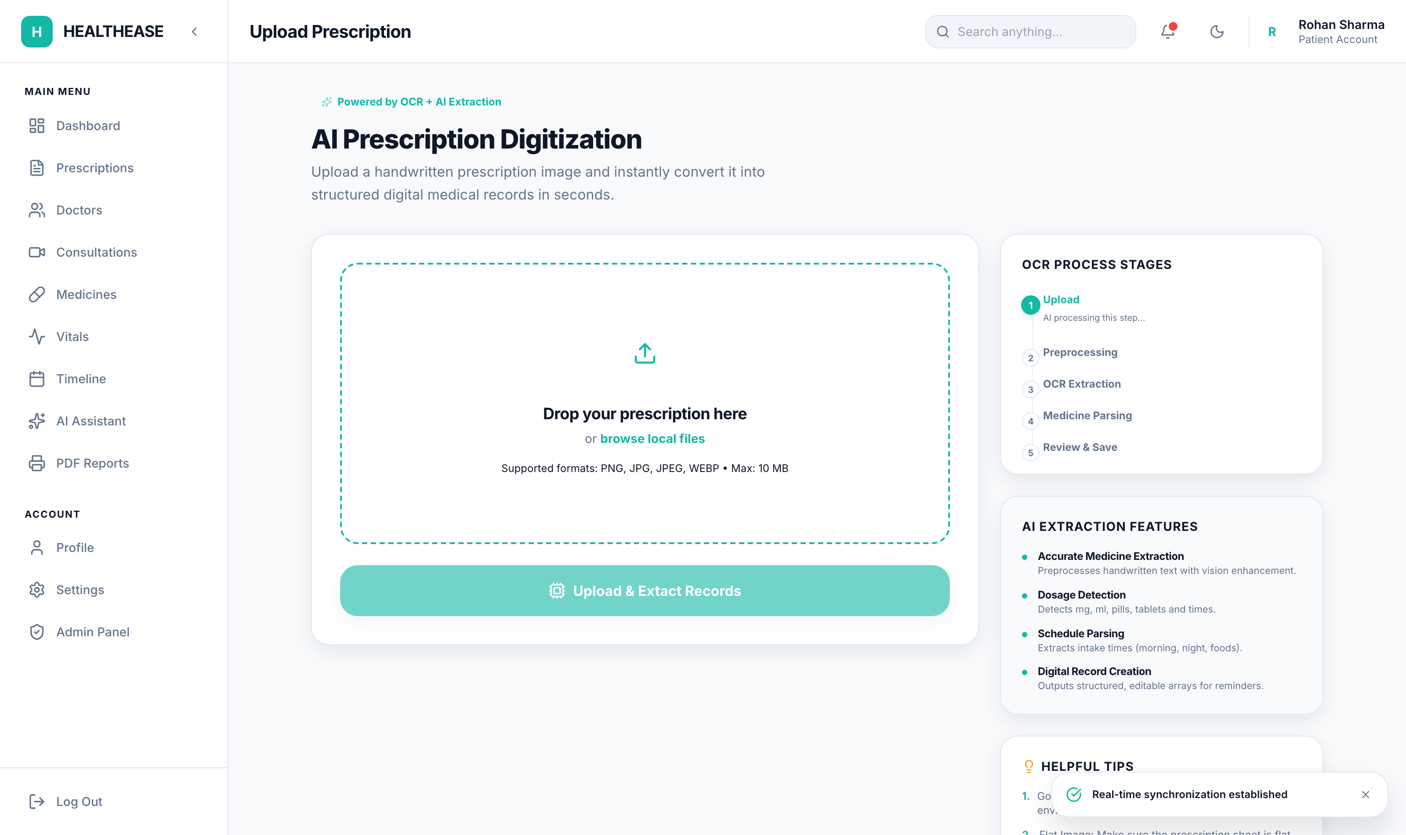
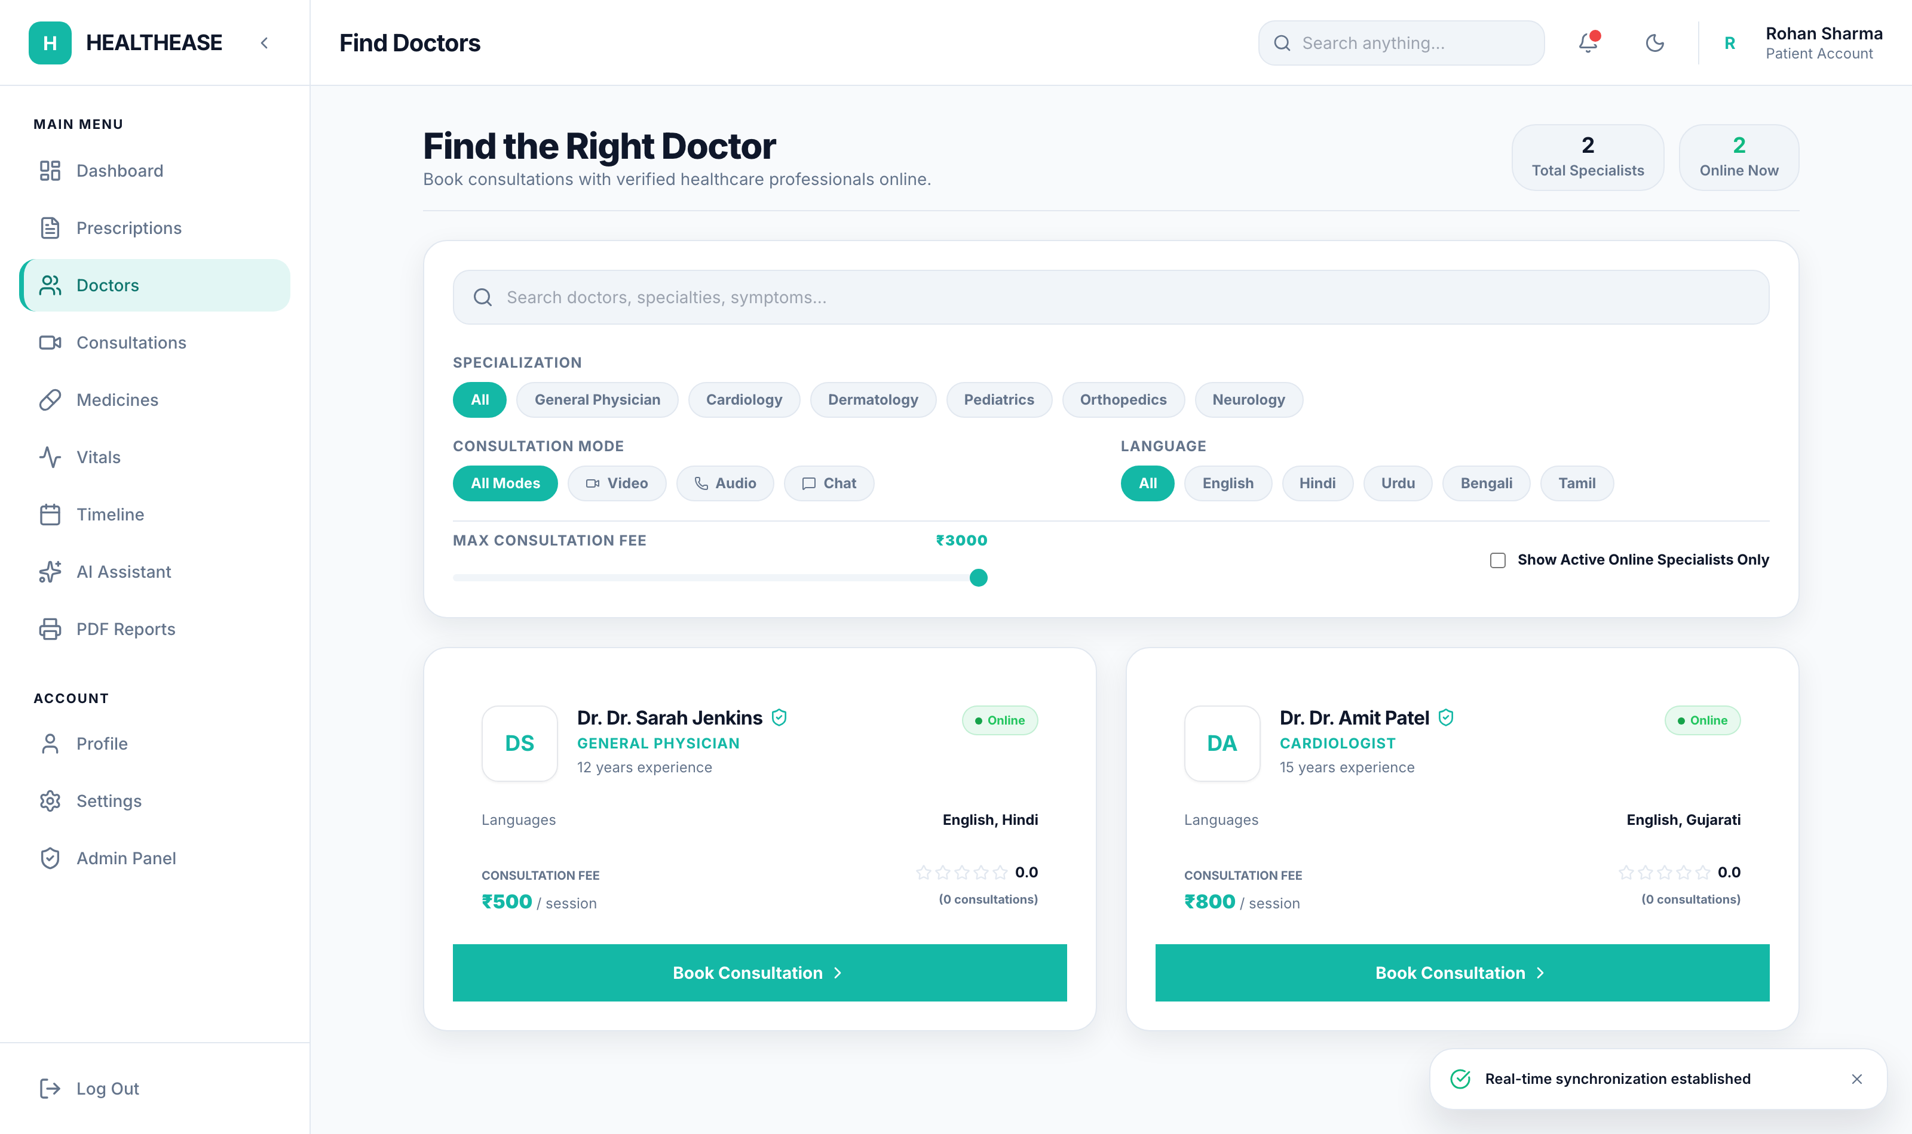
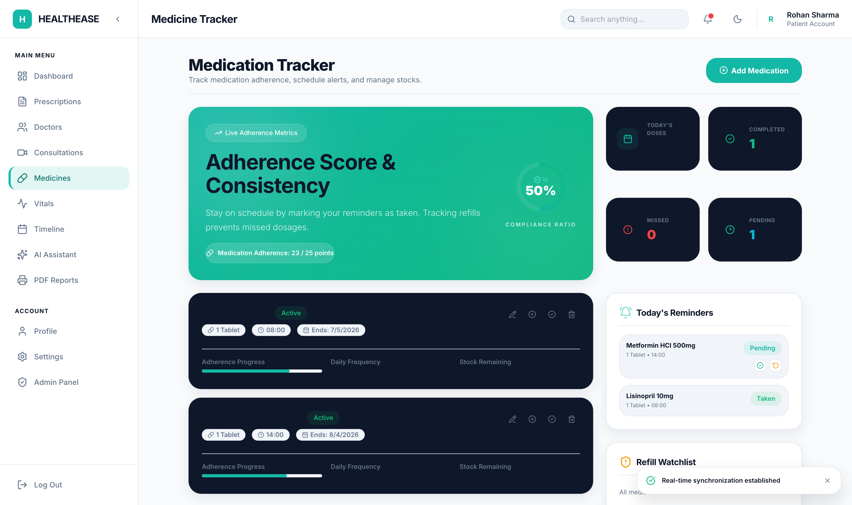
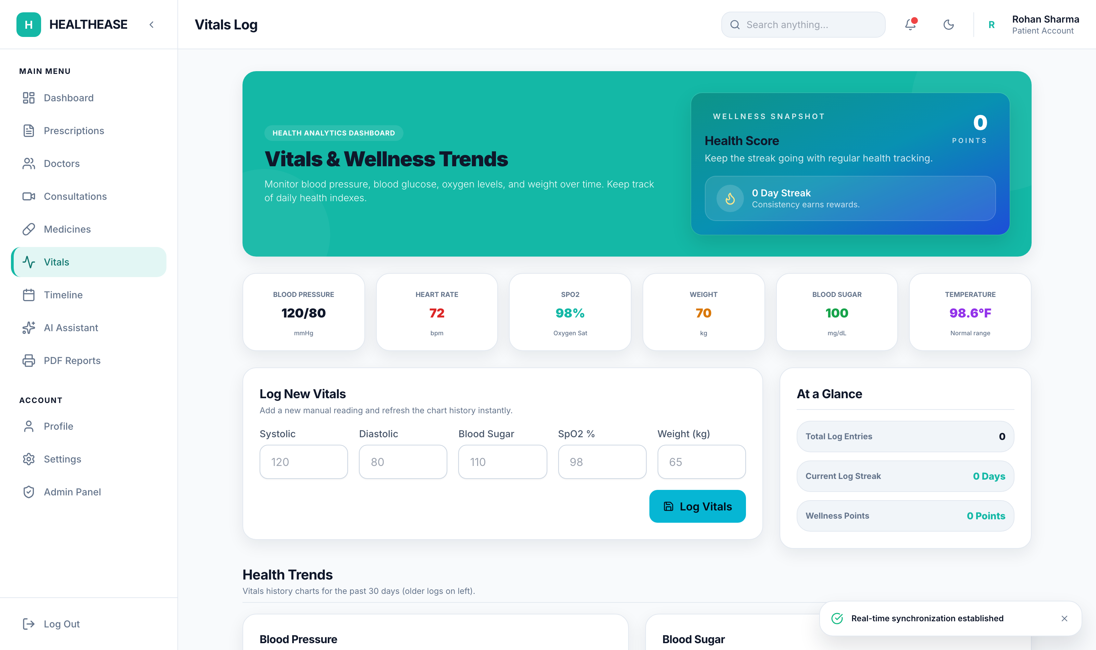
RESULTS & TESTING
Application Results
Patient Dashboard
Prescription Records
Prescription Digitizer
Doctor Marketplace
Medicine Tracker
Vitals Analytics
HealthEase — AI Healthcare Platform
20

Slide 21
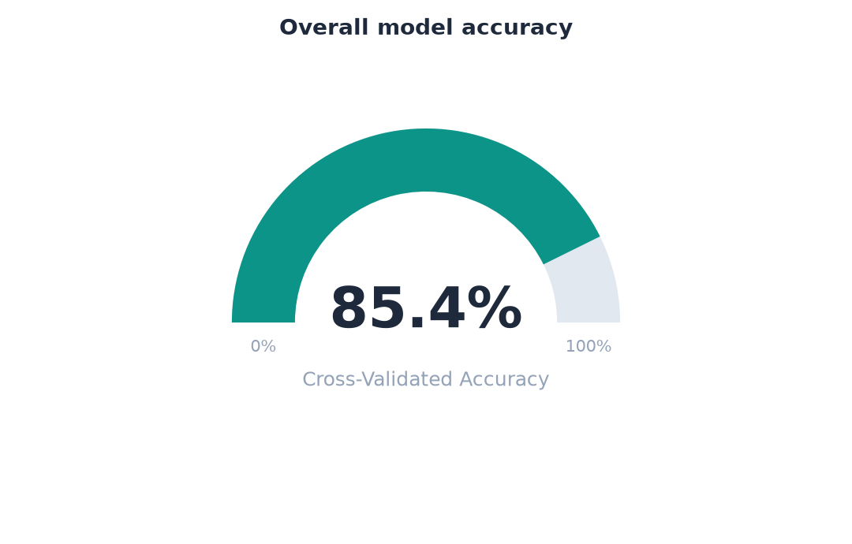
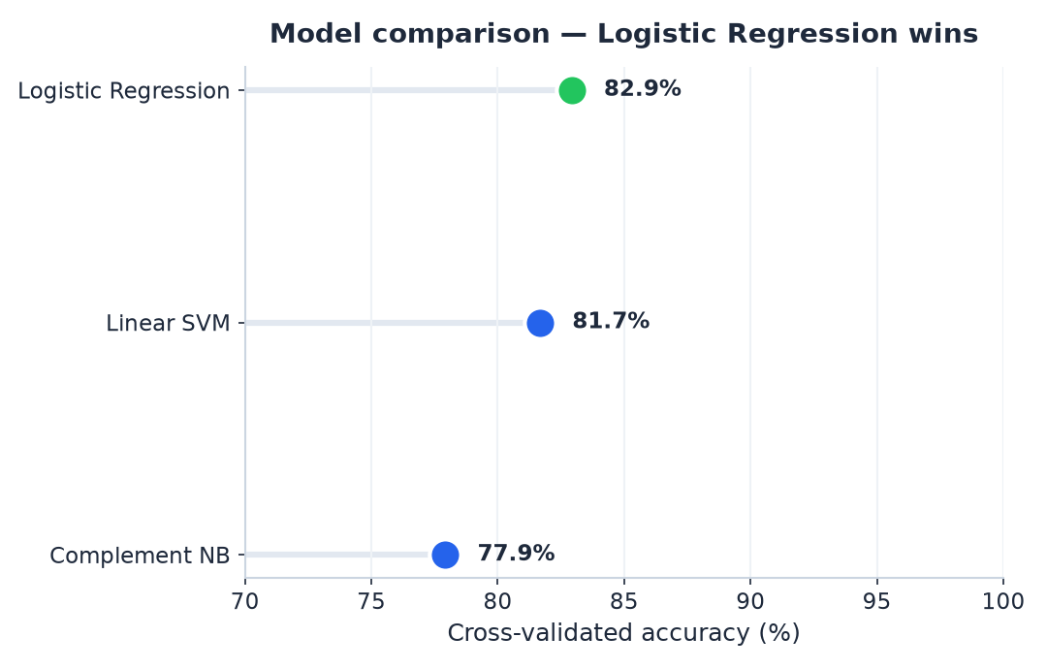
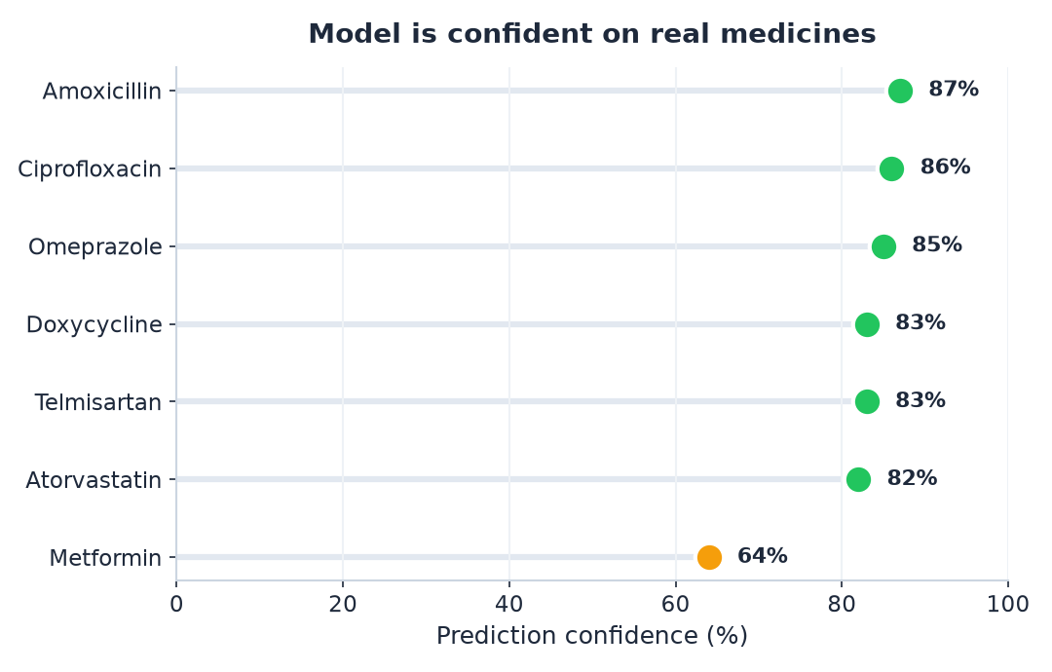
RESULTS & TESTING
ML Graphs & Analytics
HealthEase — AI Healthcare Platform
21

Slide 22
RESULTS & TESTING
Testing
ID | Module | Input | Expected | Result
T01 | Auth | Valid login | JWT returned | Pass
T02 | Auth | Wrong password | 401 error | Pass
T03 | OCR | Prescription image | Structured fields | Pass
T04 | ML Classify | "Amoxicillin" | Bacterial Infection | Pass
T05 | Interactions | 2 drugs | Interaction list | Pass
T06 | Reminder | Set 08:00 | Reminder saved | Pass
T07 | Health Score | Vitals logged | Score 0–100 | Pass
HealthEase — AI Healthcare Platform
22

Slide 23
CONCLUSION
Future Scope
WebRTC live video consults
Predictive ML for vitals trends
Mobile app
1
2
3
4
5
Wearable sync (Apple/Google Fit)
Expand to 50+ drug classes
HealthEase — AI Healthcare Platform
23

Slide 24
Thank You

