Slide 1

ECE 210 Review Session
MIDTERM TWO
ALEX ZHANG, JASON FLANAGAN, GRANT MCKECHNIE

Slide 2
The Path
Circuits!
Generalize circuits into arbitrary linear systems
Analyzing linear systems by hand is painful (so much algebra, time derivatives…)
  Three capacitors in a circuit = 3rd order differential equation. YUCK
Introducing the frequency domain!
  This is a pivotal moment. You will live and breathe in this domain for at least the remainder of your time here. The Fourier domain pops up in signal processing, power transfer, energy, communications, matrix/vector multiplication, antenna arrays, and so much more.
  So powerful that even quantum computing still uses it.
  The only 3-of-5 for EEs that doesn’t feature the Fourier domain is ECE391. Boring class anyway.
Phasors - single sinusoid, steady state only
Fourier series: Periodic functions, steady state only
Fourier Transform: Almost all functions, steady state only
Laplace Transform: Almost all functions, transient and steady state solutions

Slide 3
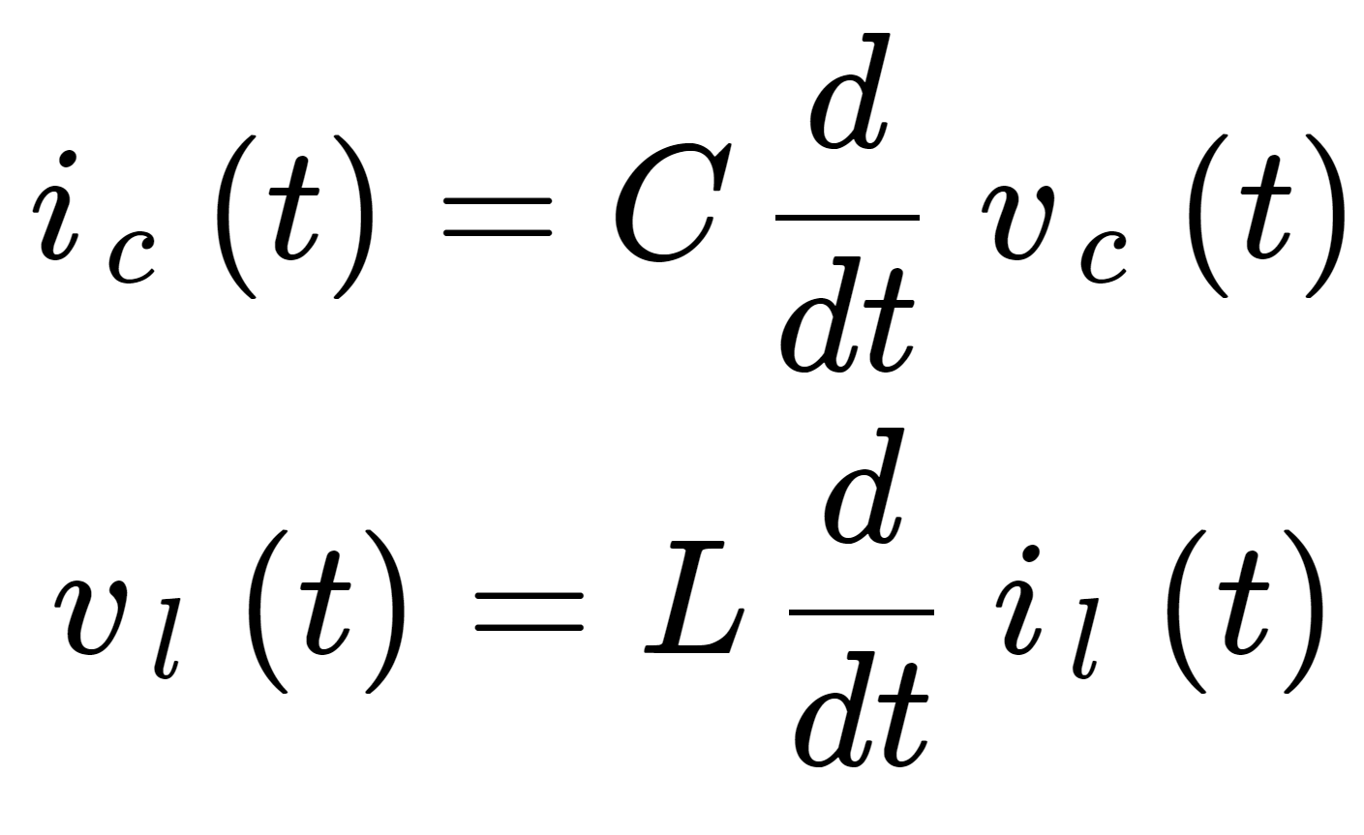
RL, RC, RLC Circuit
▪ RL and RC circuits require setting up and solving a first-order ODE
▪ RLC circuits require setting up and solving a second-order
At the steady state,
  Capacitors act as open circuits
  Inductors act as wires
Continuous functions of time:
  Voltage across a capacitor
  Current through an inductor
Notes:
Jason,
tau = L/R
tau = RC

Slide 4
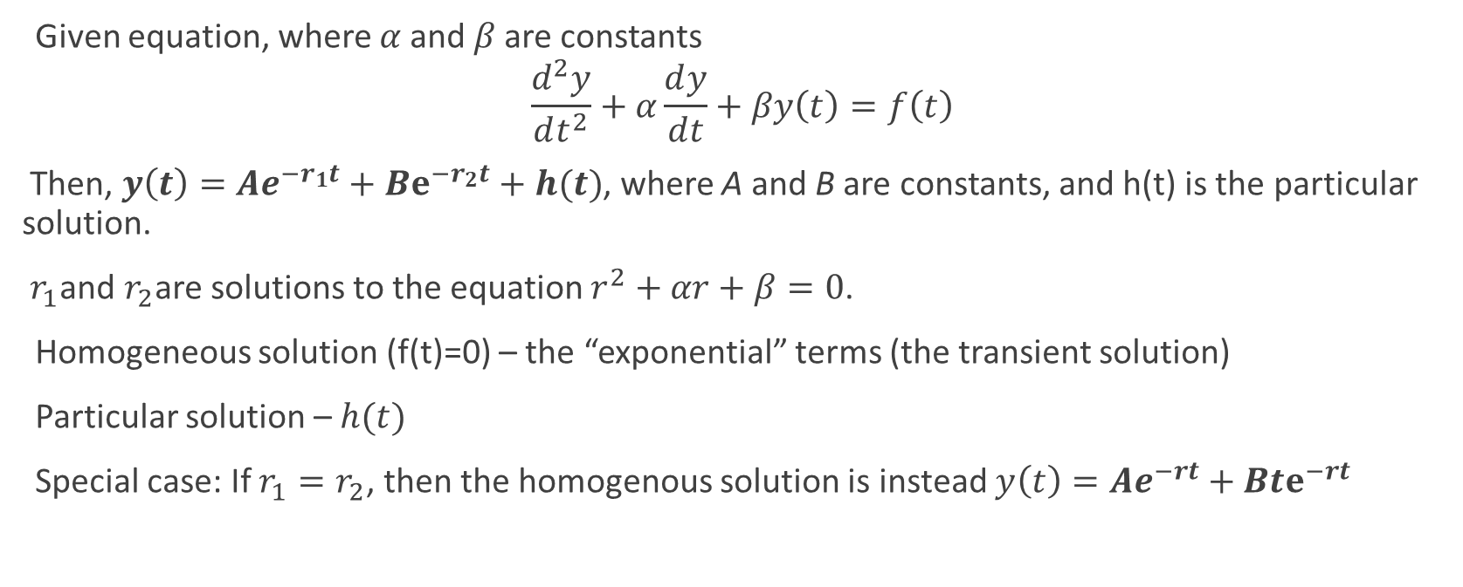
Second Order Differential Equations
Notes:
Jason

Slide 5
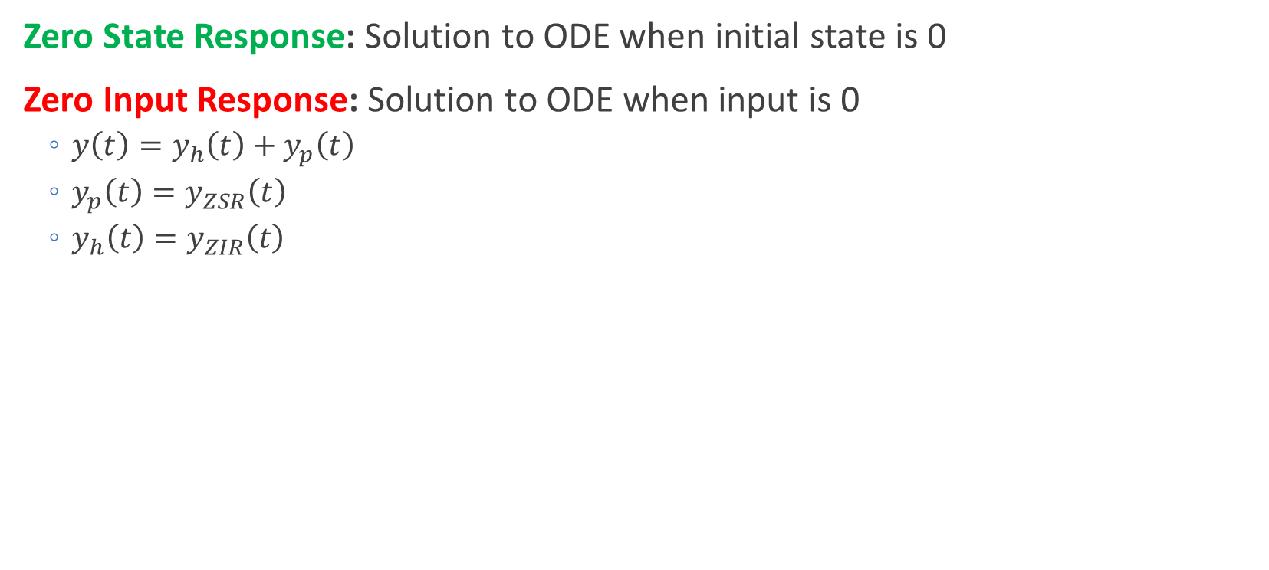
First and Second Order Circuits
Notes:
Jason

Slide 6
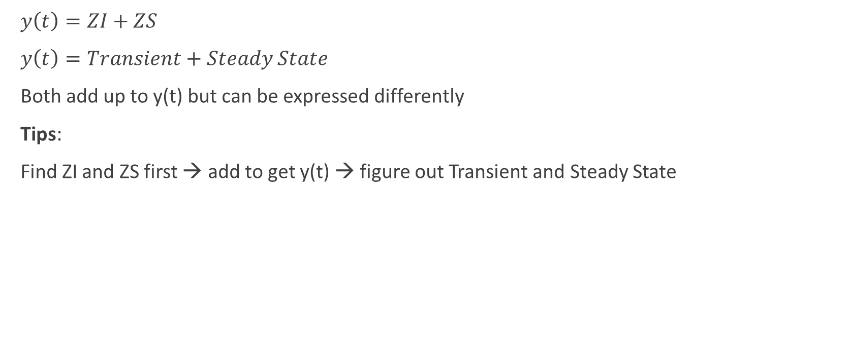
y(t) expressions
Notes:
Jason

Slide 7
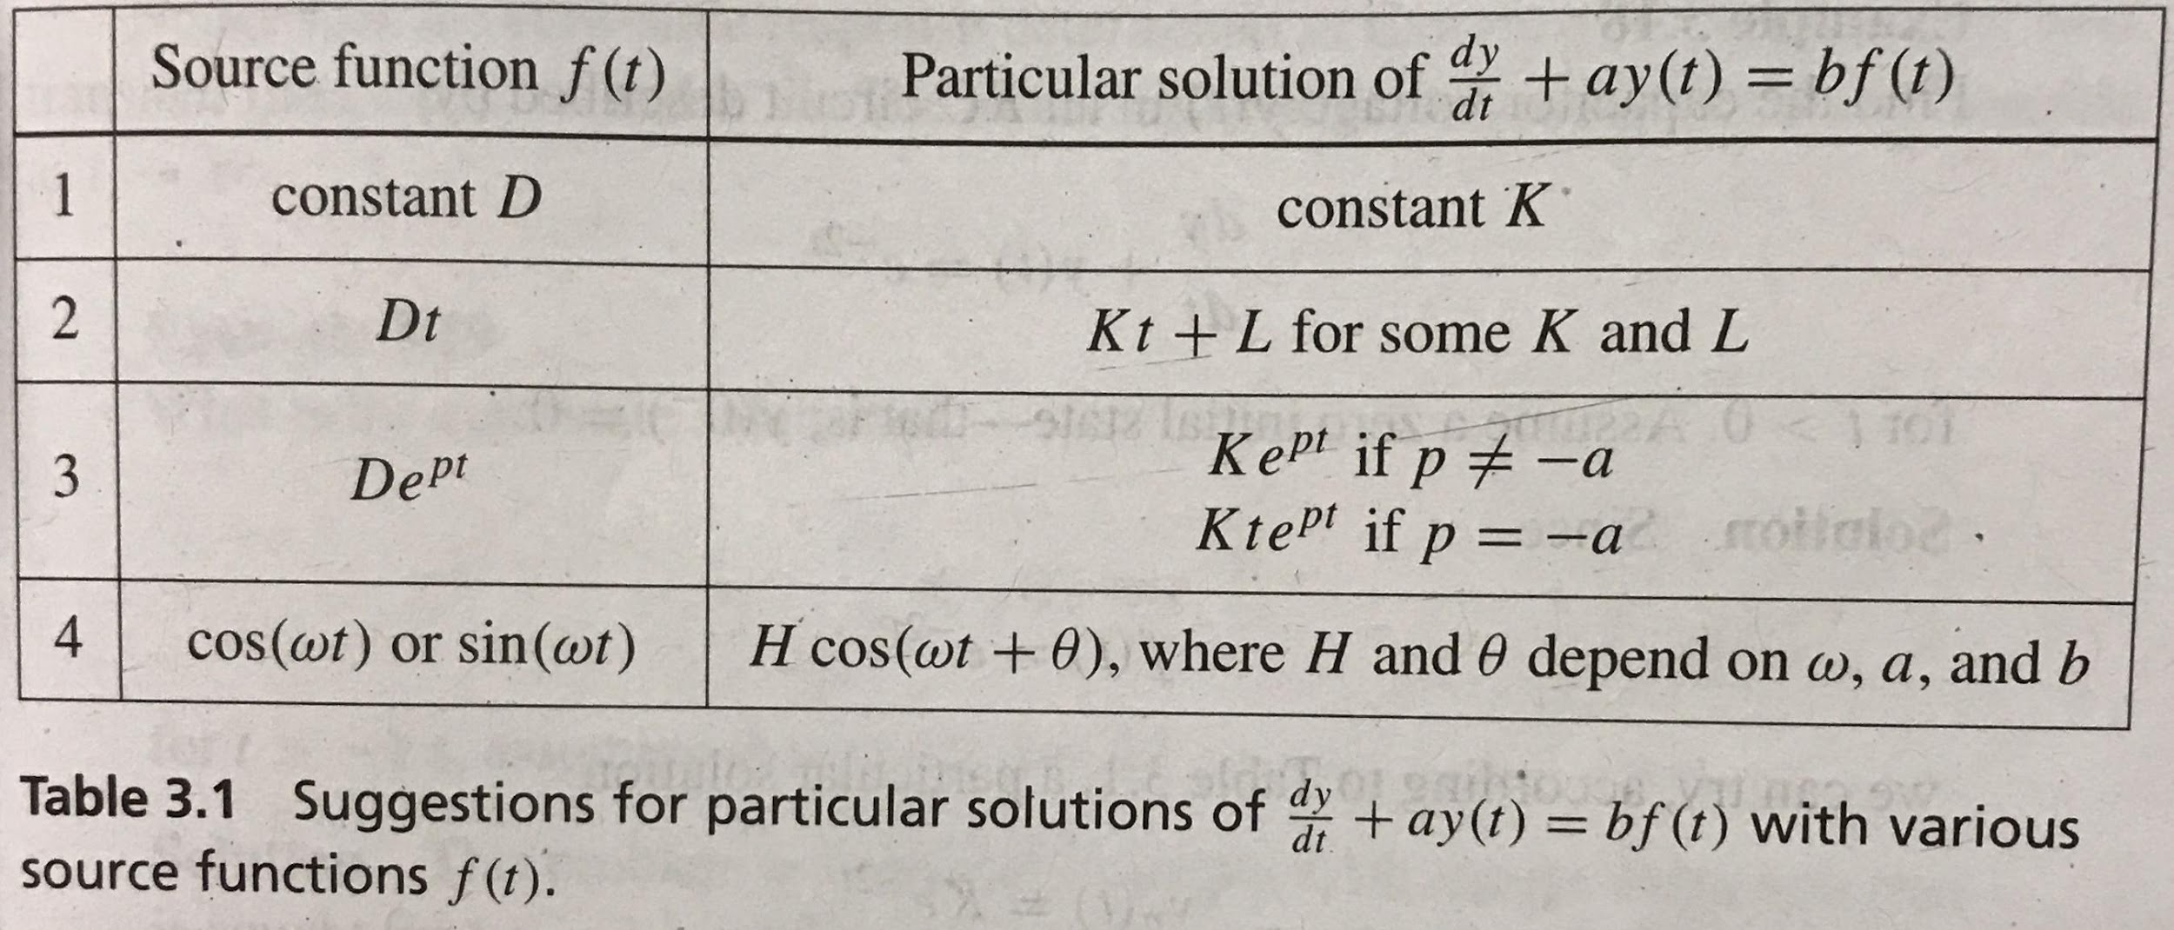
Notes:
Jason

Slide 8
Conceptual Questions (30 seconds each)
A system converts its input f(t) = 64.27cos(2t+3000pi) + 20.3cos(4t) into a steady-state output
y(t) = 1038sin(2t – 1.25pi). Is the system LTI? Why?
Notes:
Jason
The system is not LTI: Input frequency of 2 causes two output frequencies, which is illegal for LTI systems (Y = HF must hold) Note: output can lose frequencies, but not vice versa.
Yes, we can create some H(w) with certain |H(2)| and angle response for H(2) that yields that sin and also have |H(4)| = 0.

Slide 9
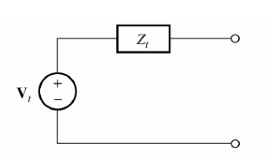

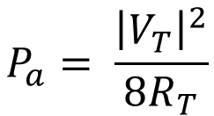
Available Power
Notes:
Grant

Slide 10
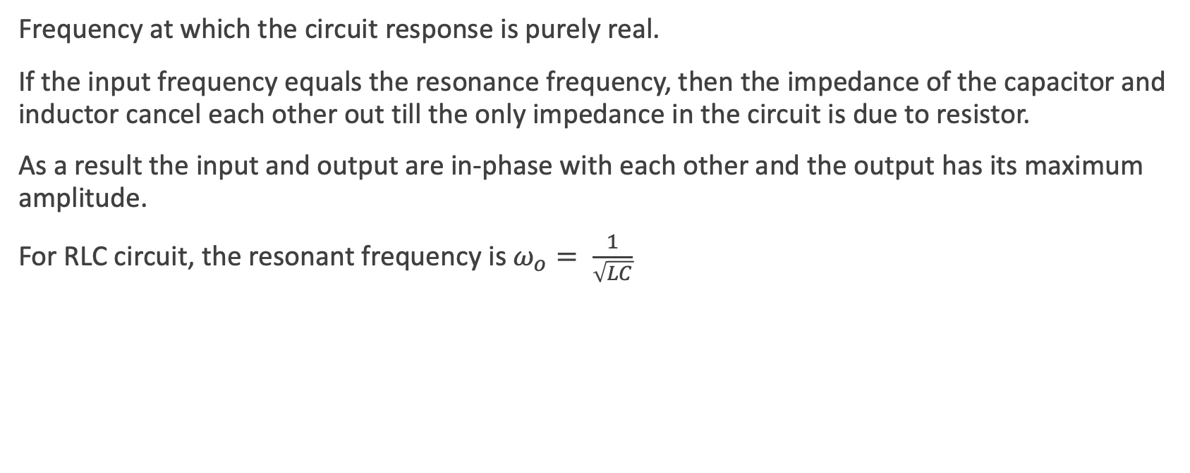
Resonance
Notes:
Pg no. 153, Grant

Slide 11
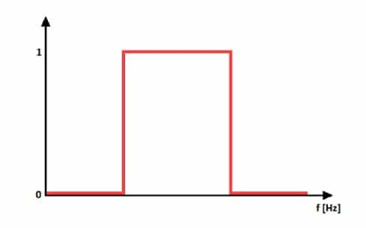

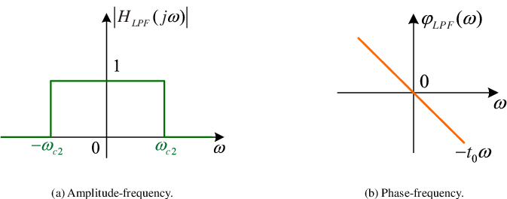
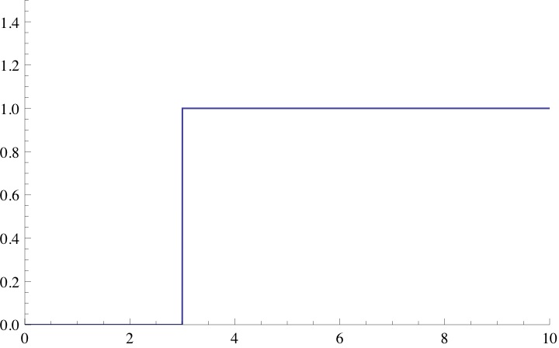
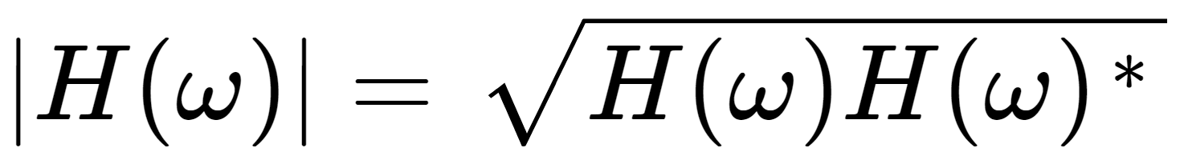
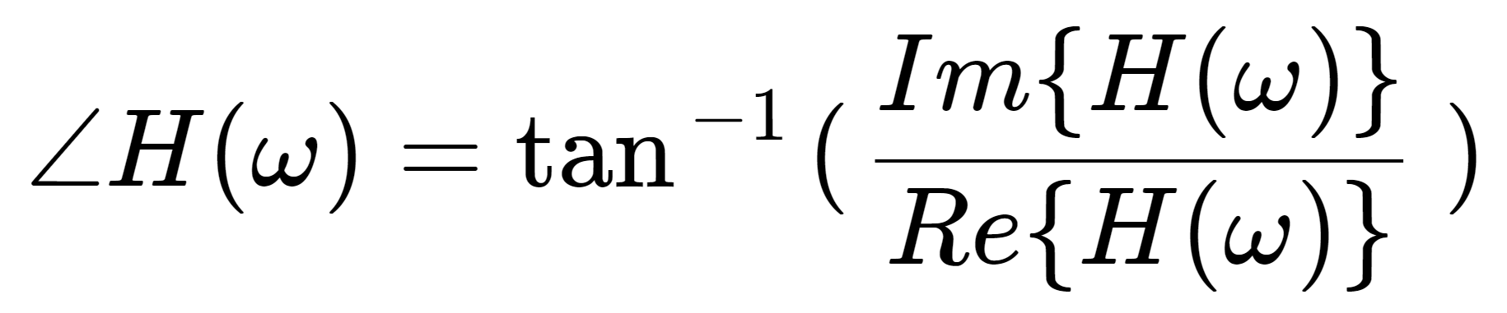
Filters
(2)
(3)
(1)
Notes:
Grant

Slide 12
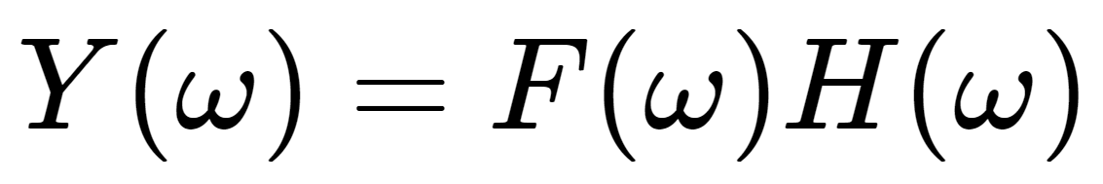
Steps to Find a Filter
Remember, scale your input
  So response is output / input
In order to determine type of filter, evaluate |H(w)| at 0, ∞, and in between (possibly at w0)
Low Pass
|H(0)|=1
|H(∞)|=0
High Pass
|H(0)|=0
|H(∞)|=1
Band Pass
|H(0)|=0 |H(w0)|>0
|H(∞)|=0
Notes:
Grant

Slide 13


Conceptual Questions
A linear system has the following frequency response:
Find the output of the system when the input is
Notes:
Jason
3 sin(3 t - 3) = 3 cos(3 t - 3 - pi/2) -> phasor -> 3 e^j(-3 - pi/2). H(3) = e^j3. So output phasor is 3e^-3j e^-jpi/2 e^3j = 3 e^-jpi/2 -> 3 cos(3t - pi/2) = 3sin(3t).
3 -> phasor -> 3. H(0) = 1, so output phasor is 3.
Final answer: 3sin(3t) + 3

Slide 14
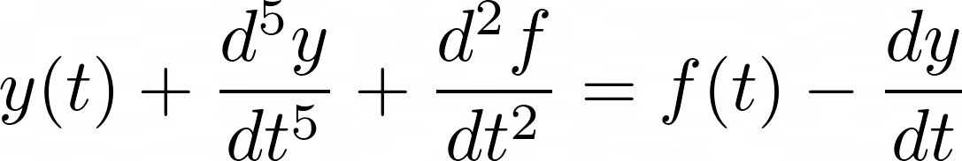
Conceptual Questions
A linear system is described by the following differential equation:
Find the frequency response H(w) of the system.
Notes:
Grant

Slide 15
Conceptual Question Solution
Notes:
Grant

Slide 16
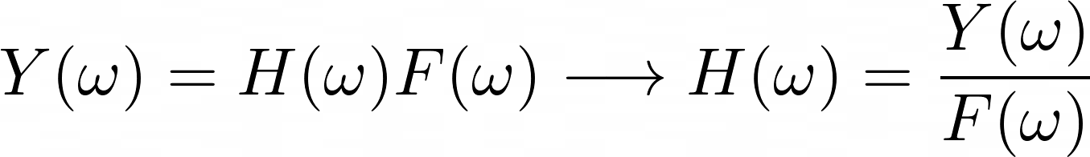
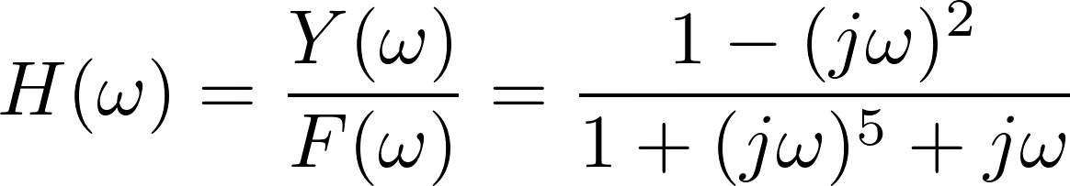
Conceptual Question Solution
Notes:
Grant

Slide 17
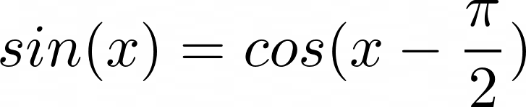
Phasor Definition
Notes:
Grant

Slide 18
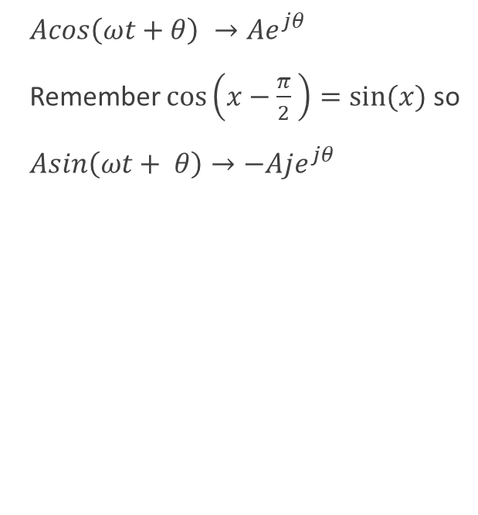
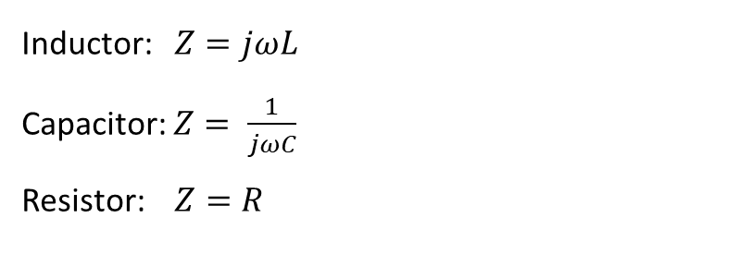
Phasors, Co-sinusoids, and Impedance
Once you’ve converted every circuit element in the phasor domain, you can analyze the circuit using all the ways covered in the first midterm!!!
Node Voltage
Superposition
Loop Current
Source Transformations
NOTE: The solution obtained after analysis with the phasor method is the STEADY STATE SOLUTION !!!
Notes:
Grant

Slide 19
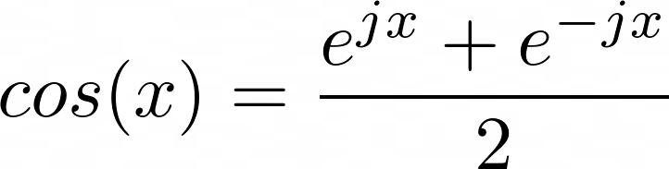
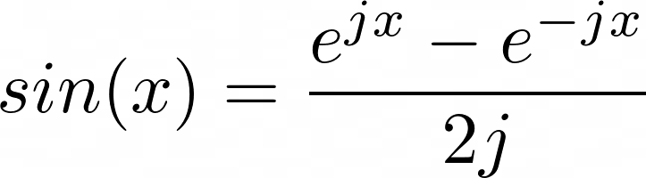
Formulae to Remember:
Notes:
These are also analogous to the equations to find the real part and complex part of a complex number (because cosine is the real part and sine is the complex part)
Jason

Slide 20
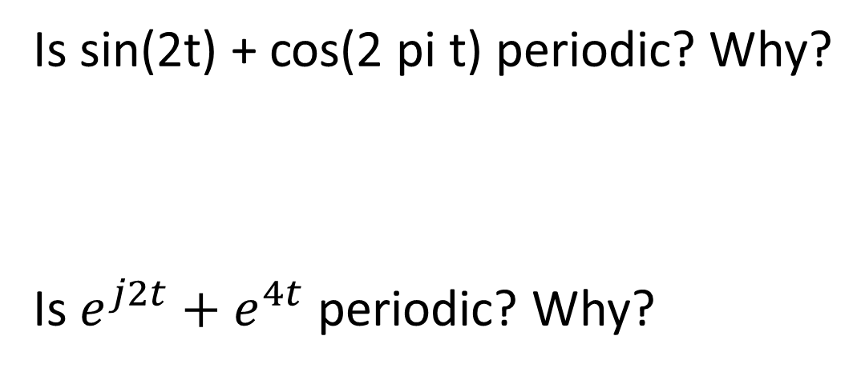
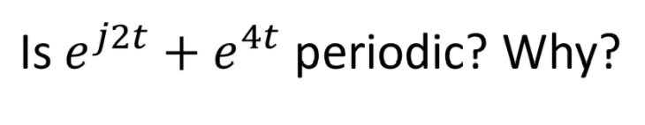
Conceptual Questions (30 seconds each)
Notes:
w = {2, 2pi}. T = {2pi/2, 2pi/2pi} -> {pi, 1}. No LCM where these multiplied by an integer exists.
e^4t is not a cosinusoid
ALEX

Slide 21
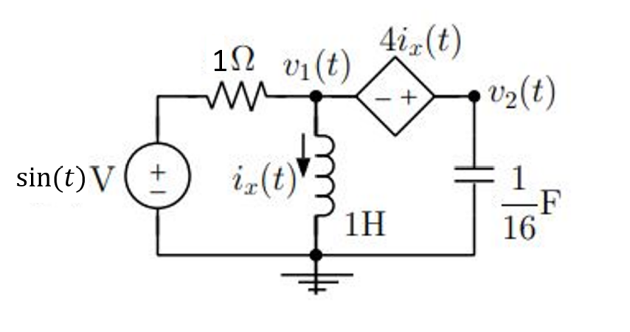
Conceptual Question
Convert the following circuit into the phasor domain:
Notes:
Frequency is 1. Do usual shenanigans. ALEX

Slide 22
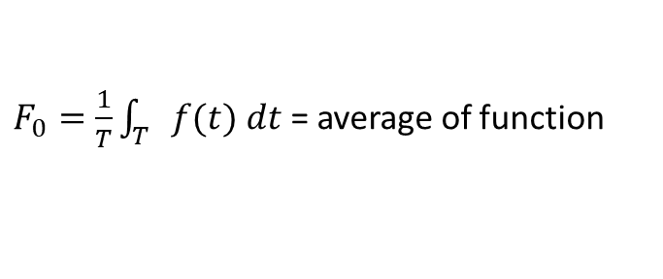
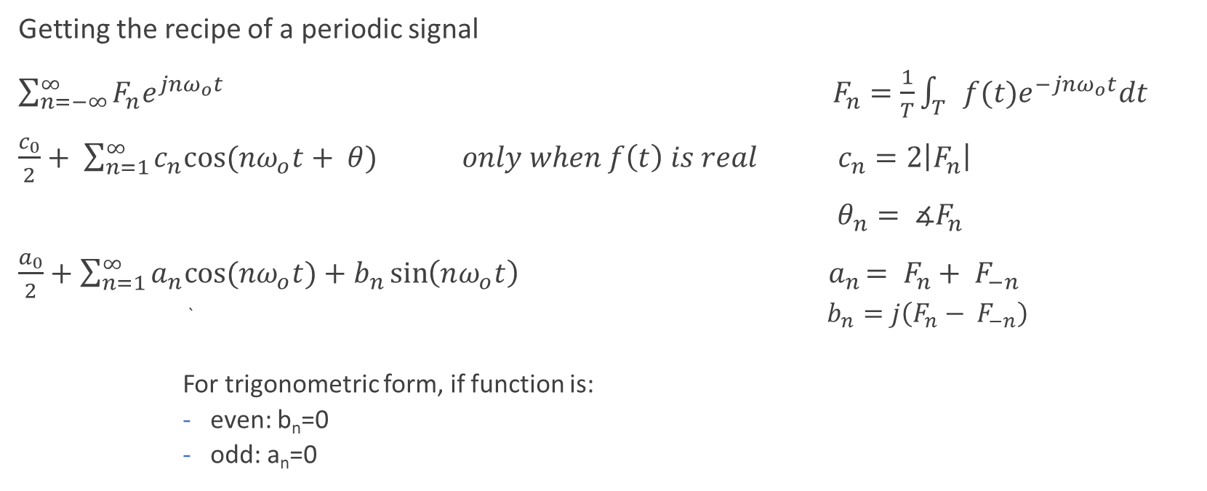
Fourier Series
Notes:
Is input signal is just cosines and sines, just split them into e^ terms then match the coefficients. Otherwise use the formulae. Converting from one to the other is simple by formulae as well.

Slide 23
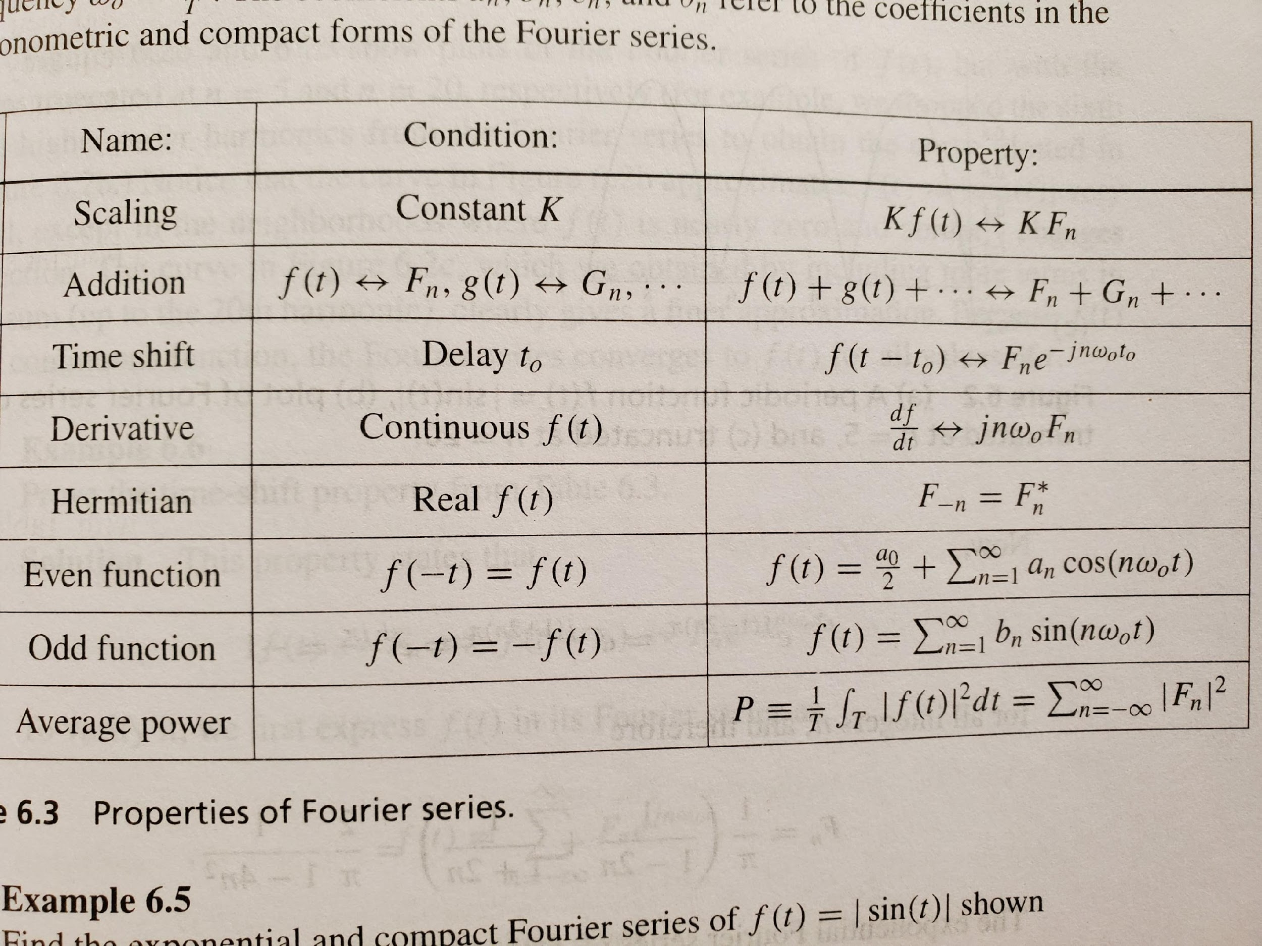

Slide 24
Other properties of Fourier Series
Division by 0 IS BAD. If a coefficient depends on division by 0, find it using another method.
For discontinuities in the sequence: the Fourier series converges to the middle of the discontinuity.
Gibbs phenomenon: there are ripples that appear right before a big jump, which we can only get rid of if we let n go to infinity.
Conditions for existence and usage of Fourier Series:
- f(t) must be periodic (nonperiodic signals are dealt with using a Fourier Transform, you’ll learn this very soon ;)
- f(t) must be absolutely integrable.
- There must be a finite number of maxes and mins over one period, and a finite number of finite discontinuities over one period.
Notes:
Sin(1/x) has infinite discontinuities (but also isn’t periodic anyway)

Slide 25
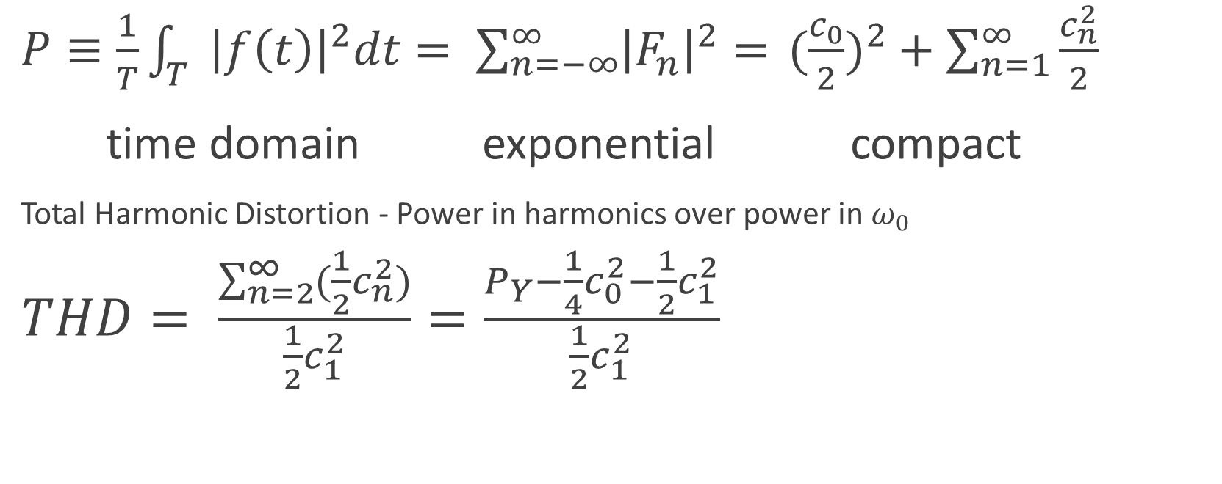

Parseval’s Theorem

Slide 26
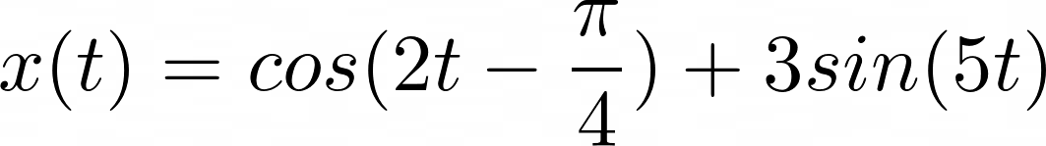
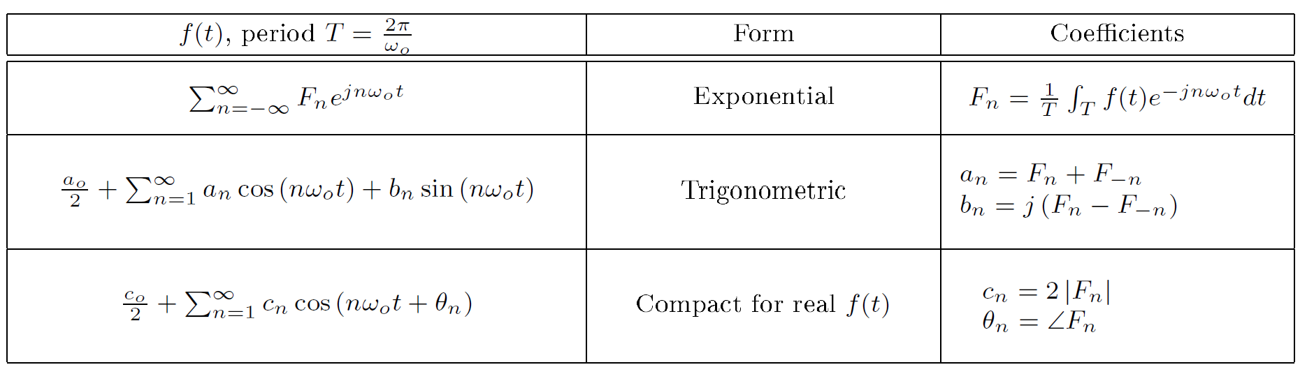
Fourier Series:
Find the Exponential Fourier series of the following expression:
Notes:
Be lazy, match terms

Slide 27

Fourier Series:
Find the Exponential Fourier series of the following expression:
Notes:
Does not exist! x(t) is not periodic.

Slide 28
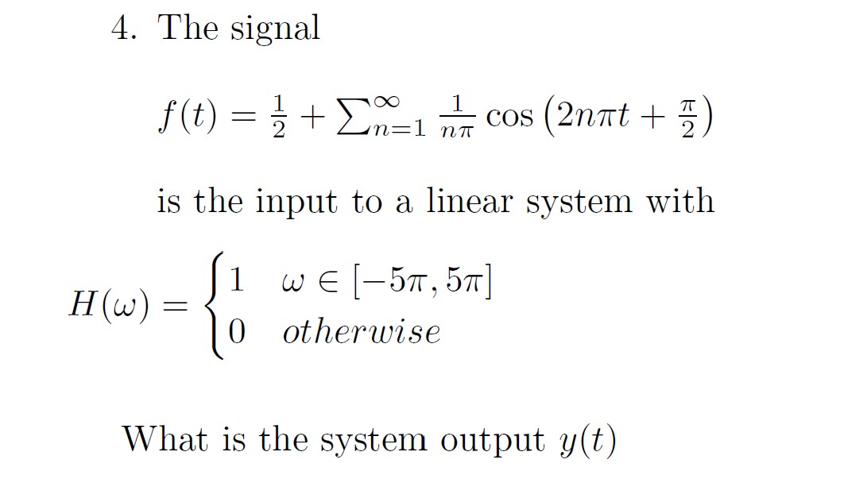
Old HW Question
Notes:
Only n = 0, 1, 2 survives, so write out those terms and you’re done.

Slide 29
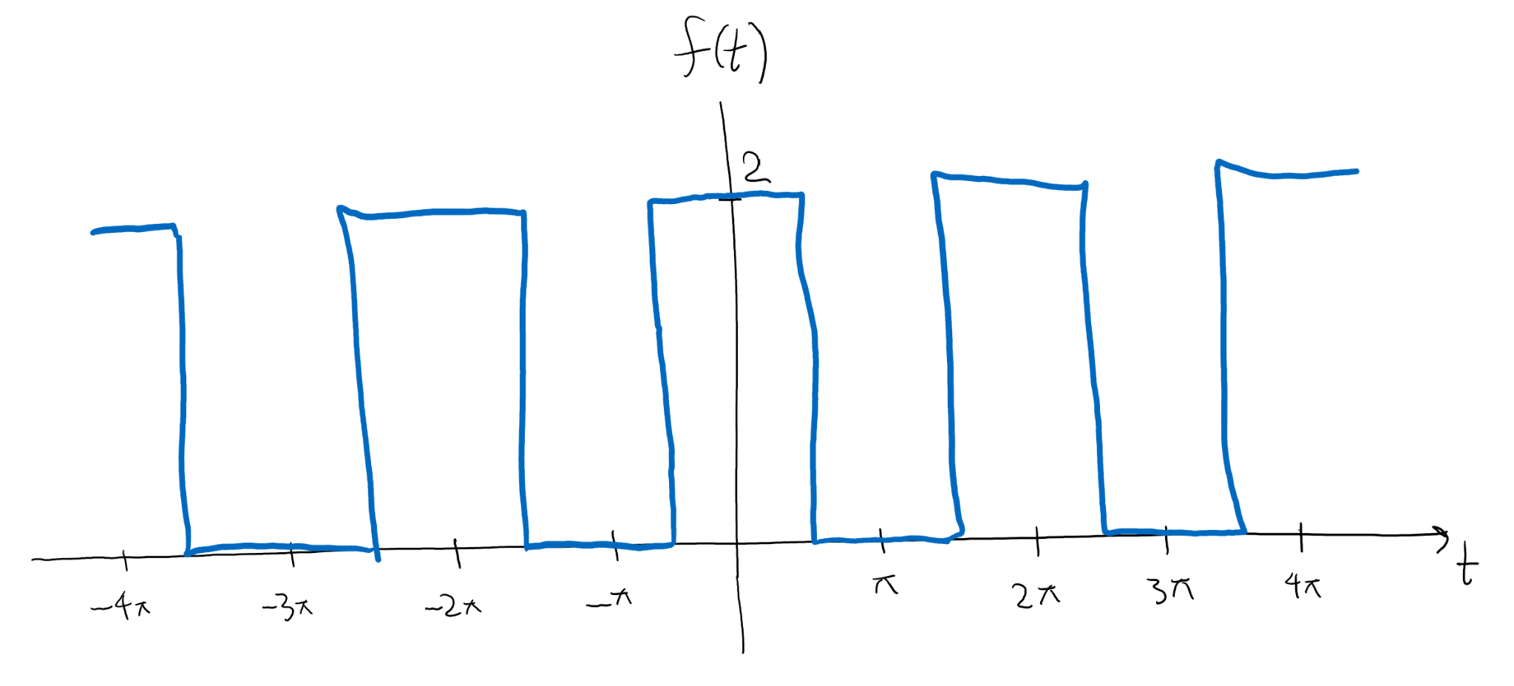
Monster Problem
Find the exponential Fourier series of the following signal:

Slide 30

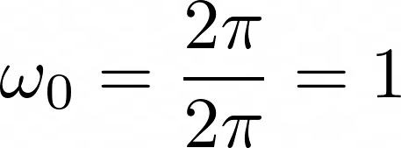
Monster Problem Solution
Step 1: Find T and w_0.

Slide 31
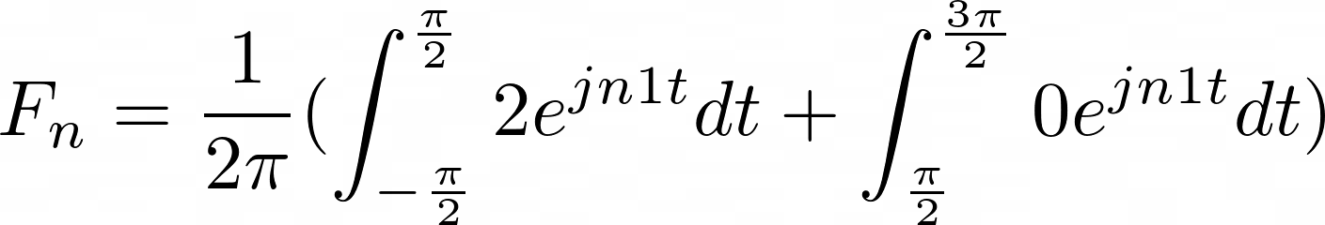
Monster Problem Solution
Step 2: Set up the integral

Slide 32
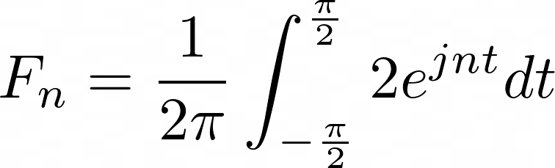
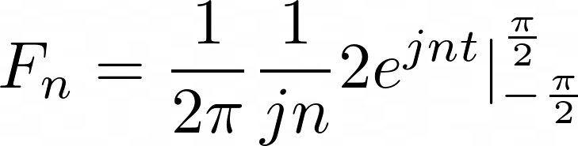
Monster Problem Solution
Step 3: Evaluate said integral

Slide 33
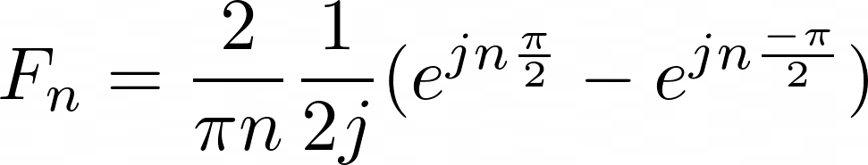
Monster Problem Solution
Step 3: Evaluate said integral
Can we simplify?

Slide 34
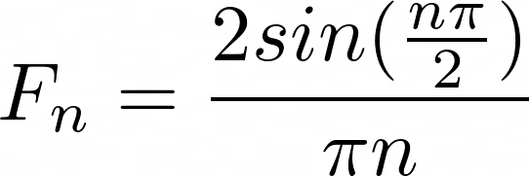
Monster Problem Solution
Step 3: Evaluate said integral

Slide 35
Monster Problem Solution
Step 4: Done!
Or are we…

Slide 36
Monster Problem Solution
What if n = 0?
Yikes. We need a different equation.

Slide 37
Monster Problem Solution
Step 2: Set up the integral, but now n = 0

Slide 38
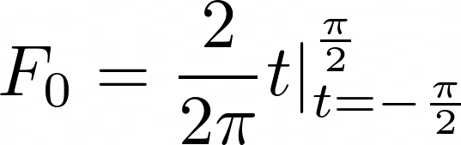
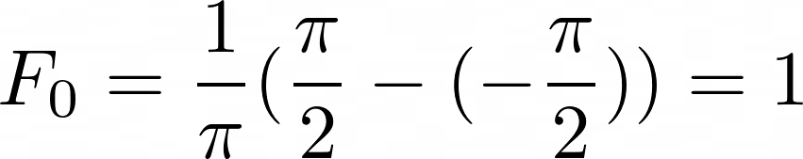
Monster Problem Solution
Step 2: Evaluate the integral, but now n = 0

Slide 39

Monster Problem Solution
Now we’re done!

Slide 40
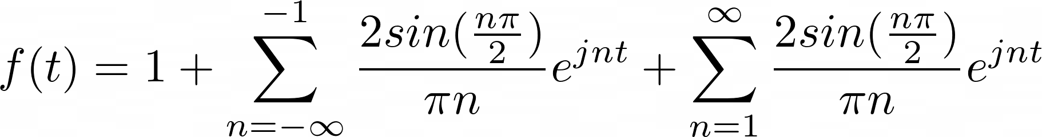
Monster Problem Solution
Now we’re done!

Slide 41
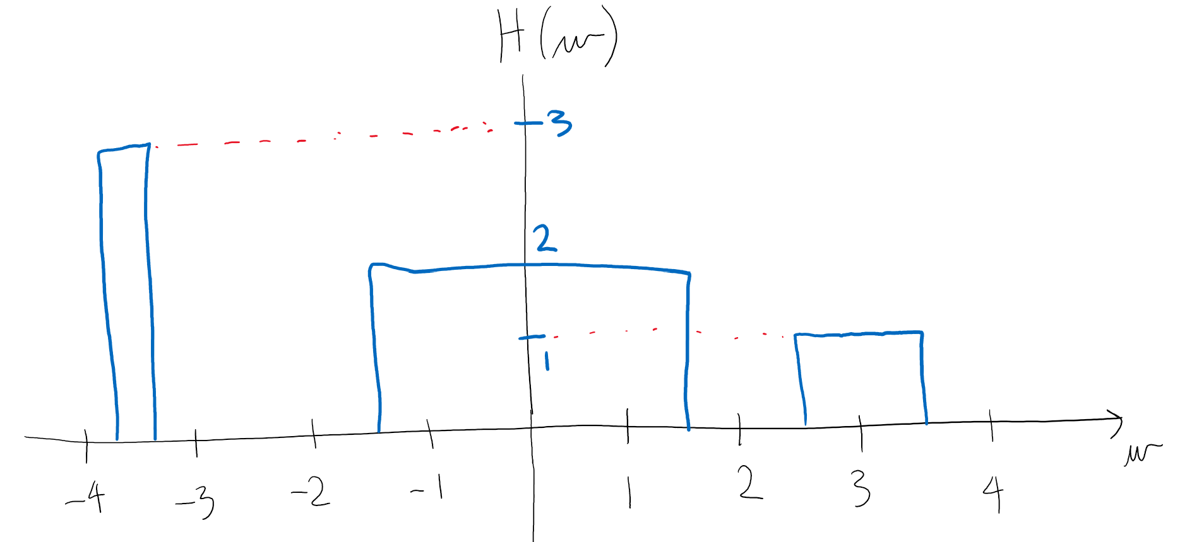
Monster Problem Part 2
Now we pass f(t) through a linear system with the following frequency response:
What is the output y(t)?

Slide 42
Monster Problem Part 2
What is the output y(t)?
Step 1: What actually are the frequencies in f(t)?

Slide 43
Monster Problem Part 2
What is the output y(t)?
Step 1: What actually are the frequencies in f(t)?
Answer: w = all integers!

Slide 44
Monster Problem Part 2
What is the output y(t)?
Step 2: What frequencies will survive the filter?

Slide 45
Monster Problem Part 2
What is the output y(t)?
Step 2: What frequencies will survive the filter?
Answer: -3.7 to -3.3, -1.5 to 1.5, 2.5 to 3.5.
(Note that these are just guesses)

Slide 46
Monster Problem Part 2
What is the output y(t)?
Step 3: What values of n survive the filter?

Slide 47
Monster Problem Part 2
What is the output y(t)?
Step 3: What values of n survive the filter?
n = -1, 0, 1, 3. Everything else is multiplied by 0 and thus goes away!

Slide 48
Monster Problem Part 2
What is the output y(t)?
Step 4: Now calculate Y = HF only at n = -1, 0, 1, and 3.

Slide 49
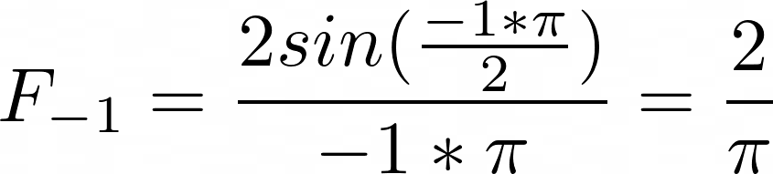

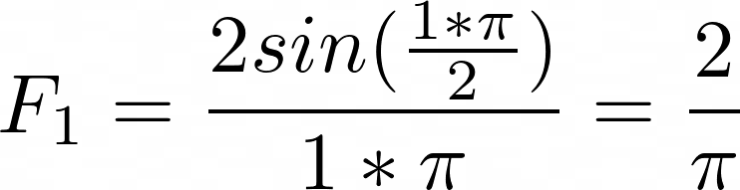
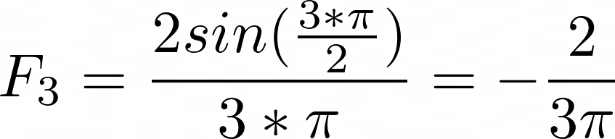
Monster Problem Part 2
Step 4: Now calculate Y = HF only at n = -1, 0, 1, and 3.

Slide 50

Monster Problem Part 2
Step 4: Now calculate Y = HF only at n = -1, 0, 1, and 3.

Slide 51
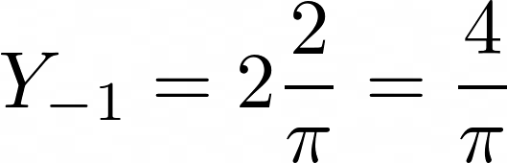

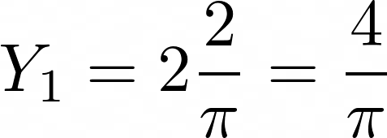
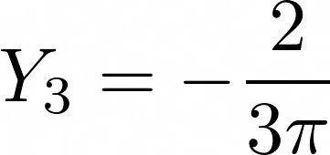
Monster Problem Part 2
Step 4: Now calculate Y = HF only at n = -1, 0, 1, and 3.

Slide 52
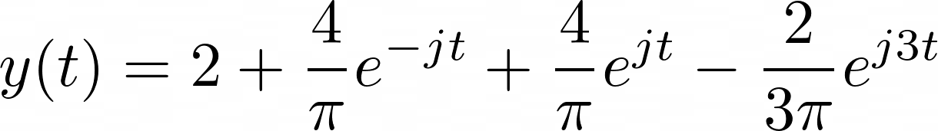
Monster Problem Part 2
All together now…

Slide 53
Monster Problem Part 3
Calculate the average power of y(t).
(Write down y(t), then I’ll give you the tables on the next slide)

Slide 54



Slide 55


Monster Problem Part 3
Average power: In the tables!

Slide 56
Monster Problem Part 4
Find the trigonometric and compact forms of y(t).
(Write down y(t), then I’ll give you the tables on the next slide)

Slide 58
Monster Problem Part 4
Trigonometric form… What was the formula again?

Slide 59





Monster Problem Part 4
Ok. Let’s go!

Slide 60

Monster Problem Part 4
Altogether now…

Slide 61
Monster Problem Part 4
Compact form… What was the formula again?

Slide 62





Monster Problem Part 4
Ok. Let’s go!

Slide 63

Monster Problem Part 4
But wait… What’s the full formula?
Oh no. y(t) isn’t completely real.
COMPACT FORM FOR y(t) DOESN’T EXIST!!!!

Slide 64
Monster Problem Part 5
Ha I’m kidding.
Give yourself a pat on the back.
That was a hard one.

Slide 65

Feedback! Please please fill it out!

Slide 66


Spring 2014 Question 1

Slide 68


Spring 2014 Question 2

Slide 70


Spring 2018 Question 4

Slide 73

Spring 2018 Question 4 Continued

Slide 74

Fall 13 Question 8

Slide 76


Fall 2017 Question 2

Slide 78

Spring 2016 Question 5

