Slide 1
STRUCTURED QUERY LANGUAGE

Slide 2
HISTORY
IBM Sequel language developed as part of System R project at the IBM San Jose Research Laboratory
Renamed Structured Query Language (SQL)
ANSI and ISO standard SQL:
  SQL-86
  SQL-89
  SQL-92
  SQL:1999
  SQL:2003
  SQL:2006
  SQL:2008
  SQL:2011
  SQL:2016
    “Not all examples here may work on your particular system”

Slide 3
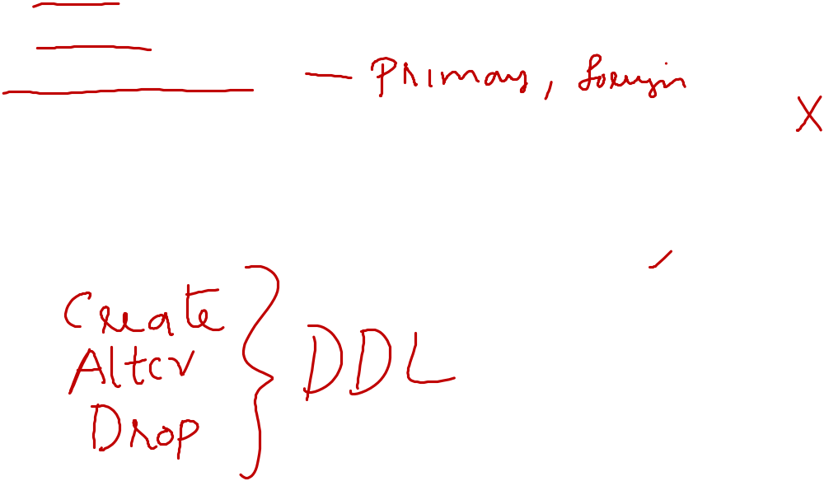
DATA DEFINITION LANGUAGE
Allows the specification of not only a set of relations but also information about each relation, including:
The schema for each relation.
The domain of values associated with each attribute.
Integrity constraints
The set of indices to be maintained for each relations.
Security and authorization information for each relation.
The physical storage structure of each relation on disk.

Slide 4
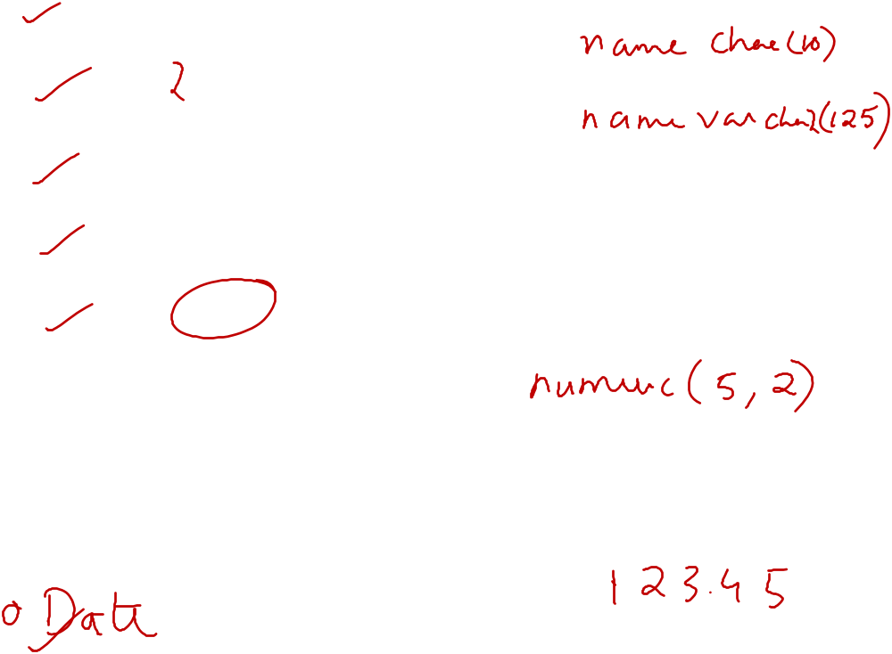
DOMAIN TYPES IN SQL
char(n). Fixed length character string, with user-specified length n.
varchar(n). Variable length character strings, with user-specified maximum length n.
int. Integer (a finite subset of the integers that is machine-dependent).
smallint. Small integer (a machine-dependent subset of the integer domain type).
numeric(p,d). Fixed point number, with user-specified precision of p digits, with n digits to the right of decimal point.
real, double precision. Floating point and double-precision floating point numbers, with machine-dependent precision.
float(n). Floating point number, with user-specified precision of at least n digits.

Slide 5
CREATE TABLE CONSTRUCT
An SQL relation is defined using the create table command:
create table r (A₁ D₁, A₂ D₂, ..., A_{n} D_{n},
(integrity-constraint₁),
...,
(integrity-constraint_{k}))
  r is the name of the relation
  each A_{i} is an attribute name in the schema of relation r
  D_{i} is the data type of values in the domain of attribute A_{i}
Example:
create table branch
(branch_name char(15) not null,
branch_city char(30),
assets integer)

Slide 6
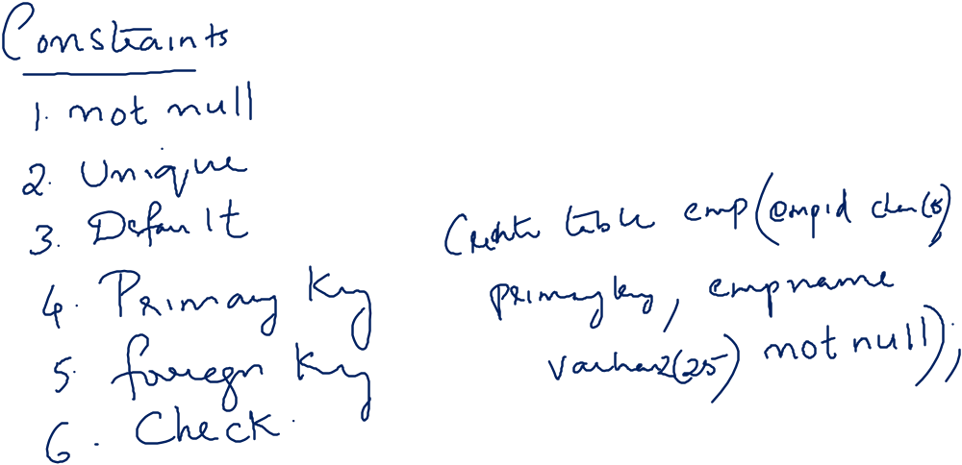

Slide 7
INTEGRITY CONSTRAINTS IN CREATE TABLE
not null
primary key (A₁, ..., A_{n} )
Example: Declare branch_name as the primary key for branch
.
create table branch
(branch_name char(15),
branch_city char(30),
assets integer,
primary key (branch_name))
primary key declaration on an attribute automatically ensures not null in SQL-92 onwards, needs to be explicitly stated in SQL-89

Slide 8
ALTER TABLE CONSTRUCTS
The alter table command is used to add attributes to an existing relation:
alter table r add A D
where A is the name of the attribute to be added to relation r and D is the domain of A.
  All tuples in the relation are assigned null as the value for the new attribute.
The alter table command can also be used to drop attributes of a relation:
alter table r drop A
where A is the name of an attribute of relation r
The alter table command can also be used to Modify existing columns
alter table r modify (A <new datatype> (<new size>))
  Dropping of attributes not supported by many databases

Slide 9
DROP TABLE CONSTRUCTS
The drop table command deletes all information about the dropped relation from the database.
Drop table r
EXAMINING OBJECTS CREATED BY USER
Finding out tables created by a user
  Select * from TAB;
Describe the Table structure
  Describe <table name>

Slide 10
BASIC QUERY STRUCTURE
SQL is based on set and relational operations with certain modifications and enhancements
A typical SQL query has the form:
select A₁, A₂, ..., A_{n}
from r₁, r₂, ..., r_{m}
where P
  A_{i} represents an attribute
  R_{i} represents a relation
  P is a predicate.
The result of an SQL query is a relation.
Notes:
2

Slide 11
THE SELECT CLAUSE
The select clause list the attributes desired in the result of a query
  corresponds to the projection operation of the relational algebra
Example: find the names of all branches in the loan relation:
select branch_name
from loan
NOTE: SQL names are case insensitive (i.e., you may use upper- or lower-case letters.)
  E.g. Branch_Name ≡ BRANCH_NAME ≡ branch_name
  Some people use upper case wherever we use bold font.
Notes:
3

Slide 12
THE SELECT CLAUSE (CONT.)
SQL allows duplicates in relations as well as in query results.
To force the elimination of duplicates, insert the keyword distinct after select.
Find the names of all branches in the loan relations, and remove duplicates
select distinct branch_name
from loan
The keyword all specifies that duplicates not be removed.
select all branch_name
from loan
Notes:
4

Slide 13
THE SELECT CLAUSE (CONT.)
An asterisk in the select clause denotes “all attributes”
select *
from loan
The select clause can contain arithmetic expressions involving the operation, +, –, ∗, and /, and operating on constants or attributes of tuples.
The query:
select loan_number, branch_name, amount ∗ 100
from loan
would return a relation that is the same as the loan relation, except that the value of the attribute amount is multiplied by 100.
Notes:
5

Slide 14
THE WHERE CLAUSE
The where clause specifies conditions that the result must satisfy
  Corresponds to the selection predicate of the relational algebra.
To find all loan number for loans made at the Perryridge branch with loan amounts greater than $1200.
select loan_number
from loan
where branch_name = 'Perryridge' and amount > 1200
Comparison results can be combined using the logical connectives and, or, and not.
Comparisons can be applied to results of arithmetic expressions.
Notes:
6

Slide 15
THE WHERE CLAUSE (CONT.)
SQL includes a between comparison operator
Example: Find the loan number of those loans with loan amounts between $90,000 and $100,000 (that is, ≥ $90,000 and ≤ $100,000)
select loan_number
from loan
where amount between 90000 and 100000
Notes:
7

Slide 16
THE FROM CLAUSE
The from clause lists the relations involved in the query
  Corresponds to the Cartesian product operation of the relational algebra.
Find the Cartesian product borrower X loan
select ∗
from borrower, loan
Find the name, loan number and loan amount of all customers
having a loan at the Perryridge branch.
select customer_name, borrower.loan_number, amount
from borrower, loan
where borrower.loan_number = loan.loan_number and
branch_name = 'Perryridge'
Notes:
8

Slide 17
MODIFICATION OF THE DATABASE – DELETION
Delete all account tuples at the Perryridge branch
delete from account
where branch_name = 'Perryridge'

Slide 18
EXAMPLE QUERY
Delete the record of all accounts with balances below the average at the bank.
delete from account
where balance < (select avg (balance )
from account )
  Problem: as we delete tuples from deposit, the average balance changes
  Solution used in SQL:
  1. First, compute avg balance and find all tuples to delete
  2. Next, delete all tuples found above (without recomputing avg or
  retesting the tuples)

Slide 19
MODIFICATION OF THE DATABASE – INSERTION
Add a new tuple to account
insert into account
values ('A-9732', 'Perryridge', 1200)
or equivalently
insert into account (branch_name, balance, account_number)
values ('Perryridge', 1200, 'A-9732')
Add a new tuple to account with balance set to null
insert into account
values ('A-777','Perryridge', null )

Slide 20
THE RENAME OPERATION
The SQL allows renaming relations and attributes using the as clause:
old-name as new-name
Find the name, loan number and loan amount of all customers; rename the column name loan_number as loan_id.
select customer_name, borrower.loan_number as loan_id, amount
from borrower, loan
where borrower.loan_number = loan.loan_number
Notes:
9

Slide 21
TUPLE VARIABLES
Tuple variables are defined in the from clause via the use of the as clause.
Find the customer names and their loan numbers for all customers having a loan at some branch.
select customer_name, T.loan_number, S.amount
from borrower as T, loan as S
where T.loan_number = S.loan_number
Find the names of all branches that have greater assets than
some branch located in Brooklyn.
select distinct T.branch_name
from branch as T, branch as S
where T.assets > S.assets and S.branch_city = 'Brooklyn'
Keyword as is optional and may be omitted
borrower as T ≡ borrower T
Notes:
10

Slide 22
ORDERING THE DISPLAY OF TUPLES
List in alphabetic order the names of all customers having a loan in Perryridge branch
select distinct customer_name
from borrower, loan
where borrower loan_number = loan.loan_number and
branch_name = 'Perryridge'
order by customer_name
We may specify desc for descending order or asc for ascending order, for each attribute; ascending order is the default.
  Example: order by customer_name desc

Slide 23
SET OPERATIONS
The set operations union, intersect, and except operate on relations and correspond to the relational algebra operations ∪, ∩, −.
Each of the above operations automatically eliminates duplicates; to retain all duplicates use the corresponding multiset versions union all, intersect all and minus all.
Suppose a tuple occurs m times in r and n times in s, then, it occurs:
  m + n times in r union all s
  min(m,n) times in r intersect all s
  max(0, m – n) times in r minus all s

Slide 24
SET OPERATIONS
Find all customers who have a loan, an account, or both:
(select customer_name from depositor)
union
(select customer_name from borrower)
Find all customers who have both a loan and an account.
(select customer_name from depositor)
intersect
(select customer_name from borrower)
Find all customers who have an account but no loan.
(select customer_name from depositor)
minus
(select customer_name from borrower)

Slide 25
AGGREGATE FUNCTIONS
These functions operate on the multiset of values of a column of a relation, and return a value
avg: average value
min: minimum value
max: maximum value
sum: sum of values
count: number of values
Schema

Slide 26
AGGREGATE FUNCTIONS (CONT.)
Find the average account balance at the Perryridge branch.
select avg (balance)
from account
where branch_name = 'Perryridge'
Find the number of tuples in the customer relation.
select count (*)
from customer
Find the number of depositors in the bank.
select count (distinct customer_name)
from depositor

Slide 27
GROUP BY CLAUSE
GROUP BY takes one or more columns, and treats all rows with the same value in that column as a single group when you apply aggregate function.
Find the number of depositors for each branch.
Note: Attributes in select clause outside of aggregate functions must
appear in group by list
select branch_name, count (distinct customer_name)
from depositor, account
where depositor.account_number = account.account_number
group by branch_name

Slide 28
AGGREGATE FUNCTIONS – HAVING CLAUSE
HAVING is used in combination with GROUP BY to ignore groups that don't meet certain criteria.
Find the names of all branches where the average account balance is more than $1,200.
select branch_name, avg (balance)
from account
group by branch_name
having avg (balance) > 1200
Note: predicates in the having clause are applied after the
formation of groups whereas predicates in the where
clause are applied before forming groups

Slide 29
The GROUP BY Clause SQL is used to group rows with same values.
The GROUP BY Clause is used together with the SQL SELECT statement.
The SELECT statement used in the GROUP BY clause can only be used contain column names, aggregate functions, constants and expressions.
SQL Having Clause is used to restrict the results returned by the GROUP BY clause.

Slide 30
STRING OPERATIONS
SQL includes a string-matching operator for comparisons on character strings. The operator “like” uses patterns that are described using two special characters:
  percent (%). The % character matches any substring.
  underscore (_). The _ character matches any character.
Find the names of all customers whose street includes the substring “Main”.
select customer_name
from customer
where customer_street like '% Main%'
Match the name “Main%”
like 'Main\%' escape '\'
SQL supports a variety of string operations such as
  concatenation (using “||”)
  converting from upper to lower case (and vice versa)
  finding string length, extracting substrings, etc.

Slide 31
NULL VALUES
It is possible for tuples to have a null value, denoted by null, for some of their attributes
null signifies an unknown value or that a value does not exist.
The predicate is null can be used to check for null values.
  Example: Find all loan number which appear in the loan relation with null values for amount.
select loan_number
from loan
where amount is null
The result of any arithmetic expression involving null is null
  Example: 5 + null returns null
However, aggregate functions simply ignore nulls
  More on next slide

Slide 32
NULL VALUES AND THREE VALUED LOGIC
Any comparison with null returns unknown
  Example: 5 < null or null <> null or null = null
Three-valued logic using the truth value unknown:
  OR: (unknown or true) = true,
  (unknown or false) = unknown
  (unknown or unknown) = unknown
  AND: (true and unknown) = unknown,
  (false and unknown) = false,
  (unknown and unknown) = unknown
  NOT: (not unknown) = unknown
  “P is unknown” evaluates to true if predicate P evaluates to unknown
Result of where clause predicate is treated as false if it evaluates to unknown

Slide 33
NULL VALUES AND AGGREGATES
Total all loan amounts
select sum (amount )
from loan
  Above statement ignores null amounts
  Result is null if there is no non-null amount
All aggregate operations except count(*) ignore tuples with null values on the aggregated attributes.

Slide 34

JOINED RELATIONS**
Join operations take two relations and return as a result another relation.
These additional operations are typically used as subquery expressions in the from clause
Join condition – defines which tuples in the two relations match, and what attributes are present in the result of the join.
Join type – defines how tuples in each relation that do not match any tuple in the other relation (based on the join condition) are treated.

Slide 35

JOINED RELATIONS – DATASETS FOR EXAMPLES
Relation loan
Relation borrower
Note: borrower information missing for L-260 and loan information missing for L-155

Slide 36


JOINED RELATIONS – EXAMPLES
loan inner join borrower on
loan.loan_number = borrower.loan_number
loan left outer join borrower on
loan.loan_number = borrower.loan_number
  Select <col name1>,<colname2>,..<colname n> from <Table name1> Inner Join<Table name2> ON < Table name1> .<col name1>=< Table name2> .<col name2> where<condition> order by <Col name1> ,<col name2> …<col name n)

Slide 37
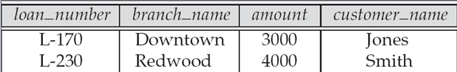

JOINED RELATIONS – EXAMPLES
loan natural inner join borrower
loan natural right outer join borrower

Slide 38

JOINED RELATIONS – EXAMPLES
loan full outer join borrower using (loan_number)
Find all customers who have either an account or a loan (but not both) at the bank.
select customer_name
from (depositor natural full outer join borrower )
where account_number is null or loan_number is null

Slide 39
Cross Joins
  Select <col name1>,<colname2>,..<colname n> from <Table name1> Cross Join<Table name2>
Self Joins
  from <tablename> [<Alias>],<Tablename>[<alias>]….

Slide 40
VIEWS
In some cases, it is not desirable for all users to see the entire logical model (that is, all the actual relations stored in the database.)
Consider a person who needs to know a customer’s name, loan number and branch name, but has no need to see the loan amount. This person should see a relation described, in SQL, by
(select customer_name, borrower.loan_number, branch_name
from borrower, loan
where borrower.loan_number = loan.loan_number )
A view provides a mechanism to hide certain data from the view of certain users.
Any relation that is not of the conceptual model but is made visible to a user as a “virtual relation” is called a view.

Slide 41
VIEW DEFINITION
A view is defined using the create view statement which has the form
create view v as < query expression >
where <query expression> is any legal SQL expression. The view name is represented by v.
Once a view is defined, the view name can be used to refer to the virtual relation that the view generates.
When a view is created, the query expression is stored in the database; the expression is substituted into queries using the view.

Slide 42
There are 2 types of Views in SQL:
Simple View
  Simple views can only contain a single base table.
Complex views
  can be constructed on more than one base table.
  complex views can contain: join conditions, a group by clause, a order by clause.

Slide 43
COMPARISON
Simple View | Complex View
Contains only one single base table or is created from only one table. | Contains more than one base tables or is created from more than one tables.
We cannot use group functions like MAX(), COUNT(), etc. | We can use group functions.
Does not contain groups of data. | It can contain groups of data.
DML operations could be performed through a simple view. | DML operations could not always be performed through a complex view.
INSERT, DELETE and UPDATE are directly possible on a simple view. | We cannot apply INSERT, DELETE and UPDATE on complex view directly.
Simple view does not contain group by, distinct, pseudocolumn like rownum, columns defiend by expressions. | It can contain group by, distinct, pseudocolumn like rownum, columns defiend by expressions.
Does not include NOT NULL columns from base tables. | NOT NULL columns that are not selected by simple view can be included in complex view.

Slide 44
EXAMPLE QUERIES
A view consisting of branches and their customers
create view all_customer as
(select branch_name, customer_name
from depositor, account
where depositor.account_number =
account.account_number )
union
(select branch_name, customer_name
from borrower, loan
where borrower.loan_number = loan.loan_number )
Find all customers of the Perryridge branch
select customer_name
from all_customer
where branch_name = 'Perryridge'

Slide 45
UPDATES THROUGH VIEWS (CONT.)
Some updates through views are impossible to translate into updates on the database relations
  create view v as
  select loan_number, branch_name, amount
  from loan
  where branch_name = ‘Perryridge’
Most SQL implementations allow updates only on simple views (without aggregates) defined on a single relation

Slide 46
UPDATING/INSERTING/DELETING A VIEW
Conditions for updating/Inserting/Deleting a View
    The SELECT clause may not contain the keyword DISTINCT.
    The SELECT clause may not contain summary functions.
    The SELECT clause may not contain set functions.
    The SELECT clause may not contain set operators.
    The SELECT clause may not contain an ORDER BY clause.
    The FROM clause may not contain multiple tables.
    The WHERE clause may not contain subqueries.
    The query may not contain GROUP BY or HAVING.
    Calculated columns may not be updated.
    All NOT NULL columns from the base table must be included in the view in order for the INSERT query to function.

Slide 47
If a view satisfies all the conditions mentioned, then view can be updated/inserted/deleted.
This would ultimately update the base table from which the view was created and the same would reflect in the view itself.
Dropping Views
  DROP VIEW view_name;

Slide 48
TRANSACTION CONTROL COMMANDS
The following commands are used to control transactions.
  COMMIT − to save the changes.
  ROLLBACK − to roll back the changes.
  SAVEPOINT − creates points within the groups of transactions in which to ROLLBACK.
used only with the DML Commands
Not applicable for DDL Commands since its autocommitted

Slide 49
THE COMMIT COMMAND
The COMMIT command is the transactional command used to save changes invoked by a transaction to the database.
The COMMIT command saves all the transactions to the database since the last COMMIT or ROLLBACK command.
The syntax for the COMMIT command is as follows.
  COMMIT;

Slide 50
THE ROLLBACK COMMAND
  The ROLLBACK command is the transactional command used to undo transactions that have not already been saved to the database.
  This command can only be used to undo transactions since the last COMMIT or ROLLBACK command was issued.
  The syntax for a ROLLBACK command is as follows:
      ROLLBACK;

Slide 51
THE SAVEPOINT COMMAND
A SAVEPOINT is a point in a transaction when you can roll the transaction back to a certain point without rolling back the entire transaction.
The syntax for a SAVEPOINT command is as shown below.
  SAVEPOINT SAVEPOINT_NAME;
This command serves only in the creation of a SAVEPOINT among all the transactional statements. The ROLLBACK command is used to undo a group of transactions.
The syntax for rolling back to a SAVEPOINT
  ROLLBACK TO SAVEPOINT_NAME;

