Slide 1

Telco Customer Churn Prediction System
Tresa Varghese

Slide 2
Problem Statement
- Customer churn is an important aspect that has direct impact on overall revenue of a company
- Early detection of customers who has higher probability to churn is critical
Helps retention team to target customers with appropriate offers
Analysis of data about customers who churn in the past can reveal any potential issues that need specific attention
- Build machine learning model to predict customer churn

Slide 3
Datasets
1. IBM Accelerator catalog
Information about customers from fictional company Telco
Predictor variables includes various information about customer such as demographics, services used etc.
Target Class: Customer Churn
0 -> Customer did not churn
1 -> Customer left the company
27% of rows have Customers have Churn = 1
2. United States zip codes database
Maps zip codes to county names

Slide 4
Data Cleaning
Missing values in Total Charges column
correlated with Monthly Charges and Tenure Months column
Column dropped
Missing values in Churn Reason column
Data not available at the time of prediction.
Column dropped

Slide 5
Preprocessing
Numerical Columns:
Transformed into same scale using MinMaxScaler
Categorical Columns:
Low cardinality columns: One Hot Encoding
High cardinality column: Zip Code
Mapped with corresponding county value.
Label Encoding

Slide 6
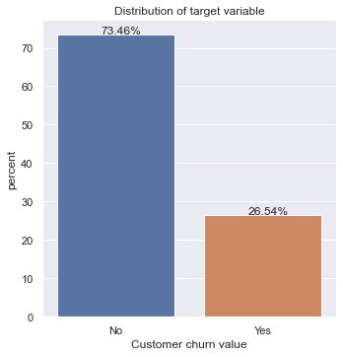
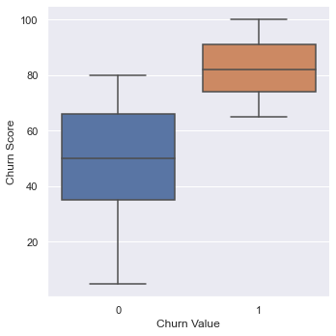
EDA

Slide 7
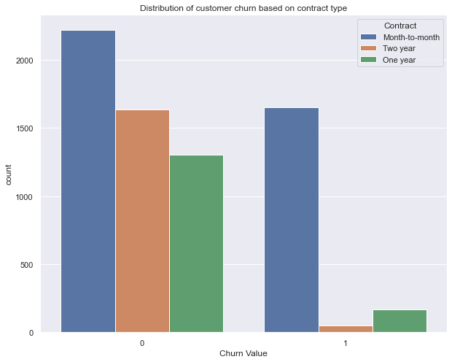
EDA

Slide 8
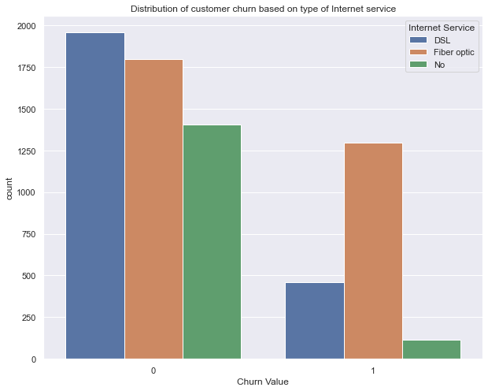
EDA
Among the customers who churned, 70% of them had Fibre Optic Internet Service with the company

Slide 9
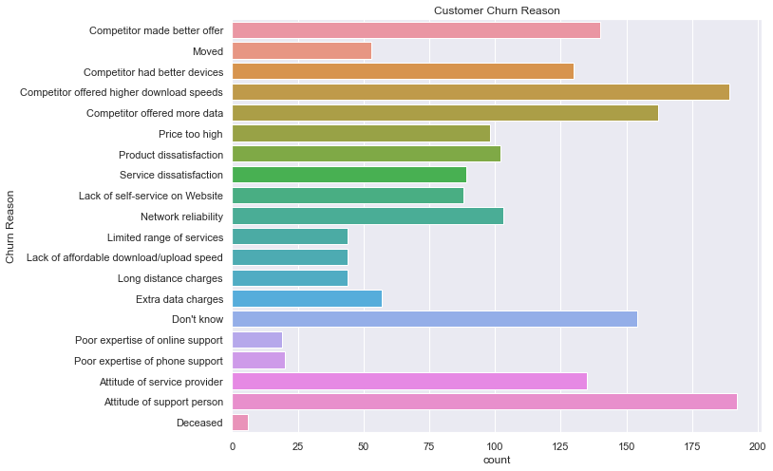
33% of the customers who left the company were offered with better internet or devices by competitors.
37% were not satisfied with the services provided by the company

Slide 10
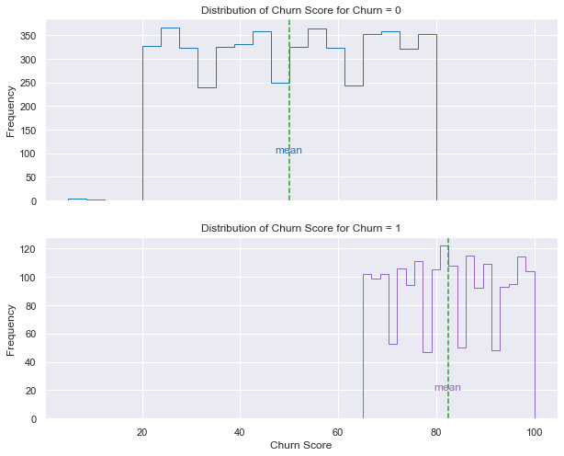
EDA
The difference between average churn score of those who churn and do not churn is between 31.74 and 33.01

Slide 11
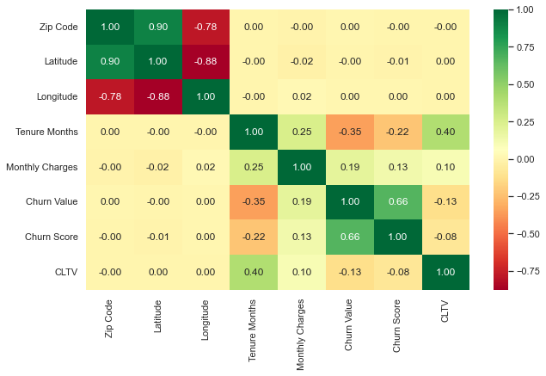
Correlation Analysis

Slide 12
Machine Learning Algorithms
Ada Boost
Linear Discriminant Analysis
Light Gradient Boosting Machine

Slide 13
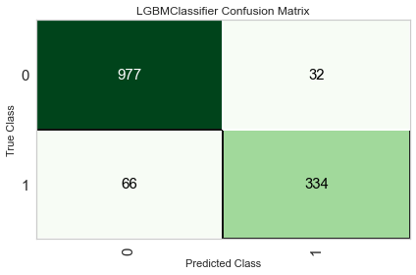
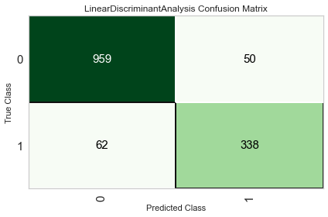

Confusion matrix
Best Recall score = 0.845

Slide 14
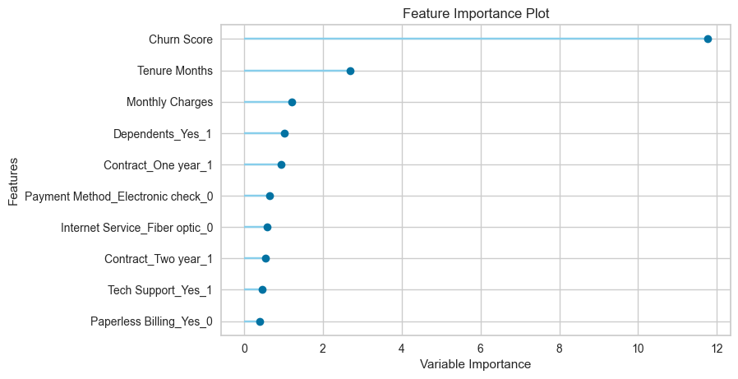
Feature Importance

Slide 15
Future Extensions
Availability of transaction data of customers can further assist in finding time sensitive trends in customer behavior
More research on competitors in the market and the services they offer can reveal any attention needed on the services and packages offered by the company
It also helps in understanding where the company stands in the competitive market.

