Slide 1

Covid predictive modeling and dashboard
Tresa Varghese

Slide 2
Problem Statement
- COVID-19 is an infectious disease caused by the SARS-CoV-2 virus.
- Having a system that can monitor the current situation of Covid around the world provides better control and improve confidence at a time of uncertainty.
- This can be achieved with the following steps
Data ingestion pipeline to periodically ingest daily Covid data
Perform necessary transformations on the data and store in the cloud
Create live dashboard
Construct predictive model

Slide 3
Datasets
1. IBM Accelerator catalog
Information about customers from fictional company Telco
Predictor variables includes various information about customer such as demographics, services used etc.
Target Class: Customer Churn
0 -> Customer did not churn
1 -> Customer left the company
27% of rows have Customers have Churn = 1
2. United States zip codes database
Maps zip codes to county names

Slide 4
Data Cleaning
Missing values in Total Charges column
correlated with Monthly Charges and Tenure Months column
Column dropped
Missing values in Churn Reason column
Data not available at the time of prediction.
Column dropped

Slide 5
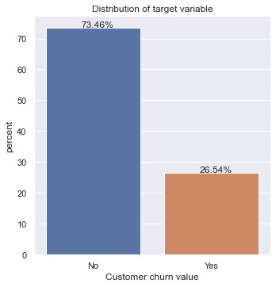
EDA

Slide 6
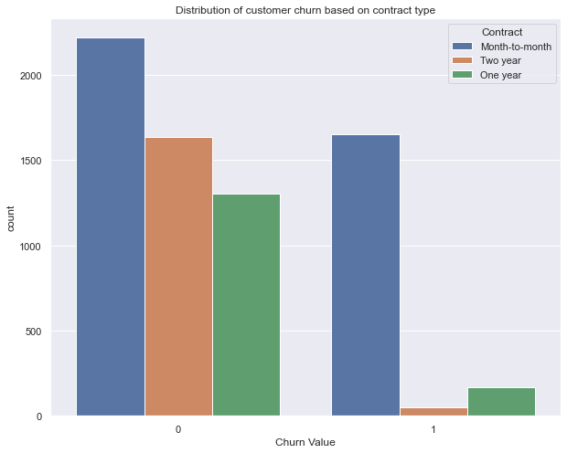
EDA

Slide 7
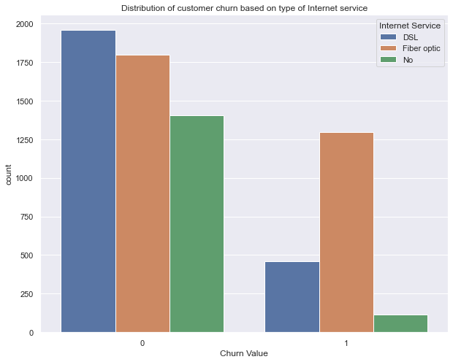
EDA
Among the customers who churned, 70% of them had Fibre Optic Internet Service with the company

Slide 8
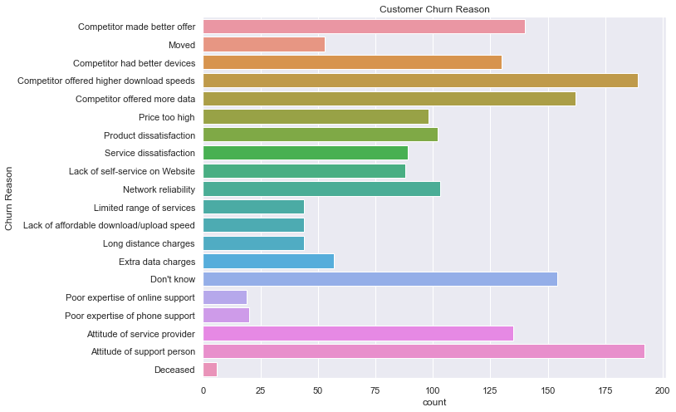
Churn reason
33% of the customers who left the company were offered with better internet or devices by competitors.
37% were not satisfied with the services provided by the company

Slide 9
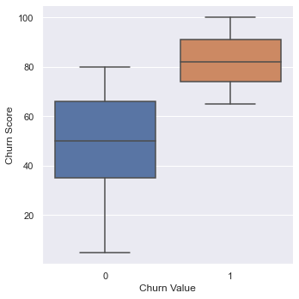
Churn Score
Check whether the difference between the mean churn score or both classes are statistically significant.
Welch’s Test for unequal variance

Slide 10
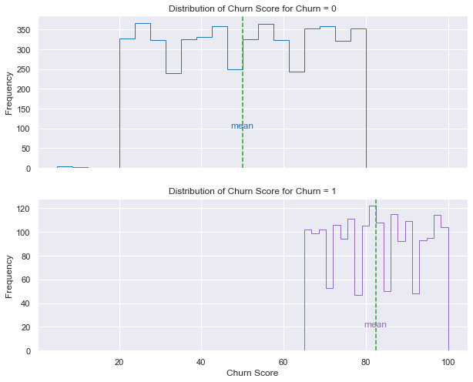
EDA
The difference between average churn score of those who churn and do not churn is between 31.74 and 33.01

Slide 11
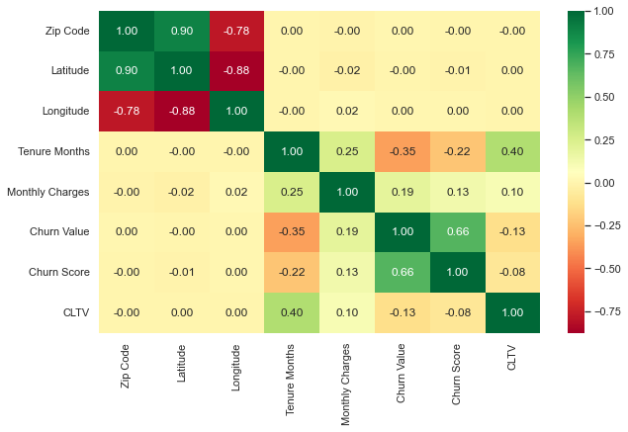
Correlation Analysis

Slide 12
Preprocessing
Numerical Columns:
Transformed into same scale using MinMaxScaler
Categorical Columns:
Low cardinality columns: One Hot Encoding
High cardinality column: Zip Code
Mapped with corresponding county value.
Label Encoding

Slide 13
Machine Learning Algorithms
Ada Boost
Linear Discriminant Analysis
Light Gradient Boosting Machine

Slide 14
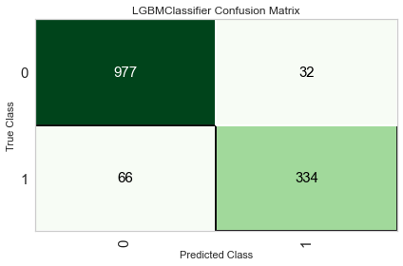
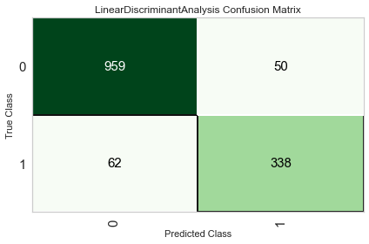

Confusion matrix
Best Recall score = 0.845

Slide 15
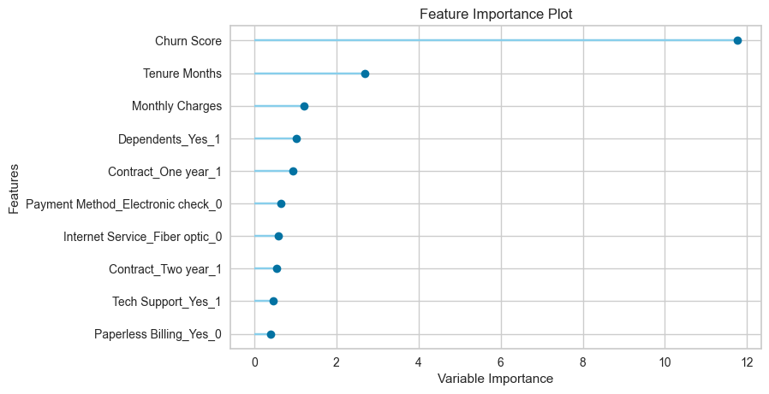
Feature Importance

Slide 16
Future Extensions
Availability of transaction data of customers can further assist in finding time sensitive trends in customer behavior
More research on competitors in the market and the services they offer can reveal any attention needed on the services and packages offered by the company
It also helps in understanding where the company stands in the competitive market.

