Slide 1

Covid predictive modeling and dashboard
Tresa Varghese

Slide 2
Problem Statement
- COVID-19 is an infectious disease caused by the SARS-CoV-2 virus.
- Having a system that can monitor the current situation of Covid around the world provides better control and improve confidence at a time of uncertainty.
- This can be achieved with the following steps
Data ingestion pipeline to periodically ingest daily Covid data
Perform necessary transformations on the data and store in the cloud
Create live dashboard
Construct predictive model

Slide 3
Datasets
COVID-19 Data Repository by the Center for Systems Science and Engineering (CSSE) at Johns Hopkins University
Data repository for the 2019 Novel Coronavirus Visual Dashboard operated by the Johns Hopkins University Center for Systems Science and Engineering (JHU CSSE)
2. Canada population data by province
Dataset containing province specific population data

Slide 4
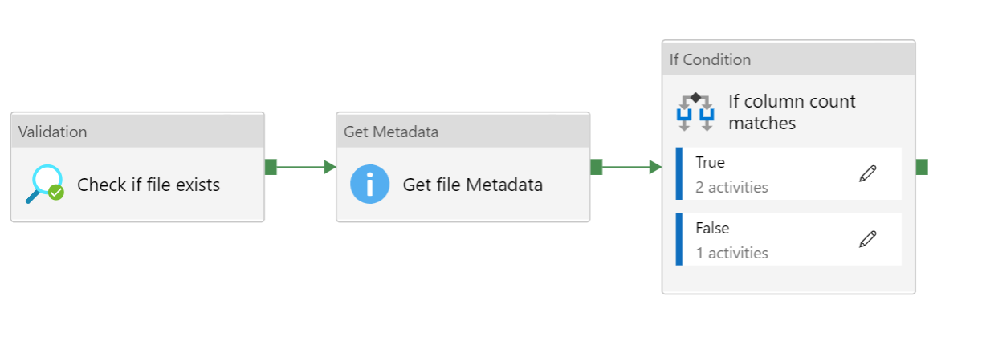
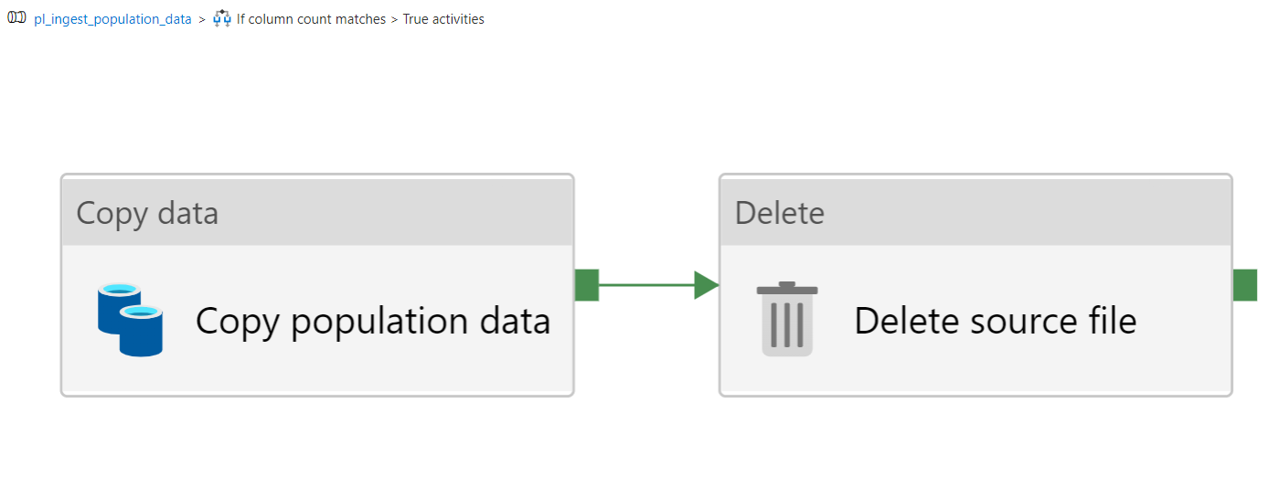
Data Ingestion
Pipeline for fetching population data from Azure Blob storage into Data Lake Gen 2

Slide 5
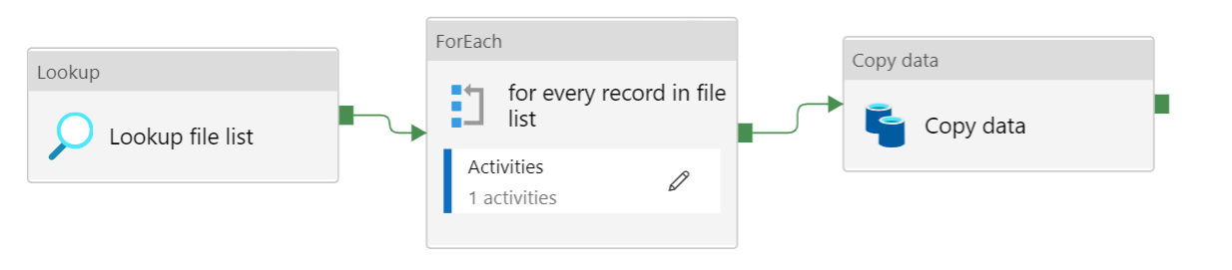
Data Ingestion
Pipeline for fetching daily covid data from CSSE repository into Data Lake Gen 2

Slide 6
Data Wrangling
Missing values
only for Repatriated Travellers
Eventually get deleted when we filter for province specific data

Slide 7
Data Wrangling
Preprocessing and feature engineering
Create time series data frame by melting wide data frame is into long data frame
Feature engineered the following columns
number of daily deaths and confirmed cases
7 day and 30-day moving average of confirmed cases and deaths
exponential weighted moving average of confirmed cases and deaths
Mortality rate as ratio of number of deaths to number of confirmed cases
Corrected errors in some columns with value 0.
The resulting time-series data frame is written as csv file for further processing

Slide 8
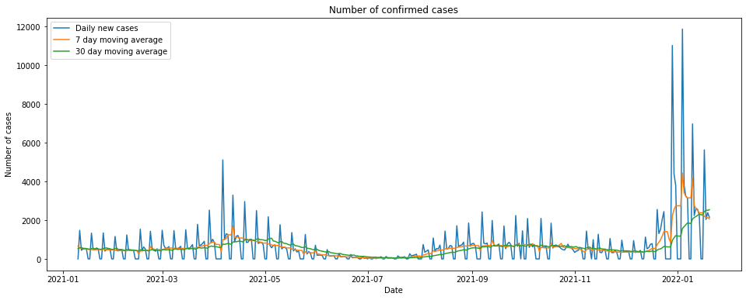
EDA

Slide 9
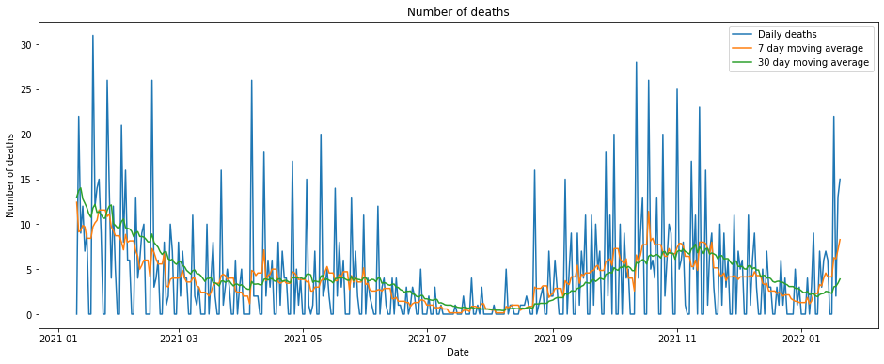
EDA

Slide 10
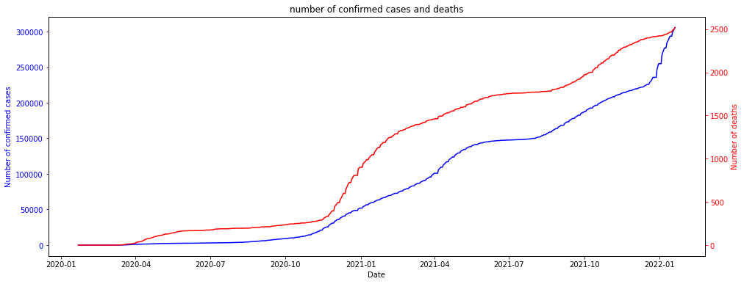
EDA

Slide 11
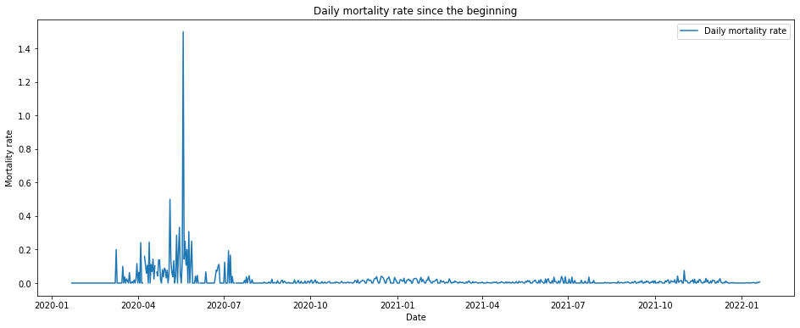
EDA

Slide 12
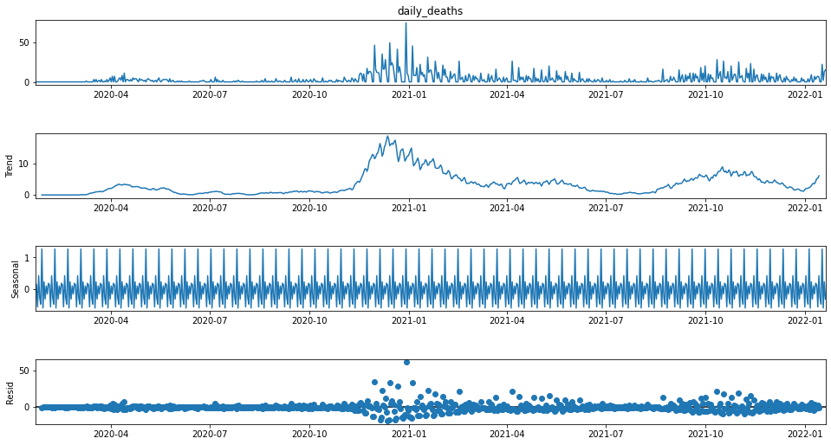
EDA

Slide 13
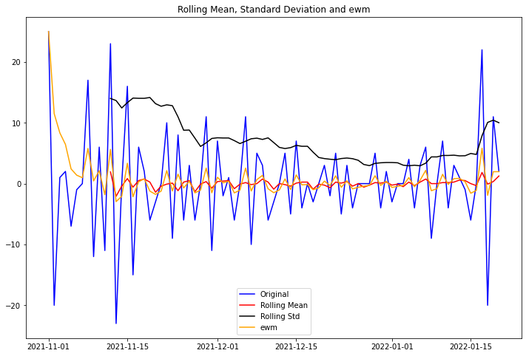
EDA

Slide 14
Machine Learning Algorithms
Ada Boost
Linear Discriminant Analysis
Light Gradient Boosting Machine

Slide 15
Future Extensions
Availability of transaction data of customers can further assist in finding time sensitive trends in customer behavior
More research on competitors in the market and the services they offer can reveal any attention needed on the services and packages offered by the company
It also helps in understanding where the company stands in the competitive market.

