Slide 1

Covid predictive modeling and dashboard
Tresa Varghese

Slide 2
Problem Statement
- COVID-19 is an infectious disease caused by the SARS-CoV-2 virus.
- Having a system that can monitor the current situation of Covid around the world provides better control and improve confidence at a time of uncertainty.
- This can be achieved with the following steps
Create a data ingestion pipeline to periodically ingest daily Covid data
Perform necessary transformations on the data and store it
Create live dashboard based on the data
Construct predictive model using ML/DL models to make projections

Slide 3
Datasets
COVID-19 Data Repository by the Center for Systems Science and Engineering (CSSE) at Johns Hopkins University
Data repository for the 2019 Novel Coronavirus Visual Dashboard operated by the Johns Hopkins University Center for Systems Science and Engineering (JHU CSSE)
2. Canada population data by province
Dataset containing province specific population data

Slide 4
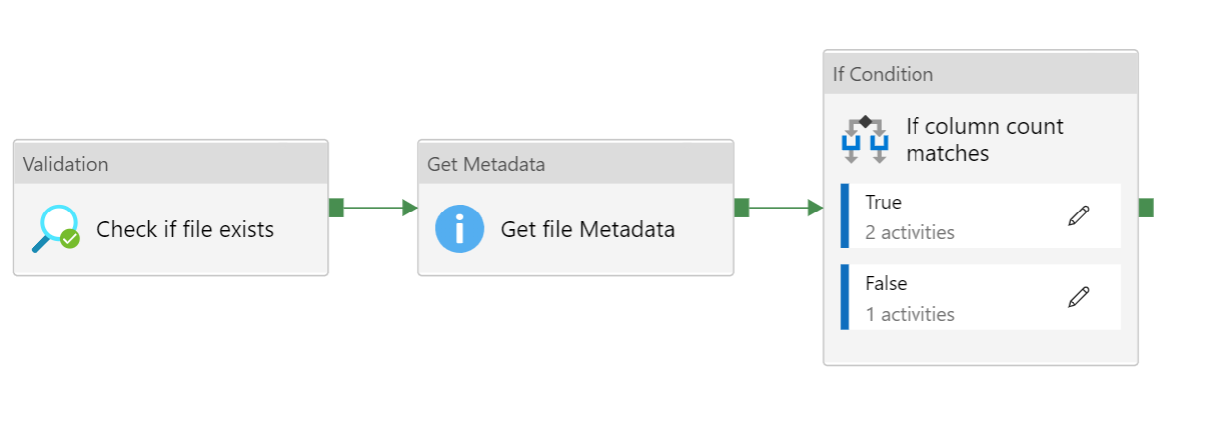
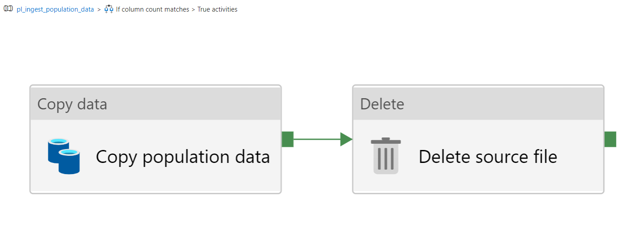
Data Ingestion
Pipeline for fetching population data from Azure Blob storage into Data Lake Gen 2

Slide 5
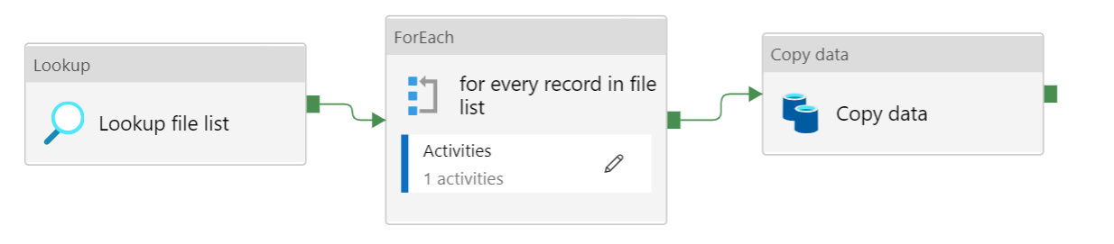
Data Ingestion
Pipeline for fetching daily covid data from CSSE repository into Data Lake Gen 2

Slide 6
Data Wrangling
Missing values
Values missing for only for Repatriated Travellers
Eventually get deleted when we filter for province specific data
Filtering
Include only the data from top 10 provinces, filter out everything else.

Slide 7
Data Wrangling
Preprocessing and feature engineering
Create time series data frame by melting wide data frame is into long data frame
Feature engineered the following columns
number of daily deaths and confirmed cases
7 day and 30-day moving average of confirmed cases and deaths
exponential weighted moving average of confirmed cases and deaths
Mortality rate as ratio of number of deaths to number of confirmed cases
Corrected errors in some columns with value 0.
The resulting time-series data frame is written as csv file for further processing

Slide 8
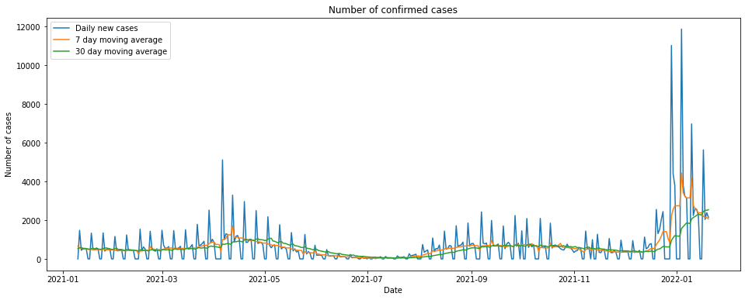
EDA

Slide 9
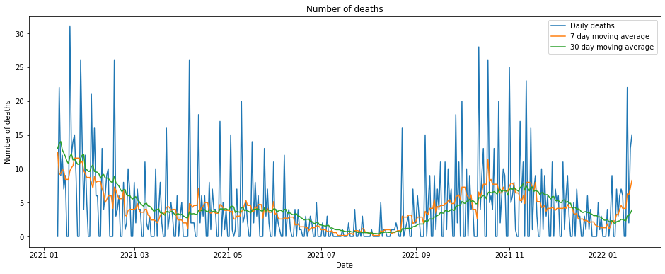
EDA

Slide 10
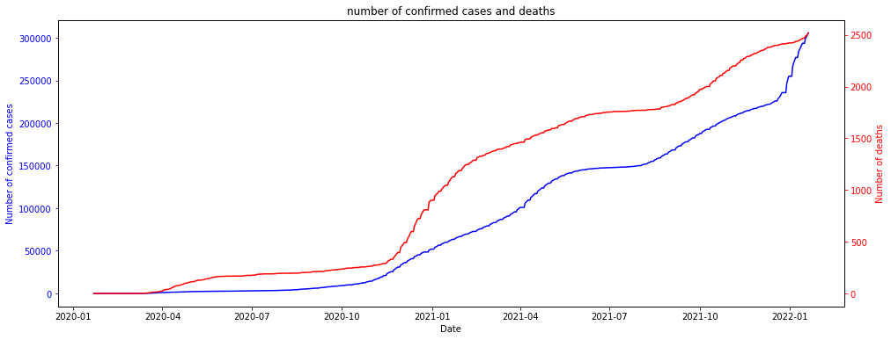
EDA

Slide 11
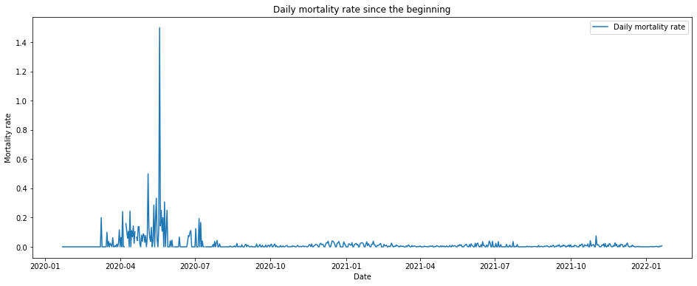
EDA

Slide 12
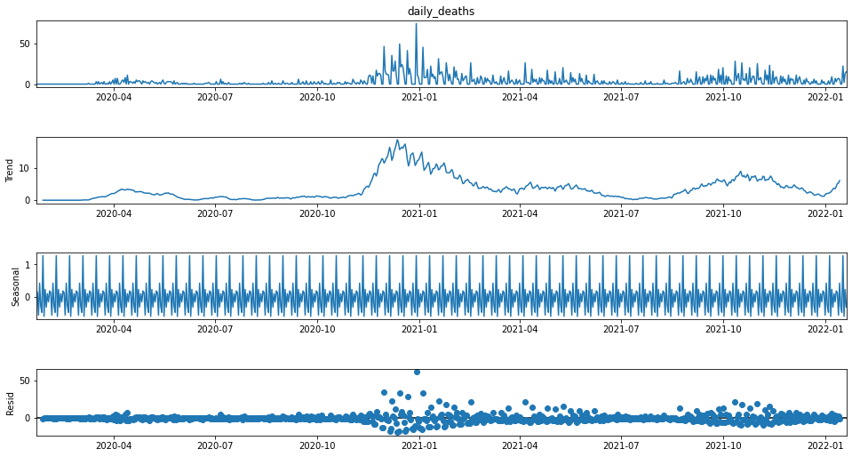
EDA

Slide 13
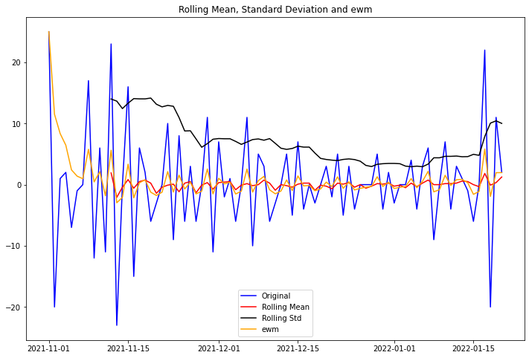
EDA

Slide 14
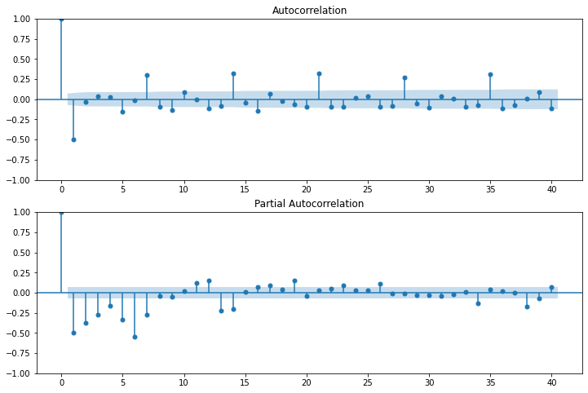
ACF and PACF

Slide 15
Predictive Modeling
LSTM:
Long Short-Term Memory
A kind of recurrent neural network (RNN) architecture
They have some sort of ‘memory’
RNNs feed the output back as an input, making the output dependent on prior events.
Useful in cases when we need to go back longer in time
Capable of keeping the important information, and forget the useless one

Slide 16
Hyper parameter tuning
The parameters we need to tune in our LSTM deep learning model are
Number of training epochs
Number of batches
Used trial and error method with multiple iterations and chose number of epochs as 3 and batch size as 1.

Slide 17
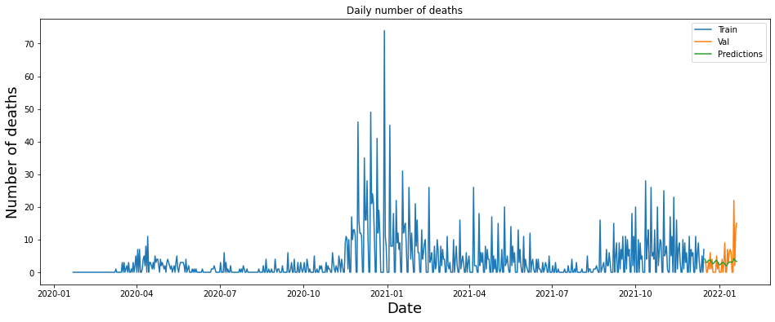
Final model

Slide 18
Model performance
Measure used: RMSE
It is a forecasting problem
It punishes large errors
Results in a score that is in the same units as the number of deaths.
RMSE on test set: 4.6

Slide 19
Future Extensions
- Additional features that may contribute to the number of deaths like number of cases, number of elderly people, and other factors can also be considered.
- A multivariate, multi-step forecasting needs to be done in such cases.

