Slide 1
The Cyborg's Pen
Quantifying the Emotional Gap and Stylistic Divergence in Human vs. AI Narratives
Tianji Zhou
University of Maryland
zhou0805@umd.edu

Slide 2
Introduction
From Tool to Co-Creator
Generative AI has evolved from a passive tool to an active co-creator, challenging notions of authorship .
The Core Problem
While LLMs excel at syntactic construction, they mimic emotional markers without genuine lived experience.
RLHF & Homogenization
Reinforcement Learning from Human Feedback (RLHF) optimizes quality but may flatten narrative complexity, raising questions about authorship.

Slide 3
Literature Review & Research Gaps
Theory and Practice Gap
Research Area‘s Gap
Methodological Gap
Current Status:
AI alignment causes "homogenization" and a "safe convergence" of content, but these insights remain largely qualitative or survey-based.
Current Status:
Existing detection benchmarks predominantly evaluate factual texts (news, academic papers) or rely on outdated models like GPT-2/3.
Current Status:
Research struggles to explain why traditional statistical detectors fail when SOTA models master lexical mimicry and deceive detection tools.
Operationalize the "safe convergence" into a quantifiable metric:
"Emotional Numbness“
(reduction in variance that distinguishes
machine output from human creativity).
The research focuses on narrative texts
Stress-tests SOTA models to determine whether they have eliminated the stylistic features present in outdated models.
We benchmarked lexical methods against DistilBERT to reveal "evasion mechanisms" and detect the observable "emotional rigidity" imposed by alignment protocols.

Slide 4
Research Questions Overview
RQ1
Linguistic Patterns
RQ2
Semantic Compliance & Topic Strategy
RQ3
Detection Robustness
What are the key quantifiable differences in lexical diversity, syntactic complexity, and emotional expression between short stories written by humans and those generated by AI?
To what extent do AI narratives follow or deviate from the semantic constraints of prompts compared to humans?
As model complexity increases, does the
style gap in generated narratives shrink? Does this indicate that AI’s ability to mimic human “flaws” is evolving?

Slide 5
Data Collection: Parallel Corpus
Methodology: Paired evaluation using 2,000 identical prompts.
Human Ground Truth (N=2,000)
Base AI Group (N=6,000)
SOTA AI Group (N=367)
Source: Reddit Writing Prompts from Kaggle with specific prompts
(Random sampling).
Source: AI Generated
Models: GPT-4o-mini, Gemini 2.0 Flash, Claude 3 Haiku.
Source: AI Generated
Models: Claude 4.5 Sonnet (N=300), Gemini 3 Pro (N=67)
conducted a manual review→correcting formatting errors, ignoring incomplete stories, and identifying the causes of errors→Integration
A CSV table（final_dataset_human_vs_ai.csv） of 2000 thematic stories and 8367 individual stories based on human prompts

Slide 6
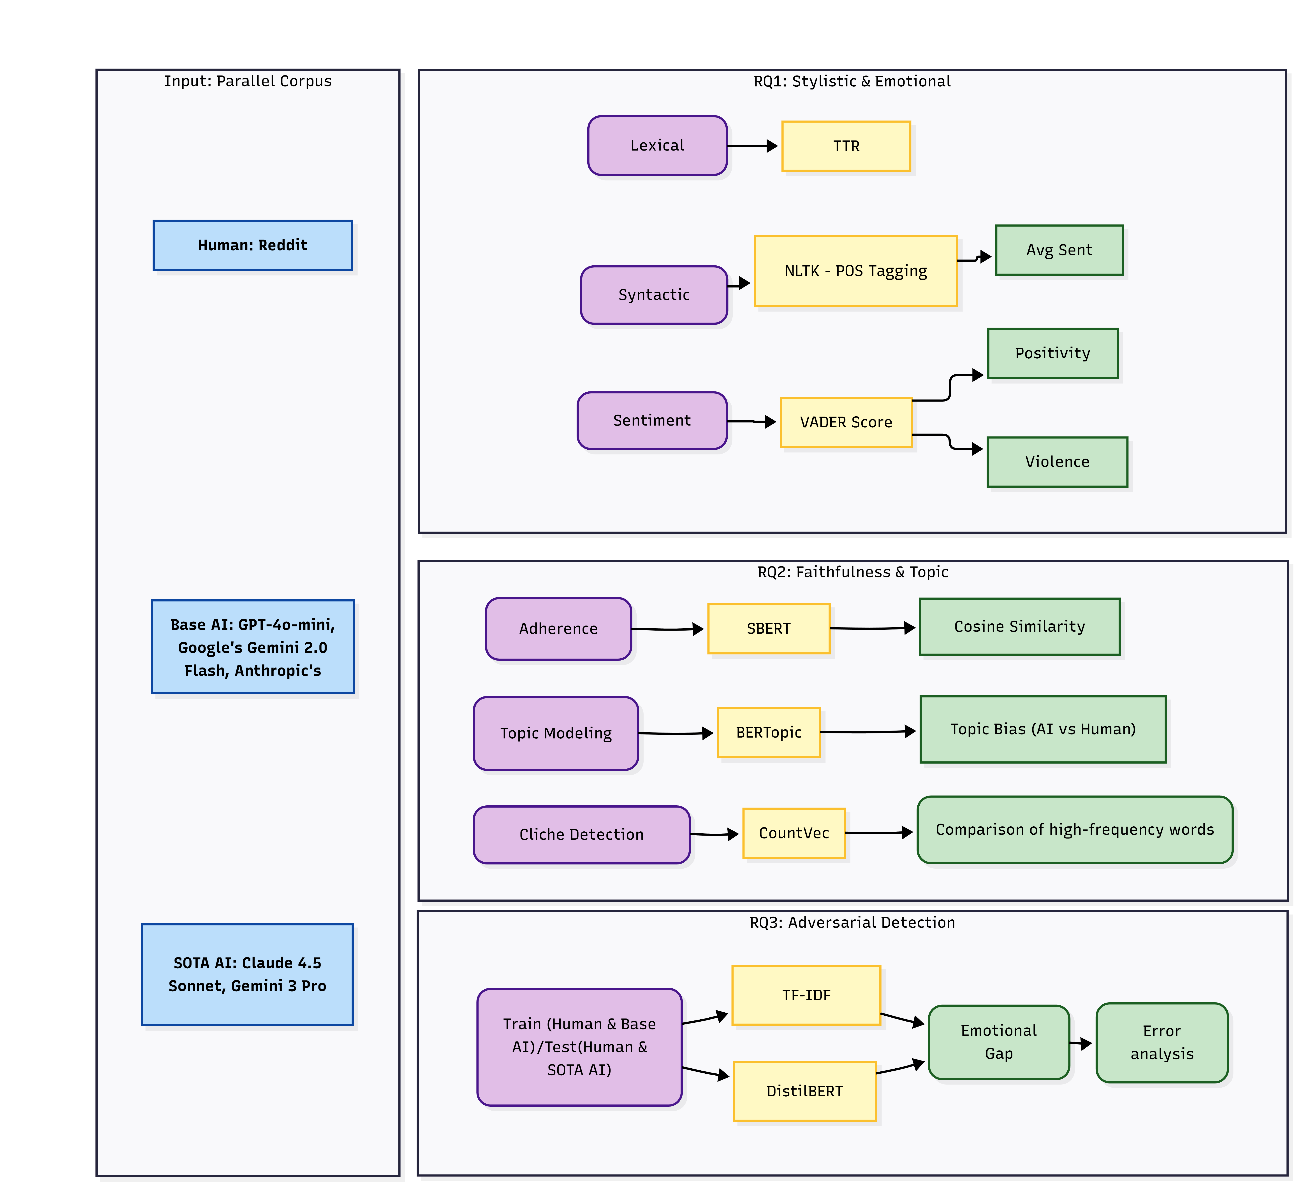
Methodology
RQ 1
TTR
Syntactic Complexity - NLTK
VADER - Positivity/Violence
RQ 2
Semantic Adherence - SBERT
Topic modeling - BERTopic
Cliché Detection - CountVec
RQ 3
Train/Test Model
TF-IDF vs DistilBERT
Emotional Gap
Error analysis

Slide 7
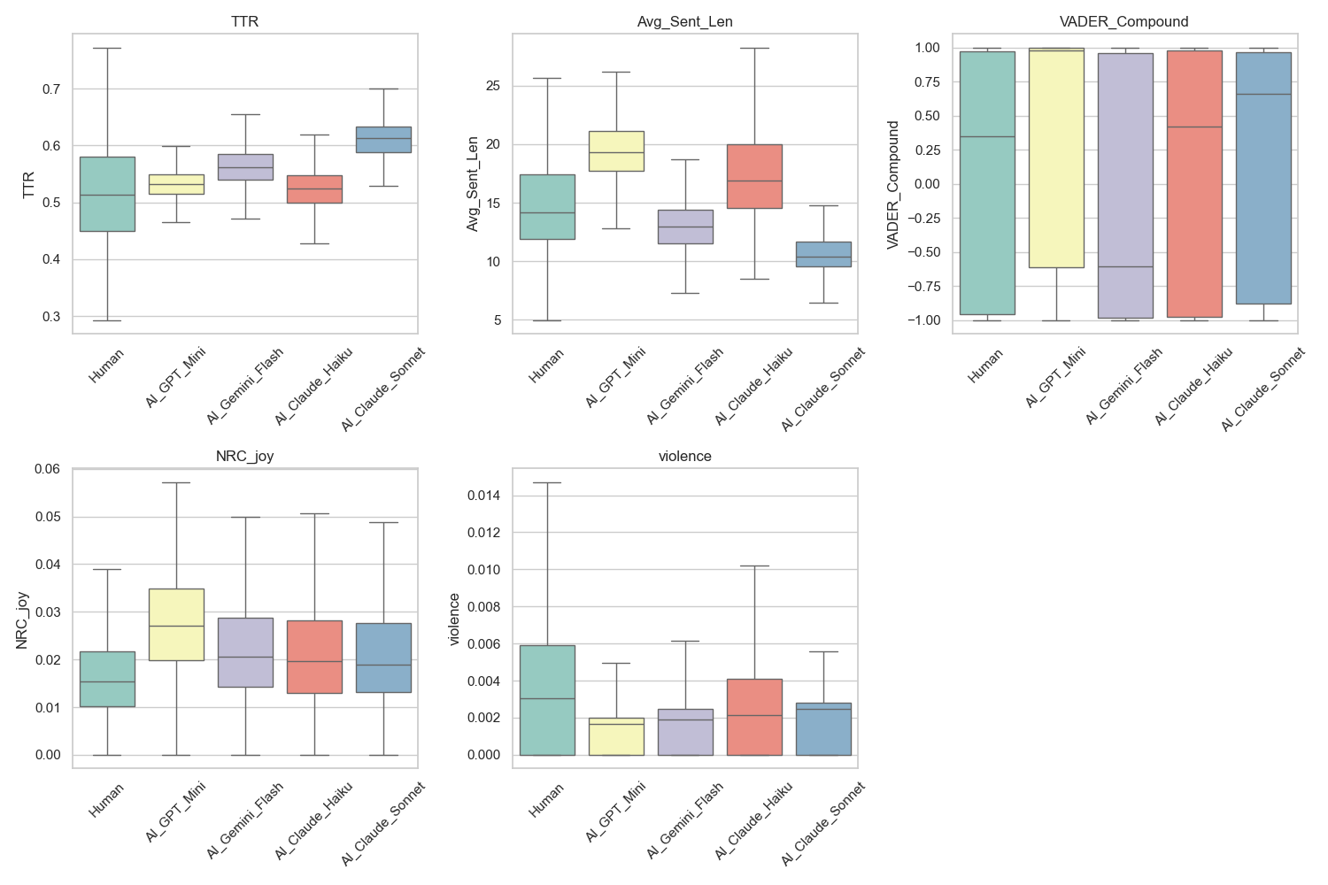
Results for RQ1
Linguistic Features（TTR & Sent_Len）
Human: Higher spontaneity(1.3), more flexible in their use of language.
AI: Preference for readability(0.4-0.8). High lexical diversity(SOTA) but repetitive sentence structures.
Sentiment Analysis (VADER & Joy &Violence)
Human: Neutral approach, using negative sentiment as necessary narrative tools for dramatic conflict.
AI：Exhibits extreme "Positive Bias“(Except Gemini)
Alignment Strategy (VADER)
General AI: Emphasizes safety & joy, even if the prompt contains negative words.
Exception (Gemini 2.0 Flash)：Negative bias. Amplifies conflict objectively based on prompts.
E.g. (ID=1963) “The world was a symphony of screams... My axe sang a bloody tune... leaving through rotten flesh,” /（ ID=748 ） “I hate you. There, I said it... This is a declaration of war,”

Slide 8
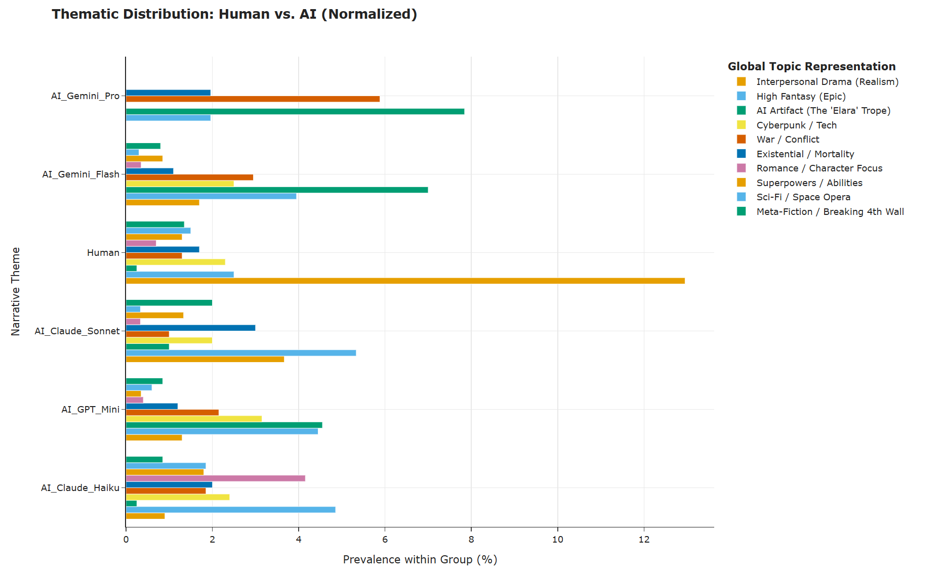
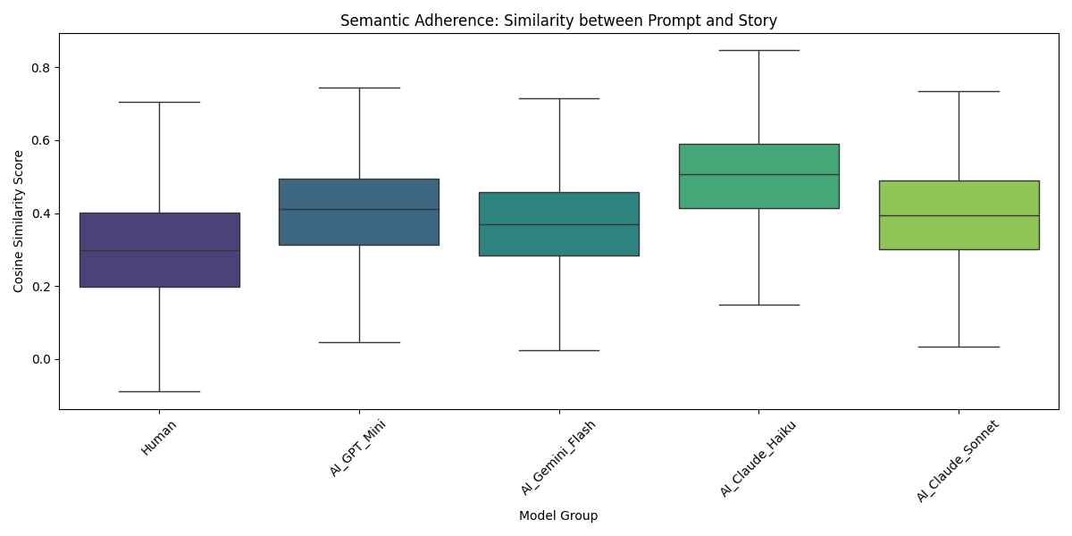
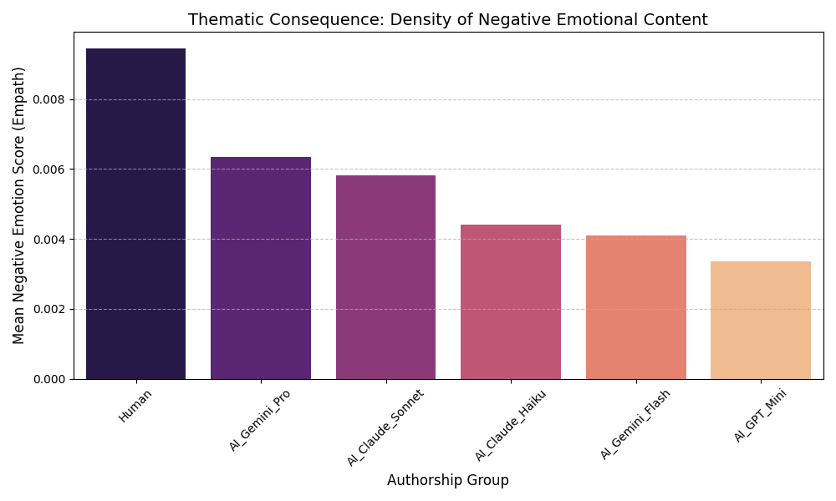
Results for RQ2
Semantic Adherence
Human: Low Cosine Similarity (~0.3), favoring creativity over strict relevance.
AI: High Cosine Similarity (>0.45). Strictly adheres to literal constraints ("Obedient").
Topic Distribution
Human: "Interpersonal Drama“ - emotional realism
AI: “AI Artifact,” “Sci-Fi/Space Opera,” and “High Fantasy ” - non-realism
Underlying Strategy – Thematic Consequence
Inverse relationship between AI authorship and negative sentiment density.
AI's preference for science fiction themes is a strategy to minimize conflict and thus avoid the risks of harmful content associated with realism.

Slide 9
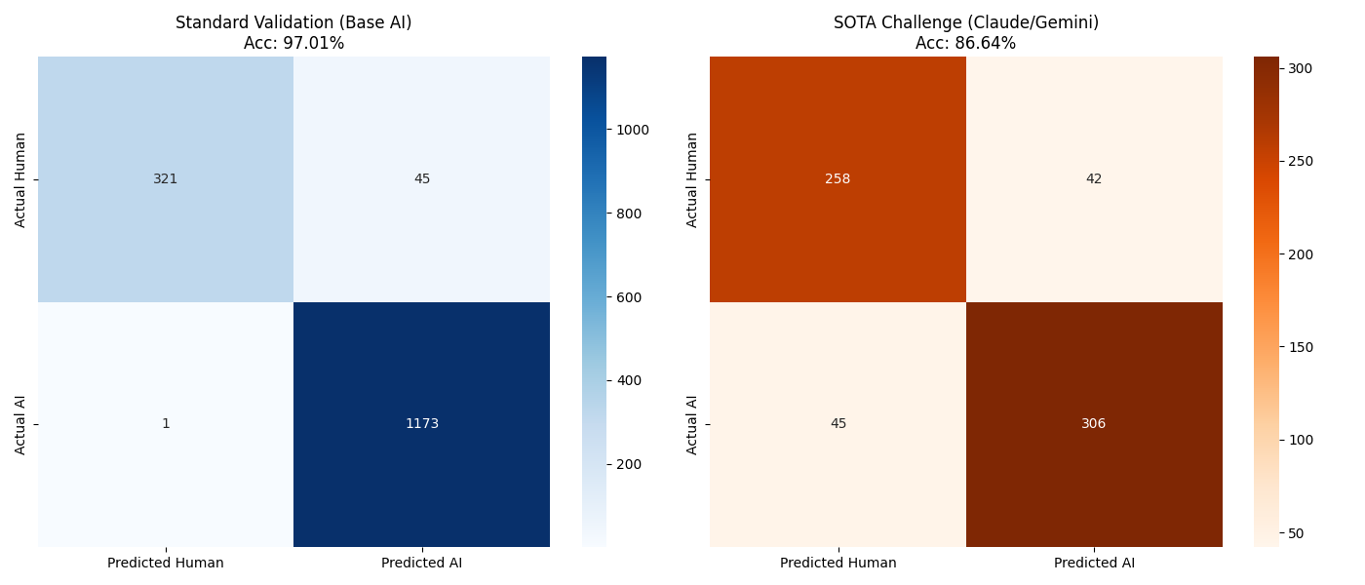
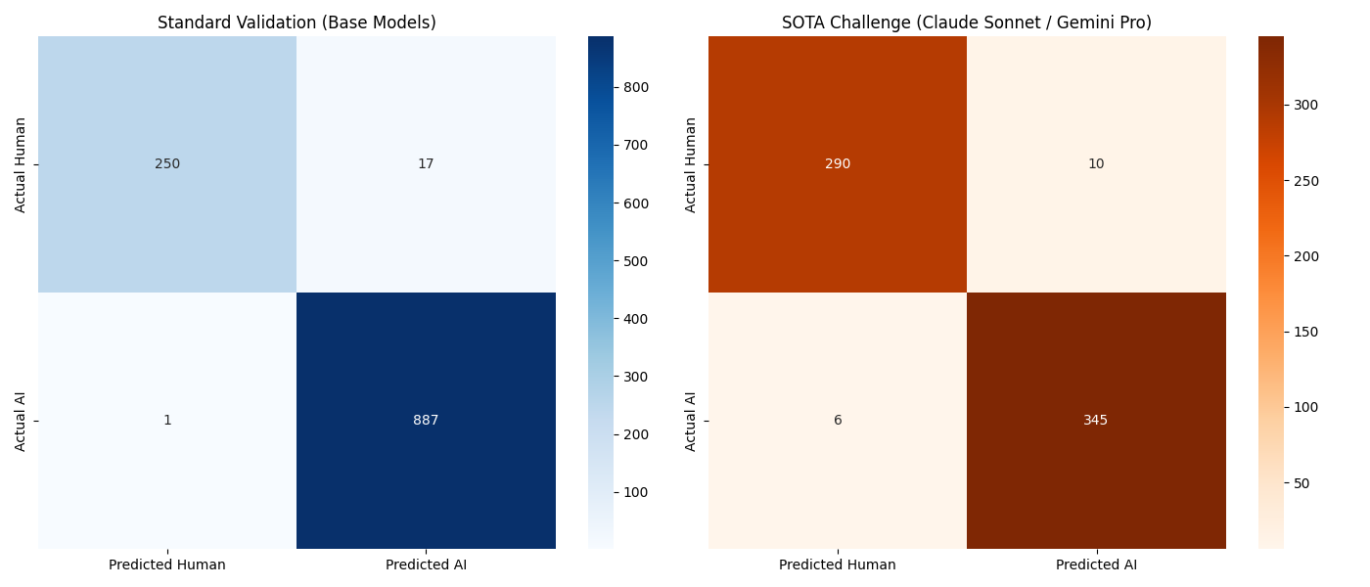
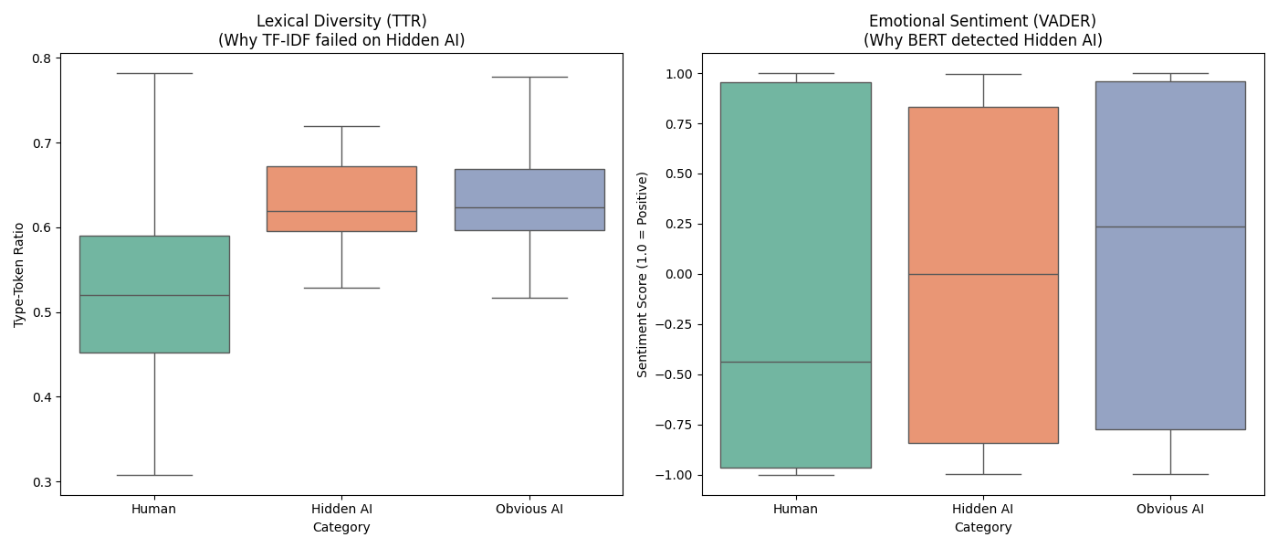
Results for RQ3
TF-IDF
Performance Divergence
Metric | Base | SOTA
Accuracy | 0.97013 | 0.866359
Precision | 0.963054 | 0.87931
Recall | 0.999148 | 0.871795
F1-Score | 0.980769 | 0.875536
TF-IDF Failure: SOTA models expand vocabulary, erasing specific keyword fingerprints / High TTR
DistilBERT Robustness: High accuracy. While vocabulary shifts, differences in deep semantic structure can still be detected.
DistilBERT
Metric | Base | SOTA
Accuracy | 0.984416 | 0.975422
Precision | 0.981195 | 0.971831
Recall | 0.998874 | 0.982906
F1-Score | 0.989955 | 0.977337
Analyze "Hidden AI"
"Hidden AI" Group: AI narratives that fooled TF-IDF still exhibit high neutrality/positivity (Score ~0.00).
AI's preference for science fiction themes is a strategy to minimize conflict and thus avoid the risks of harmful content associated with realism.
Conclusion: SOTA models have achieved "Lexical Camouflage" but failed with "Emotional Gap." The "Safe/Less Conflict" remains the most distinct feature of AI.

Slide 10
Conclusion, Discussion & Limitations
Problems With AI-generated Content
AI sacrifices literary merit for safety. It smooths out the "rough edges" of conflict and pain, resulting in narratives that are structurally smooth but emotionally "unconvincing" and lacking human texture.
Sample Size Constraints
Gemini 3 Pro (N=67) :limited by the API rate limit, causing 233 of them to generate a 90s timeout during generation, so only N=67 items were generated
AI’s Escape Strategy
AI sacrifices literary merit for safety. It smooths out the "rough edges" of conflict and pain, resulting in narratives that are structurally smooth but emotionally "unconvincing" and lacking human texture.
Inside The Model
No access to internal weights of commercial models; analysis limited to output-only features
The Future of Detection
AI cannot hide its Semantic Essence—stereotypical emotional bias and overly adhering to the theme. Future detection must shift focus from “surface words” to “deep emotional texture” and “Topic Relevance”.

Slide 11
Q&A
Thank you for your listening.
Tianji Zhou
zhou0805@umd.edu

