Slide 1
Lecture 21 Continuous Problems Fréchet Derivatives
Notes:
Over the past twenty years,
important advanced have been made in inverse theory
using tools drawn from functional analysis
that are centered about the concept of ‘adjoint operators’.
In oceanography and atmospheric science, the are associated with the
lingo ‘data assimilation’.
And in seismology, with the waveform tomography.

Slide 2
Syllabus
Lecture 01 Describing Inverse Problems Lecture 02 Probability and Measurement Error, Part 1 Lecture 03 Probability and Measurement Error, Part 2 Lecture 04 The L₂ Norm and Simple Least Squares Lecture 05 A Priori Information and Weighted Least Squared Lecture 06 Resolution and Generalized Inverses
Lecture 07 Backus-Gilbert Inverse and the Trade Off of Resolution and Variance Lecture 08 The Principle of Maximum Likelihood Lecture 09 Inexact Theories Lecture 10 Nonuniqueness and Localized Averages Lecture 11 Vector Spaces and Singular Value Decomposition
Lecture 12 Equality and Inequality Constraints Lecture 13 L₁ , L∞ Norm Problems and Linear Programming Lecture 14 Nonlinear Problems: Grid and Monte Carlo Searches Lecture 15 Nonlinear Problems: Newton’s Method Lecture 16 Nonlinear Problems: Simulated Annealing and Bootstrap Confidence Intervals Lecture 17 Factor Analysis Lecture 18 Varimax Factors, Empircal Orthogonal Functions Lecture 19 Backus-Gilbert Theory for Continuous Problems; Radon’s Problem Lecture 20 Linear Operators and Their Adjoints Lecture 21 Fréchet Derivatives Lecture 22 Exemplary Inverse Problems, incl. Filter Design Lecture 23 Exemplary Inverse Problems, incl. Earthquake Location Lecture 24 Exemplary Inverse Problems, incl. Vibrational Problems

Slide 3
Purpose of the Lecture
use adjoint methods to compute
data kernels
Notes:
This lecture applies the mathematical techniques that we developed
during the last lecture to derive data kernels. Keep in mind that knowing
the data kernel is just the first step. You then have to solve the inverse
problem. But we have already built up a repertoir of techniques for that.

Slide 4
Part 1
Review of Last Lecture
Notes:
Here we review the results of last lecture.
Again, we proceed by analogy with the discrete case.

Slide 5
a function m(x) is the continuous analog of a vector m
Notes:
A function is analogous to a vector.
We’ve used this many times in the class,
approximating a function as a vector of discrete values, with some sampling delta-x.

Slide 6
a linear operator ℒ is the continuous analog of a matrix L
Notes:
A linear operator – a linear combination of derivatives and integrals - is analogous to a matrix.
We’ve used this approximation in the class,
when we approximated the second derivative so as to be able to quantify roughness.

Slide 7
a inverse of a linear operator ℒ⁻¹ is the continuous analog of the inverse of a matrix L⁻¹
Notes:
The inverse operator undoes the effect of the operator,
just as a multiplication by the inverse matrix undoes the effect
of multiplying by the original matrix.

Slide 8
a inverse of a linear operator can be used to solve a differential equation if ℒm=f then m=ℒ⁻¹f just as the inverse of a matrix can be used to solve a matrix equation if Lm=f then m=L⁻¹f
Notes:
Inverse operators solve differential equations,
just as a matrix inverse solves a matrix equation.

Slide 9
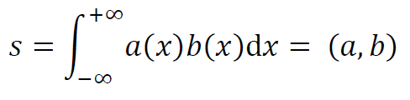
the inner product is the continuous analog of dot product s= a^{T}b
Notes:
An inner product, an integral abbreviated (a,b),
is analagous to a dot product.

Slide 10
the adjoint of a linear operator is the continuous analog of the transpose of a matrix L^{T}
ℒ †
Notes:
The adjoint of an operator
is another operator ...

Slide 11
the adjoint can be used to manipulate an inner product just as the transpose can be used to manipulate the dot product (La) ^{T}b= a ^{T}(L^{T}b)
(ℒa, b) =(a, ℒ†b)
Notes:
that can be used to manipulate an inner product.

Slide 12


table of adjoints
c(x)
d/dx
d²/dx²
c(x)
-d/dx
d²/dx²
Notes:
Here’s a table of the adjoints we just worked out.
We’ll use them later in the lecture.

Slide 13
Part 2
definition of the Fréchet derivatives
Notes:
You here this word, Frechet derivative, a lot in inverse theory.

Slide 14


first rewrite the standard inverse theory equation in terms of perturbations
a small change in the model
causes a small change in the data
Notes:
First, recognize that many inverse problems are nonlinear
but have been linearized using Taylor’s Theorem or some related method.
In these cases, the data kernel is approximate and really only relates
small changes in the model to small changes in the data.

Slide 15

second compare with the standard formula for a derivative
Notes:
But this form of the data kernel is very similar to
the first term of Taylors Theorem
relating a perturbation Delta-m in a discrete model parameter m
to a corresponding perturbation Delta-d in the data d.
Thus the data kernel is some sort of derivative.

Slide 16

third identify the data kernel as a kind of derivative
this kind of derivative is called a
Fréchet derivative
Notes:
We identify the data kernel as a new kind of derivative
the Frechet derivative

Slide 17



definition of a Fréchet derivative
,
this is mostly lingo
though perhaps it adds a little insight about
what the data kernel is
Notes:
This derivative relates delta-m to delta-d via an inner product.
Keep in mind that delta-m is a function;
it is defines for all x,
hence computing its effect on the data requires an integral over all x.

Slide 18
Part 2
Fréchet derivative of Error
Notes:
Here we compute that derivative of Error with respect to the model.
This allows us to use a gradient method to solve an inverse problem.

Slide 19
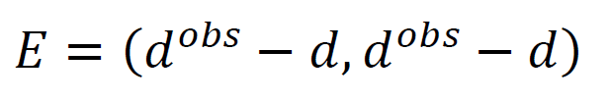
treat the data as a continuous function d(x)
then the standard L₂ norm error is
Notes:
This is the standard definition of error,
but for a function d(x).

Slide 20



=
let the data d(x) be related to the model m(x)
by
could be the data kernel integral
because integrals are linear operators
Notes:
Step 1 is to say that the data is equal to a linear operator acting on the model function.
Thus could be a data kernel integral, but could be something else, too.

Slide 21


now do a little algebra to relate
to
a perturbation in the model
causes
a perturbation in the error
Notes:
The Frechet derivative relates a perturbation in m to a perturbation in E.

Slide 22




if m⁽⁰⁾ implies d⁽⁰⁾ with error E⁽⁰⁾ then ...
Notes:
Start with a guess m(0) that gives data d(0) with error E(0).
Now linearize around this guess to get a formula for delta-E.

Slide 23
if m⁽⁰⁾ implies d⁽⁰⁾ with error E⁽⁰⁾ then ...
all this
is just
algebra
Notes:
First steps are just algebraic manipulation.
Note in last step we ignore a 2nd order term involving the square of a perturbation.

Slide 24
if m⁽⁰⁾ implies d⁽⁰⁾ with error E⁽⁰⁾ then ...
use δd = ℒδm
Notes:
Now we employ the relationship between model and data.

Slide 25

if m⁽⁰⁾ implies d⁽⁰⁾ with error E⁽⁰⁾ then ...
use adjoint
Notes:
Now we employ the adjoint.
This is the critical step, because now the formula for delta-E is the same
form as a Frechet derivative.

Slide 26

if m⁽⁰⁾ implies d⁽⁰⁾ with error E⁽⁰⁾ then ...
Fréchet derivative of Error
Notes:
And we just read the Frechet derivative out of the inner product.

Slide 27
you can use this derivative to solve and inverse problem using the gradient method
Notes:
The derivative of E can now be used in a gradient algorithm.

Slide 28

example
Notes:
Example of a moderately complicated linear operator.

Slide 29
example
d(x) =
this is the relationship between model and data
Notes:
The operator relates model function m(x) to data d(x)

Slide 30

example
construct adjoint
Notes:
Here’s its adjoint.
Recall that the adjoint of d/dx is –d/dx
and the adjoint of the integral from minus infinity to x
is the integral from x to infinity.

Slide 31

example
Fréchet derivative of Error
Notes:
So here’s the Frechet derivative of error.

Slide 32
(A)
m(x)
(B)
x
d(x)
(C)
x
log₁₀ E/E₁
iteration
Notes:
The black curve in A is the true model function.
The red curve in B is the true data.
The dotted curve in A is the initial guess for the model.
The solid curve in A is the final model, which is very close to the true model.
The black curve in E is the error for the first 100 steps.
The final result took 15000 iterations of the gradient method.
But it recovered the model very well.
Fig. 11.5. Example of the solution of a continuous inverse problem using a gradient method to minimize the error E, where an adjoint method is used to compute ∇E . (A) A test function, m^{true}(x) (black), trial function (dotted green) reconstructed function after 40 iterations (dashed green) and final reconstructed function after 15,890 iterations (green). (B) The data, d(t) satisfies d(t)=ℒm(t), where ℒ is the linear operator discussed in the text. (C) Error E as a function of iteration number, for the first 100 iterations. MatLab script gda11_03.

Slide 33
Part 3
Backprojection
Notes:
This is an approximate way of solving inverse problems.

Slide 34
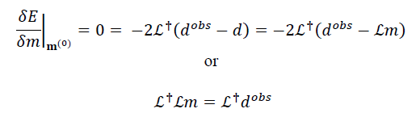
continuous analog of least squares
Notes:
Note that if we set the Frechet derivative of error to zero, we get a formula that is
very reminiscent of least squares.

Slide 35



now define the identity operator ℐ
m(x) = ℐ m(x)
Notes:
Now here’s a trick.
First define an ‘identity operator”, curly-I, that acts link an identity matrix.
Now add and subtract it from the equation, and manipulate.
What you get is true, but pretty useless.

Slide 36



view as a recursion
Notes:
Now view it as a recursion.
The first iteration, with m(0) set to zero,
gives a simple formula for m(1),
in which ...

Slide 37
view as a recursion
using the adjoint as if it were the inverse
Notes:
... in which the adjoint acts like an inverse.
This approximation is called ‘backprojection’

Slide 38
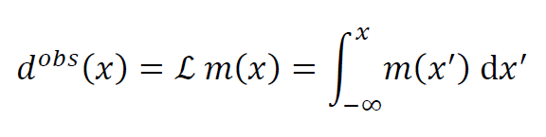
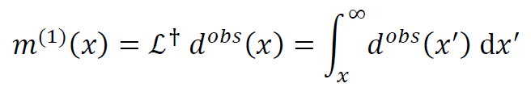
example
exact
m(x) = ℒ⁻¹ d^{obs} = d d^{obs} / dx
backprojection
Notes:
Here’s an example.
Curly-L is the indefinite integral.
So the exact inverse is the first derivative.
But the backprojection, based on the adjoint, is another integral.

Slide 39
example
exact
m(x) = ℒ⁻¹ d^{obs} = d d^{obs} / dx
backprojection
crazy!
Notes:
Crazy!
It couldn’t possibly work!

Slide 40
(A)
m(x)^{true}
(B)
x
m^{est}(x)
(C)
x
m⁽¹⁾(x)
x
Notes:
... or could it ?
(C) is the back projection.
It isn’t perfect, but its surprisingly good.
Fig. 11.6. (A) True one-dimensional model m^{true}(x). The data satisfty d^{obs}= ℒ m^{true}, where ℒ is the indefinite integral. (B) Estimated model, using m^{est} = ℒ⁻⁻¹ d^{obs} where ℒ is the first derivative. Note that m^{est}=m^{true}. (C) Backprojected model m⁽¹⁾= ℒ† d^{obs} , where ℒ† is the adjoint of ℒ. Note that, up to an overall multiplicative factor, m⁽¹⁾≈ m^{true}. MatLab script gda11_04.

Slide 41
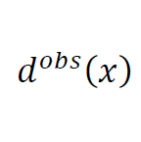
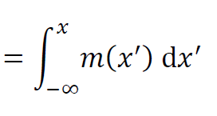
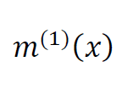
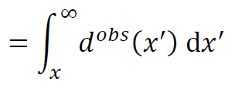
interpretation as tomography
m is slowness
d is travel time of a ray from –∞ to x
backprojection
integrate (=add together) the travel times of all rays that pass through the point x
Notes:
The indefinite integral could be interpreted as an ultrasimplified tomography problem.
The function m(x) is the acoustic slowness (reciprocal velocity)
The function d(x) is the travel time along rays from minus infinity to x.
The backprojection has the following interpretation:
to get m(x),
integrate (add together) traveltimes associated with only the rays that pass thru the point x.

Slide 42
discrete analysis Gm=d
G= UΛV^{T} G^{-g}= VΛ⁻¹U^{T} G^{T}= VΛU^{T}
if Λ⁻¹≈ Λ then G^{-g}≈ G^{T}
backprojection works when the singular values are all roughly the same size
Notes:
Why does this work?
We’ll, it works best when all the singular values have approximately the same size.
Then the inverse is close to the transpose.

Slide 43
suggests scaling
Gm=d → WGm=Wd
where W is a diagonal matrix chosen to make the singular values more equal in overall size
Traveltime tomography:
W_{ii} = (length of ith ray)⁻¹
so [Wd]_{i} has interpretation of the average slowness
along the ray i.
Backprojection now adds together the average slowness of all rays that interact with the point x.
Notes:
It also suggest that we perform scaling to try to make all the singular values about equal.
In tomography, a reasonable scaling is by the reciprocal of the length of each ray.
Then the data are the average slowness along the ray.
And back projection sums the average slowness of all rays that intersect a given point.
Sensible, but it’s still suprising that it works.

Slide 44
(A)
(B)
(C)
x
x
x
y
y
y
Notes:
Here’s an example in (C).
It doesn’t work perfectly, but recovered some of the features.
For it to work best, the ray coverage should be uniform.
Here, we have too many rays around the edges of the box.
Fig. 11.7. Example of backprojection. (A) True two-dimensional model, for which traveltimes associated with a dense and well-distributed set of rays is measured. (B) Estimated model, using damped least squares. (C) Estimated model, using back projection. MatLab script gda11_05.

Slide 45
Part 4
Fréchet Derivative
involving a differential equation
Notes:
This is the most important part of the lecture,
the part that it heavily utilized in seismology and oceanography/atmospheric science.

Slide 46
Part 4
Fréchet Derivative
involving a differential equation
seismic wave equation
Navier-Stokes equation of fluid flow
etc
Notes:
Because these fields solve differential equations.

Slide 47


data d is related to field u via an inner product
field u is related to model parameters m via a differential equation
Notes:
The idea is that the model function is the “forcing m(x)” term of a differential equation.
But the data are computed from the “field u(x)” part of the differential equation.

Slide 48


pertrubation δd is related to perturbation δu via an inner product
write in terms of perturbations
perturbation δu is related to perturbation δm via a differential equation
Notes:
Write everything in terms of perturbations,
to allow for the possibility that the problem is linearized.

Slide 49
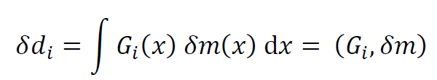
what’s the data kernel ?
Notes:
The goal is the data kernel G.
Or if you prefer, the Frechet derivative.

Slide 50

easy using adjoints
data inner product with field
Notes:
Derivation is very straightforward.
Start with the data equation.

Slide 51

easy using adjoints
data is inner product with field
field satisfies ℒδu= δm
Notes:
Insert the solution of the differential equation.

Slide 52

easy using adjoints
data is inner product with field
field satisfies ℒδu= δm
employ adjoint
Notes:
Move the operator to the other side of the inner product.

Slide 53

easy using adjoints
data is inner product with field
field satisfies ℒδu= δm
employ adjoint
inverse of adjoint is adjoint of
inverse
Notes:
Use the rule that the inverse of the adjoint
is the adjoint of the inverse

Slide 54

easy using adjoints
data is inner product with field
field satisfies ℒδu= δm
employ adjoint
inverse of adjoint is adjoint of
inverse
data kernel
Notes:
Identify the left function in the inner product as the data kernel.

Slide 55

easy using adjoints
data is inner product with field
field satisfies ℒδu= δm
employ adjoint
inverse of adjoint is adjoint of
inverse
data kernel
data kernel satisfies “adjoint differential equation
Notes:
rewrite result as a differential equation for the data kernel.

Slide 56
most problem involving differential equations are solved numerically so instead of just solving you must solve
and
Notes:
Why rewrite as a differential equation?
In most cases, you need to solve the original equation numerically.
So the computational tools are already in place to solve the adjunct differential equation.

Slide 57
so there’s more work but the same sort of work
Notes:
if you can do one numerical solution, you can do more ...

Slide 58
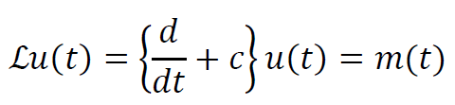
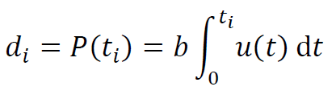
example time t instead of position x
field solves a Newtonian-type heat flow equation
where u is temperature and m is heating
data is concentration of chemical whose production rate is proportional to temperature
Notes:
Example:
We’ll use time instead of space.
Differential equation, simple cooling of a hot object as a function of time.
u(t) is temperature
m(t) is heat source function (e.g. flame)
Data
suppose a chemical reaction occurs as a rate proportional to temperature.
The data are the amount of the chemical at time t.

Slide 59
example time t instead of position x
field solves a Newtonian-type heat flow equation
where u is temperature
data is concentration of chemical whose production rate is proportional to temperature
= (bH(t_{i}-t), u)
so h_{i}= bH(t_{i}-t)
Notes:
Note this implies a specific formula for h_{i},
involving a step function.

Slide 60
we will solve this problem analytically using Green functions in more complicated cases the differential equation must be solved numerically
Notes:
The reason we chose such a simple differential equation is that
we can do most everything numerically.

Slide 61

Newtonian equation
its Green function
Notes:
Original equation and its green function.
Take my word for it being correct.
The temperature is zero before the heat is applied at time tau
and then jumps up to a maximum
and immediately cools exponentially.

Slide 62
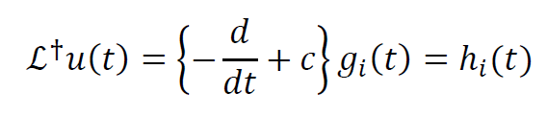

adjoint equation
its Green function
Notes:
Adjunct equation. Recall adjunct of d/dt is –d/d/
and adjunct of constant is itself.
Again, take my word on the green function.

Slide 63
note that the adjoint Green function
is the original Green function
backward in time
that’s a fairly common pattern
whose significance will be pursued in a homework problem
Notes:
Note that the two green function differ only in the sense of time.
That’s a common behavior we’ll explore in a homework problem.

Slide 64
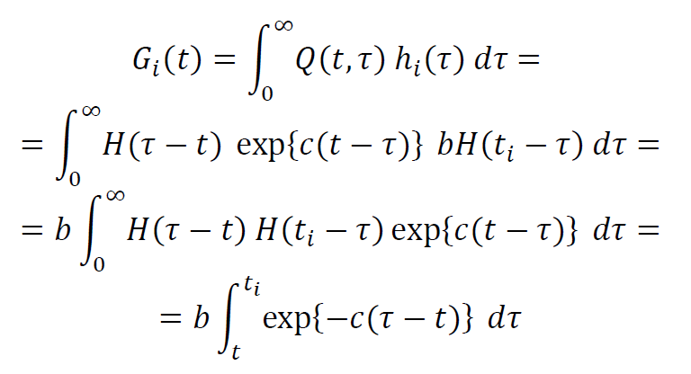
we must perform a Green function integral to compute the data kernel
Notes:
How compute the data kernel.
It is the solution to the adjunct differential equation.
We know the green function for that equation,
so we just need to do the green function integral.
Note that the two step functions change the limits of integration.

Slide 65

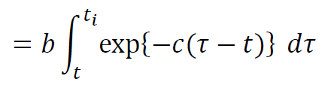
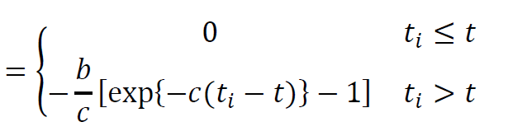
Notes:
The final result is as shown.
Note that the data kernel is zero for times t > ti.
Ti represents the time of the data.
A perturbation in heating after ti can have no effect on the temperature at ti.
Hence the zero in this case.

Slide 66
time, t
row, i
Notes:
Here’s a depiction of the data kernel.
Fig. 11.9. Data kernel g_{i}(t) for the continuous inverse problem involving a differential equation. See text for further discussion. MatLab script gda11_06.

Slide 67
(A)
F(t,τ=30)
(B)
time, t
m(t)
(C)
time, t
u(t)
(D)
time, t
d(t)
time, t
Notes:
Here’s an exampe.
typical green function of the original differential equation.
(B) (Black) True heating (model function)
(C) True temperature
(D) True amount of chemical (the data)
(B) Red, estimated heating (model function)
Apart from the high-frequency noise, its not bad.
The noise is due to the fact that the data don’t contain any
sharp features. They hide high-frequency fluctuation in the
flame. Thus the solution has suprious high frequency noise.
Fig. 11.8. Example of the solution of a continuous inverse problem involving a differential equation. (A) Green function H(t,τ) for τ=30. (B) True (black) and estimated (red) heat production function m(t). (C) Temperature u(t), which solves ℒu=m. (D) Observed data d(t), which is proportional to the integral of u(t). MatLab script gda11_06.

Slide 68
Part 4
Fréchet Derivative
involving a parameter in
differential equation
Notes:
This is especially relevant to seismological imaging,
because seismic velocity is a parameter in the differential equation.

Slide 69
Part 4
Fréchet Derivative
involving a parameter in
differential equation
Notes:
This lecture is all mathematic.
Sorry, but there’s no way around it.
We’re going to suppose that you have some familiarity with
differential equations,
So here goes.

Slide 70
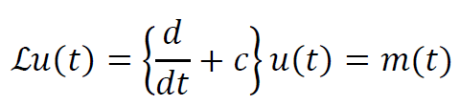
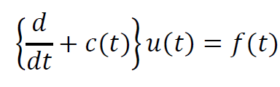
previous example
unknown functi on is “forcing”
another possibility
forcing is known
parameter is unknown
Notes:
Previously, assumed that the unknown was the “forcing” (source term).
Now assume it is a parameter in the differential operator.

Slide 71


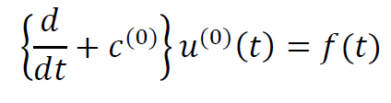
linearize around a simpler equation
and assume you can solve this equation
Notes:
We linearize around a set of parameters for which we can
solve the differential equation.

Slide 72
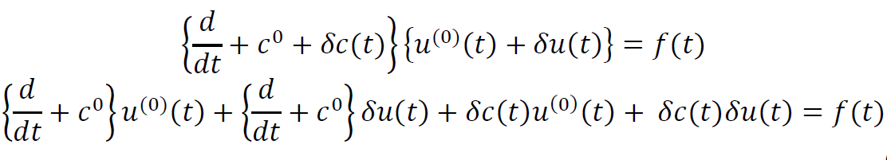
the perturbed equation is
subtracting out the unperturbed equation,
ignoring second order terms, and rearranging gives ...
Notes:
The perturbed equation can be written in terms of
unperturbed parameters
and
perturbations.
After a bit of algebra, we obtain ..

Slide 73
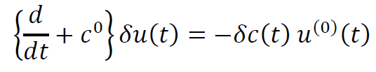
then approximately
pertubation to parameter acts as an unknown forcing
so it is back to the form of a forcing
and the previous methodology can be applied
Notes:
An equation in which relates
the perturbation in the parameter, now in the form of a forcing
to the perturbation in the field.
In wave theory, this approximation is known as the ‘Born approximation’
We can now use the previous methods to work out the data kernel.

