Slide 1
Admission Analysis
Analyzing Key Admission Trends and Insights
VARINDERPAL SINGH
DECEMBER
2024

Slide 2
Introduction
Objective:
• Analyze admission trends based on GPA, SAT scores, scholarships, age, and gender.
• Identify key insights to understand admission patterns.
Methodology:
• Data cleaning and preprocessing.
• Visualizing trends using Python.
• Deriving insights from figures and patterns.

Slide 3
Data Overview
The dataset used in this project is synthetic dataset for practical analysis purposes.
Dataset Details:
• Contains records of applicants with GPA, SAT scores, acceptance status, scholarship status, age, and program applied.
• Cleaned and processed for better analysis.
Data Cleaning Steps:
• Removed missing values.
• Standardized data formats.
• Filtered out inconsistencies.

Slide 4
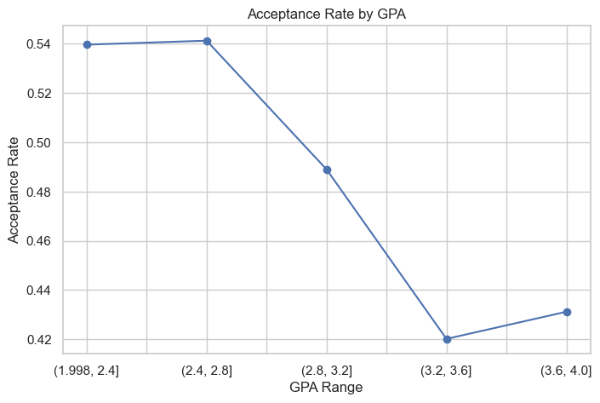
Acceptance Rate by GPA
• Higher GPAs tend to have better acceptance rates.
• A significant Drop in acceptance rate observed in mid-range GPAs.
• Possible factors: competition, program difficulty, or admission criteria.

Slide 5
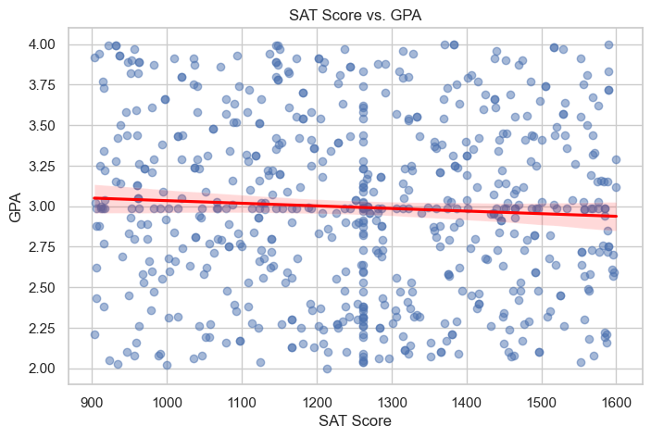
SAT score vs. GPA
• Weak correlation between SAT scores and GPA.
• High SAT scores do not necessarily translate to high GPAs.
• Possible explanation: Different grading standards, varied
academic backgrounds.

Slide 6
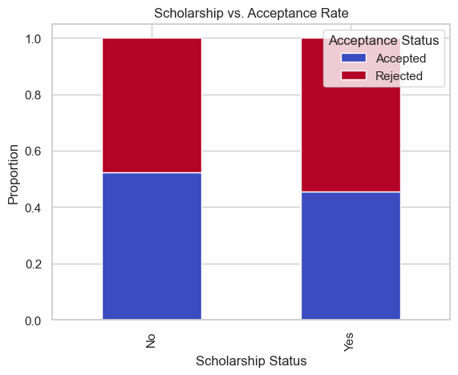
Scholarship vs. Acceptance Rate
• Applicants with scholarships have a slightly higher acceptance rate.
• Scholarships may be linked to strong academic performance
or financial aid policies.
• Further analysis needed to determine causation.

Slide 7
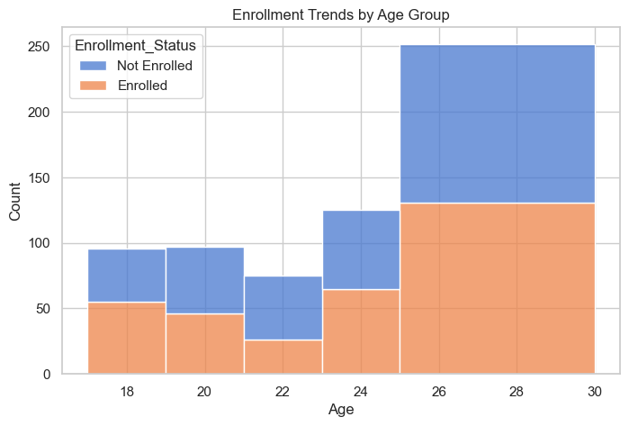
Enrollment Trends by Age
• Younger applicants (18-22) show lower enrollment rates.
• Older applicants (26-30) have higher non-enrollment rates.
• Possible reasons: Career shifts, financial constraints, late
education decisions.

Slide 8
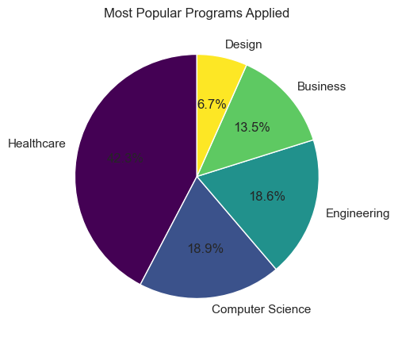
Most Popular Programs Applied
• Healthcare is the most preferred program.
• Engineering, Computer Science, and Business are also in
demand.
• Design has the least applicants.

Slide 9
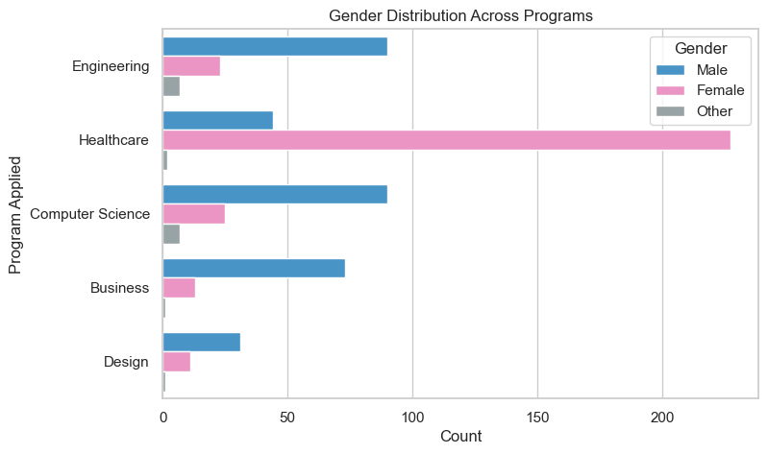
Gender Distribution Across Programs
• Significant gender disparity in certain fields.
• Healthcare is female-dominated, whereas Engineering and CS have more male applicants.
•Indicates trends in career choices based on gender.

Slide 10
Conclusion
Key Findings
• GPA plays a crucial role in acceptance rates. SAT scores show little correlation with GPA.
• Scholarships slightly improve admission chances.
• Enrollment rates vary significantly by age.
• Gender disparities exist in program selection.
Future Recommendations
• Further study on factors influencing scholarship allocation.
• Understanding reasons for non-enrollment among older applicants.
• Promoting gender diversity in certain programs.

