Slide 1





To Develop a CNN Model To Classify Images Of Plastic Waste

Slide 2

Learning Objectives
To Understand Convolutional Neural Networks (CNNs) for image classification.
Learn image preprocessing techniques for better model accuracy.
To Explore TensorFlow or Keras and OpenCV for deep learning and image processing.
Implementation of data augmentation and transfer learning to improve model performance.
Evaluate model performance using accuracy, precision, recall, and F1-score.
GOAL
Source :
www.freepik.com/

Slide 3
Tools and Technology used
The technology used is a Convolutional Neural Network (CNN), a deep learning model for image classification.
Programming Language: Python
Deep Learning Framework: TensorFlow or Keras, PyTorch
Image Processing: OpenCV.
Data Handling: Pandas, NumPy
Development Environment: Jupyter Notebook
Dataset Sources: Kaggle.

Slide 4
Methodology
Data Collection: Gather images of plastic waste from public datasets or custom sources.
Data Preprocessing: Resize, normalize, and augment images using OpenCV and TensorFlow.
CNN Model Design: Build a multi-layer CNN using convolution, pooling, and dense layers.
Training and Optimization: Train the model on a labeled dataset with Adam optimizer and categorical cross-entropy loss.
Evaluation: Validate the model using accuracy metrics and confusion matrix.
Deployment: Deploy the model using TensorFlow for real-world applications.

Slide 5
Problem Statement:
Plastic waste is a major environmental issue, requiring efficient classification for recycling.
Manual sorting is time-consuming and error-prone.
An automated image classification system can help in identifying different types of plastic waste for better waste management.

Slide 6
Solution:
A CNN-based image classification model will be trained to recognize and classify different types of plastic waste.
The model will process images, extract relevant features, and categorize waste into predefined classes, aiding automated waste segregation.

Slide 7
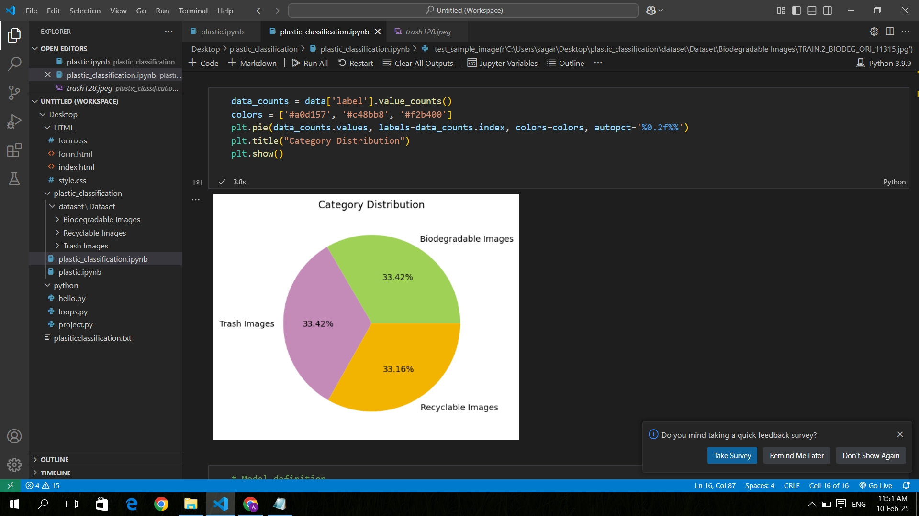
Screenshot Of Output:

Slide 8
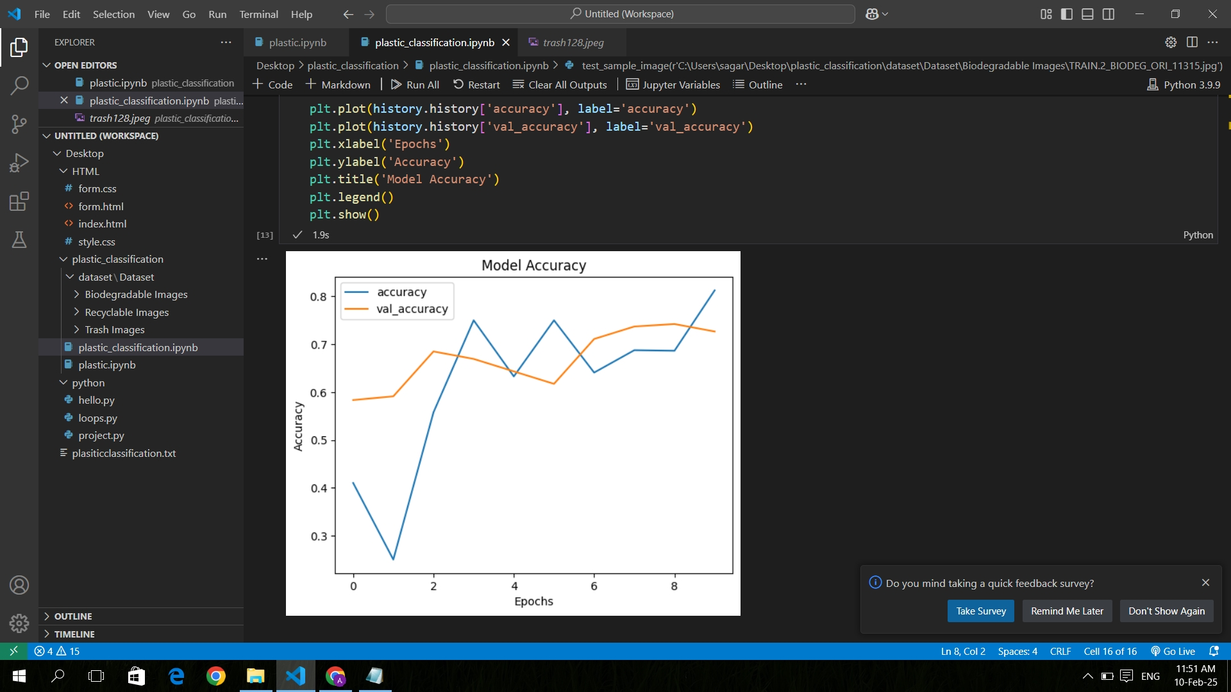
Screenshot Of Output:

Slide 9
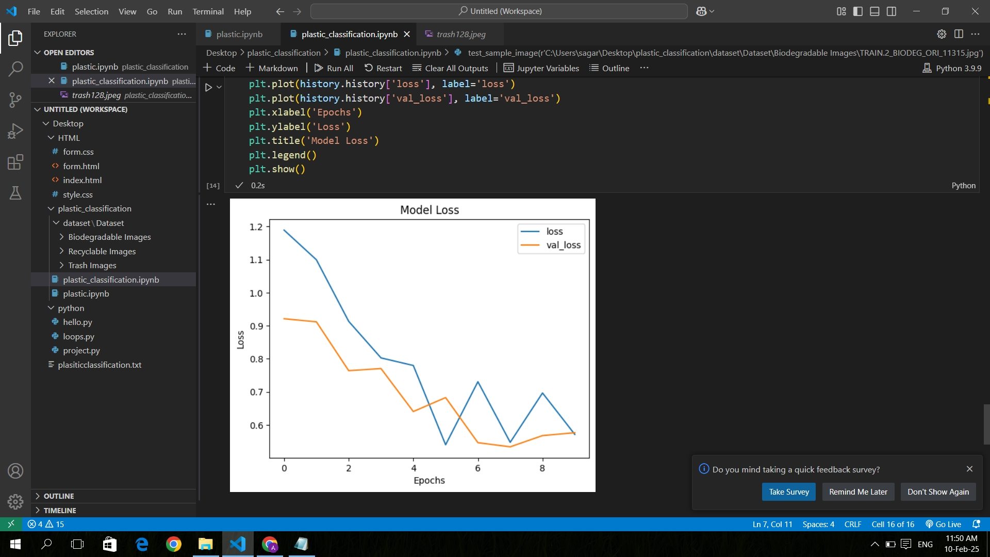
Screenshot Of Output:

Slide 10
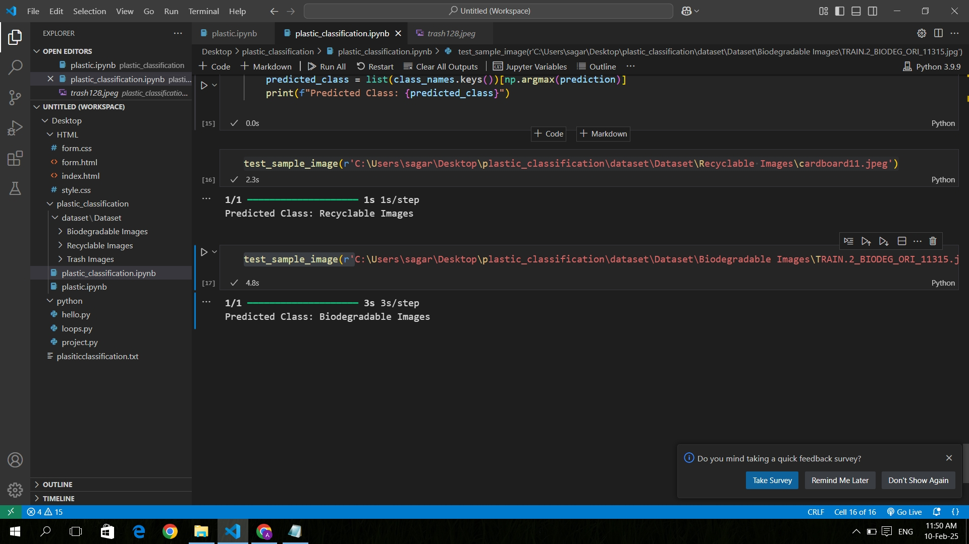
Screenshot Of Output:

Slide 11
Conclusion:
The CNN model accurately classifies plastic waste, improving recycling efforts. It helps in better waste sorting and management.
Transfer learning enhances model performance and adaptability. It allows the model to learn from pre-trained networks for quicker results.
Edge AI integration enables real-time waste classification. This improves the speed and efficiency of waste sorting systems.
The model optimizes waste management through efficient sorting. It contributes to better resource recovery and waste reduction.

