Slide 1
Path Loss
Path Loss
Shadowing
Antenna

Slide 2
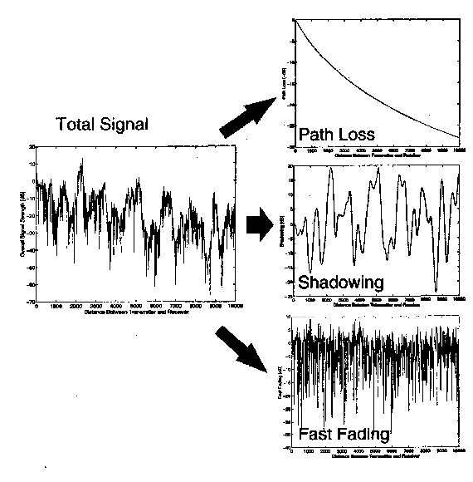
Local Coverage

Slide 3
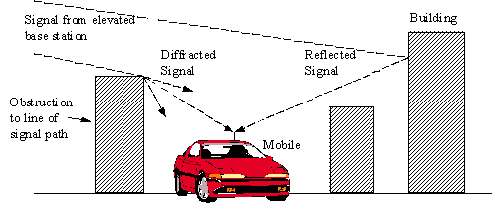
Path Loss
reduction in power density (attenuation) of an electromagnetic wave as it propagates through space
A lot of pattern (depends on environment)
Ideal pattern : Free space (« Line Of Sight »)
Pr on 1/d²
Complexity

Slide 4
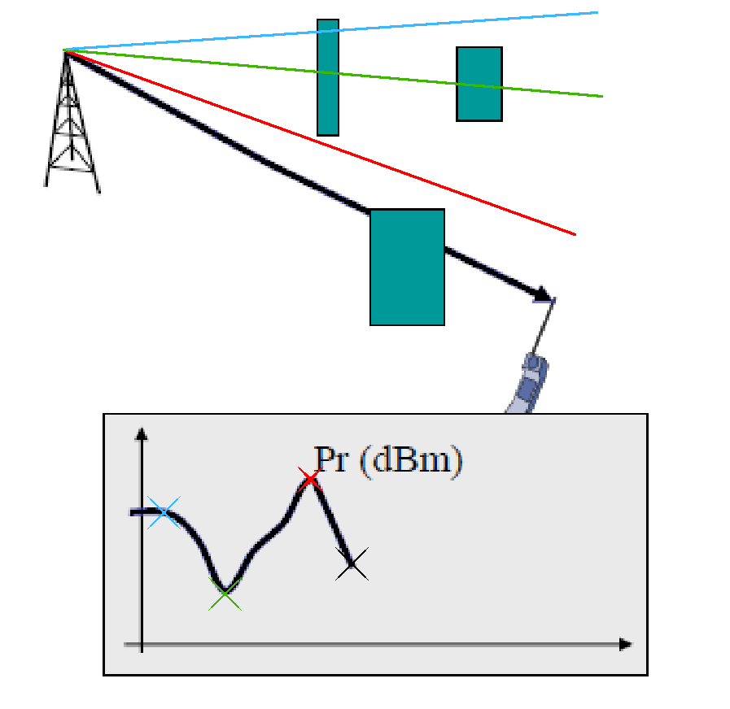
Shadowing
Variation due
to obstacles
Random phenomena

Slide 5
Antenna
Sensitivity
Loss
Problem mobile power / antenna power :
  mobile should be able to contact the base station

Slide 6
Antenna
Input :
  Trafic
  Capacity
  Surface to cover
Ouput :
  Number of Cell
  Place

Slide 7
Some number
20 000 sites to cover the whole France
500 for Toulouse
13 for Roland Garros

