Slide 1

Long Term Evolution
Tuesday 2nd April 2013
Philippe TRAN BA – Adrian POIGET – Adrien THIBAUD

Slide 2
Introduction
Multi-User
Local Coverage
Geolocalisation
National Coverage

Slide 3
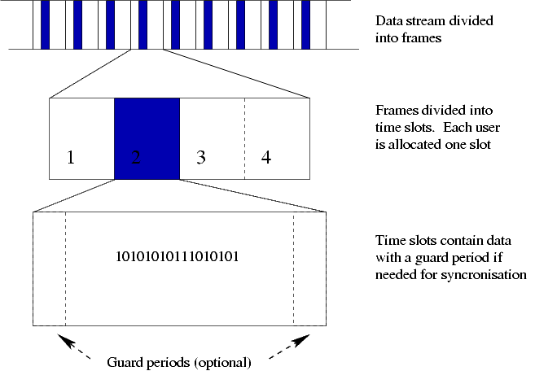
Multi-User
TDMA (Time Division Multiple Access) :

Slide 4
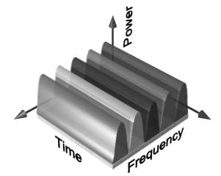
Multi-User
FDMA (Frequency Division Multiple Access) :

Slide 5
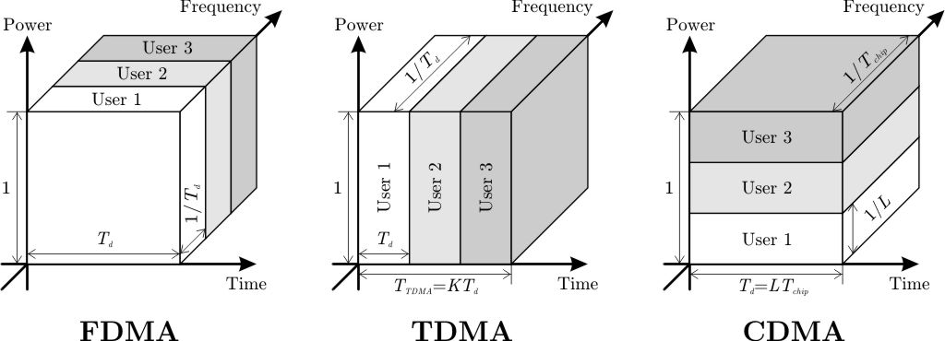
Multi-User
CDMA (Code Division Multiple Access) :

Slide 6
Local Coverage
Path Loss
Shadowing
Antenna

Slide 7
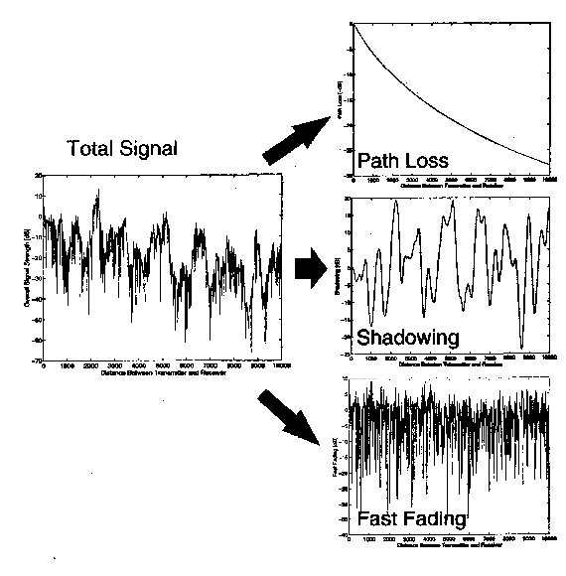
Local Coverage

Slide 8
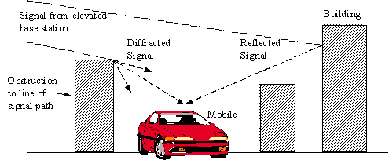
Path Loss
reduction in power density (attenuation) of an electromagnetic wave as it propagates through space
A lot of pattern (depends on environment)
Ideal pattern : Free space (« Line Of Sight »)
Pr on 1/d²
Complexity

Slide 9
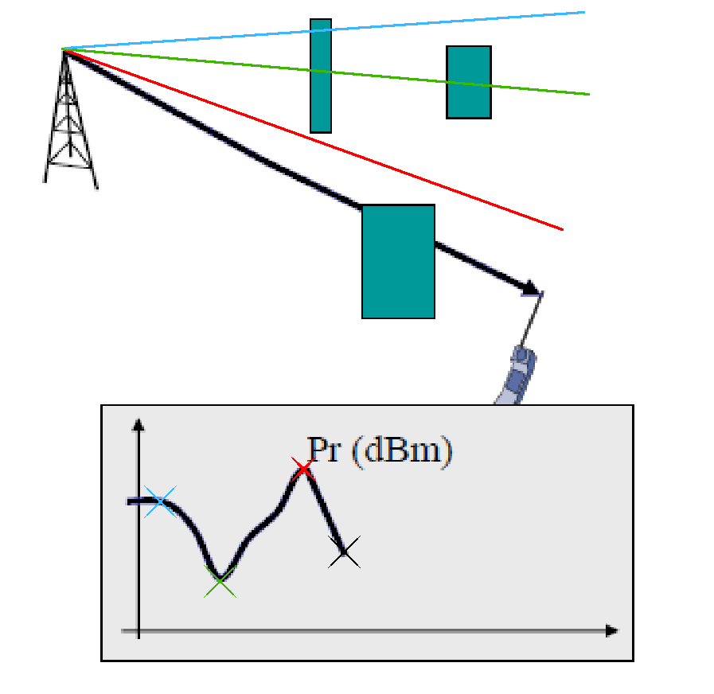
Shadowing
Variation due
to obstacles
Random phenomena

Slide 10
Antenna
Sensitivity
Loss
Problem mobile power / antenna power :
  mobile should be able to contact the base station

Slide 11
Antenna
Input :
  Trafic
  Capacity
  Surface to cover
Ouput :
  Number of Cell
  Place

Slide 12
Some number
20 000 sites to cover the whole France
500 for Toulouse
13 for Roland Garros

Slide 13
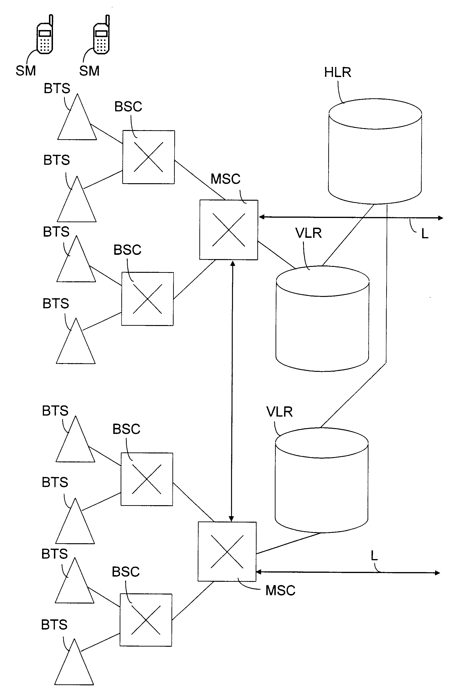
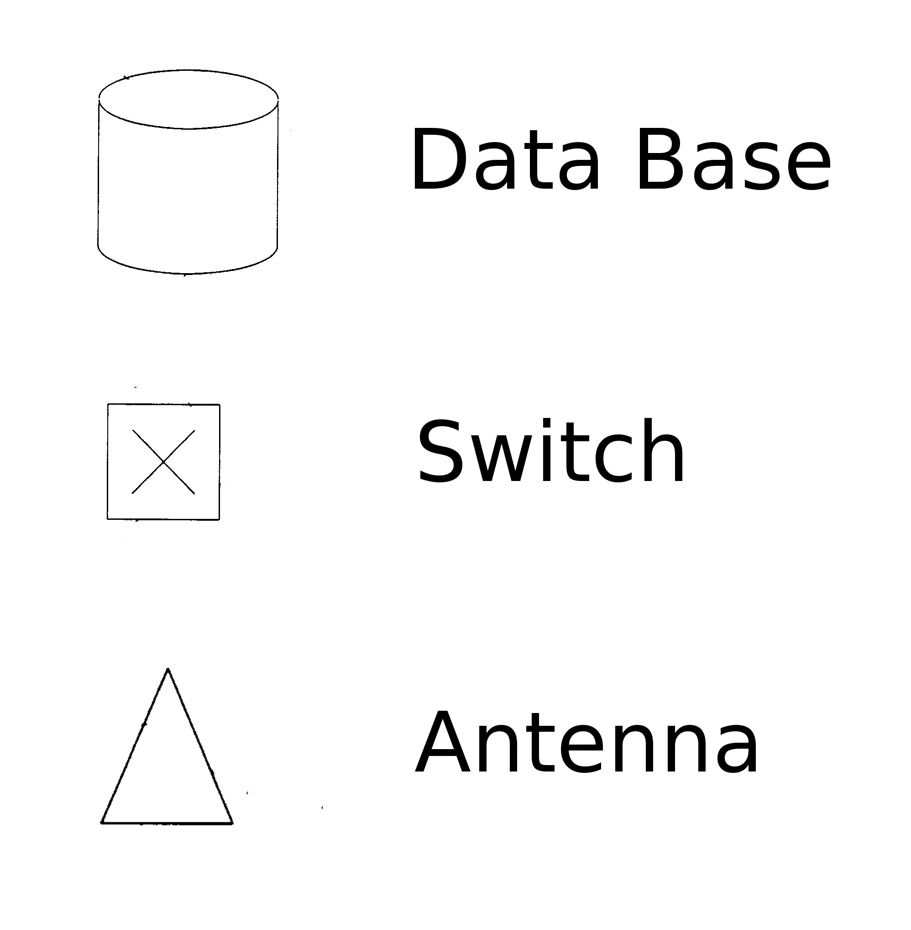
Geolocalisation
SM : Station Mobile
BTS : Base Station System
BSC : Base Station Controller
MSC : Mobile-service Switching Center
HLR : Home Location Register
VLR : Visitor Location Register

