Slide 1

ELURU COLLEGE OF ENGINEERING AND TECHNOLOGY
Assistant professor
MALWARE DETECTION WITH VIGOROUS ABILITY
USING DEEP LEARNING
Submitted by
S. PRABHU SAI KALYAN (19JD1A0594)
V. SASIDHAR (19JD1A05A3)
M .JAYA RAKESH VARMA (19JD1A0558)
Submitted to
v. Rajesh babu (M.tech)

Slide 2
INDEX
Abstract
INTRODUCTION
Existing System
Disadvantages
PROPOSED SYSTEM
Advantages
SYSTEM REQUIREMENTS
System architecture
UML DIAGRAMS
conclusion

Slide 3
ABSTARCT
Security breaches due to attacks by malicious software (malware) continue to escalate posing a major security concern in this digital age.
With many computer users, corporations, and governments affected due to an exponential growth in malware attacks, malware detection continues to be a hot research topic.
Recent malwares use polymorphic, metamorphic, and other evasive techniques to change the malware behaviours quickly and to generate a large number of new malwares. Such new malwares are predominantly variants of existing malwares,and machine learning algorithms (MLAs) are being employed recently to conduct an effective malware analysis.
However, such approaches are time consuming as they require extensive feature engineering, feature learning, and feature representation.

Slide 4
INTRODUCTION
In this digital world of Industry 4.0, the rapid advancement of technologies has affected the daily activities in businesses as well as in personal lives. Internet of Things (IoT) and applications have led to the development of the modern concept of the information society.
However, security concerns pose a major challenge in realizing the benefits of this industrial revolution as cyber criminals attack individual PC’s and networks for stealing confidential data for financial gains and causing denial of service to systems. Such attackers make use of malicious software or malware to cause serious threats and vulnerability of systems. A malware is a computer program with the purpose of causing harm to the operating system (OS

Slide 5
EXISTING SYSTEM
As of today, the topic of malware detection has received plenty of attention in the literature. However, few works focus on the ML methodologies employed and, to the best of our knowledge, none of them provides a clear classification of malware detection systems based on the metrics and ML techniques used. Focusing on a period spanning from 2016 to 2021, this section chronologically identifies such literature contributions and places them the current work.

Slide 6
DISADVANTAGE OF EXISTING SYSTEM:
NOT SUITABLE MULTIPLE ENVIRONMENT.
CAN’T DETECT UNKNOWN MALWARE.
HIGH RESOURCE CONSUMPTION & COMPLEXITY.

Slide 7
PROPOSED SYSTEM
The proposed scheme guides one in picking optimal ML techniques based on the dataset age and analysis method chosen in the first and second step, respectively.
Namely, the first two steps associate the age of the dataset used for evaluation with one of the three analysis methods. The third step indicates the ML classification techniques to be used based on the choice made during the preceding steps. The final step depends on whether the dataset used is balanced in terms of malware and benign apps.
This will determine if accuracy is indeed a trustworthy metric. In all cases, however, the AUC metric is preferable, as it constitutes a more conclusive and realistic evaluation of models, even when substantially imbalanced datasets are utilized.As a rule, the value of AUC is extracted by examining the ranking of scores rather than their exact values produced when a method is applied to a dataset

Slide 8
ADVANTAGE OF PROPOSED SYSTEM :
HIGH ACCURACY OF DETECTION.
MORE SECURE.
MULTIPATH MALWARE ANALYSIS.

Slide 9
HARDWARE & SOFTWARE REQUIREMENTS:
HARDWARE REQUIREMENTS:
PROCESSOR : Pentium IV or Higher
RAM : 4 GB (Min)
HARD DISK : 500 GB
SOFTWARE REQUIREMENTS:
DOMAIN : Python, Django
OPERATING SYSTEM : Windows 10 /11(64bit)
LANGUAGE : Python 3.X

Slide 10
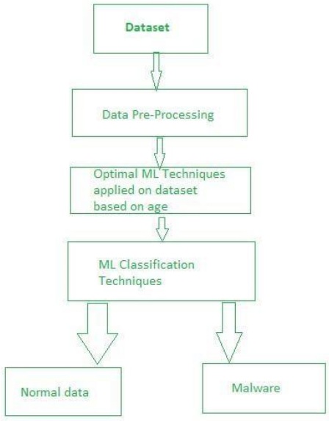
SYSTEM ARCHITECTURE:

Slide 11
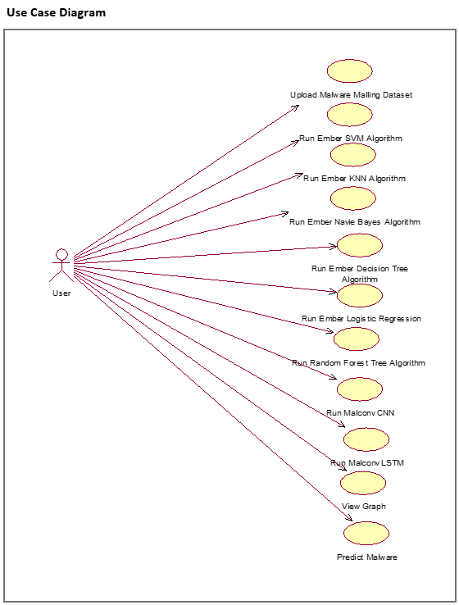
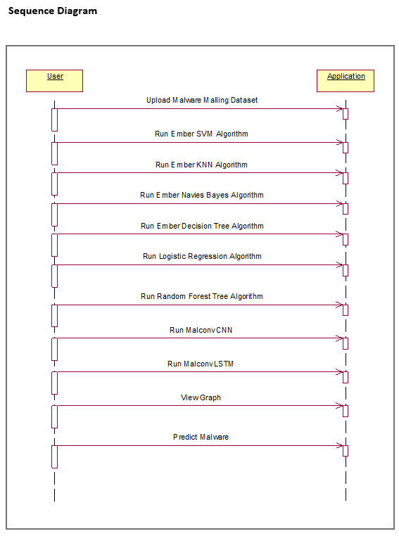
UML DIAGRAMS:

Slide 12
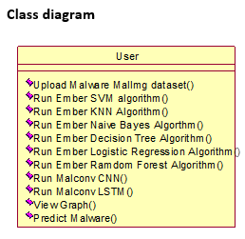
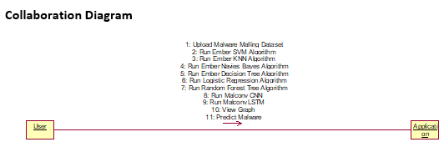

Slide 13
CONCLUSION:
This project evaluated classical machine learning algorithms (MLAs) and deep learning architectures based on Static analysis, Dynamic analysis and image processing techniques for malware detection and designed a highly scalable framework called Scale Mal Net to detect, classify and categorize zero-day malwares. This framework applies deep learning on the collected malwares from end user hosts and follows a two-stage process for malware analysis. In the first stage, a hybrid of Static and Dynamic analysis was applied for malware classification. In the second stage, malwares were grouped into corresponding malware categories using image processing approaches. Various experimental analysis conducted by applying variations in the models on both the publicly available benchmark datasets and privately collected datasets in this study indicated that deep learning-based methodologies outperformed classical MLAs. The developed framework is capable of analyzing large number of malwares in real-time, and scaled out to analyze even larger number of malwares by stacking a few more layers to the existing architectures. Future research entails exploration of these variations with new features that could be added to the existing data.

Slide 14
THANK YOU

