Slide 1
Методологии за разработка на софтуер
A software development methodology or system development methodology in software engineering is a framework that is used to structure, plan, and control the process of developing an information system.
История
Основни методологии
Принципи и процеси използвани днес

Slide 2
1970s
Structured programming since 1969
Cap Gemini SDM, originally from PANDATA, the first English translation was published in 1974. SDM stands for System Development Methodology
1980s
Structured Systems Analysis and Design Methodology (SSADM) from 1980 onwards
Information Requirement Analysis/Soft systems methodology
1990s
Object-oriented programming (OOP) has been developed since the early 1960s, and developed as a dominant programming approach during the mid-1990s
Rapid application development (RAD) since 1991
Scrum, since the late 1990s
Team software process developed by Watts Humphrey at the SEI
Extreme Programming since 1999

Slide 3
Методологии

Slide 4
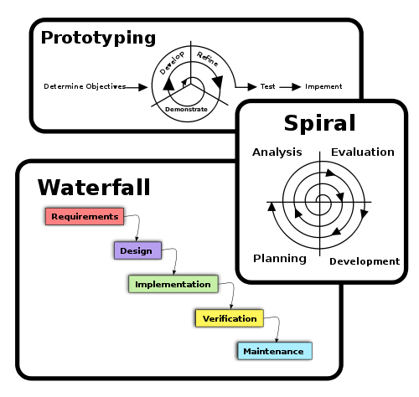

Slide 5
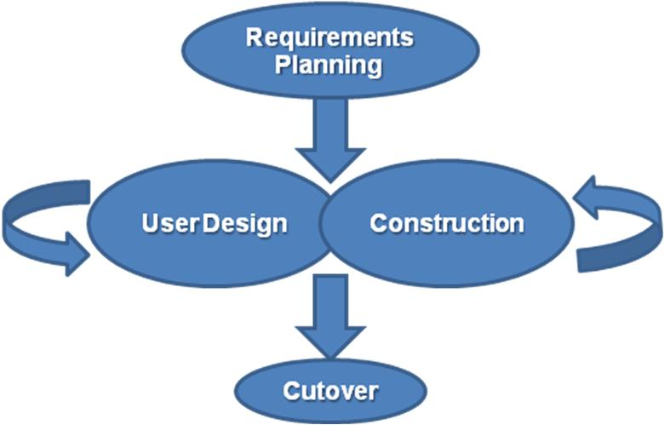
RAD
Rapid application development
Rapid application development (RAD) is a software development methodology that uses minimal planning in favor of rapid prototyping. The "planning" of software developed using RAD is interleaved with writing the software itself. The lack of extensive pre-planning generally allows software to be written much faster, and makes it easier to change requirements.

Slide 6
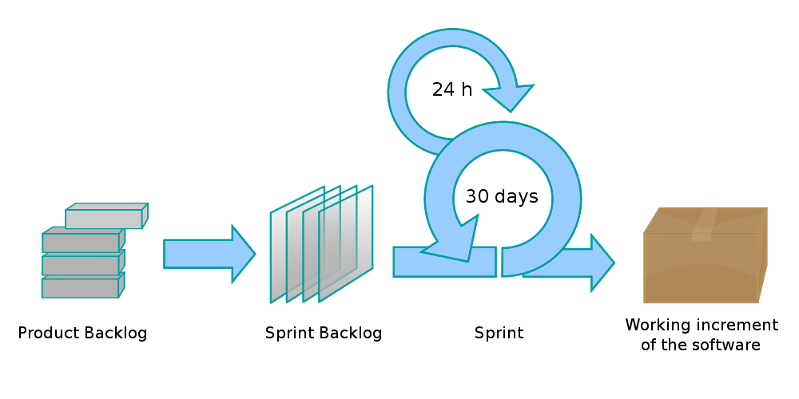
SCRUM
Scrum is a process skeleton that contains sets of practices and predefined roles. The main roles in Scrum are[7]:
the “ScrumMaster”, who maintains the processes (typically in lieu of a project manager)
the “Product Owner”, who represents the stakeholders and the business
the “Team”, a cross-functional group who do the actual analysis, design, implementation, testing, etc.

Slide 7
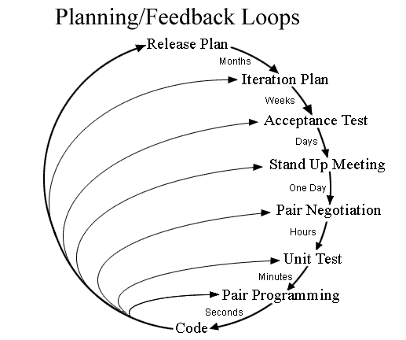
EXTREME PROGRAMMING

Slide 8
Lean Software Development
Lean software development is a translation of Lean manufacturing and Lean IT principles and practices to the software development domain. Adapted from the Toyota Production System, a pro-lean subculture is emerging from within the Agile community.
Lean principles
Lean development can be summarized by seven principles, very close in concept to lean manufacturing principles:
Eliminate waste
Amplify learning
Decide as late as possible
Deliver as fast as possible
Empower the team
Build integrity in
See the whole

Slide 9
Принципи

Slide 10
This is a list of approaches, styles, and philosophies in software development. It contains also software development processes, software development methodologies and single practices, principles and laws.
Behavior Driven Development (BDD)
Big Design Up Front (BDUF)
Blind Men And Elephant Approach (BMAEA)
Brooks's law
Cathedral and the Bazaar (see also Release early, release often (RERO))
Code and fix
Continuous integration
Convention over configuration
Conway's Law
Cowboy coding
Design-driven development (D3)
Design Driven Testing (DDT)

Slide 11
Don't Make Me Think (book by Steve Krug about human computer interaction and web usability)
Don't repeat yourself (DRY) or Duplication is Evil (DIE) or Once and Only Once (OAOO), Single Point of Truth (SPoT), Single Source Of Truth (SSOT)
Domain-Driven Design
Evolutionary prototyping
Feature Driven Development
Good Enough For Now (GEFN)
Hollywood Principle
Iterative and incremental development
Joint application design, aka JAD or "Joint Application Development"
Kaizen
Kanban
KISS principle original (Keep It Simple and Stupid), derogatory (Keep It Simple, Stupid!)

Slide 12
Model-driven architecture (MDA)
MoSCoW Method
Open source
Open Unified Process
Principle of good enough (POGE)
Quick-and-dirty
Release early, release often (RERO) - see also The Cathedral and the Bazaar
Responsibility-driven design (RDD)
Separation of concerns (SoC)
Service-oriented modeling
Test-driven development (TDD)
When it's ready [1]
Win-Win Model
Worse is better (New Jersey style, as contrasted with the MIT approach)
You Ain't Gonna Need It (YAGNI)

