Slide 1
Как се правят реално-времеви проекти
Какво е реално-времеви проект
Теория – Sockets, Protocols
Технологии – nodejs, twisted, eventmachine,...

Slide 2
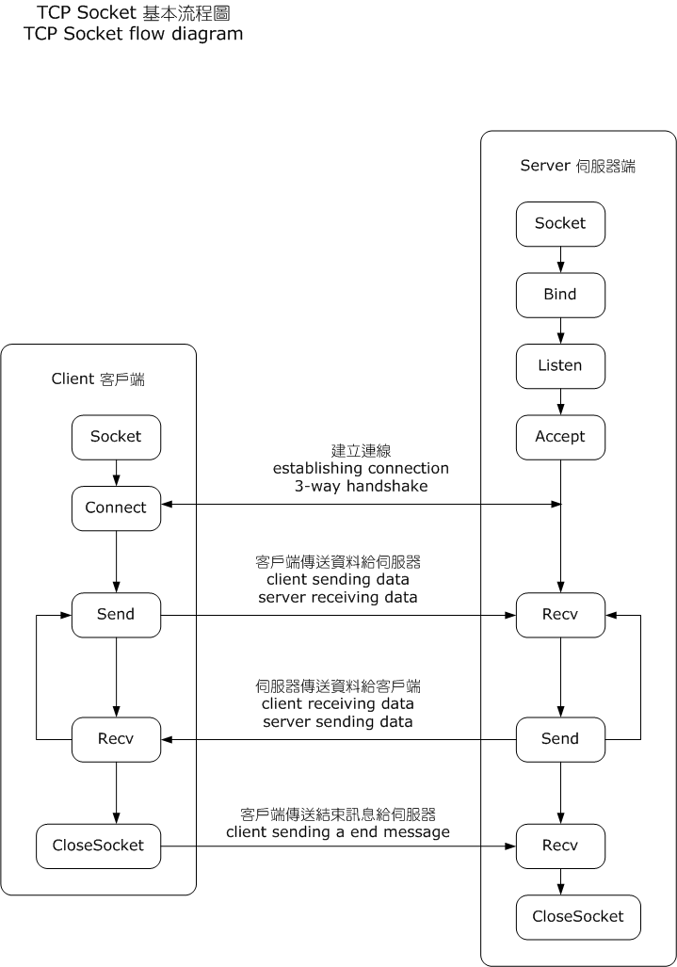
Socket

Slide 3
Protocols
Transmission Control Protocol (TCP)
User Datagram Protocol (UDP)
XMPP ( Extensible Messaging and Presence Protocol )
WebSockets

Slide 4
Технологии
Nodejs
  Nowjs – web sockets
  Dnode – web sockets
  Node-xmpp
  SocketStream – web sockets, full featured framework
Twisted
EventMachine
Java
ZeroMQ

Slide 5
nowjs
Server:
var nowjs = require("now");
var everyone = nowjs.initialize(httpServer);
everyone.now.getServerInfo = function(callback){
db.doQuery(callback);
}
Client:
<script>
now.getServerInfo(function(data){
// data contains the query results
});
</script>

Slide 6
SocketStream
Server
exports.actions =
init: (cb) ->
cb "SocketStream version #{SS.version} is up and running."
# Quick Chat Demo
sendMessage: (message, cb) ->
if message.length > 0
SS.publish.broadcast 'newMessage', message
cb true
else
cb false
Client
SS.socket.on 'disconnect', -> $('#message').text('SocketStream server is down :-(')
SS.socket.on 'reconnect', -> $('#message').text('SocketStream server is up :-)')
exports.init = ->
SS.server.app.init (response) ->
$('#message').text(response)
SS.client.demo.init()

Slide 7
References
http://weblogs.java.net/blog/spericas/archive/2010/10/06/web-sockets-and-html5-glassfish
http://nowjs.com/
https://github.com/socketstream/socketstream/
http://www.slideshare.net/ismasan/websockets-and-ruby-eventmachine
http://bg.wikipedia.org/wiki/User_Datagram_Protocol
http://en.wikipedia.org/wiki/WebSocket
http://en.wikipedia.org/wiki/Internet_socket
http://www.igniterealtime.org/about/jive_xmpp_wp.pdf

