Slide 1

Javascript BASICS
/*Magic lives here*/
GameCraft Training
@Rado_g

Slide 2
Agenda ☺
Client-side programming
Console play >_
JavaScript 101
The DOM Tree
JSON {coolness : “maximum”}
jQuery (Where things get better)

Slide 3

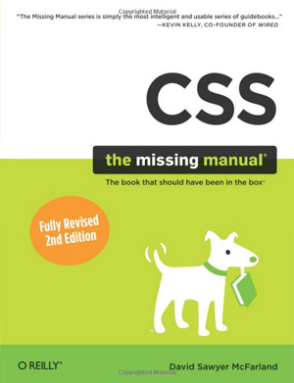
Some prereqs (What you should already know)
Object Oriented Programming – Classes, Interfaces, Methods, Scopes
HTML & CSS (concept level)

Slide 4
JavaScript
Executed by the Browser (Client side)
  Not(d)e – There’s also Server Side JS
Serves for
  Doing fancy stuff with the HTML
  Creating richer UI
  AJAX
  Doing Web Applications
Prototype based, dynamic, scripting language
Notes:
Zoom it -> wtf + no int a = 5; + no compiling

Slide 5
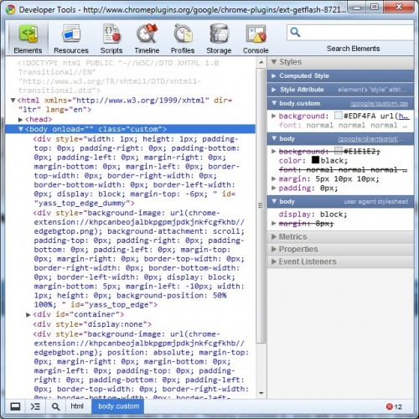
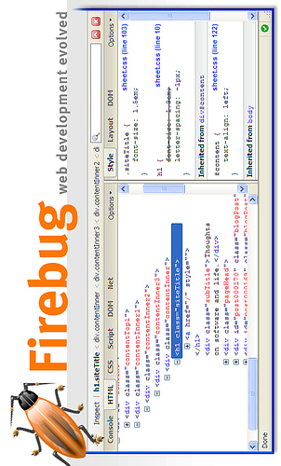
Tools of Trade – Debuggers

Slide 6
Tools of Trade – IDEs
Netbeans v. >= 6.9
Aptana Studio
JavaScript Development Tools for Eclipse
MyEclipse
Visual Studio (+ Telerik JustCode 4 JavaScript)
VIM
TextMate (ако ядете ябълки)

Slide 7
JavaScript 101 - Variables
Variables – no types. Defined with var
  var a = 5;
  var b = “string”;
  var getRandom = function(arg) { return arg+2; }
Types are associated with values, not with variables
  typeof
Arrays – can store different types in one array
  var arr = [1,2,3,4,5];
Hashes (Maps) – but no Objects as keys
  var keyvalue = {name : “Rado”, age : 21, work : “GameCraft”}

Slide 8
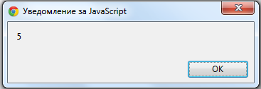
JavaScript 101 – How to run a simple script
Lets have <script type=“text/javascript”>alert(“Hello”)</script> in an html page.
Run the page via a web browser
Let’s view the code ☺ - include.html

Slide 9
JavaScript 101 – How to run a simple script
Also, you can use the src attribute :
<script type=“text/javascript” src=“javascript/include.js”></script>
JavaScript files end with .js
You can include as many JavaScript files as you want
Inclusion order is the order that the <script> tags were included
Let’s view the code ☺ - include2.html + include2.js

Slide 10
Recap!
We know how to
  Include JavaScript files in HTML
  Run them in the browser
  View the output in the console
  Define simple variables
Next → typeof

Slide 11
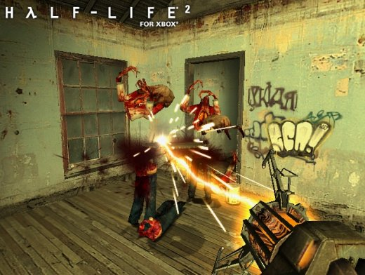
typeof = Gravity Gun in Half Life 2 ☺

Slide 12
Javascript 101 - Types
JavaScript is Dynamic Language, but there are types too
Lets have the following code :
var calc = function(a,b) { return a+b; }
  cacl(5,3) → 8;
  calc(“rado”, “rado”) → “radorado”
  calc(true, true) → 2
  calc(“rado”, true) → “radotrue”
What if we want to sum only numbers ?
  Enter, typeof
  typeof(5) → “number”
  typeof(“rado”) → “string”

Slide 13
Javascript 101 – Types - Undefined
Undefined is a special value for undefined variables
var a; typeof(a); // “undefined”
typeof(undefined); // “undefined”
This is a standart check:
if(typeof(something) !== “undefined”) { … }

Slide 14
JavaScript 101 Arrays
Arrays are defined without initial size
  var arr = []; // empty array
There are few methods to deal with arrays
  arr.push(2); // now array has one element
  arr[0]; // 2
  arr[1]; // undefined
  arr.length; // 1
But, if we want to check for arrays :
typeof(arr) === “object”
So there is a way :
  arr.constructor === Array (But we will talk later about Prototypes)

Slide 15
JavaScript 101 Functions
Functions are something very important in JavaScript
typeof(func) === “function”
Functions can :
  Take functions as arguments
  Be anonymous
  Return functions
  Be assigned to variables
  Be Called from variables
They also create objects and define scope
Go go examples !

Slide 16
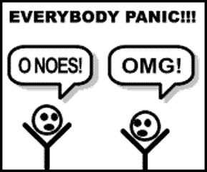
CLOSURES

Slide 17
Closures && Scope
Scope = visibility of variables
Closure = function + all variables that are defined in the function’s scope
We can “walk” between different closures
Closures are created by functions
A function can see its parent scope
Window is the object at the top of the hierarchy
Examples – closures.js
More info - http://jibbering.com/faq/notes/closures/

Slide 18
Objects && Prototypes

Slide 19
Objects + Prototypes
In JavaScript, there are no classes
JavaScript works with Prototypes
Objects are created by functions
The function is the constructor
Obj.hasOwnProperty() – testing for not prototype properties
Examples – prototype.js, number.js, array_prototype.js, string_prototype.js namespace.js

Slide 20
JSON (and the Argonaths)
{
description : “XML on diet”,
meaning : “JavaScript Simple Object Notation”,
usedFor : [
{ case : “Create JS objects”} , { case : “Model for data-transportation”, {case : “Configuration files”}
]
}
Every big JS library is based on JSON configurations
Examples ☺

Slide 21
JavaScript Pitfalls (Some of them)
Always insert ;
Never use the with() operator – random behaviour
Never use new Array(). Use [] for creating arrays
Always use === instead of == (== is broken)
There is no block scope
  Declare all variables at the top of functions
Avoid global variables as much as possible
Use new only with InitialCaps variables

